Slide 1
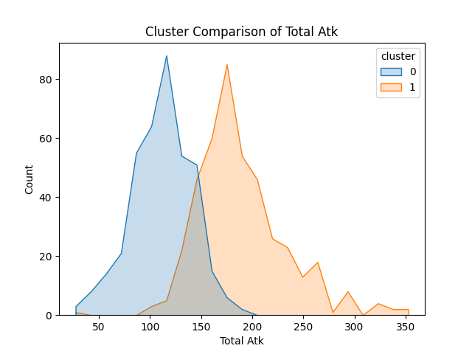
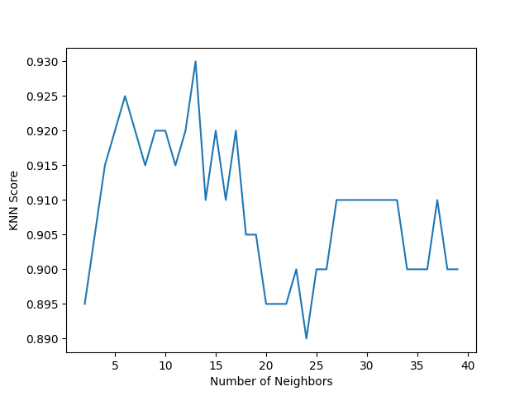
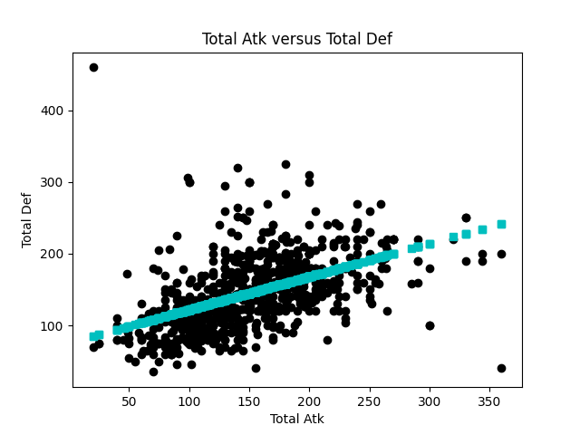



Patterns and Bias in Pokemon
Soham Manoli
Background
Results
The word Pokemon (Pokémon) immediately raises ears when mentioned in a conversation. Considering that Pokemon holds such an important place in many individual's childhoods, can the Pokemon data set be used to answer a pair of questions that could expose bias or patterns found in Pokemon.
Figure 1 illustrates that there are two distinct clusters that are formed when looking at stats such as Attack, which supports the notion that there are in fact patterns within the stats of Pokemon.
In order to classify a new Pokemon, a KNN classifier was trained with a test accuracy of 0.93 as shown in Figure 2. If given a new Pokemon (not in the training set used), the model would classify whether the given Pokemon was Legendary or not 93% of the time. With this number in mind, it is safe to assert that new Legendary Pokemon can be classified.
Research Questions
The unsupervised and supervised learning questions that this research project aims to answer is:
1). Can we identify patterns while looking at Attack, Defense, Speed, and the Type(s) that Pokemon have?
2). If a new Pokemon is found in the wild, can I classify whether it is a legendary Pokemon or not?
Conclusions
Figure 1. Graph generated using unsupervised learning (clustering). There are two prominent clusters that have formed. The clusters represent two groups of Pokemon, one with lower Total Atk and the other with higher Total Atk. The overlap between the two clusters can be interpreted to represent moderate Total Atk.
The results of this project highlight the notion that Pokemon are designed to be separated into different groups. This is sometimes done explicitly as seen with Legendary Pokemon or implicitly with grouping found in stat distributions.
In the future, more work must be done to pinpoint the exact relationship between these groupings (Figure 3) and define the logic behind forming such groups. Ultimately, this information could potentially benefit all players from several intersections as it can be used to further improve the game that is loved by so many.
Methods
Several techniques were applied to the data, including data visualization, feature engineering, clustering, linear regression analysis, and classification using the KNearestNeighbor (KNN) algorithm. Popular python libraries such as pandas, matplotlib, seaborn, and sklearn were used.
For question one, the features of the Pokemon dataset were engineered to include Total Atk, which is the sum of Attack and Sp. Atk, and converting Type from letters to numbers so that these features could be clustered efficiently. For question 2, the same engineered features were used to train a KNN model that labels Legendary Pokemon from Non-Legendary Pokemon.
It is important to acknowledge that the dataset used may not have every possible feature present.
Acknowledgments
Figure 2. KNN Score Graph for a model that inputs Pokemon Stats and outputs Legendary status.
Figure 3. Scatter-plot illustrating a linearly-modeled relationship between Total Atk and Total Def.
Thanks to Dr. Caspi, Mr. Tanimoto, Julia, Irene, Jessica, and AI4ALL organizers for enriching, supporting, and funding this research project.
AI4ALL@Paul G. Allen School
Notes:
<number>

