Slide 1
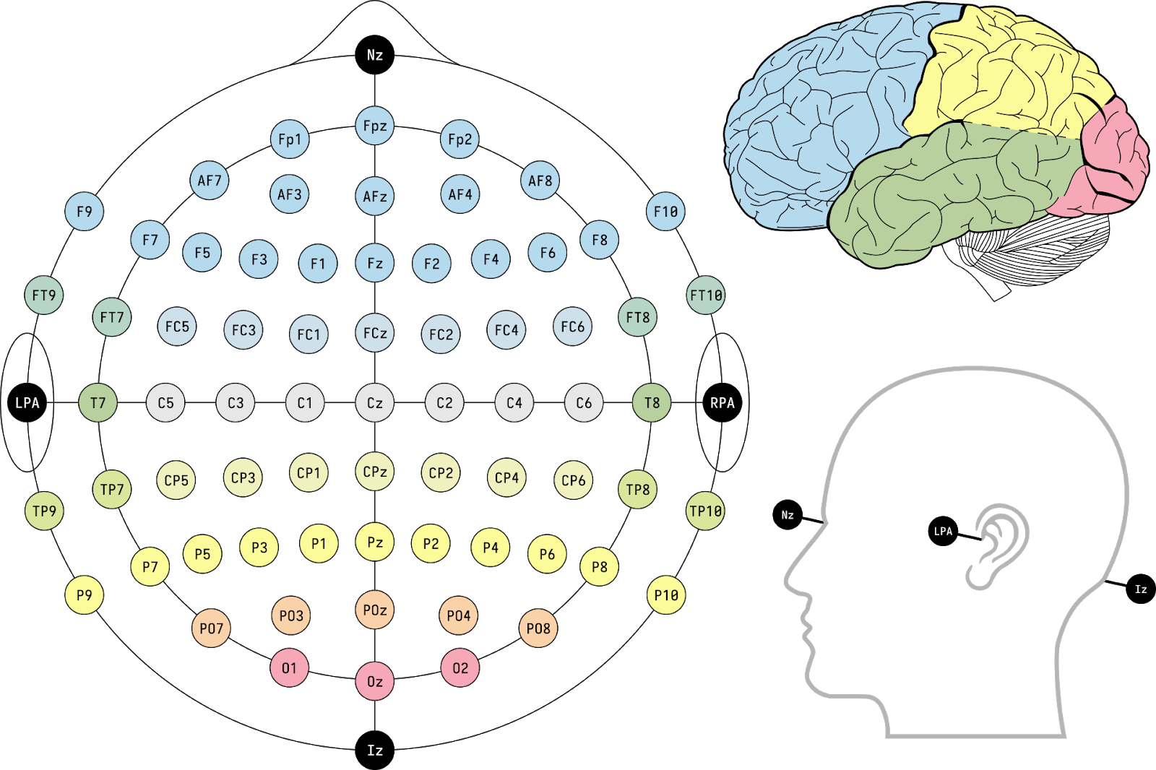
SleepPhysionet
MASS
Clinical dataset
(T3, T4) = (T7, T8)
(T5, T6) = (P7, P8)
(A1, A2) = (M1, M2) are ears electrodes

Slide 2
SleepPhysionet
MASS
Clinical dataset
MASS dataset:
T5, T6 became P7, P8
T3, T4 became T7, T8
A1, A2 are also called M1, M2 - near the ears

