Slide 1
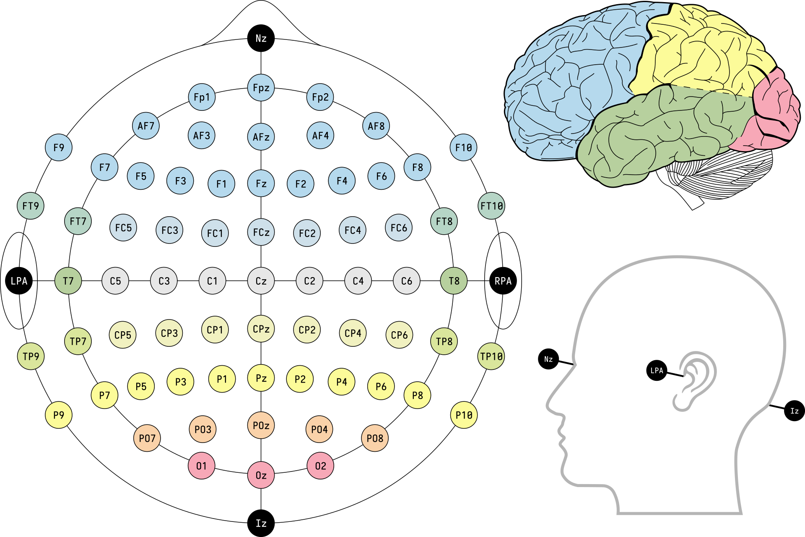

Slide 2
SleepPhysionet

Slide 3
MASS

Slide 4
Clinical

Slide 5
MASS dataset:
T5, T6 became P7, P8
T3, T4 became T7, T8
A1, A2 are also called M1, M2 - near the ears

