Slide 1


PHP Implementation

Slide 2
Requirements
Must run on all platforms (Windows, Mac, Linux).
Must be compatible with all common browsers.
Must be user friendly.
Must contain sufficient documentation.

Slide 3
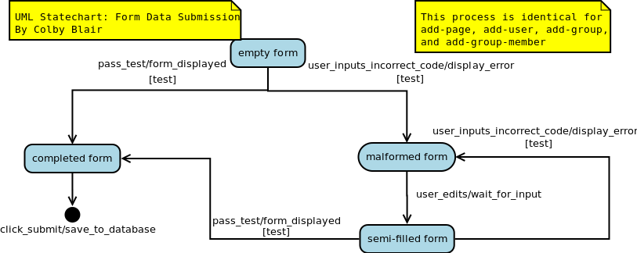

Slide 4
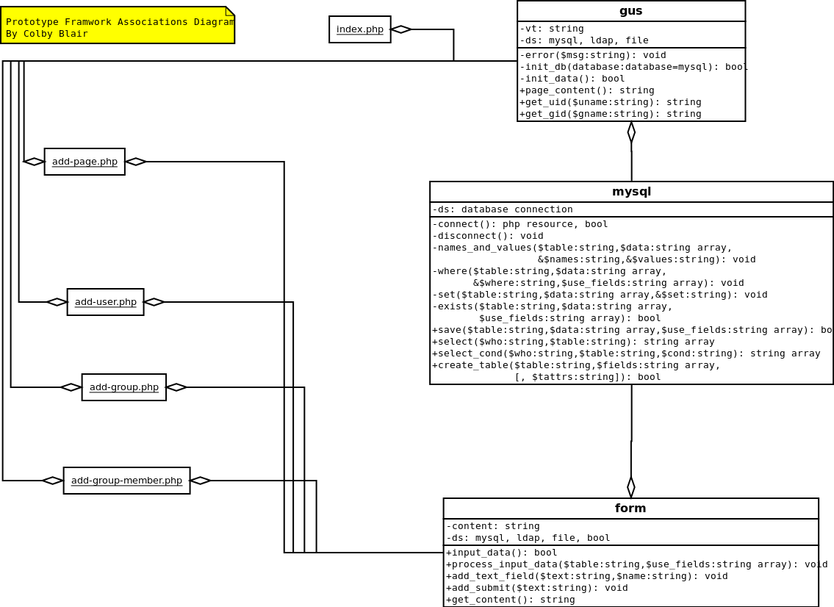

Slide 5
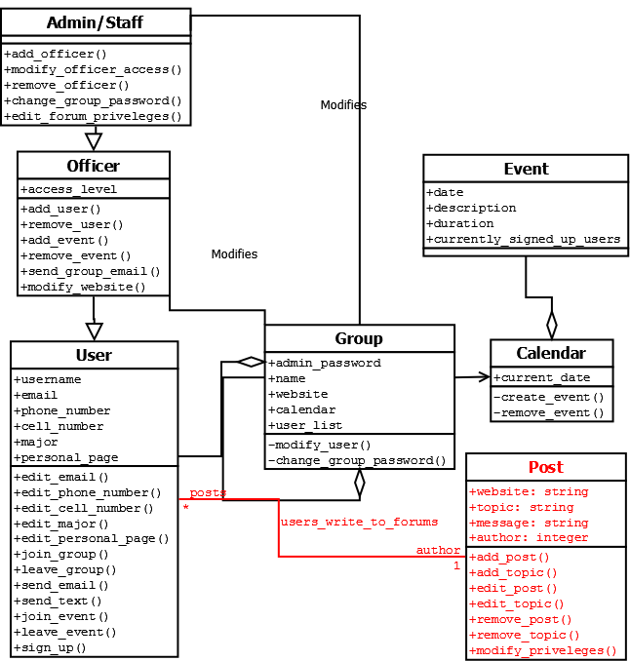

Slide 6
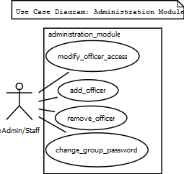
System Feature 1 : Officer Management (Admin Module)

Slide 7
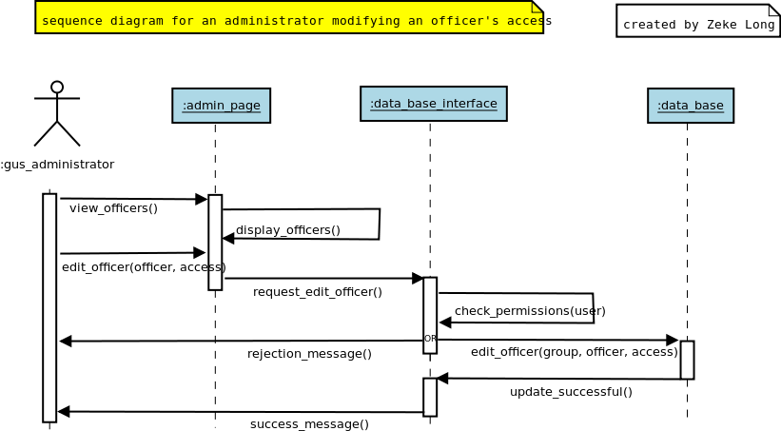

Slide 8
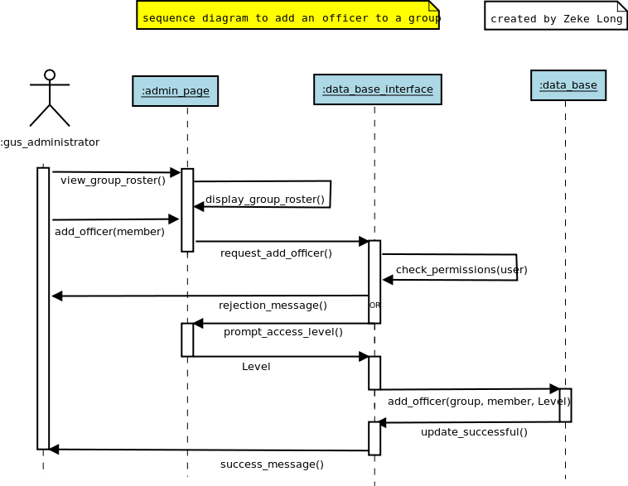

Slide 9
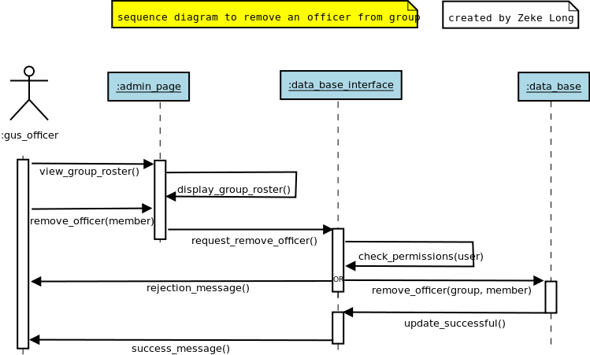

Slide 10
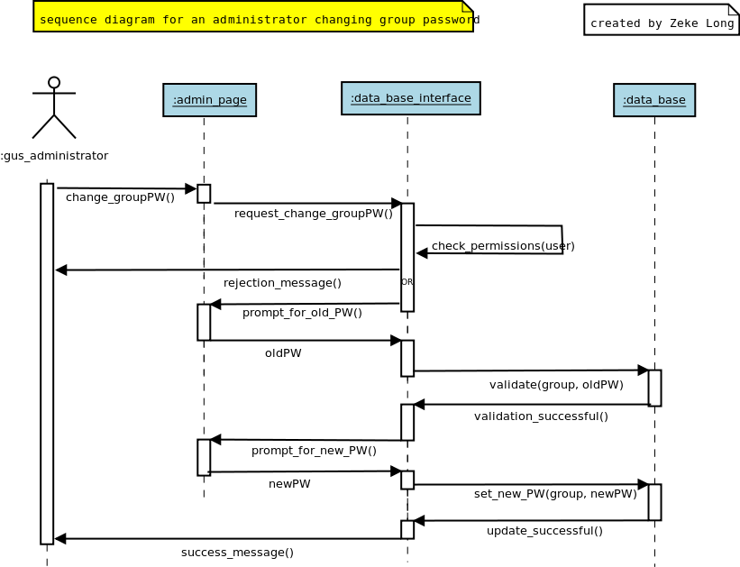

Slide 11
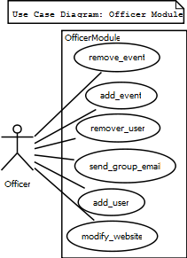
System Feature 2 : Group Management ( Officer Module )

Slide 12
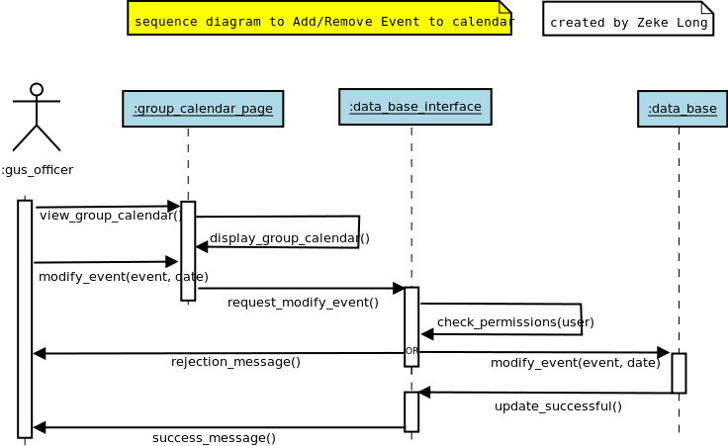

Slide 13
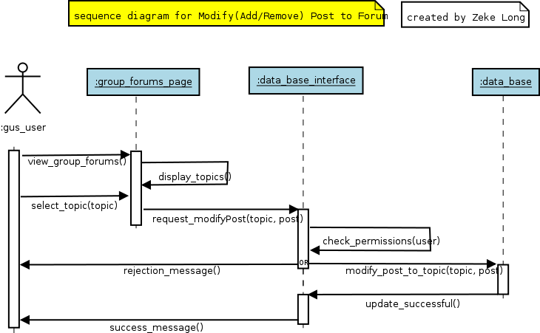

Slide 14
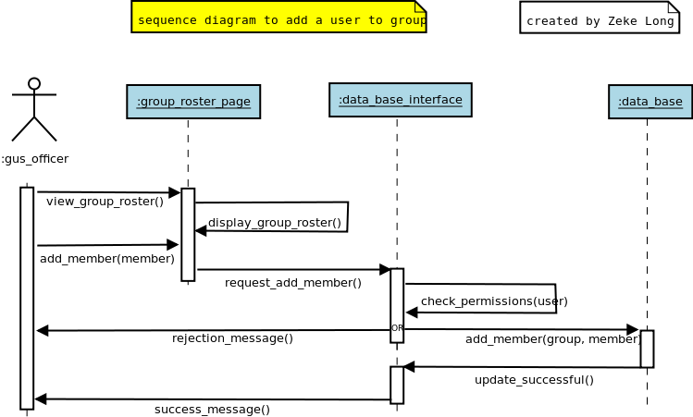

Slide 15
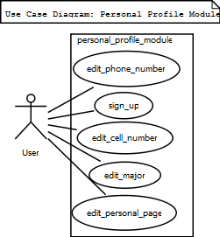
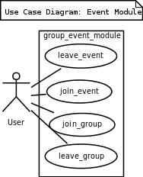
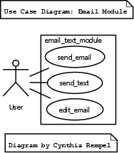
System Feature 3 : User Menu

Slide 16
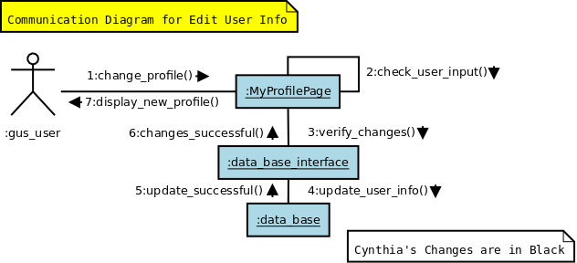
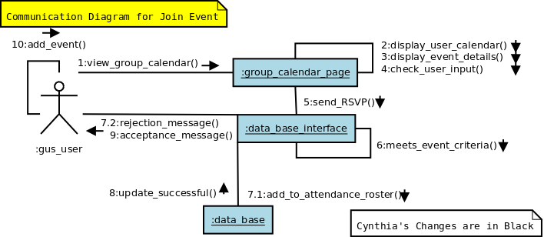

Slide 17
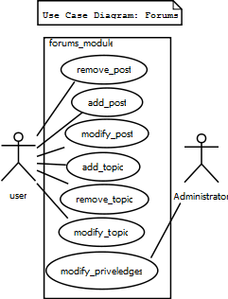
System Feature 4 : Forum Module

Slide 18
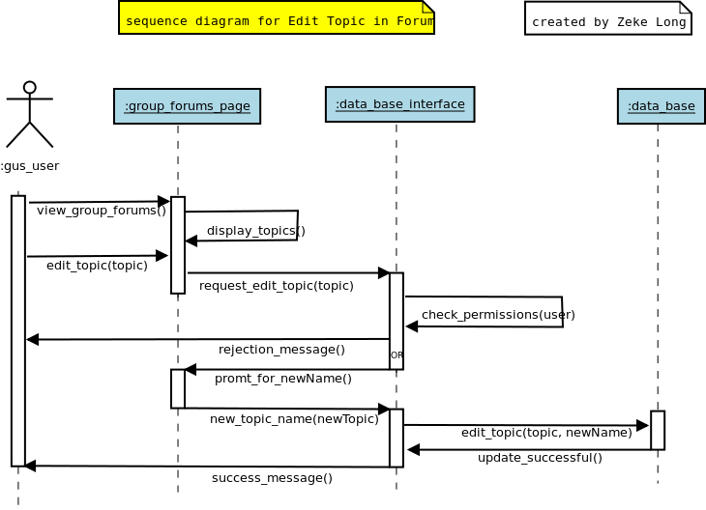

Slide 19
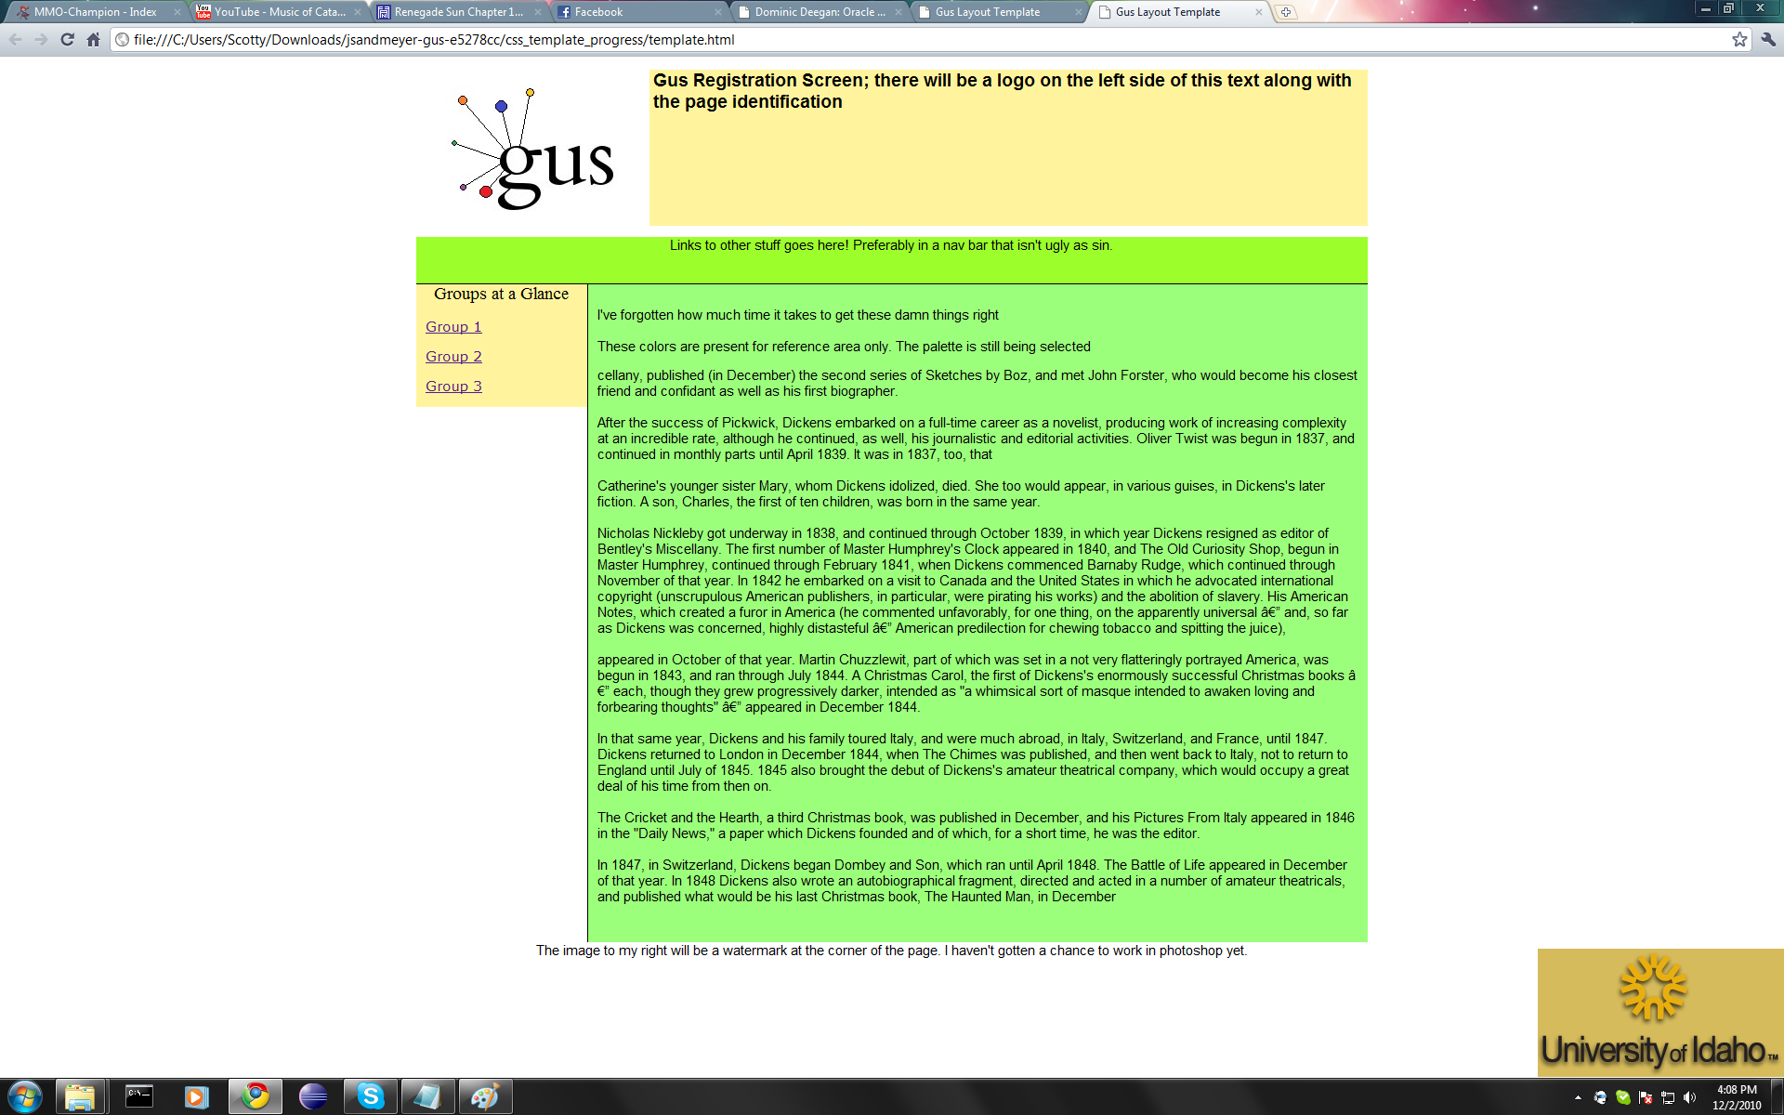
Visual Design Development

Slide 20
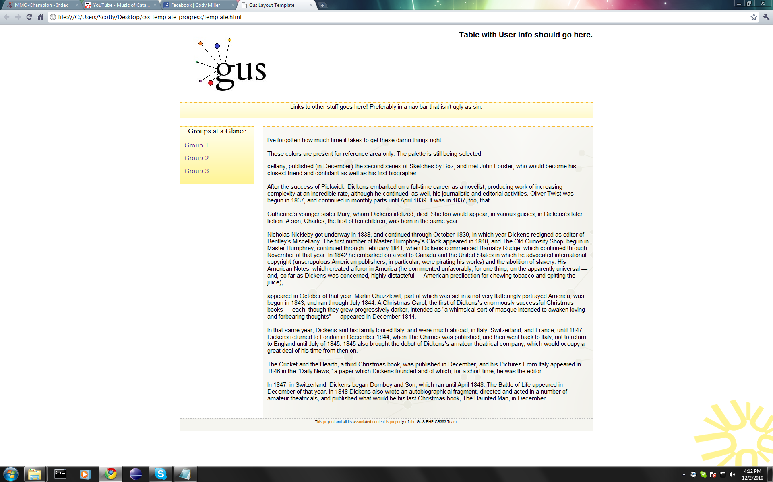

Slide 21
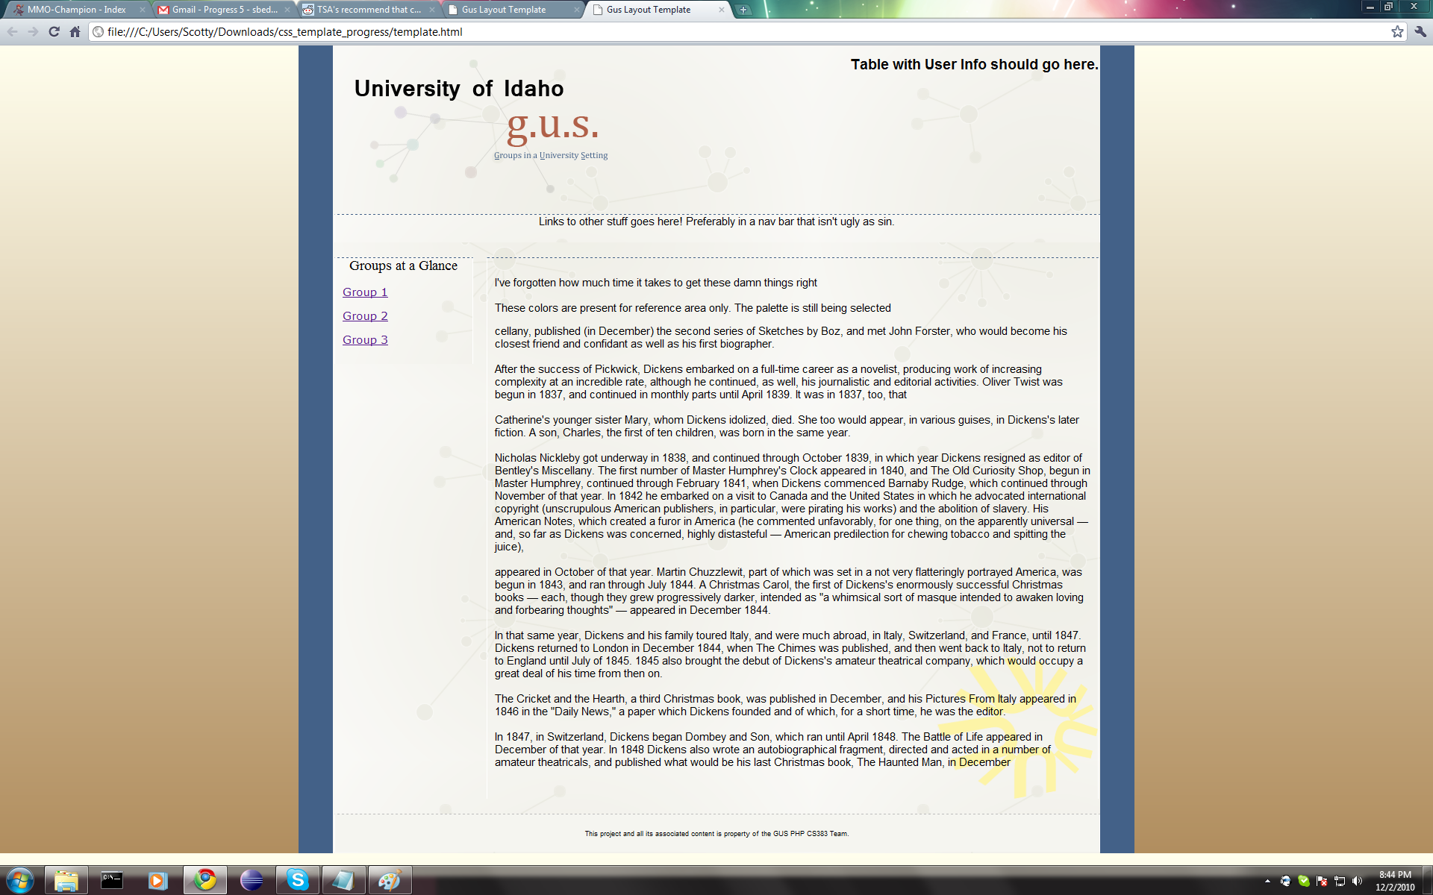

Slide 22
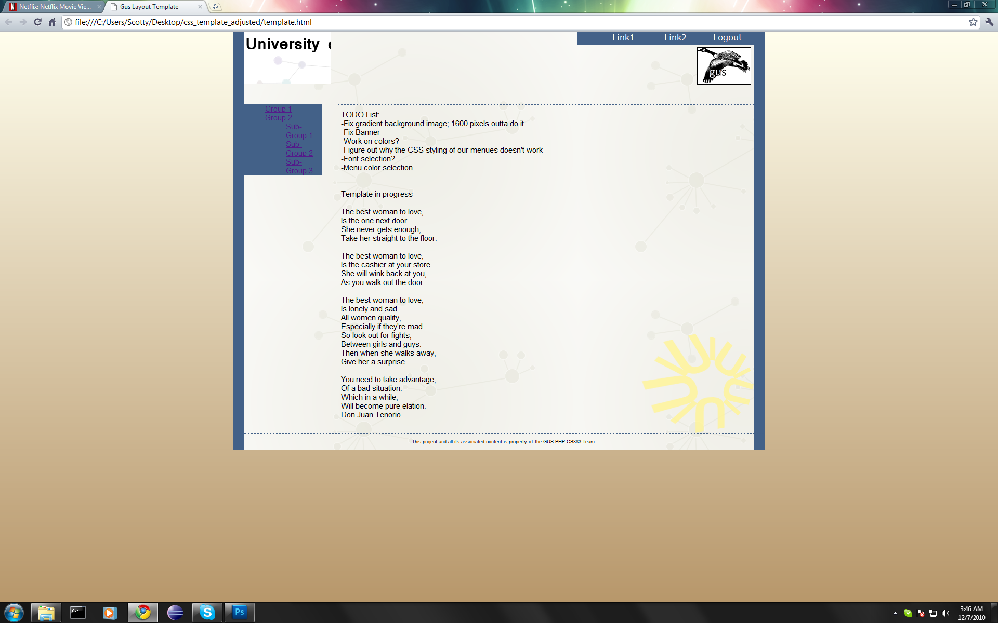

Slide 23
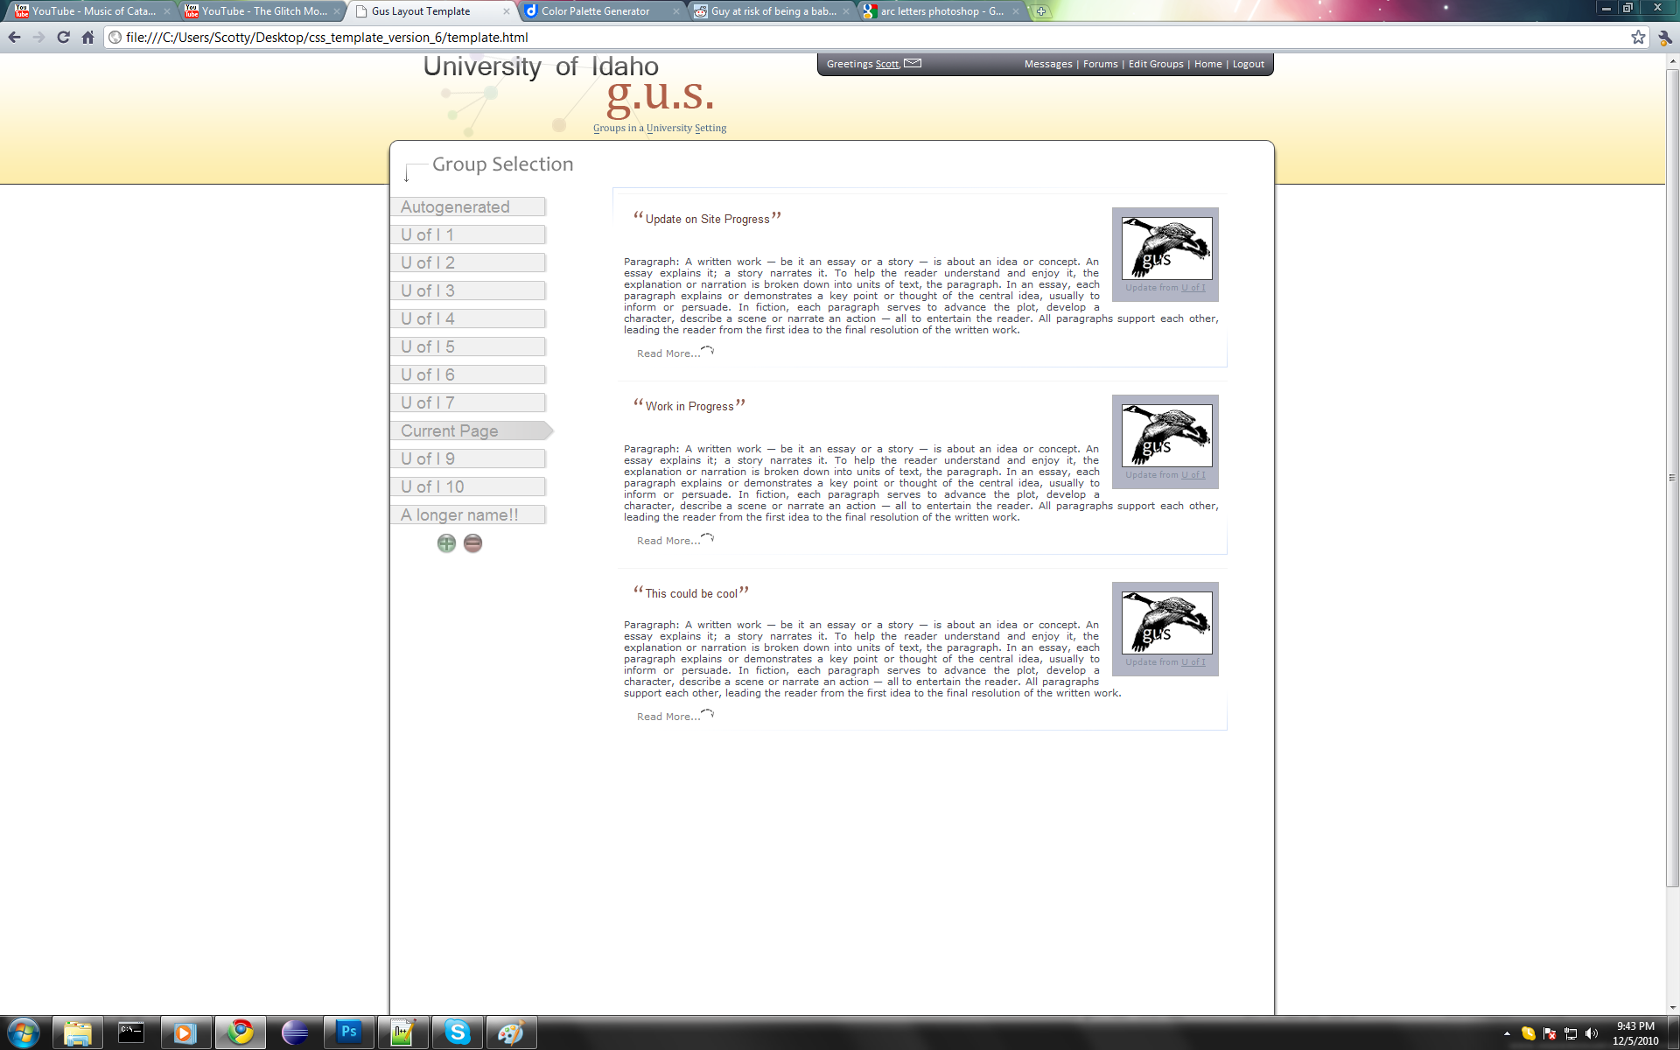

Slide 24
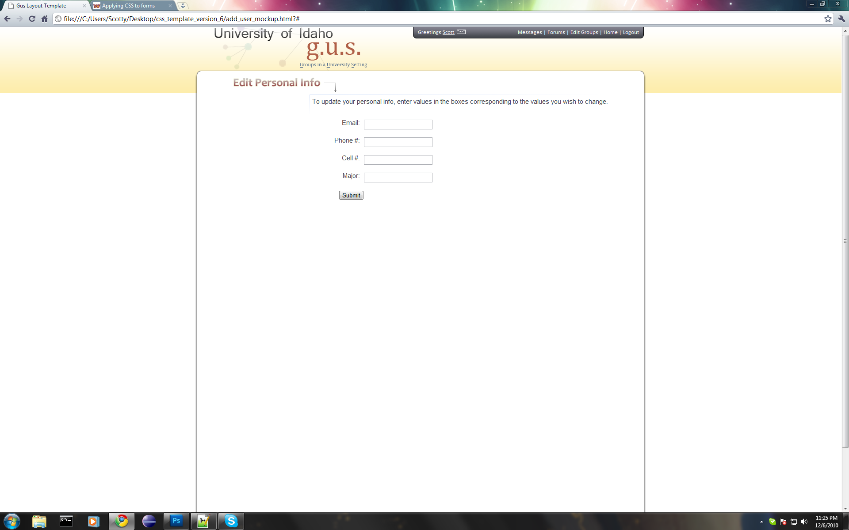

Slide 25
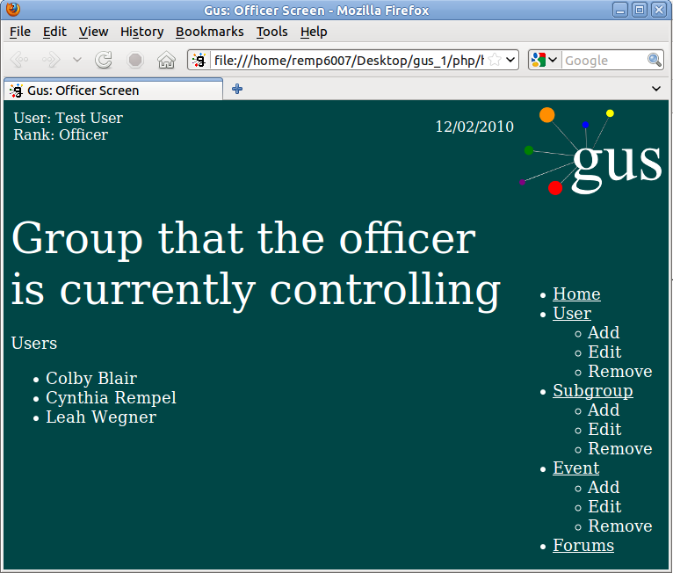

Slide 26
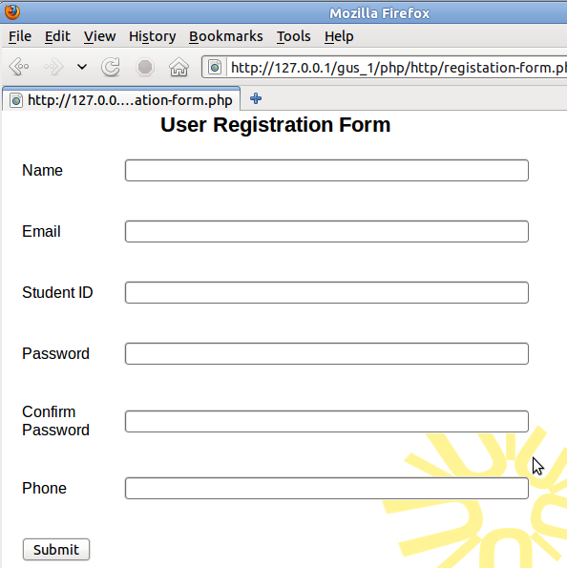
Use case: Register for GUS.
Actor: User.
Goal: Register for prospective user.
Preconditions: User is at GUS registration page.
Related Use Cases: Edit personal information
Steps:
1. User enters their name.
2. User enters their email.
3. User enters their username.
4. User enters their password.
5. User enters their password again.
6. User enters their phone number.
7. User clicks Submit.
Alternatives: User navigates away from page.
Admins can manually add users.
Post Conditions: The user's information is
validated, and then sent to GUS to be put in
the database.

Slide 27
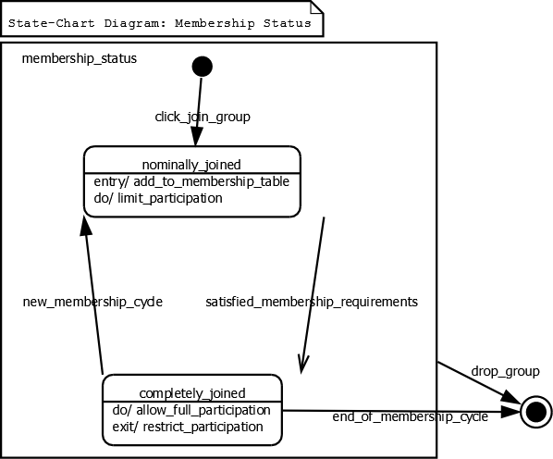

Slide 28
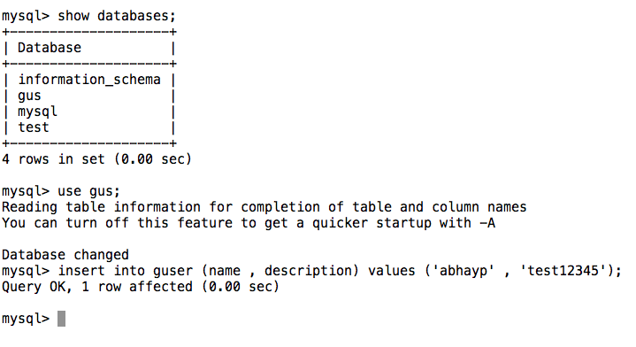
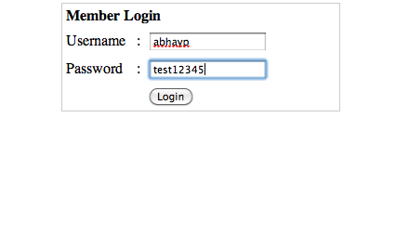

Slide 29
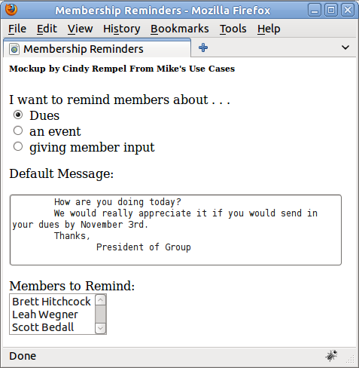
Use case: Notify members concerning dues/fees
from Mike's use cases.
Actor: Group leader.
Goal: Notify members of outstanding expenses.
Preconditions: Expense information is already entered into GUS.
Related use cases: enter fee information, send message,
notify members, toll out waivers
Steps:
1. Click 'money‘.
2. Click 'send notifications‘.
3. Write a reminder message.
4. Choose the users who need to be reminded.
Alternatives: The user cancels out.
Postconditions: A message is sent to each applicable member.

Slide 30
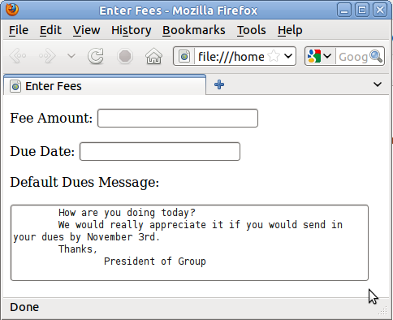
Use case: Enter fee information
Actor: User
Goal: Store group dues in GUS database
Preconditions: User is logged on and at the group's user page
Related use cases: Remind users to pay dues,
enter membership criteria
Steps:
1. Click 'enter fee information‘.
2. Type in fee amount.
3. Select due date from a calendar.
4. Click 'save‘.
Alternatives:
Postconditions: The dues information is saved in
the GUS database.
This use-case can be expanded by using the same
screen for an user to specify all the membership criteria:
waivers, dues, service project, class standing, GPA,
major, etc.

Slide 31
Organizing People
Connect skills to the task at hand
  Which skills will achieve the task at hand?
  What skills does each person have that he or she wants to use to accomplish the task?
  Getting participation
      Do your team mates understand what is expected? Ask them open-ended questions about what they are expected to do.
      Do your team mates understand and have access to the needed technology?
      Do your team mates feel confident enough to share what they have with others?
  Keeping Participation
      Try to find something positive in what each of your team mates did, and give them positive credit.
      Always ask each person if they know what they are doing, and if they are happy with it
      People have a need to be acknowledged.
Notes:
If the over-arching task is write a document, a really easy way to get programmers to collaborate is to turn their piece of the documentation into code.
For example: when I wanted to collaborate with a php expert, it was a lot more effective to wait for him to write the code, and then line-by-line turn it into text, instead of under utilizing his enthusiasm on drawing a diagram.
Although html is not taught in the main CS curriculum writing a web page seems a lot more relevant and approachable to a less experienced programmer than jumping straight into an advanced language, or even latex.

