Slide 1
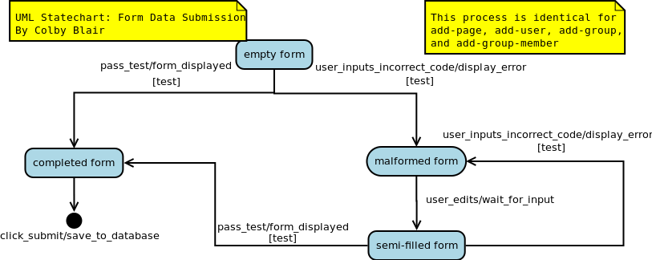

Slide 2
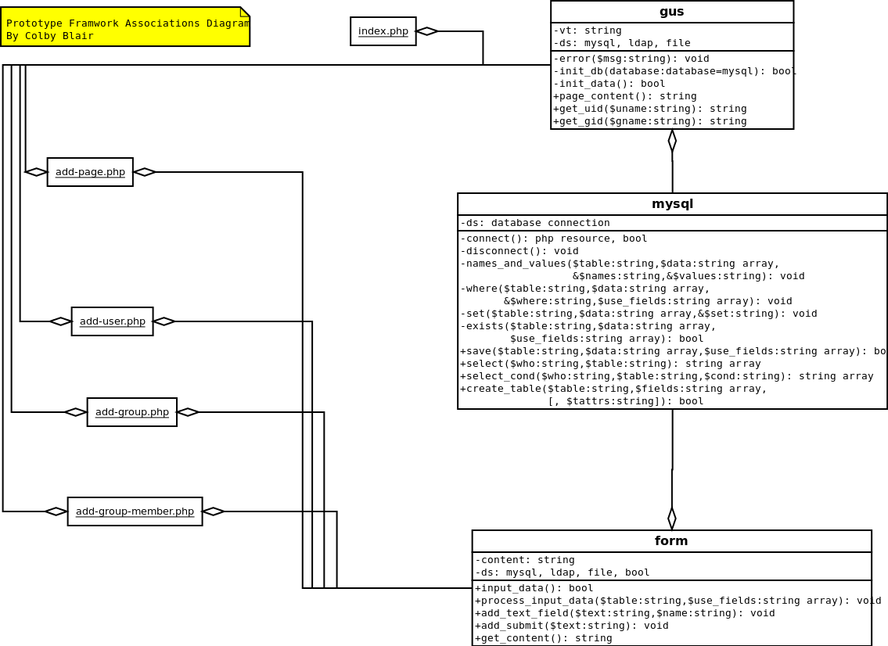

Slide 3
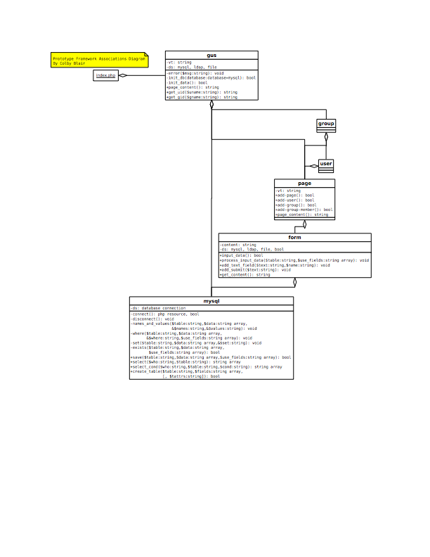

Slide 4
<?php//main.php
define("DBMODE", "mysql");define("DBHOST", "localhost");define("DBADMIN", "gusadm");define("DBUN", "gusgen"); //should be a less privileged userdefine("DBPW", "SHI/hel7");define("DBNAME", "gus");define("TMPLDIR", getcwd() . "/templates");?>
<?php//mysql.php
... public function save($table, $data,$use_fields) { foreach($data as $row) { $names = $values = $where = $set = ""; $this->names_and_values($row, $names, $values); $this->where($row,$where,$use_fields); $this->set($row,$set); if($this->exists($table,$row,$use_fields)) { $query = "UPDATE $table SET $set WHERE $where"; } else { $query = "INSERT INTO $table ($names) VALUES ($values)"; } $result = mysql_query($query, $this->ds); if(!$result) $this->error("mysql->save query: $query"); } return(true); }...?>

Slide 5
ggroup_member
+-----+-----+| gid | uid |+-----+-----+| 2 | 2 || 3 | 3 || 3 | 2 |+-----+-----+
ggroup
+-----+--------------------+--------------------------------+| gid | name | description |+-----+--------------------+--------------------------------+| 1 | default | This is the default gus group. || 2 | group1 | Test group 1. || 3 | fighting-mongooses | Slurm! |+-----+--------------------+--------------------------------+
guser
+-----+---------+----------+-------------+| uid | name | password | description |+-----+---------+----------+-------------+| 2 | cblair | NULL | Colby Blair || 3 | jvandal | NULL | Joe Vandal || 4 | test | NULL | Test user |+-----+---------+----------+-------------+

Slide 6
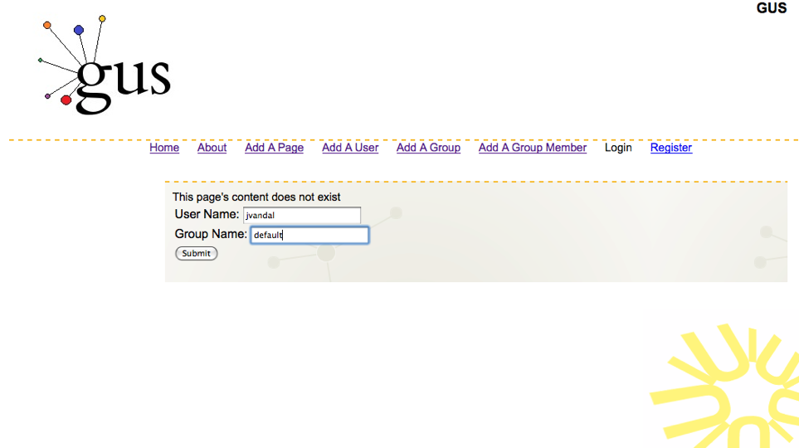
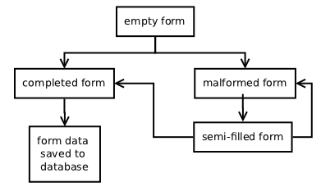
ggroup_member
+-----+-----+| gid | uid |+-----+-----+| 2 | 2 || 3 | 3 || 3 | 2 |+-----+-----+
+-----+-----+| gid | uid |+-----+-----+| 2 | 2 || 3 | 3 || 3 | 2 || 1 | 3 |+-----+-----+

