Slide 1

WEEK 1: Introduction to JavaScript

Slide 2
REVIEW
Padding
Content
Border
Margin
Hello World

Slide 3
REVIEW
Color is represented in three ways:

Slide 4
REVIEW
Color is represented in three ways:
Default value

Slide 5
REVIEW
Color is represented in three ways:
Default value
HEX value

Slide 6
REVIEW
Color is represented in three ways:
Default value
HEX value
RGB value

Slide 7
REVIEW
Two main types of Fonts:

Slide 8
REVIEW
Two main types of Fonts:
1. Serif fonts

Slide 9
REVIEW
Two main types of Fonts:
Serif fonts
Sans-serif fonts

Slide 10
TODAY’S OUTLINE
Intro to JavaScript
Basic Syntax
Conditional Statements
Loops

Slide 11
Goal Today
Learning JavaScript

Slide 12
Intro to JavaScript
JavaScript is the scripting language of the web
Not the same as Java!

Slide 13
Intro to JavaScript
Like CSS, you can select elements and manipulate their actions
Hide/Unhide menus
Photo Slider (carousel)
Popup modals (like Facebook’s Photo Viewer)
Form Validation
One-Scroll Homepage

Slide 14
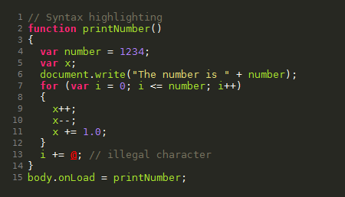
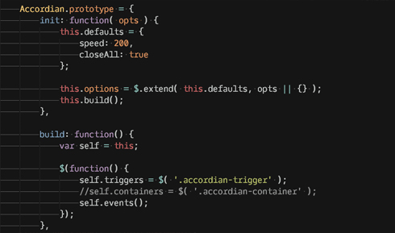
Intro to JavaScript
Sample JavaScript

Slide 15
How do you use JavaScript?

Slide 16
Intro to JavaScript
Like CSS, you link to a separate .js file that contains your file
<script type=“text/javascript” src=“home.js”></script>

Slide 17
Basic Syntax
Variables
They take in numbers, text, booleans (true/false) and functions
var x = 8;
var y = “John”
var z = ‘Ochieng’
var a = true;
Text (in computer science, we call them “strings”) can be surrounded by single or double quotes

Slide 18
Basic Syntax
Concatenation
You can add numbers or combine “strings”
“a” now stores 16. “b” stores John Ochieng.
Note: only use “var” to initialize (if the variable name has never been used before)
var a = x + x;
var b = y + “ ” + z;
var c = 5 + “ five”;

Slide 19
Basic Syntax
Shorthand increment/decrement
var x = 1;
x = x + 1;
// x is now 2
x += 1;
// x is now 3
x++;
// x is now 4
x--;
// x is now 3
To increment by 1, there are 3 ways:
1) x = x+1
2) x += 1
3) x++
Same goes for decrementing

Slide 20
Conditionals
If … Else
If something do this, else do that
If(x > 9000) {
alert(“Over 9000!”);
} else {
console.log(“Weak”);
}
alert(…) is a JavaScript function that creates a popup.
console.log(…) outputs whatever is inside onto the console (e.g. Chrome’s console).
Both useful for debugging.

Slide 21
Summary
JavaScript Basic Syntax
Conditionals
Next workshop is a handson lab:

