Slide 1
Week 2 : Web Development
INTRODUCTION TO BACK-END PROGRAMMING
Monday, June 12th

Slide 2

REVIEW

Slide 3
REVIEW
Front-End

Slide 4
REVIEW
Front-End
Back-End

Slide 5
FRONT-END REFRESHER
What is a Website?

Slide 6
FRONT-END REFRESHER
What is a Website?
Collection of Web Pages
index.html
about.html
contact.html
…
www.msoma.org

Slide 7
FRONT-END REFRESHER
CSS
HTML
JavaScript
Webpage

Slide 8
FRONT-END REFRESHER
What is a Website?
Collection of Web Pages
What makes a Website?
HTML (Skeleton)
CSS (Clothes)
JavaScript (Muscle)
Front-end is what everyone can see

Slide 9
HTML
How do you create a HTML document?

Slide 10
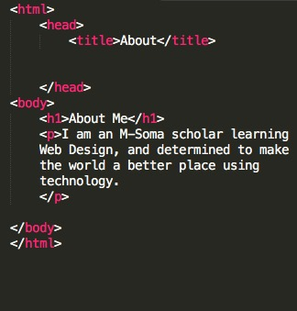
HTML
Open Sublime Text
Create a New File
Save As index.html
Add these tags:
<html> </html>
<head> </head>
<body> </head>
Inside head add title tags
<title> </title>

Slide 11
CSS
How do you tell your HTML document where the CSS file is?

Slide 12
CSS
How do you tell your HTML document where the CSS file is?
1. Relative Path
Desktop/
msoma/
index.html
css/
style.css

Slide 13
CSS
How do you tell your HTML document where the CSS file is?
2. Absolute Path
Desktop/
msoma/
index.html
css/
style.css

Slide 14
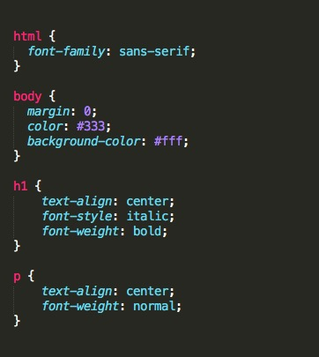
CSS
Open Sublime Text
Create a New File
Save As style.css
Add all your fancy styles

Slide 15
CSS Quiz
How do you change text color?
How do you the change background color?
How do you make text bold, italic?
How do you place text to the center of the page?
What types of fonts look good on a website?
How do you make the background an image?

Slide 16
CSS Quiz
How do you change text color?
color: #333;
How do you the change background color?
background-color: #fff;
How do you make text bold, italic?
font-weight: bold;
font-style: italic;
How do you place text to the center of the page?
text-align: center;
What types of fonts look good on a website?
Titles / headings - Serif
Paragraphs – Sans-serif
How do you make the background an image?
background-image: url(nairobi.png);

Slide 17
INTRODUCTION TO BACK-END

Slide 18
BACK-END
The Back-End consists of three parts:
An Application

Slide 19
BACK-END
The Back-End consists of three parts:
An Application
Can be a Website (web application) OR a mobile app

Slide 20
BACK-END
The Back-End consists of three parts:
An Application
Can be a Website (web application) OR a mobile app
What is in an application?
HTML
CSS
JS
Views

Slide 21
BACK-END
The Back-End consists of three parts:
An Application
A Server

Slide 22
BACK-END
The Back-End consists of three parts:
An Application
A Server
A Database

Slide 23
BACK-END
Common Back-End technologies:
Ruby on Rails
PHP
Django
Node JS

