Slide 1

Welcome to M-Soma!
Founded in 2016 by scholars at the University of California, Berkeley

Slide 2
Welcome to M-Soma!
Founded in 2016 by scholars at the University of California, Berkeley
You are the reason we started this program
www.msoma.org

Slide 3
The M-Soma Team
Monicah Wambugu
Moses Surumen
Fhadzhil Wamalwa
Fanice Nyatigo
Plus over 60 mentors!

Slide 4
Moses Surumen
Electrical Engineering & Computer Science senior at UC Berkeley
Tutor at the Computer Science department – Algorithms and Data Structures course
Worked at Equity Bank (Pre-University program) from 2013-2014

Slide 5
Monicah Wambugu
Information Technology Masters scholar at UC Berkeley
Bachelors degree in Computer Science
Worked as a Software Engineer at Mobile Surveys Inc. before grad school

Slide 6
Fhadzhil Wamalwa
Electrical Engineering Masters scholar at the University of Pretoria, South Africa
Bachelors degree in Electrical Engineering
Worked as an engineer at Equity Bank

Slide 7
Fanice Nyatigo
Junior studying Bioengineering at the University of California, Berkeley
Working on bio-tech projects

Slide 8
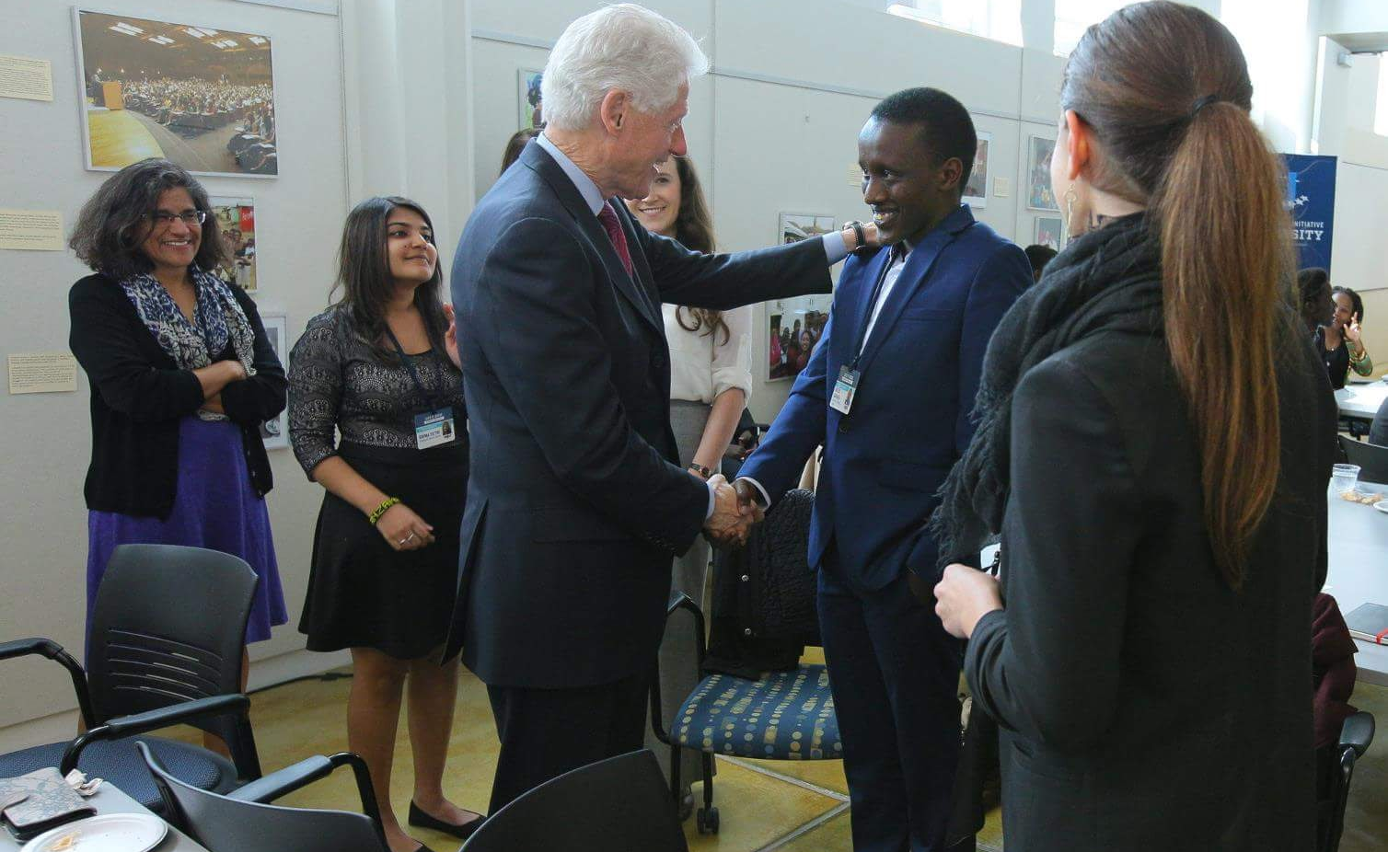
Clinton Global Initiative ‘16
April 3rd 2016

Slide 9
Mentors
US | Canada | South Africa | Kenya
30+ | 10+ | 6+ | 20+
Berkeley | Toronto | Cape Town | UoN
MIT | McGill | Pretoria | Kenyatta
Princeton | UBC |  | JKUAT
Stanford |  |  | …
Yale
Upenn
We have a diverse network of mentors you can talk to about:
College Apps
Career Advice
Collaborate
…

Slide 10
Schedule
Week 1
Web Development: Front-End

Slide 11
Schedule
Week 1
Front-End
Week 2
Back-End

Slide 12
Schedule
Week 1
Front-End
Week 2
Back-End
Week 3
Intro to Programming

Slide 13
Schedule
Week 1
Front-End
Week 2
Back-End
Week 3
Programming
Week 4
Programming

Slide 14
Courses
Web Development
Computer Programming (what is Programming?)
Design Thinking
Social Implications of Computing (discussion)

Slide 15
Week 1: Web Development
Learning Objectives:
Learn how to make a website using HTML, CSS, and JavaScript
Learn key principles that make a website “beautiful”
Meet and share passion with other scholars interested in learning programming

Slide 16
Web Design
Course Logistics:
One programming workshop daily: 9:00am-10:30am

Slide 17
Web Design
Course Logistics:
One programming workshop daily: 9:00am-10:30am
One lab: 11:00am – 12:30pm

Slide 18
Web Design
Course Logistics:
One programming workshop daily: 9:00am-10:30am
One lab: 11:00am – 12:30pm
One Project per Week***

Slide 19
Web Design
Course Logistics:
One programming workshop daily: 9:00am-10:30am
One lab: 11:00am – 12:30pm
One Project per Week***
Mini-assignments everyday
Fast paced

Slide 20
Need help on Projects?
Ask questions (anytime):
Email (msurumen@berkeley.edu , monicah_wambugu@berkeley.edu)

Slide 21
Need help on Projects?
Ask questions (anytime):
Email (msurumen@berkeley.edu , monicah_wambugu@berkeley.edu)
Do NOT copy code from your friends

Slide 22
Need help on Projects?
Ask questions (anytime):
Email (msurumen@berkeley.edu , monicah_wambugu@berkeley.edu)
Do NOT copy code from your friends
Google

Slide 23
Need help on Projects?
Ask questions (anytime):
Email (msurumen@berkeley.edu , monicah_wambugu@berkeley.edu)
Do NOT copy code from your friends
Google
Stack Overflow

Slide 24
Questions?

Slide 25
Tools you need!
GitHub account (Facebook for developers)

Slide 26
Tools you need!
GitHub account (Facebook for developers)
Git : software that connects your computer to Github

Slide 27
Tools you need!
GitHub account (Facebook for developers)
Git
Command Line / Terminal / Shell / Command Prompt

Slide 28
Tools you need!
GitHub account (Facebook for developers)
Git
Command Line / Terminal / Shell / Command Prompt
Code Editor – Sublime Text

Slide 29
GITHUB
Go to www.github.com to create an Account

Slide 30
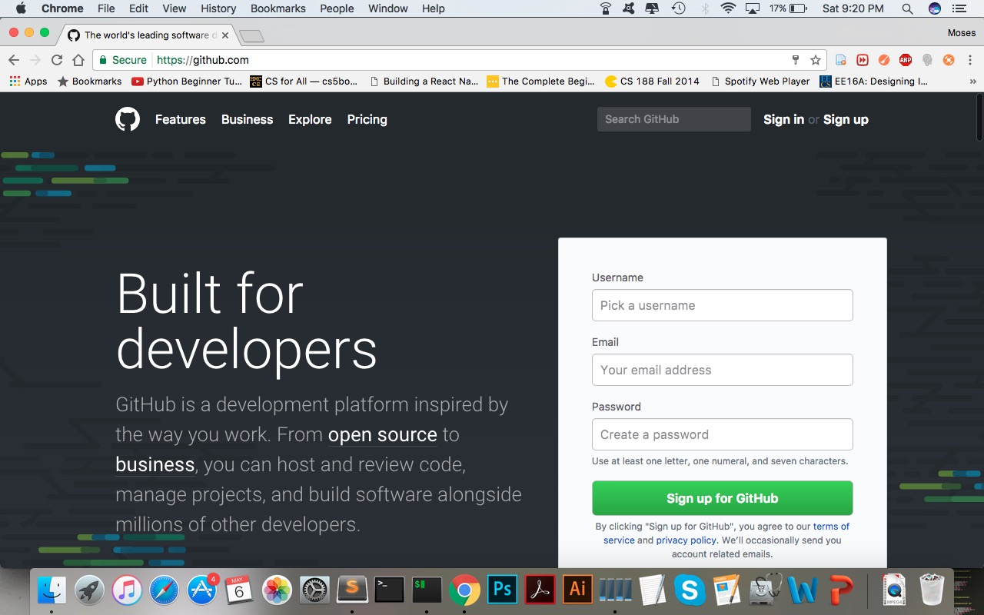

Slide 31
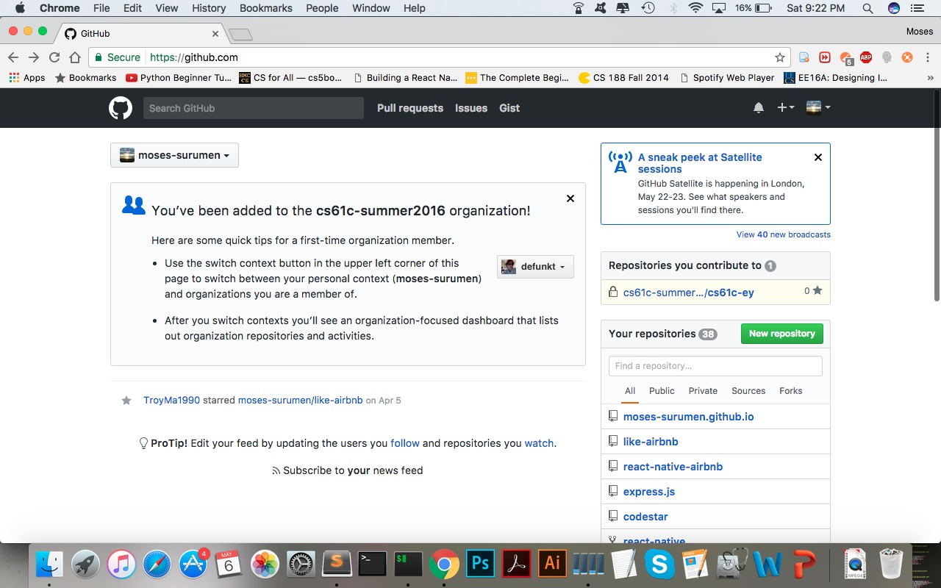

Slide 32
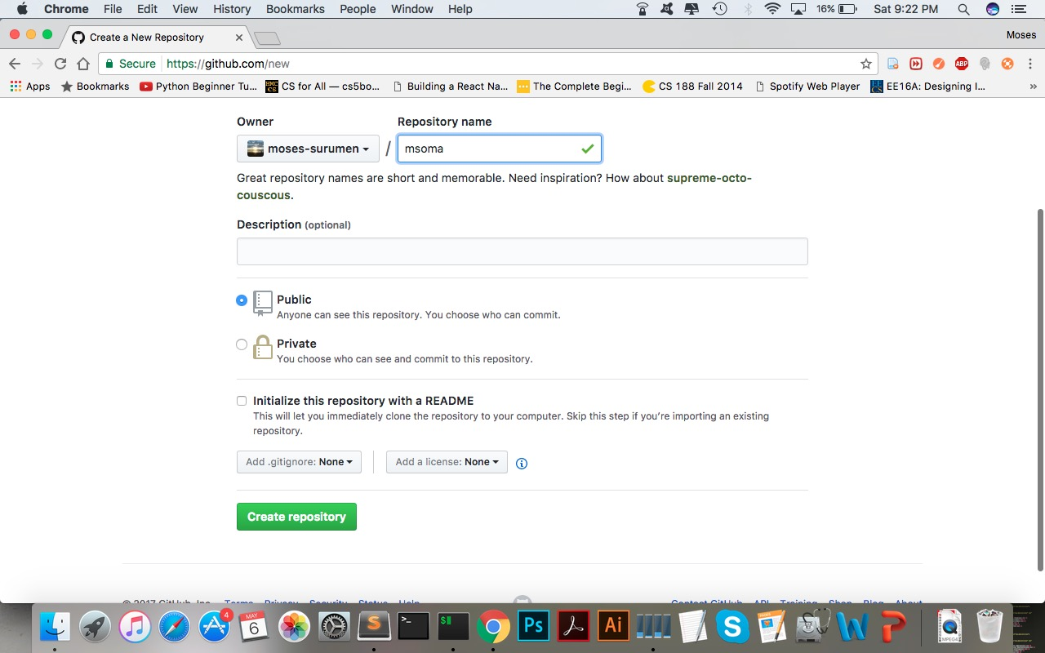

Slide 33
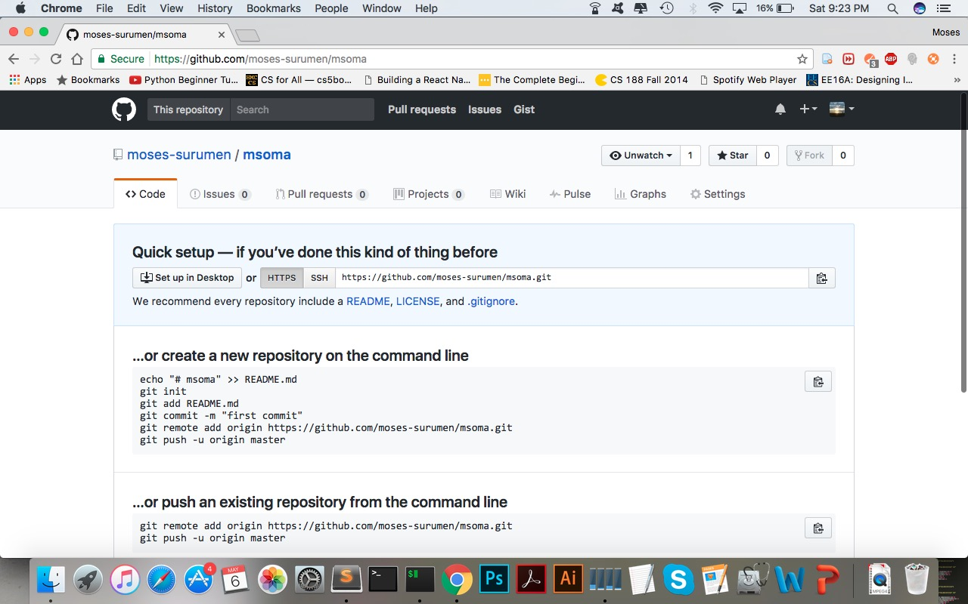

Slide 34
Git
A means to “transport” your files from your computer to Github

Slide 35
Git
Github
PULL
My
Computer
EMAIL?
Your Computer
PUSH

Slide 36
Git
Github
PULL
Yout
Computer

Slide 37
Downloading Git
Go to
https://git-for-windows.github.io/
Follow installation instructions

Slide 38
Command Prompt
Find on Applications / Utilities on your computer
(already installed)

Slide 39
Command Prompt
This is a program that executes commands!

Slide 40
Command Prompt
This is a program that executes commands!
You can use it to open, or delete files
Or create files and directories

Slide 41
Command Prompt
Change directory – cd directory_name

Slide 42
Command Prompt
Change directory – cd directory_name
Make directory – mkdir directory_name

Slide 43
Command Prompt
Change directory – cd directory_name
Make directory – mkdir directory_name
Create file – touch file_name.txt

Slide 44
Command Prompt
Change directory – cd directory_name
Make directory – mkdir directory_name
Create file – touch file_name.txt
Go back from directory – cd ..
Many other commands we will explore later

Slide 45
Exercise: Using Git and Github
Open your Command Prompt
Follow instructions on the Github page we stopped at
Initialize empty repository
Add remote (Remote is the online repository you created on Github)

Slide 46
Web Anatomy
What is a Website?

Slide 47
Web Anatomy
Website: collection of pages called served from a single domain
About
Home

Slide 48
Web Anatomy
Website: collection of pages called served from a single domain
About
Home
Page: just files written in HTML
index.html
about.html

Slide 49
Web Anatomy
Website: collection of pages called served from a single domain
About
Home
Page: just files written in HTML
index.html
about.html
Domain: an address that represents a server where the files are located (e.g. http://www.msoma.org )

Slide 50
How websites are shown
Server
File
Browser
Example: http://www.msoma.org/

Slide 51
How websites are shown
A user types in an address on their browser (Google Chrome, Firefox, Opera, Safari)

Slide 52
How websites are shown
A user types in an address on their browser (Google Chrome, Firefox, Opera, Safari)
The browser looks up the address which points to a server somewhere in the world (we use a WebFaction server located in Los Angeles, California)

Slide 53
How websites are shown
A user types in an address on their browser (Google Chrome, Firefox, Opera, Safari)
The browser looks up the address which points to a server somewhere in the world (we use a WebFaction server located in Los Angeles, California)
The browser loads all the required files (HTML files plus more files sometimes)

Slide 54
Getting a server to host your pages
Your computer can be a web server
Free web hosting services:
Github (yay!)
Many others
For this course you can just develop on your computer

Slide 55
What websites are made of
Front-end
What users can “see”
Back-end
What users can’t “see”
Ex. Buttons, Images, Text
Ex. Algorithms behind Logins, Search, etc.

Slide 56
What websites are made of
HTML
Structure
= Skeleton
CSS
Design
= Clothes
Javascript
Function
= Muscle

Slide 57
Introduction to HTML
A well writted HTML file should be understandable without styling (CSS)

Slide 58
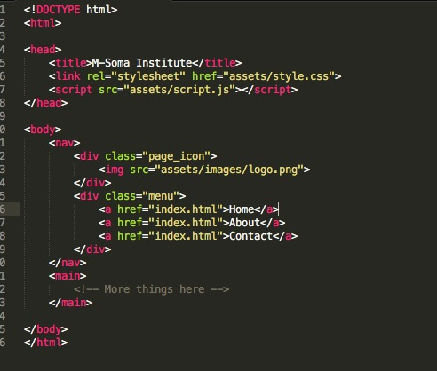

Slide 59
How do I make a Website?
Web Browser
Chrome
Firefox
Code Editor
Coda 2
Sublime Text
Image Editor (Optional)
Adobe Photoshop
Safari
Dreamweaver

Slide 60
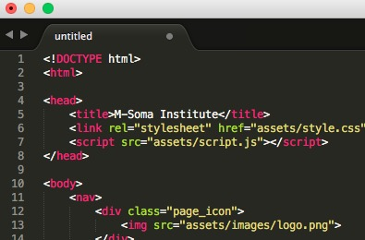
Editors and File Structure
A text editor is a program that edits plain text files
For us, we want one that is code-friendly and highlights code beautifully
Our pick: Sublime Text

Slide 61
Relative and Absolute Path
Relative Path: path to a file relative to current file, e.g. Link to “page.html” or “images/logo.png”

Slide 62
Relative and Absolute Path
Relative Path: path to a file relative to current file, e.g. Link to “page.html” or “images/logo.png”
Absolute Path: complete path to a file or web page, e.g. Link to “C:/Users/Moses/Desktop/page.html” or “https://www.facebook.com”

Slide 63
Relative and Absolute Path
Example: You’re currently in index.html, how do you access site.css by relative path?
workspace/
index.html
about.html
css/
site.css

Slide 64
Relative and Absolute Path
Answer: “css/site.css”
workspace/
index.html
about.html
css/
site.css

Slide 65
Relative and Absolute Path
Example: You’re currently in index.html, how do you access site.css by absolute path?
workspace/
index.html
about.html
css/
site.css

Slide 66
Relative and Absolute Path
Answer: “C:/workspace/css/site.css”
workspace/
index.html
about.html
css/
site.css

Slide 67
Relative and Absolute Path
To go up a folder (going back), use two dots and a slash (../)
C:/
workspace/
index.html
about.html
css/
site.css
msoma.html
How do you access msoma.html from index.html?

Slide 68
HTML Structure

Slide 69
Tags
Tags start with a left bracket < and end with a right bracket >
This is a paragraph tag: <p>
There are opening and closing tags. Closing tags start with </ instead:
Example: </p>
Together, a set of tags is called an element

Slide 70
Tags
You can add content between an opening and a closing tag:
Example, a paragraph element:
<p>Hello World!</p>

Slide 71
Tags
Opening tags must have a closing tag
Not acceptable: <p>Hello!
Acceptable: <p>Hello!</p>
There are exceptions for special tags:
Example: <br>
This is a line break tag
Also: <link rel=“stylesheet” href=“style.css”>
This is a link tag to your css file (will discuss later)

Slide 72
Basic HTML Structure
All webpages have 3 core elements to them:
HTML tag
Head tag
Body tag
The head and body tags are within the HTML tags

Slide 73
Basic HTML Structure
HTML
Head
Body

Slide 74
Basic HTML Structure
All HTML pages must start with the <html> tag and end with the </html> tag
Inside the HTML tags, put the head tags (notice indent)
<html>
<head>
</head>
</html>

Slide 75
Basic HTML Structure - Header
What goes in <head></head>?
Title of page, links to css and javascript files, website info, etc
Everything not rendered on the page (content)
Title:
<title> </title>
Defines the title displayed on browser/window tabs

Slide 76
Basic HTML Structure - Header
<html>
<head>
<title>First Webpage</title>
</head>
</html>

Slide 77
Basic HTML Structure - Body
What goes in <body></body>?
Content for your page
This is what the viewer sees
Heading tags:
<h1></h1>, <h2></h2>, <h3></h3>, …
Paragraph tags:
<p></p>

Slide 78
Basic HTML Structure - Body
Other Useful tags:
<br> for line break (jumps to next line for text)
<strong>…</strong> for bold text
<em>…</em> for italicized text
<hr> for horizontal line

Slide 79
Images and Links

Slide 80
Images and Links
Links
<a>..</a> tags. Also called anchor tags
Example:
<a href=“https://www.youtube.com”>You Tube</a>
Href is an example of an element attribute
Attributes are always followed by =
Between <a></a> is the text displayed on the browser

Slide 81
Images and Links
Images
<img> tag
Image tags rely a lot on HTML attribute (like href)
src attribute
Defines the image source (relative or absolute path)
Example: <img src=“/path/to/file.png”>
Height and width attributes, e.g
<img src=“/path/to/file.png” height=“100” width=“100”>

Slide 82
Lists
Unordered lists (bullets)
<ul>
<li>Moses</li>
<li>Monicah</li>
<li>Fanice</li>
</ul>
Moses
Monicah
Fanice

Slide 83
Lists
Ordered lists (numbers)
<ol>
<li>Moses</li>
<li>Monicah</li>
<li>Fanice</li>
</ol>
Moses
Monicah
Fanice

Slide 84
Structure of your Environment
workspace/
index.html
assets/
css/
site.css
js/
site.js
images/
Image01.png

Slide 85
Summary
Code Editor
Git
GitHub
Command Prompt/Terminal
HTML Basics
Next workshop is a handson lab:

