Slide 1

WEEK 1: FRONT-END INTRO TO CSS

Slide 2
REVIEW
HTML
Structure
= Skeleton
CSS
Design
= Clothes
Javascript
Function
= Muscle

Slide 3
REVIEW
What 3 elements are essential in HTML?

Slide 4
REVIEW
What 3 elements are essential in HTML?
HTML tags

Slide 5
REVIEW
What 3 elements are essential in HTML?
HTML tags
Head tags

Slide 6
REVIEW
What 3 elements are essential in HTML?
HTML tags
Head tags
Body tags

Slide 7
REVIEW
Images
<img> tag
Image tags rely a lot on HTML attribute (like href)
src attribute
Defines the image source (relative or absolute path)
Example: <img src=“/path/to/file.png”>
Height and width attributes, e.g
<img src=“/path/to/file.png” height=“100” width=“100”>

Slide 8
TODAY’S OUTLINE
Divs and Spans
IDs and Classes
Intro to CSS
CSS Properties

Slide 9
HTML without CSS

Slide 10
Goal Today
Style websites and make beautiful pages

Slide 11
Divs and Spans
<div></div> tags are the primary tags we will use from now on
They are essentially tags with no special properties (like <strong> or <h1>)
You customize them with CSS
They are stacked vertically, meaning you cannot have two divs side by side unless you alter the CSS

Slide 12
Divs and Spans
<span></span> tags are used from time to time
Like a div tag, they have no special properties
You customize them with CSS
They are stacked horizontally, meaning you can have two spans side by side

Slide 13
IDs and Classes

Slide 14
IDs and Classes
IDs and Classes are both attributes to HTML elements
They look like this: <div id=“main-content”> or <p class=“intro”>

Slide 15
IDs and Classes
IDs
Unique to a single HTML file (no other IDs on page can have the same ID)
Classes
There can be one or more of the same class on a given page

Slide 16
IDs and Classes
IDs and Classes are very important concepts for CSS.
This is how CSS will select certain elements and style them

Slide 17
Intro to CSS

Slide 18
Intro to CSS
CSS stands for Cascading Style Sheets
They go in another file with an extension of .css
Link to the CSS file from your HTML file (in the <head></head> tags)
<link rel=“stylesheet” type=“text/css” href=“/path/to/style.css”>

Slide 19
Intro to CSS
Intro to CSS
Basic structure of CSS:
SELECTOR
p { color: red; font-size: 16px; }
Basic Structure of CSS:
PROPERTY
VALUE

Slide 20
Intro to CSS
Intro to CSS
A selector can be the HTML element name, ID or Class name
SELECTOR
p { color: red; font-size: 16px; }
Basic Structure of CSS:
PROPERTY
VALUE

Slide 21
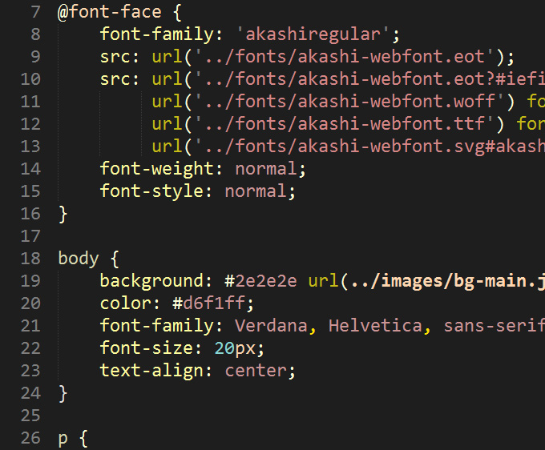
Intro to CSS
Intro to CSS
Sample CSS document

Slide 22
CSS Properties
color
Changes the color of your text
Value is either a default color value (red, blue, etc.), RGB or HEX value
background-color
Changes the background color of your HTML element

Slide 23
CSS Properties
text-align
Values: left, center, right, justify
text-decoration
Values: underline, overline, line-through

Slide 24
CSS Properties
font-size
Value in px (ex: 16px or 24px)
Other ways to define font too (but we won’t go over them)
font-weight
Values: normal, bold, bolder, or lighter
Or use values from 100, 200, …, to 900
400 = normal, 700 = bold

Slide 25
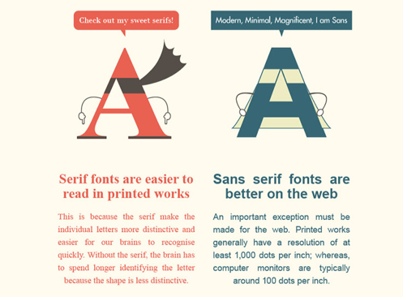
Fonts
There are two types of fonts: Serif and Sans-serif

Slide 26


Common Web Fonts
Some fonts are considered “web-safe” meaning you can use them for your website without any trouble
Examples are

Slide 27
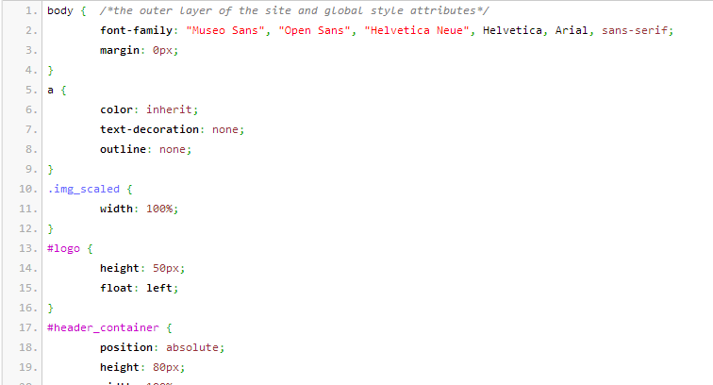
CSS Properties – Font-Family

Slide 28
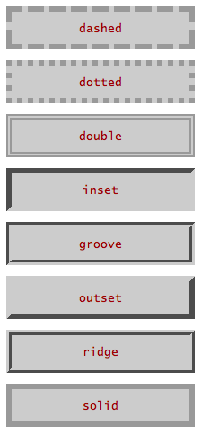
CSS Properties
border
Takes in 3 values, space-separated
1st value: border-width in px (pixels)
2nd value: border-style
3rd value: color
Example: border: 1px solid #999;
Thin solid gray border around your element

Slide 29
Centering a Div
Text or Div Element
Centering text is easy, use text-align: center
What if you want to center a <div> that has a certain width?

Slide 30
Centering a Div
Center me! I want this box to be in the center! :)

Slide 31
Centering a Div
To center a <div>, add 2 CSS properties to the element:
margin-left: auto;
margin-right: auto;

Slide 32
Centering an Image

Slide 33
Centering a Image
To center an image, add:
margin-left: auto;
margin-right: auto;
display: block

Slide 34
Centering an Image

Slide 35
COLOR
What is a white color?
What is a black color?

Slide 36
COLOR
What is a white color?
ALL colors
What is a black color?
Means no color

Slide 37
Color on the Web
Color on the Web Can be represented in three ways:
A default color value
Hex Value
RGB Value

Slide 38
Color on the Web
Default Color
16 pre-defined CSS colors
Example: red, blue, black, white, maroon, etc.
Too limited may not be what you want!

Slide 39
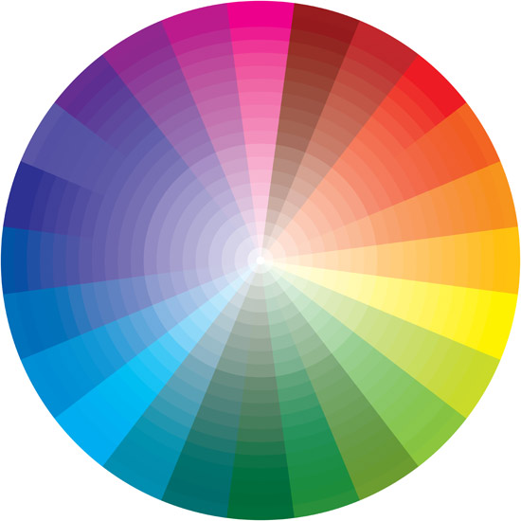
Color on the Web
Hex Color (Hexadecimal)
Millions of ways to define a color!
Syntax: Pound sign # followed by 6 digits/characters from 0 to 9 and A to F
Example: #FF0000 (red), #339CCD (light blue), #888888 (gray)

Slide 40

CSS Color - Hex
Hex values are 6 digits, or 3 bytes.Each byte is 2 digits and represents a “color”
Red corresponds to the 1st byte, Green to the 2nd, Blue to the 3rd
A “0” indicates no color. Increasing the value to 1, 2, etc. increases the color. An “F” indicates full color (lightest)
Example: #0000FF - Equivalent to “no reds”, “no greens”, “full blues” = Pure Blue

Slide 41
CSS Color - RGB
RGB colors
Syntax: rgb(255, 0, 0)
rgb(…) takes in 3 values: red, green, blue
Similar to Hex. 0 in rgb is 00 in hex, 255 in rgb is FF in hex
Examples:
rgb(255, 0, 0) vs. #FF0000
rgb(51, 156, 205) vs #339CCD

Slide 42
Summary
Divs and Spans
CSS Properties
Next workshop is a handson lab:

