Slide 1

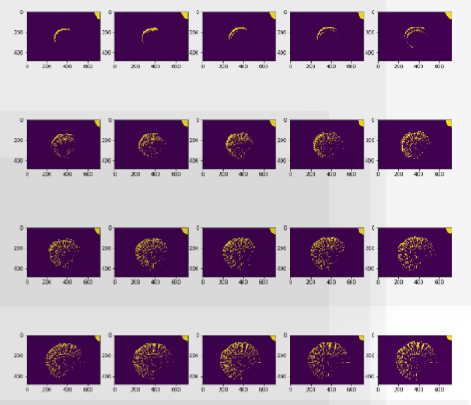
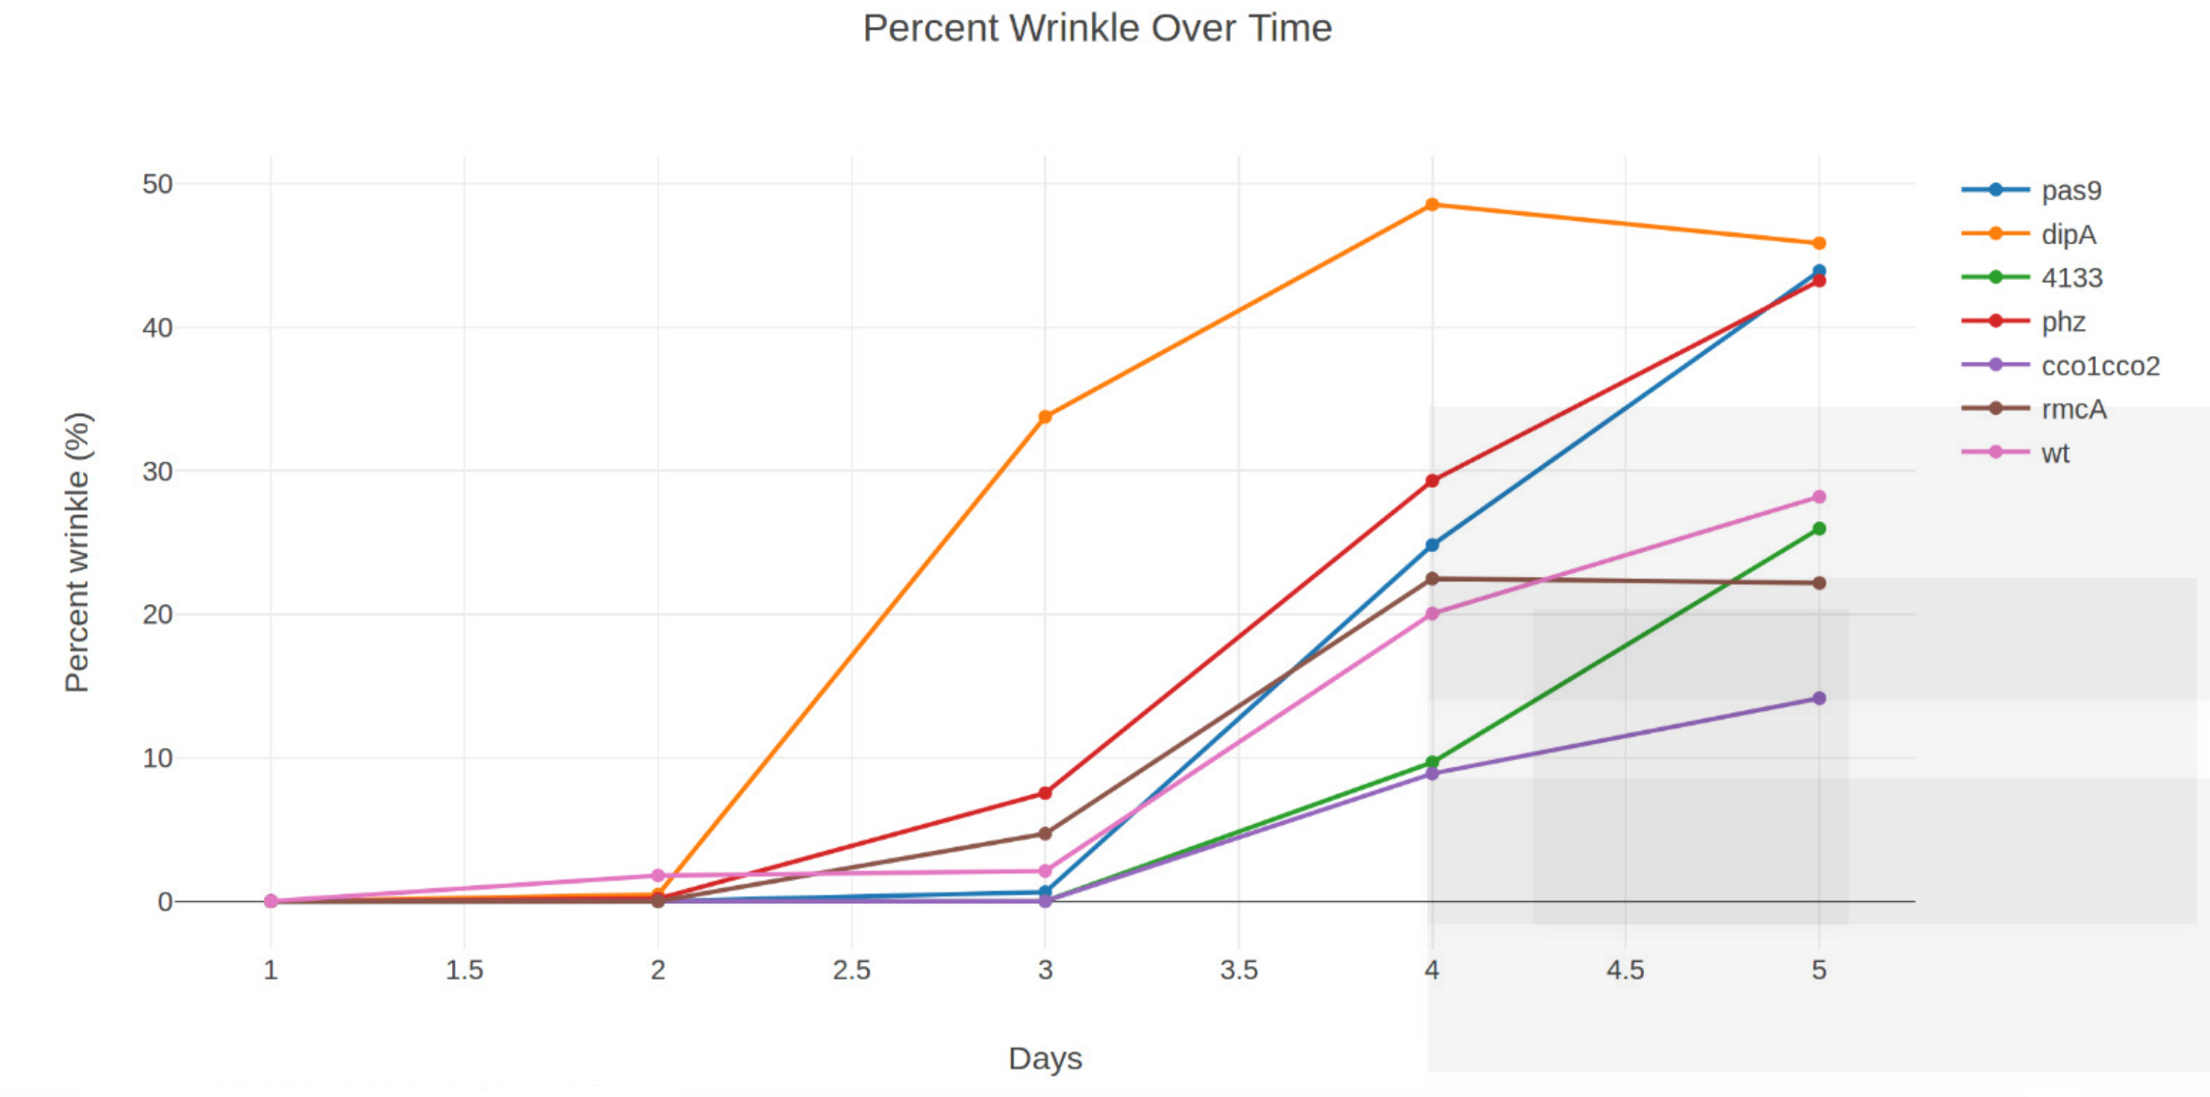
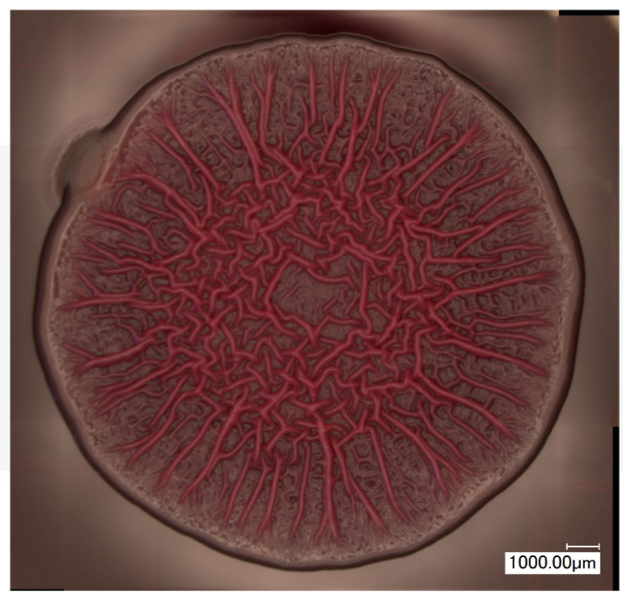
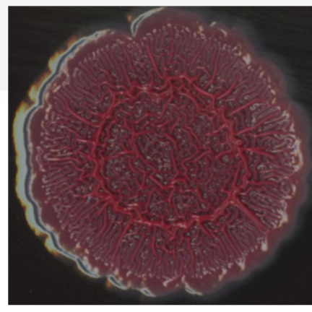
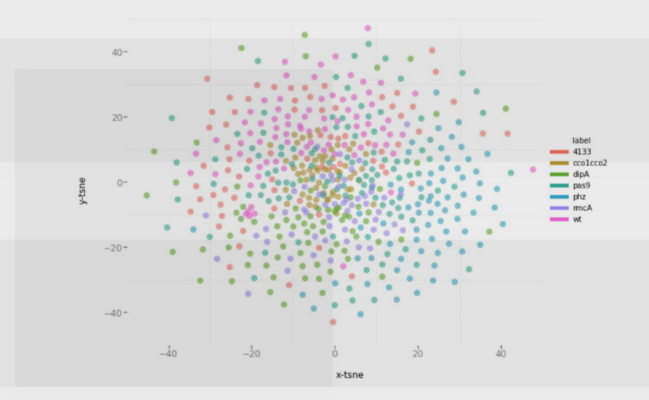
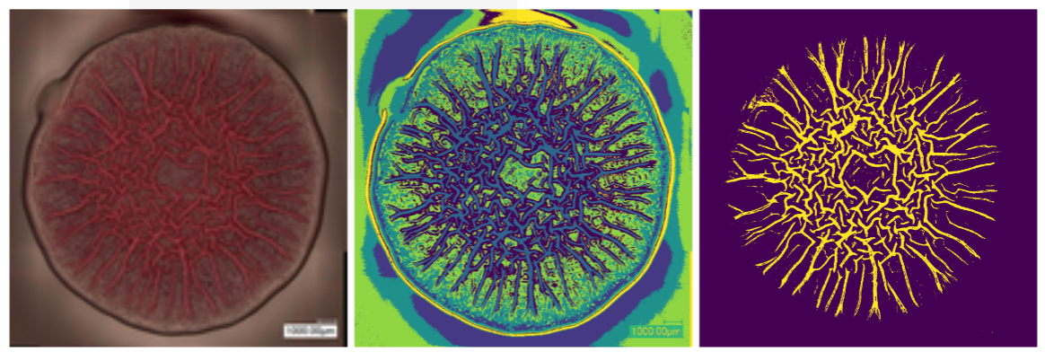
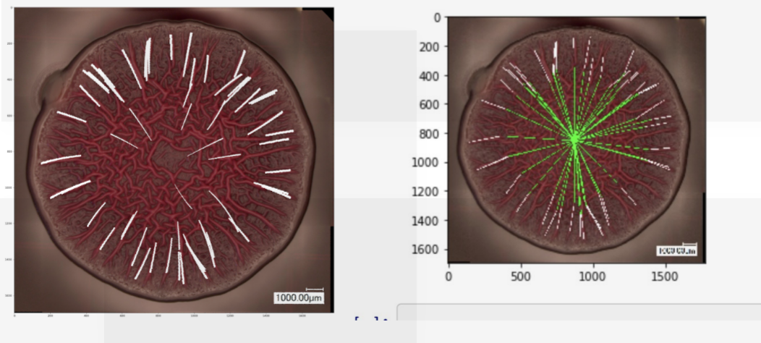
Studying the Formation of Biofilms to Diagnose and Treat Infection
R.Jaber, M.Sorba, C.Yang, I.Wainstein
Data Science Capstone Project
With Prof. Lars Dietrich
Discovering Quantitative Features
The two biofilms below undergone different mutations, and we want to understand their differences in order to learn more about the underlying process that drives their formation. Historically, the research community uses qualitative descriptions to compare features. The goal of this project is to develop methods to extract quantitative features.
Feature Extraction Over Time
Why over time is important.
d
Deep Features
Let algorithms discover new features that based on differences between biofilms.
Figure 1. Example biofilms with varying characteristics
Pre-defined feature extraction
This method involves quantifying pre-defined features that are know to be important.
Figure 3. TSNE
Outcomes
Robust algorithms to out direct features and deep features for hundreds of biofilms and new biofilms.
Public code for researchers to build on
Website for non-programming savvy to get features from new biofilms.
Figure 2. Unsuprivised classification by color to identify wrinkle class
Acknowledgments
In this template, acknowledgments are set in Calibri, 32 points. Try to keep the acknowledgments to one or two lines.
Figure 3. Number of spokes and ratio of spoke to clustered wrinkle

