Slide 1
Aaina
Influencer Marketing Platform
Admin Dashboard — Product Walkthrough
August 2026

Slide 2
Admin Dashboard
The web console used by the Aaina team to run the marketplace.

Slide 3
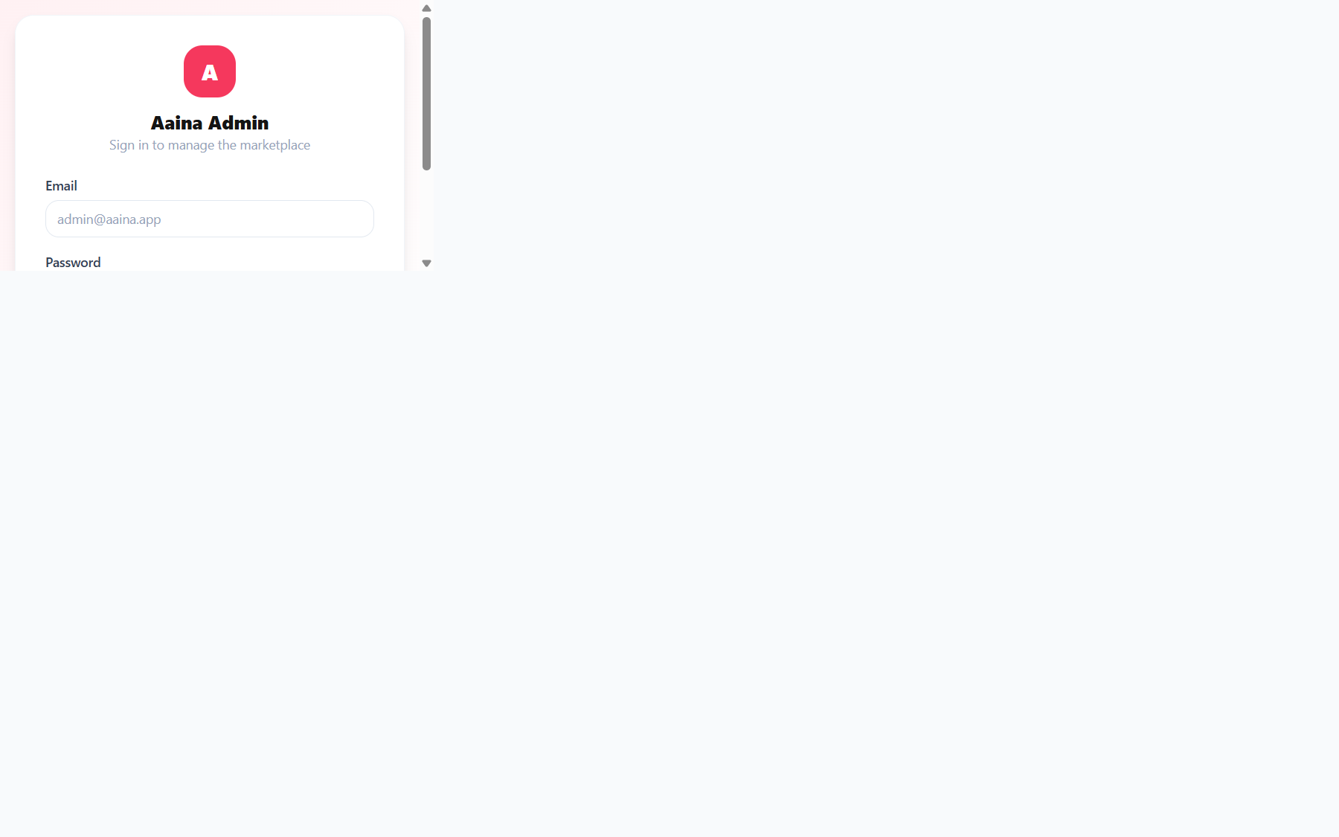
Admin Login
Secure sign-in for administrators and employees.

Slide 4
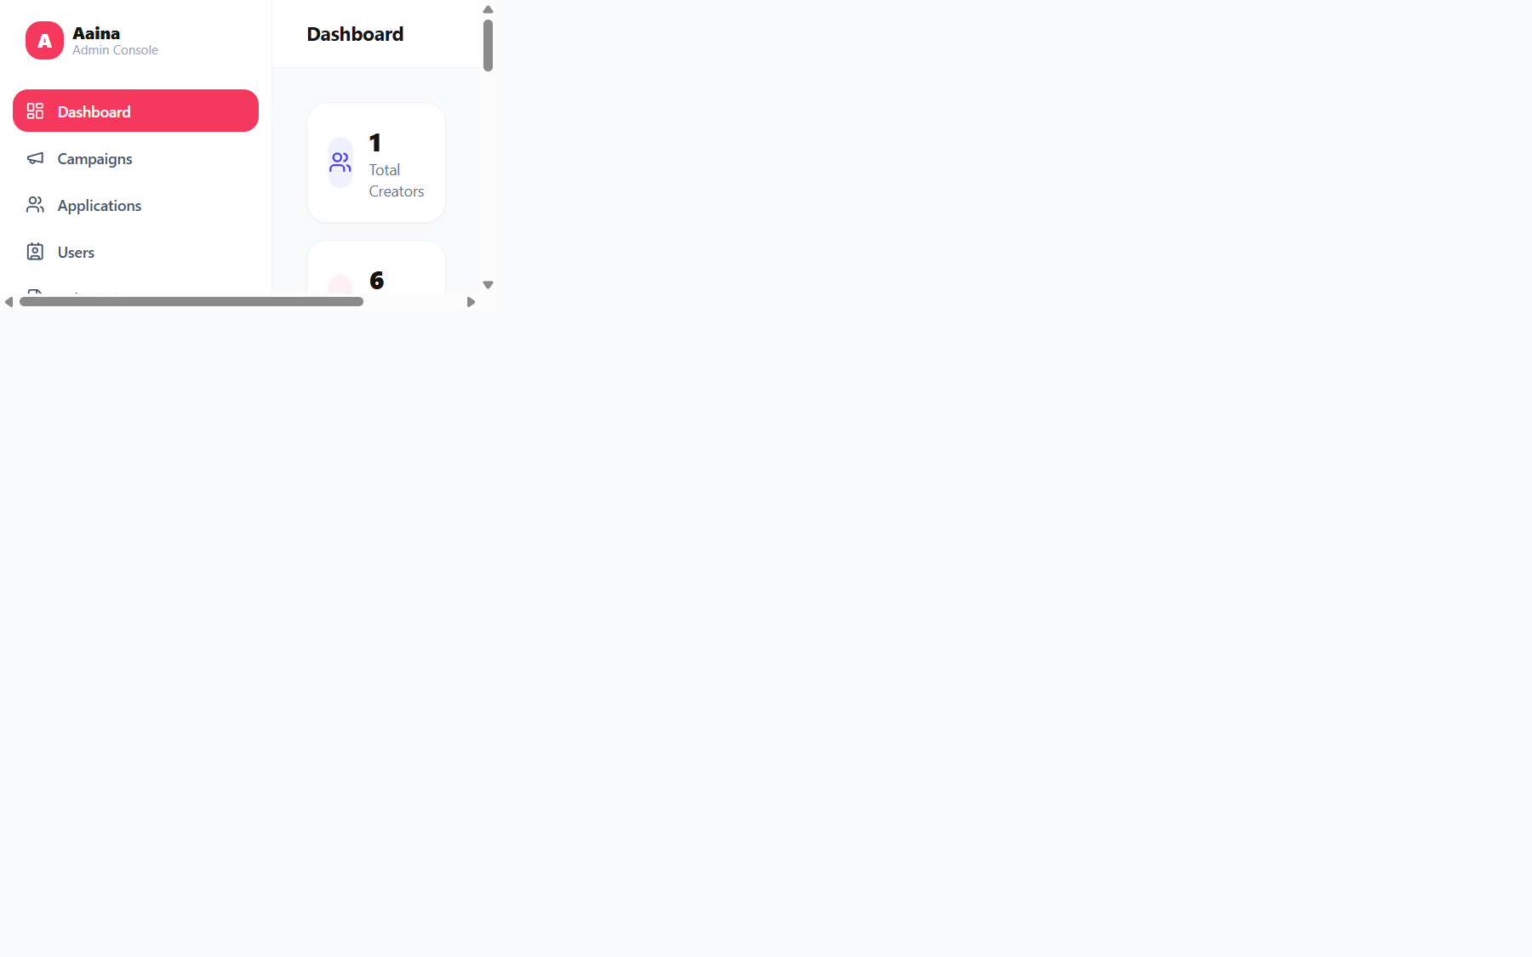
Dashboard
At-a-glance KPIs: creators, active campaigns, applications and pending submissions.

Slide 5
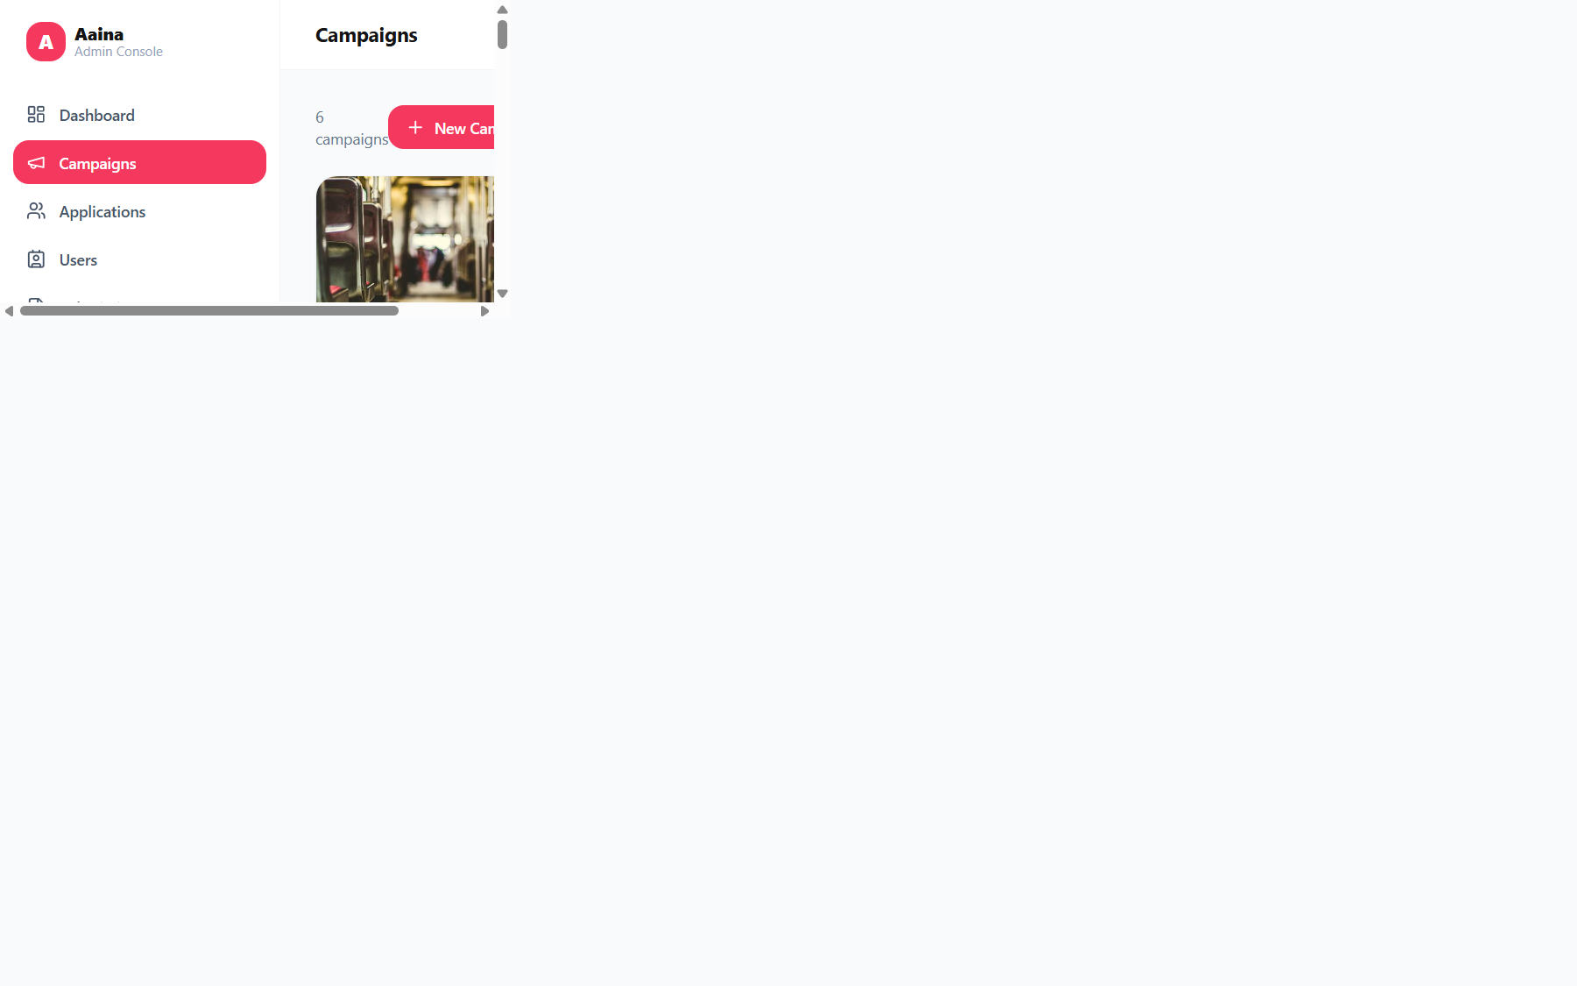
Campaigns
Create and manage brand campaigns, budgets and status.

Slide 6
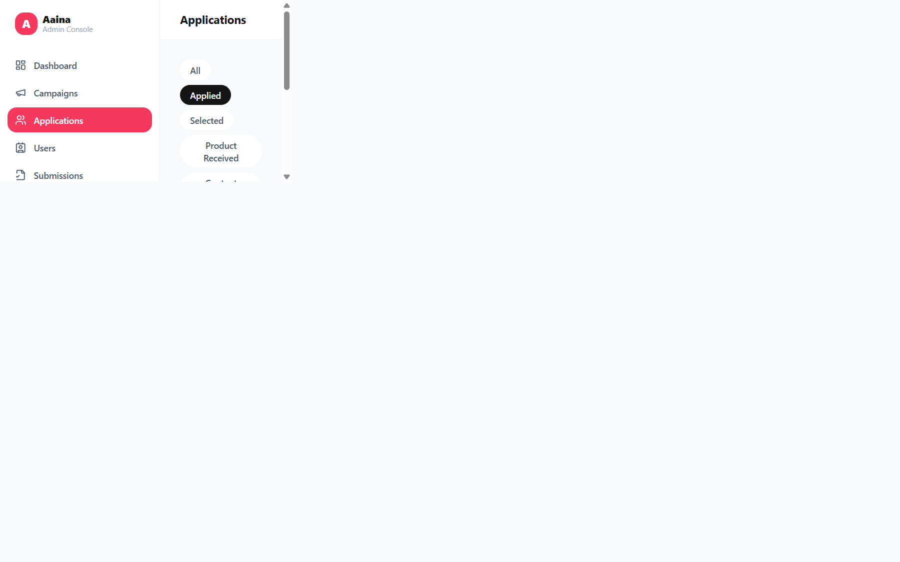
Applications
Review creator applications and approve or reject participation.

Slide 7
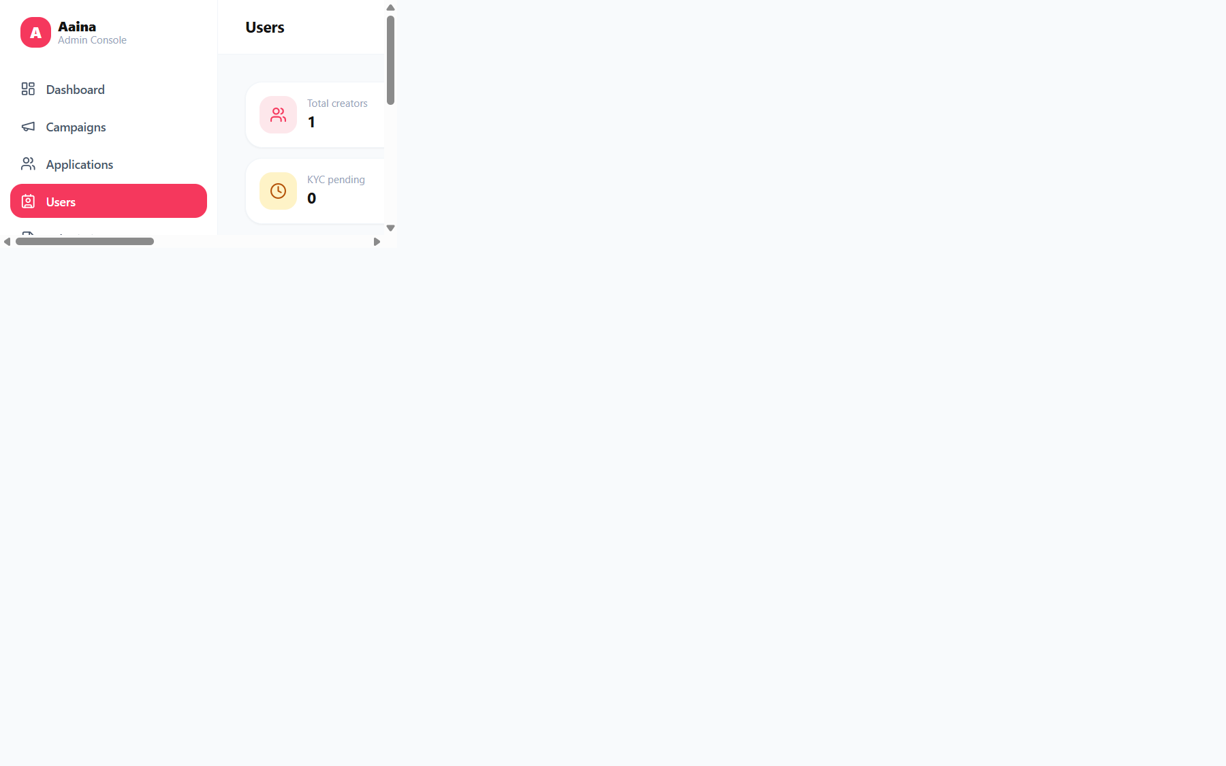
Users
Directory of all creators with profiles and social reach.

Slide 8
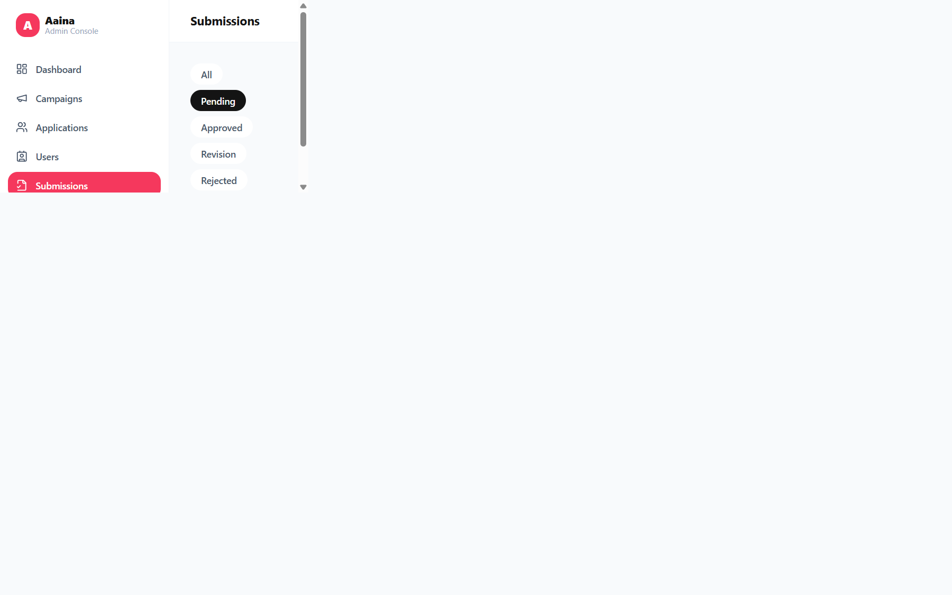
Submissions
Review submitted content and approve, request revisions or reject.

Slide 9
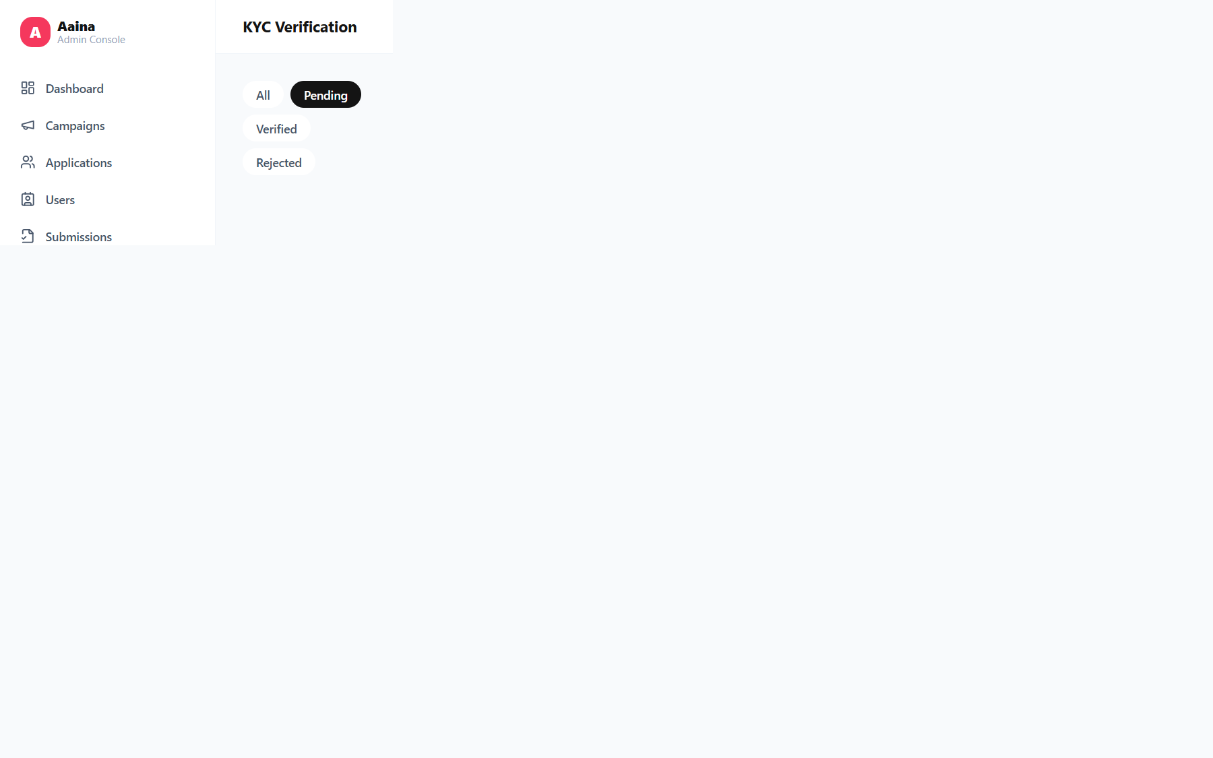
KYC Verification
Verify creator identity documents before payouts.

Slide 10
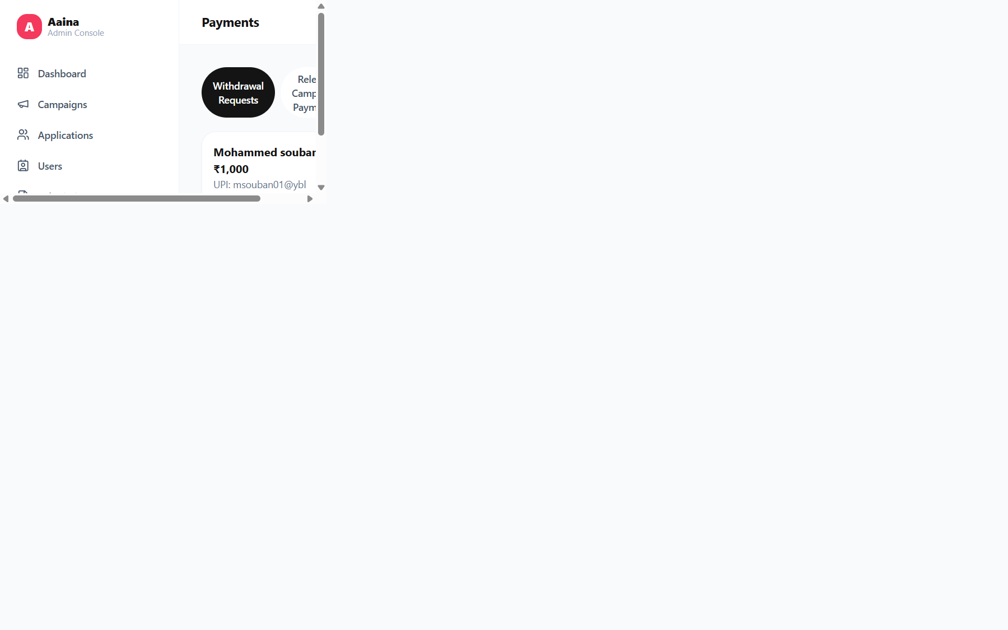
Payments
Track and process creator payouts and payment history.

Slide 11
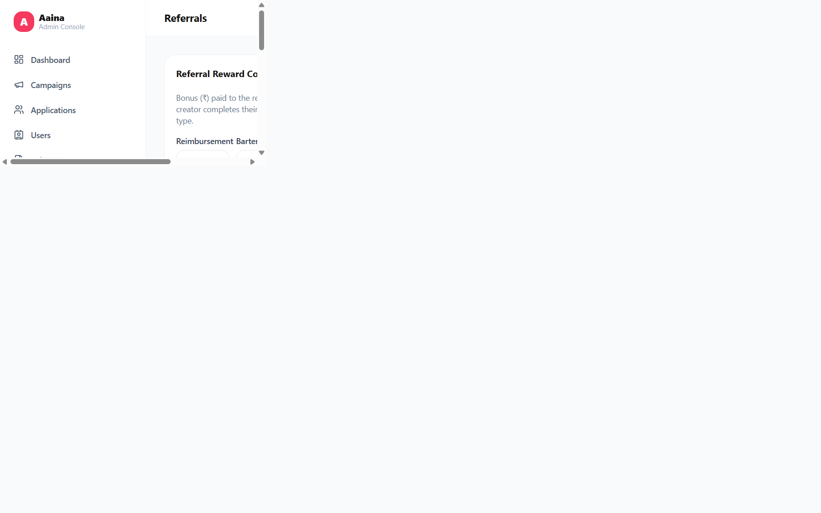
Referrals
Monitor the referral program and commissions earned.

Slide 12
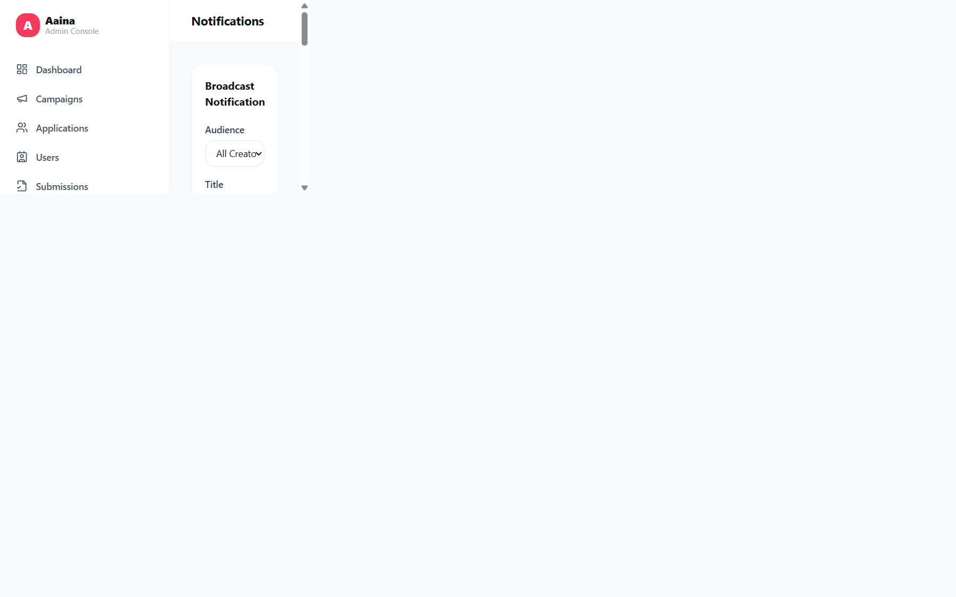
Notifications
Broadcast and manage in-app notifications to creators.

Slide 13
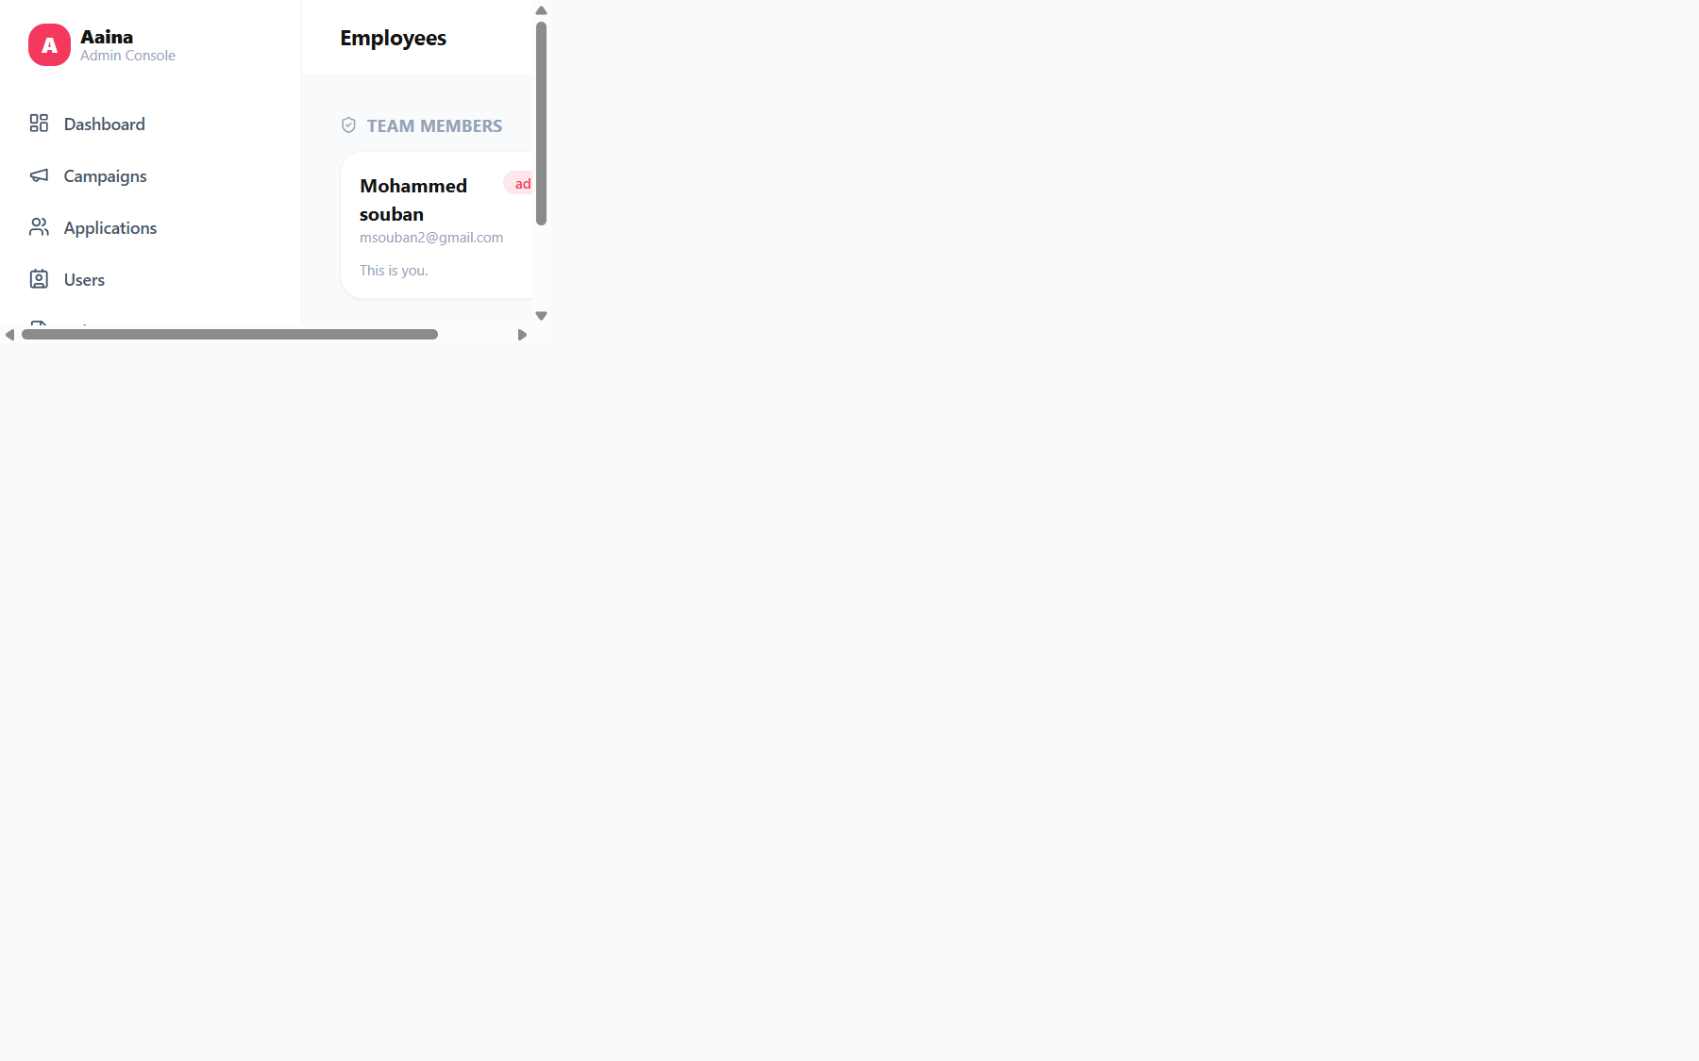
Employees
Manage the admin team and add new team members.

Slide 14
Thank you
Aaina — Influencer Marketing Platform

