Slide 1
Interaction of Particles with Matter
In order to detect a particle it must interact with matter!
The most important interaction processes are electromagnetic:
Charged Particles:
Energy loss due to ionization (e.g. charged track in drift chamber)
heavy particles (not electrons/positrons!)
electrons and positrons
Energy loss due to photon emission (electrons, positrons)
bremsstrahlung
Photons:
Interaction of photons with matter (e.g. EM calorimetry)
photoelectric effect
Compton effect
pair production
Other important electromagnetic processes:
Multiple Scattering (Coulomb scattering)
scintillation light (e.g. energy, trigger and TOF systems)
Cerenkov radiation (e.g. optical (DIRC/RICH), RF (Askaryan))
    transition radiation (e.g. particle id at high momentum)
Can calculate the above effects with a combo of classical E&M and QED.
In most cases calculate approximate results, exact calculations very difficult.

Slide 2
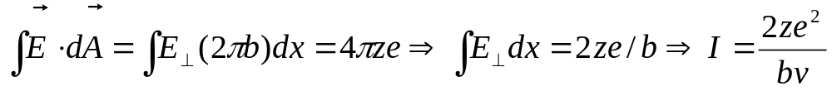
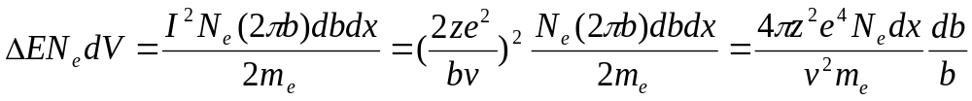
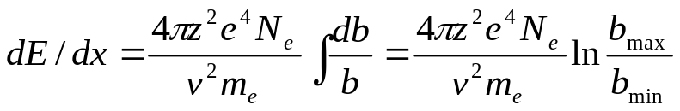
Classical Formula for Energy Loss
Average energy loss for a heavy charged particle: mass=M, charge=ze, velocity=v
Particle loses energy in collisions with free atomic electrons: mass=m, charge=e, velocity=0
Assume the electron does not move during the “collision” & M’s trajectory is unchanged
Calculate the momentum impulse (I) to electron from M:
•
b=impact parameter
•
Next, use Gauss’s law to evaluate integral assuming
infinite cylinder surrounding M:
M, ze, v
The energy gained by the electron is ΔE=p²/2m_{e}=I²/2m_{e}
The total energy lost moving a distance dx through a medium with electron density N_{e} from
collisions with electrons in range b+db is:
Therefore the energy loss going a distance dx is:
But, what should be used for the max and min impact parameter?
The minimum impact parameter is from a head on collision
Although E&M is long range, there must be cutoff on b_{max}, otherwise dE/dx→∞
Relate b_{max} to “orbital period” of electron, interaction short compared to period
Must do the calculation using QM using momentum transfer not impact parameter.

Slide 3
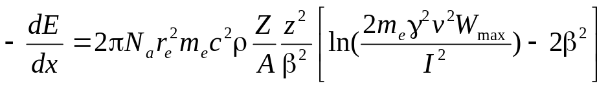
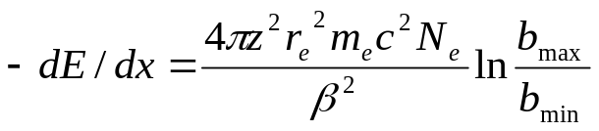
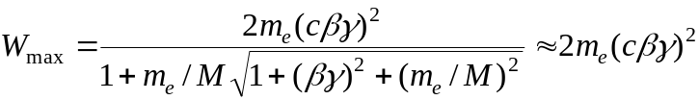
Bethe-Bloch Formula for Energy Loss
Average energy loss for heavy charged particles
Energy loss due to ionization and excitation
Early 1930’s Quantum mechanics (spin 0)
Valid for energies <100’s GeV and β >>zα (≈z/137)
heavy= m_{incident}>>m_{e}
proton, k, π, μ
Fundamental constants
r_{e}=classical radius of electron
m_{e}=mass of electron
N_{a}=Avogadro’s number
c=speed of light
=0.1535MeV-cm²/g
Absorber medium
I=mean ionization potential
Z= atomic number of absorber
A=atomic weight of absorber
ρ=density of absorber
δ=density correction
C=shell correction
Incident particle
z=charge of incident particle
β=v/c of incident particle
γ=(1-β²)^{-1/2}
W_{max}=max. energy transfer
in one collision
Note: the classical dE/dx formula contains
many of the same features as the QM version: (z/β)², & ln[]

Slide 4
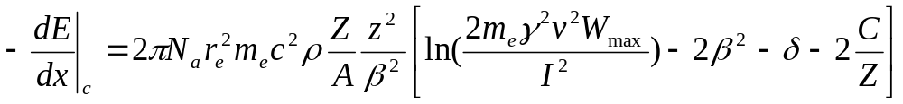
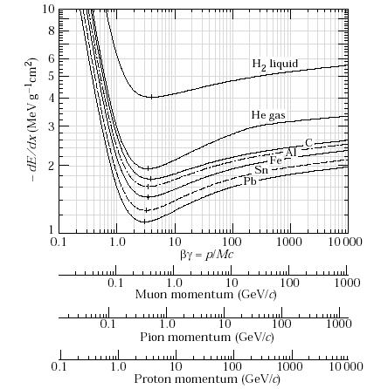
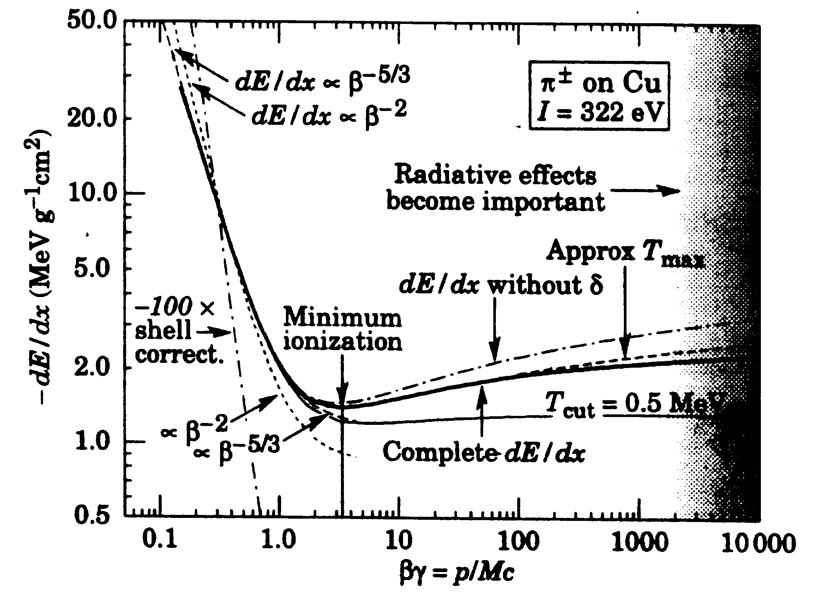
Corrected Bethe-Bloch Energy Loss
δ=parameter which describes how transverse electric field of incident particle
is screened by the charge density of the electrons in the medium.
δ≈ 2lnγ+ζ, with ζ a material dependent constant (e.g. Table 2.1of Leo)
C is the “shell” correction for the case where the velocity of the incident particle
is comparable (or less) to the orbital velocity of the bound electrons (β≈zα ).
Typically, a small correction (see Table 2.1 of Leo)
Other corrections due to spin, higher order diagrams, etc are small, typically <1%
PDG
plots

Slide 5
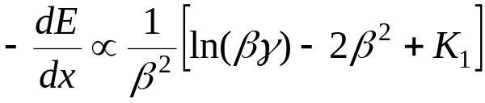
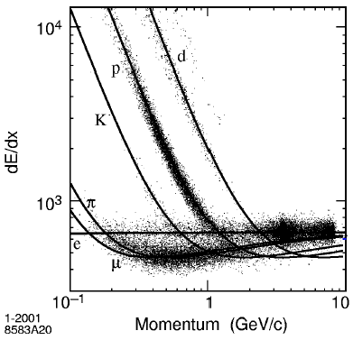
Average Energy loss of heavy charged particle
The incident particle’s speed (β=v/c) plays an important role in the amount of energy lost while traversing a medium.
K₁ a constant
1/β² term dominates at low momentum (p)
β=momentum/energy
ln(βγ) dominates at very high momenta (“relativistic rise”)
β term never very important (always ≤1)
βγ=p/m, γ=E/m, β=E/p
Data from BaBar experiment
 | π | K | p
β | 0.58 | 0.20 | 0.11
1/β² | 2.96 | 25.4 | 89.0
ln(βγ) | -0.34 | -1.60 | -2.24
p=0.1 GeV/c
 | π | K | p
β | 0.99 | 0.90 | 0.73
1/β² | 1.02 | 1.24 | 1.88
ln(βγ) | 1.97 | 0.71 | 0.06
p=1.0 GeV/c

Slide 6
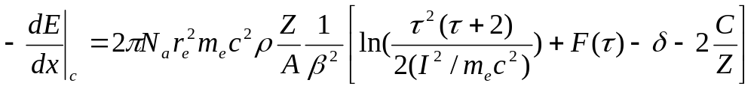
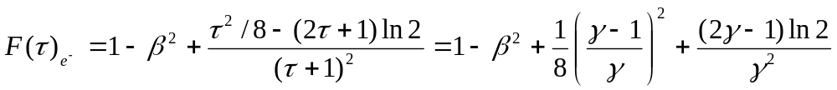
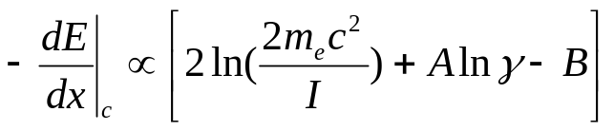
Energy loss of electrons and positrons
Calculation of electron and positron energy loss due to ionization and excitation
complicated due to:
spin ½ in initial and final state
small mass of electron/positron
identical particles in initial and final state for electrons
Form of equation for energy loss similar to “heavy particles”
τ is kinetic energy of incident electron in units of m_{e}c². τ =E_{ke}/ m_{e}c² =γ-1
Note:
Typo on P38 of Leo
2r→2τ
For both electrons and positrons F(τ) becomes a constant at very high incident energies.
Comparison of electrons and heavy particles (assume β=1):
A B
electrons: 3 1.95
heavy 4 2

Slide 7
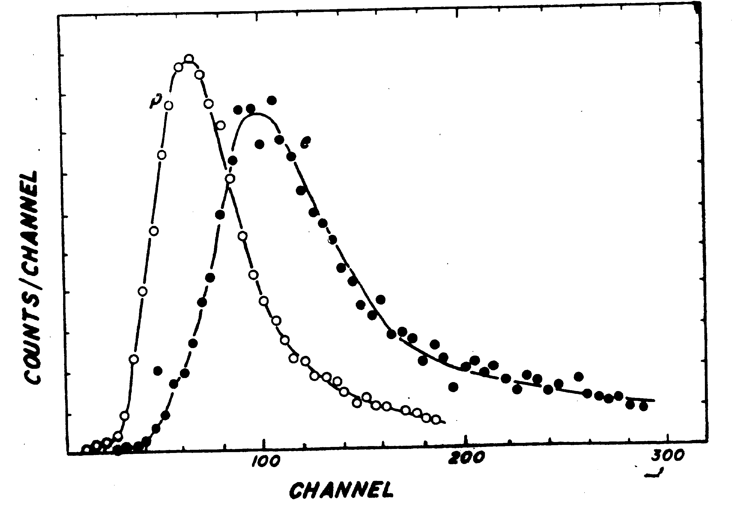
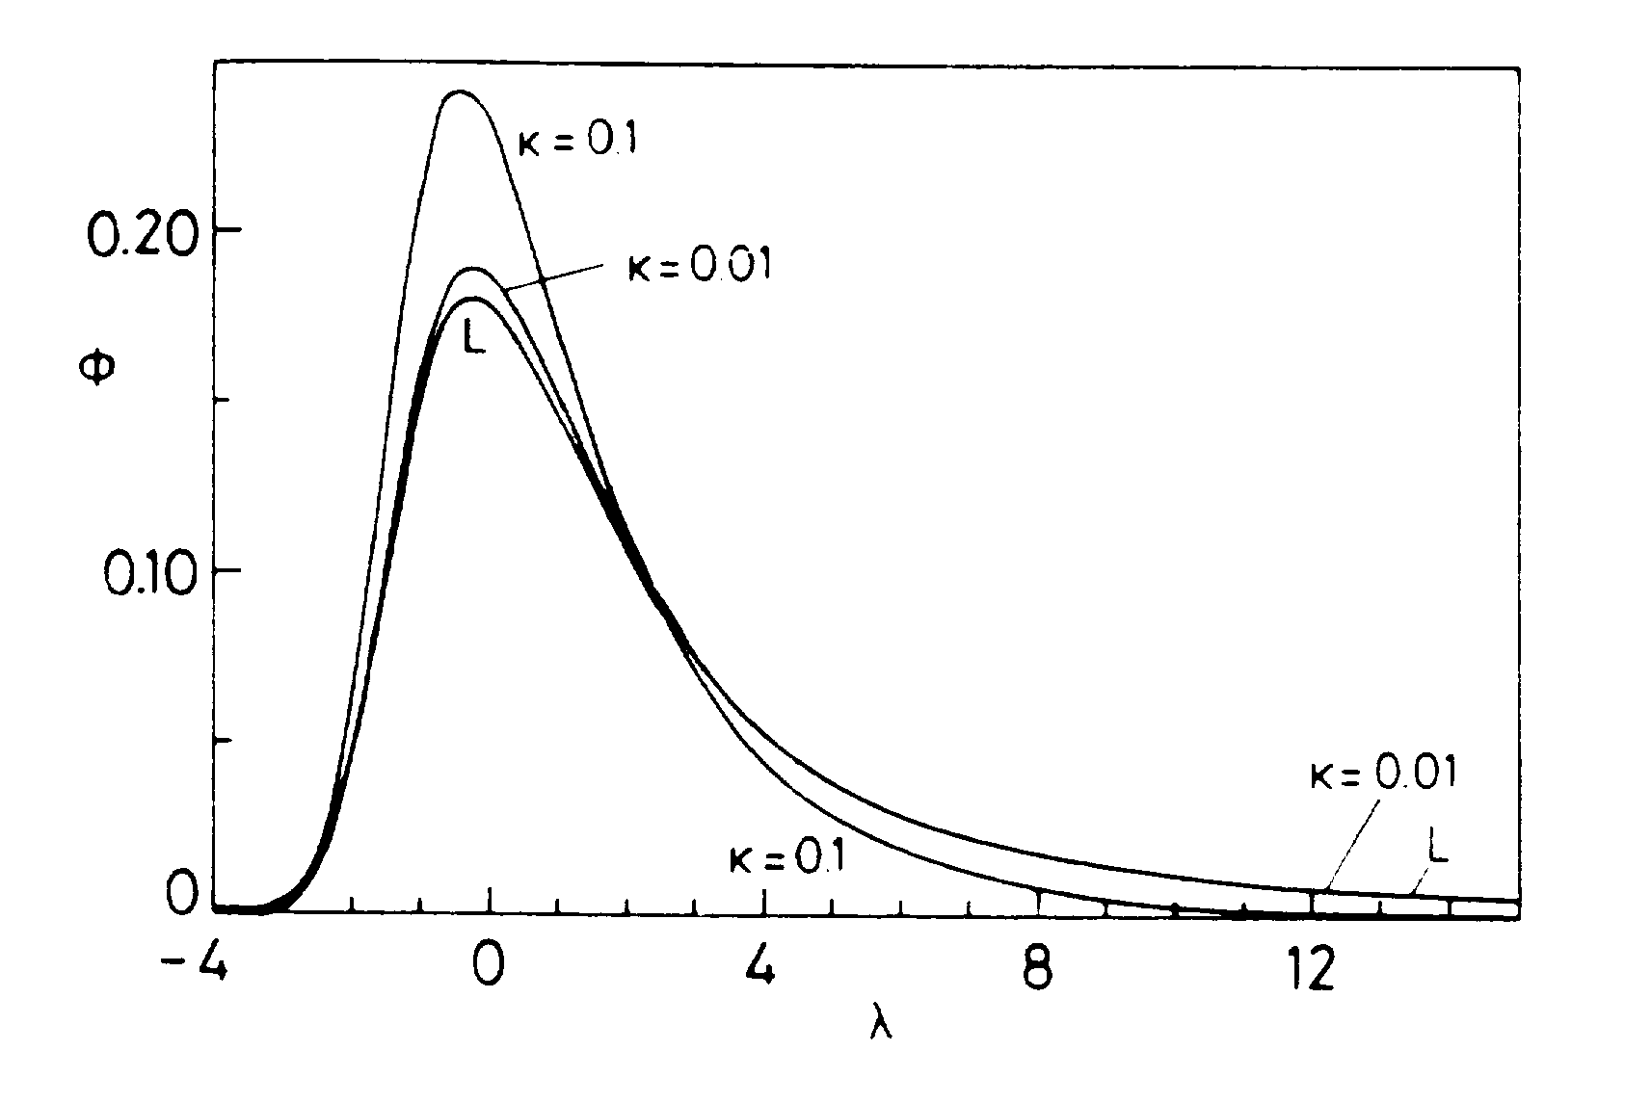
Distribution of Energy Loss
Amount of energy lost from a charged particle going through material
can differ greatly from the average or mode (most probable)!
Landau (L) and Vavilov energy
loss calculations
Measured energy loss of 3 GeV π’s and
2 GeV e’s through 90%Ar+10%CH₄ gas
The long tail of the energy loss distribution makes particle ID using dE/dx difficult.
To use ionization loss (dE/dx) to do particle ID typically measure many samples and
calculate the average energy loss using only a fraction of the samples.
Energy loss of charged particles through a thin absorber (e.g. gas) very difficult
to calculate. Most famous calculation of thin sample dE/dx done by Landau.

Slide 8
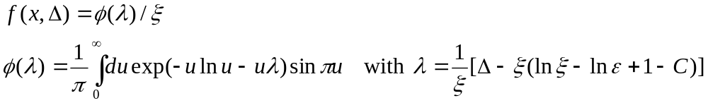

Landau model of energy loss for thin samples
Unfortunately, the central limit theorem is not applicable here so the energy loss distribution is not gaussian.
The energy loss distribution can be dominated by a single large momentum transfer collision. This violates one of the conditions for the CLT to be valid.
Conditions for Landau’s model:
1) mean energy loss in single collision < 0.01 W_{max}, W_{max}= max. energy transfer
2) individual energy transfers large enough that electrons can be considered free,
small energy transfers ignored.
3) velocity of incident particle remains same before and after a collision
The energy loss pdf, f(x, Δ), is very complicated:
Must evaluate
integral
numerically
Δ=energy loss in absorber
x=absorber thickness
ξ= approximate average energy loss= 2πN_{a}r_{e}²m_{e}c²ρ(Z/A)(z/β)²x
C=Euler’s constant (0.577…)
lnε=ln[(1-β²)I²]-ln[2m_{e}c²β²)I²]+β² (ε is min. energy transfer allowed)
Can approximate f(x,Δ) by:
The most probable energy loss is Δ_{mp}≈ξ[ln(ξ/ε)+0.2+δ]
Other (more sophisticated) descriptions exist for energy loss in thin samples by Symon,
Vavilov, Talman.

Slide 9
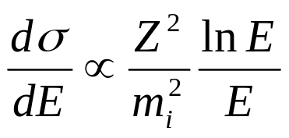
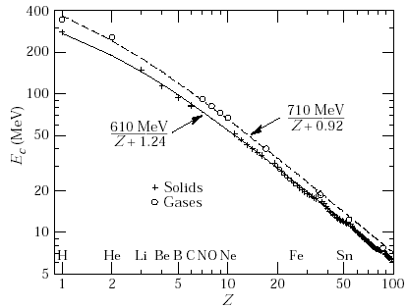
Bremsstrahlung (breaking radiation)
Classically, a charged particle radiates energy when it is accelerated: dE/dt=(2/3)(e²/c³)a²
In QED we have to consider two diagrams where a real photon is radiated:
γ
γ
q_{i}
q_{f}
q_{i}
q_{f}
‘γ’
+
‘γ’
Z_{i}
Z_{f}
Z_{i}
Z_{f}
The cross section for a particle with mass m_{i} to radiate a photon of E in a medium
with Z electrons is:
m⁻² behavior expected since classically
radiation ∝ a²=(F/m)²
Until you get to energies of several hundred GeV bremsstrahlung is only important for
electrons and positrons:
(dσ/dE)|_{e}/(dσ/dE)|_{μ} =(m_{μ}/m_{e})²≈37000
pdg
Recall ionization loss goes like the Z of the medium.
The ratio of energy loss due to radiation (brem.)
& collisions (ionization)for an electron with energy E is:
(dσ/dE)|_{rad}/(dσ/dE)|_{col}≈(Z+1.2) E/800 MeV
Define the critical energy, E_{crit},
as the energy where (dσ/dE)|_{rad}=(dσ/dE)|_{col}.

Slide 10
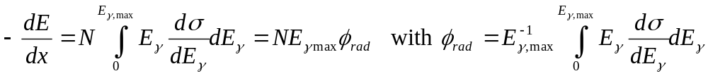
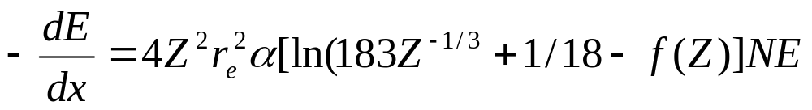
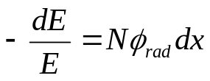

Bremsstrahlung (breaking radiation)
The energy loss due to radiation of an electron with energy E can be calculated:
N=atoms/cm³=ρN_{a}/A (ρ=density, A=atomic #)
E_{γ,max}=E-m_{e}c²
The most interesting case for us is when the electron has several hundred MeV or more, i.e. E>>137m_{e}c²Z^{1/3}. For this case we φ_{rad} is practically independent of energy and E_{γ,max}=E:
Thus the total energy lost by an electron traveling dx due to radiation is:
We can rearrange the energy loss equation to read:
Since φ_{rad} is independent of E we can integrate this equation to get:
L_{r} is the radiation length,
L_{r} is the distance the electron travels to lose all but 1/e of its original energy.

Slide 11

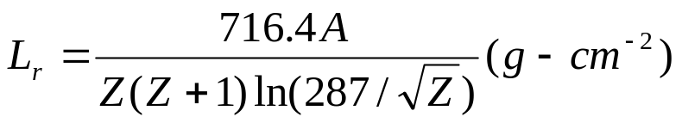
Radiation Length (L_{r})
The radiation length is a very important quantity describing energy loss of electrons
traveling through material. We will also see L_{r} when we discuss the mean free path for
pair production (i.e. γ→e⁺e⁻) and multiple scattering.
There are several expressions for L_{r} in the literature, differing in their complexity.
The simplest expression is:
Leo and the PDG have more complicated expressions:
Leo, P41
PDG
L_{rad1} is approximately the “simplest expression” and L_{rad2} uses 1194Z^{-2/3} instead of 183Z^{-1/3}, f(z) is an infinite sum.
Both Leo and PDG give an expression that fits the data to a few %:
The PDG lists the radiation length of lots of materials including:
Air: 30420cm, 36.66g/cm² teflon: 15.8cm, 34.8g/cm²
H₂O: 36.1cm, 36.1g/cm² CsI: 1.85cm, 8.39g/cm²
Pb: 0.56cm, 6.37g/cm² Be: 35.3cm, 65.2g/cm²
Leo also has a table of
radiation lengths on P42
but the PDG list is more
up to date and larger.

Slide 12
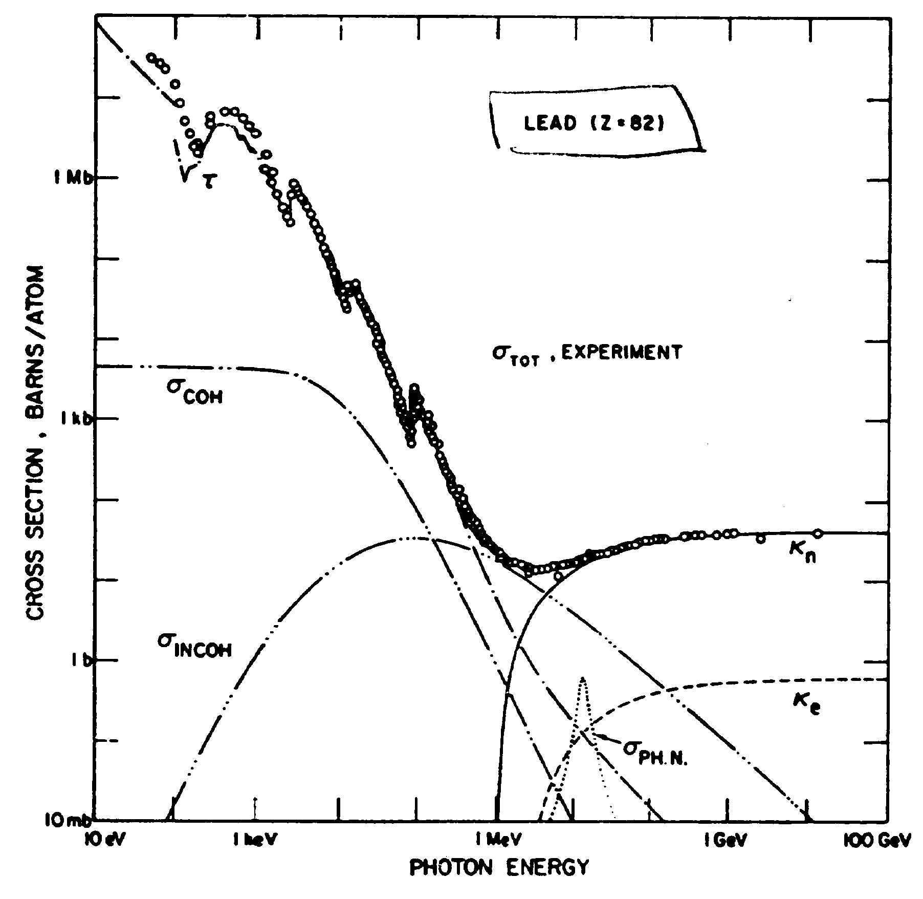
Interaction of Photons (γ’s) with Matter
There are three main contributions to photon interactions:
Photoelectric effect (Eγ < few MeV)
Compton scattering
Pair production (dominates at energies > few MeV)
Contributions to photon interaction cross section for lead
including photoelectric effect (τ), rayleigh scattering (σ_{coh}),
Compton scattering (σ_{incoh}), photonuclear absorbtion (σ_{ph,n}),
pair production off nucleus (K_{n}), and pair production
off electrons (K_{e}).
Rayleigh scattering (σ_{coh}) is the classical physics process
where γ’s are scattered by an atom as a whole. All electrons
in the atom contribute in a coherent fashion. The γ’s energy
remains the same before and after the scattering.
A beam of γ’s with initial intensity N₀ passing through a medium is attenuated in number (but not energy) according to:
dN=-μNdx or N(x)=N₀e^{-μx}
With μ= linear attenuation coefficient which depends on the total interaction
cross section (σ_{total}= σ_{coh}+ σ_{incoh} + +).

Slide 13
Photoelectric effect
The photoelectric effect is an interaction where the incoming photon (energy E_{γ}=hv) is absorbed by an atom and an electron (energy=E_{e}) is ejected from the material:
E_{e}= E_{γ}-BE
Here BE is the binding energy of the material (typically a few eV).
Discontinuities in photoelectric cross section due to discrete binding energies of atomic
electrons (L-edge, K-edge, etc).
Photoelectric effect dominates at low γ energies (< MeV) and hence gives low energy e’s.
Exact cross section calculations are difficult due to atomic effects.
Cross section falls like E_{γ}^{-7/2}
Cross section grows like Z⁴ or Z⁵ for E_{γ}> few MeV
Einstein wins Nobel prize in 1921 for his
work on explaining the photoelectric effect.
Energy of emitted electron depends on energy
of γ and NOT intensity of γ beam.

Slide 14
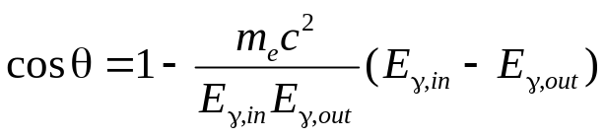
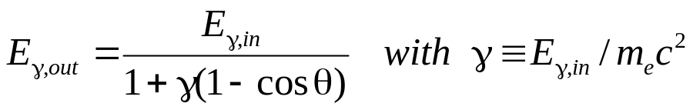

Compton Scattering
Compton scattering is the interaction of a real γ with an atomic electron.
γ_{out}
γ_{in}
θ
Solve for energies and angles
using conservation of energy
and momentum
•
φ
electron
The result of the scattering is a “new” γ with less energy and a different direction.
Not the
usual γ!
The Compton scattering cross section was one of the first (1929!) scattering cross sections to be calculated using QED. The result is known as the Klein-Nishima cross section.
At high energies, γ>>1, photons are scattered mostly in the forward direction (θ=0)
At very low energies, γ≈0, K-N reduces to the classical result:

Slide 15
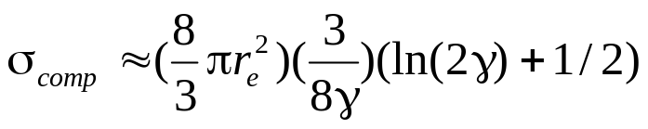
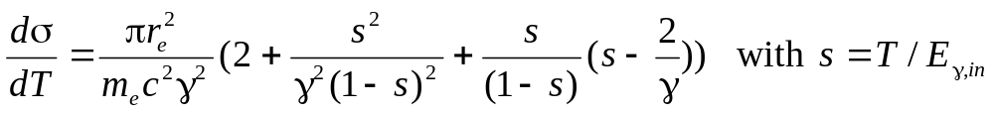
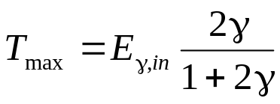
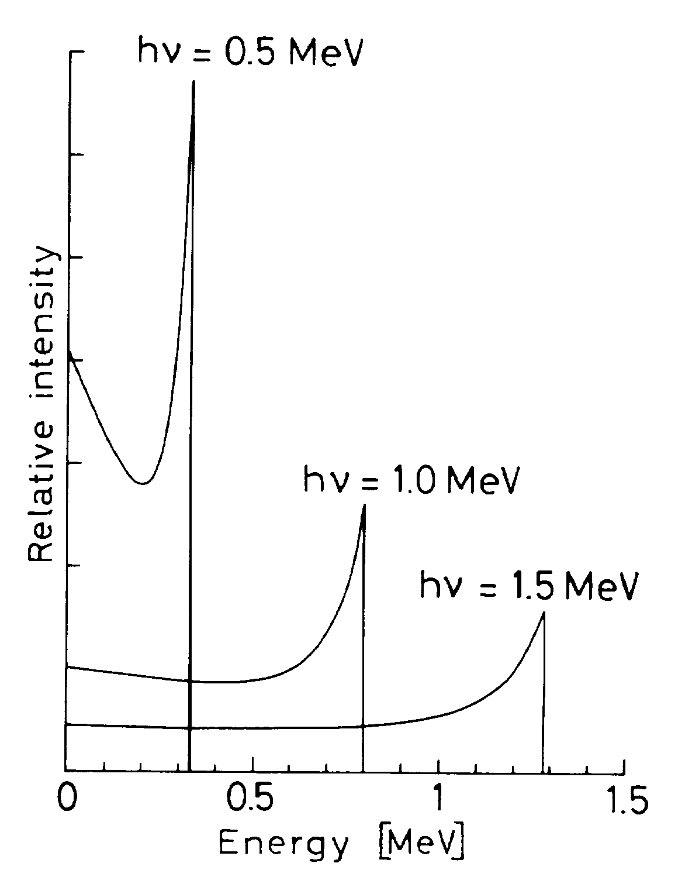
Compton Scattering
At high energies the total Compton scattering cross section can be approximated by:
(8/3)πr_{e}²=Thomson cross section
From classical E&M=0.67 barn
We can also calculate the recoil kinetic energy (T) spectrum of the electron:
This cross section is strongly peaked around T_{max}:
T_{max} is known as the
Compton Edge
Kinetic energy distribution
of Compton recoil electrons

Slide 16
Pair Production (γ→e⁺e⁻)
This is a pure QED process.
A way of producing anti-matter (positrons).
e⁻
e⁺
Threshold energy for
pair production in field
of nucleus is 2m_{e}c², in
field of electron 4m_{e}c².
γ_{in}
+
γ_{in}
γ_{v}
e⁺
γ_{v}
e⁻
Z
Z
Z
Z
Nucleus or electron
Nucleus or electron
First calculations done by Bethe and Heitler using Born approximation (1934).
At high energies (E_{γ}>>137m_{e}c²Z^{-1/3}) the pair production cross sections is ≈ constant.
σ_{pair} =4Z²αr_{e}²[7/9{ln(183Z^{-1/3})-f(Z)}-1/54]
Neglecting some small correction terms (like 1/54, 1/18) we find:
σ_{pair} = (7/9)σ_{brem}
The mean free path for pair production (λ_{pair}) is related to the radiation length (L_{r}):
λ_{pair}=(9/7) L_{r}
Consider again a mono-energetic beam of γ’s with initial intensity N₀ passing through
a medium. The number of photons in the beam decreases as:
N(x)=N₀e^{-μx}
The linear attenuation coefficient (μ) is given by: μ= (N_{a}ρ/A)(σ_{photo}+ σ_{comp} + σ_{pair}).
For compound mixtures, μ is given by Bragg’s rule: (μ/ρ)=w₁(μ₁/ρ₁)++ w_{n}(μ_{n}/ρ_{n})
with w_{i} the weight fraction of each element in the compound.

Slide 17
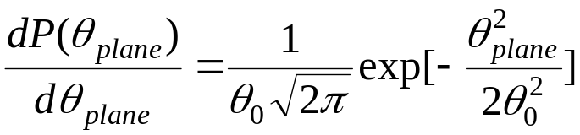
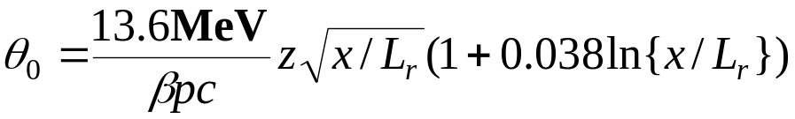
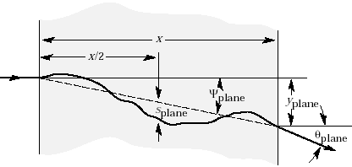
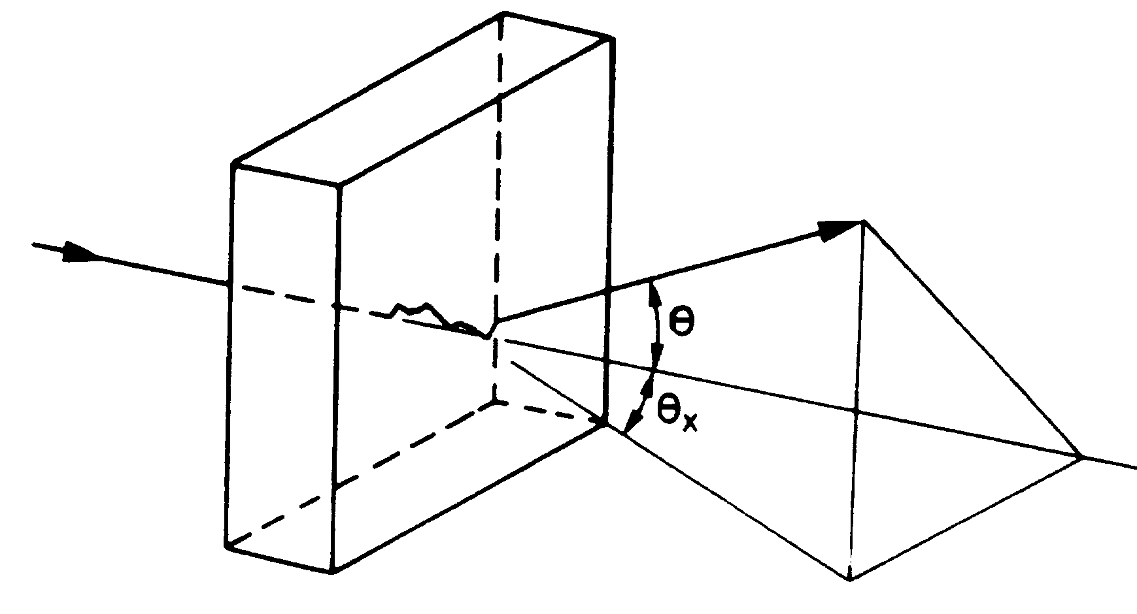
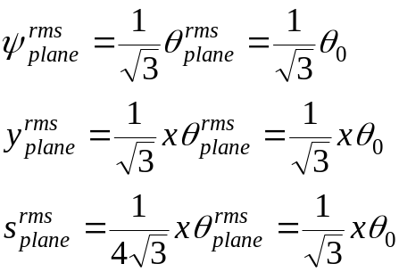
Multiple Scattering
A charged particle traversing a medium is deflected by many small angle scatterings.
These scattering are due to the coulomb field of atoms and are assumed to be elastic.
In each scattering the energy of the particle is constant but the particle direction changes.
In the simplest model of multiple scattering we ignore large angle scatters.
In this approximation, the distribution of scattering angle θ_{plane} after traveling a distance x
through a material with radiation length =L_{r} is approximately gaussian:
with
In the above equation β=v/c, and p=momentum of incident particle
The space angle θ= θ_{plane}√2
The average scattering angle <θ_{plane}>=0, but the RMS scattering angle <θ²_{plane}>^{1/2}= θ₀
Some other quantities
of interest are given in
The PDG:
The variables s, y, θ, ψ are correlated, e.g. ρ_{yθ}=√3/2

Slide 18
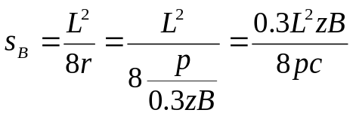
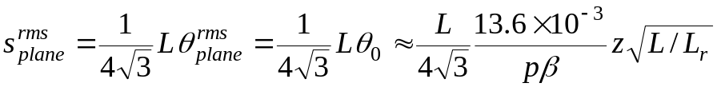
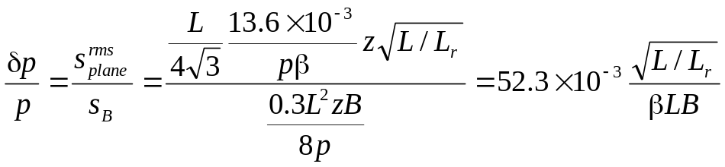
Why We Hate Multiple Scattering
Multiple scattering changes the trajectory of a charged particle.
This places a limit on how well we can measure the momentum of a charged particle
(charge=z) in a magnetic field.
Trajectory of charged particle
in transverse B field.
s=sagitta
note: r²=(L/2)²+(r-s)²
r²=L²/4+r²+s²-2rs
s=L²/(8r)+s²/(2r)
s≈L²/(8r)
L/2
r=radius of curvature
The sagitta due to bending in B field is:
GeV/c, m, Tesla
The apparent sagitta due to MS is:
GeV/c, m
The momentum resolution δp/p is just the ratio of the two sigattas:
Independent of p
As an example let L/L_{r}=1%, B=1T, L=0.5m then δp/p ≈ 0.01/β.
Typical values
Thus for this example MS puts a limit of 1% on the momentum measurement

