Slide 1
JRA interim SNOwGLoBES report
Michael soughton

Slide 2
SNOwGLoBES
My project requires that I investigate the noise contribution within the detector to determine how to distinguish it from supernova neutrinos.
SNOwGLoBES simulates a supernova event as measured by a detector.
Produces a supernova flux as predicted by the Livermore, GVKM and Garching models.
Computes cross-sections of neutrino interactions within a specified detector type and geometry.
Applies smearing matrices to compute interaction products spectra and a detector response.
Finally, applies post smearing matrices which simulates the detector efficiency.

Slide 3
Installation
SNOwGLoBES requires the programm ‘GLoBES’ to run.
This can be installed by downloading the file and using ‘./configure’, ‘make’ and ‘make install’, although one may have to specify the location of the GNU Scientific Libraries (GSL) if they are not in the default location.
SNOwGLoBES can be installed using ‘git clone https://github.com/SNOwGLoBES/snowglobes.git’ and then using ‘make’ as before, although the paths to the GLoBES installation files and to where SNOwGLoBES is to be installed must be specified.
SNOwGLoBES requires ROOT to run – ROOT can be easily setup on the Feynman cluster, one may just have to load a recent version of GCC.

Slide 4
Producing plots
SNOwGLoBES is still in development and so can be a little finicky to run.
Instructions available at ‘https://epp.phys.susx.ac.uk/SnoPlus/SuperNova/SnowGlobes’.
Briefly:
Run a macro to produce .dat files for the Garching flux.
Now compile code which takes in information from these files.
Run a few more commands from this code to produce more .dat files.
Run a ROOT macro (some are provided but any could be used) to produce plots from the data files (making sure to set the detector size to 2.4 times the default size to simulate a 40kt detector).
Looked into how the program produces the fluences so that I could change them if desired.
Shows a time profile of a supernova event.
Will look into noise levels once work on the trigger parameters for a no-noise supernova have progressed on the DUNE servers and have knowledge of these parameters.

Slide 5
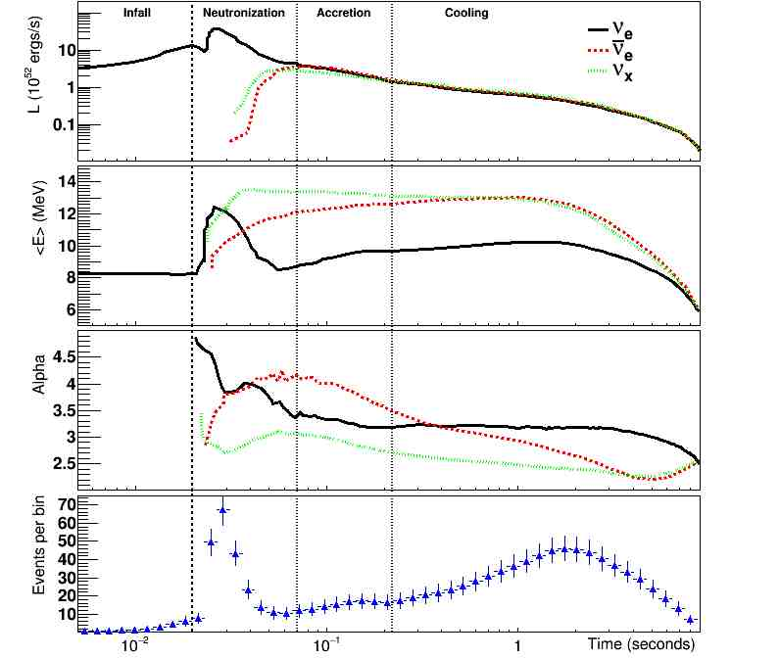

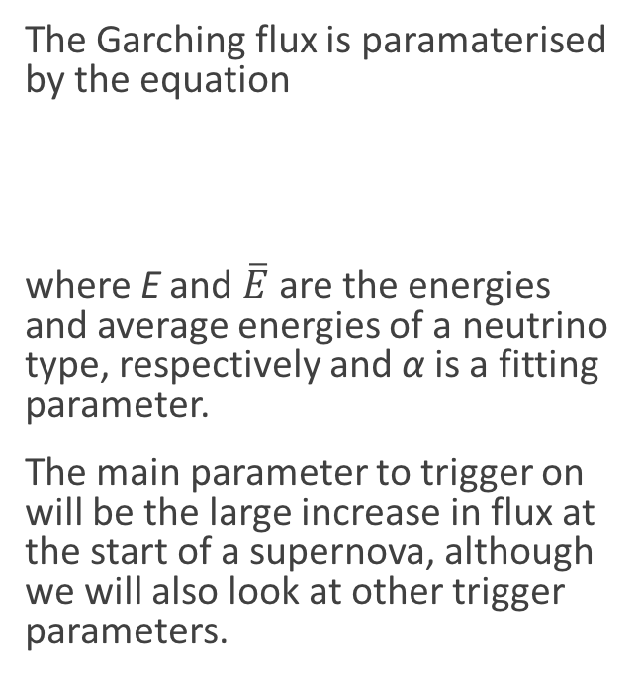
Plot of Garching flux
The Garching flux is paramaterised by the equation
where E and $\overline{E}$ are the energies and average energies of a neutrino type, respectively and α is a fitting parameter.
The main parameter to trigger on will be the large increase in flux at the start of a supernova, although we will also look at other trigger parameters.

