Slide 1
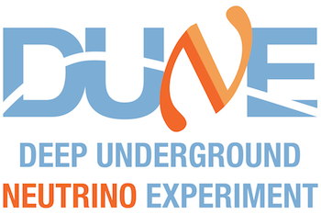
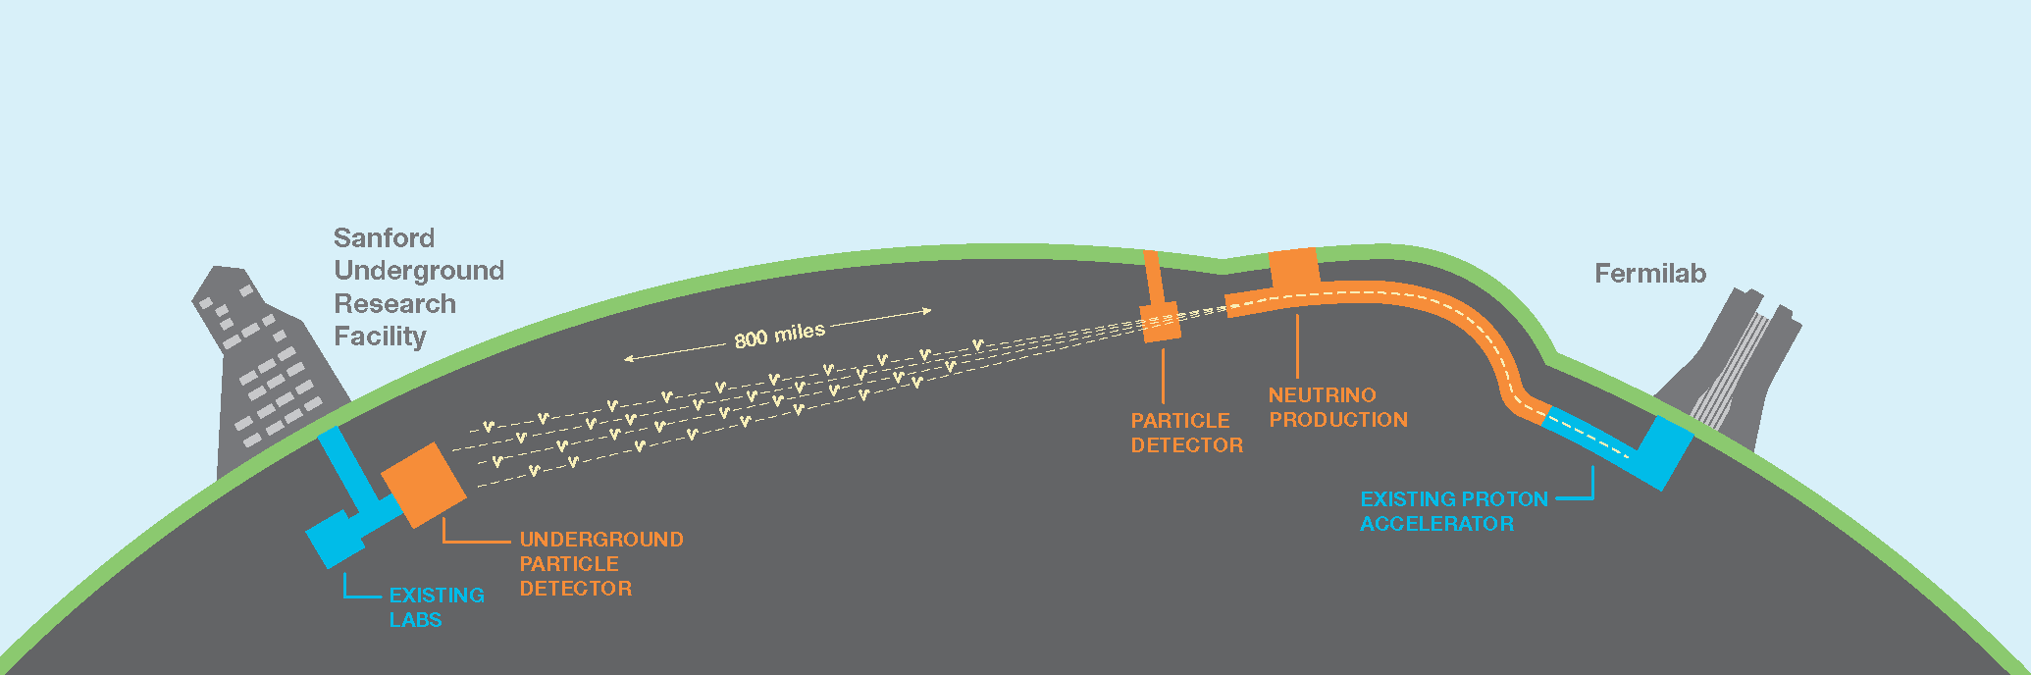
Research into the implementation of a Supernova neutrino detector for DUNE
Supernovas are
DUNE is due to be part of the next generation of neutrino detectors, which is to be based in Northern America and finished construction within the next decade. DUNE will search for CP-violation in neutrino oscillations, determine the ordering of the neutrino masses, test the three-neutrino paradigm, search from proton decay if it exits and will provide new information on how supernovae explode [1] and what new physics can be learnt from a supernova neutrino burst - there has only been one recorded supernova neutrino event.
About neutrinos
Other aims of dune
What can it tell us about supernovae

