Slide 1
SOLANA MOBILE · CLOCK IN
01
SKYHEDGE
Weather risk,
with a receipt.
NOAA
NOAA evidence → clear protection terms → wallet approval → finalized Solana proof
EVIDENCE FIRST
Devnet pilot · SKYT has no real-world value

Slide 2
THE PROBLEM
02
Weather loss is personal.
The evidence should be inspectable.
01
Name a place
A farm, an event, or another rainfall-exposed plan.
02
Understand the trigger
Exact station, dates, units, fixed payout, and maximum test cost.
03
Approve deliberately
No invisible transaction: the wallet signs only after review.

Slide 3
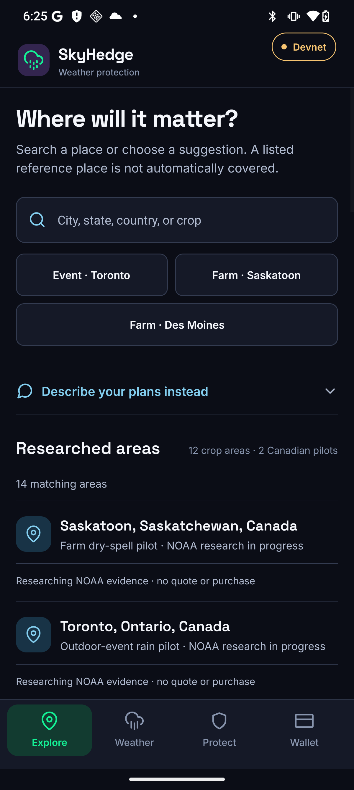
NATIVE ANDROID
03
A phone-native decision flow
Choose a place → inspect rainfall evidence → review a SKYT test contract → approve in an MWA-compatible wallet.
Truthful by design
Research-only markets stay blocked. Missing NOAA data is never filled with an estimate.
Captured on the Seeker from the production-API APK.

Slide 4
VERIFICATION MODEL
04
The oracle attests.
The program enforces.
NOAA
SkyHedge signer
Solana program
Final station observation
for the pinned window
Authorized attestation
with source hash
Checks signer and rules;
controls claim transfer
A hash is an audit link, not independent proof that NOAA was truthful. No live payout is claimed before the real observation and final-data period.

Slide 5
PILOT STATUS AND NEXT PROOF
05
One complete journey beats twelve promises.
VERIFIED
REMAINING PILOT GATES
Native Android APK
Executable Devnet program + IDL
NOAA station and pricing package
Finalized chain-status reads
Cancel expired empty Draft
Create, fund, and open a fresh market
Sign one non-admin mobile test purchase
Verify the finalized position
Today: valueless Devnet SKYT. Later: regulated USD/USDC collateral, more locations, and operational oracle automation.

