Slide 1
Final presentation
Kaitlyn Paik

Slide 3
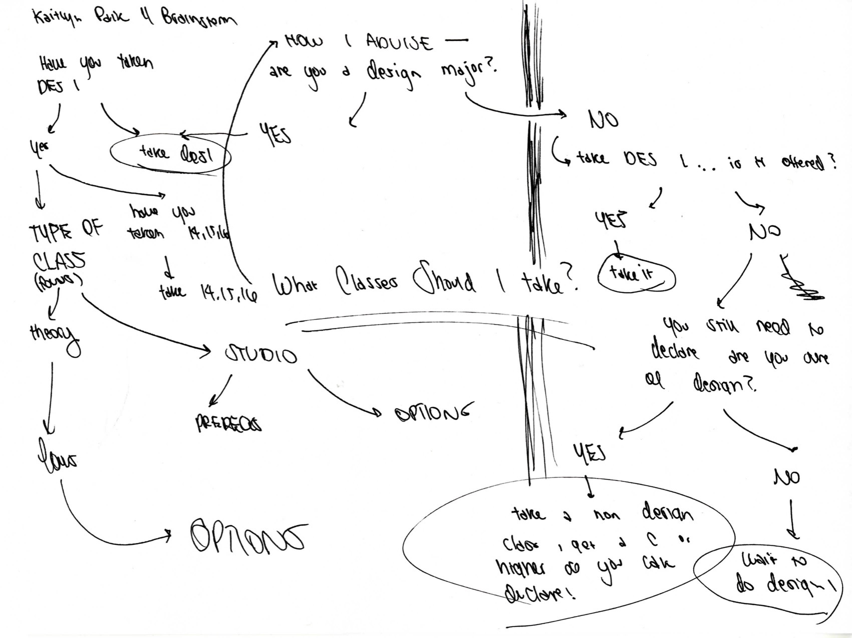

Slide 4
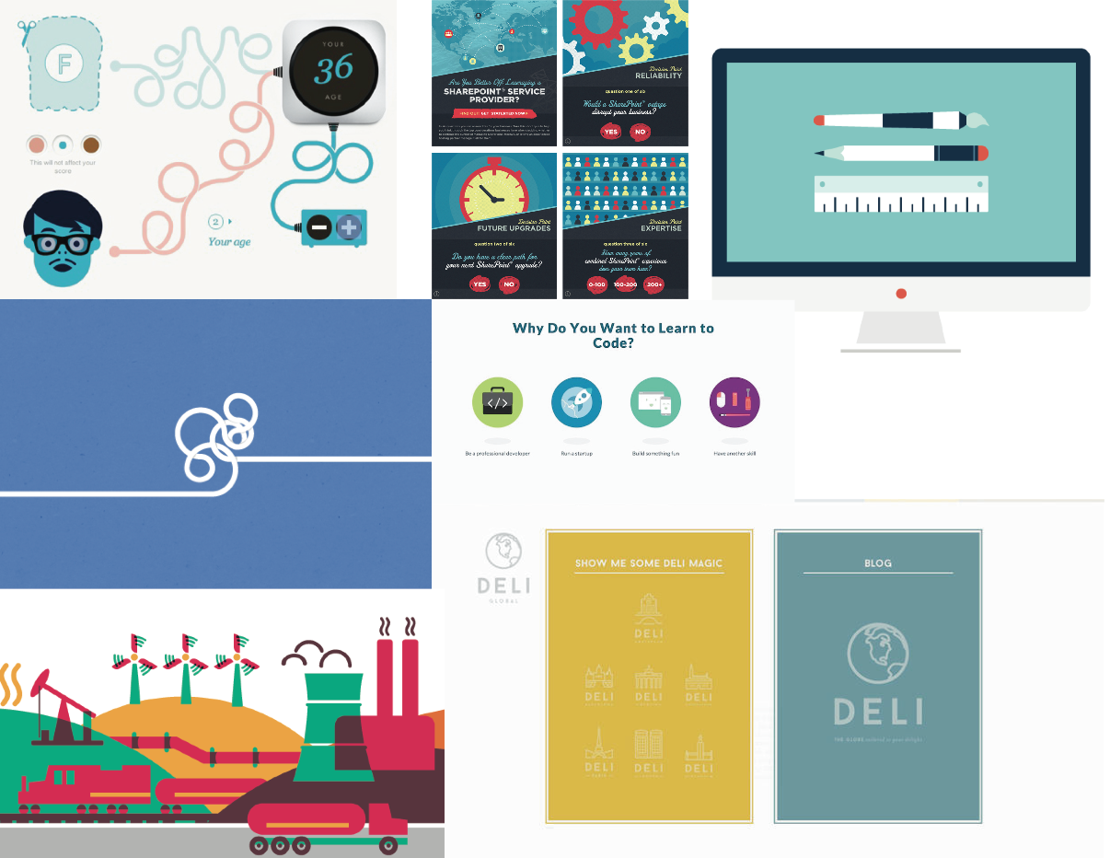

Slide 5
