Slide 1
Comparing Optimization and Estimation Techniques for Low-Thrust Spacecraft Rendezvous
Cox, A., Sparapany, M., York, C., Zaidi, W.
April 25, 2018
AAE 568 Course Project, Purdue University

Slide 2
Problem Motivation
Target
Chaser
Control Chaser to
  match position (radius, phase)
  match velocity
with Target while minimizing propellant usage

Slide 3

Problem Motivation, Cont’d
Target
Chaser
Uncertainties
  Where is chaser?
  What are true dynamics?
  How accurate are measurements?

Slide 4
Low-Thrust Control
Target
Chaser with low-thrust:
Chaser
T: Thrust magnitude (const)
m: Chaser mass (const)
α: Thrust angle (ctrl)
Earth

Slide 5
Problem Overview
1. Generate optimal trajectory to achieve rendezvous
Plant
Optimal Control Solver
E/UKF Update
E/UKF Prediction

Slide 6
Problem Overview
Dynamics uncertainties
2. Propagate truth and estimated state, covariance for subset of optimal arc
Measurement uncertainties
Plant
Optimal Control Solver
E/UKF Update
E/UKF Prediction

Slide 7
Problem Overview
3. Update state, covariance estimates via measurement(s)
Plant
Optimal Control Solver
E/UKF Update
E/UKF Prediction

Slide 8
Problem Overview
4. Re-optimize to rendezvous and continue
Plant
Optimal Control Solver
E/UKF Update
E/UKF Prediction

Slide 9
Optimization Problem Definition
Goal: minimize propellant usage = maximize m_{f} = minimize t_{f}
Subject to:

Slide 10
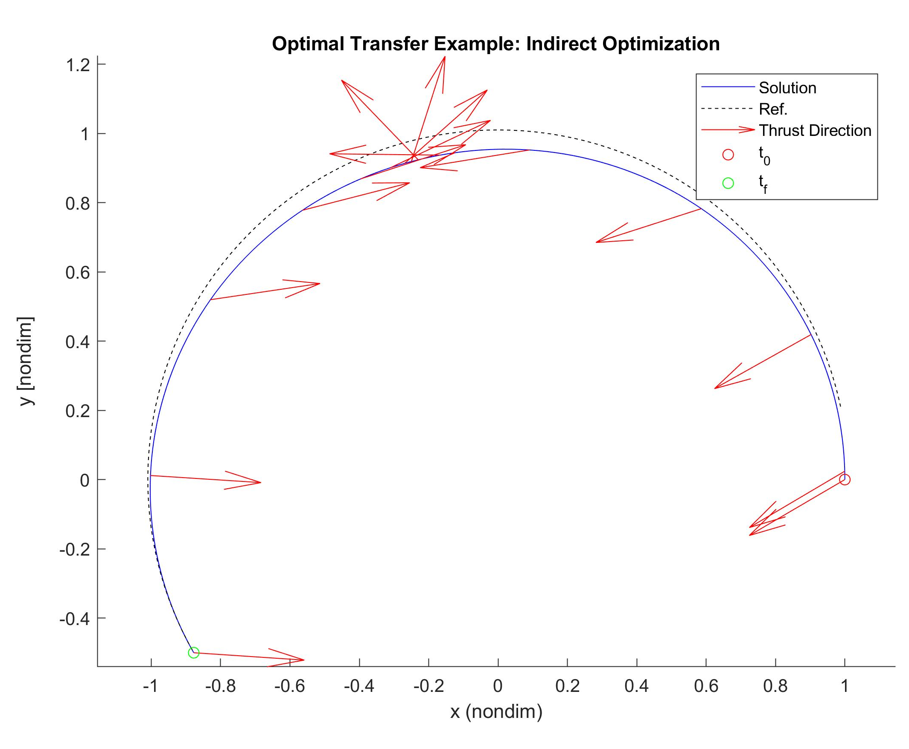
Indirect Optimization
Non-dimensionalize the problem by initial radius, mean motion, and spacecraft mass to help convergence
Utilize Euler-Lagrange Equations
Two-Point Boundary Value Problem requires one more constraint from the Transversality Condition,
TOF: 13.338 hrs

Slide 11
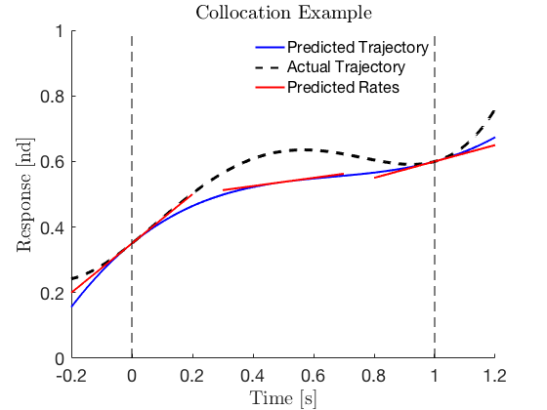
Direct Optimization
Model dynamics by piecewise 3rd-degree polynomials (control constant along segments)
Constraint:
polynomial midpoints
Driven by Sequential Quadratic Programming
(SQP from MATLAB’s fmincon)

Slide 12
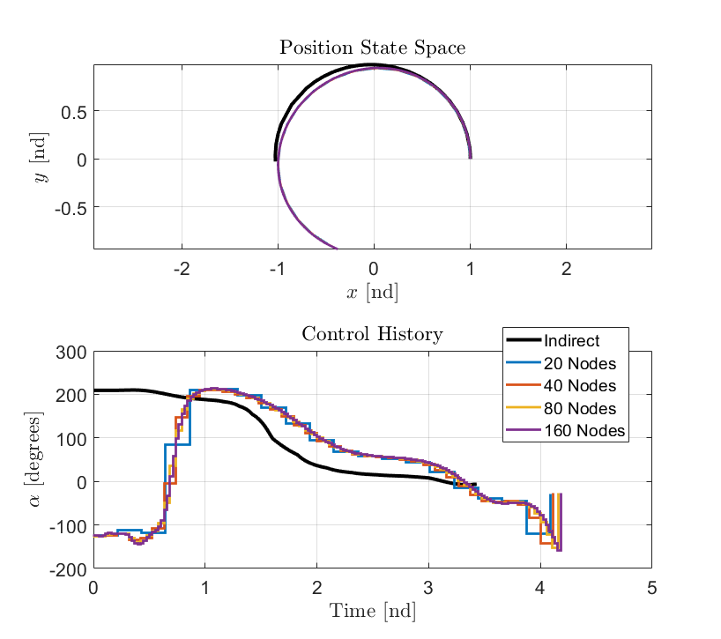
Indirect vs. Direct Optimization
 | Direct | Indirect
Pros | No variational calculus Easy to make initial guess (no costates) Easy to find a potential (suboptimal) solution | Root-solver is simpler Solution guaranteed locally optimal Convincing global optimum with engineering judgement
Cons | Unsure if solution is optimal, or even real Numerical optimizer is more complicated | Initial guess hard to make Sensitive to initial guess
Better sol’n
Consistent, but not global optimum
similar trend
control “flip”

Slide 13
Estimation Problem Definition
Collin

Slide 14
Extended Kalman Filter
Collin

Slide 15
Unscented Kalman Filter
Waqar

Slide 16
Estimation Method Comparison
Waqar

Slide 17
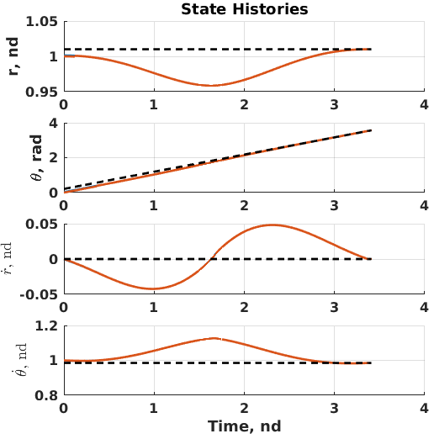
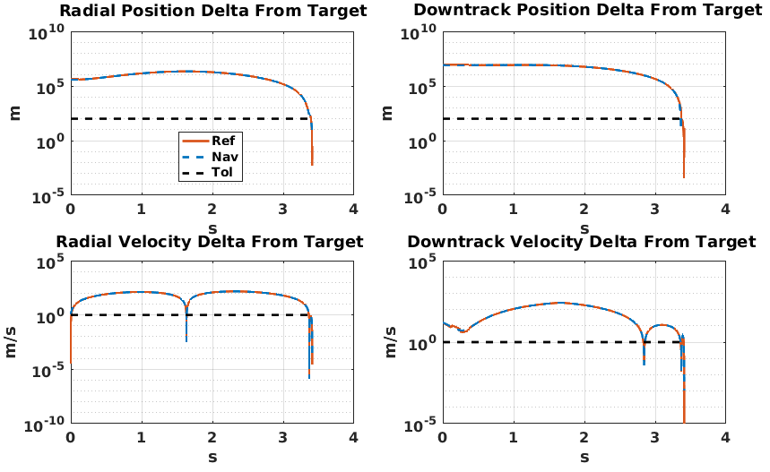
Example: Indirect + EKF Results

Slide 18
Contributions
Andrew: Dynamics derivation, integration of components into mission loop
Michael: Direct optimization implementation, optimizer comparison
Collin: EKF implementation, indirect optimization implementation
Waqar: UKF implementation, estimator comparison

Slide 19
Comparing Optimization and Estimation Techniques for Low-Thrust Spacecraft Rendezvous
Cox, A., Sparapany, M., York, C., Zaidi, W.
April 25, 2018
AAE 568 Course Project, Purdue University

Slide 20
Plant
Optimal Control Solver
E/UKF Update
E/UKF Prediction

