Slide 1
AI Shape detection User manual
By Mann Parekh

Slide 2
TABLE OF CONTENTS
Acknowledgements
About Me
My Internship Journey with Clevered
About App
How to use the App
Option Name
Developer contact details

Slide 3
Acknowledgements
A big thank you to everyone who has helped
me in this journey of App Development – My mentors, Mr. Ken, and my parents.

Slide 4
About me
My name is Mann Parekh and I’m a Grade 12 student from Mumbai, India.
I’ve always been passionate about technology and I’ve been learning various programming languages over the past couple of years.
AI and Machine Learning is fun to learn. It’s also a really important topic as AI and ML is the future of technology.
I’d like to get fluent in Python as it is one of the most used programming languages and relatively simple to write and understand.

Slide 5
My Internship Journey with Clevered
It’s been a fun learning experience. The sessions were always interactive, interesting, and the faculty was friendly and supportive throughout the journey.
The warmup sessions were pretty useful and I had no problems understanding the modules that were taught.
Communication via emails was flawless and Shivani mam always replied in a short time.

Slide 6
About App
It is an AI Shape Detection software.
When the code is run, a webpage opens up, asking you to upload a file.
After uploading an image of a shape, the algorithm recognizes it and gives its name as an output.

Slide 7
How to use the App
Run the code.
Click on the link that appears which opens a new page.
Refresh the page and it will ask you to upload a picture of a shape.
You can choose an image of any shape from your files and click on the “submit” button.
The algorithm will identify the shape and give its name as output.

Slide 8
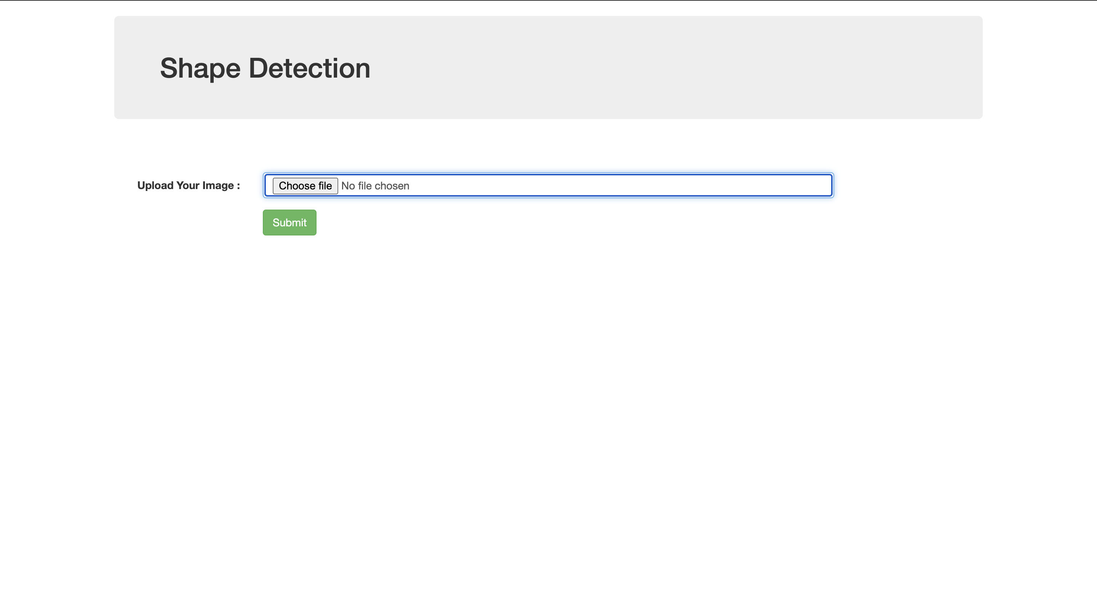
Option Name
In case the server does not respond, try refreshing the page and uploading the file again.

Slide 9
Developer contact details
Developer name: Mann Parekh
Mobile No. : +918104011091
Email: msparekh25@gmail.com

Slide 10
Thank you!

