Slide 1


Using MsPASS for Data Processing on HPC and Cloud Systems
Session 1: Data Management with MsPASS
Prof. Gary L. Pavlis
Department of Earth and Atmospheric Sciences
Indiana University, Bloomington, IN

Slide 2
Introductions
Gary Pavlis
  50-year history in computational seismology
  Taught 35 years at Indiana University
  Emeritus professor (old, “retired” guy) since 2018
  Co-developer of MsPASS
  I am doing all this as a volunteer in service to this community

Slide 3
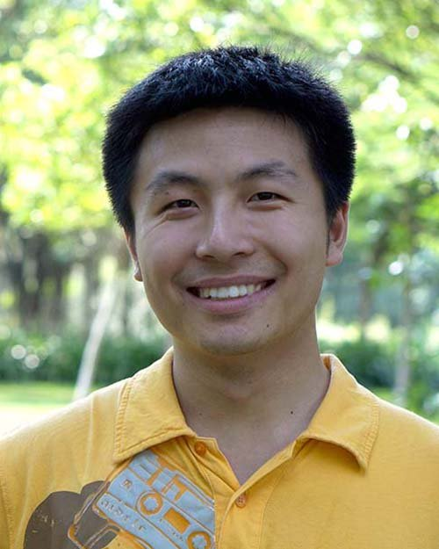
Ian Wang
Career path:
Ph.D. @Indiana University, 2017
Postdoc @CREST, 2017 - 2018
Research Associate @TACC, 2018 - now
Manage the HPC P&A Group @TACC, 2022 – 2025
Private industry since 2025
Coding learning path:
Worked mostly in C++ during Ph.D.
Picked up Python, Matlab, and others, too
Learned parallel runtime systems during postdoc
Seismology + HPC @TACC
Interest in Seismology:
A seismologist since undergrad
Mostly into signal processing and receiver functions during master
Ph.D. work: 3D plane wave migration, 410 and 660 discontinuities, water in the transition zone
Currently: seismic data management and processing, profiler, performance monitoring etc.

Slide 4
Course would not have been possible without Earthscope staff:
Tammy Bravo
Melissa Weber
Gillian Haberli
Sophia Parafina
Chad Trabant
Austin Ulakovich
Interns: Asif Ashraf and Eshanta Mishra

Slide 5
Course Business

Slide 6
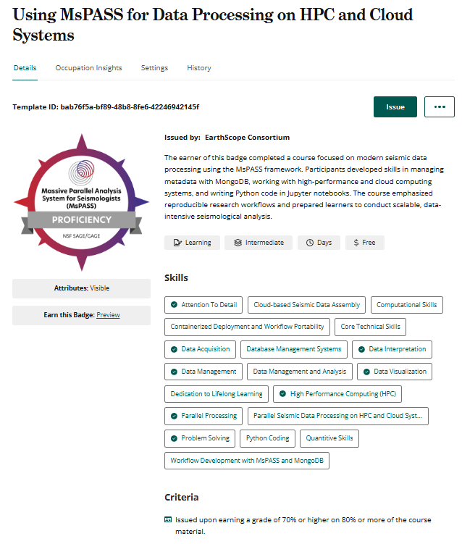
EarthScope Digital Credential
By completing this course,
you’ll earn a Proficiency-Level Digital Credential
What it means:
You’ve completed all required course activities, earning a grade of 70% or higher on 80% of the course material.
You’ve demonstrated key skills through evaluated work
Your achievement is verified and shareable
Why it matters:
Showcases your skills on platforms like LinkedIn or on your CV
Recognizes your applied learning and continued professional growth
Becomes part of your professional learning pathway

Slide 7

How to Claim Your Credential
Step 1: After the course ends, you’ll get an email from Credly
Step 2: Click the link in the email to accept your badge
Step 3: Add it to your LinkedIn profile, resume, or digital portfolio
Have questions?
Email us at courses@earthscope.org

Slide 8
Axioms of the modern world:
Everyone is an expert and everyone is an idiot
Beware the Dunning-Kruger Effect (video title: “Why Stupid People Think They’re Smart”)
Don’t build your career on expertise in something that can be done by a robot

Slide 9
Career corollaries:
Expert
To be successful you must become an expert in many things
Know what you know and realize you know little else
You must be a lifelong learner
Continue to enroll in courses like this one
Idiot
Be patient – remember you are one too
Educate them, don’t run them down
Preach and live the lesson of the Dunning-Kruger Effect

Slide 10
Career corollary 2: AI and the future
Learn to use the AI as a tool in your work
Avoid becoming an expert in areas the robot can do better
  Encyclopedic professor – minutia
  Problems dependent on busy work done better by a robot
Develop problem solving skills
Develop skills in assembling and interpreting information using the AI as a tool
Learn to use tools like MsPASS that can exploit the new world
Use the AI to hone your programming skills, not to do the work for you
  Use AI guidance as a suggestion not gospel truth
  An AI is a good teacher for the “how do I …” questions

Slide 11
Course Corollaries:
Ask questions for all the rest of us idiots – highly likely you aren’t alone
Use good judgement because you may not know the difference
  Your problem may or may not be unique
  There are limits to what we can solve remotely
Mechanism:
  Zoom chat
  Zoomp poll
  Zoom breakouts if needed
  Slack
  Raise your hand if appropriate – stay muted until recognized
  Attend office hour help sessions for personalized help

Slide 12
Assumptions
You have listened to the precourse lectures
You completed the precourse quiz and understand how to use Moodle
You have run the precourse notebooks
  Confirms you can get into GeoLab in the right configuration
  Confirms you have a basic knowledge of jupyter lab
  Confirms you have a working data set assembled for today’s exercise

Slide 13
Assignments after each session
Not just busy work
  Designed to reinforce learning goals of sessions
  Reading assignments important to improve learning for next session
  You need to complete all of quizes for Earthscope certification
  Completion requires only persistence
    Wrong answers give feedback to improve understanding
    Retry until you have all the answers right
All done in Moodle
Feedback important to keep us together
  Questions/comment box for each assignment section
  Attend office hours for personalized help
  Will address any comments or questions in that box at the start of session2 and session3

Slide 14
Course Agenda
Session 1: Big picture overview
  Overview of MsPaSS
  Data objects
  Data management
  Desktop setup and operation (an assignment)
Session 2: Parallel processing with MsPASS
Session 3: HPC clusters, cloud computing, and accessing the Earthscope waveform archives

Slide 15
How these sessions will work
All sessions will begin with a short lecture overview
Days 2 and 3 will have feedback review from homework
Focus is hands-on work with Jupyter notebooks for each session
Homework
  Step 1 is always to read through the completed notebook text
  Complete Moodle quiz

Slide 16
Using the Notebooks
In the class we will lead you through the notebooks step-by-step and talking about what we are doing
Questions first – details later
  Answering questions is first priority
  If we need to push forward, may skip some details
Designed to be self-contained
  You are expected to read the markdown box text
  Pass 1 – skim during class sessions
  Pass 2 – read again if needed as background for Moodle quiz
  Follow hyperlinks and at least skim that material
  If time runs short I’ll give an overview and say “complete the rest of this after the session”
For those unable to attend live zoom session
  Listen to recorded lectures
  Read through the notebooks running cells sequentially
  Ignore the recording of the notebook sessions unless you get confused. Fast forward and/or ask a question on slack if you encounter problems

Slide 17
MsPASS
Massively Parallel
  Single CPU thing of the past
  Archaic software infrastructure
Analysis System for Seismology
  Research analysis – flexibility
  For Seismology research – tool for us not computer scientists
https://www.mspass.org/

Slide 18
A fundamental qualifier:
“research computing”

Slide 19
Production versus Research IT systems
Production (Enterprise software)
Solves Specific Problem
Performance is critical
  Time is money
  Mission critical role with repeating tasks
Operable with minimum skill set necessary for job – skilled labor is expensive
Data model well known and fixed
Research
Handle range of problems
Performance is secondary
  Being feasible sufficient
  Many one-up solutions
Can assume users are specialists and life-long learners
Data highly variable (one person’s signal is another’s noise)

Slide 20
Key Roles MsPASS can play in research today
The only game in town for novel ”big data” problems
  Manage large data sets (terrabytes with millions of seismograms)
  Parallel processing
  Scalability allows prototyping on a desktop before running on big iron
  Best tool today for accessing data from the Earthscope cloud waveform archive
Tools for low-level work to assemble event-based data
Generic parallel tools for handling continuous data
Complete set of tools for P-wave receiver function processing
Tools for spectral estimation
Newer tool for automated processing of teleseismic P waves (son of dbxcor)
Foundation for new implementation of our 3D migration code (pwmig)
  MsPASS extension
  Earthscope course scheduled for Novemeber

Slide 21
What is MsPASS good for
Generic waveform processing toolkit
Scalability
  Prototype on a desktop
  If needed scale up to HPC or cloud
  Likely to become the tool of choice for interacting with Earthscope DMC when archive is completely migrated to the cloud
Data management (integrated database)
Reproducible science: With GeoLab your MsPASS notebook will allow reproducing at least the low-level processing to assemble your dataset

Slide 22
Aside: Reproducible Science
Today a large fraction of seismology papers should be published in the Journal of Irreproducible Results
Reasons:
  Data assembly sequence impossible to recreate
  Data processing sequence impossible to recreate
  Use of specialized research code not available to reader
Solutions
  1 and 2 are solved by MsPASS
    it was a design goal
    The data set and notebooks used in this course are an example
  Journals now universally address 3 - “Data” statements in more recent papers

Slide 23
MsPASS is NOT
Ideal solution for problems we viewed as solved:
  Real time data handling
  Seismic event catalog processing
  Seismic reflection processing
  Archival data management for Earthscope and other data centers
A complete solution for all of seismology
  This is a framework, not a turnkey solution to all problems
  May require some work to develop your custom “workflow”
  Use of python as job control language makes flexibility feasible
  More custom solutions require contributions from people like you
A commercial product
  100% open source – free
  Future depends on the community

Slide 24
What is in the box?
Exceptionally complete documentation (https://mspass.org ) for open-source package
  Assume you have all had a quick look at that material
Database to manage large data sets
Parallel processing
  HPC or cloud functionality
  Clean error handling for long running jobs
Flexible but simple to use IO abstractions (read-write almost any format and from URL)
Python job control language
  Reproducibility automatic if you submit jupyter notebook with your paper
Algorithms – low level preprocessing (solved problem) focus
  All obspy signal processing algorithms
  Low-level windowing, bundling, and similar grungy stuff
  Three-component primitives (rotation and transformation)
  Trace editng
  Header math
  SNR calculations
  All common P receiver function deconvolution
  Array-based body wave arrival time estimation with multichannel correlation
  Prototype array P wave deconvolution
Docker container or anaconda package distribution

Slide 25
Sermonette/Sales Pitch
MsPASS makes archaic
  SAC
  AH
  Most, if not all, existing generic waveform handling tools
MsPASS supercedes ObsPy
  If you use ObsPy you can use MsPASS with minimal effort
  MsPASS has integrated data management and parallel processing not possible with ObsPy
MsPASS is now a rock-solid package
  Processed many millions of seismograms
  Haven’t seen a seg fault in 3 years
  Most errors are user errors or unexpected data problems

Slide 26
I know ObsPy well, why should I move to MsPASS?
MsPASS is obspy on steroids
  MsPASS is a superset of obspy
  All obspy waveform processing functions are part of MsPASS
  Most obpsy python scripts are easily convert to a MsPASS script
For large data sets
  Integrated database for data management essential
  Clean error handling to run large jobs running for hours
  Parallel processing functionality
  Cross-platform compatibility – runs on desktop to highest end supercomputer or cloud system
Cloud computing capable
Reproducibility
Key thing: built for the future while obspy was designed almost 20 years ago

Slide 27
Documentation, documentation, documentation:
User Manual
Python API Reference
C++ API
Tutorials – you are all using files in a directory of this repository
Notes:
Follow user manual link and review TOC

Slide 28
IMPORTANT Consequence of good documentation
The reference material is there if you know the layout:
  The last slide was an overview
  RTFM
The current generation AI’s are very good at answering questions about MsPASS
  The reason they are good is because the user manual is large
  I’ll show you an example
  Because of AI capabilies I will completely gloss over ”implementation details” and focus on fundamentals

Slide 29
Data Management
First a little online poll

Slide 30
Data Management: size matters
For humans handling more than a few hundred “things” at once is problematic
“Handling” means:
  Being able to find the thing(s) you want to work with
  Have the data organized into a stack of stuff in logical groupings
    Paper files are the original database – centuries of experience prior to digital age
    Computers files and folders (directories) are the logical extension of paper files
  Being able to comprehend the contents of things you “find”
    If you are an English speaker and a paper file is in Chinese you need a translator (data format)
    For computer data you need to know the format and translate what the machine reads to something you can digest
“Big data” means a Database system is required to manage information

Slide 31
Database Management Systems (DBMS)
Unix file system and the hierarchic database
  Evolved from fundamental concept of a tree structure in early computer science
  Viewed as archaic in the IT world
  Still used by large fraction of seismologists as unix directory file structures
    Directory path is grouping (e.g. year/day directory like 2012/245)
    Files (leaf of tree) are waveform data or other data files (name convention)
    We will see the Earthscope archive has a legacy structure like that
Relational Database systems
  First used in seismology in nuclear monitoring research
  Now a standard part of most network operations but “under the hood”
  Relational == Tables
  You likely use multiple RDBMS systems ”under the hood” every day when you ran many modern internet “Apps”
Document Database
  Used in MsPASS
  Used because it is far less rigid than an RDBMS – more suitable for research applications
  Unconventional, but
    MongoDB is as stable as any RDBMS
    You have likely used MongoDB when running some internet Apps. You can’t tell from the application laye

Slide 32
Poll question 2:
Helpful for me to know my audience
Do the poll while we take a short break
After break we will work on Session1 notebook on GeoLab

Slide 33
Review of Key Concepts of Part 1 of the notebook

Slide 34
MsPASS Data Object Concepts
Metadata and sample data are different things and need to be handled differently
  Sample data stored in “array-like” containers
  Header data stored in a “dictionary-like” container (Metadata)
  ”Is a” (MsPASS) versus “has a” (obpsy) perspective on header data
For parallel processing we require an ”ErrorLogger” container

Slide 35
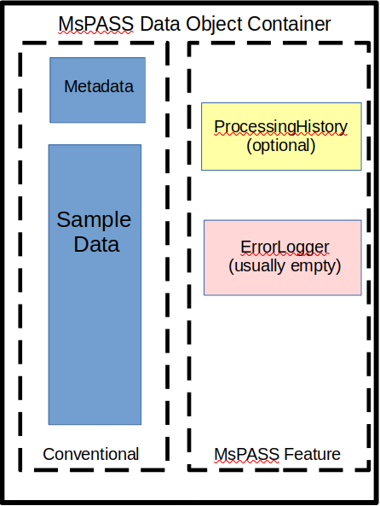
MongoDB collection
{ “npts” : 1024,
“t0” : 601489897876697.89,
“sta” : “AAK”
”chan” : “BHZ”
…
}
{ “npts” : 1024,
“t0” : 601489897876684.24,
“sta” : “BZN”
”chan” : “BHZ”
…
}
…
For geeky details see: https://www.mspass.org/user_manual/data_object_design_concepts.html#

Slide 36
Part 2: MongoDB fundamentals

Slide 37
Generic Database concept: CRUD
Create
  Stock MongoDB
  Db.insert_one
  Db.insert
  MsPASS Extension
  Db.save_data
  Db.save_inventory
  Db.save_catalog
Read
  Stock MongoDB
  Db.find_one
  Db.find
  MsPASS Extension
  Db.read_data
Update
Delete

Slide 38
Create: MsPASS save_data method concepts
Key concepts:
  Data object is torn to pieces with save
  Different containers are saved in different “collections” or files
Header (Metadata container) saved in
  wf_miniseed
  wf_TimeSeries
  wf_Seismogram
Sample data
  Files
  Gridfs (internal to MongoDB)
Error log
Processing History

Slide 39
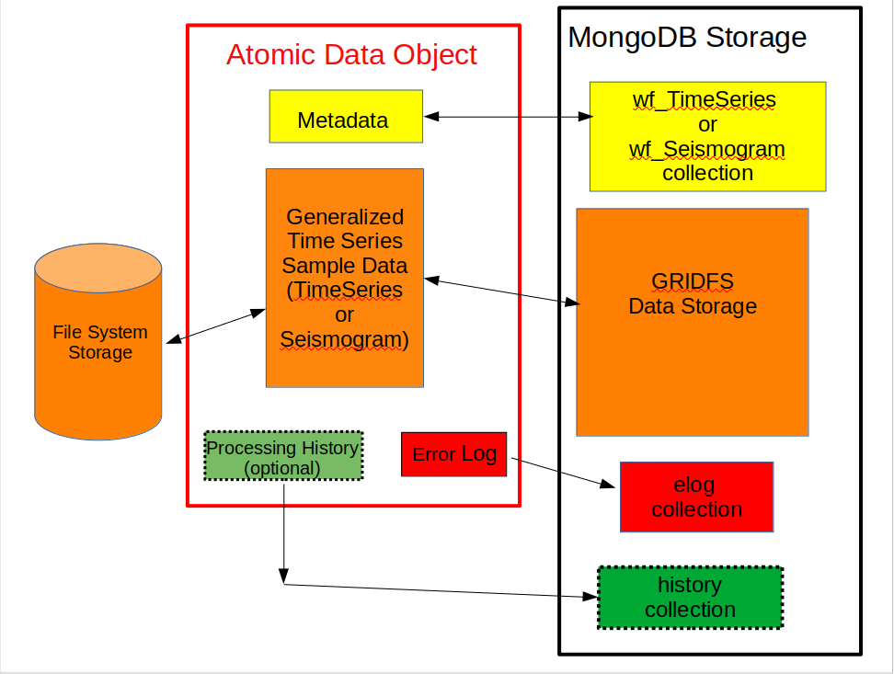
Graphical Representation of Save/read operations
FDSN data center

Slide 40
Database Queries
A key concept of the R of CRUD
You almost never want “all” the things a database manages
All database systems use some “query language” to select the data desired
Standard in RDBMS is “Structured Query Language” (SQL)
MongoDB uses a different query language based on python dictionaries

Slide 41
MongoDB Query Language (MQL)
Two query methods:
  find_one – retrieve first document matching query
  find – retrieve command cursor == list of documents matching query
  arg0 of both is a python dictionary
Many online sources
  Most are poor
  Most just echo examples in MongoDB documentation
MsPASS advice
  See User Manual section Using MongoDB with MsPASS
  Today’s tutorial and similar tutorial found here

Slide 42
How Queries are used in MsPASS
Serial Atomic read loops
Serial Ensemble read loops
cursor = db.wf_miniseed.find(query)
for doc in cursor:
d = db.read_data(doc,collection=‘wf_TimeSeries’)
... Processing functions …
db.save_data(d)
srcid = db.source.find(query).distinct(‘_id’)
for sid in srcid:
wf_query = {‘source_id’ : sid}
cursor = db.wf_miniseed.find(wf_query)
ensemble = db.read_data(cursor)
… Processing functions
db.save_data(ensemble,collection=‘wf_TimeSeries’)

