Slide 1


Using MsPASS for Data Processing on HPC and Cloud Systems
Session 2: Parallel Processing
Prof. Gary L. Pavlis
Department of Earth and Atmospheric Sciences
Indiana University, Bloomington, IN

Slide 2
Agenda Today
Questions from Homework
Lecture1: Parallel Processing
  Review of key points from precourse lecture on this topic
  MsPASS services
  Parallel containers
  Serial database driven workflows in MsPASS
  Converting serial workflow to a parallel one
  Futures
Hands on work on GeoLab
  Simple serial process prototyping
  Debugging serial prototype
  Conversion to parallel
  Monitoring performance with dask diagnostics
  Example of more complicated workflow and conversion to parallel
Lecture 2: Issues with stock dask scheduler
  Oversubscribing CPUs
  Memory management
  Solution in newest MsPASS release using Futures and a “sliding window”

Slide 3
Key points from Precourse Lecture
HPC and Cloud computers are clusters
  Core – cpu
  Blade/Node – one standalone computer
  Shared versus distributed memory
Parallel processing concepts
  Threads – shared memory only
  MPI – standard framework for simulation code
  Foreman/worker – standard big data approach (what MsPASS uses)

Slide 4
With that background a short poll to help me understand my audience

Slide 5
Service Concept
Generic abstraction of UNIX daemon (background process)
Central to cloud computing
Main ideas
  A service is a piece of software that runs in the background
  A service responds to requests via an API
  A service is often conceptualized as a black box with a name tag

Slide 6
MongoDB
Dask
GeoLab

Slide 7
You interact with services via an API
(Application Programming Interface)
Database Service: pymongo
Cluster service: dask distributed
Frontend service: interactive with jupyter notebook or batch python script run

Slide 8
Why do I need to know this?
You don’t to get started – Monday was a case in point
When this material is important
  When you are tuning a workflow for performance
  When you are configuring an HPC cluster (Friday topic)
  When something goes wrong – it is possible to crash any of these services

Slide 9
Dask distributed
Generic parallel processing framework of MsPASS
Importance: provide a generic mechanism to run task in parallel
Concepts: next slide

Slide 10
Generic Parallel Processing
Recall Precourse lecture concepts
  Baking a cake analogy
  Foreman-worker model
  Directed Acyclic Graph – under the hood detail
Foreman == scheduler
Workers do what the boss tells them to do
DAG and “futures” (dask) support generic parallel algorithm

Slide 11
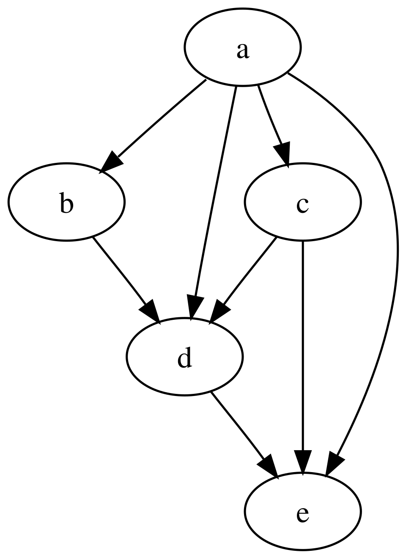
Directed Acyclic Graph – how schedulers manage data flow
Boxes a, b, c, d, and e are compute tasks
Arrows show data flow
“Acyclic” – data flows only one way
Key point is this is a generic scheduling method
  Good for goal of flexibility in research computing
  Can be bad for efficiency (performance)
From: https://en.wikipedia.org/wiki/Directed_acyclic_graph

Slide 12
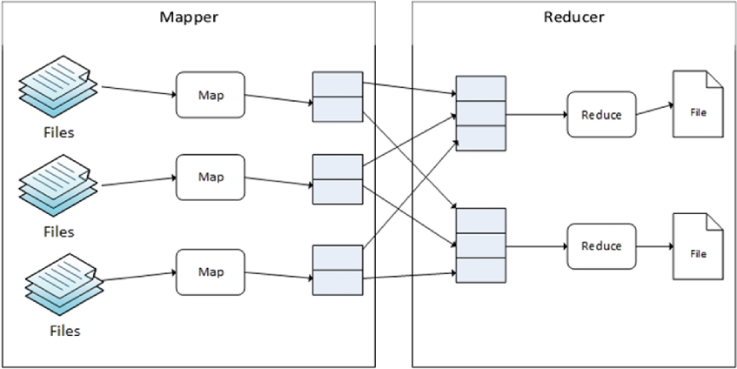
Generic map-reduce concept
Applications:
Data input is a (huge) list of the same things
Map – apply a common algorithm to each thing
Reduce
  Combine things
  Order cannot matter

Slide 13

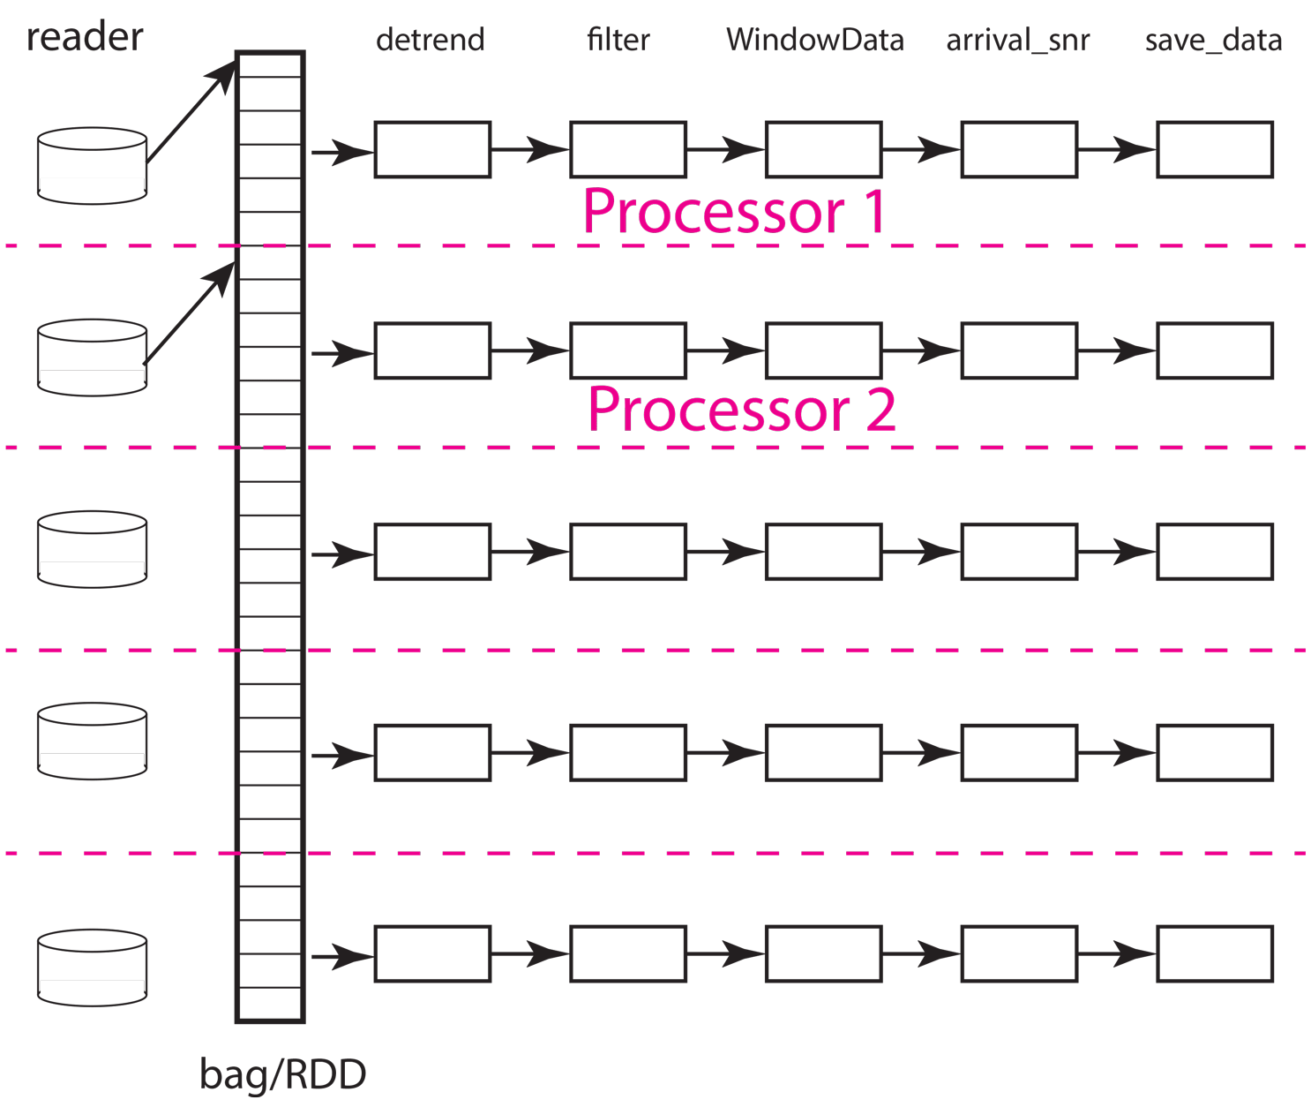
Most seismic processing workflows are pipelines
Origin (reader) is a read operator that loads data into a parallel container (bad/rdd)
Process each datum with 5 processing functions (boxes with names at top)
Example shows how scheduler might pass work to 2 processors running in parallel
A pure pipeline DAG is the definition of “embarrassingly parallel”

Slide 14
Some key concepts
Parallel container (bag) – notebooks will make this clearer
Workers run processing functions (detrend, filter, WindowData, arrival_snr, and save_data in previous animated figure)
Scheduler tells workers which components of the data set (things in bag/RDD container) to run when
  Animation show that happening sequentially
  In real life the order is not sequential
  Scheduler has to guess how many data to handle simultaneously from
    Memory use
    How busy CPUs are
  We will see a real time version running session2 notebook

Slide 15
Algorithm restrictions of map-reduce
All algorithms must be expressed as a function
Function input as arg0 should always be the same
Arguments must be constant for all data
Return type can and often is different from arg0 input
Should never throw an exception unless you want the workflow to abort for the entire dataset
Reduce has additional restrictions
Use wrapper functions to adapt existing code
See this section of the MsPASS User Manual for summary of MsPASS algorithms

Slide 16
Let’s look briefly at a dask example
Open notebook: ParallelProcessingFundamentals.ipynb”
  Quick look at an example pipeline workflow
Open notebook “SeismicReduceOperatorExample.ipynb”
  Quick look to show you flow structure
  Run and review this notebook at your leisure – it is largely a reference
  An important point is to date we’ve not found a useful example of a Reduce operator in seismic processing – see closing text box of the example

Slide 17
Serial Prototyping
ALWAYS the starting point for any parallel workflow
  Get all the syntax right
  Assure the suite of algorithms work together
If you don’t need parallel processing don’t bother (feasibility)
Used to establish timing data to estimate resources for full data set

Slide 18
Parallelization example:
Serial Form
cursor=db.wfcollection.find(query)
for doc in cursor:
d = db.read_data(doc)
d = proc1(d)
d = proc2(d)
db.save_data(d)
Parallel Version (dask)
cursor = db.wfcollection.find(query)
df = read_to_dataframe(db,cursor)
mybag = read_distributed_data(df,db)
mybag = mybag.map(proc1)
mybag = mybag.map(proc2)
out = write_distributed_data(mybag,db)
Creation
Process
Save result
Note:
Above omits optional arguments for clarity that are nearly always required
We’ll look at real examples shortly in notebooks

Slide 19
An important detail: parallel clients
Problem happens when workers need access the MongoDB
All MsPASS seismic read and write functions require MongoDB
Recall MsPASS services wiring diagram

Slide 20
Each of those workers needs a database client running
How to set up workers
  Prior to 2026 – serialize db
  New solution – worker plugin

Slide 21
How to set up worker clients:
from mspasspy.util.db_utils import MongoDBWorker
from mspasspy.client import Client
mspass_client = Client()
dask_client = mspass_client.get_scheduler()
parallel_dbworker = MongoDBWorker(mspass_client)
dask_client.register_worker_plugin(parallel_dbworker)

Slide 22
IMPORTANT WARNING:
Prior to earlier this year we used a serialization approach to push database handle to workers
That works for small data sets, but fails with very large data sets
We have NOT yet fixed all the documentation
  Most of the user manual example have the old (wrong) form
  Most of our tutorials are wrong (Earthscope2026 is the main exception)
  All previous MsPASS Earthscope tutorials used the old serialization approach
Use the tutorials from this course or follow guidance in this page of the MsPASS User Manual

Slide 23
To GeoLab
We’ll first go through ”ParallelProcessingFundamentals.ipynb”
  You should already have that open
Step 2 is running the “Session2.ipynb” notebook

Slide 24
Part 2: Dask Futures
Distributed memory implementation of concurrent.futures that became a standard in python 3.2 (2011)
The standard python futures interface is a useful thing to know independent of MsPASS (numerous online sources)
Dask uses the futures API under the hood for almost everything
More primitive so it has fewer safeties

Slide 25
Dask Futures API key components
submit – Send a function to run one datum on the cluster
future.result – block until a single future completes
gather – block while a list of futures complete and return results as a list
as_completed – handle a list of futures as they finish
scatter – broadcast data to workers (improves performance for a large data set needing common large objects like a travel time calbulator)

Slide 26
Converting a pipeline workflow for futures
Map Operator Form
Import dask.bag as dbg
mybag = dbg.from_sequence(x)
mybag = mybag.map(convert_to_query)
mybag = mybag.map(read_data)
mybag = mybag.map(proc1)
mybag = mybag.map(proc2)
mybag = mybag.map(db.save_data)
mybag.compute()
Futures form
dask_client = mspass_client.get_scheduler()
def process_one(x):
q = convert_to_query(x)
d = read_data(q)
d = proc1(d)
d = proc2(d)
return d
data_list = generate_list_to_drive_processing()
Flist=list()
for x in data_list:
f = dask_client.submit(process_one,x)
Flist.append(f)
Result = dask_clent.gather(Flist)

Slide 27
Problems with that crude example
If the list is huge it will overwhelm the scheduler
Memory use will grow out of control
Return result can be huge

Slide 28
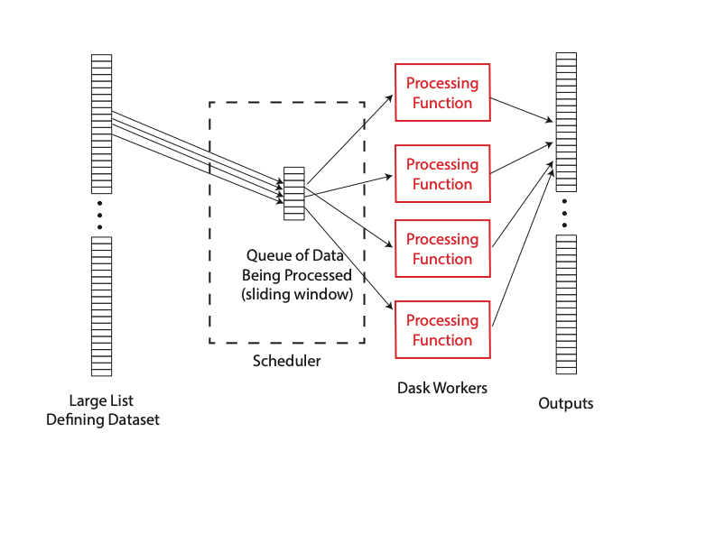
Solution: MsPASS sliding_window_pipeline
Data submitted sequentially to queue
Scheduler decides which worker gets which datum to handle
Processing function takes input form list and emits something
Output is a list with length the same as input
Not illustrated is that when a reader or writer blocks the scheduler gives it more work (more data being handled simultaneously than number of workers)

Slide 29
Advantages of Sliding Window Algorithm
Memory used is predictable (queue size time maximum memory required by function during processing)
Let’s the operating system manage resources more effectively
Proven capability to handle millions of inputs simultaneously IF the input is list of documents, ids, or database queries

