Slide 1




Session 3: Accessing Earthscope Cloud Store Data with MsPASS
Prof. Gary L. Pavlis
Dept of Earth and Atmospheric Sciences
Indiana University

Slide 2
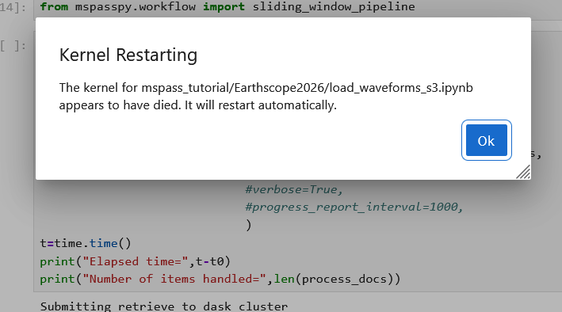
Questions and comments: Part 1 – response by me
Had a couple reports of this infamous (to us) jupyter splash screen
What happens if the operating system kills the job
  Usually means a memory fault
  In this case it was hitting file quota limit on GeoLab
  Happened when people had to rerun the load_waveforms_s3 notebook and didn’t do a complete cleanup

Slide 3
Lessons
If you get that infamous message, it means the OS killed the main python job script process
  Memory fault
  Something else that the OS considered a limit (in this case storage quota)
Takes detective work to solve
  Hypothesis driven testing
  Shell command line tools to test file storage issues
  Look at log files
    I’ll show you where they are on geolab for hints
    They can be challenging to interpret
  Use assorted memory monitoring tools – ask your favorite AI for suggestions

Slide 4
Other questions from howework2
What are the most common causes of metadata mismatches (such as net, sta , chan, and loc) that send data to the cementry collection, and how can they be prevented?
  Usually not a problem with net, sta, chan, or loc but a mismatch of startime::endtime periods with IRIS holdings and what the provider gives as the time range of operation of a station – e.g. a maintenance window with a sensor swap.
  The examples in this data all belonged in the cemetery – unreliable data best discarded
  This is a type example of why error handlers and something like the cemetery are essential for large processing jobs to be stable
Late from Session 1 homework: student got a different answer than I got – I’ll show you my key notebook and discuss this one

Slide 5
Any others?

Slide 6
Part 1 of Today: Ian Wang on Using MsPASS on an HPC cluster

Slide 7
Cloud Computing Overview

Slide 8
My take as a Scientist on Cloud Computing
A lot of web sources are corrupted by commercial sales pitches
  Technical audience
  Nontechnical (manager) audience
This is a huge subject with trillions of $ involved
I will focus today on a few key concepts relevant to “big data” == MsPASS
  Abstraction of what a processor is
  Abstraction of data storage
  Web view of data

Slide 9
Concept one: Processor Abstraction

Slide 10
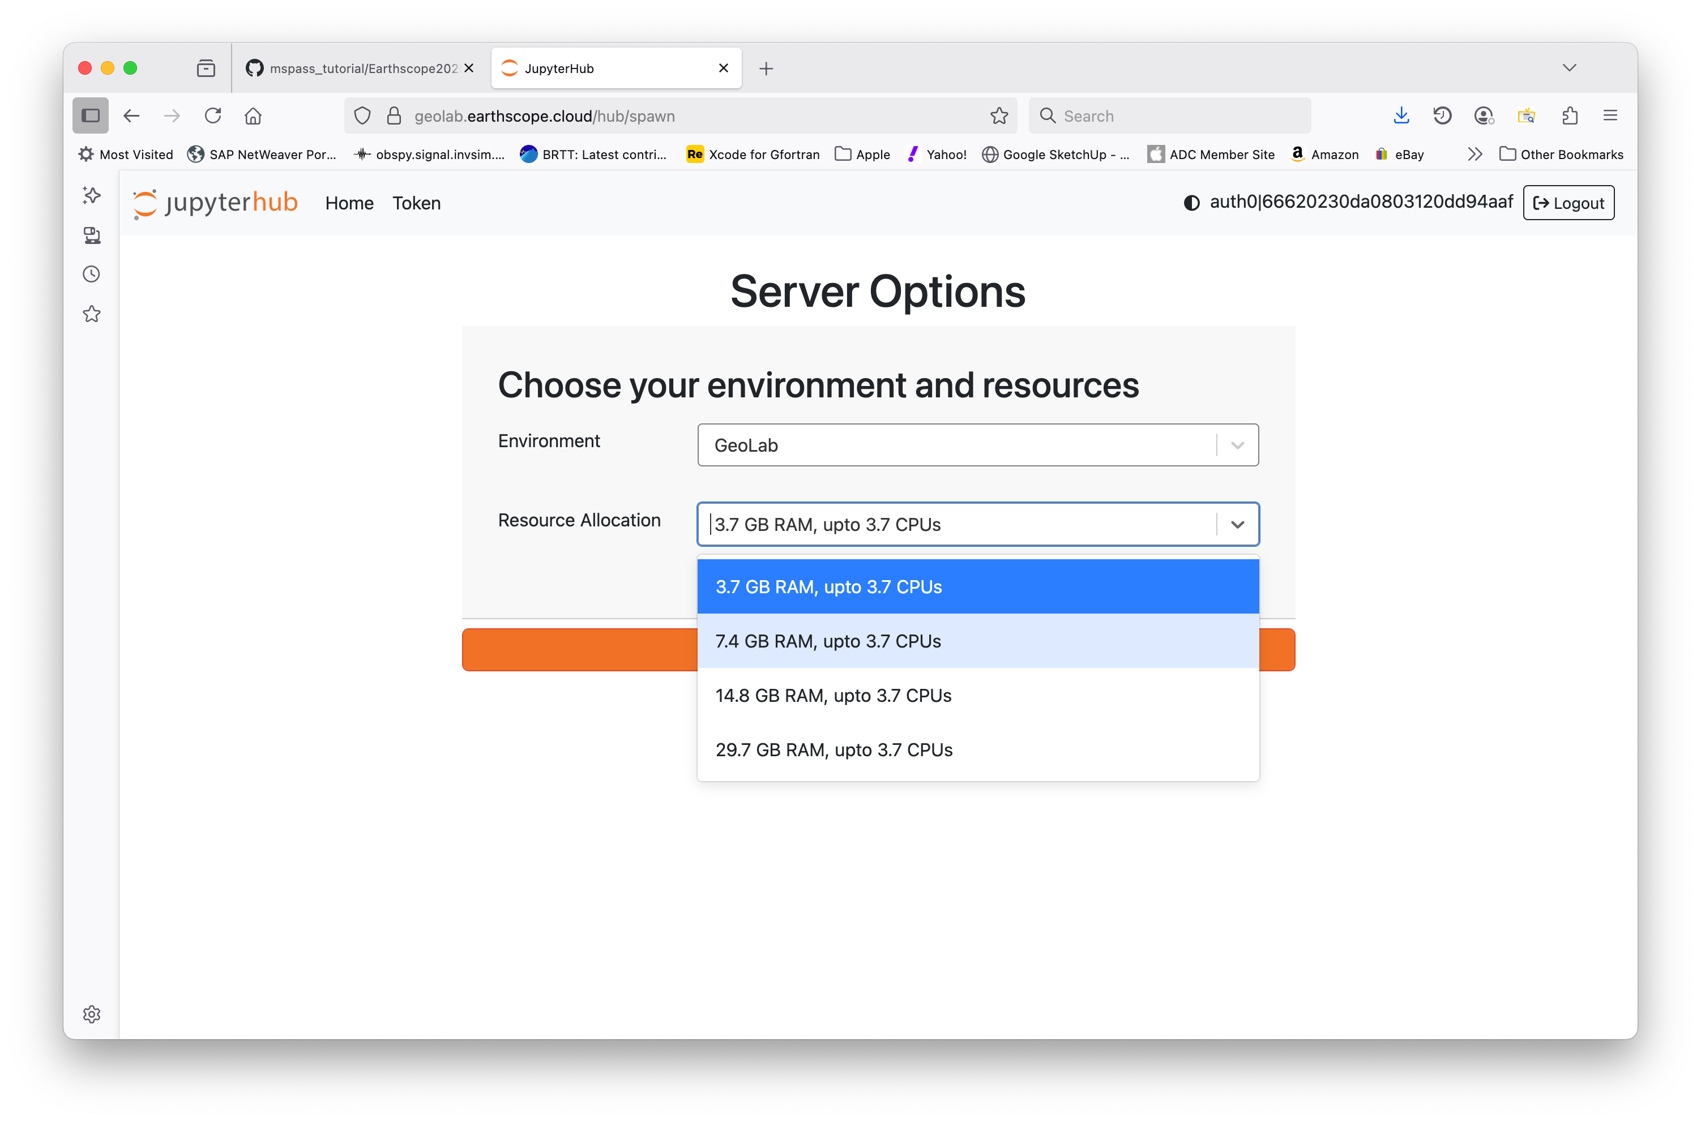
What is this?

Slide 11
Key Points
GeoLab is a cloud gateway
Abstracts processors (“CPU” is not entirely accurate) and memory assigned to you while connected
You have no clue what processor type or which node(s) of the cluster are assigned to your login

Slide 12
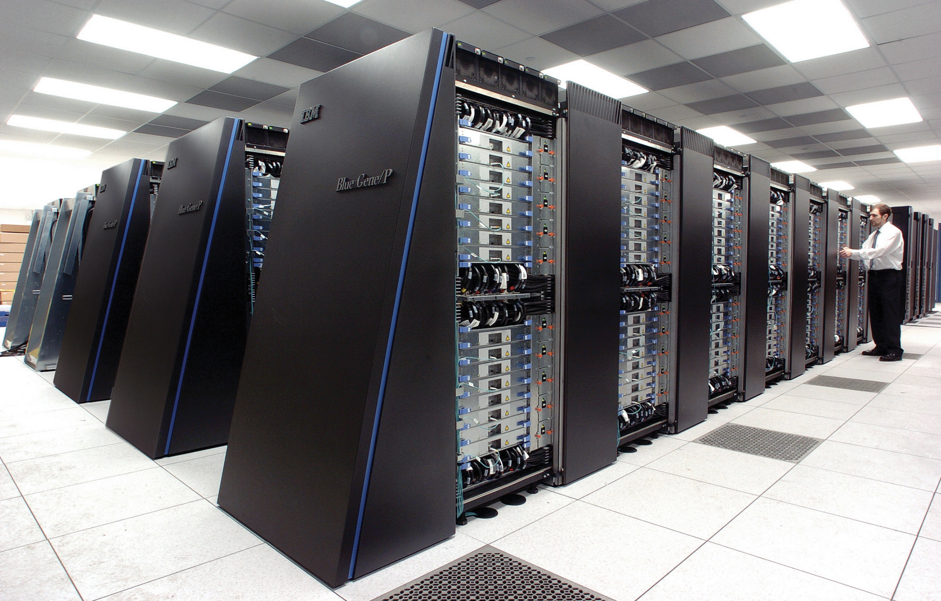
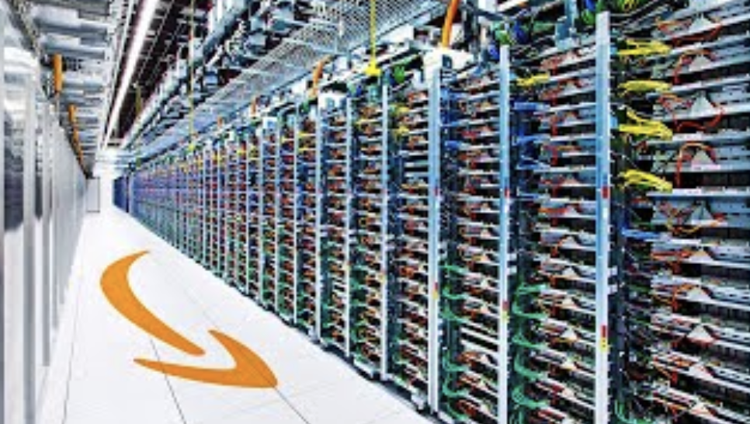
How Does This Differ from HPC
HPC
Amazon Data Center

Slide 13
Quick Answer
Hardware is similar – multiple racks each with a stack of blades
Software is completely different

Slide 14
HPC versus Cloud Systems
(a scientist perspective)
Cloud Systems
Driven by commercial interests
  E-commerce market
  Decreasing IT costs for the company
TANSTAFL (There Ain’t No Such Thing As a Free Lunch – Robert Heinlein)
We are poorly financed customers
Data handling and web focus
  Optimized to handle large data volumes
  Broad range of processing functionality
  Center of e-commerce
Entirely dependent upon containers
HPC Systems
Created to support science
  Support from NSF, DOE, and universities
  Focus on simulation
Grant support
Set up to support academic research
Simulation focus
  Compute performance optimized
  Batch processing (homogenous processing)
Containers (virtual machines) are a newer application

Slide 15
HPC versus Cloud Software
HPC
Batch processing
Hardware conscious
  Job requests resources as N nodes
  Job requests other resources
Components (processes) tightly connected together (mpi)
Cloud
Service abstraction
Resources assigned dynamically
Components (services) loosely connected (typically a url)

Slide 16
Key point: MsPASS is the only existing seismic processing system built for cloud architecture

Slide 17
Some Key Points:
In a cloud system everything is abstracted
  Processors
  Memory use
  Services
HPC systems are “bare metal” – MsPASS creates the abstraction to make use indistinguishable from that on the cloud or a desktop

Slide 18
Concept two: Data Abstraction

Slide 19
Discussion
What is your concept of what a “computer file” is?
Similarly, what is a “file system” like the unix or windows file system?
We will be using a zoom poll here

Slide 20
Computer File
A collection of digital data stored on an external (to a running program) device (i.e. outside of system main memory)
Loaded into system memory through a programming API
  Loading of bits is a low-level operation done under the hood in any language
  Usually “blocking”
    Your program halts until IO operation completes
    Operating system lets other process run while your program waits for input/output operation to complete
Usually requires a special API to crack the format of the file after staged to memory
  Miniseed
  StationXML
  etc

Slide 21
File System
A system for organizing computer files
Born from the then new technology of magnetic disks (random access storage)
Traditional implementations tightly linked to disk storage
Software file system emulators
  Necessary evil to handle some hardware – notably large disk arrays
  Used for decades – earliest IRIS servers used archival tape storage that simulated a unix file system

Slide 22
An example: Modern HPC Cluster file Systems
Petabyte+ scale disk array found on most HPC clusters
Some version of this was used at IRIS Data Center in Seattle that is now being phased out
NOT a “unix file” system although the “path” (e.g. /N/scratch/pavlis) looks like a unix file system directory to a program
In all cases I know where the data can actually be found is managed by a relational DBMS (File “Metadata”)

Slide 23
Why did I inflict that on you?
Important to know that if you are working on a HPC system
  Awful performance for large numbers of small files (e.g. SAC data)
  You can crash an HPC cluster with excessive file operations
Cloud systems
  The actual data storage is similar to Lustre
    binary blobs on giant disk arrays
    Treated as “objects” instead of “files”
  The API to access that data we will use (S3) does NOT simulate a file system
Understanding blocking IO and it impacts on a parallel job is fundamental

Slide 24
Cloud Storage
You likely use cloud stores every day with your phone and/or desktop
Today’s exercise focused on earthscope_sdk to access waveform archive now being moved to Amazon’s cloud service called “S3”

Slide 25
Amazon S3 (Simple Storage Service)
Best understood by examples we will run in a notebook after I finally stop talking
Key concepts to take away from the exercise:
  Standard python API is a package called boto3
  S3 Bucket → File System
  Object → File
  A unique Object (File) is accessed by a unique key

Slide 26
MsPASS Design
Was shaped by modern concepts in cloud computing
  Service concepts (cluster, db, and frontend services)
  Data abstraction (data objects and database reader - Session 1)
  Containerized (distributed as docker container)
Design allows the exact same package to run on
  Desktop
  HPC
  Cloud (GeoLab)

Slide 27
To Geolab Notebook – Session3.ipynb

Slide 28
Issues with prototype and Possible Solutions
Issues
GeoLab storage limit
Resource limit (GB-hour metric)
Possible solutions
Pay for your own S3 bucket for output (TANSTFL)
Pay for additional processor time (TANSTFL)
Set up lambda service
  See our 2025 paper with link on Moodle
  Very inexpensive (free currently possible) for modest performance

Slide 29
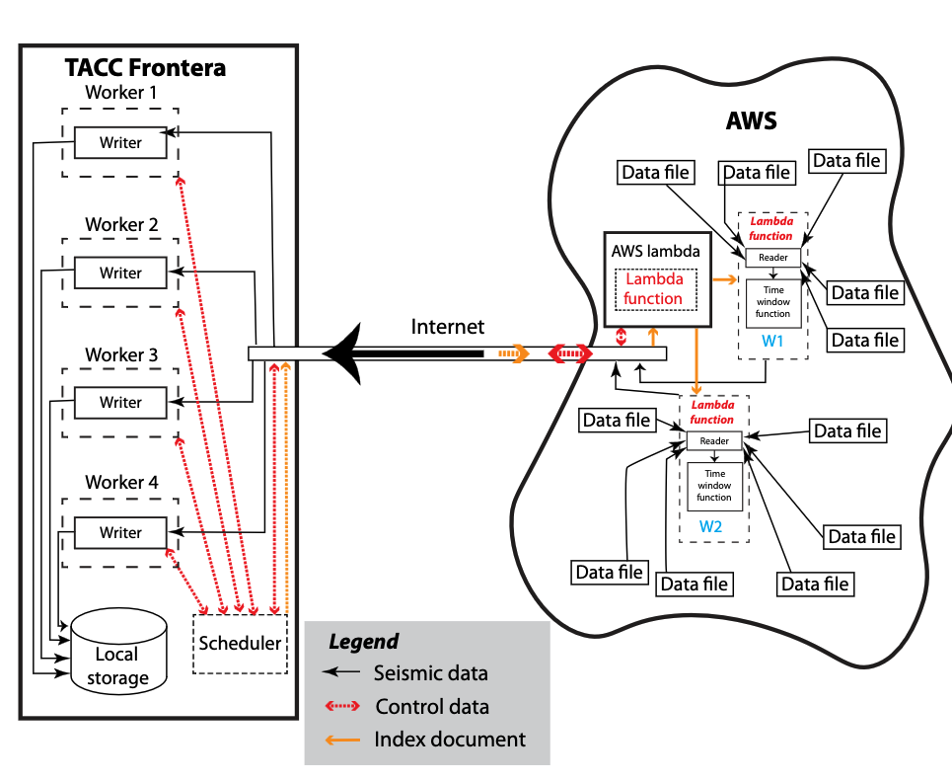
Data Flow Diagram for using AWS Lambda service
Key points:
The prototype you ran should work to drive a lambda
You could run the left hand box on your local system
From Mohapatra et al (2025) – reprint on moodle

Slide 30
Earthscope Data Services Cloud Plans
Chad Trabant

Slide 31
Closing Topics
Final Project: Instructions on Moodle
  Don’t take on too much
    Demonstrate independent application of MsPASS and/or
    Demonstrate from words and coding you grasp one or more key concepts from the class
  Defining problem and some prototyping is good enough for certificate
  Plenty of time – Aug 15 deadline
  I am willing help you continue after Aug 15 to take help you in your research
  Use your favorite AI to help you – that is not only fair but recommended with MsPASS
  Use email to Pavlis@iu.edu as I my monitoring of slack is sporatic after the class is over
Certification deadline: Aug 15 (complete all Moodle exercises by then)
Cleanup your debris before leaving for last time: GeoLab notebook file “Housecleaning.ipynb”

Slide 32
Discussion and Review

Slide 33
Optional Material: keep in presentation but used only if needed for discussions

Slide 34
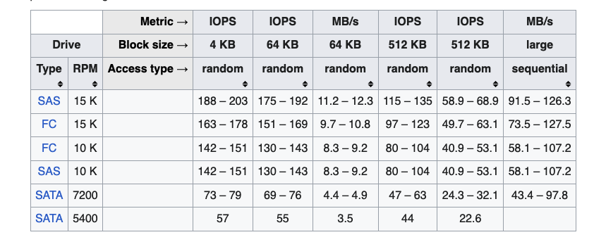
Mechanical Hard Disk Speeds
https://en.wikipedia.org/wiki/IOPS

Slide 35
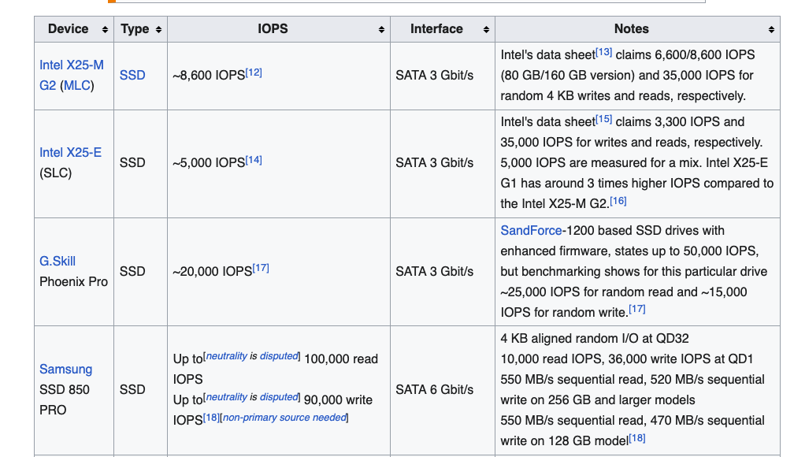
Solid State Disk (SSD) speeds
https://en.wikipedia.org/wiki/IOPS

Slide 36
Storage Device Transfer Speeds
Transfer rate (MB/s)
0.1
1
10
100
1000
Web service
Long haul internet
Magnetic disks
Solid State Disks
Discussion points:
human perception of time is not logarithmic
Consider time to copy 1 TB (10¹²) of data

Slide 37
Latency
Latency (ms)
0.01
0.1
1
10
100
1000
SSD Disk
SATA disks
Stock magnetic disks
Internet ping times
boto3
Day File
Transfer
Time
Local
Network
WAN
Useful source: https://planetscale.com/blog/io-devices-and-latency

Slide 38
Input example comparison
Python Example
S3 boto3 equivalent
with open(fname, mode="rb") as fh:
if foff > 0:
fh.seek(foff)
flh = io.BytesIO(fh.read(nbytes))
st = obspy.read(flh, format=format)
obj = s3client.get_object(Bucket=bucket,Key=s3key)
mseed_content=obj["Body"].read()
st = obspy.read(io.BytesIO(mseed_content),format="mseed")
Discussion: What limits performance in both cases?

Slide 39
Key point you should take from discussion
With boto3 “get_object” requires moving binary data into memory
Where that data lives matters
  If data is local transfer speed can be gigabytes/s
  If data is remote band limited by network (1 – 10+ Mb/s) – “long haul internet” problem

