Slide 1
Massively Parallel Analysis System for Seismology (MsPASS)
Prof. Gary L. Pavlis
Department of Earth and Atmospheric Sciences
Indiana University, Bloomington, IN

Slide 2
Overview
Overview lecture on what MsPASS is and why you should use it
Hands on session working through jupyter notebook

Slide 3
MsPASS
Massively Parallel
Single CPU thing of the past
Archaic software infrastructure
Analysis System for Seismology
Research analysis – flexibility
For Seismology – tool for us not computer scientists
https://www.mspass.org/

Slide 4
What is in the box?
Exceptionally complete documentation (https://mspass.org ) for open-source package
Database to manage large data sets
Parallel processing
HPC or cloud functionality
Clean error handling for long running jobs
Flexible but simple to use IO abstractions (read-write almost any format and from URL)
Python job control language
Algorithms – low level preprocessing (solved problem) focus
All obspy signal processing algorithms
Low-level windowing, bundling, and similar grungy stuff
Three-component primitives (rotation and transformation)
Trace editng
Header math
SNR calculations
All common P receiver function deconvolution+novel new method
Docker container or anaconda package distribution

Slide 5
What is MsPASS good for
Generic waveform processing toolkit
Scalability
Prototype on a desktop
If needed scale up to HPC or cloud
Likely to become the tool of choice for interacting with Earthscope DMC when they get their cloud system working

Slide 6
Sermonette/Sales Pitch
This community needs to recognize what we have given you
MsPASS makes archaic
SAC
AH
Most, if not all, existing generic waveform handling tools
MsPASS supercedes ObsPy
If you use ObsPy you can use MsPASS with minimal effort
Drastically increases functionality over ObsPy

Slide 7
I know ObsPy well, why should I move to MsPASS?
If you are only working with 10000 or less waveforms at a time it won’t help
For large data sets
Integrated database for data management essential
Clean error handling to run large jobs running for hours
Parallel processing functionality
Cross-platform compability – runs on desktop to highest end supercomputer or cloud system
Likely to become the standard for low-level interaction with new Earthscope cloud system

Slide 8
One-liner perspectives on MsPASS
Only open-source, generic system today for large-scale parallel processing of seismology data
Only open-source, generic solution today suitable for cloud computing
ObsPy on steroids
Runs on almost any system
Written by a pair of geeky seismologists for seismologists
Now a very stable package
Documentation written by seismologists who happen to also be the main developers

Slide 9
Documentation, documentation, documentation:
User Manual
Python API Reference
C++ API
Tutorials – you all should have cloned this repository already

Slide 10
MsPASS is NOT
Ideal solution for problems we viewed as solved:
Real time data handling
Seismic event catalog processing
Seismic reflection processing
Archival data management
A complete solution for all of seismology
This is a framework, not a turnkey solution to all problems – may require some work to develop your custom “workflow”
More custom solutions require contributions from people like you

Slide 11
Discussion
MsPASS is a framework for research computing. What does the “research” keyword mean in this context?

Slide 12
Production versus Research IT systems
Production
Solves Specific Problem
Performance is critical
Time is money
Mission critical role with repeating tasks
Operable with minimum skill set necessary for job
Data model well known and fixed
Research
Handle range of problems
Performance is secondary
Feasible sufficient
Many one-up solutions
Can assume users are specialists and life-long learners
Data highly variable (one person’s signal is another’s noise)

Slide 13
Key Roles MsPASS can play in research today
Manage large data sets
Tools for low-level work to assemble event-based data
Generic parallel tools for handling continuous data
Complete set of tools for P-wave receiver function processing
Tools for spectral estimation
Hands on exercise focus

Slide 14
Hands on exercise part one: Data management
Indexing miniseed files
Managing source metadata
Managing receiver (station) metadata
Seismic data reader and writer abstraction

Slide 15
MsPASS Data Management Technology
MongoDB is the integrated database of MsPASS
MongoDB is a “document database”
Jargon name: a document == python dictionary
A “document” is the ultimate seismic header
You can save almost anything there
Completely flexible (by default) in what you save
See the Data Management section of the MsPASS User Manual

Slide 16
To Jupyter Notebook
Launch docker container as described here

Slide 17
Parallel schedulers
Map-reduce model
Modern jargon term
Online sources obscure some simple concepts
Main paradigm for MsPASS parallel processing
A modern paradigm likely to have a long lifetime
I will introduce by analogy to unix pipeline concepts I assume all of you know

Slide 18
Seismic Reflection Workflow model
Example: seismic unix
Illustrates traditional model
Key point is data flow through processors
Processors read input, modify it, and emit output
Read
Bandpass
NMO
mute
display
# real examples would add arguments for parameters
subfilt < mydata | sunmo | sumute | suxwig

Slide 19
How to parallelize a similar job (2 processors)

Slide 20
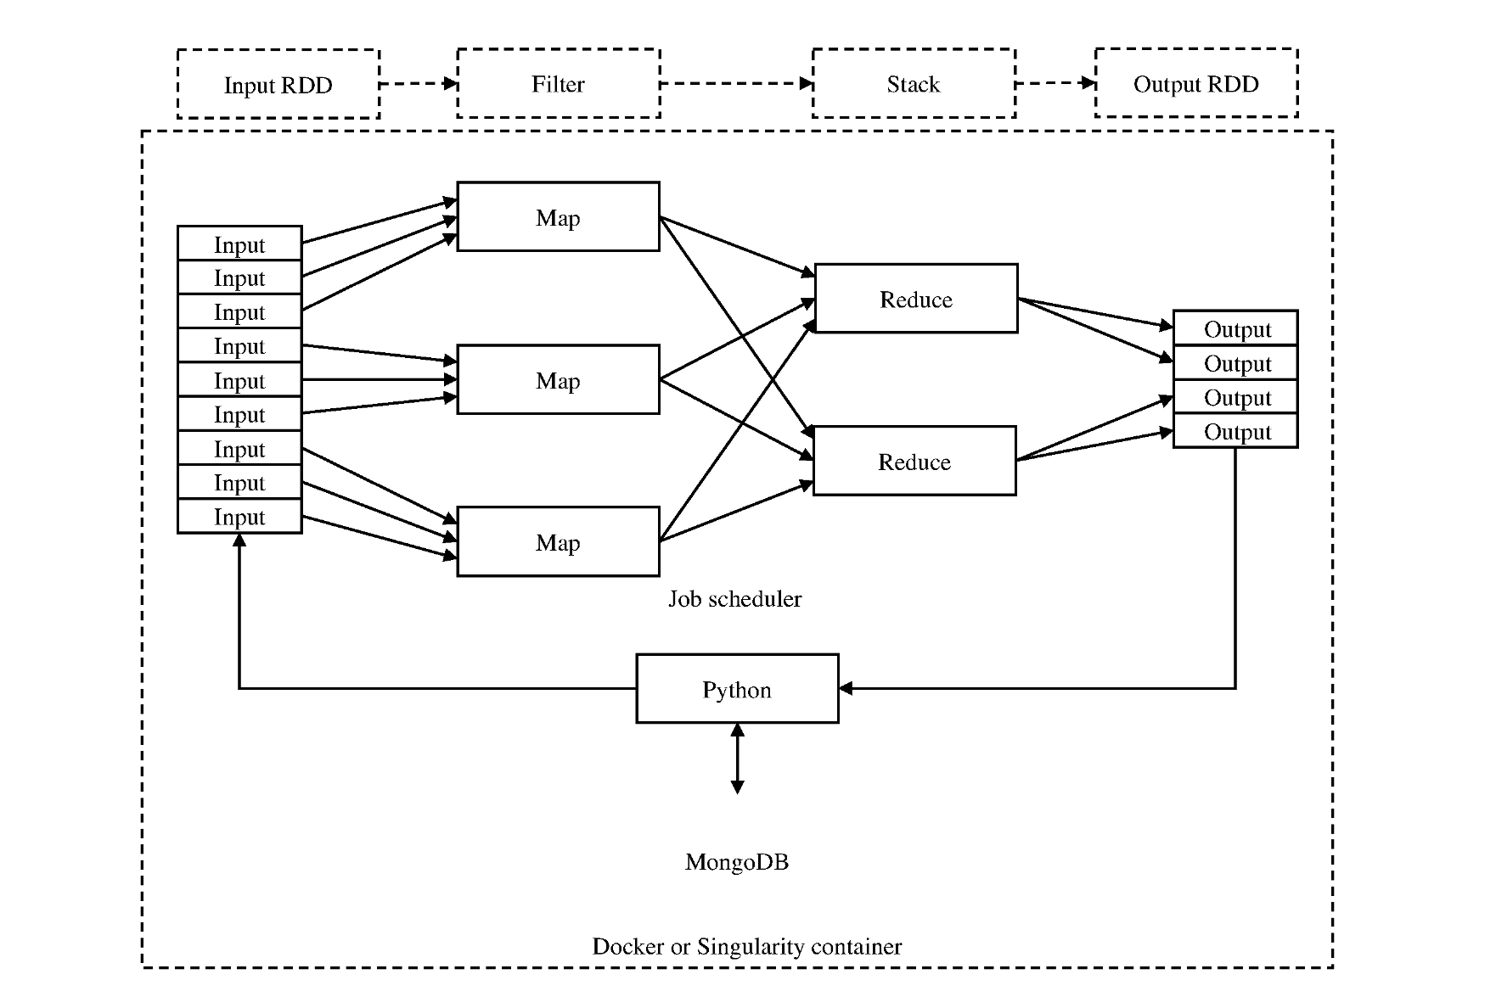
MsPASS Parallelization: map-reduce model
Key points
Map operator
Behaves like a unix filter
Scheduler assigns each datum to processes
Reduce operator
Data flow
Parallel pipeline
Conceptually similar to unix shell | symbol
Scheduler moves data
Faster for threads than nodes
From Wang and Pavlis(2021)

Slide 21
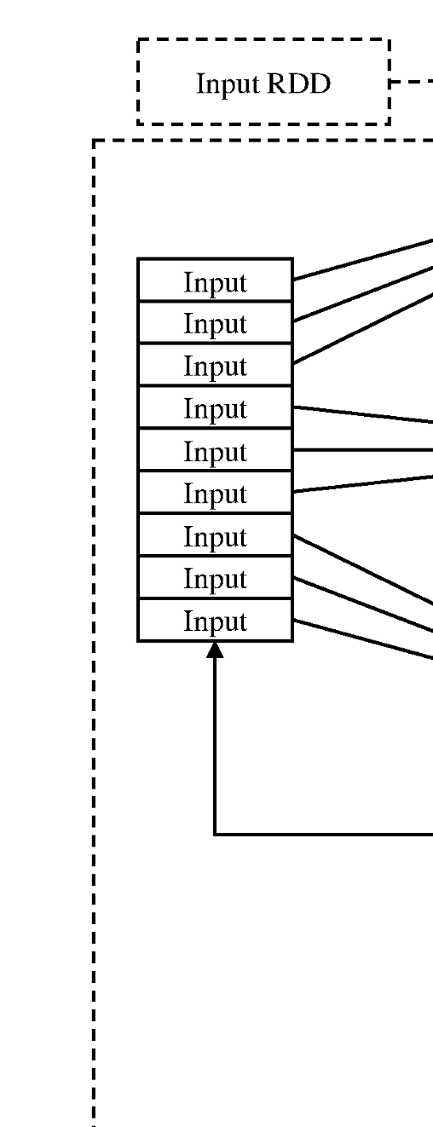
Spark RDD == Dask bag
Documentation for both Spark and Dask obscure this topic
RDD/bag concepts
Algorithmically identical to a large array of things (objects)
Workers can pull any component in equal time
The collection of things (data set) may not fit in memory
Other parallel containers
Dataframe (table)
Array (matrix bigger than memory)

Slide 22
Comparison of serial and parallel workflows
Serial
Parallel (Dask)
cursor = db.wf_Seismogram.find({})
for doc in cursor:
d = db.read_data(doc,collection=“wf_Seismogram”)
d = signals.detrend(d,’demean’)
d = signals.filter(d,”bandbass”,
freqmin=0.01,freqmax=2.0)
d = WindowData(d,200.0,500.0,t0shift=d.t0)
db.save_data(d,collection=”wf_Seismogram”,
data_tag=“results”)
cursor = db.wf_Seismogram.find({})
data = read_distributed_data(db, cursor)
data = data.map(signals.detrend,'demean')
data = data.map(signals.filter,"bandpass", freqmin=0.01, freqmax=2.0)
# windowing is relative to start time. 300 s window starting at d.t0+200
data = data.map(lambda d : WindowData(d, 200.0, 500.0, t0shift=d.t0))
res = data.map(db.save_data,
collection="wf_Seismogram”,data_tag=“results”)
data_out = data.compute()
Key point: loop processing easily translated to series of map operators
Result acts like: detrend < datafile | filter > outfile

