Slide 5
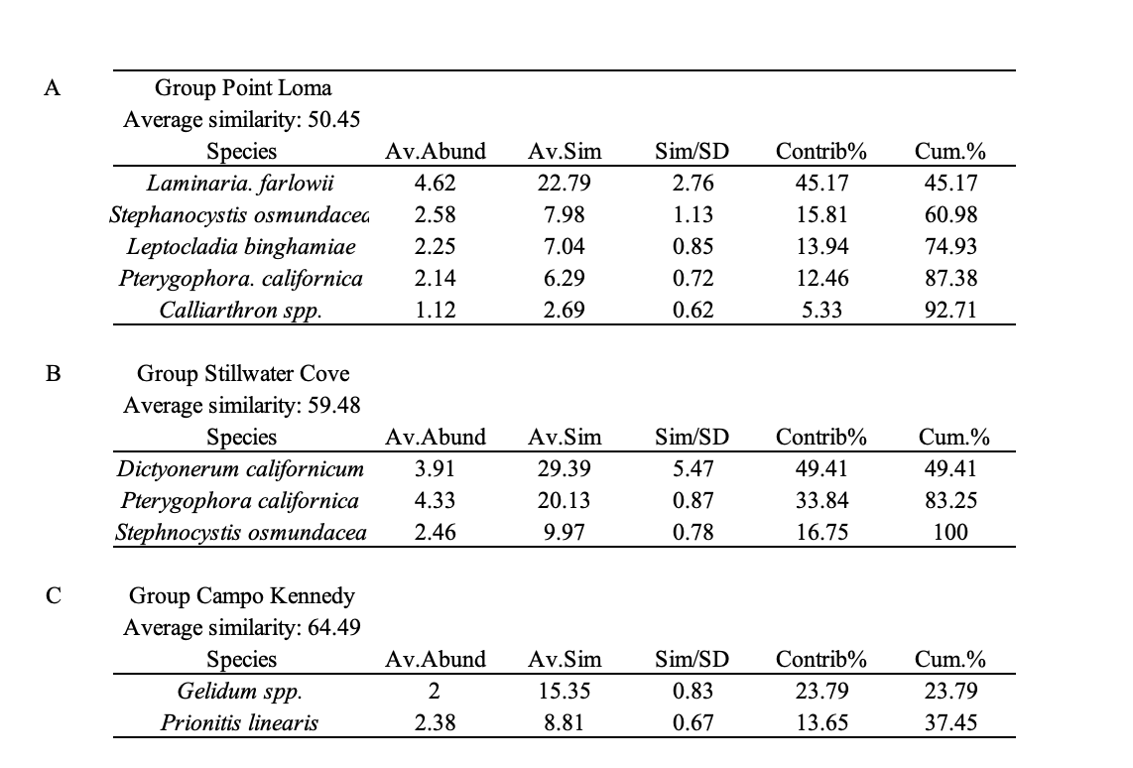

Slide 6
Table 5. Two three-way Model I PERMANOVAs examining differences in estimates of (A) net daytime production and (B) nighttime respiration for the habitats among study sites, dates, and between forested and deforested habitats. Data are based changes in dissolved oxygen (DO) as measured by three PME MiniDOTs® placed within each habitat type at site and at each date. Net daytime production was determined as the hourly changes in DO integrated over a 24-hour period, nighttime respiration was based on nighttime decreases in seawater DO over the same period.

Slide 7
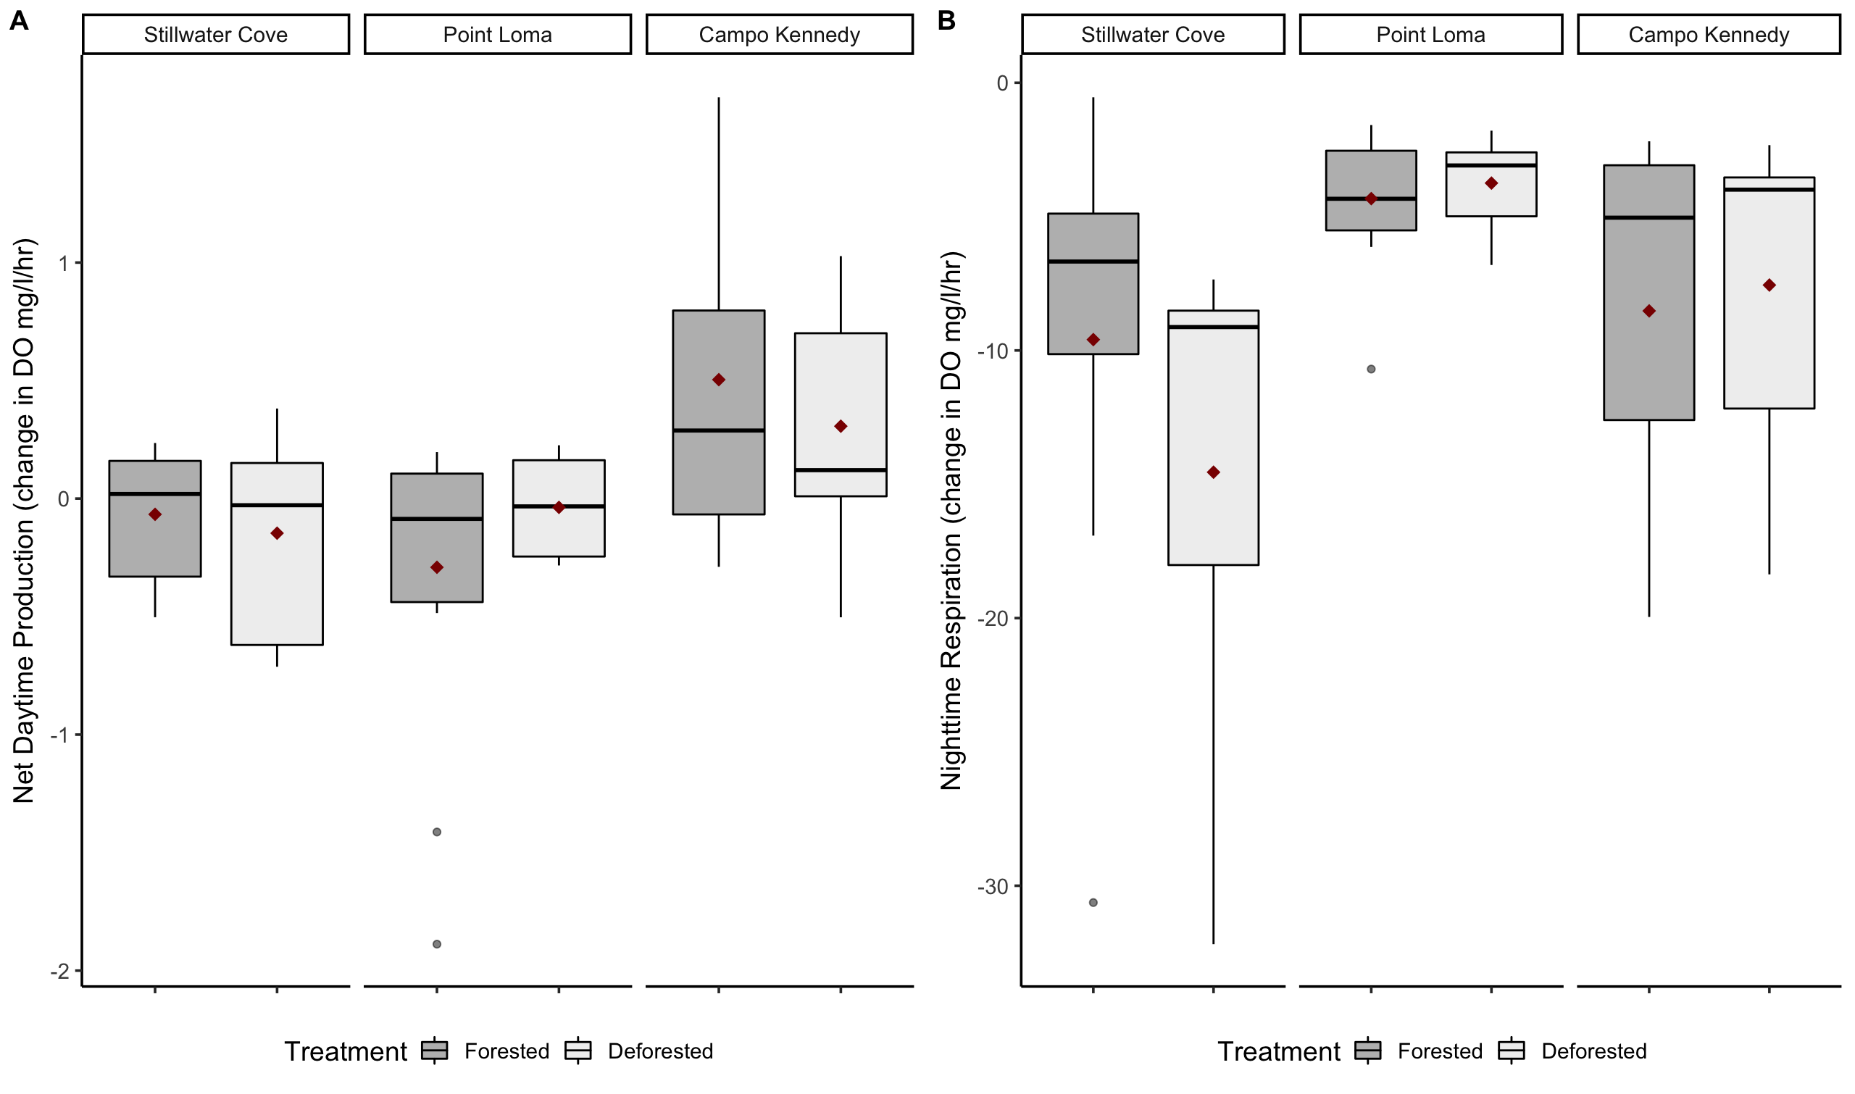
Figure 5: Field-based estimates of (A) net daytime production and (B) nighttime respiration in forested and deforested habitats at each site during 2017 and 2018. Units are given in the change in DO/mg/l/m². Estimates of production were based on hourly changes in seawater DO as measured by MiniDOT® DO sensors placed within each habitat type at each site (n = 3 per habitat per site). Black bars indicate the median, red diamonds indicate the mean.

