Slide 1
System Architecture Overview
Perspective: Validation
(gameplay.intel.com)
Mike Speer

Slide 2
Business Objective
Enable gaming community to make purchase decisions based on 2 use case scenarios:
What game titles can my existing hardware* run for a selected user experience?
What hardware* is needed to support a specific game title?
*Hardware is defined as the combination of processor sku and associated embedded graphics controller for specific platform

Slide 3
Strategy
Utilize efforts and data from existing game testing labs for analysis
Design new web service front end to support presentation and interaction from gaming community
Provide client side software component to identify hardware platform (cpu + embedded graphics)
Long term minimal staffing requirements to support continuous effort by non-technical team

Slide 4
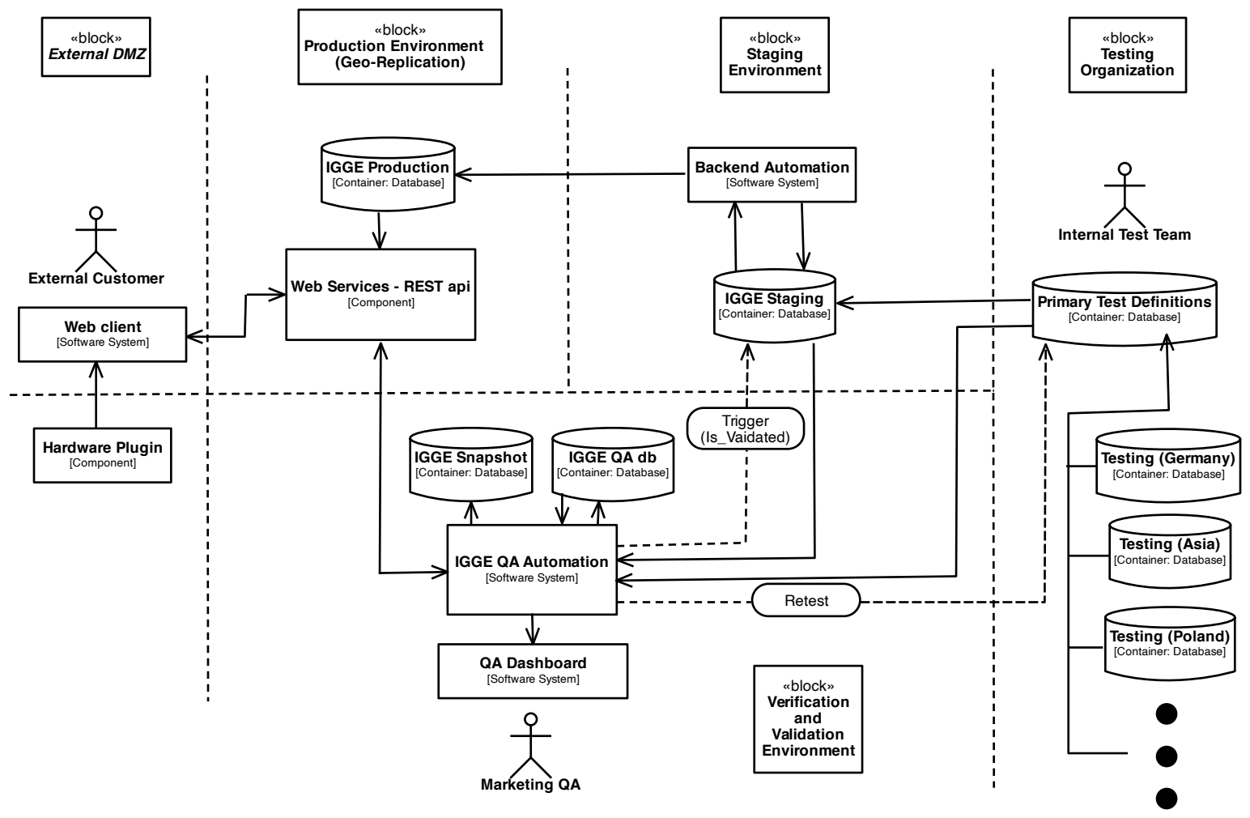
Generalized Architect Overview

Slide 5
Verification and Validation Environment
Design Criteria
Process to be manageable with low impact by non-developer with maximum automation
Act as gatekeeper to automated weekly push of data to public interface
100% test coverage
Record of visual verification and approval of collateral
Maintain history (snapshots) of external web interface

Slide 6
V&V Implementation Details
Initial prototype constructed in python with wxpython gui
Bare metal capability to automatically generate supporting databases for Dev/Test/Prod env’s with configuration files
Automated scheduling to simplify identification of outstanding QA tasks and tracking of regression testing items.
Multi-view dashboard (Grid/list)
One button push to prod
Final implementation ported to C# for production

Slide 7
Sample Code from Prototype
IGGEQAgui.py (render dashboard gui and map functions)
traverse_GSWSResults.py (scan test lab db for changes and compare to validation db)
ss_functions.py (various functions associated with snapshot process of production environment)
be_functions.py (various functions to support backend ops)
create_IGGEBEdb.py (starting point for bare-metal install of db)
thumbnailGrid.py (QA dashboard grid display of game thumbnail images)

