Slide 1

Michael Spiegel
University of Virginia
Department of Computer Science
April 18, 2011
Notes:
Advisor Paul Reynolds. Committee Chair Andrew Grimshaw. Committee members abhi shelat, Steve Boker, Doug Lea.

Slide 2
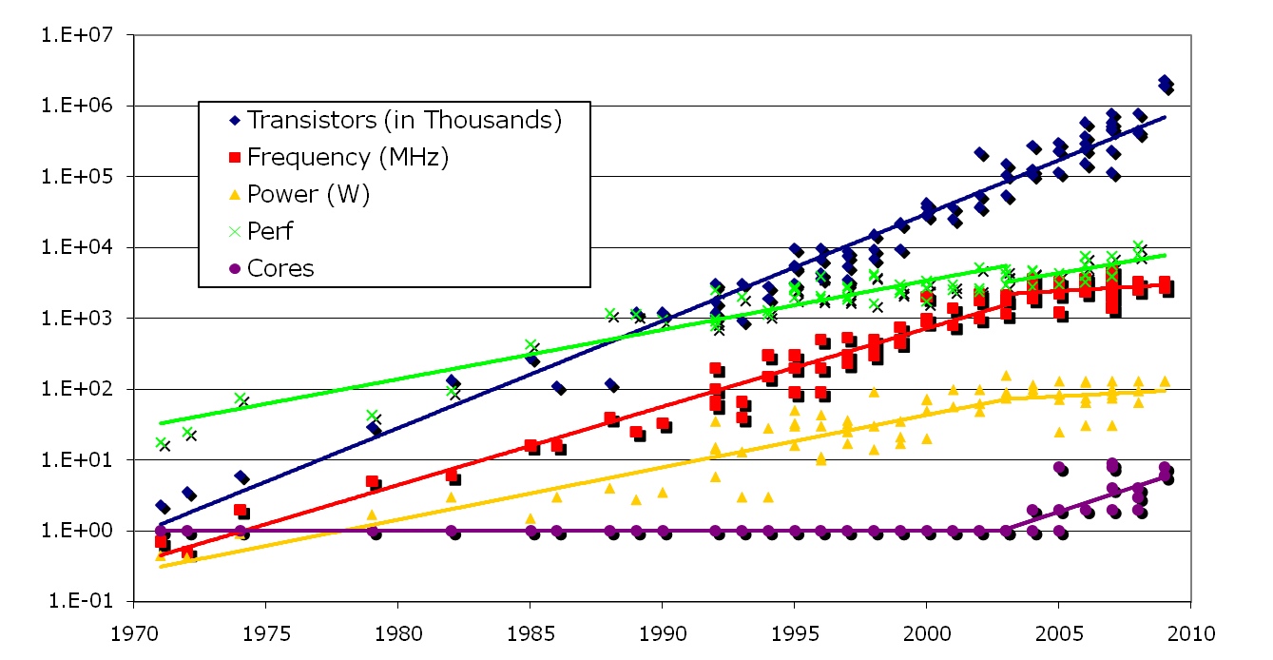
Motivation
Data from Kunle Olukotun, Lance Hammond, Herb Sutter, Burton Smith, Chris Batten, and Krste Asanoviç. Courtesy of Kathy Yelick (ISCA ’09 – Ten Ways to Waste a Parallel Computer).
Apr. 18, 2011
Notes:
10 seconds on this slide!

Slide 3
Thesis
Cache-conscious concurrent data structures for many-core systems will show significant performance improvements over the state of the art in concurrent data structure designs for those applications that must contend with the memory wall.
Apr. 18, 2011

Slide 4
Data Structure Properties
Data Structure | Lock-free | Cache-conscious | Randomized | Sorted
j.u.c. skip list | Y | N | Y | Y
Treap, Randomized search tree | N | N | Y | Y
B^{link}-tree | N | Y | N | Y
Cache-oblivious B-tree | N | N | Yª | Y
Lock-free skip tree | Y | Y | Y | Y
ª randomized cache-oblivious B-tree algorithm does not support deletions
Apr. 18, 2011
Notes:
Cache-oblivious B-tree performs at best (log2 e)(logB N) memory transfers per search operation under a 2-level memory model (44% overhead).

Slide 5
Agenda
Motivation
Thesis
Summary of results & contributions
Background & related work
Dense skip tree definition & proofs
Parallel branch & bound applications
Synthetic branch & bound application
Shared-memory supercomputer benchmarks
Future work
Apr. 18, 2011

Slide 6
Contributions
Novel cache-conscious lock-free algorithms that implement an ordered set abstract data type.
Prove cache-conscious structure of lock-free skip tree.
Lock-free skip tree up to x2.3 faster in some workloads compared to lock-free skip list with only a 13% maximum penalty across all workloads.
Set of guidelines for selecting the skip tree as a priority queue in a parallel branch-and-bound application.
Submitting lock-free skip tree to JSR-166 for Java 8.
Apr. 18, 2011

Slide 7
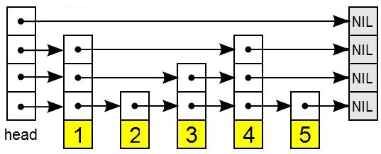
Skip List
levels
2
1
0
Pugh, William (June 1990). "Skip lists: a probabilistic alternative to balanced trees." Communications of the ACM.
Apr. 18, 2011
Notes:
A linked list with express lanes. A new node is assigned a height with a geometric distribution. The amortized cost for search, insert, and delete is O(log n). No global balancing requirements. A purely-functional skip list has amortized cost O(n).

Slide 8
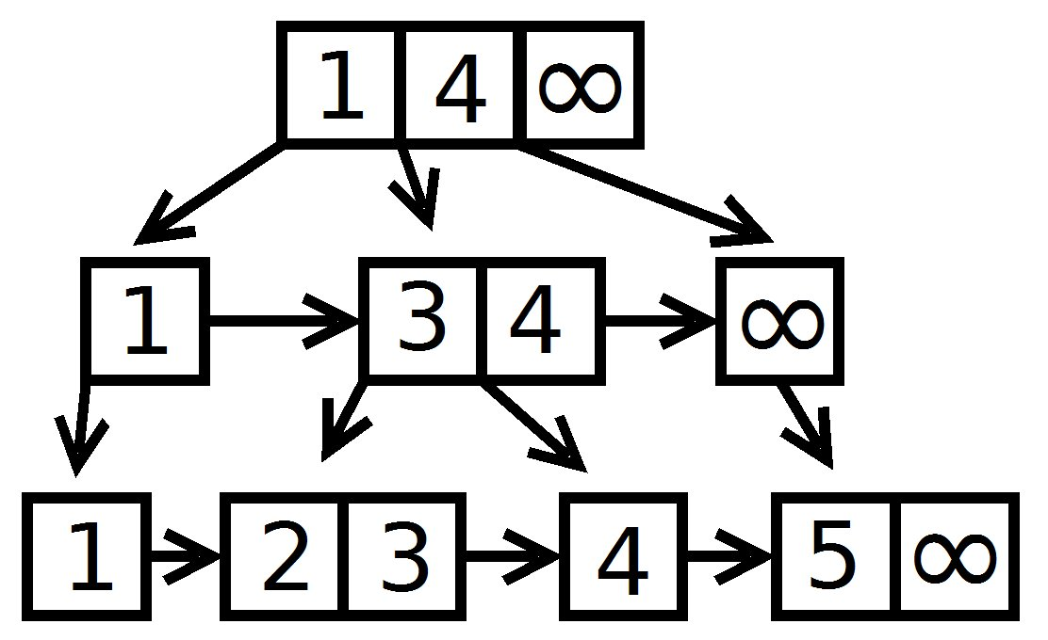
Dense Skip Tree
levels
2
1
0
Apr. 18, 2011

Slide 9
Contributions to Skip Tree
Introduce “link” pointers to allow nodes to split independently of their parent nodes.
Relax the requirement that non-leaf nodes behave as partitions.
Optimal paths through the tree are temporarily violated by deletion operations, and eventually restored using online node compaction.
Use empty nodes only for deletion operations.
Apr. 18, 2011

Slide 10
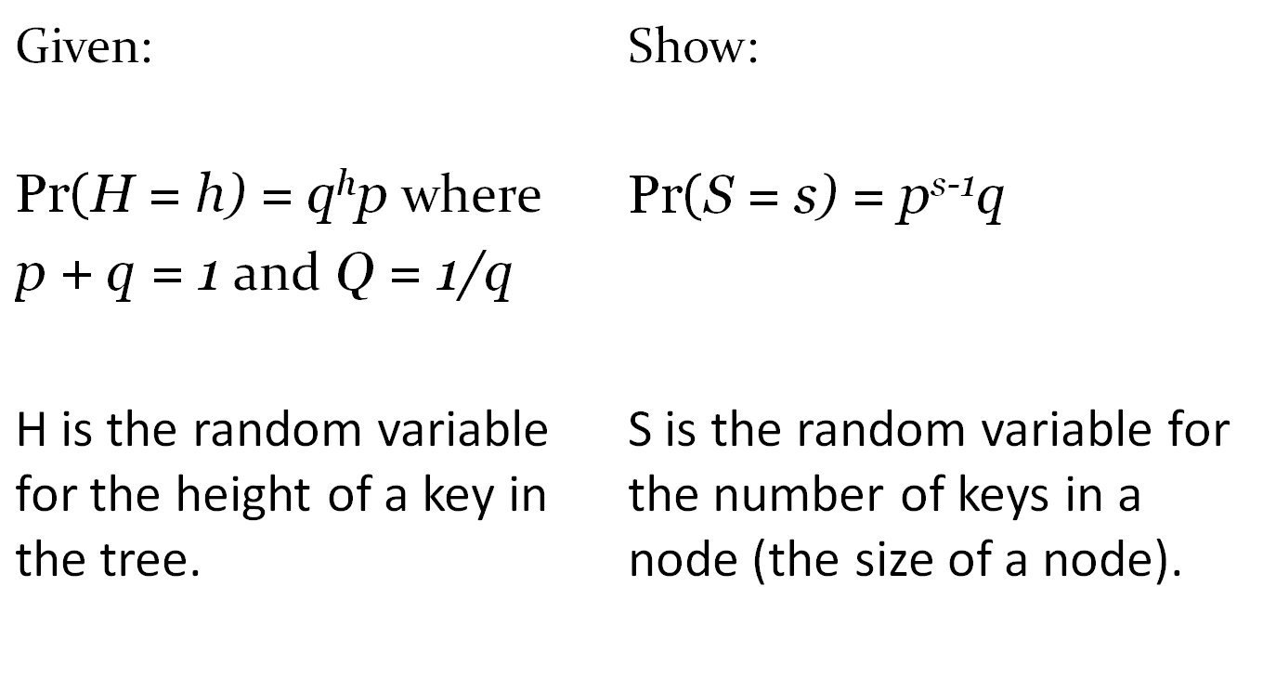
Deriving Node Size Distribution
Apr. 18, 2011
Notes:
p is the probability of success. High success probability == more keys at level 0.

Slide 11
Proof Outline
Begin with Pr(H = h) = q^{h}p.
Reduce Pr(S = s) to a one-player game:
  Player starts with score of zero.
  Let random variable X represent the final score.
  At each turn, three outcomes:
    continue the game with +1 score
    continue the game without addition to score
    terminate the game
Identify the probability generating function of X.
Identify the probability distribution of X.
Use the distribution of X to determine S.
Apr. 18, 2011

Slide 12
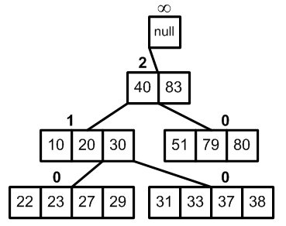
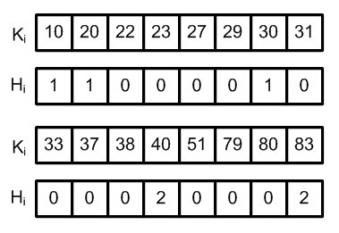
Key and Height Vectors
Apr. 18, 2011

Slide 13
Agenda
Motivation
Thesis
Summary of results & contributions
Background & related work
Dense skip tree definition & proofs
Parallel branch & bound applications
Synthetic branch & bound application
Shared-memory supercomputer benchmarks
Future work
Apr. 18, 2011

Slide 14
Evaluation Methodology
Synthetic benchmarks
  Execution consists solely of data structure operations
  Application-neutral comparison
Application benchmarks
  Measure performance in a productive context
  Difficult to compare across applications
Measures of success
  Throughput
  Scalability
  Memory footprint
Apr. 18, 2011

Slide 15
Parallel Branch & Bound (B&B)
Given a solution space X and an objective function f(X)→ℝ, find x* such that f(x*)=min{f(x) |x∊X}
branch(S)={S₁, S₂, …, S_{n}}
if lower(A)>upper(B), then A may be discarded from the search space.
Four Applications:
  15 puzzle
  Graph coloring
  Asymmetric traveling salesperson problem
  0-1 Knapsack
Apr. 18, 2011
Notes:
Breadth-first search.

Slide 16
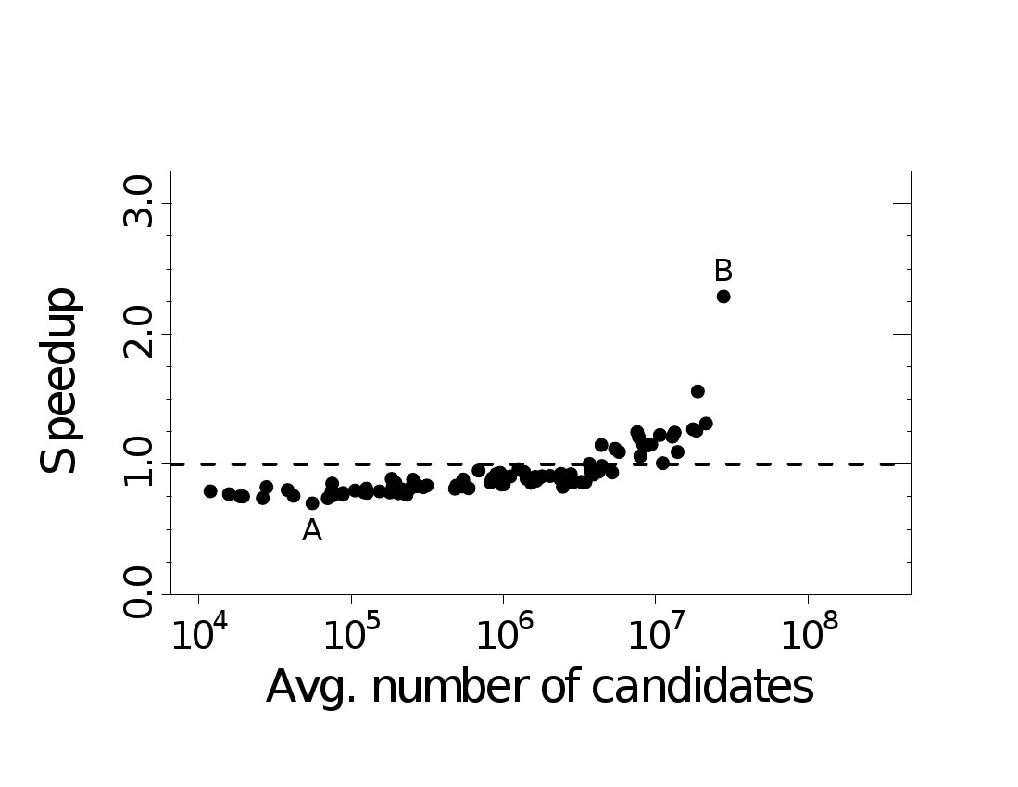
Skip Tree Performance:
15 Puzzle
Sun Fire T1000
Apr. 18, 2011

Slide 17
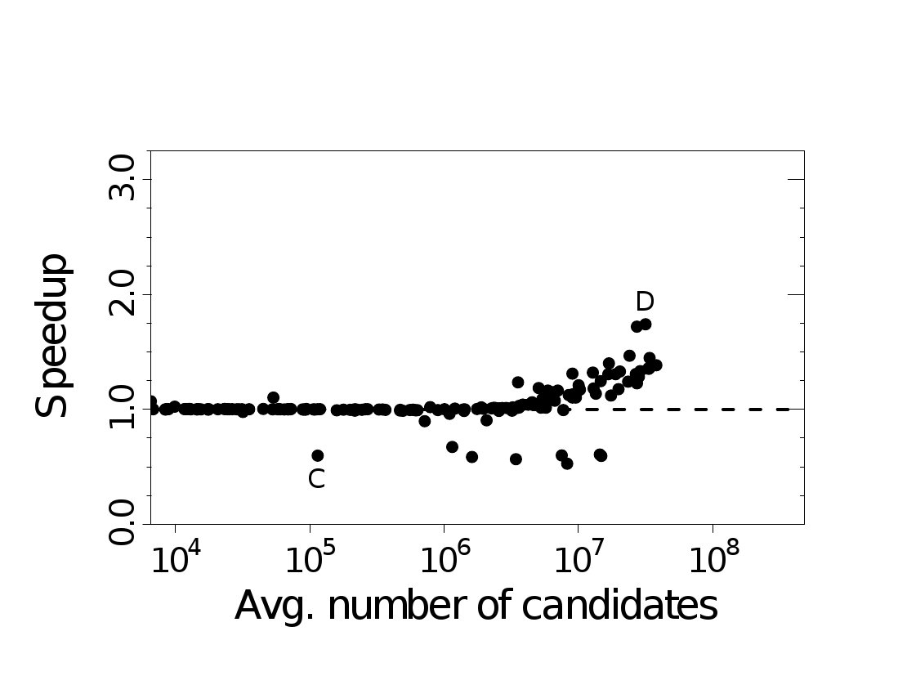
Skip Tree Performance:
Graph Coloring
Sun Fire T1000
Apr. 18, 2011

Slide 18
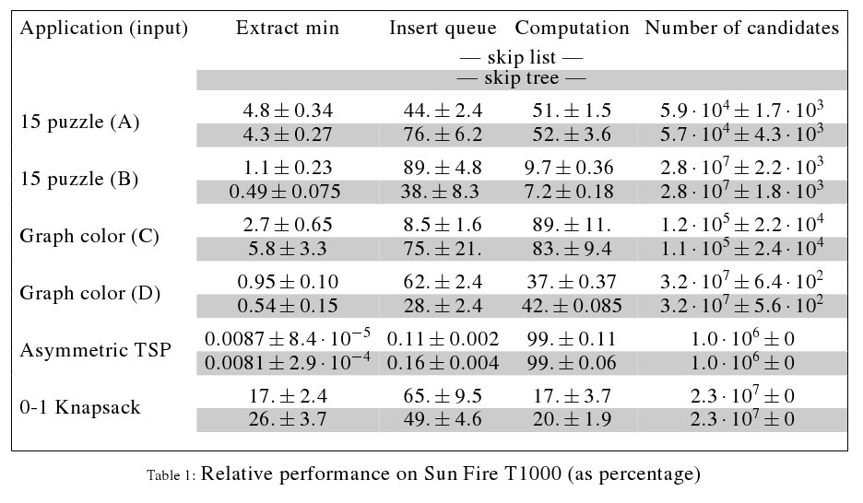
Application Phases
Apr. 18, 2011

Slide 19
Synthetic Application
Simplify a real branch & bound application to its essentials.
Ask the following questions:
  Does the distribution of lower bounds affect performance?
  Does the computation time of the lower bounds affect performance?
  Does the branching factor of the application affect performance?
Apr. 18, 2011

Slide 20
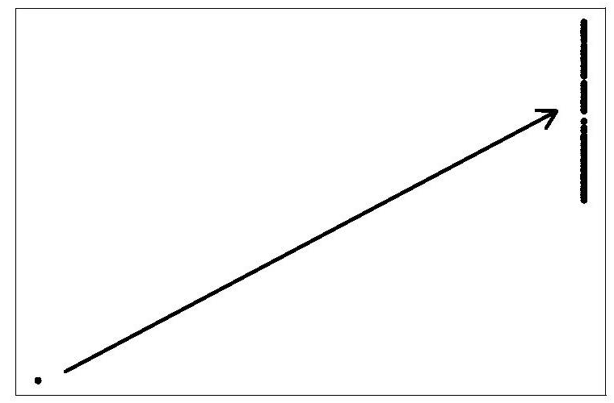
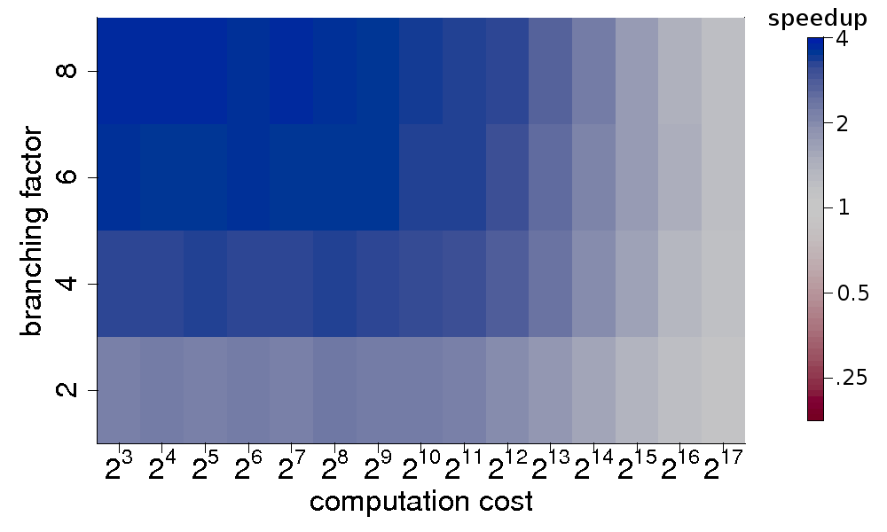
Synthetic Application I
Monotonic Distribution
Apr. 18, 2011
Notes:
Admissible heuristic. Intel Xeon results.

Slide 21
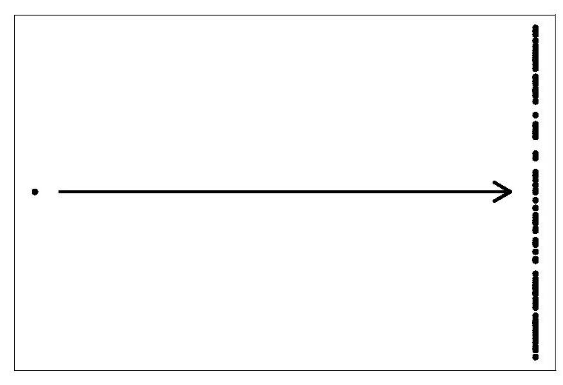
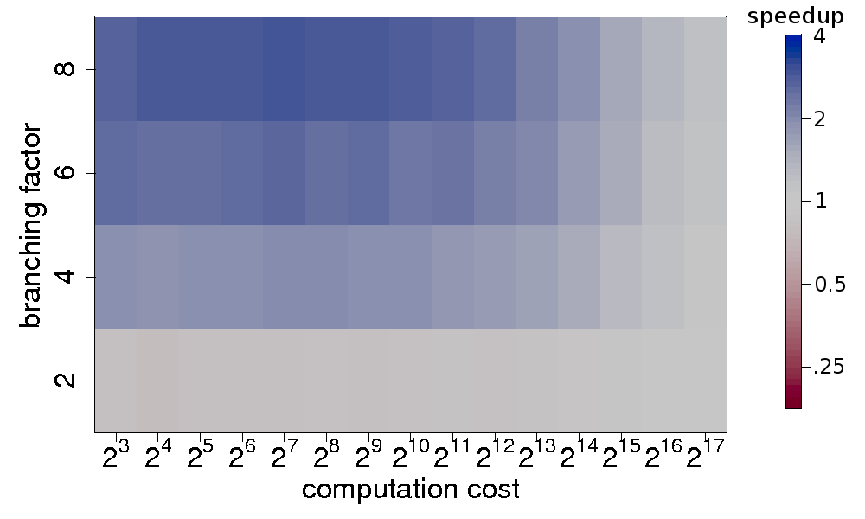
Synthetic Application II
Uniform Distribution
Apr. 18, 2011
Notes:
Intel Xeon results.

Slide 22
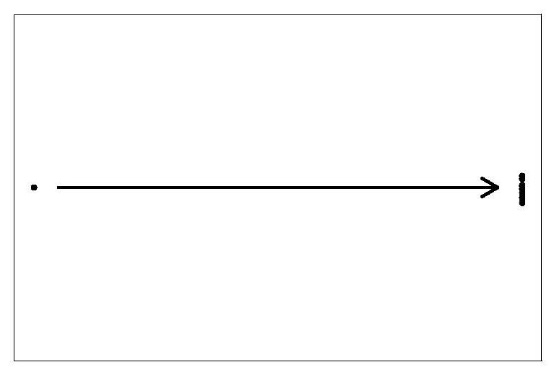
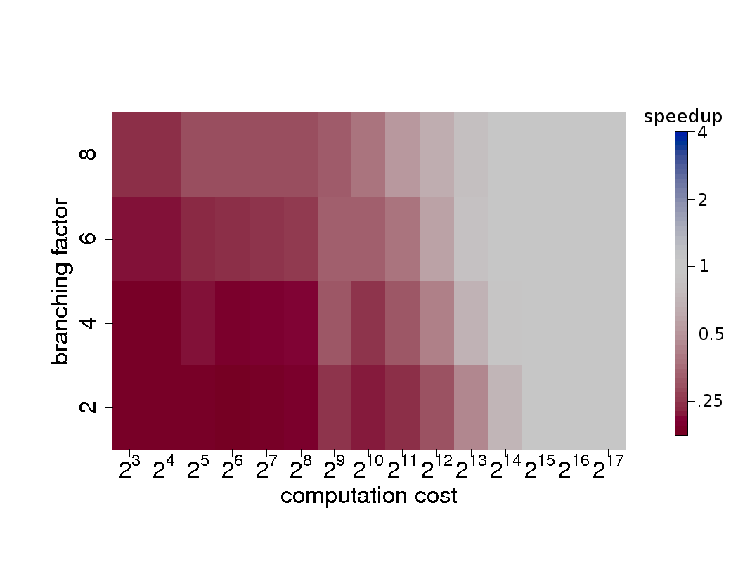
Synthetic Application III
Restricted Distribution
Apr. 18, 2011
Notes:
Sun Fire T1000 results.

Slide 23
Azul Systems Supercomputer
RISC instruction set
54 core processor
Up to 16 processors in appliance (864 cores)
Instructions added for Java object allocation & garbage collection
Custom Java VM based on OpenJDK
Uniform memory access
Pauseless GC, low latency, needs more heap
Apr. 18, 2011

Slide 24
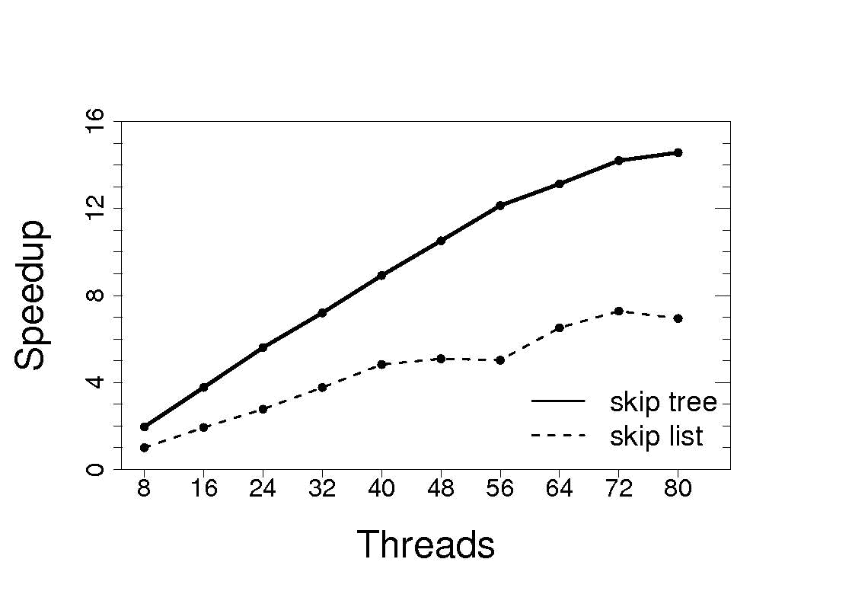
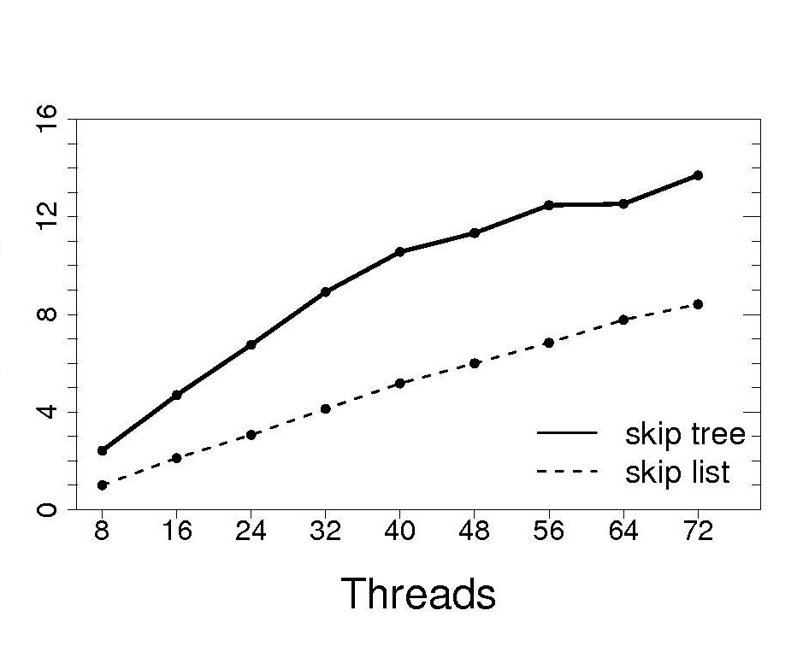
Azul Systems B&B Benchmarks
Graph Coloring
15 Puzzle
Apr. 18, 2011

Slide 25
SGI Altix UV 1000
Each blade is 2 Intel Xeon X7560 (Nehalem) 8-core processors.
256 blades (4096 processors)
16 cores on each blade share 128 GB of local memory.
Up to 16 TB of shared memory.
NUMAlink interconnect. Paired node 2D torus.
SUSE Linux Enterprise Server 11.
PBS batch scheduling. Linux cpusets interface to manage resources.
Apr. 18, 2011
Notes:
blacklight.psc.teragrid.org. Pittsburgh Supercomputing Center.

Slide 26
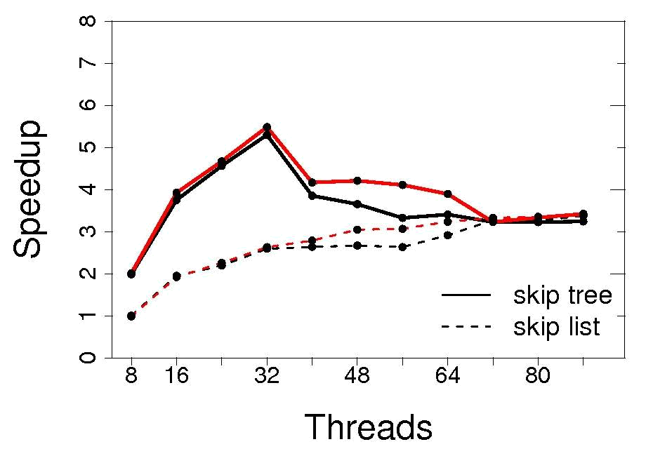
SGI Altix B&B Benchmarks
Graph Coloring
Apr. 18, 2011

Slide 27
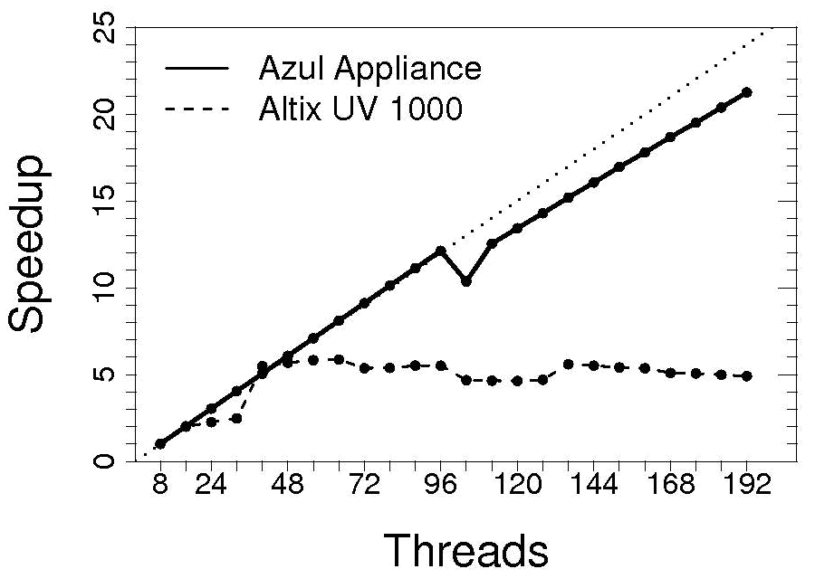
SGI Altix JVM Benchmarks
16 Queens Fork/Join Test
Apr. 18, 2011

Slide 28
Scope
Data from Kunle Olukotun, Lance Hammond, Herb Sutter, Burton Smith, Chris Batten, and Krste Asanoviç. Courtesy of Kathy Yelick (ISCA ’09 – Ten Ways to Waste a Parallel Computer).
Apr. 18, 2011
Notes:
10 seconds on this slide!

Slide 29

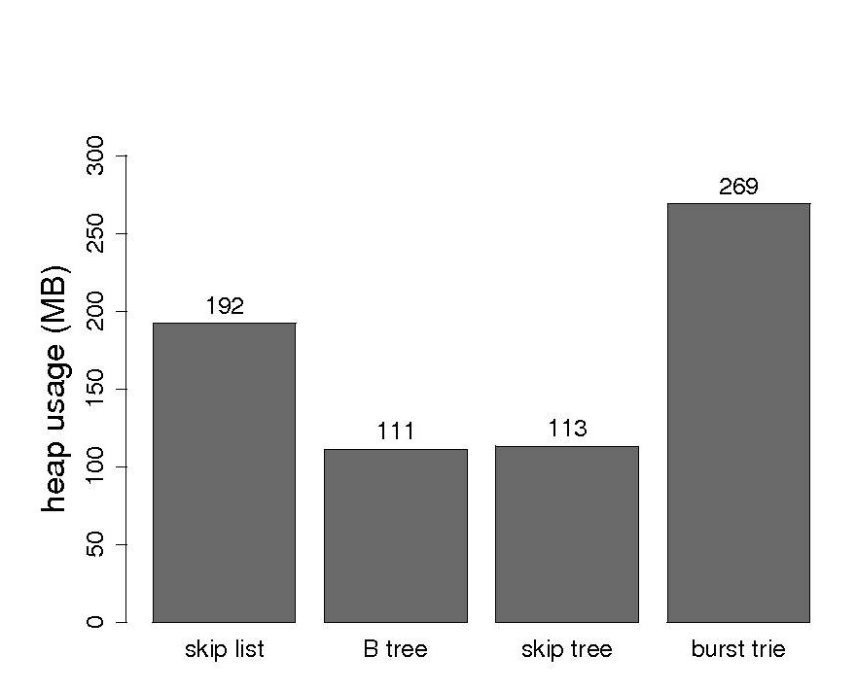
Apr. 18, 2011

Slide 30
Contributions
Novel cache-conscious lock-free algorithms that implement an ordered set abstract data type.
Prove cache-conscious structure of lock-free skip tree.
Lock-free skip tree up to x2.3 faster in some workloads compared to lock-free skip list with only a 13% maximum penalty across all workloads.
Set of guidelines for selecting the skip tree as a priority queue in a parallel branch-and-bound application versus the skip list.
Submitting lock-free skip tree to JSR-166 for Java 8.
Apr. 18, 2011

Slide 31

Future Work
Near-term:
Extend cache-conscious randomization techniques to other irregular computation patterns.
One domain: graph processing algorithms.
Post-doctoral assignment at Renaissance Computing Institute (www.renci.org).
Long-term:
Three strategies for cache aware applications — in the algorithm, in the application library, or in the runtime.
Runtime optimization is cheaper when cores are available.
(Most) runtime IR specify how to compute, instead of what to compute.
Apr. 18, 2011
Notes:
“Optimization Hinders Evolution” — Alan Perlis

Slide 32

Questions
Apr. 18, 2011

Slide 33

Apr. 18, 2011

Slide 34
Consistency Models (I)
Sequential consistency
  Enforces program order within each individual processor.
  Allows all processors to assume they are observing the same order of events.
Quiescent consistency
  Operations of any processors separated by a period of quiescence should appear to take effect in their real-time order.
Apr. 18, 2011

Slide 35
Consistency Models (II)
Linearizable consistency
  All function calls have a linearization point at some instant between their invocation and their response.
  All functions appear to occur instantly at their linearization point.
  Weakest consistency model that preserves program order among individual processes and satisfies compositionality.
Serializable consistency
  An extension of sequential consistency. The result of any execution is the same as if all transactions were executed in some sequential order.
Apr. 18, 2011

Slide 36

L1 cache reference | 0.5 ns
Branch mispredict | 5 ns
L2 cache reference | 7 ns
Mutex lock/unlock | 25 ns
Main memory reference | 100 ns
Compress 1K bytes with Zippy | 3,000 ns
Send 2K bytes over 1 Gbps network | 20,000 ns
Read 1 MB sequentially from memory | 250,000 ns
Round trip within same datacenter | 500,000 ns
Disk seek | 10,000,000 ns
Read 1 MB sequentially from disk | 20,000,000 ns
Send packet CA->Netherlands->CA | 150,000,000 ns
Source: Jeff Dean LADIS 2009 keynote
Apr. 18, 2011

Slide 37

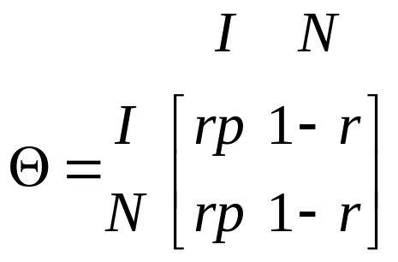
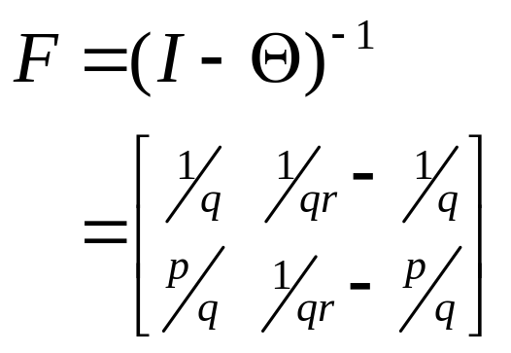
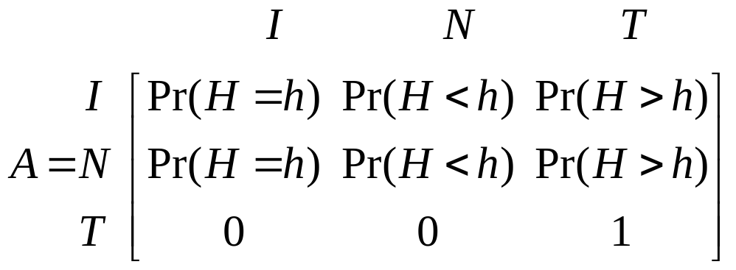
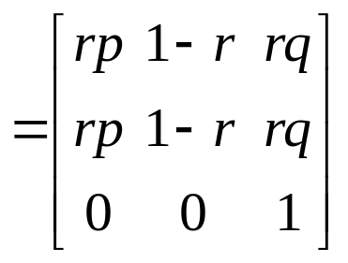

(I) Increment State:
    (H_{i}=h) and (H₀,H₁,…H_{i-1} ≤h)
(N) Neutral State:
    (H_{i} ≤h) and (H₀,H₁,…H_{i-1} ≤h)
(T) Terminating State:
    At least one of H₀,H₁,…H_{i} is > h.
Apr. 18, 2011
Notes:
Animations on this slide. Markov chain in an absorbing Markov chain. Theta is the transition matrix for the transient states. F is the fundamental matrix of the Markov chain.

Slide 38

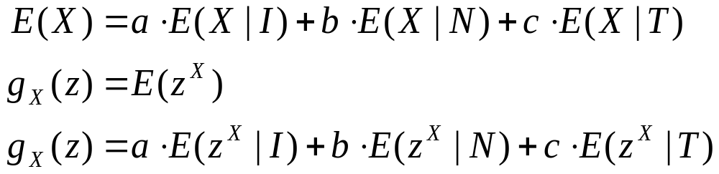
(I) The game continues with the addition of one point.
a = Pr(τ=I) = Pr(H=h) = q^{h}p
(N) The game continues without addition to the score.
    b = Pr(τ=N) = Pr(H<h) = 1-q^{h}
(T) The game terminates.
c = Pr(τ=T) = Pr(H>h) = q^{h+1}
Apr. 18, 2011
Notes:
(1) Partition theorem for Expectation. (2) Definition of generating function.

Slide 39

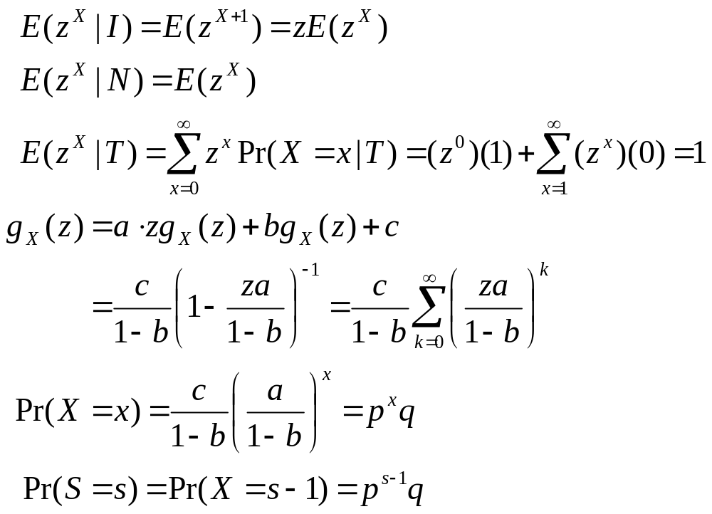
Apr. 18, 2011

Slide 40

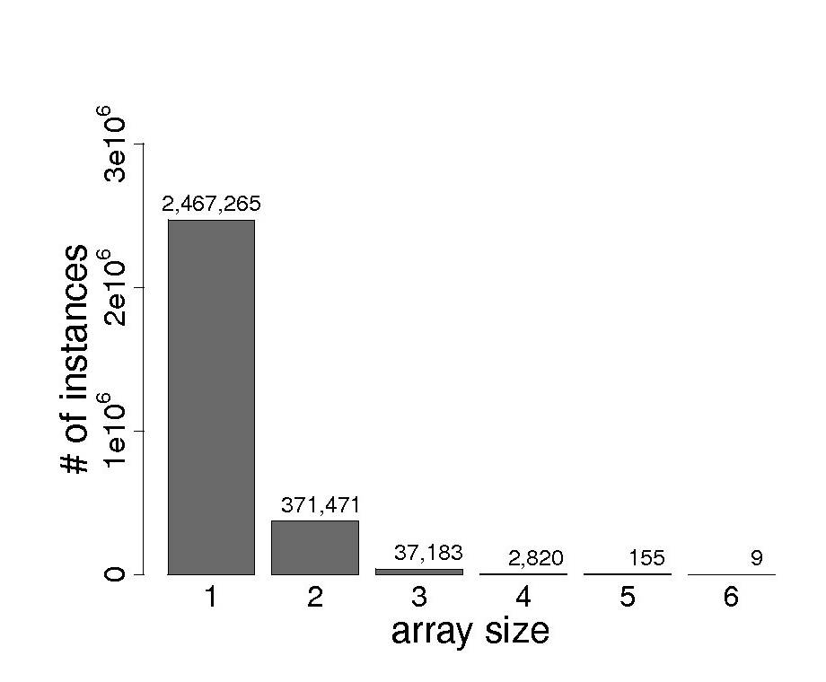
Apr. 18, 2011

Slide 41
Fixing the Runtime
HotSpot JVM on Linux is not cpuset-aware.
  5 line patch submitted to the OpenJDK project.
HotSpot NUMA garbage collection on Linux is not cpuset-aware. Requires moving to libnuma 1.2 API from older libnuma 1.1 API.
  200 line patch to the OpenJDK project.
libnuma bug in cpuset interface.
  3 line patch accepted in libnuma 2.0.6-rc4.
Apr. 18, 2011

Slide 42
Related Data Structures
Lock-free skip list in the java.util.concurrent library. Written by Doug Lea and the JCP JSR-166 Expert Group.
Optimistic relaxed-balance AVL tree [Bronson et. al., 2010].
B^{link}-tree [Lehman and Yao, 1981; Sagiv, 1985].
Apr. 18, 2011
Notes:
Synthetic benchmarks are next.

Slide 43
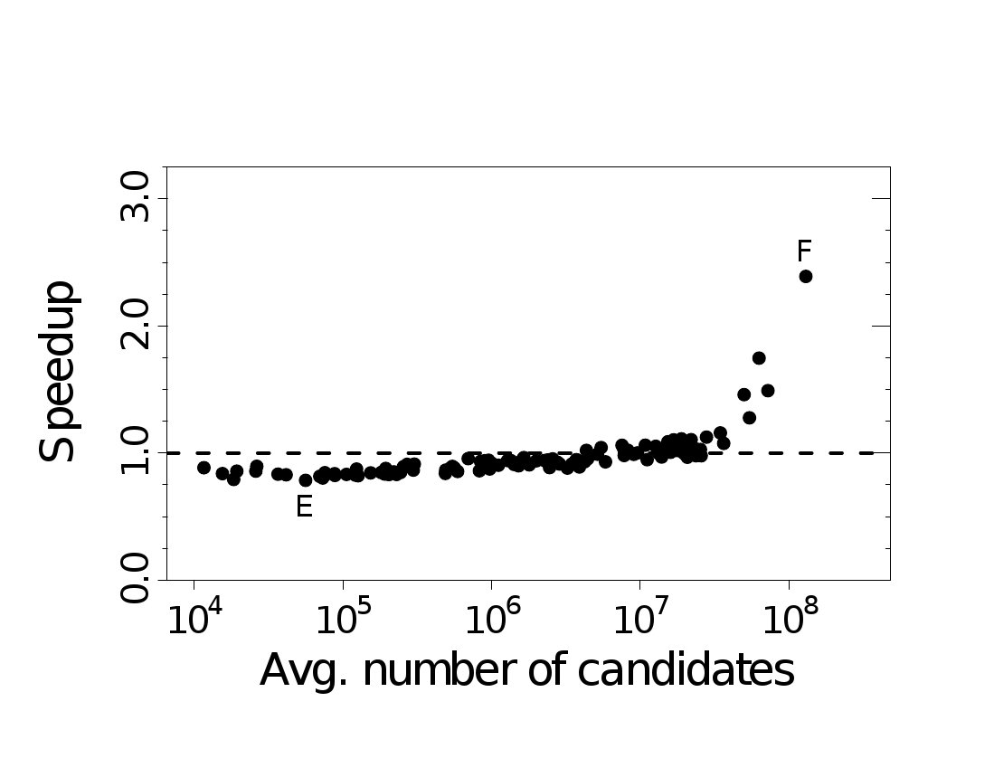
Skip Tree Performance:
15 Puzzle
Intel Quad-core Xeon
Sun Fire T1000
Apr. 18, 2011

Slide 44
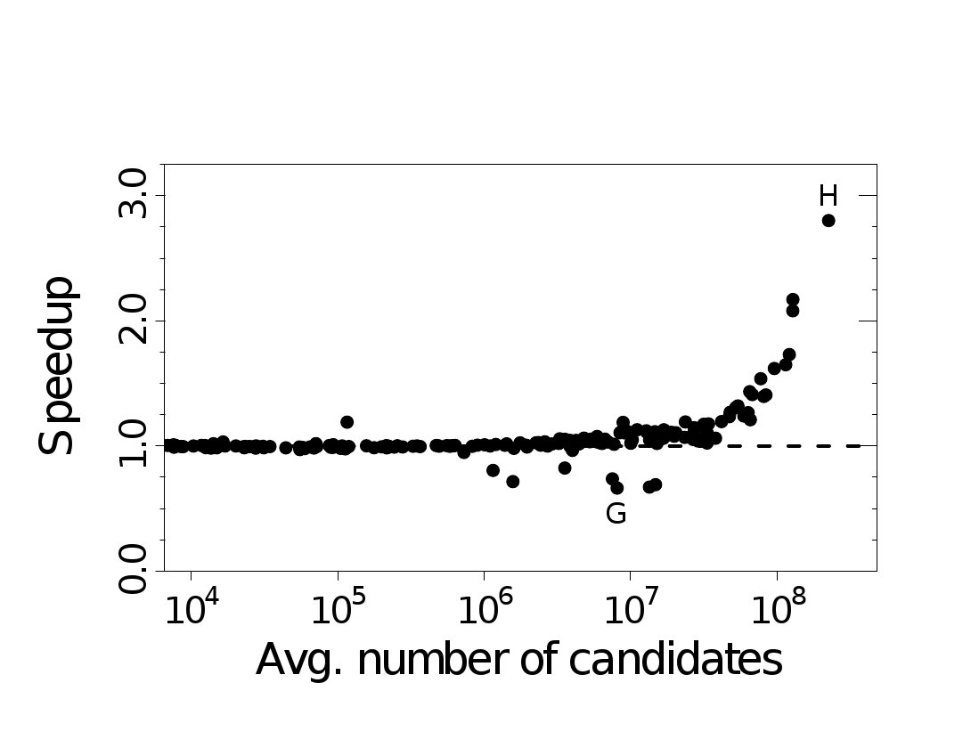
Skip Tree Performance:
Graph Coloring
Intel Quad-core Xeon
Sun Fire T1000
Apr. 18, 2011

Slide 45
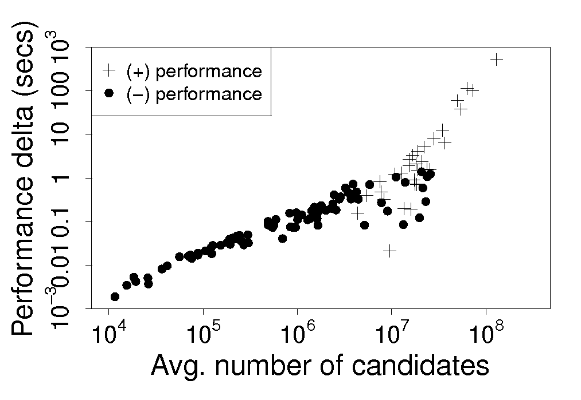
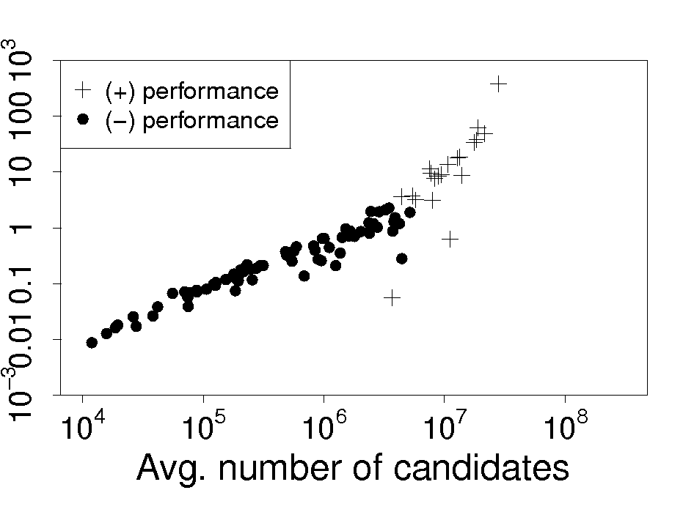
Skip Tree Absolute Speedup:
15 Puzzle
Intel Quad-core Xeon
Sun Fire T1000
Apr. 18, 2011

Slide 46
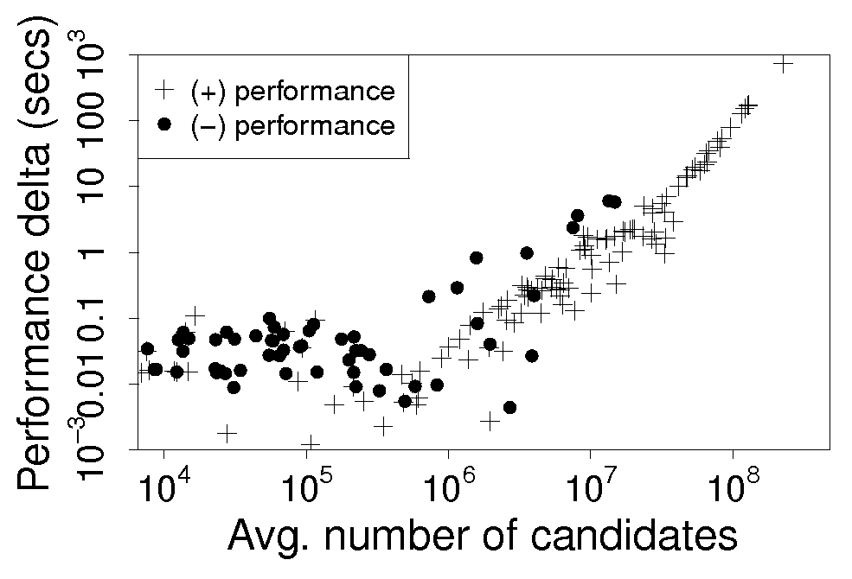
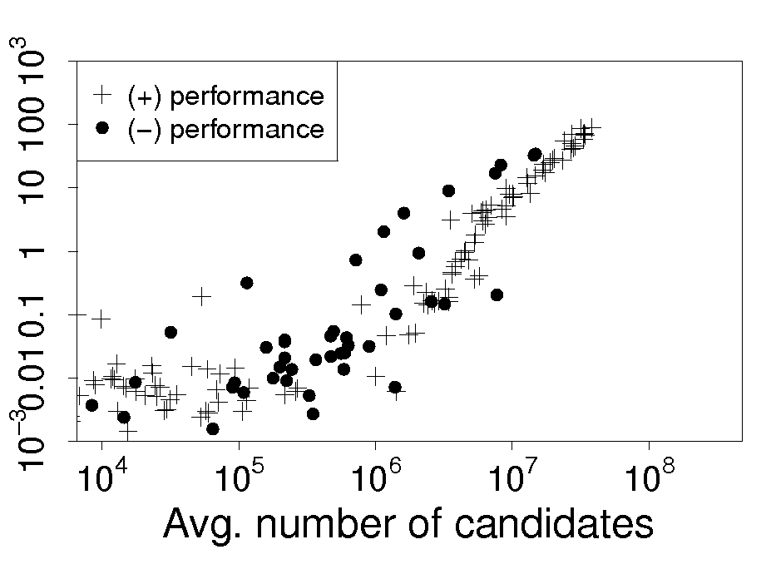
Skip Tree Absolute Speedup:
Graph Coloring
Intel Quad-core Xeon
Sun Fire T1000
Apr. 18, 2011

Slide 47
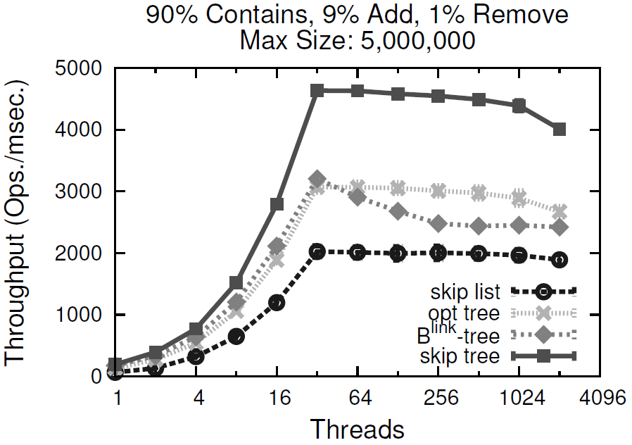
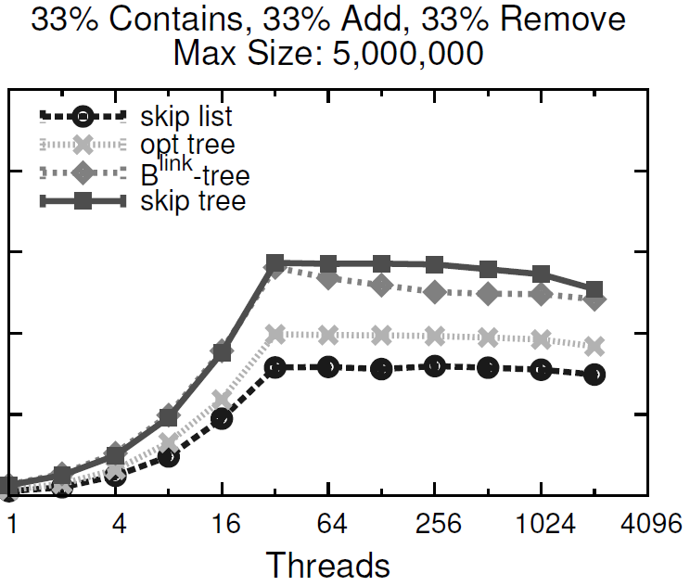
Synthetic Benchmarks - I
Apr. 18, 2011
Notes:
Sun Fire T1000 (Niagara). 8 UltraSPARC T1 cores at 1.0 GHz and 32 logical processors. The cores share a 3 MB level-2
unified cache. HotSpot JVM version 1.6.0 update 16. q = 1 / 32.

Slide 48
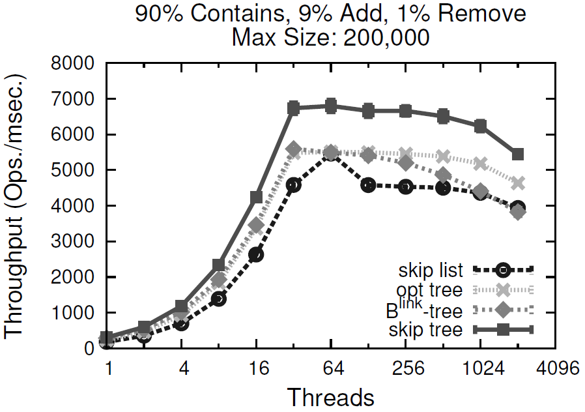
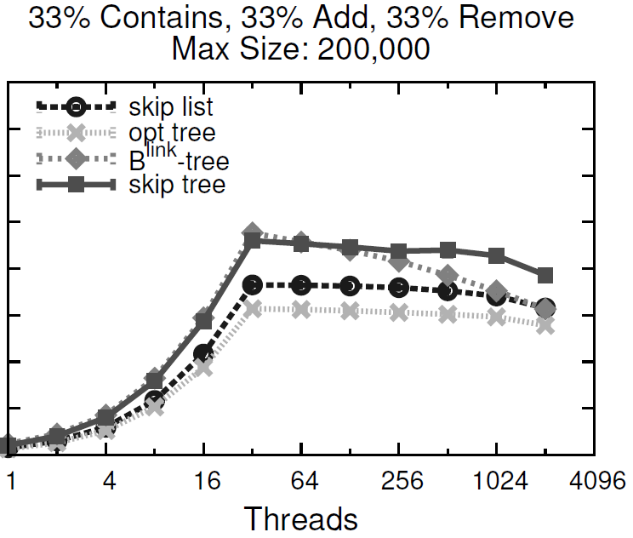
Synthetic Benchmarks - II
Apr. 18, 2011
Notes:
Sun Fire T1000 (Niagara). 8 UltraSPARC T1 cores at 1.0 GHz and 32 logical processors. The cores share a 3 MB level-2
unified cache. HotSpot JVM version 1.6.0 update 16.

Slide 49
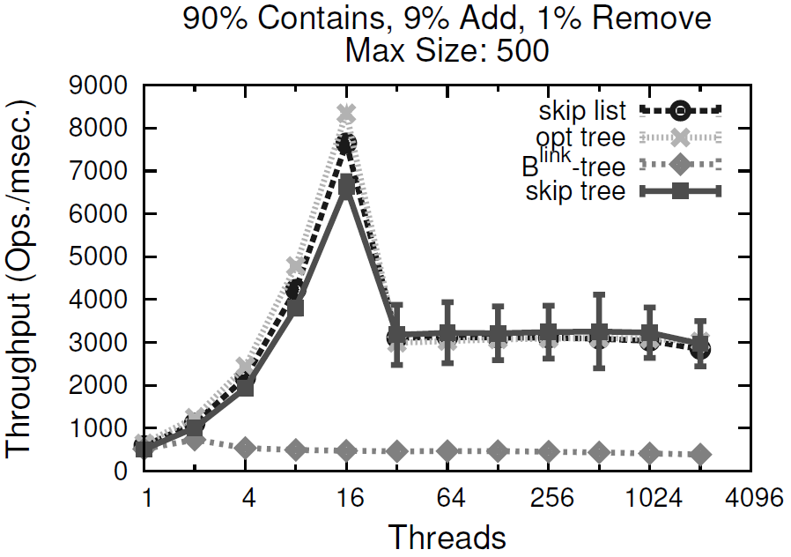
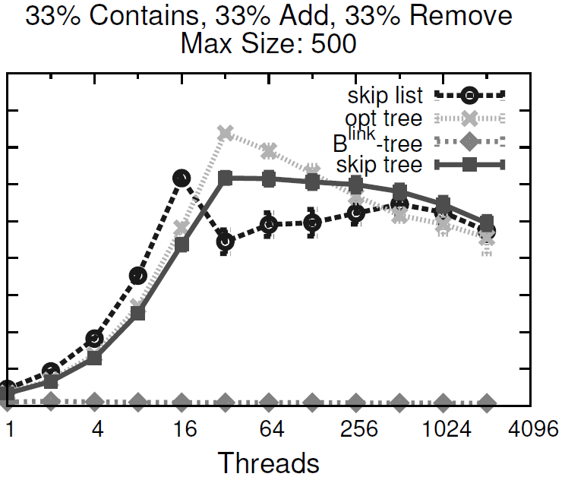
Synthetic Benchmarks - III
Apr. 18, 2011
Notes:
Sun Fire T1000 (Niagara). 8 UltraSPARC T1 cores at 1.0 GHz and 32 logical processors. The cores share a 3 MB level-2
unified cache. HotSpot JVM version 1.6.0 update 16.

Slide 50
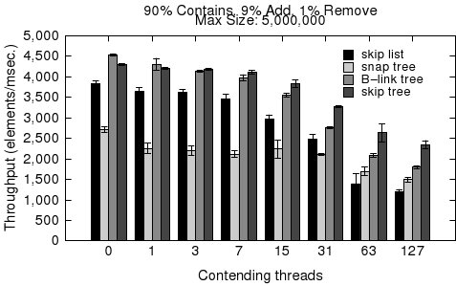
Iterators Under Contention
Apr. 18, 2011

Slide 51
Additional Desirable Properties
Data Structure | Concurrent | Cache-conscious | Randomized | Sorted
Lea skip list | Y | N | Y | Y
Treap, Randomized search tree | N | N | Y | Y
B^{link}-tree | Y | Y | N | Y
Cache-oblivious B-tree | Y | N | Yª | Y
Lea hash table | Y | closed address (N) | N | N
Purcell & Harris hash table | Y | open address (N) | N | N
Hopscotch hash | Y | open address (Y) | N | N
HAT-trie | N | Y | N | Y
Lock-free skip tree | Y | Y | Y | Y
Apr. 18, 2011
<number>/27
Notes:
Cache-oblivious B-tree performs at best (log2 e)(logB N) memory transfers per search operation under a 2-level memory model (44% overhead).

Slide 52
Lock-Free Skip Tree - I
Each level contains a sequence of elements that are in sorted order. Each level ends with +∞.
The leaf level does not contain duplicate elements.
Given some value, v, and some level, there exists exactly one pair of adjacent elements A and B such that A < v ≤ B.
Apr. 18, 2011
Notes:
Let T be the domain set. T is an ordered set. There are five rules in total. Skip two slides ahead to use skip-tree picture.

Slide 53
Lock-Free Skip Tree - II
tail(N) - The tail set of some node N consists of the union of N and the tail set of the right sibling of N.
Given some value v, let {W, X} and {Y , Z} be the elements at adjacent levels that satisfy property C. Define source as the child node of W and X, and target as the node of Z.
Require that target∊ tail(source).
Given some value, v, and some node N. If v is ≥ all the elements of N, then v will always be ≥ all the elements of N.
Apr. 18, 2011
Notes:
Skip one slide ahead to use skip-tree picture.

Slide 54
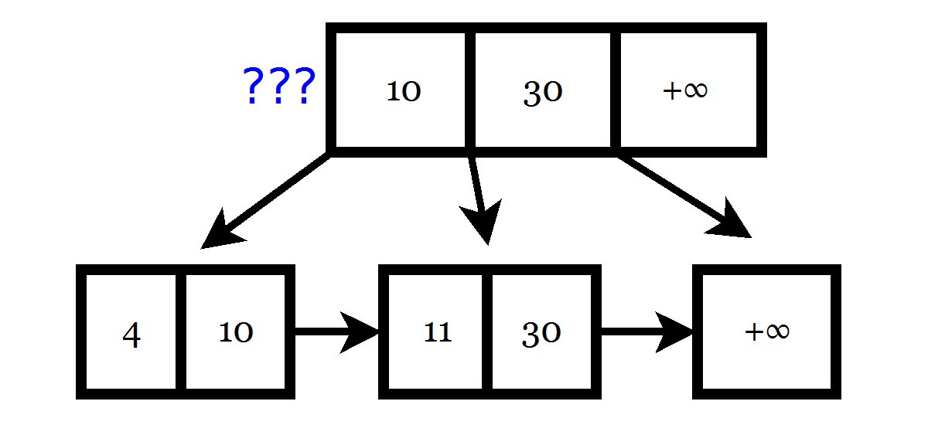
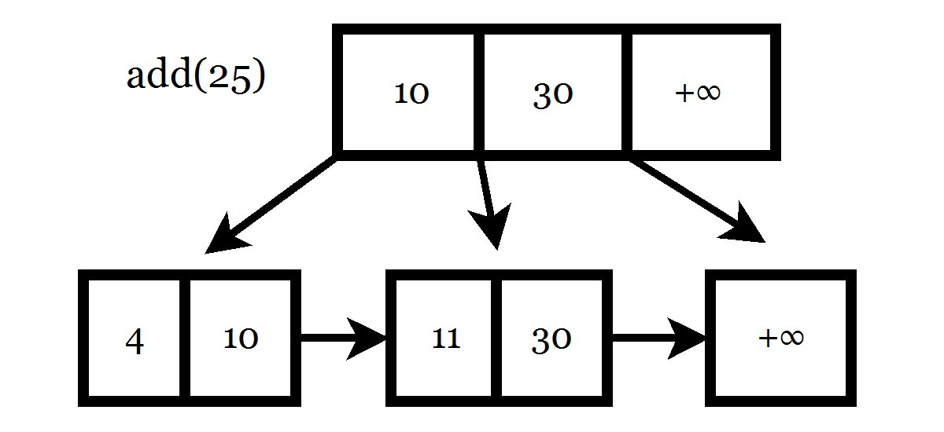
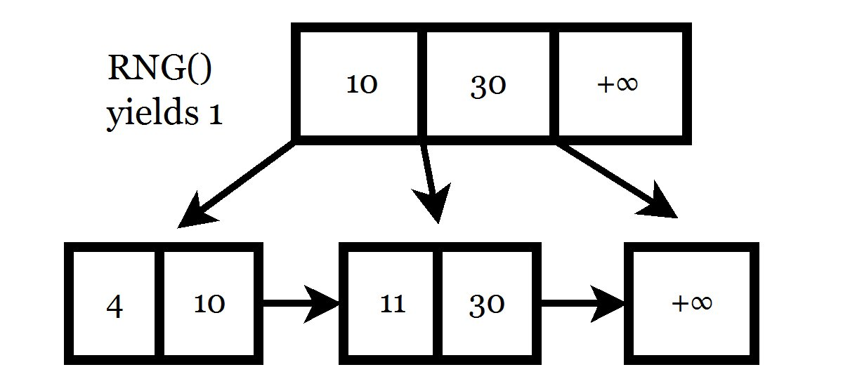
Insertion
Apr. 18, 2011
Notes:
This slide contains animations.

Slide 55
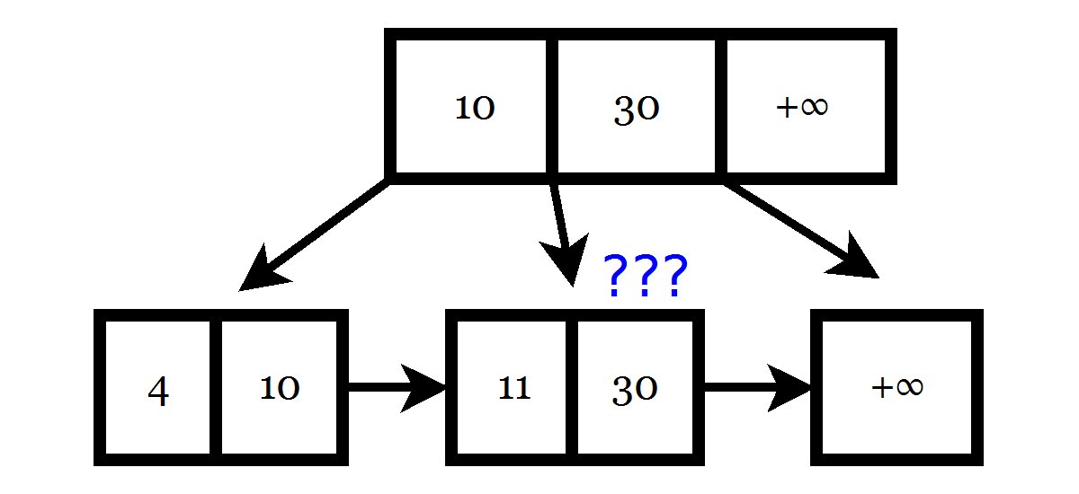
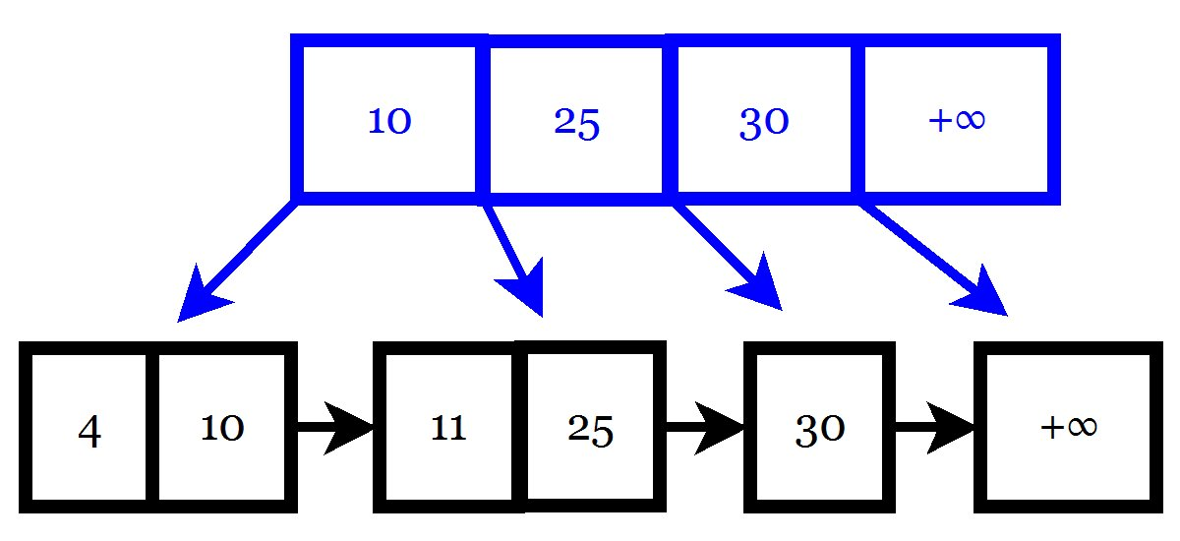
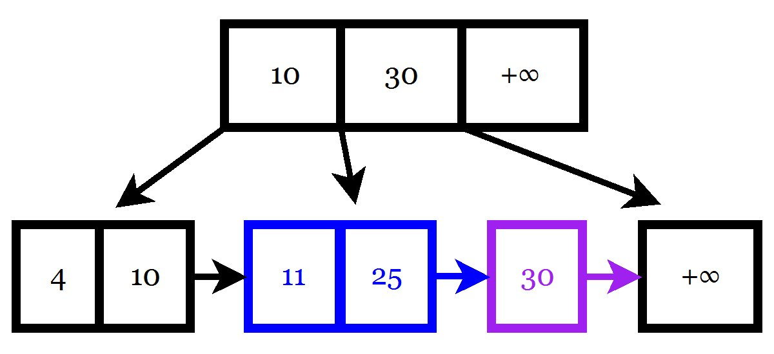
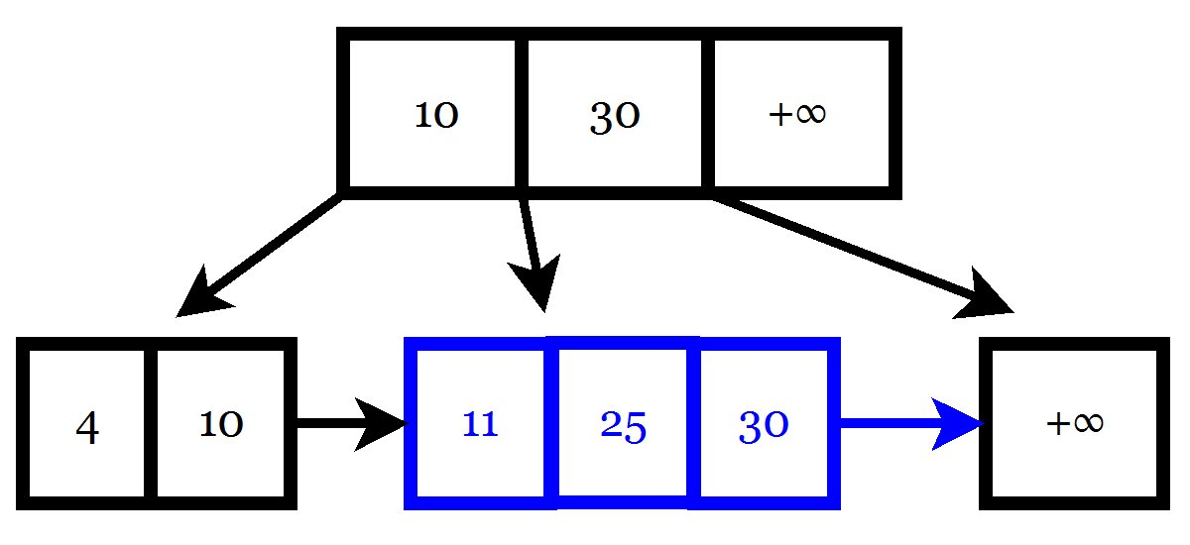
Insertion
Apr. 18, 2011
Notes:
This slide contains animations. Node deletion is next.

Slide 56
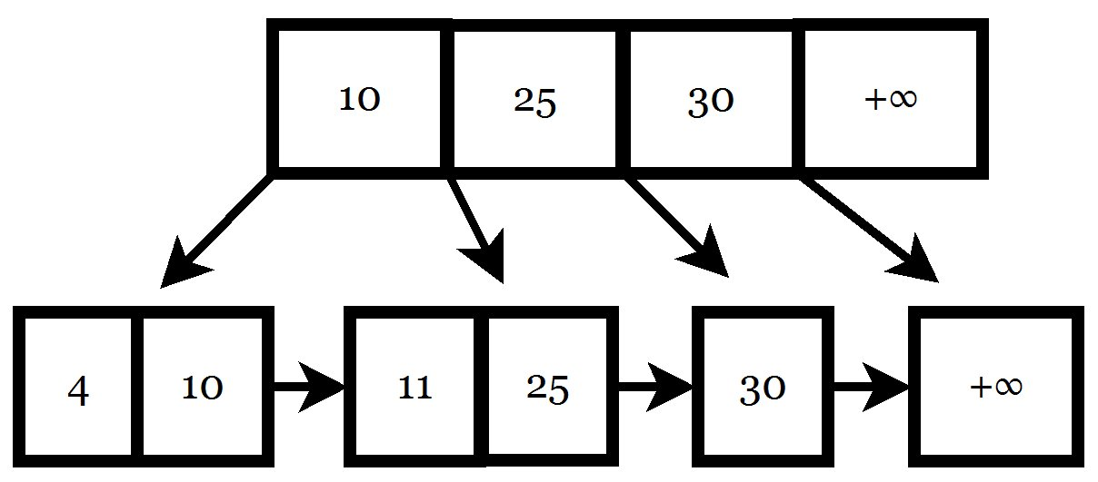
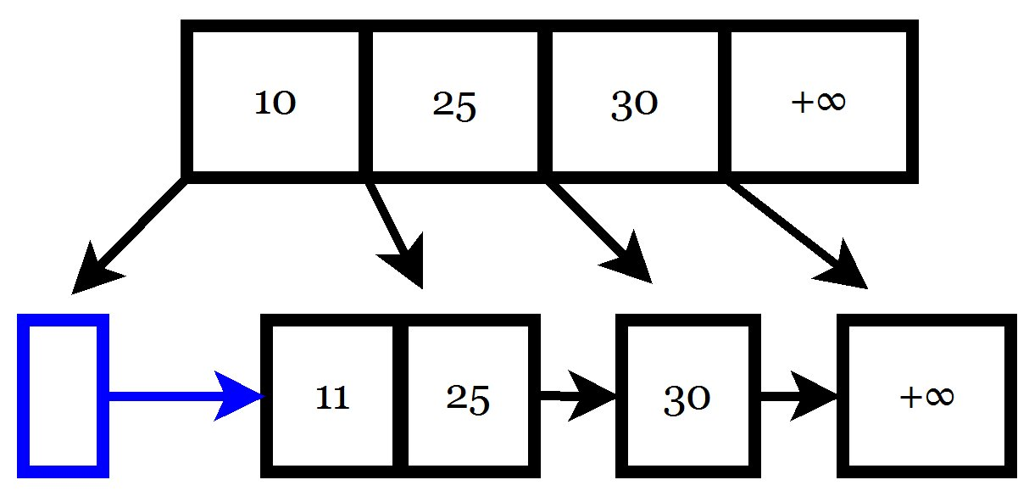
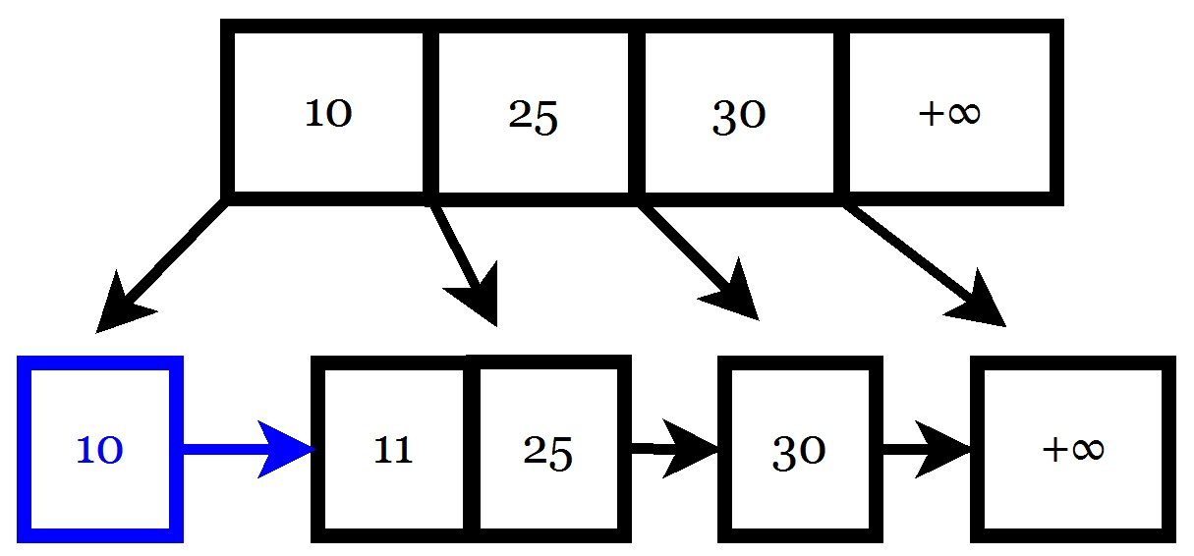
Deletion
Apr. 18, 2011
Notes:
This slide contains animations.

Slide 57



Deletion
Apr. 18, 2011
Notes:
This slide contains animations. Node compaction is next.

Slide 58





Node Compaction
Apr. 18, 2011
Notes:
This slide contains animations.

Slide 59


Node Compaction
Apr. 18, 2011
Notes:
This slide contains animations.

Slide 60


Node compaction – I & II
Apr. 18, 2011
Notes:
Empty node and Suboptimal child reference.

Slide 61


Node compaction – III & IV
Apr. 18, 2011
Notes:
Duplicate child and Element migration.

Slide 62

Lock-free Burst Trie
Apr. 18, 2011

Slide 63

Burst Trie States
Apr. 18, 2011

