Slide 1
Quantum Clinical Trial Optimization
CT.gov-scale data → scenario QUBOs → classical vs QAOA (local + AWS Braket SV1)
Goal: demonstrate quantum-ready optimization on large, public medical datasets (non-HIPAA).
Approach: build scenarios from CT.gov, encode selection as a QUBO portfolio problem, benchmark solvers.
Outputs: reproducible notebooks + artifacts (CSV/JSON) + figures + SV1 task results in S3.
Repository: quantum-clinical-trial-optimization • Deck: Executive Summary

Slide 2
Data & Pipeline (end-to-end)
Context
Ingest: ~557k CT.gov XML trial records stored in Amazon S3 (us-west-2).
Parse + extract metadata locally (concurrent extraction) into Parquet; keep small samples in Git.
Feature layer: sponsor, phase/status, cost proxy, safety proxy, feasibility/region features.
Scenarios (A/B/C): candidate pools + exports for optimization and benchmarking.
Executive Summary

Slide 3
Optimization Framing (QUBO)
Method
Decision variables: xᵢ ∈ {0,1} indicates whether trial i is selected.
Objective: benefit − λ_cost·cost − λ_safety·risk, implemented as energy minimization.
Constraints: portfolio size and rules expressed via quadratic penalties (A·terms).
Stable variable ordering enables deterministic bitstring → NCT ID decoding.
Executive Summary

Slide 4
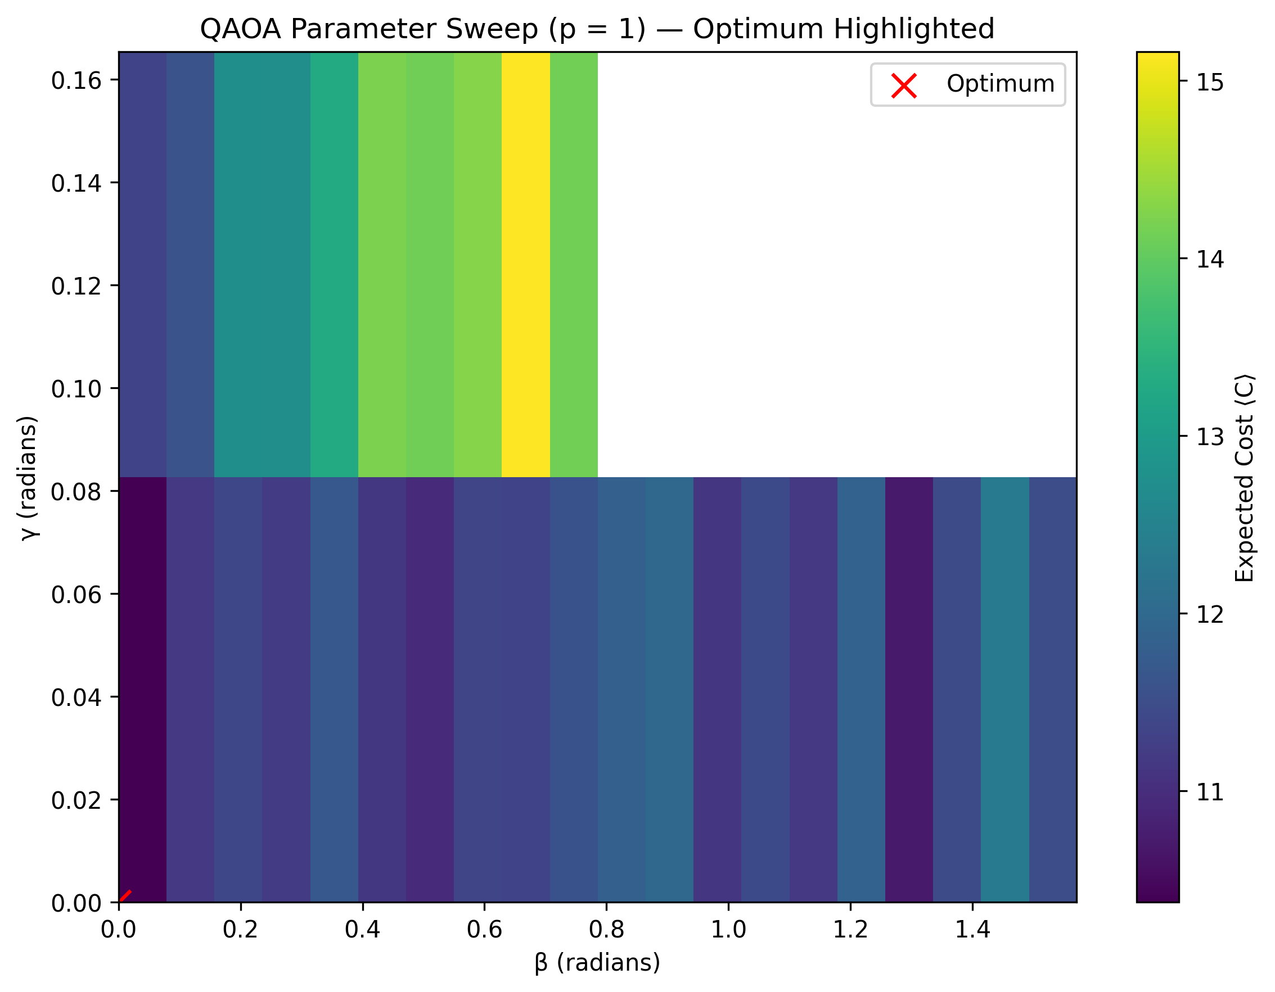
Solver Stack
Benchmark
Classical baseline: greedy / heuristic (and exact when small).
QAOA p=1 sweeps: γ/β grid search; stability via Jaccard overlap vs baseline selection.
AWS Braket SV1: cloud circuit execution; results persisted to amazon-braket-* S3 bucket.
SV1 qubit limit (34): pool-based sub-QUBO strategy for larger scenarios.
Executive Summary

Slide 5
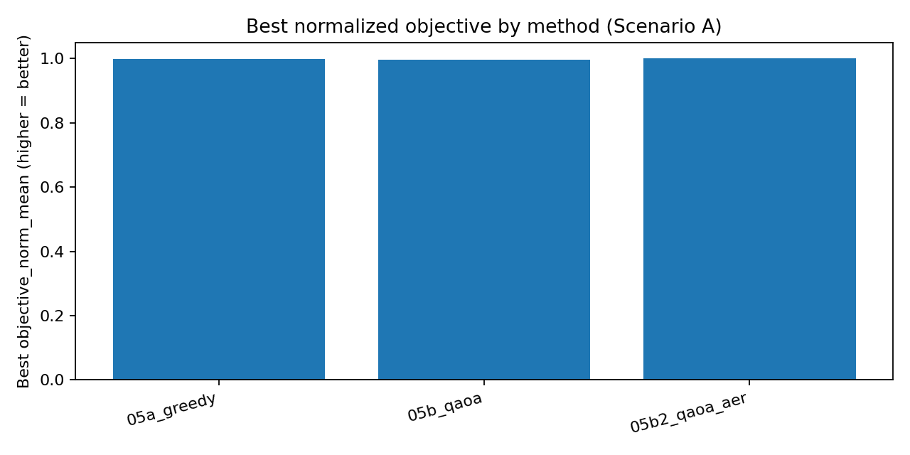
Scenario A: Robustness + Cross-Method Comparison
Results
Scenario A classical baseline selected_n=-1.
Greedy vs QAOA (sim + Aer) compared on objective quality and stability across noise/λ settings.
Executive Summary

Slide 6
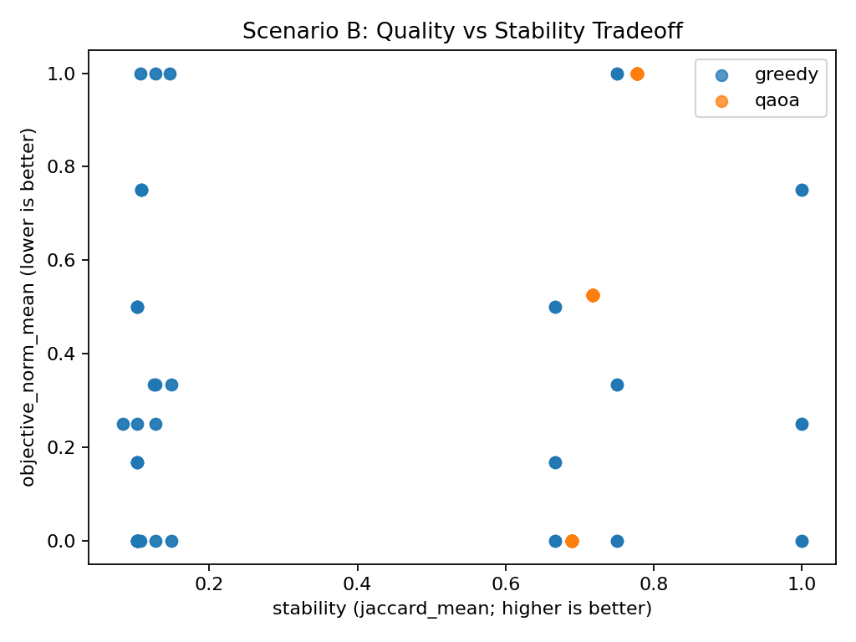
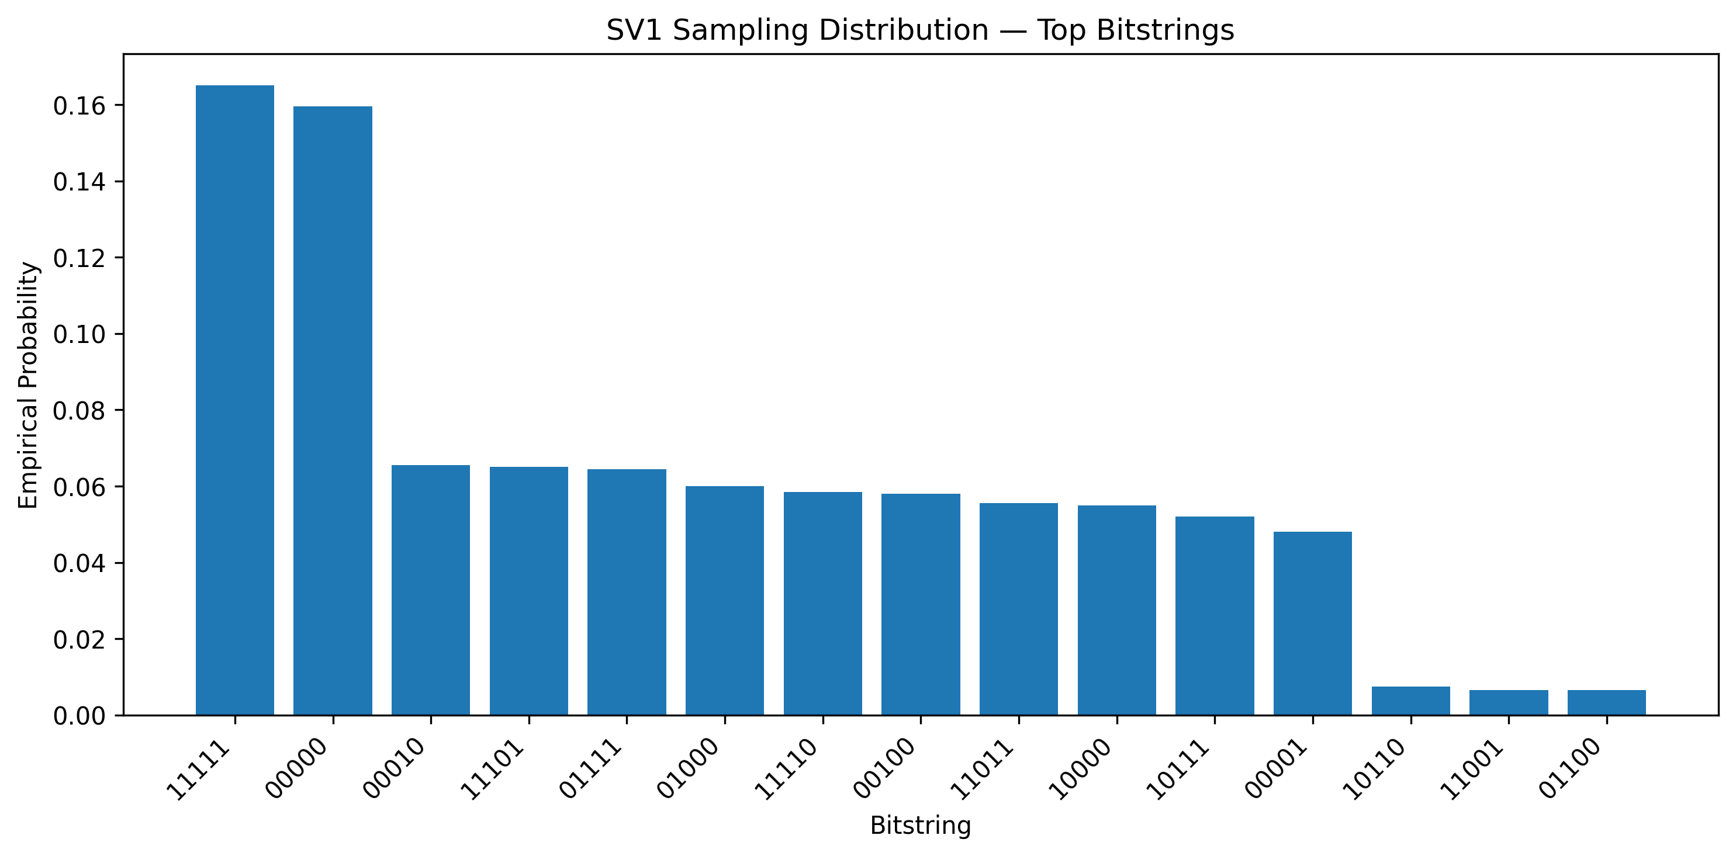
Scenario B: Robustness + Braket SV1 Run
Results
Scenario B classical baseline selected_n=10.
SV1 summary: n_pool=34, shots=-1 (per run).
Executive Summary

Slide 7
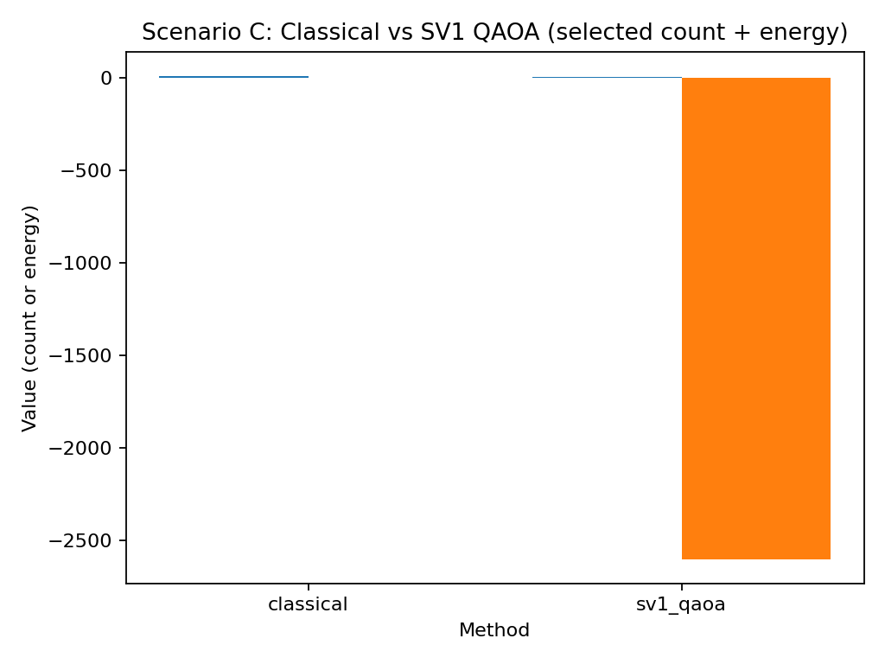
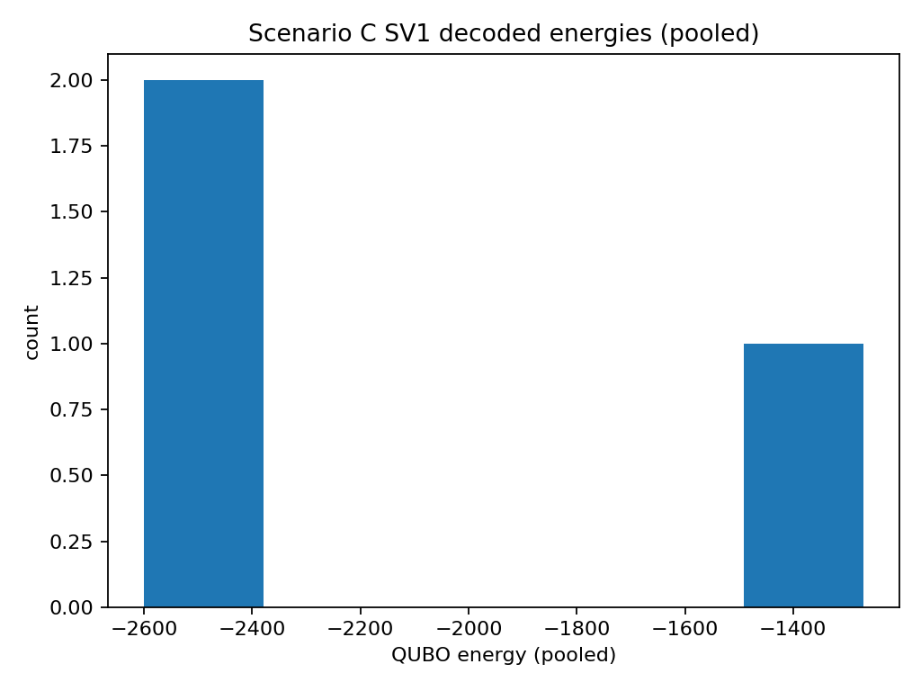
Scenario C: Scaling Under SV1 Qubit Limits
Results
Scenario C: classical selected_n=-1, SV1 selected_n=-1.
Pool strategy: n_full=60 → n_pool=34 to fit SV1.
Executive Summary

Slide 8
Key Takeaways & Next Steps
Close
End-to-end demo: large S3 corpus → scenarios → QUBO → solver benchmarks.
Robustness sweeps quantify quality vs stability (energy + Jaccard overlap).
Braket SV1 integration persists results to S3; decoding pipeline reconstructs best portfolios.
Next: p>1 QAOA, smarter pooling/partitioning, optional TN1 runs, cost tracking automation.
Executive Summary

