Slide 1
Quantum Clinical Trial Optimization — Technical Briefing
Implementation details: data ingestion, scenario layer, QUBO build, QAOA (local + AWS Braket SV1), decoding
Audience: technical stakeholders (data engineering + optimization + quantum simulation).
Repo is notebook-driven with reproducible artifacts (CSV/JSON) and visual diagnostics.
Technical Briefing

Slide 2
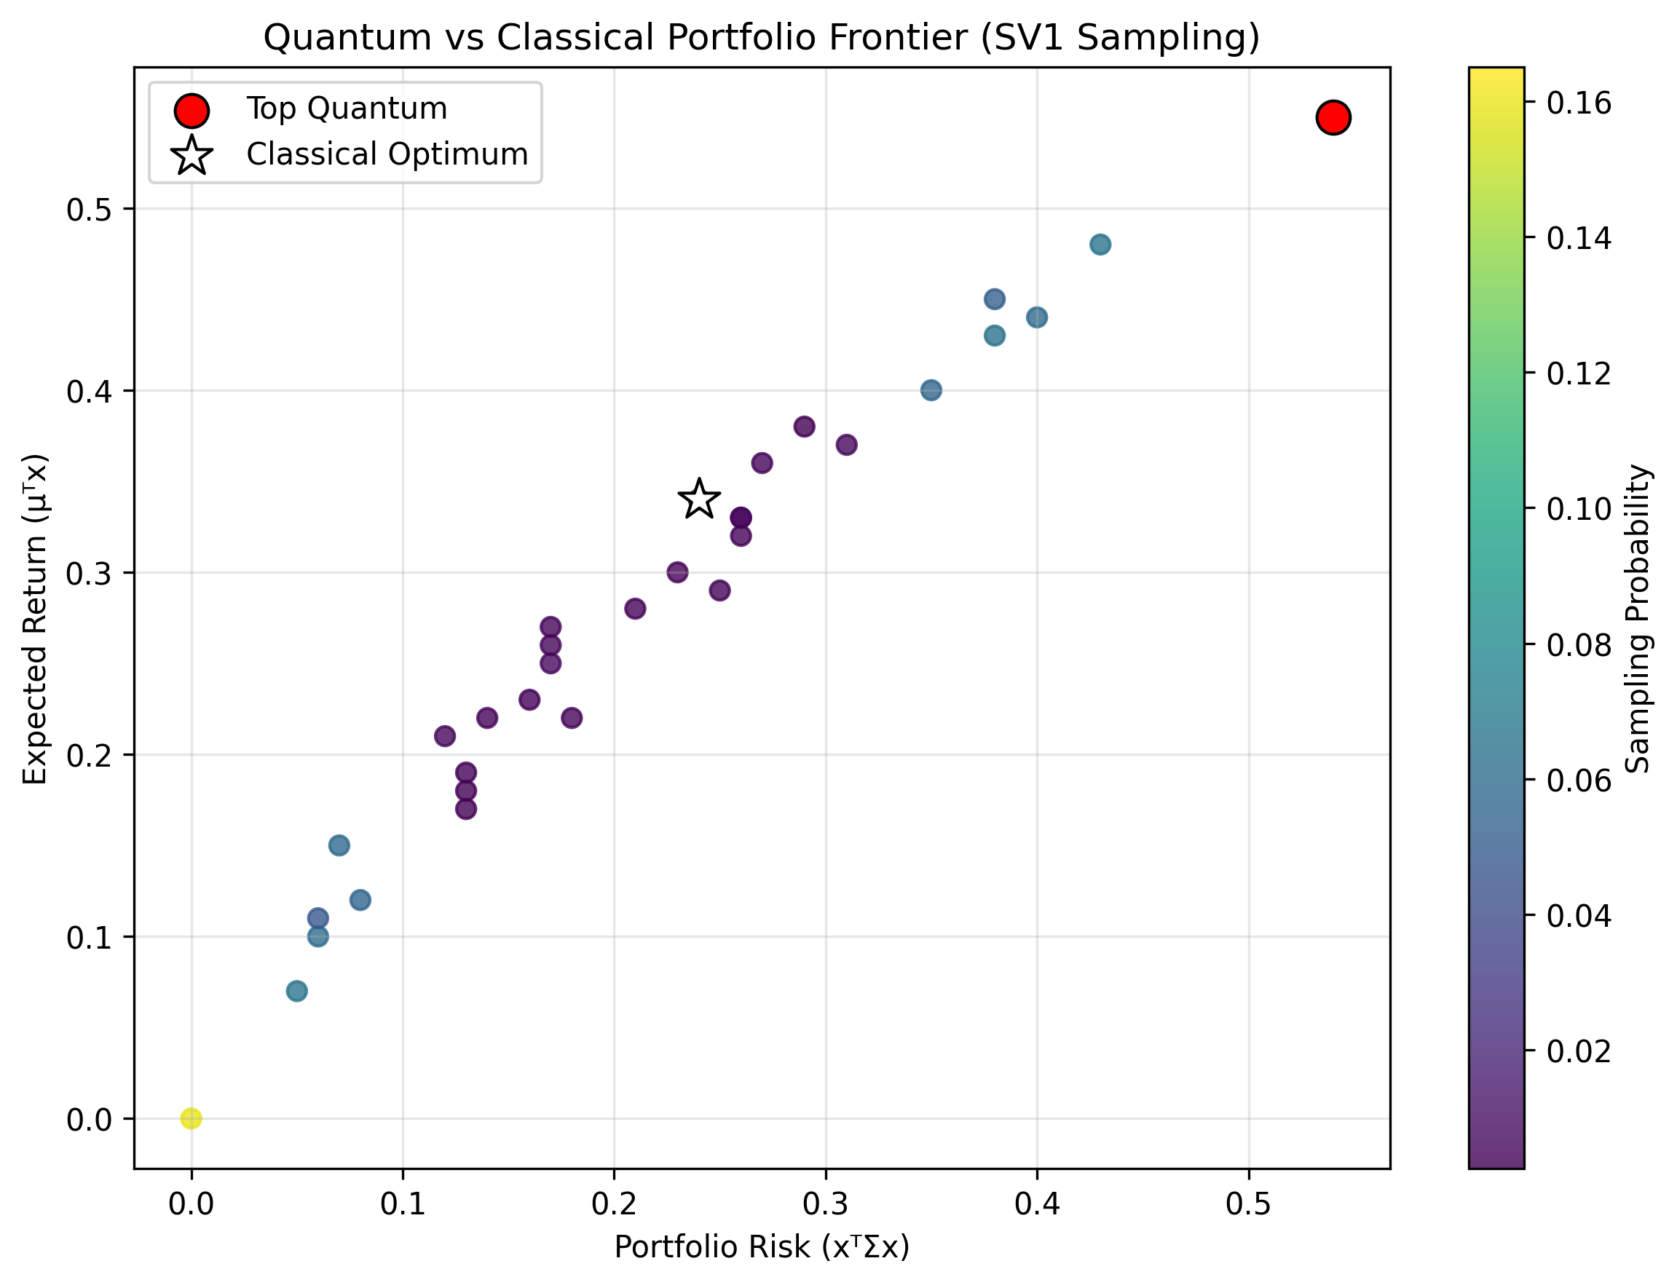
CT.gov Ingestion & Storage
Data
Raw source: CT.gov XML corpus stored in S3; local workflows parse and persist metadata.
High-performance extraction: concurrent parsing into Parquet for downstream analytics.
Git policy: do not commit large/raw/interim layers; keep small samples + summaries.
Technical Briefing

Slide 3
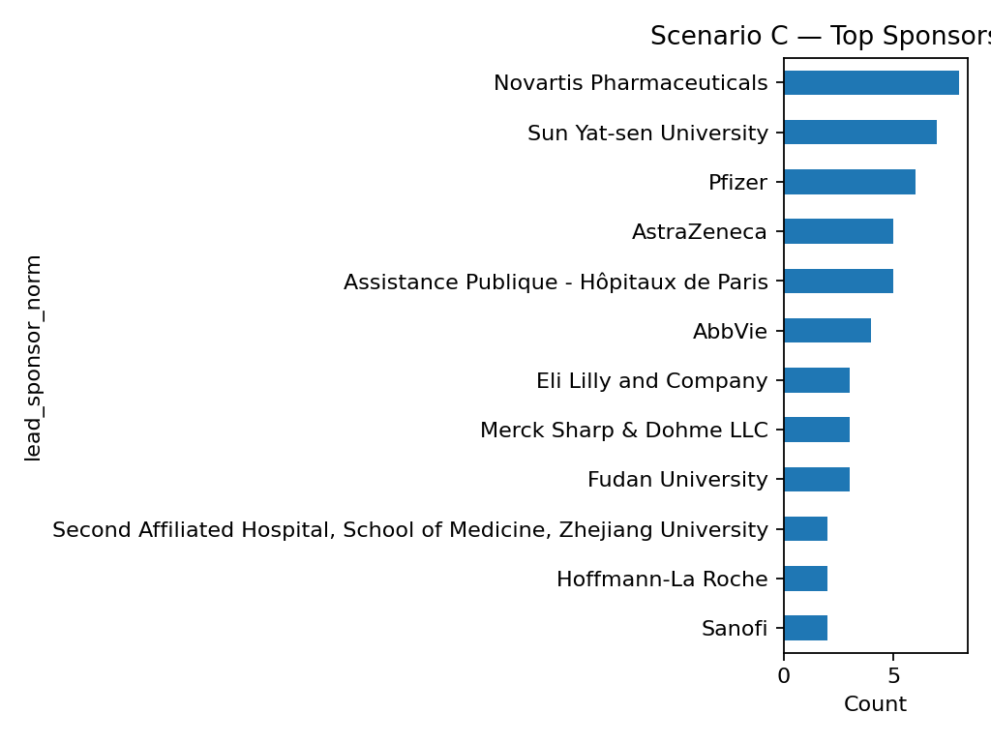
Scenario Candidate Build
Features
Candidate tables unify identifiers (NCT ID), sponsor normalization, and scenario filters.
Engineered features: benefit proxy, cost proxy, safety proxy, feasibility/region and pool scores.
Exports: scenario candidate CSVs + selection-ready columns for optimization.
Technical Briefing

Slide 4
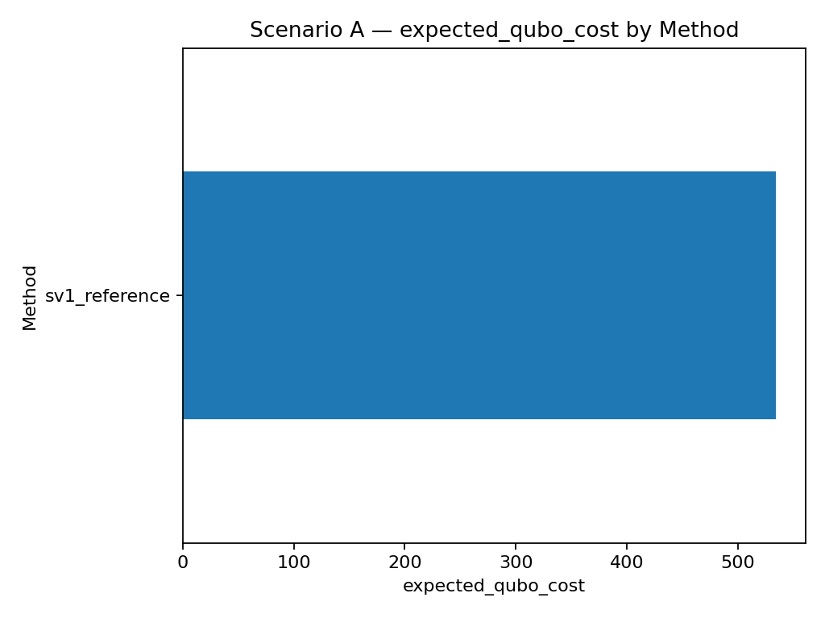
QUBO Formulation
QUBO
Binary selection model: minimize energy E(x)=xᵀQx (QUBO matrix) with constraint penalties.
Penalty A enforces portfolio-size and rules; λ_cost/λ_safety tune trade-offs.
Stable variable ordering ensures deterministic bitstring → trial ID decoding.
Technical Briefing

Slide 5
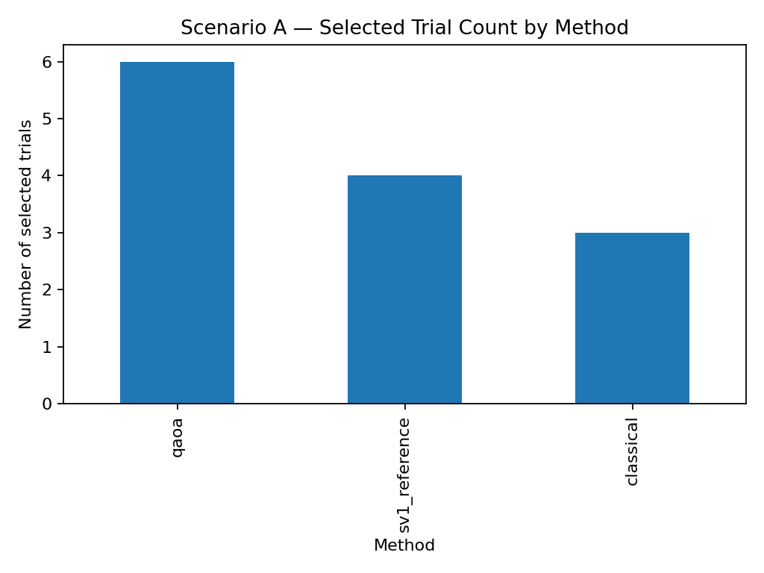
Classical Baseline Solvers
Baseline
Greedy/heuristic baseline used when exact enumeration is infeasible.
Artifacts: best bitstring + selected trials CSV + summary metrics.
Baselines: A selected_n=-1; B selected_n=10; C selected_n=10.
Technical Briefing

Slide 6
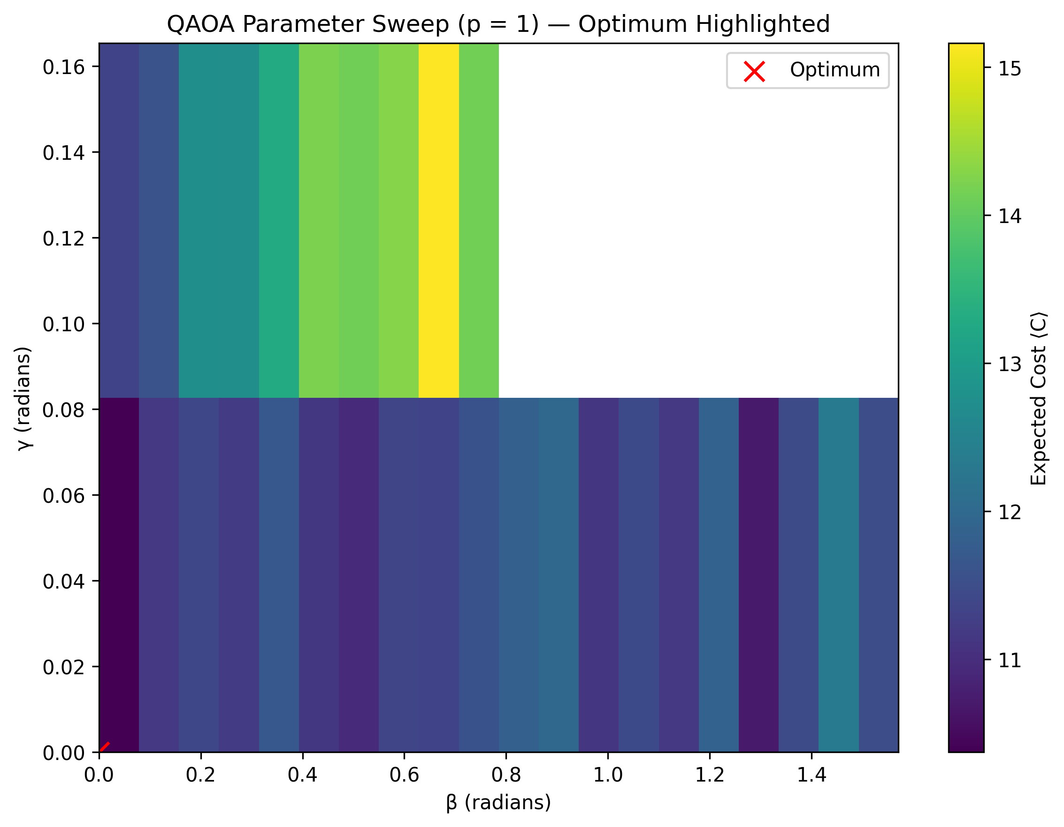
QAOA Parameter Sweep (p=1)
QAOA
Local QAOA: build Ising form (h,J) and run γ/β sweeps; score by decoded energy and stability.
Diagnostic plots: heatmaps (objective energy) + Jaccard overlap vs baseline selection.
Aer provides local reference; Braket SV1 provides cloud execution with S3 outputs.
Technical Briefing

Slide 7
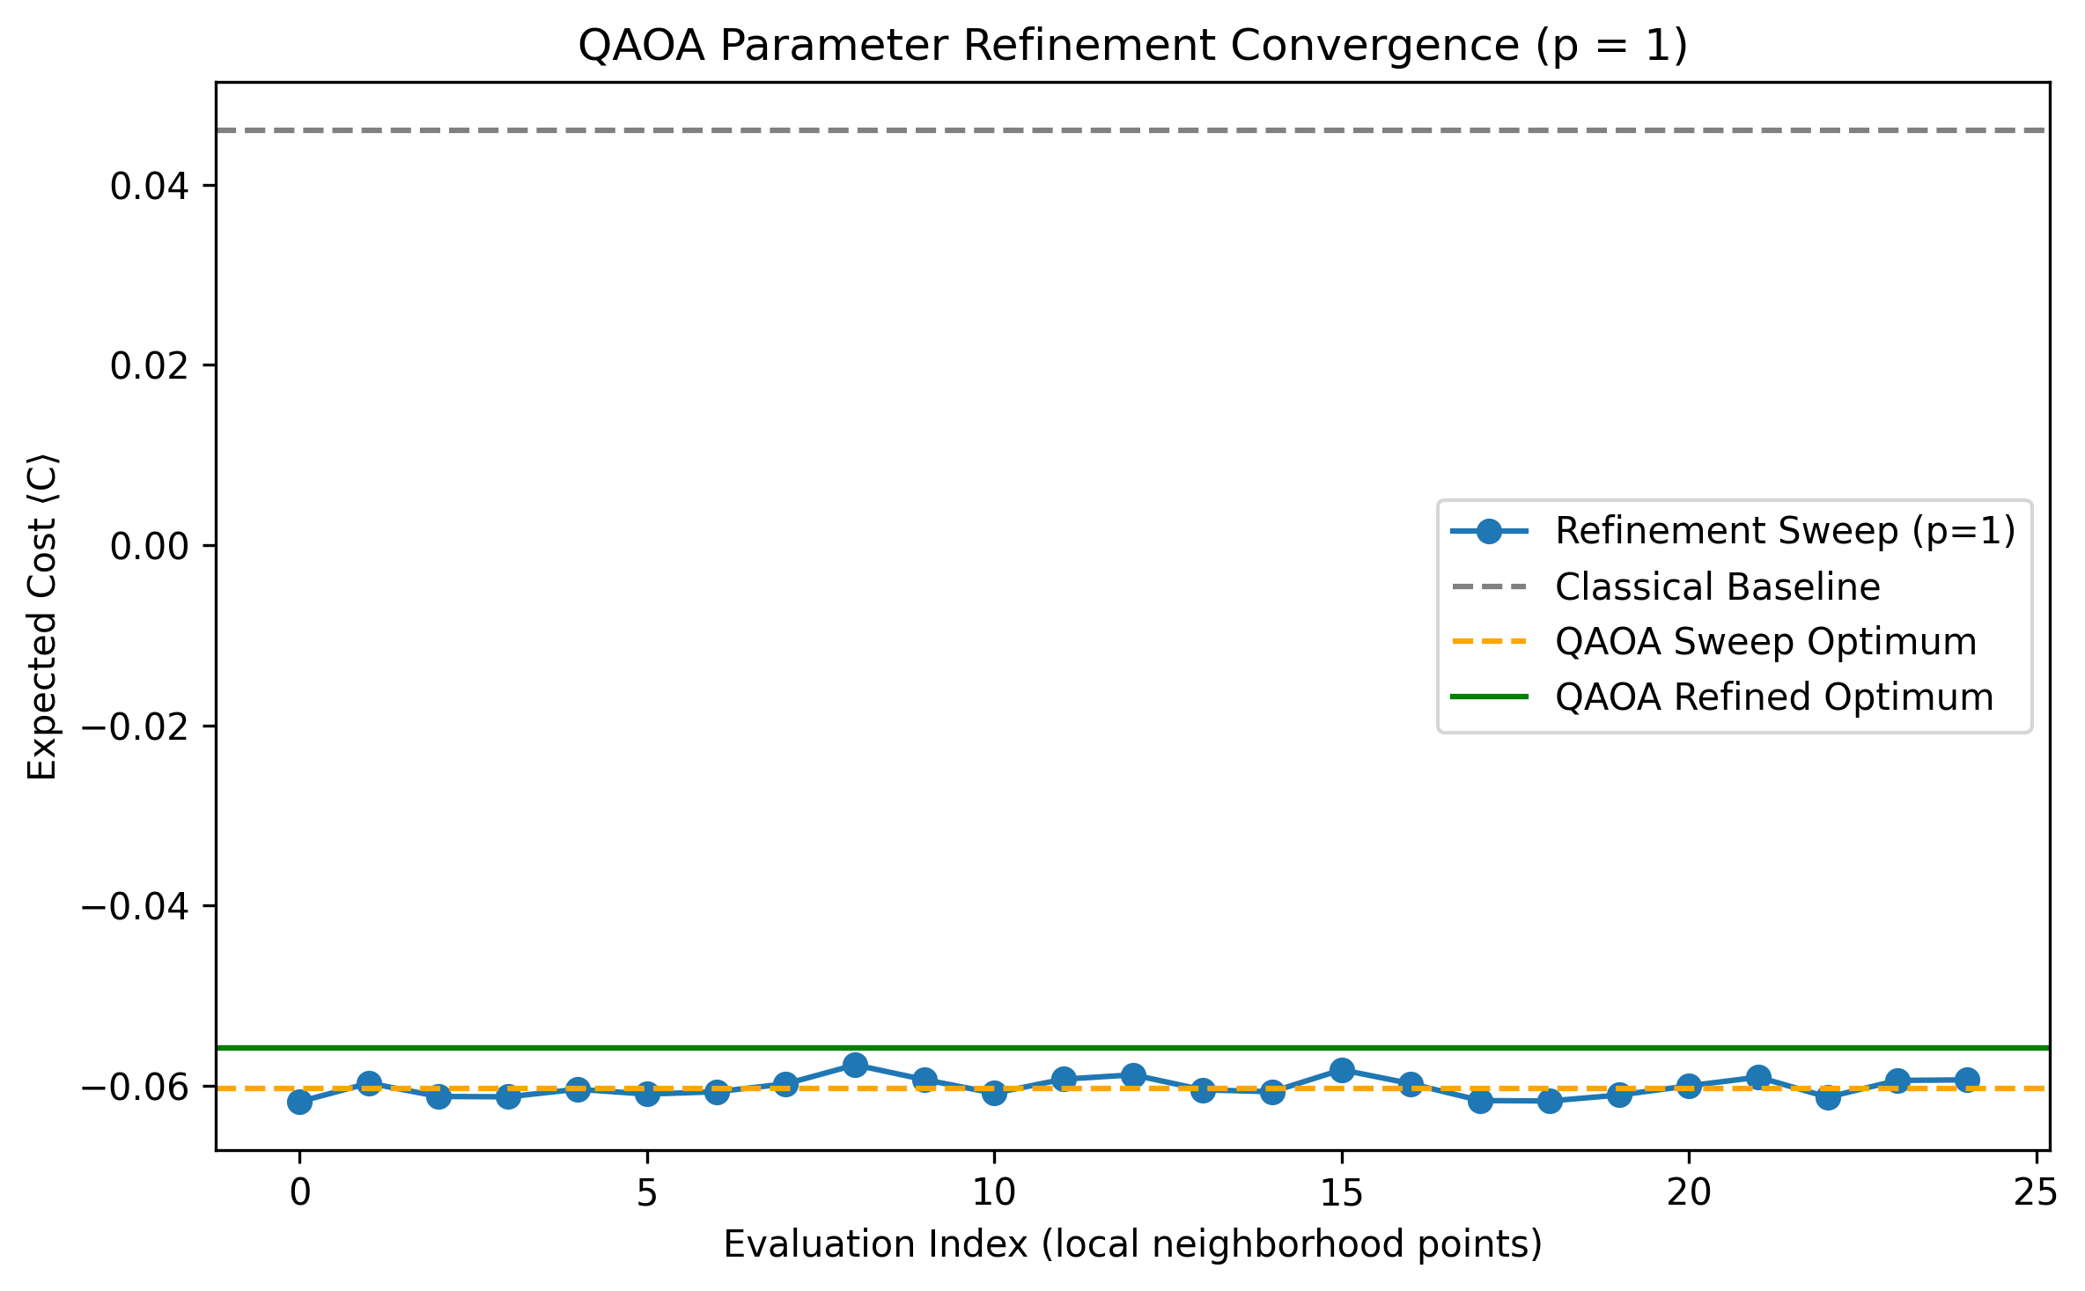
Refinement Runs & Convergence
Diagnostics
Refinement: narrow sweep ranges around promising γ/β regions.
Convergence curve: best energy found as sweep progresses.
Technical Briefing

Slide 8
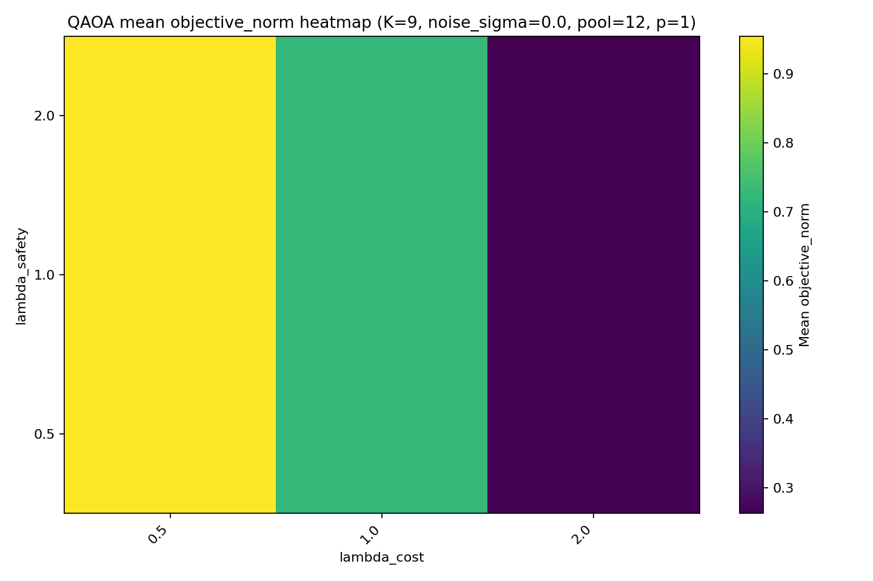
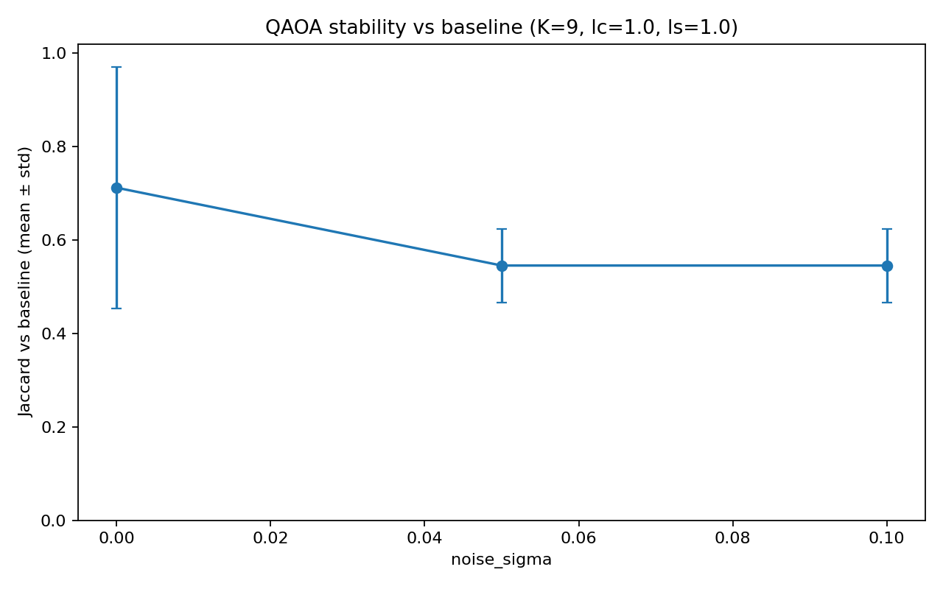
Scenario A Robustness Sweeps
Robustness
Grid over (K, λ_cost, λ_safety, noise_sigma) to assess sensitivity.
Stability: Jaccard overlap of selected sets vs baseline selection.
Objective: best decoded QUBO energy per config (mean/std across seeds).
Technical Briefing

Slide 9
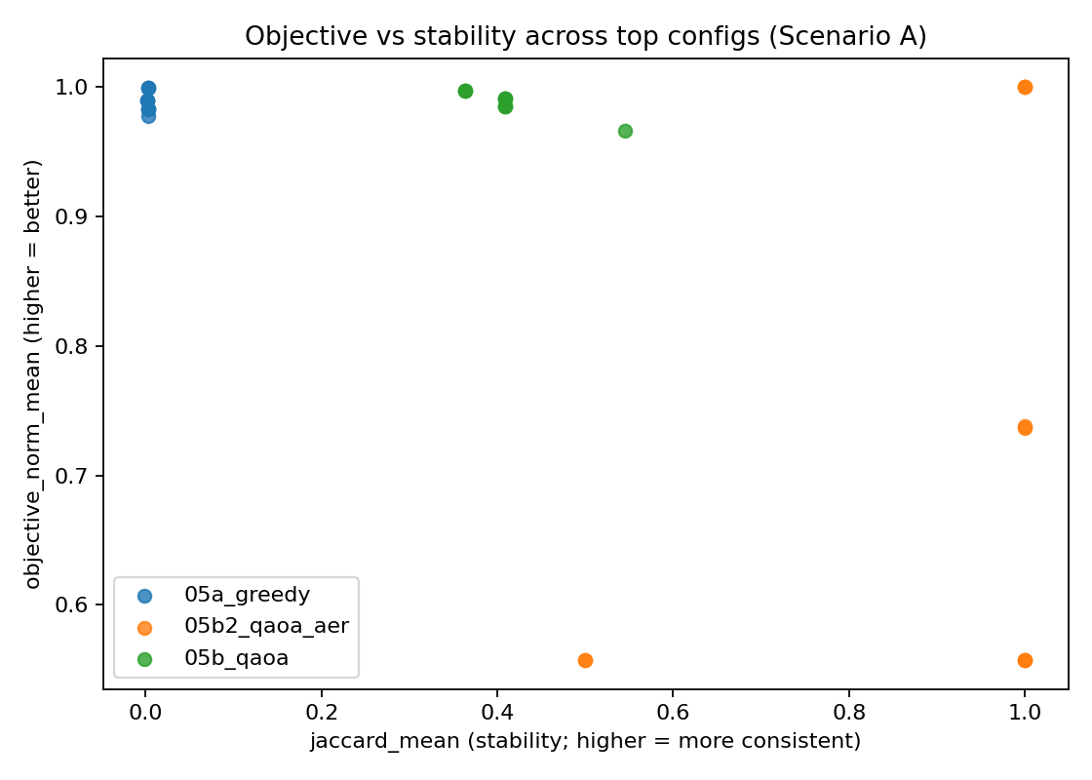
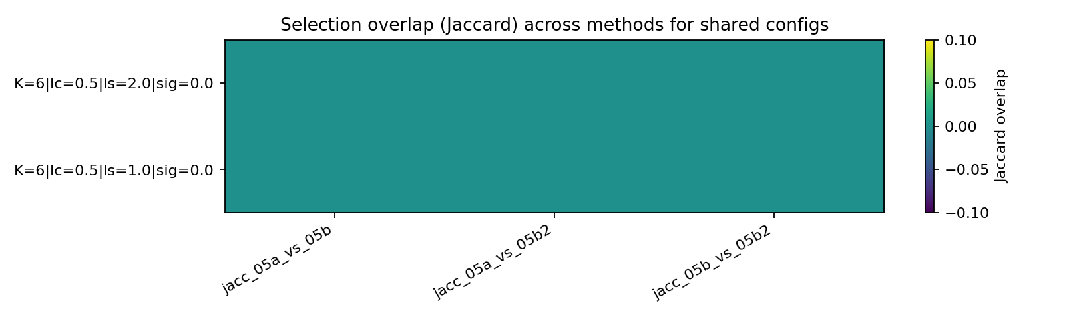
Scenario A: Cross-Method Comparison
Comparison
Aggregate across configs and compare best-by-method objective and stability.
Overlap heatmap highlights convergence vs divergence in portfolios.
Technical Briefing

Slide 10
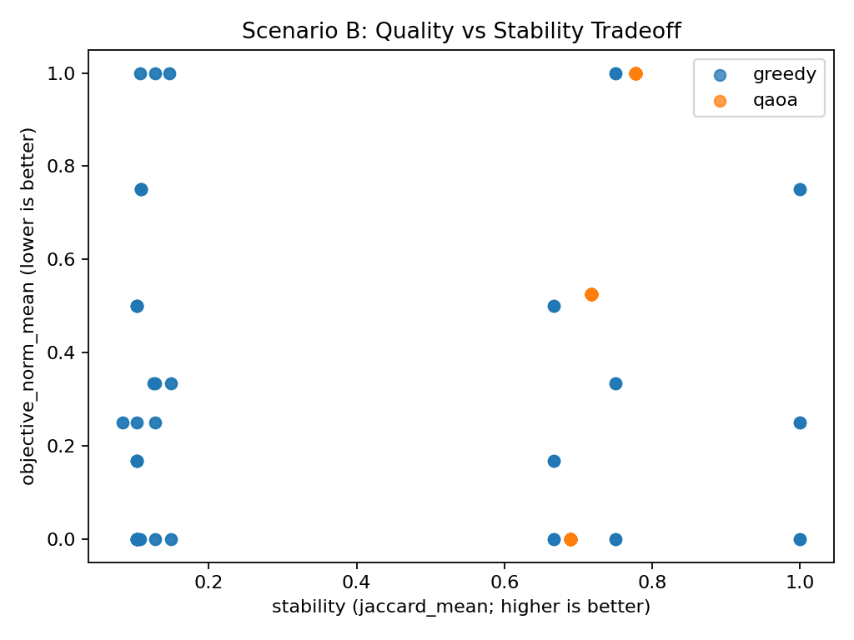
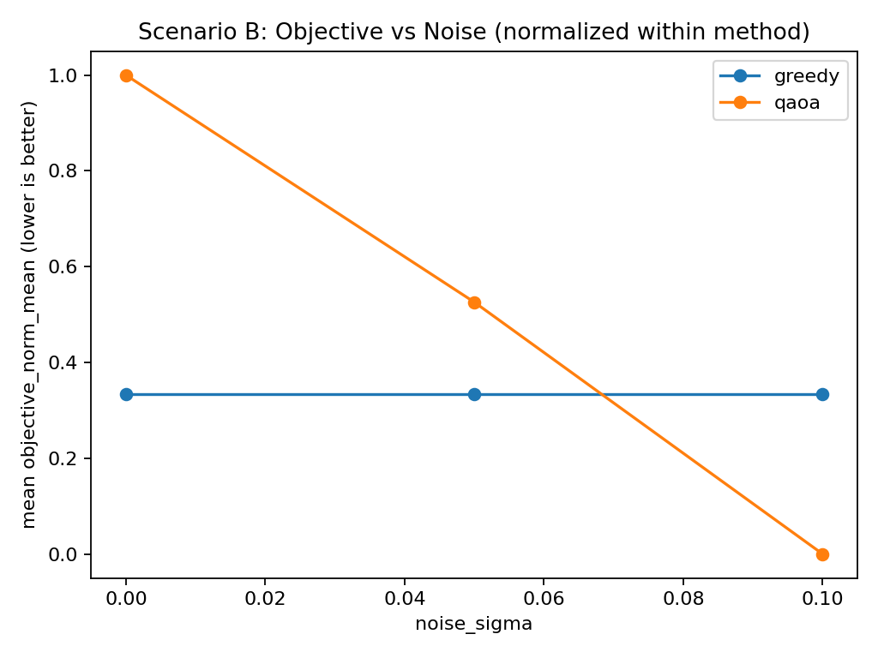
Scenario B Robustness Sweeps
Scenario B
Applied robustness sweeps to an alternate scenario slice.
Primary plots: objective vs noise; objective vs stability (Jaccard).
Technical Briefing

Slide 11
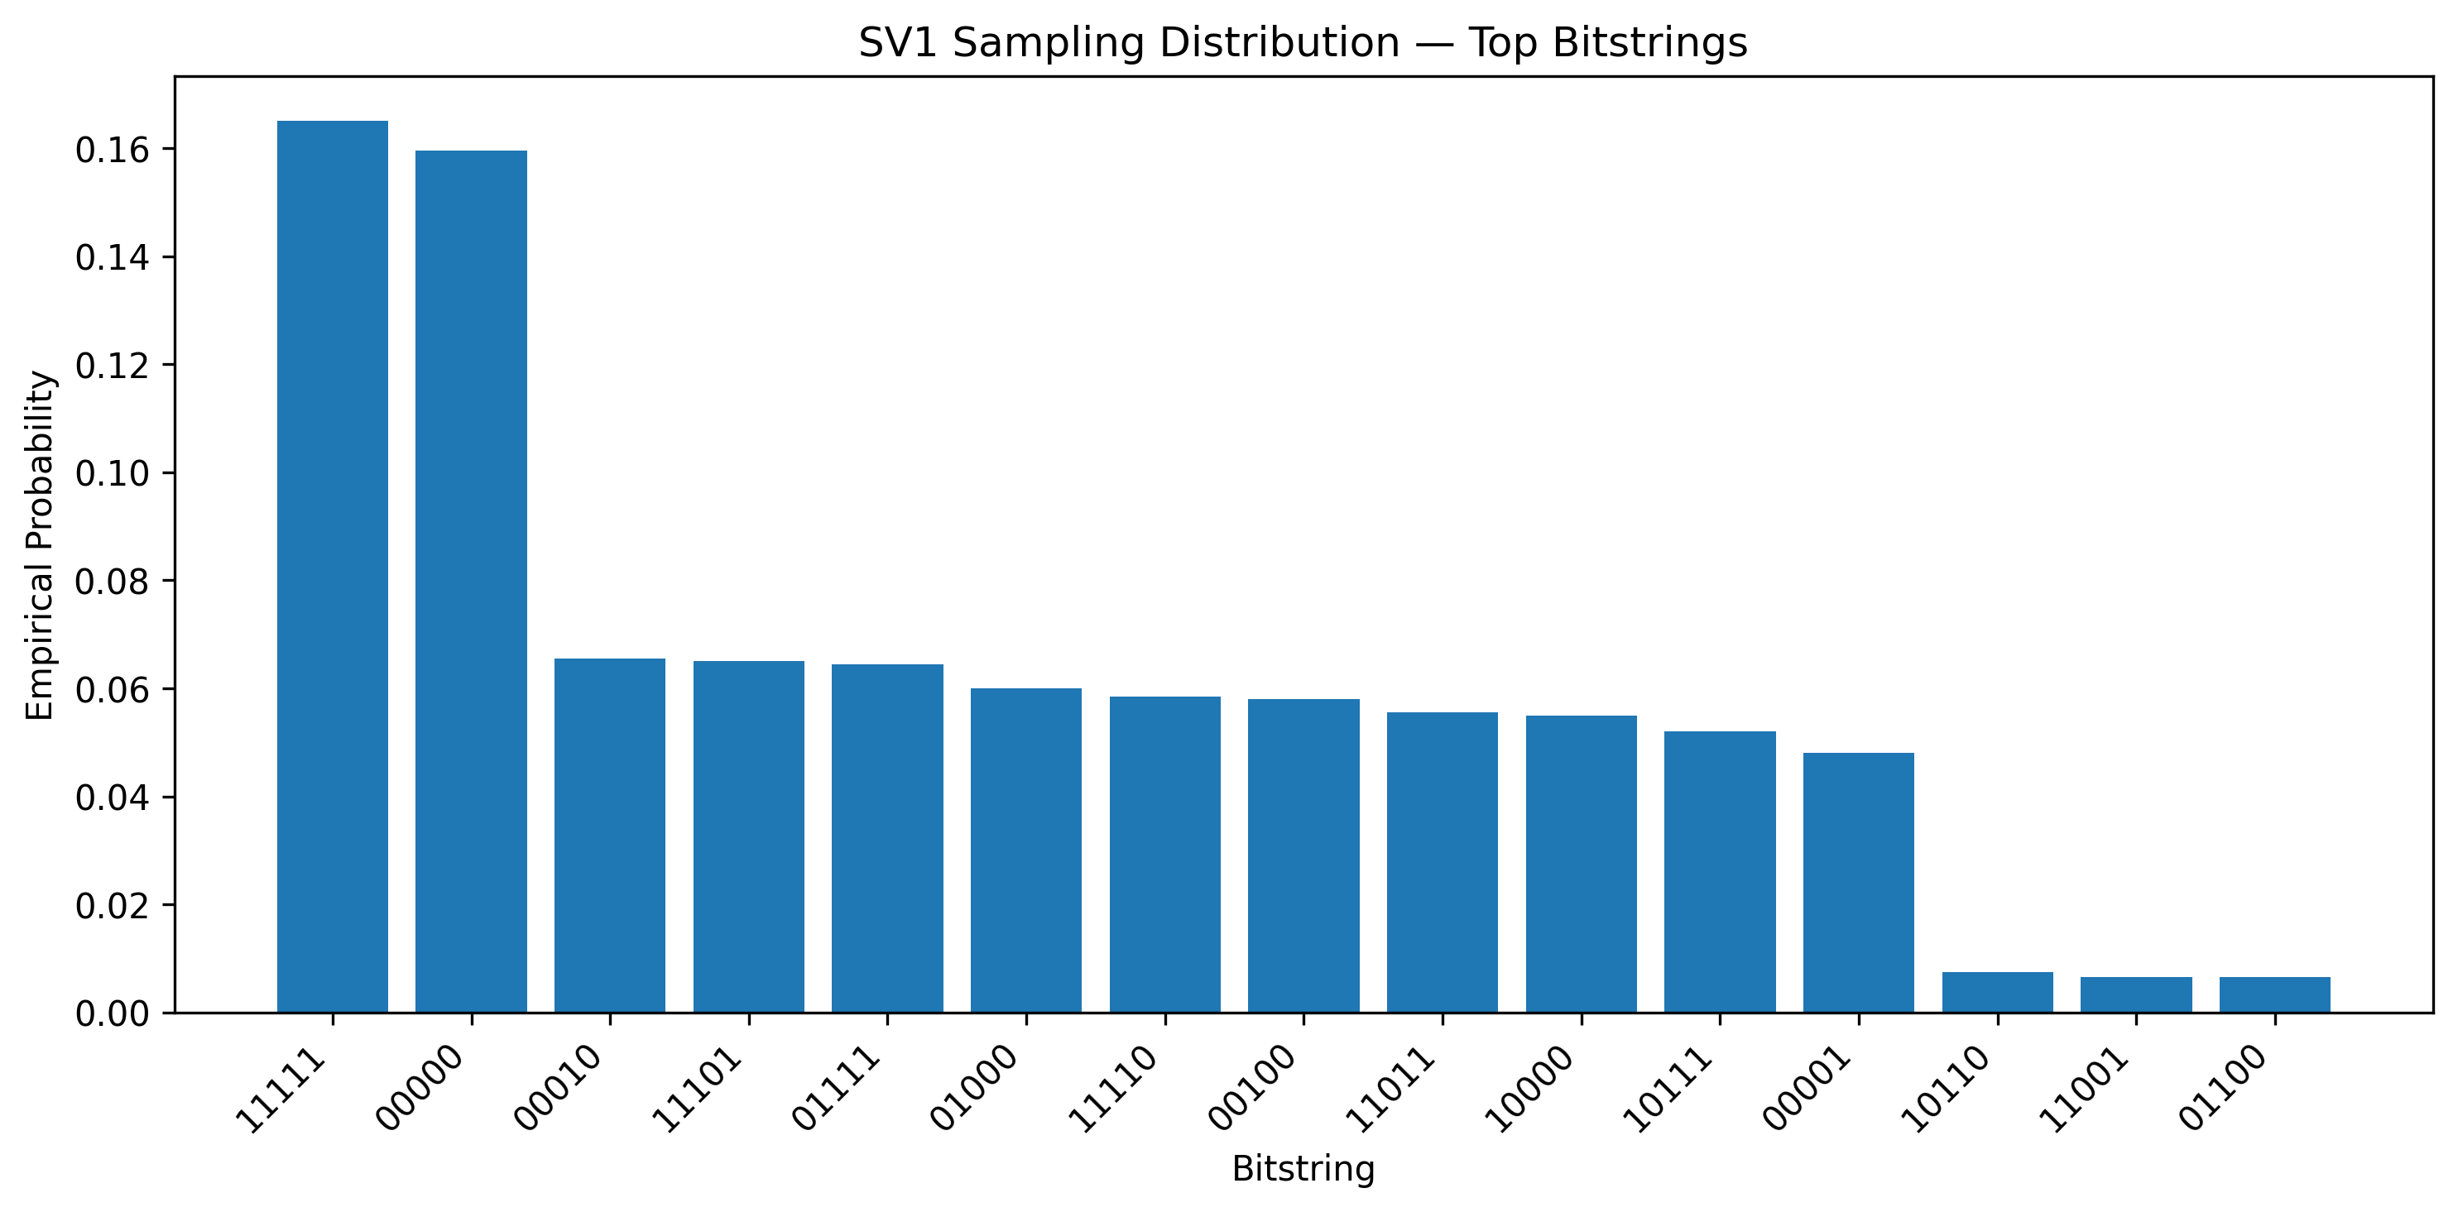
AWS Braket SV1 Execution Model
Braket
Submit circuits to SV1; results stored in an amazon-braket-* bucket (service-managed).
Workflow: submit tasks → record ARNs → decode results.json from S3 to portfolios.
Operational gotchas: bucket restrictions, polling/resume, region/time skew handling.
Technical Briefing

Slide 12
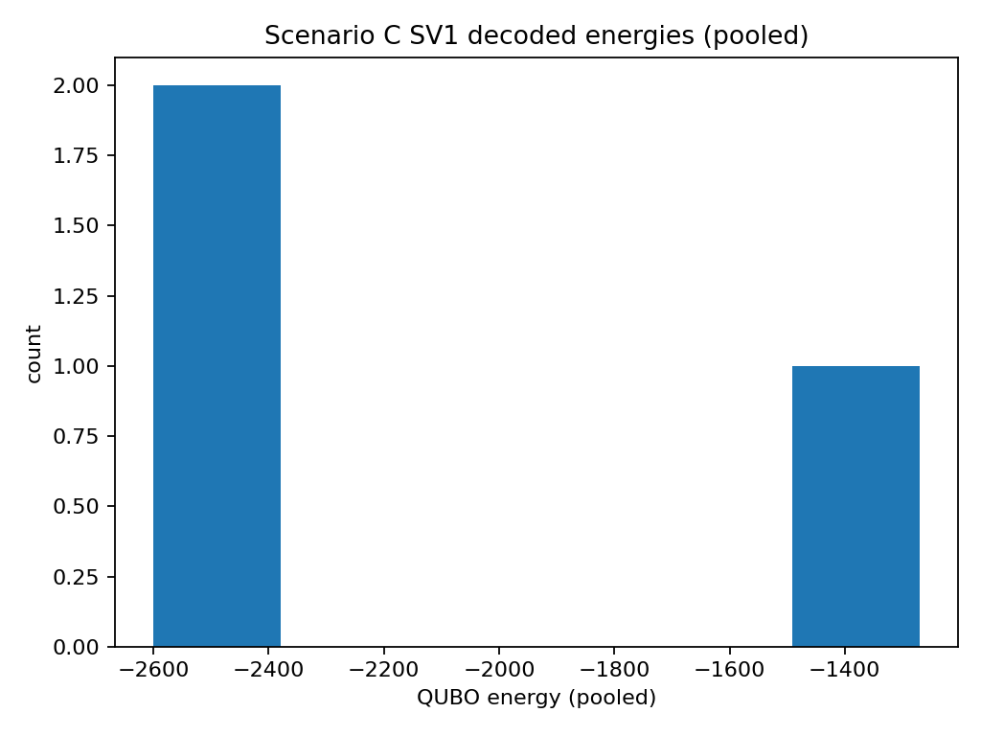
SV1 Qubit Cap (34) → Pool-Based Sub-QUBO
Scaling
Scenario C example: n_full=60 variables, pooled to n_pool=34.
Pool: choose a high-signal subset to fit device; decode pooled bitstring back to full space.
Compare trends and stability; pooling alters the reachable search space.
Technical Briefing

Slide 13
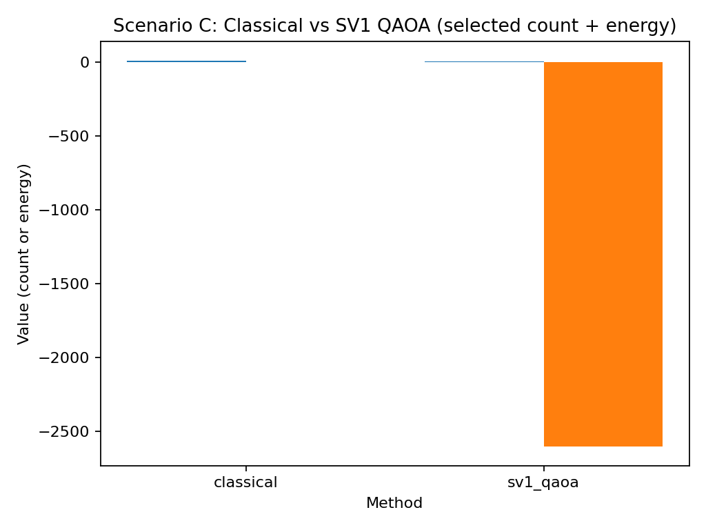
Scenario C: Classical vs SV1 (Pooled)
Scenario C
Selections: classical selected_n=-1; SV1 selected_n=-1.
Energy (QUBO): classical=nan; SV1 best=nan.
Interpretation: pooling changes the search space; evaluate feasibility + stability alongside energy.
Technical Briefing

Slide 14
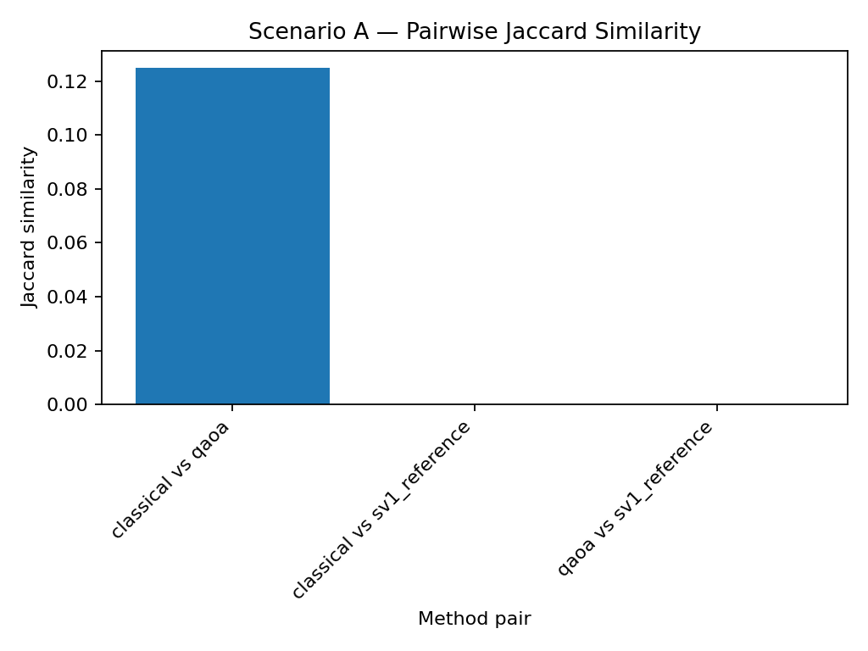
Metrics & Diagnostics
Metrics
Jaccard overlap quantifies stability under parameter/noise changes.
Selected-count plots validate constraint enforcement + penalty calibration.
Pairwise overlap helps detect multiple near-optimal portfolio basins.
Technical Briefing

Slide 15
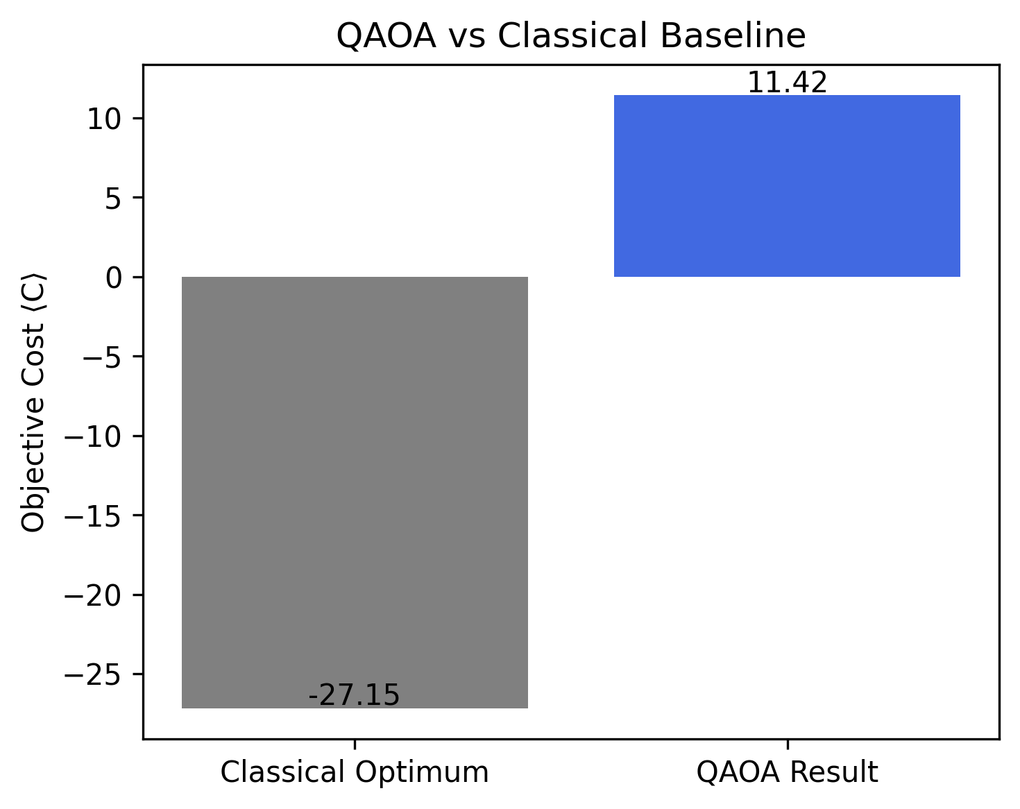
Next Steps
Roadmap
Batch Braket submissions (or Braket Jobs) for larger sweeps; add automated cost/runtime reporting.
Explore p>1 QAOA and alternative decompositions (partitioned QUBOs).
Optional: TN1/DM1 runs and noise-model comparisons; smarter pooling strategies.
Technical Briefing

