Slide 1
EECE 2160: Embedded Design: Enabling Robotics
Prof. John Kimani
Bits, Data Types, and Operations
Many of these slides are adapted by slides developed by David Kaeli (NEU) and Gregory Byrd, NCSU

Slide 2
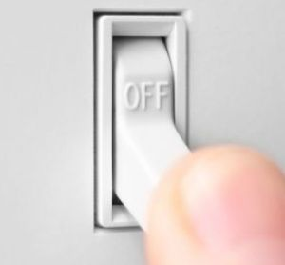

How do we represent data in a computer?
At the lowest level, a computer is an electronic machine
works by controlling the flow of electrons
Easy to recognize two conditions:
presence of a voltage – we’ll call this state “1”
absence of a voltage – we’ll call this state “0”
Could base state on value of voltage, but control and detection circuits more complex
compare turning on a light switch to measuring or regulating voltage

Slide 3
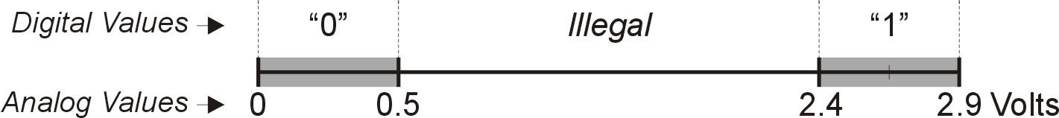
Computer is a binary digital system
Digital system:
finite number of symbols
Binary (base two) system:
has two states: 0 and 1
Basic unit of information is the binary digit, or bit
Values with more than two states require multiple bits
A collection of two bits has four possible states: 00, 01, 10, 11
A collection of three bits has eight possible states: 000, 001, 010, 011, 100, 101, 110, 111
A collection of n bits has 2^{n} possible states

Slide 4
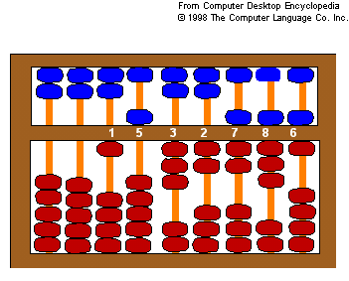
What kinds of data do we need to represent?
Numbers
signed, unsigned, integers, floating point, complex, rational, irrational, …
Text
characters, strings, …
Images
pixels, colors, shapes, …
Sound
Logical – true, false
Instructions
…
Data type:
representation and operations within the computer
We will start with numbers…

Slide 5
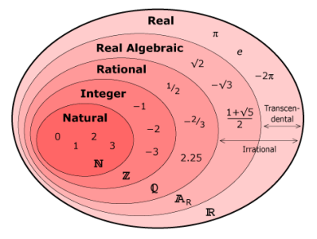
Unsigned Integers
Non-positional notation
could represent a number (“5”) with a string of ones (“11111”)
problems?
Weighted positional notation
like decimal numbers: “329”
“3” is worth 300, because of its position, while “9” is only worth 9
most
significant
least
significant
329
101
10²
10¹
10⁰
2²
2¹
2⁰
3x100 + 2x10 + 9x1 = 329
1x4 + 0x2 + 1x1 = 5

Slide 6
Unsigned Integers (cont.)
An n-bit unsigned integer represents 2^{n} values:
from 0 to 2^{n}-1
2² | 2¹ | 2⁰
0 | 0 | 0 | 0
0 | 0 | 1 | 1
0 | 1 | 0 | 2
0 | 1 | 1 | 3
1 | 0 | 0 | 4
1 | 0 | 1 | 5
1 | 1 | 0 | 6
1 | 1 | 1 | 7

Slide 7
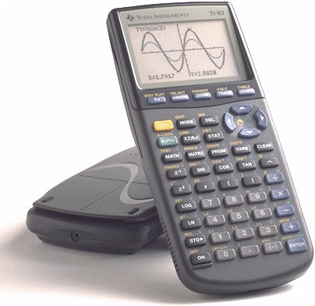
Unsigned Binary Arithmetic
Base-2 addition – just like base-10!
add from right to left, propagating carry
carry
10010 10010 1111
+ 1001 + 1011 + 1
11011 11101 10000
10111
+ 111
Subtraction, multiplication, division,…

Slide 8

Signed Integers
With n bits, we have 2^{n} distinct values
assign about half to positive integers (1 through 2^{n-1}) and about half to negative (- 2^{n-1} through -1)
that leaves two values: one for 0, and one extra
Positive integers
just like unsigned – zero in most significant bit 00101 = 5
Negative integers
sign-magnitude – set top bit to show negative, other bits are the same as unsigned 10101 = -5
one’s complement – flip every bit to represent negative 11010 = -5
in either case, MS bit indicates sign: 0=positive, 1=negative

Slide 9
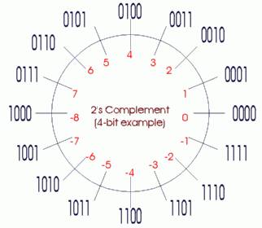
Two’s Complement
Problems with sign-magnitude and 1’s complement
two representations of zero (+0 and –0)
arithmetic circuits are complex
How to add two sign-magnitude numbers?
e.g., try 2 + (-3)
How to add to one’s complement numbers?
e.g., try 4 + (-3)
Two’s complement representation developed to make circuits easy for arithmetic
for each positive number (X), assign value to its negative (-X), such that X + (-X) = 0 with “normal” addition, ignoring carry out
00101 (5) 01001 (9)
+ 11011 (-5) + (-9)
00000 (0) 00000 (0)

Slide 10
Two’s Complement Representation
If number is positive or zero,
normal binary representation, zeroes in upper bit(s)
If number is negative,
start with positive number
flip every bit (i.e., take the one’s complement)
then add one
00101 (5) 01001 (9)
11010 (1’s comp) (1’s comp)
+ 1 + 1
11011 (-5) (-9)

Slide 11
Two’s Complement Signed Integers
MS bit is sign bit – it has weight –2^{n-1}
Range of an n-bit number: -2^{n-1} through 2^{n-1} – 1
The most negative number (-2^{n-1}) has no positive counterpart
-2³ | 2² | 2¹ | 2⁰
0 | 0 | 0 | 0 | 0
0 | 0 | 0 | 1 | 1
0 | 0 | 1 | 0 | 2
0 | 0 | 1 | 1 | 3
0 | 1 | 0 | 0 | 4
0 | 1 | 0 | 1 | 5
0 | 1 | 1 | 0 | 6
0 | 1 | 1 | 1 | 7
-2³ | 2² | 2¹ | 2⁰
1 | 0 | 0 | 0 | -8
1 | 0 | 0 | 1 | -7
1 | 0 | 1 | 0 | -6
1 | 0 | 1 | 1 | -5
1 | 1 | 0 | 0 | -4
1 | 1 | 0 | 1 | -3
1 | 1 | 1 | 0 | -2
1 | 1 | 1 | 1 | -1

Slide 12
Converting Binary (2’s C) to Decimal
If leading bit is one, take two’s complement to get a positive number
Add powers of 2 that have “1” in the corresponding bit positions
If original number was negative, add a minus sign
n | 2^{n}
0 | 1
1 | 2
2 | 4
3 | 8
4 | 16
5 | 32
6 | 64
7 | 128
8 | 256
9 | 512
10 | 1024
X = 01101000_{two}
= 2⁶+2⁵+2³ = 64+32+8
= 104_{ten}
Assuming 8-bit 2’s complement numbers

Slide 13
More Examples
X = 00100111_{two}
= 2⁵+2²+2¹+2⁰ = 32+4+2+1
= 39_{ten}
n | 2^{n}
0 | 1
1 | 2
2 | 4
3 | 8
4 | 16
5 | 32
6 | 64
7 | 128
8 | 256
9 | 512
10 | 1024
X = 11100110_{two}
-X = 00011010
= 2⁴+2³+2¹ = 16+8+2
= 26_{ten}
X = -26_{ten}
Assuming 8-bit 2’s complement numbers

Slide 14
Converting Decimal to Binary (2’s C)
First Method: Division
Divide by two – remainder is least significant bit
Keep dividing by two until answer is zero, writing remainders from right to left
Append a zero as the MS bit; if original number negative, take two’s complement
X = 104_{ten} 104/2 = 52 r0 bit 0
52/2 = 26 r0 bit 1
26/2 = 13 r0 bit 2
13/2 = 6 r1 bit 3
6/2 = 3 r0 bit 4
3/2 = 1 r1 bit 5
X = 01101000_{two} 1/2 = 0 r1 bit 6

Slide 15
Converting Decimal to Binary (2’s C)
Second Method: Subtract Powers of Two
Change to positive decimal number
Subtract largest power of two less than or equal to number
Put a one in the corresponding bit position
Keep subtracting until result is zero
Append a zero as MS bit; if original was negative, take two’s complement
n | 2^{n}
0 | 1
1 | 2
2 | 4
3 | 8
4 | 16
5 | 32
6 | 64
7 | 128
8 | 256
9 | 512
10 | 1024
X = 104_{ten} 104 - 64 = 40 bit 6
40 - 32 = 8 bit 5
8 - 8 = 0 bit 3
X = 01101000_{two}

Slide 16
Hexadecimal Notation
It is often convenient to write binary (base-2) numbers as hexadecimal (base-16) numbers instead.
fewer digits -- four bits per hex digit
less error prone -- easy to corrupt long string of 1’s and 0’s
Binary | Hex | Decimal
0000 | 0 | 0
0001 | 1 | 1
0010 | 2 | 2
0011 | 3 | 3
0100 | 4 | 4
0101 | 5 | 5
0110 | 6 | 6
0111 | 7 | 7
Binary | Hex | Decimal
1000 | 8 | 8
1001 | 9 | 9
1010 | A | 10
1011 | B | 11
1100 | C | 12
1101 | D | 13
1110 | E | 14
1111 | F | 15

Slide 17
Converting from Binary to Hexadecimal
Every four bits is a hex digit.
start grouping from right-hand side
0011 1010 1000 1111 0100 1101 0111
3
A
8
F
4
D
7
This is not a new machine representation, just a convenient way to write the number

Slide 18
Operations: Arithmetic and Logical
Recall: a data type includes representation and operations
We now have a good representation for signed integers, so let’s look at some arithmetic operations:
Addition
Subtraction
Sign Extension
We’ll also look at overflow conditions for addition
Multiplication, division, etc., can be built from these basic operations
Logical operations are also useful:
AND
OR
NOT

Slide 19
Addition
As we’ve discussed, 2’s comp. addition is just binary addition
Assumptions (for now):
assume all integers have the same number of bits
ignore carry out
assume that sum fits in n-bit 2’s comp. representation
01101000 (104) 11110110 (-10)
+ 11110000 (-16) + (-9)
01011000 (88) (-19)
Assuming 8-bit 2’s complement numbers

Slide 20
Subtraction
Negate subtrahend (2nd no.) and add
Assumptions (for now):
assume all integers have the same number of bits
ignore carry out
assume that sum fits in n-bit 2’s comp. representation
01101000 (104) 11110110 (-10)
- 00010000 (16) - (-9)
01101000 (104) 11110110 (-10)
+ 11110000 (-16) + (9)
01011000 (88) (-1)
Assuming 8-bit 2’s complement numbers

Slide 21
Sign Extension
To add two numbers, we must represent them with the same number of bits
If we just pad with zeroes on the left:
Instead, replicate the Most Significant Bit (MSB) -- sign bit:
4-bit 8-bit
0100 (4) 00000100 (still 4)
1100 (-4) 00001100 (12, not -4)
4-bit 8-bit
0100 (4) 00000100 (still 4)
1100 (-4) 11111100 (still -4)

Slide 22
Overflow
If operands are too big, then sum cannot be represented as an n-bit 2’s comp number
We have overflow if:
signs of both operands are the same, and
sign of sum is different
Another test -- easy for hardware:
carry into MS bit does not equal carry out
01000 (8) 11000 (-8)
+ 01001 (9) + 10111 (-9)
10001 (-15) 01111 (+15)

Slide 23
Logical Operations
Operations on logical TRUE or FALSE
two states -- takes one bit to represent: TRUE=1, FALSE=0
View n-bit number as a collection of n logical values
operation applied to each bit independently
A | B | A AND B
0 | 0 | 0
0 | 1 | 0
1 | 0 | 0
1 | 1 | 1
A | B | A OR B
0 | 0 | 0
0 | 1 | 1
1 | 0 | 1
1 | 1 | 1
A | NOT A
0 | 1
1 | 0

Slide 24
Examples of Logical Operations
AND
useful for clearing bits
AND with zero = 0
AND with one = no change
OR
useful for setting bits
OR with zero = no change
OR with one = 1
NOT
unary operation -- one argument
flips every bit
11000101
AND 00001111
00000101
11000101
OR 00001111
11001111
NOT 11000101
00111010

Slide 25
Text: ASCII Characters
American Standard Code for Information Interchange-ASCII
Maps 128 characters to 7-bit code.
both printable and non-printable (ESC, DEL, …) characters
00 | nul | 10 | dle | 20 | sp | 30 | 0 | 40 | @ | 50 | P | 60 | ` | 70 | p
01 | soh | 11 | dc1 | 21 | ! | 31 | 1 | 41 | A | 51 | Q | 61 | a | 71 | q
02 | stx | 12 | dc2 | 22 | " | 32 | 2 | 42 | B | 52 | R | 62 | b | 72 | r
03 | etx | 13 | dc3 | 23 | # | 33 | 3 | 43 | C | 53 | S | 63 | c | 73 | s
04 | eot | 14 | dc4 | 24 | $ | 34 | 4 | 44 | D | 54 | T | 64 | d | 74 | t
05 | enq | 15 | nak | 25 | % | 35 | 5 | 45 | E | 55 | U | 65 | e | 75 | u
06 | ack | 16 | syn | 26 | & | 36 | 6 | 46 | F | 56 | V | 66 | f | 76 | v
07 | bel | 17 | etb | 27 | ' | 37 | 7 | 47 | G | 57 | W | 67 | g | 77 | w
08 | bs | 18 | can | 28 | ( | 38 | 8 | 48 | H | 58 | X | 68 | h | 78 | x
09 | ht | 19 | em | 29 | ) | 39 | 9 | 49 | I | 59 | Y | 69 | i | 79 | y
0a | nl | 1a | sub | 2a | * | 3a | : | 4a | J | 5a | Z | 6a | j | 7a | z
0b | vt | 1b | esc | 2b | + | 3b | ; | 4b | K | 5b | [ | 6b | k | 7b | {
0c | np | 1c | fs | 2c | , | 3c | < | 4c | L | 5c | \ | 6c | l | 7c | |
0d | cr | 1d | gs | 2d | - | 3d | = | 4d | M | 5d | ] | 6d | m | 7d | }
0e | so | 1e | rs | 2e | . | 3e | > | 4e | N | 5e | ^ | 6e | n | 7e | ~
0f | si | 1f | us | 2f | / | 3f | ? | 4f | O | 5f | _ | 6f | o | 7f | del

Slide 26
C-Data Types
Sizes of C-Data types depend on architecture and compiler (options), E.g. 32bit processor:
Size definitions
b: Bit (e.g. 1kb = 1024 * 1 bit = 1024bits)
B: Byte (e.g. 3MB = 1024*1024 * 3byte = 3,145,728 bytes
= 25,165,824 bits)
Nibble = 4 bits.
Type | Size [Bytes] |  | Type | Size [Bytes]
signed char | 1 |  | unsigned short | 2
unsigned char | 1 |  | signed int | 4
signed short | 2 |  | unsigned int | 4

Slide 27
Summary
Computers operate in binary
Conversion from / to binary
Negative number representation
Two’s complement
Arithmetic and logical operations
Hexa-decimal representation (convenient for user)
ASCII character representation
C-Data types

