Slide 1
EECE 2160: Embedded Design: Enabling Robotics
Prof. John Kimani
Introduction to C++ Programming

Slide 2
A Simple C++ Program
#include <iostream>
#include <string>
using namespace std;
int main()
{
int num1;
string str;
cout << "Enter a number: ";
cin >> num1;
cout << "Enter a string: ";
cin >> str;
cout << "You entered " << num1 << " and " << str << endl;
}

Slide 3
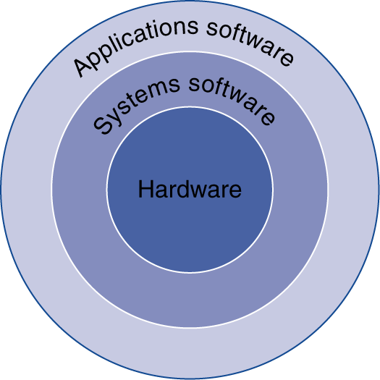
Below Your Program
Application software
Written in high-level language
System software
Compiler: translates HLL code to machine code
Operating System: service code
Handling input/output
Managing memory and storage
Scheduling tasks & sharing resources
Hardware
Processor, memory, I/O controllers
§1.2 Below Your Program

Slide 4
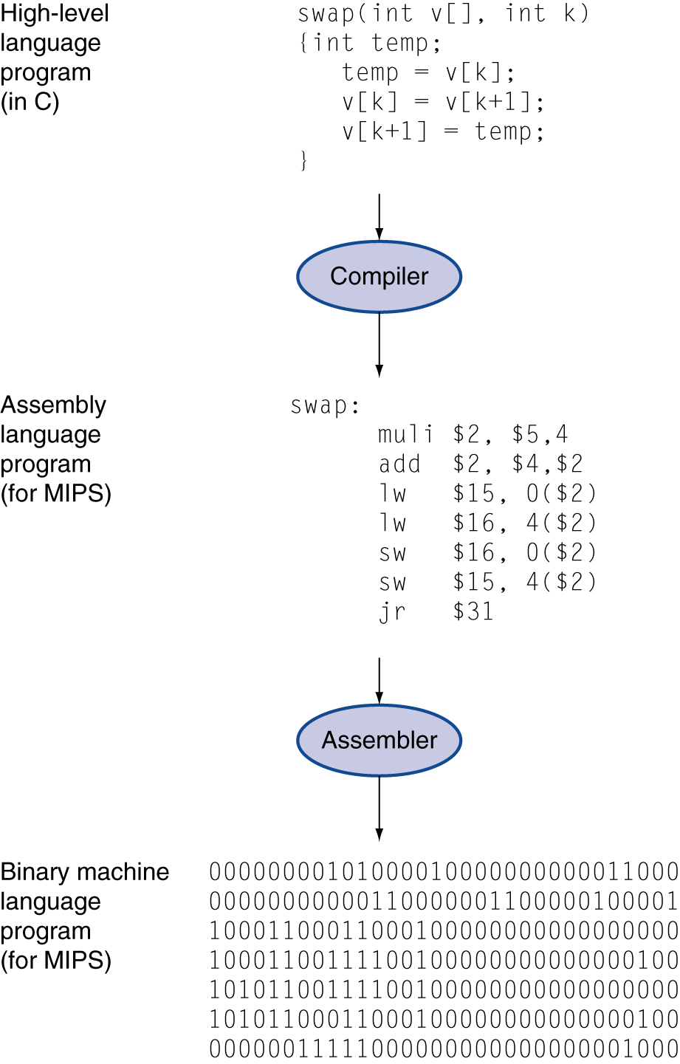
Levels of Program Code
High-level language
Level of abstraction closer to problem domain
Provides for productivity and portability
Assembly language
Textual representation of instructions
Hardware representation
Binary digits (bits)
Encoded instructions and data

Slide 5
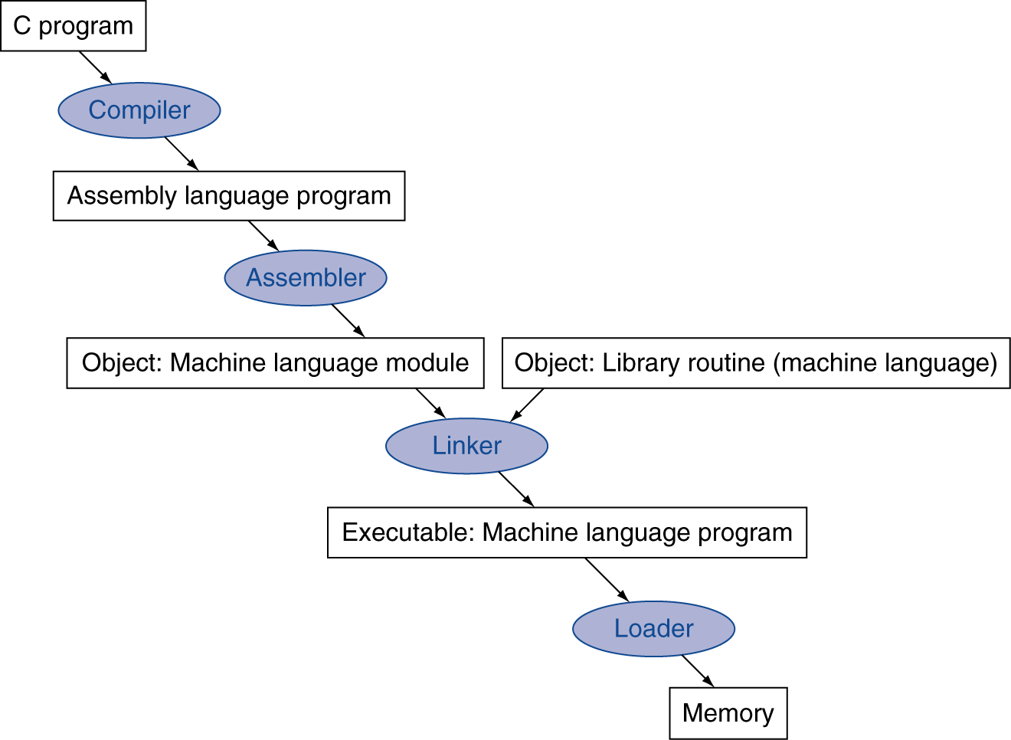
Translation and Startup
Many compilers produce object modules directly
Static linking

Slide 6
Translation and Startup
Calc.cpp
Many compilers produce object modules directly
Compiler
Calc.s
Assembler
Calc.o
Linker
calc
./calc

Slide 7
Functions
Functions are blocks of code that perform a number of pre-defined commands
There can be only one function of a given name
Functions enable abstraction
Enable code reuse – Can be called from various locations
You can use:
Create your own functions
Build-library functions
cout
cin

Slide 8
C++ Functions
#include <iostream>
using namespace std;
int getSum(int a, int b)
{
return a + b;
}
int main()
{
int num1 = 5, num2 = 10;
int results = getSum(num1, num2);
cout << results << endl;
}

Slide 9
C++ Functions
#include <iostream>
using namespace std;
int getSum(int a, int b)
{
return a + b;
}
int main()
{
int num1 = 5, num2 = 10;
int results = getSum(num1, num2);
cout << results << endl;
}
/* Compiles and
prints out 15 */

Slide 10
C++ Functions
#include <iostream>
using namespace std;
int main()
{
int num1 = 5, num2 = 10;
int results = getSum(num1, num2);
cout << results << endl;
}
int getSum(int a, int b)
{
return a * b;
}

Slide 11
Function prototypes
Function prototypes informs the compiler about the existence of a function
#include <iostream>
using namespace std;
int getSum(int a, int b); /* prototype - function declaration */
int main()
{
int num1 = 5, num2 = 10;
int results = getSum(num1, num2);
cout << results << endl;
}
int getSum(int a, int b) /* function definition */
{
return a * b;
}

Slide 12
Passing Values to Functions
#include <iostream>
Using namespace std;
/* prototypes */
void printValue(int i); /* i is a value */
void getValue1(int* pi); /* pi is a pointer */
void getValue2(char& ch); /* ch is a reference */
int main() {
char ch1; int num1, num0 = 10;
printValue(num0);
getValue1(&num1);
getValue2(ch1);
cout << num1 << “ and “ << ch1 << endl;
}
void printValue(int i) { /* passing by value */
cout << i << endl;
}
void getValue1(int* pi) { /* passing by pointers */
cin >> *pi;
}
void getValue2(char& ch) { /* passing by reference */
cin >> ch;
}
passing by
reference

Slide 13
Comments /* */, //
Always comment your code
/**Project: SortAlgorith.c
* Author: John Kimani
* Date: Created on Jan 08, 2015
* Purpose: This program reads in 10 numbers and sorts them in ascending order
*/
#include<stdio.h>
// prototype - function declaration
void PrintData(double speed1, char* name1, int age1, char gender);
int main()
{
// Calls printData to print the values
PrintData(16.3, “John”, 15, ‘M’);
} //end main

Slide 14
Comments
/**Function: PrintData
* Input: Runners speed, name, age, gender
* Output: None:
* Purpose: Prints the competitors information
*/
void PrintData(double speed1, char* name1, int age1, char gender)
{
//Prints the information passed into the funtion
printf(“Speed: %g\n Name: %s\n Age: %i\n M/F: %c\n", speed1, name1, age1, gender);
}// end function1

Slide 15
Coding Standards
For procedural programming:
Every function should have a preamble that describes in a few sentences the purpose of the function, describes the input variables (type and range), the output variables (type and range), and describes any side effects (e.g., modification of global variables, memory allocation, etc.).
Every line of code should be commented.
Variable names should be descriptive and should be nouns. Variables names should be lower-case.
Function names should be descriptive and should be verbs. Function names should be lower-case.
Error checking should be used when calling library and syscall functions.
Use proper indentation to clearly define control flow in your program.
Utilize structs whenever possible to build reusable data structures.
Functions should be limited in length to a single page of code.
For larger programs, create and use header files to remove function declarations and definitions in the main file.
For procedural programming:
Every function should have a preamble that describes in a few sentences the purpose of the function, describes the input variables (type and range), the output variables (type and range), and describes any side effects (e.g., modification of global variables, memory allocation, etc.).
Every line of code should be commented.
Variable names should be descriptive and should be nouns. Variables names should be lower-case.
Function names should be descriptive and should be verbs. Function names should be lower-case.
Error checking should be used when calling library and syscall functions.
Use proper indentation to clearly define control flow in your program.
Utilize structs whenever possible to build reusable data structures.
Functions should be limited in length to a single page of code.
For larger programs, create and use header files to remove function declarations and definitions in the main file.

Slide 16
C++ in Embedded Systems
Advantages of C++ in Embedded Systems
Object oriented programming
Classes
Inheritance
Virtual functions
Templates
namespaces

Slide 17
Resources on Learning C++ Programming
C++ Tutorial:
http://www.learncpp.com/

