Slide 1
Unix/Linux Tutorial
EECE 2160: Embedded Design: Enabling Robotics
Slides adapted from EECE 7352 Computer Architecture

Slide 2
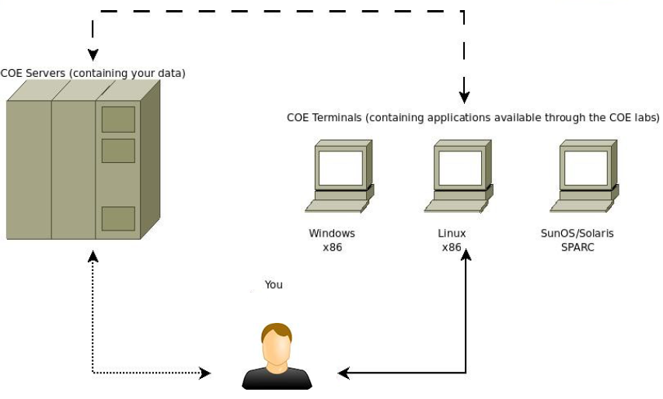
COE Lab Architecture

Slide 3
Access COE Lab remotely
SSH
“secure shell”: a network protocol for secure data communication
Typically used to log into a remote machine and execute commands in command-line
SSH tools
In Windows:
Putty
MobaXTerm
In Linux/Mac: ssh is already installed, can be used directly from a terminal

Slide 4
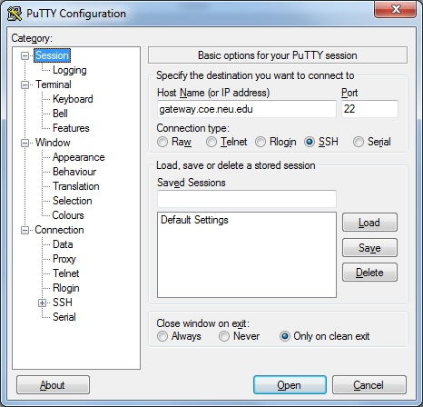
Under Windows
Putty: http://www.chiark.greenend.org.uk/~sgtatham/putty/download.html

Slide 5
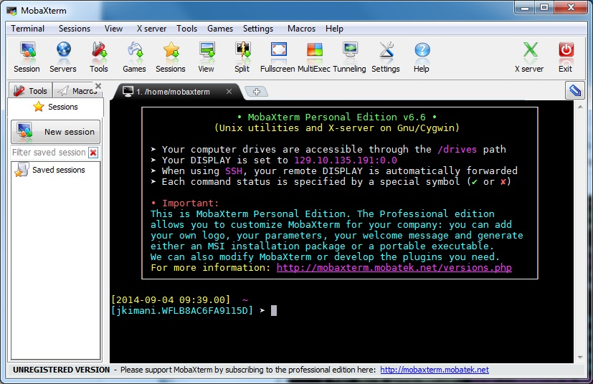
Under Windows
MobaXTerm: http://mobaxterm.mobatek.net/

Slide 6
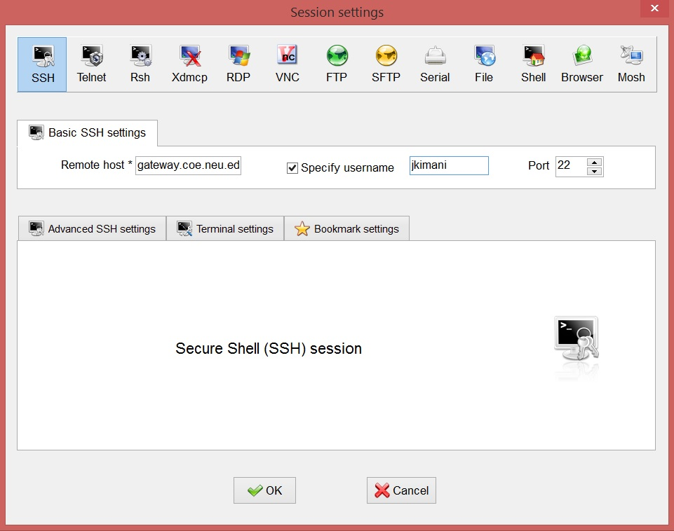
Access COE Linux on MobaXterm
1. Select “SSH”
2. Enter
“gateway.coe.neu.edu”
3. Check to specify your username
4. Enter your username
5. Click “OK”

Slide 7
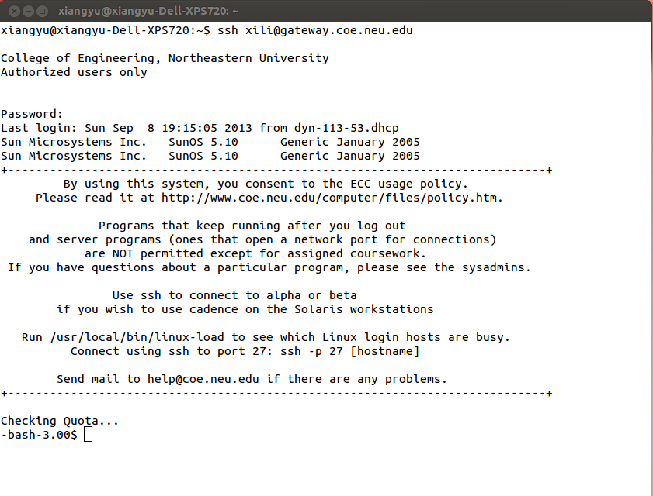
Under Linux
Terminal

Slide 8
Using the COE Linux systems
You will use your COE login and password in the following steps
ssh to “gateway.coe.neu.edu”
Respond with your password when requested. You should be able to login.

Slide 9
Shell
A program that takes keyboard commands and passes them to the operating system to carry out.
Bourne Shell (sh)
Bourne-Again Shell (bash)
Korn Shell(ksh)
Tab completion
press key “Tab” to automatically fills in partially typed commands.
Ctrl + c
Abort current task and regain user control

Slide 10
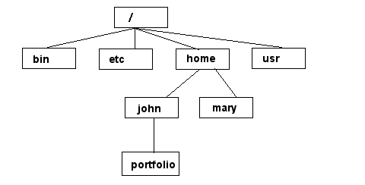
Unix/Linux File System
NOTE: Unix file names
are CASE SENSITIVE!
/home/mary/
/home/john/portfolio/
The Path

Slide 11
General Commands
who
shows who is connected to the server
pwd (printing working directory)
shows the path of the current directory
ps (process status)
shows running processes on current machine
ls (list)
list files and directories
man (manual)
display the manual of the command

Slide 12
General Commands
whereis
locate the commands
exit
close ssh connection

Slide 13
Navigation Commands
cd (change directory)
cd .. (change to parent directory)
cd ~ (change to home directory)
cd / (change to root directory)
ls (list files and directories)
ls -a (list all entries)
ls -l (list in long format)
ls -al (options can be combined)
less / more
find (locate files or directory)
find / -name file-name.txt

Slide 14
File and Directory Commands
mkdir (make directory)
mkdir <directory-name>
mv (move): move file/directory, rename
mv <old-file> <new-file>
mv <old-directory> <new-directory>
mv <file> <directory>
rm (remove): delete file
rm <file-name>
rm -r: delete directory (recursively)
rm -r <directory-name>

Slide 15
File and Directory Commands
cp (copy file)
cp file.txt newfile.txt
cp file.txt ./TA
copy all files to a directory
cp ./TA/* ~/TA-backup
copy both files and directories (recursively)
cp -r ./TA/* ~/TA-backup

Slide 16
Example Task
To find your current path use “pwd”
$ pwd
/users/Faculty/jkimani
To create a directory use “mkdir”
$ mkdir EECE2160
To change to a specific directory use “cd”
$ cd EECE2160
$ pwd
/users/Faculty/jkimani/EECE2160
To change to your home directory use “cd”
$ cd
$ pwd
/users/Faculty/jkimani
To move up one directory level use “..”
$ cd ..
$ pwd
/users/Faculty

Slide 17
File permissions
Each file in Unix/Linux has an associated permission level
This allows the user to prevent others from reading/writing/executing their files or directories
Use “ls -l filename” to find the permission level of that file

Slide 18
Permission levels (Files and directories)
-bash-3.00$ ls -l
drwxr-xr-x 2 jkimani Faculty 4096 Sep 3 22:21 C_Programs
-rw-r--r-- 1 jkimani Faculty 122 Sep 4 10:22 Exercise1.c
1st Character distinguishes files, directories, & links
“-” normal file
“d” directory
“l” symbolic link
Permission levels
“r” means “read only” permission
“w” means “write” permission
“x” means “execute” permission

Slide 19
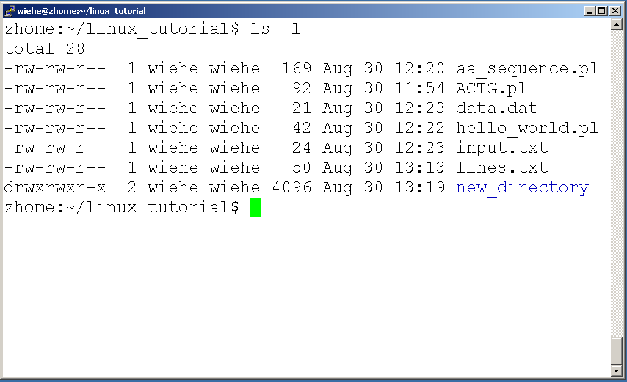
File Permissions
User (you) “u”

Slide 20
File Permissions
Group “g”

Slide 21
File Permissions
Other (The World) “o”

Slide 22
Command: chmod
If you own the file, you can change it’s permissions with “chmod”
Syntax: chmod [user/group/others/all]+[permission] [file(s)]
Example:
See the tutorial and the manual pages on how to use this command
Be very careful when using this command
Before: | -rw-r--r-- publicity.html
Command: | chmod og=rw publicity.html
After: | -rw-rw-rw- publicity.html

Slide 23
Transferring Files
SCP
Secure copy protocol
Command-line tool in shell
can transfer files between your local machine and a COE lab machine
Example:
scp localfile.txt username@gateway.coe.neu.edu:~/remotefile.txt
scp username@gateway.coe.neu.edu:~/remotefile.txt localfile.txt
SFTP
Secure file transfer protocol
Typically used in Windows GUI mode
winscp: http://winscp.net/eng/index.php

Slide 24
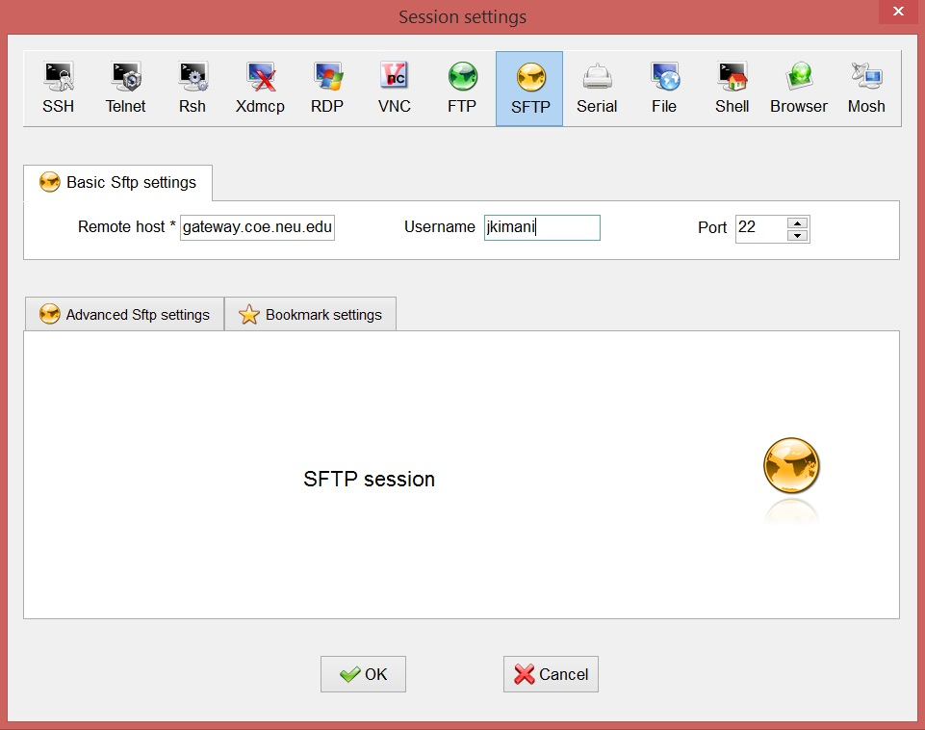
Transferring Files on MobaXterm
1. Select “SFTP”
2. Enter
“gateway.coe.neu.edu”
3. Enter your username
4. Click “OK”

Slide 25
GCC
GNU Compiler Collection
C programs compiler used under linux/unix
Example
gcc helloworld.c (generates an a.out executable binary, ./a.out to run it)
gcc helloworld.c -o helloworld.out (generate helloworld.out instead of a.out as default)
gcc -S helloworld.c (generates assembly code)
gcc -O<n> myfile.c (choose O0, O1,O2,O3 as optimization levels)

Slide 26
Command Line Text Editors
Vi (Vim is improved Vi)
http://yannesposito.com/Scratch/en/blog/Learn-Vim-Progressively/
Nano
http://www.nano-editor.org/dist/v2.2/nano.html
Emacs
http://www.gnu.org/software/emacs/tour/

Slide 27
Vi
Two modes
Command mode: typing commands which cause actions to be taken on the file, type “i” to enter insert mode
Insert mode: where entered text is inserted into the file, type “ESC” to exit to command mode
Commands
vi myfile.txt (open myfile.txt using vi)
i (enter insert mode, then you can type)
ESC :w (save modified file)
ESC :q (exit file without saving)
ESC :wq (save & exit)
ESC :x (save & exit)

Slide 28
Linux Tutorial Exercise
Unix Tutorial for Beginners
http://www.ee.surrey.ac.uk/Teaching/Unix/

