Slide 1
EECE 2160: Embedded Design: Enabling Robotics
Prof. John Kimani
Debugging
Textbook: Chapter 15 - Testing and Debugging

Slide 2
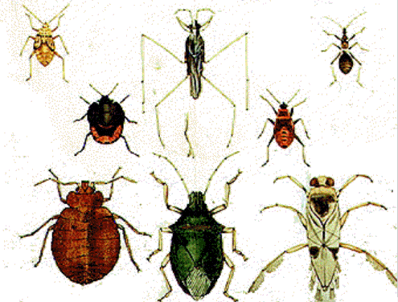
Debugging
Debugging is a black art
Outline for discussion
Prevent Bugs
relation to testing
why debugging is hard
types of bugs
process
techniques
tools
avoiding bugs

Slide 3
Prevent Bugs
Create functions to handle repeated tasks.
Give meaningful variable names
Use indentations.
Read your code after typing.
Turn on compiler warnings.
Avoid global variables.

Slide 4
Prevent Bugs
Write small experimental code before integrating into the whole program.
Add one feature each time.
Have a testing plan.
Check the return values.
Check array indexes.

Slide 5
Debugging and testing
Testing and debugging go together like peas in a pod:
Testing finds errors; debugging localizes and repairs them
Together these form the “testing/debugging cycle”: we test, then debug, then repeat
Any debugging should be followed by a reapplication of all relevant tests, particularly regression tests. This avoids (reduces) the introduction of new bugs when debugging.
Testing and debugging need not be done by the same people (and often should not be)

Slide 6
Why debugging is hard
There may be no obvious relationship between the external manifestation(s) of an error and its internal cause(s)
Symptom and cause may be in remote parts of the program
Changes (new features, bug fixes) in program may mask (or modify) bugs
Symptom may be due to human mistake or misunderstanding that is difficult to trace
Bug may depend on other software/system state, things others did to you systems weeks/months ago

Slide 7
Types of bugs
Types of bugs (gotta love em):
Compile time: syntax, spelling, static type mismatch
Usually caught with compiler
Heed warnings – typically they point to a real issue!
Design: flawed algorithm
Incorrect outputs
Program logic (if/else, loop termination, select case, etc).
Incorrect outputs
Memory nonsense: null pointers, array bounds, bad types, leaks
Runtime exceptions
Interface errors between modules, threads, programs (in particular, with shared resources: sockets, files, memory, etc.)
Runtime exceptions
Deadlocks: multiple processes fighting for a resource
System freezes or never-ending process

Slide 8
What is a Debugger?
“A software tool that is used to detect the source of program or script errors, by performing step-by-step execution of application code and viewing the content of code variables.” -MSDN

Slide 9
What is a Debugger? (con't)
A debugger is not an IDE
Though the two can be integrated, they are separate entities
A debugger loads in a program (compiled executable, or interpreted source code) and allows the user to trace through the execution
Debuggers typically can do disassembly, stack traces, expression watches, and more

Slide 10
Why use a Debugger?
No need for precognition of what the error might be
Flexible
Allows for “live” error checking – no need to re-write and re-compile when you realize a certain type of error may be occurring
Dynamic
Can view the entire relevant scope
Beach time!!!

Slide 11
Why people don’t use a Debugger?
With simple errors, may not want to bother with starting up the debugger environment
Obvious error
Simple to check using prints/asserts
Hard-to-use debugger environment
Error occurs in optimized code
Changes execution of program (error doesn’t occur while running debugger)

Slide 12
Debugging techniques, 1
Execution tracing
running the program
print
trace utilities
single stepping in debugger
hand simulation

Slide 13
Debugging techniques, 2
Interface checking
check procedure parameter number/type (if not enforced by compiler) and value
defensive programming: check inputs/results from other modules
documents assumptions about caller/callee relationships in modules, communication protocols, etc
Assertions: include range constraints or other information with data
Skipping code: comment out suspect code, then check if error remains

Slide 14
Execution Tracing
Follows the program through the execution. Users can step through line-by-line, or use breakpoints
Typically allows for “watches” on – registers, memory locations, symbols
Allows for tracing up the stack of runtime errors (back traces)
Allows user to trace the causes of unexpected behaviour and fix them

Slide 15
Symbol Information
Problem – a compiler/assembler translates variable names and other symbols into internally consistent memory addresses
How does a debugger know which location is denoted by a particular symbol?
We need a “debug” executable

Slide 16
Debug vs. Release Builds
Debug builds usually are not optimized
Debug executables contain:
program's symbol tables
location of the source file
line number tags for assembly instructions
GCC/GDB allows debugging of optimized code

Slide 17
Bug hunting with print
Weak form of debugging, but still common
How bug hunting with print can be made more useful:
Print variables other than just those you think suspect
Print valuable statements (not just “hi\n”)
Use exit() to concentrate on a part of a program
Move print through a through program to track down a bug

Slide 18
Debugging with print (cont)
Building debugging with print into a program (more common/valuable):
Printf/cout messages, variables/test results in useful places throughout program
Use a ‘debug’ or ‘debug_level’ global flag to turn debugging messages on or off, or change “levels”
Possibly use a source file preprocessor (#ifdef) to insert/remove debug statements
Often part of “regression testing” so automated scripts can test output of many things at once

Slide 19
Tools
Tracing programs:
strace, truss (print out system calls),
/bin/bash –X to get a shell script to say what its doing
Command-line debuggers :
gdb (C, C++), jdb (java), “perl -d”
Random stuff:
electric fence or malloc_debug, mtrace, etc (a specialized malloc() for finding memory leaks in C/C++)
purify (Part of Rational Suite, a really good memory debugging tools for C/C++ programs)

Slide 20

Using gdb
Compile debugging information into your program:
gcc -g <program>
Read the manual:
man gdb

Slide 21
gdb comands
run/continue/next/step: start the program, continue running until break, next line (don’t step into subroutines), next line (step into subroutines).
break <name>: set a break point on the named subroutine. Debugger will halt program execution when subroutine called.
backtrace: print a stack trace.
print <expr>: execute expression in the current program state, and print results (expression may contain assignments, function calls).
help: print the help menu. help <subject> prints a subject menu.
quit: exit gdb.

Slide 22
General gdb
run starts the program
set args controls the arguments to the program
breakpoints control where the debugger stops the program (set with C-x space)
next moves one step forward
step moves one step forward and also traverses function calls
continue runs the program until the next breakpoint

Slide 23
General gdb
bt shows the current backtrace (also where)
up/down move up down the stack
f # lets you switch to frame # in the current backtrace
set var=value
call allows call of a function (the syntax can get funky)
jump (jump to a particular line of code)
thread # lets you switch to a particular thread

Slide 24
Advanced GDB
watchpoints let you check if an expression changes
catchpoints let you know when interesting things like exec calls or library loads happen
watchpoints can be quite slow, best to combine with breakpoints
Notes:
Talk about why the features are useful and point them towards documentation. Do not run an example here as it’s too hard to motivate.

Slide 25
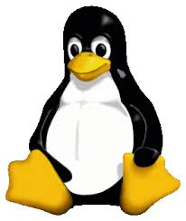
Other linux Tools
Data Display Debugger (DDD) is good for visualizing your program data www.gnu.org/software/ddd
strace / truss / ktrace let you know what system calls a process is making
gcov lets you see which parts of your code are getting executed
Profilers (gprof) to see where you are spending “time” which can help with performance logic bugs

Slide 26
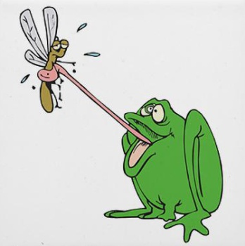
Avoiding bugs in the first place
Coding style: use clear, consistent style and useful naming standards
Document everything, from architecture and interface specification documents to comments on code lines
Hold code reviews
Program defensively
Use/implement exception handling liberally; think constantly about anomalous conditions
Be suspicious of cut/paste
Consider using an integrated development environment (IDE) with dynamic syntax checking

Slide 27
Code reviews
Primary programmer(s) for some piece of code presents and explains that code, line by line.
Audience of programmers experienced in language, code’s general domain. Audience may also contain designers, testers, customers and others less versed in code but concerned with quality and consistency.
Review is a dialogue: audience pushes presenters to reevaluate and rationalize their implementation decisions.
Extremely useful: reviews often turn up outright errors, inconsistencies, inefficiencies and unconsidered exceptional conditions.
Also useful in familiarizing a project team with a member’s code.

Slide 28
References and Resources
Textbook: Chapter 15 - Testing and Debugging
Introduction to Computing Systems: From Bits and Gates to C and Beyond, 2nd edition, © 2003 Author: Yale Patt and Sanjay Patel
GDB Tutorial
http://www.tutorialspoint.com/gnu_debugger/
The GNU GDB http://www.gnu.org/software/gdb/

