Slide 1
EECE 2160: Embedded Design: Enabling Robotics
Prof. John Kimani
Introduction to Object-oriented C++: Inheritance

Slide 2
Inheritance
The mechanism by which one class can acquires the properties of another class, and then extend that class
We will utilize the “IS_A” relationship to define inheritance
e.g. A Car is a Vehicle
Vehicle
class Car : public Vehicle { private: ... public: ... };
(base class)
Car
(derived class)

Slide 3
Arrange concepts into an inheritance hierarchy
Concepts at higher levels are more general
Concepts at lower levels are more specific (inherit properties of concepts at higher levels)
4-door Car
Boat
Bicycle
Car
Vehicle
2-door Car
Sailboat
Wheeled vehicle

Slide 4
Arrange concepts into an inheritance hierarchy
Concepts at higher levels are more general
Concepts at lower levels are more specific (inherit properties of concepts at higher levels)
Vehicle
Wheeled vehicle
Boat
Car
Bicycle
Sailboat
2-door Car
4-door Car

Slide 5
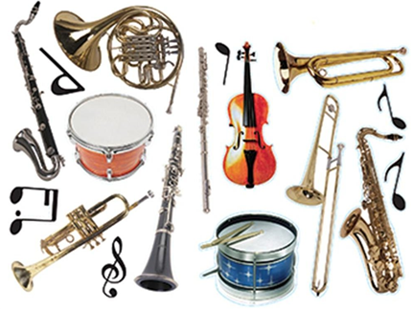
Arrange concepts into an inheritance hierarchy
Concepts at higher levels are more general
Concepts at lower levels are more specific (inherit properties of concepts at higher levels)

Slide 6
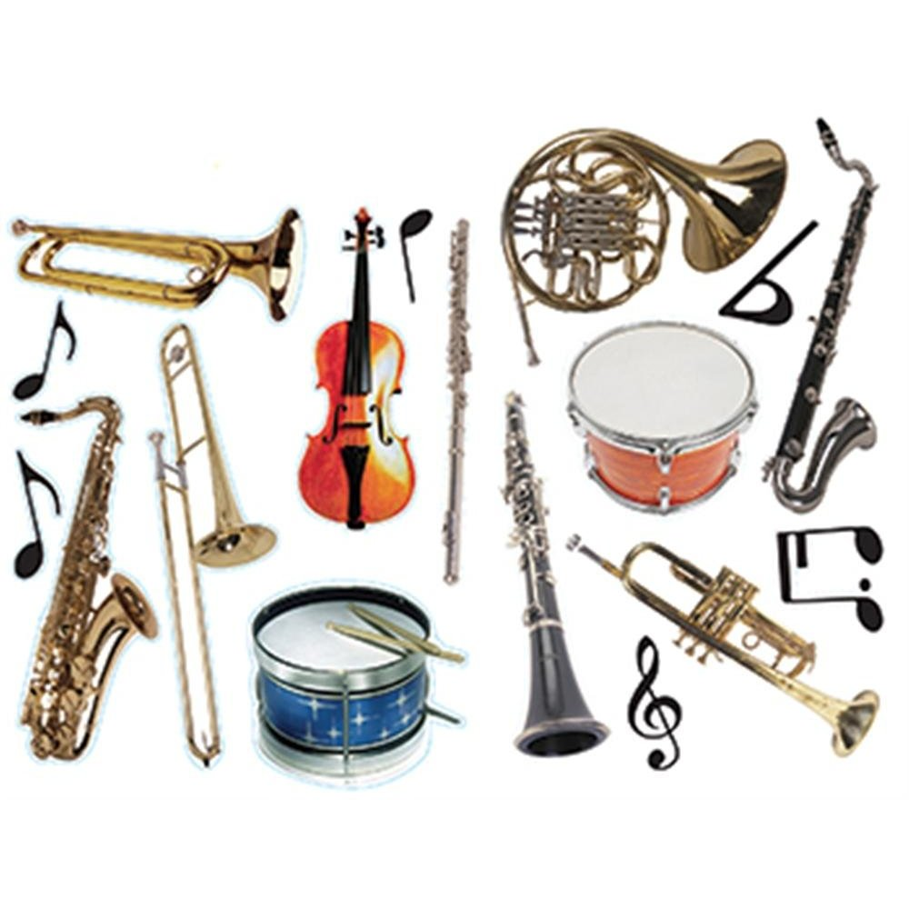
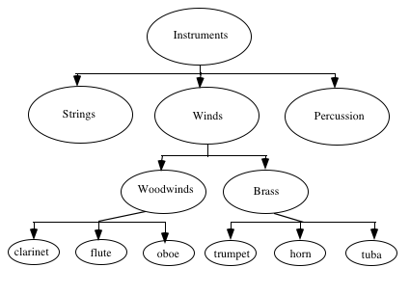
More Hierarchies

Slide 7
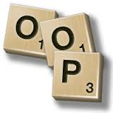
C++ and inheritance
The language mechanism by which one class acquires the properties (data and operations) of another class
Base Class (or superclass): the class being inherited from
Derived Class (or subclass): the class that inherits

Slide 8
Advantages of inheritance
When a class inherits from another class, there are 3 benefits:
You can reuse the methods and data of the existing class
(2) You can extend the existing class by adding new data and new methods
(3) You can modify the existing class by overloading its methods with your own implementations

Slide 9

Rules for building a class hierarchy
(base class)
W
Derived classes are special cases of base classes
A derived class can also serve as a base class for new classes.
There is no limit on the depth of inheritance allowed in C++ (as far as it is within the limits of your compiler)
It is possible for a class to be a base class for more than one derived class
X
Y
Z
(subclasses)

Slide 10
Multiple Inheritance
Derived classes can inherit from more than one base classes
Y
X
Z
(base classes for W)
W
(derived class, W)
class W : public Y, public X, public Z {
private:
...
public:
...
};

Slide 11
C++ Classes -Inheritance
#include <iostream>
#include <string>
using namespace std;
class Shape {
private:
int area;
public:
Shape():area(99){}//Constructor
int getArea() { return area; }
};
class Circle : public Shape {
private:
int radius;
public:
Circle():radius(5){}//Constructor
int getRadius(){return radius;}
};
int main() {
Circle myCircle;//create object
cout<<myCircle.getRadius();
// Prints 5
cout << endl;
cout << myCircle.getArea();
// Prints 99
cout << endl;
Shape myShape;
cout << myShape.getArea();
// Prints 99
cout<< myShape.getRadius();
// Not allowed! No access to derive classes
}

Slide 12
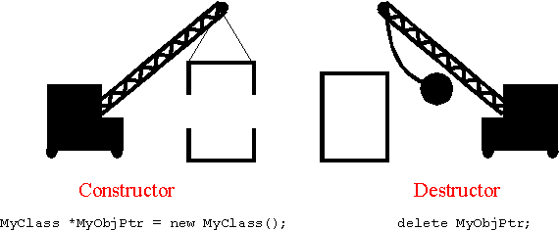
Constructors and destructors
You cannot override a base class constructor with a derived class constructor (rather, the derived class constructor calls the base class constructor first)
All base class destructors should be declared virtual
Virtual destructors are called in reverse order from the constructors for derived class objects

Slide 13
Constructors and Destructors
// include statements go here
class Shape {
private:
int area;
public:
Shape():area(99) {
cout << “\nShape Created\n”;}
~Shape(){
cout<<“\nShape Destroyed\n”;}
};
class Circle : public Shape {
private:
int radius;
public:
Circle():radius(5) {
cout << “\nCircle Created\n”;}
~Circle(){
cout<<“\nCircle Destroyed\n”;}
};
int main() {
//create object
Circle myCircle;
cout<< “More code …\n”;
}
g++ Shape.cpp –o shape
./shape
Shape Created
Circle Created
More Code …
Circle Destroyed
Shape Destroyed

Slide 14
C++ Classes -Default Constructors
// include statements go here
class Shape {
private:
int area;
public:
Shape():area(99) {
cout << “\nShape Created\n”;}
~Shape(){
cout<<“\nShape Destroyed\n”;}
};
class Circle : public Shape {
private:
int radius;
public:
Circle():radius(5) {
cout << “\nCircle Created\n”;}
~Circle(){
cout<<“\nCircle Destroyed\n”;}
};
int main() {
//create object
Shape myShape;
Circle myCircle;
cout<< “More code …\n”;
}
g++ Shape.cpp –o shape
./shape
Shape Created
Shape Created
Circle Created
More Code …
Circle Destroyed
Shape Destroyed
Shape Destroyed

Slide 15
C++ Classes -Default Constructors
// include statements go here
class AA {
public:
AA(){cout << “\nAA”;}
};
class BB : public AA {
public:
BB(){cout << “\nBB”;}
};
class CC : public BB {
public:
CC(){cout << “\nCC”;}
};
class DD : public CC {
public:
DD(){cout << “\nDD”;}
};
int main() {
//create object
cout<< “\nCreating DD”;
DD dObject;
cout<<“\nDone creating DD”;
}
}
g++ Shape.cpp –o shape
./shape
Creating DD
AA
BB
CC
DD
Done creating DD

Slide 16

Protected and Private Inheritance
Y
class X : protected Y {
...
};
With protected inheritance, public and protected members of Y become protected in X (i.e., classes derived from X inherit the public members of Y as protected)
With private inheritance, public and protected members of Y become private in X (i.e., classes derived from X inherit the public members of Y as private)
Default inheritance: private
X

Slide 17
Public Inheritance
class Base {
private:
int bPrivate;
public:
int bPublic;
protected:
int bProtected;
};
class Derived : public Base {
public:
Circle() {
bPrivate = 5; //NOT allowed
bPublic = 10; //allowed
bProtected = 15; //allowed
};
int main() {
Base cBase;
cBase.bPublic = 10; //allowed
//NOT allowed
cBase.bPrivate = 10; //NOT ok cBase.bProtected = 10; //NOT
Derived drv;
drv.bPublic = 10; //allowed
//NOT allowed
drv.bPrivate = 10; //NOT ok drv.bProtected = 10; //NOT ok
}

Slide 18
Private Inheritance
class Base {
private:
int bPrivate;
public:
int bPublic;
protected:
int bProtected;
};
class Derived : private Base {
public:
Circle() {
bPrivate = 5; //NOT allowed
bPublic = 10; //allowed
bProtected = 15; //allowed
};
int main() {
Base cBase;
cBase.bPublic = 10; //allowed
//NOT allowed
cBase.bPrivate = 10; //NOT ok cBase.bProtected = 10; //NOT
Derived drv;
//NOT allowed
drv.bPublic = 10; //NOT ok drv.bPrivate = 10; //NOT ok drv.bProtected = 10; //NOT ok
}

Slide 19
Protected Inheritance
class Base {
private:
int bPrivate;
public:
int bPublic;
protected:
int bProtected;
};
class Derived : protected Base {
public:
Circle() {
bPrivate = 5; //NOT allowed
bPublic = 10; //allowed
bProtected = 15; //allowed
};
int main() {
Base cBase;
cBase.bPublic = 10; //allowed
//NOT allowed
cBase.bPrivate = 10; //NOT ok cBase.bProtected = 10; //NOT
Derived drv;
//NOT allowed
drv.bPublic = 10; //NOT ok drv.bPrivate = 10; //NOT ok drv.bProtected = 10; //NOT ok
}

Slide 20
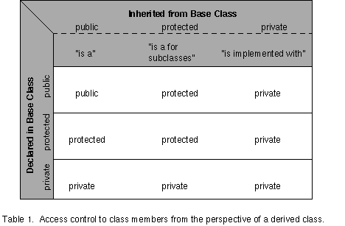
Inheritance and accessibility
Public inheritance means that the public and protected members of the base class retain their status for the derived class. Protected inheritance from a base class means that public and private members of the base class are protected in the derived class. Private inheritance means that public and protected members of the base class are private in the derived class. Private inheritance can be used to insure that a public interface inherited from a base class is not available (i.e. not public) to the users of the derived class.

Slide 21

Protected class members
Derived classes cannot access the private data of the base class
Declaring methods and data of the base class as protected (instead of private) allows derived classes to access them
Objects outside the class, however, cannot access them (same as private)

Slide 22
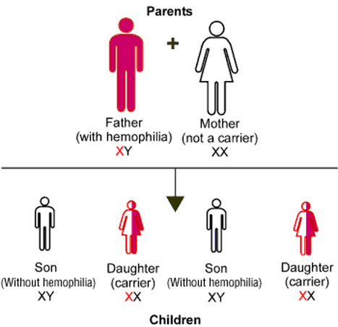
Inheritance and accessibility
A class inherits the behavior of another class and enhances it in some way
Inheritance does not mean inheriting access to another class’ private members

Slide 23
An Inheritance Example
#include <iostream>
#include <string>
using namespace std;
class Shape {
private:
int area;
public:
Shape() { area = 0; }
Shape(int theArea):area(theArea){}
int getArea() { return area; }
void setArea(int theArea)
{ area = theArea; }
void printShape() {
cout <<"Area is "<< area << endl;
}
};
class Circle: public Shape {
private:
string color;
public:
Circle() {color=“Unknown”;}
Circle(int area1,string col): Shape(area1)
{
color = col;
}
string getColor();
void setColor(string col);
void printCircle();
};

Slide 24
An Inheritance Example
class Circle: public Shape {
private:
string color;
public:
Circle() {color=“Unknown”;}
Circle(int area1,string col): Shape(area1)
{
color = col;
}
string getColor();
void setColor(string col);
void printCircle();
};
// Method Definitions
string Circle::getColor() {
return color;
}
void Circle::setColor(string col) {
color = col;
}
void Circle::printCircle() {
printShape();
cout << “ Color is: “ << color;
cout << endl;
}

Slide 25
Protected vs Private Inheritance
#include <iostream>
#include <string>
using namespace std;
class Shape {
protected:
int area;
public:
Shape() { area = 0; }
Shape(int theArea):area(theArea){}
int getArea() { return area; }
void setArea(int theArea)
{ area = theArea; }
void printShape() {
cout <<"Area is "<< area << endl;
}
};
class Circle: public Shape {
private:
string color;
public:
Circle() {color=“Unknown”;}
Circle(int area1,string col): Shape(area1)
{
color = col;
}
string getColor();
void setColor(string col);
void printCircle();
};

Slide 26
Protected vs Private Inheritance
class Circle: public Shape {
private:
string color;
public:
Circle() {color=“Unknown”;}
Circle(int area1,string col): Shape(area1)
{
color = col;
}
string getColor();
void setColor(string col);
void printCircle();
};
// Method Definitions
string Circle::getColor() {
return color;
}
void Circle::setColor(string col) {
color = col;
}
void Circle::printCircle() {
cout << “ Area is: “ << area;
cout << endl;
cout << “ Color is: “ << color;
cout << endl;
}

Slide 27
Another Example
int main() {
// Every new Circle object by default calls the Shape constructor
// first before calling the Circle constructor
cout << “Circle1's default values from default constructors:”;
Circle circle1;
circle1.printCircle();
cout << "\nCircle2's values initialized by both constructors:”;
Circle circle2(16, “Blue”);
circle2.printCircle();
cout <<“\nCircle2's values from getArea() and getColor() methods:”;
cout << “Circle2's area is: “ << circle2.getArea();
cout << “, and its color is: “ << circle2.getColor() << endl;
cout << “\nCircle1's new values:” << endl;
circle1.setArea(100);
circle1.setColor(“Red”);
circle1.printCircle();
}

Slide 28

Static vs. dynamic binding
Static Binding: the determination of which method to call at compile time
Dynamic Binding: the determination of which method to call at run time

Slide 29
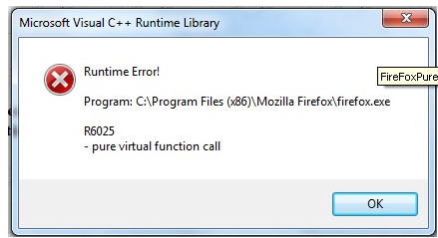
Virtual Functions
C++ uses virtual functions to implement run-time binding.
To force the compiler to generate code that guarantees dynamic binding, the word virtual should appear before the function declaration in the definition of the base class.

Slide 30
C++ Tutorial and Reference
http://www.learncpp.com/ - Chapter 11

Slide 31
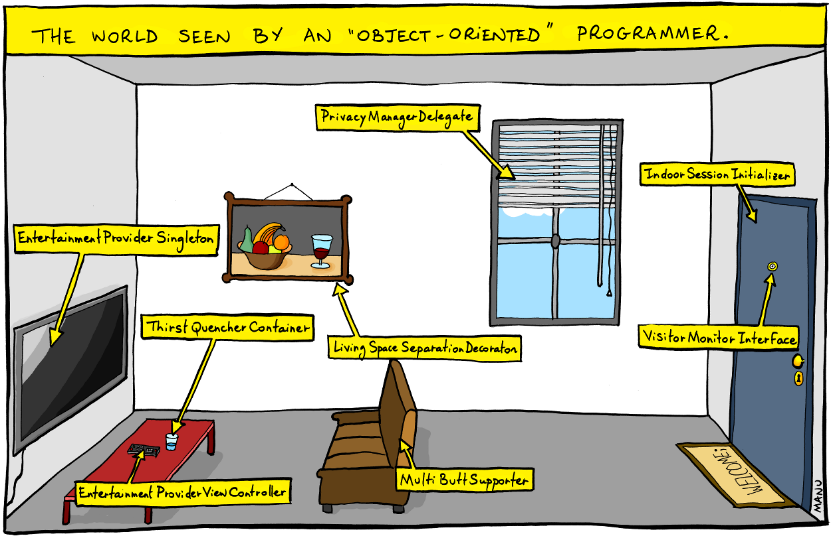
OOP

