Slide 1
EECE 2160: Embedded Design: Enabling Robotics
Prof. John Kimani
Header Files and Compiling Multiple Files

Slide 2
Using Multiple files in C/C++
Advantages of Multiple Files
Reduce redundant work
Improve portability
Enhance performance
Partition work for collaboration
Save compilation time

Slide 3
Header Files
A header file is a file with extension .h
contains C/C++ function declarations and macro definitions
header files are included using the preprocessing directive #include
Two types of header files:
Files that come with your compiler.
#include <stdio.h>
Files that the programmer writes
#include “program.h”

Slide 4
Header Files
Header files can contain:
All the constants
static const double PI = 3.14159;
Macros
#define PI 3.14159
#define REMAINDER(X, Y) ((X) % (Y))
Function prototypes
void printMyStack();
struct data structures definition
System wide global variables

Slide 5
C++ program example (Single file)
#include <iostream>
#define SIZE 500
int getSum(int data1, int data2);
int getDifference(int data1, int data2);
void printLimit();
int main() {
int a = 25, b = 15;
std::cout << “The sum is = “ << getSum(a, b) << endl;
std::cout << “The difference is = “ << getDifference(a, b) << endl;
printLimit();
return 0;
}
int getSum(int data1, int data2) {
return data1 + data2;
}
int getDifference(int data1, int data2) {
return data1 - data2;
}
void printLimit() {
std::cout << “ The limit is “ << SIZE << endl;
}

Slide 6
C++ program example (Single file)
#include <iostream>
#define SIZE 500
int getSum(int data1, int data2);
int getDifference(int data1, int data2);
void printLimit();
int main() {
int a = 25, b = 15;
std::cout << “The sum is = “ << getSum(a, b) << endl;
std::cout << “The difference is = “ << getDifference(a, b) << endl;
printLimit();
return 0;
}
int getSum(int data1, int data2) {
return data1 + data2;
}
int getDifference(int data1, int data2) {
return data1 - data2;
}
void printLimit() {
std::cout << “ The limit is “ << SIZE << endl;
}
v
This code goes to
mathfile.h
v
This code goes to
mathMain.cpp
This code goes to
mathfile.cpp

Slide 7
Example program: mathfile.h header file
#ifndef MATHFILE_H
#define MATHFILE_H
#define SIZE 500
int getSum(int data1, int data2);
int getDifference(int data1, int data2);
void printLimit();
#endif

Slide 8
Example program: mathfile.cpp source file
#include <iostream> //For cout statement
#include “mathfile.h” //Needs the header file
int getSum(int data1, int data2) {
return data1 + data2;
}
int getDifference(int data1, int data2) {
return data1 - data2;
}
void printLimit() {
std::cout << “ The limit is “<<SIZE <<endl;
}

Slide 9
Example program: mathMain.cpp source file
#include <iostream> //For cout statement
#include “mathfile.h” //Needs the header file
int main() {
int a = 25, b = 15;
std::cout << “The sum is = “ << getSum(a, b) << endl;
std::cout << “The difference is = “ << getDifference(a, b) << endl;
printLimit();
return 0;
}
v

Slide 10
Compiling Multiple Files
//mathfile.h
#ifndef MATHFILE_H
#define MATHFILE_H
#define SIZE 500
int getSum(int data1, int data2);
int getDifference(int data1, int data2);
void printLimit();
#endif
//mathMain.cpp
#include <iostream>
#include “mathfile.h”
int main() {
int a = 25, b = 15;
std::cout<<“The sum is =“<< getSum(a, b) << endl;
std::cout<<“The difference is =“ << getDifference(a, b) << endl;
printLimit();
return 0;
}
Not compiled
Compiled
//mathfile.cpp
#include <iostream>
#include “mathfile.h”
int getSum(int data1, int data2) {
return data1 + data2;
}
int getDifference(int data1, int data2) {
return data1 - data2;
}
void printLimit() {
std::cout << “ The limit is “<<SIZE <<endl;
}
Compiled
Compiled files:
Source files (.c or .cpp)
Not Compiled:
Header files (.h or .hpp)

Slide 11
A C++ Class based Project example
#include <iostream>
#include <string>
using namespace std;
class Student
{
private:
int data1;
int data2;
public:
Student() {data1 = 0; data2 = 0;}
Student(int value1, int value2);
int getSum();
};
Student::Student(int value1, int value2) {
data1 = value1;
data2 = value2;
}
int Student::getSum() {
int sum = data1 + data2;
return sum;
}
int main()
{
int a = 85;
int b = 72;
Student myStudent(a, b);
cout << a << " + " << b << " = “;
cout << myStudent.getSum();
cout << endl;
}

Slide 12
A C++ “Student.cpp” example
#include <iostream>
#include <string>
using namespace std;
class Student
{
private:
int data1;
int data2;
public:
Student() {data1 = 0; data2 = 0;}
Student(int value1, int value2);
int getSum();
};
Student::Student(int value1, int value2) {
data1 = value1;
data2 = value2;
}
int Student::getSum() {
int sum = data1 + data2;
return sum;
}
int main()
{
int a = 85;
int b = 72;
Student myStudent(a, b);
cout << a << " + " << b << " = “;
cout << myStudent.getSum();
cout << endl;
}
StudentMain.cpp
Student.h
From this program, create 3
files and a Makefile to
compile the programs:
student.h
student.cpp
studentMain.cpp
Makefile
Student.cpp

Slide 13
Example program: Student.h header file
#ifndef STUDENT_H
#define STUDENT_H
class Student {
private:
int data1;
int data2;
public:
Student() {data1 = 0; data2 = 0;}
Student(int value1, int value2);
int getSum();
};
#endif

Slide 14
Example program: Student.cpp source file
#include “Student.h” //Needs the header file
Student::Student(int value1, int value2) {
data1 = value1;
data2 = value2;
}
int Student::getSum() {
int sum = data1 + data2;
return sum;
}

Slide 15
Example : StudentMain.cpp source file
#include <iostream>
#include <string>
#include “Student.h” //Needs the header file
using namespace std;
int main()
{
int a = 85;
int b = 72;
Student myStudent(a, b);
cout << a << " + " << b << " = “;
cout << myStudent.getSum();
cout << endl;
}

Slide 16
Your Turn
Download the program “ZedBoardLeds.cpp” from Blackboard.
Log into your COE Account
Convert the C++ program “ZedBoardLeds.cpp” into the following 3 Files.
ZedBoard.h // header file
ZedBoard.cpp // source file
ZedMain.cpp // main program

Slide 17
Makefiles Review
What is “make”?: The tool is designed to allow programmers to efficiently compile large complex programs with many components easily.
The “make” utility allows us to only compile those that have changed and the modules that depend upon them.
If any of the associated files have been modified, the make utility will execute a directive command just below the dependency line.

Slide 18
Makefiles: A Minimalist Approach
Rule-based
<target>: <dependency>
<buildCommand>
If file <target> does not exist, or <dependency> files are younger, then execute <buildCommand>
Note commands need to indented by <tab>
foo: foo.c
gcc foo.c –o foo

Slide 19
Makefiles: An Example
# Simple Makefile
homework2: homework2.c
gcc homework2.c -o homework2
To run the file and compile the program, we run the command make
make
The make command will build the first target which is the only target in this example.
If you want to build a specific target if there are multiple targets, you can specify the target with the make command
make homework2

Slide 20
Makefiles: An Example
# Simple Makefile
# define variable for
# rule to create target binary
# since this is the first rule it is also the default rule
# I.e. it will be executed if no target defined
homework2: homework2.c
gcc –g –Wall homework2.c -o homework2
clean:
rm -r homework2

Slide 21
Makefiles: Using Macros
Use variables/Symbols to make life easier
E.g. Project name. Define once reuse multiple times
# define variable for
# project name (base name of file)
PROJECT = homework2
# rule to create target binary
$(PROJECT): $(PROJECT).c
gcc -g -Wall $(PROJECT).c -o $(PROJECT)
“Phony” targets do not create files, will always be executed when called.
clean:
rm -r $(PROJECT)
Trigger the target by:
> make clean
Notes:
How to call the clean target?

Slide 22
Makefiles: Macros Example
# Simple Makefile
homework2: homework2.c
gcc –g –Wall homework2.c -o homework2
clean:
rm -r homework2
# Simple Makefile
PROJECT = homework2
CFLAGS = -g -Wall
$(PROJECT): $(PROJECT).c
gcc $(CFLAGS) $(PROJECT).c -o $(PROJECT)
clean:
rm -r $(PROJECT)

Slide 23
Components of a Makefile
Comments
Rules
Dependency Lines
Shell Lines
Macros
# Simple Makefile
PROJECT = homework2
CFLAGS = -g -Wall
$(PROJECT): $(PROJECT).c
gcc $(CFLAGS) $(PROJECT).c -o $(PROJECT)
clean:
rm -r $(PROJECT)

Slide 24
Compiling Multiple Files (Mathfile files)
//mathfile.h
#ifndef MATHFILE_H
#define MATHFILE_H
#define SIZE 500
int getSum(int data1, int data2);
int getDifference(int data1, int data2);
void printLimit();
#endif
//mathMain.cpp
#include <iostream>
#include “mathfile.h”
int main() {
int a = 25, b = 15;
std::cout<<“The sum is =“<< getSum(a, b) << endl;
std::cout<<“The difference is =“ << getDifference(a, b) << endl;
printLimit();
return 0;
}
Not compiled
Compiled
//mathfile.cpp
#include <iostream>
#include “mathfile.h”
int getSum(int data1, int data2) {
return data1 + data2;
}
int getDifference(int data1, int data2) {
return data1 - data2;
}
void printLimit() {
std::cout << “ The limit is “<<SIZE <<endl;
}
Compiled
Compiled files:
Source files (.c or .cpp)
Not Compiled:
Header files (.h or .hpp)

Slide 25
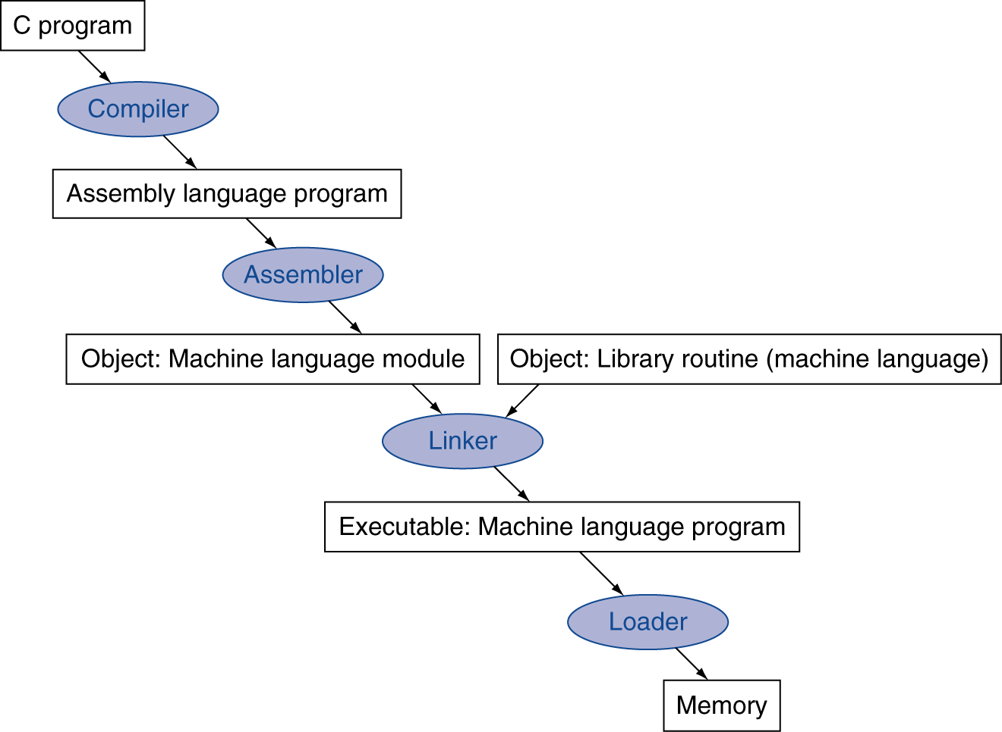
Compiler process
Calc.c
Many compilers produce object modules directly
Compiler
gcc –S
Calc.s
gcc –c
Assembler
Calc.o
Linker
gcc –o
calc
./calc

Slide 26
Example program: Makefile
# Math program Makefile
math1: mathMain.o mathfile.o
g++ mathMain.o mathfile.o -o math1
mathMain.o: mathMain.cpp mathfile.h
g++ -g -Wall -c mathMain.cpp
mathfile.o: mathfile.cpp mathfile.h
g++ -g -Wall -c mathfile.cpp
clean:
rm mathMain.o mathfile.o math1

Slide 27
Example program: Makefile
# Math program Makefile
GCC = g++
CFLAGS = -g -Wall
OBJS = mathMain.o mathfile.o
math1: $(OBJS)
$(GCC) $(OBJS) -o math1
mathMain.o: mathMain.c mathfile.h
$(GCC) $(CFLAGS) -c mathMain.c
mathfile.o: mathfile.c mathfile.h
$(GCC) $(CFLAGS) -c mathfile.c
clean:
rm $(OBJS) math1

Slide 28
Example program: make
Sample Run
$ make
g++ -g -Wall -c mathMain.cpp
g++ -g -Wall -c mathfile.cpp
g++ -g -Wall mathMain.o mathfile.o -o math1
$
$
$ ./math1
The sum is: 40
The difference is: 10
The limit is: 500
$ $
$ make clean
rm mathMain.o mathfile.o math1
$

Slide 29
A C++ “Student.cpp” example
#include <iostream>
#include <string>
using namespace std;
class Student
{
private:
int data1;
int data2;
public:
Student() {data1 = 0; data2 = 0;}
Student(int value1, int value2);
int getSum();
};
Student::Student(int value1, int value2) {
data1 = value1;
data2 = value2;
}
int Student::getSum() {
int sum = data1 + data2;
return sum;
}
int main()
{
int a = 85;
int b = 72;
Student myStudent(a, b);
cout << a << " + " << b << " = “;
cout << myStudent.getSum();
cout << endl;
}
StudentMain.cpp
Student.h
From this program, create 3
files and a Makefile to
compile the programs:
student.h
student.cpp
studentMain.cpp
Makefile
Student.cpp

Slide 30
Example program: Student Makefile
# Student program Makefile
mystudent: studentMain.o student.o
g++ studentMain.o student.o –o mystudent
studentMain.o: studentMain.cpp student.h
g++ -g –Wall -c studentMain.cpp
student.o: student.cpp student.h
g++ -g –Wall -c student.cpp
clean:
rm studentMain.o student.o mystudent

Slide 31
Example program: Student Makefile
# Student program Makefile
GCC = g++
CFLAGS = -g -Wall
OBJS = studentMain.o student.o
EXE = mystudent
$(EXE): $(OBJS)
$(GCC) $(OBJS) -o $(EXE)
studentMain.o: studentMain.cpp student.h
$(GCC) $(CFLAGS) -c studentMain.cpp
student.o: student.cpp student.h
$(GCC) $(CFLAGS) -c student.cpp
clean:
rm $(OBJS) $(EXE)

Slide 32
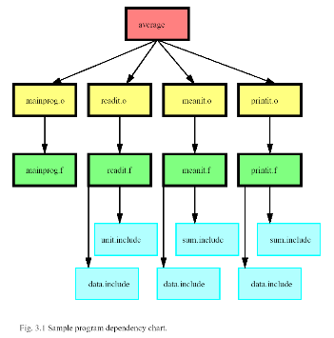
A Tree (Dependency) Example
hello
main.o
factorial.o
hello.o
factorial.o
factorial.cpp
hello.cpp
main.cpp
clean

Slide 33
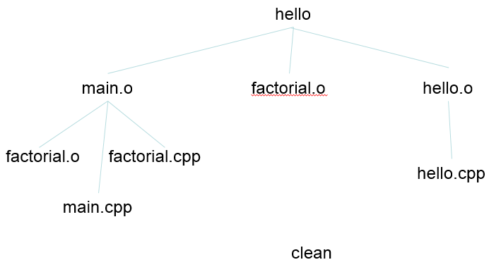
Simple Dependency Makefile
hello: main.o factorial.o hello.o
g++ main.o factorial.o hello.o -o hello
main.o: main.cpp
g++ -c main.cpp factorial.o: factorial.cpp
g++ -c factorial.cpp
hello.o: hello.cpp
g++ -c hello.cpp
clean:
rm -rf *o hello

Slide 34
Your Turn
Download the program “ZedBoardLeds.cpp” from Blackboard.
Log into your COE Account
Convert the C++ program “ZedBoardLeds.cpp” into the following 3 Files.
ZedBoard.h // header file
ZedBoard.cpp // source file
ZedMain.cpp // main program
Create a Makefile that compiles the programs
Makefile

