Slide 1

AAVSO Target Tool
Mark Sproul
msproul@skychariot.com
http://www.skychariot.com/dome/
https://github.com/msproul/
https://github.com/msproul/AAVSO

Slide 2
Quick bio
Computer engineer with over 45 years of experience.
Bachelors degree from Rutgers School of Engineering in Electrical/Computer Engineering (New Jersey)
Masters degree from Steven's Institute of Technology in Mechanical Engineering. (New Jersey)
Started working with NASA images from Voyager space craft in the 90's
In 2015 built my own observatory including a home built 15 foot dome.
Wrote all of my own software to allow remote operation of my observatory, all open source.

Slide 3

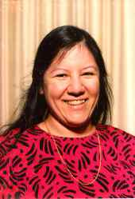
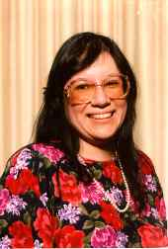
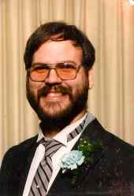
Fun Fact
Twins
Twin wives
1 day younger
Double wedding
Met studying computers at Rutgers
Keith and Debbie
Mark and Carol
http://skychariot.com/twins.html

Slide 4
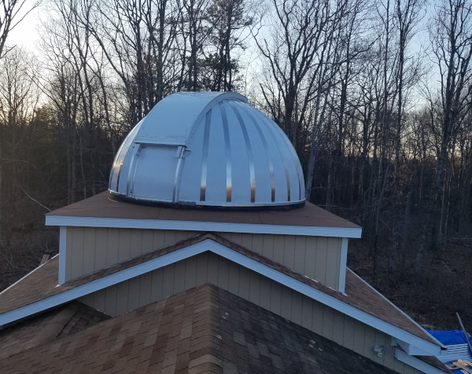
My Observatory
15 foot dome
Entirely home made
Fully motorized
Remote operation
Wood frame
Aluminum skin
Detached 24x24 bldg

Slide 5
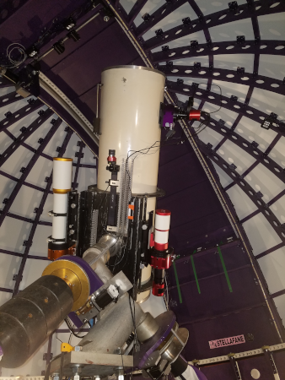
My Observatory
16 inch F4 Newtonian
4 inch F7 Refactor
3 inch F6 Refactor
500 lbs moving mass
200 lbs counter weight
Computer driven
Remote operation

Slide 6
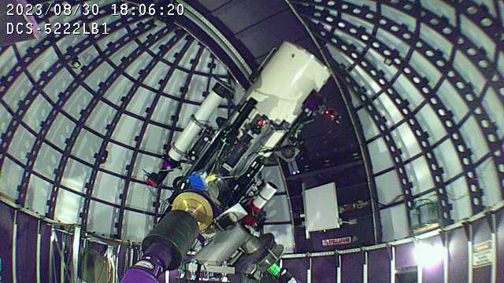
My Observatory

Slide 7
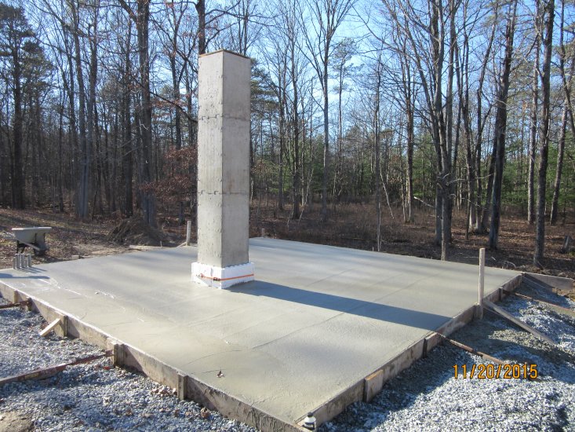

Slide 8
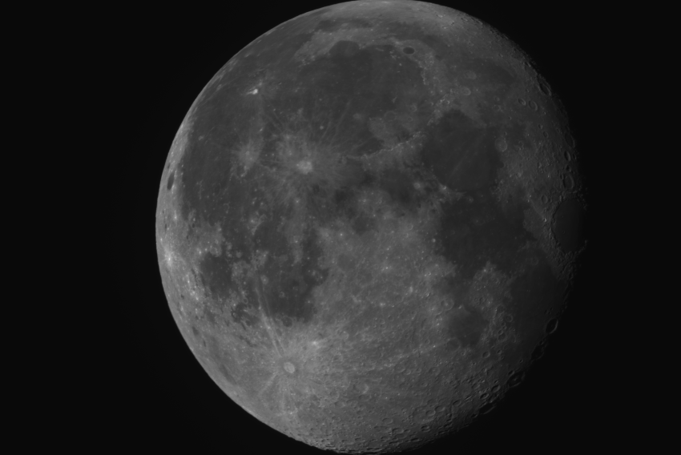

Slide 9
Target Tool, what is it
The TargetTool allows access to the AAVSO “target” lists.
  Web interface
  Email (alerts only)
  Programmatic

Slide 10
Available data
ac | Alerts/Campaigns (default)
ep | Exoplanets
cv | Cataclysmic Variables
eb | Eclipsing Variables
spp | Short Period Pulsators
lpv | Long Period Variables
yso | Young Stellar Objects
het | High Energy Targets
misc | Miscellaneous
all | All

Slide 11
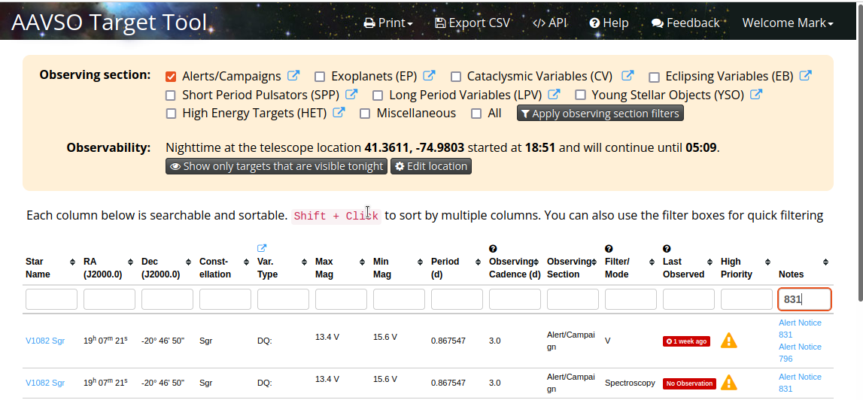
Web interface

Slide 12
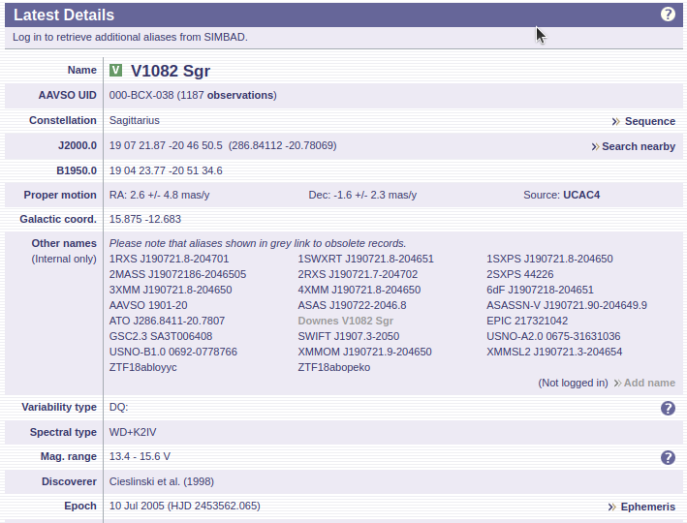

Slide 13
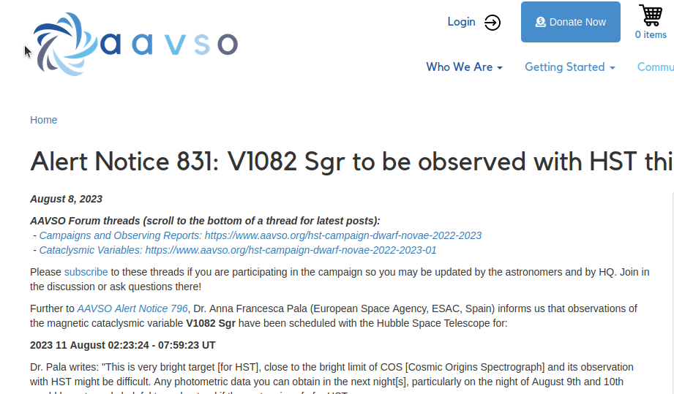
Web Interface

Slide 14
Alert Notice 831
Dr. Pala writes: "This is very bright target [for HST], close to the bright limit of COS [Cosmic Origins Spectrograph] and its observation with HST might be difficult. Any photometric data you can obtain in the next night[s], particularly on the night of August 9th and 10th would be extremely helpful to understand if the system is safe for HST.
"Since this is a relatively bright target, if possible, any spectroscopic data would also be helpful to try to model the system and understand its brightness.
"Thanks a lot for your support!"
Your V observations from tonight through August 10/11 are critical; please continue nightly V snapshots through 2023 August 25. V1082 Sgr has a range of 13.4 - 15.6 V. The most recent observations of it in the AAVSO International Database show it at V magnitude 13.942 +/- 0.016 on 2023 Aug. 7.1163 UT (F.-J. Hambsch, Atacama, Chile) and visual magnitude 13.7 on Aug. 8.5944 UT (R. Stubbings, Tetoora Road, Vic, Australia).

Slide 15
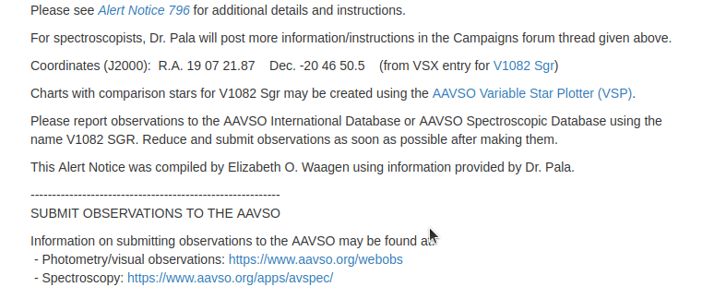
Web interface

Slide 16
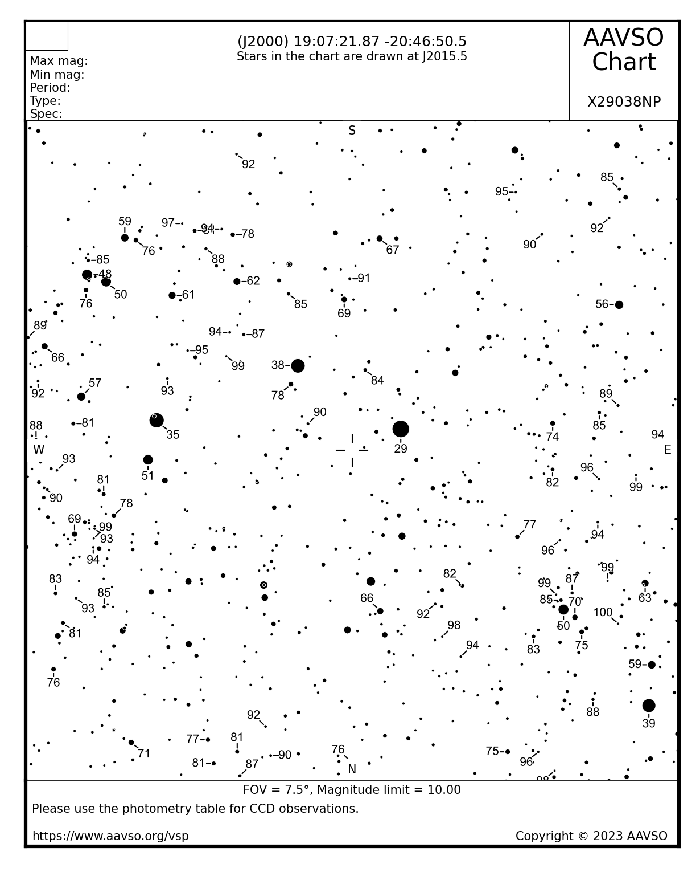
Web

Slide 17
Web interface
https://www.aavso.org/aavso-alert-notice-831
https://www.aavso.org/aavso-alert-notice-nnn

Slide 18
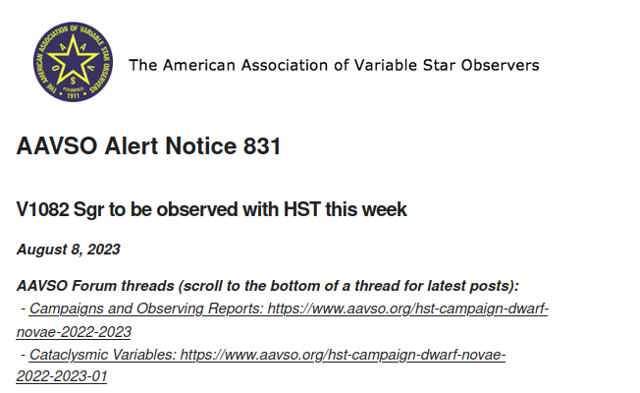
Alerts by email
You can get the alerts automatically by email.

Slide 19
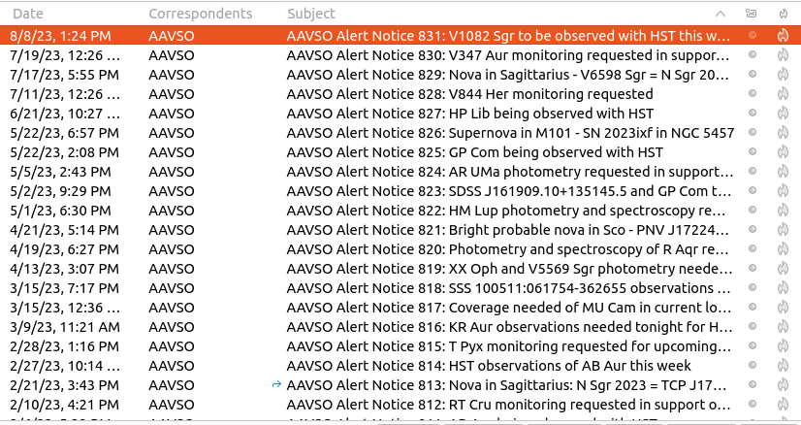
Alerts by email

Slide 20
Alerts by email
Membership NOT required
AAVSO account required
Signup on the email settings page

Slide 21
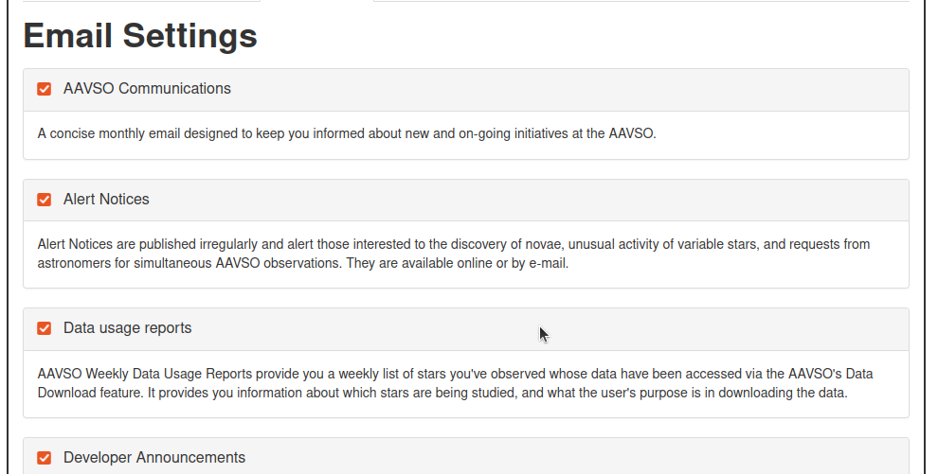
Email Settings

Slide 22
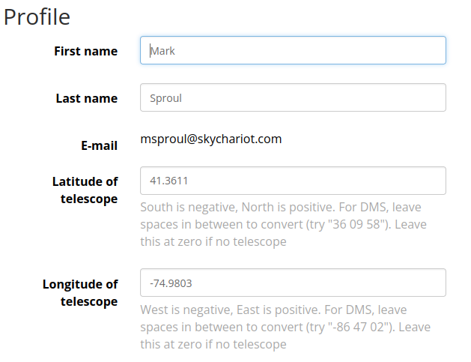
Observatory Settings

Slide 23
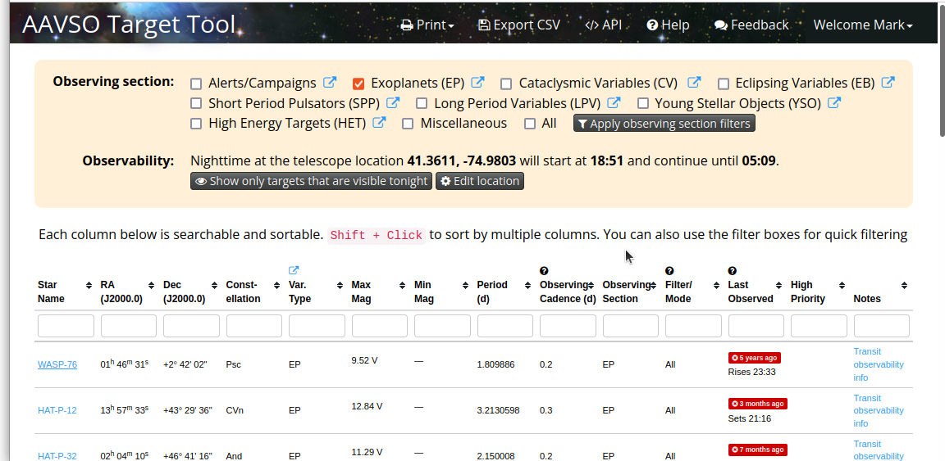
Exoplanets

Slide 24
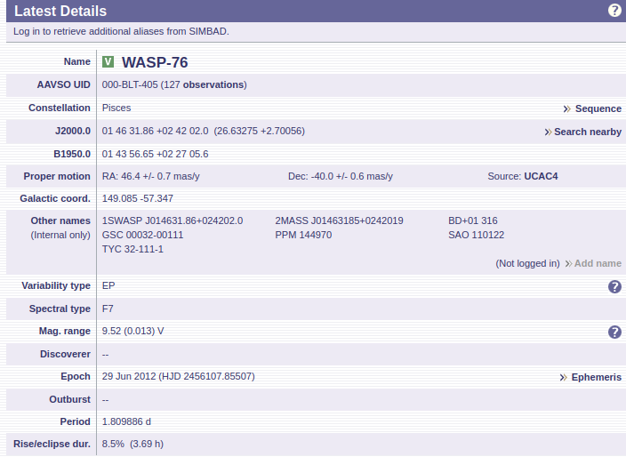

Slide 25
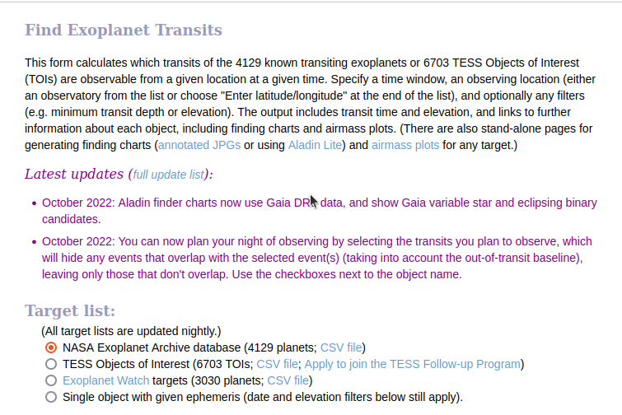
https://astro.swarthmore.edu/transits/transits.cgi

Slide 26
Programmatic interface
Access via HTTPS with JSON response data.
  HTTPS – Hyper Text Transport Protocol (Secure)
  JSON – Java Script Object Notation
Any language that has HTTPS libraries and can process JSON data. (Libraries available for all common languages)
Can be done from command line (Shell scripts)
Python code available in the on-line documentation

Slide 27
Programmatic interface
Documentation
  https://targettool.aavso.org/TargetTool/api
Examples in python
Authentication – a bit complicated but well documented.

Slide 28
curl command
“curl” is a linux command to interact with various servers on the internet.
From the curl “man page”
DESCRIPTION
curl is a tool for transferring data from or to a server. It supports these protocols: …... HTTP, HTTPS, ….... The command is designed to work without user interaction.

Slide 29
curl command
curl -X GET "https://targettool.aavso.org/TargetTool/api/v1/targets" \
-H "Authorization: <insert auth string>" \
-H "accept: application/json" \
-D "returned_header.txt"

Slide 30
Target URL
https://targettool.aavso.org/TargetTool/api/v1/targets?obs_section=all
Other parameters:
observable
orderby
latitude
longitude
targetaltitude
sunaltitude
time

Slide 31
JSON
JavaScript Object Notation
Light weight
Easy to read
Easy to parse
Very widely used for all kinds of data representation, both web and non web.

Slide 32
Raw data
{"targets": [{"max_mag": 5.6, "star_name": "CH Cyg", "max_mag_band": "V", "obs_section": ["Alerts /Campaigns"], "var_type": "ZAND+SR", "obs_cadence": 5.0, "last_data_point": 1673291348, "solar_conjunction": false, "other_info": "B and V especially needed\r\n[[Alert Notice 639 https://www.aavso.org/aavso-alert-notice-639]]\r\n[[Alert Notice 454 https://www.aavso.org/aavso-alert-notice-454]]\r\n[[Special Notice #320 https://www.aavso.org/aavso-special-notice-320]]", "period": null, "obs_mode": "All", "observability_times": [["TARGET_SETS", 1692693739]], "ra": 291.13779, "min_mag_band": "V", "min_mag": 10.1, "dec": 50.24142, "constellation": "Cyg", "filter": "B", "priority": true}, {"max_mag": 7.9, "star_name": "AG Dra", "max_mag_band": "V", "obs_section": ["Alerts / Campaigns"], "var_type": "ZAND", "obs_cadence": 3.0, "last_data_point": 1668798475, "solar_conjunction": false, "other_info": "[[Alert Notice 631 https://www.aavso.org/aavso-alert-notice-631]]", "period": 548.65, "obs_mode": "All", "observability_times": [["TARGET_SETS", 1692687092]], "ra": 240.42087, "min_mag_band": "V", "min_mag": 10.3, "dec": 66.80283, "constellation": "Dra", "filter": "B", "priority": true}, {"max_mag": 6.0, "star_name": "AG Peg", "max_mag_band": "V", "obs_section": ["Alerts / Campaigns"], "var_type": "ZAND+R", "obs_cadence": 1.0, "last_data_point": 1669666280, "solar_conjunction": false, "other_info": "[[Alert Notice 521 https://www.aavso.org/aavso-alert-notice-521]]", "period": 816.5, "obs_mode": "All", "observability_times": [["TARGET_RISES", 1692664600], ["TARGET_SETS", 1692695136]], "ra": 327.75825, "min_mag_band": "V", "min_mag": 9.4, "dec": 12.62558, "constellation": "Peg", "filter": "B", "priority": true}, {"max_mag": 9.2, "star_name": "RW Aur", "max_mag_band": "V", "obs_section": ["Alerts / Campaigns"], "var_type":

Slide 33
Formatted Data
{
"targets": [
{
"max_mag": 5.6,
"star_name": "CH Cyg",
"max_mag_band": "V",
"obs_section": ["Alerts / Campaigns"],
"var_type": "ZAND+SR",
"obs_cadence": 5.0,
"last_data_point": 1673291348,
"solar_conjunction": false,
"other_info": "B and V especially needed
"period": null,
"obs_mode": "All",
"observability_times": [["TARGET_SETS", 1692693739]],
"ra": 291.13779,
"min_mag_band": "V",
"min_mag": 10.1,
"dec": 50.24142,
"constellation": "Cyg",
"filter": "B",
"priority": true
},

Slide 34
Important Data
"max_mag": 5.6,
"star_name": "CH Cyg",
"ra": 291.13779,
"dec": 50.24142,
"constellation": "Cyg",

Slide 35
Data size
File | Size | Lines
alerts_json.txt | 768K | 28911
alerts_json_all.txt | 1.4M | 55932

Slide 36
AlpacaPi planetarium
Software I wrote to run my observatory
Fully open source
C/C++ on Linux
Utilizes “Alpaca” protocol which is next generation ASCOM (Fully ASCOM compatible)
  Alpaca ALSO uses JSON
https://github.com/msproul/AlpacaPi

Slide 37
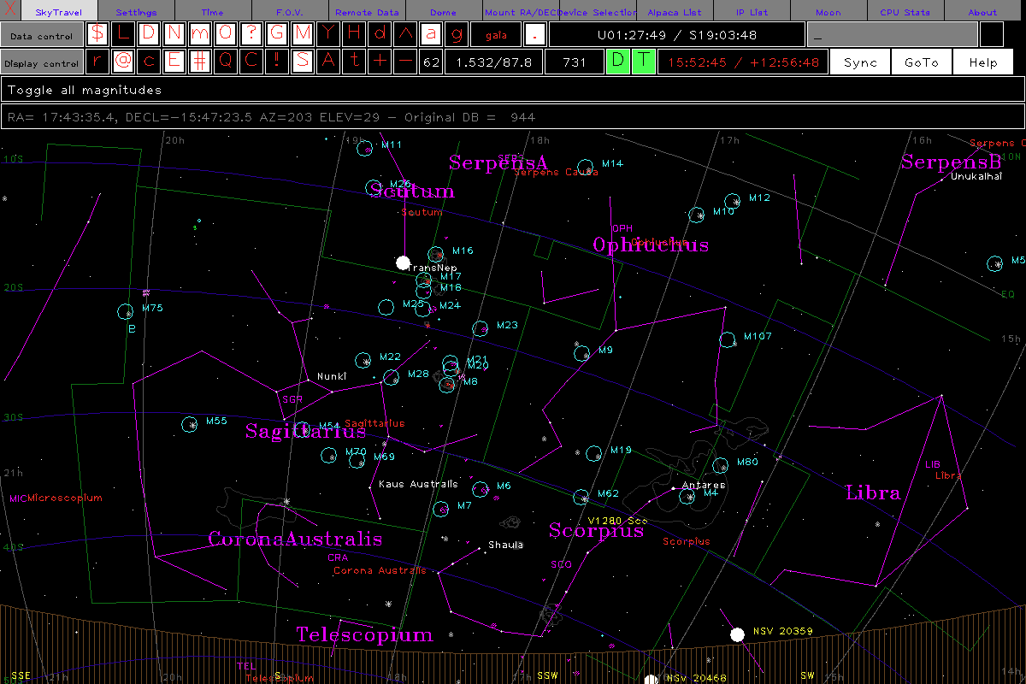

Slide 38
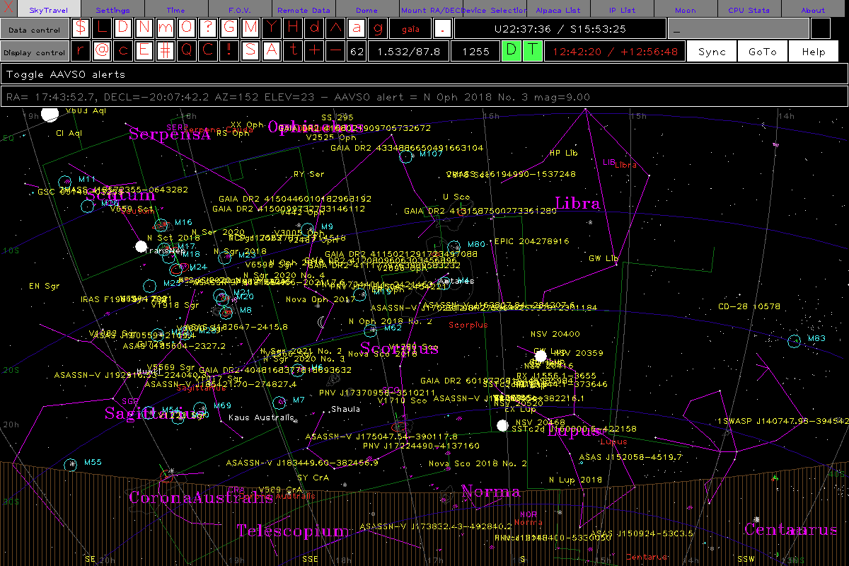

Slide 39
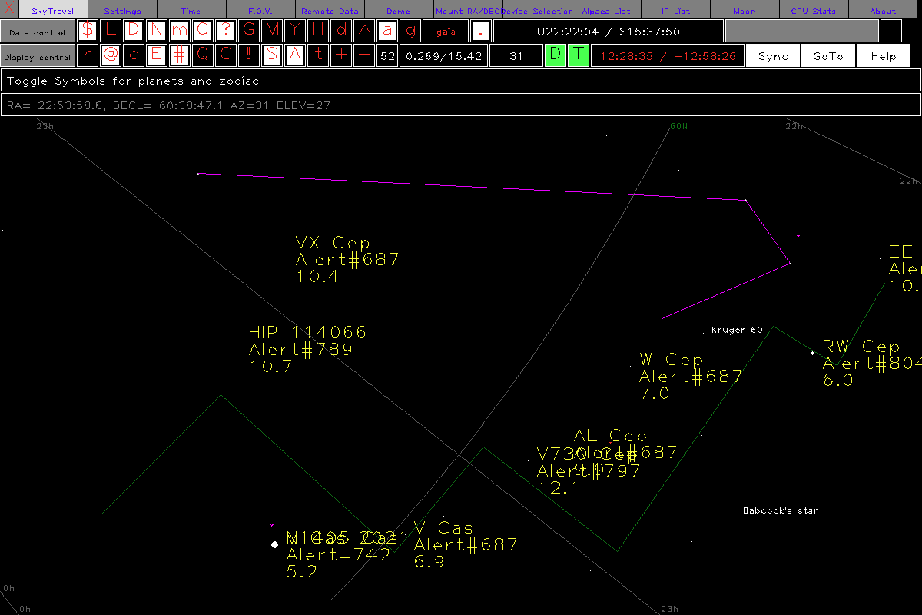
AlpacaPi planetarium

Slide 40
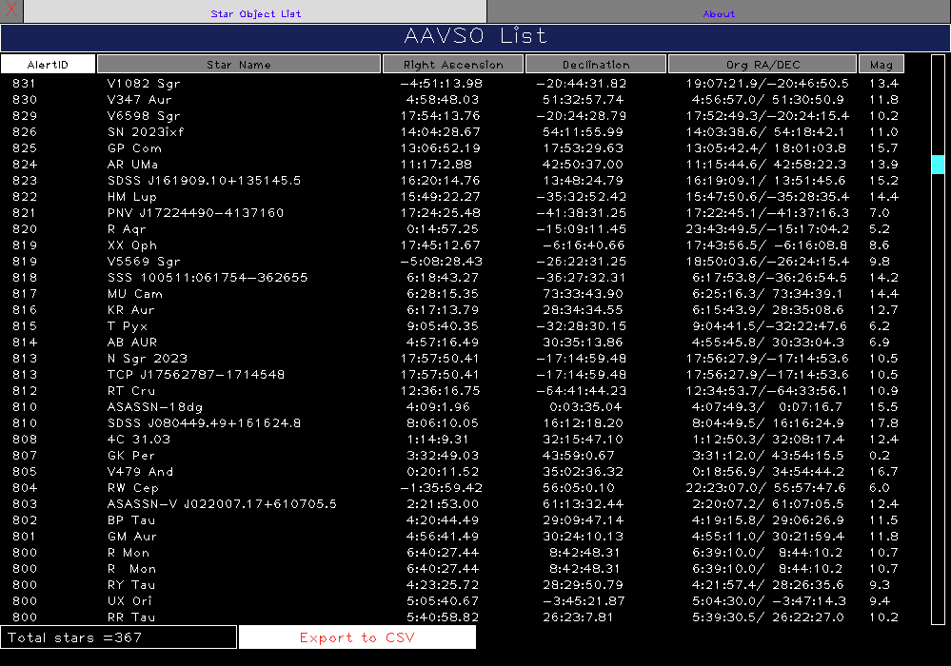

Slide 41
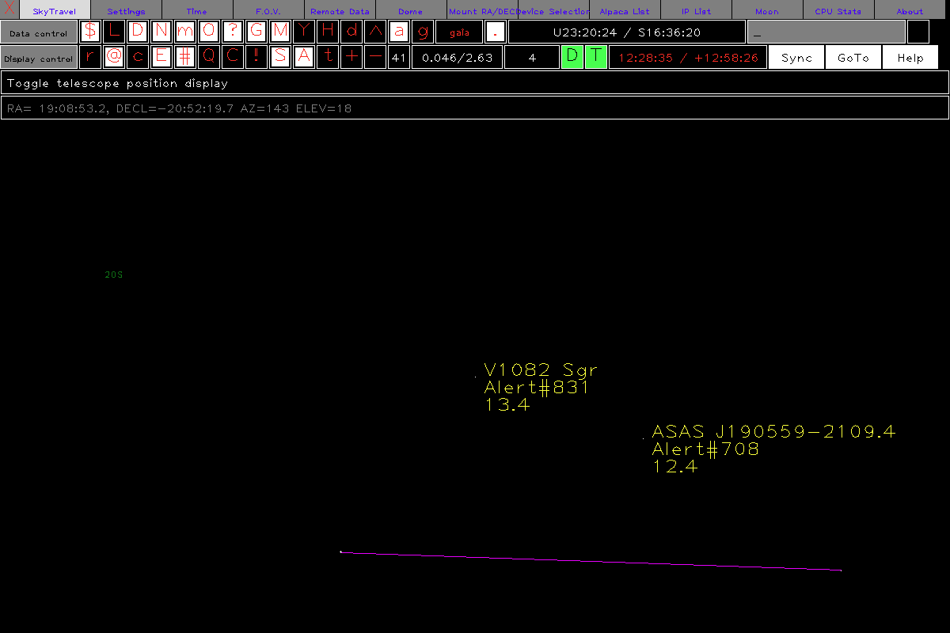

Slide 42
Web Interface

Slide 43
Demo
Switch to live demo

Slide 44
Support
I started my observatory in 2015
I am in the planning stages of some remote observatories in New Mexico
I expect to be supporting my software for running observatories for the next 20 years.
All open source

Slide 45
Summary
The AAVSO Target Tool is a good place to start for those that want to contribute to real science/research.
It is fairly easy to use and the learning curve is not too steep.
It has options for those that want to get fancy (like me) and integrate into other systems.

Slide 46
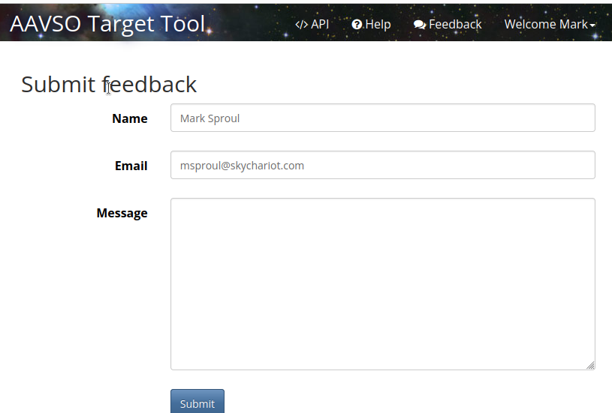
Feedback

Slide 47
Web Links
msproul@skychariot.com
https://www.aavso.org/
https://targettool.aavso.org/
https://github.com/msproul
http://www.skychariot.com/dome/

Slide 48
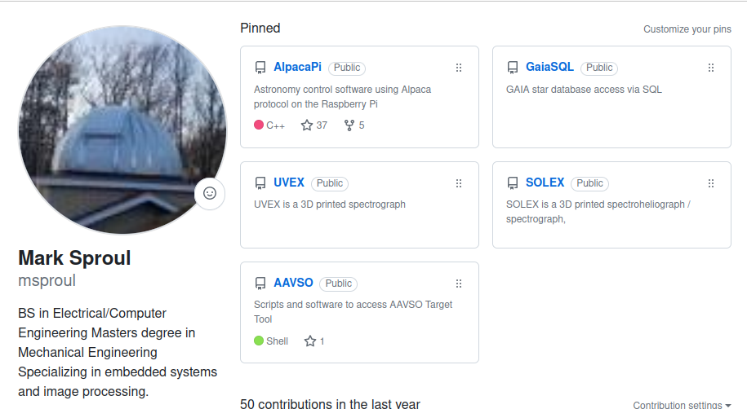
github

Slide 49
Questions
?

