Slide 1

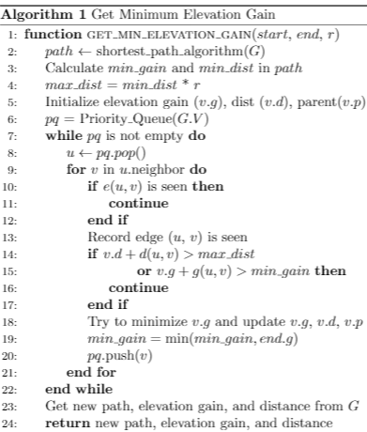
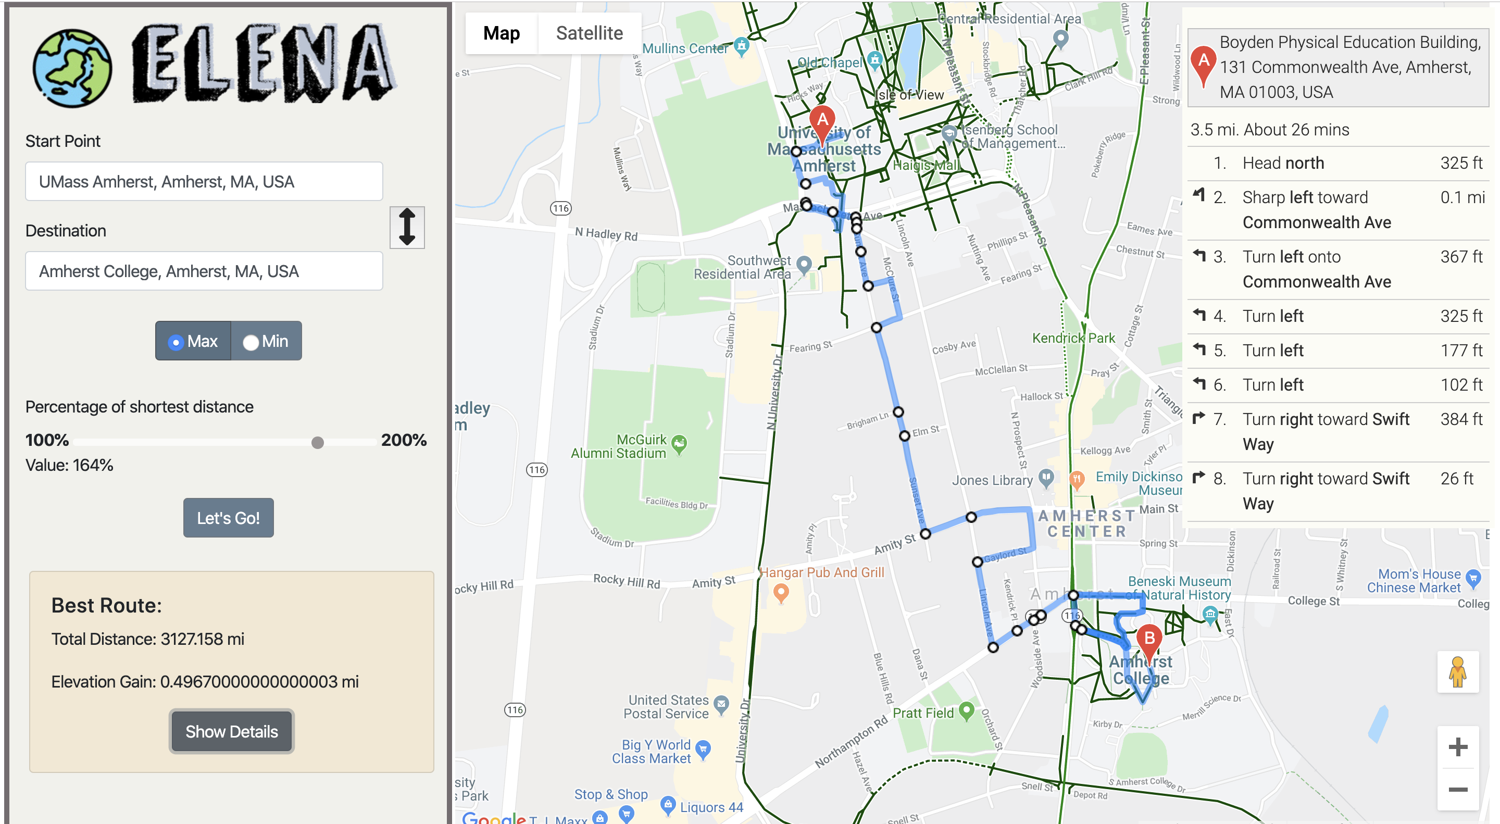
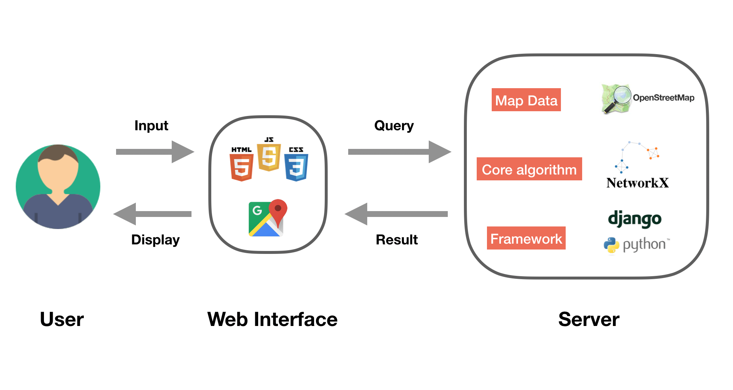
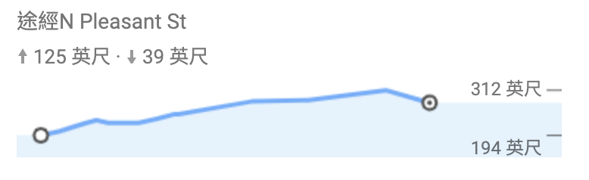
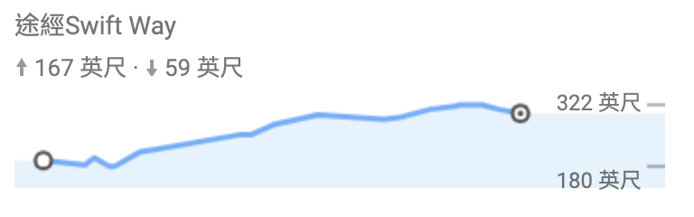
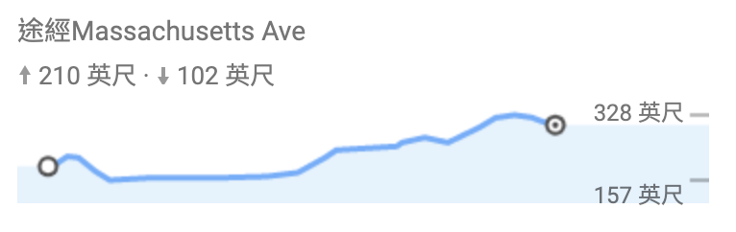
Elena: elevation-based navigation
Yu-Chuan Chen
Huan Wang
Chenmei Li
Ruei-Yao Sun
Introduction
Algorithm
Web Interface
Build a software that takes 2 places as input, output the maximum/minimum elevation gain within an user-defined x% of the shortest path.
Methodology
Evaluation
Route Comparison
Umass → Amherst College
x%=200%
System Design
More Details
• Google API: Places API, Maps JavaScript API, Geocoding API, Maps Elevation API, Directions API
• Web: HTML/CSS, Bootstrap 4, Jquery, JavaScript
• Use GitHub to do collaborative development
Google Map
* For maximum, it can be conducted in a similar way.
Max elevation gain
Min elevation gain

Slide 2
Min elevation gain
Google Map
Max elevation gain

