Slide 1
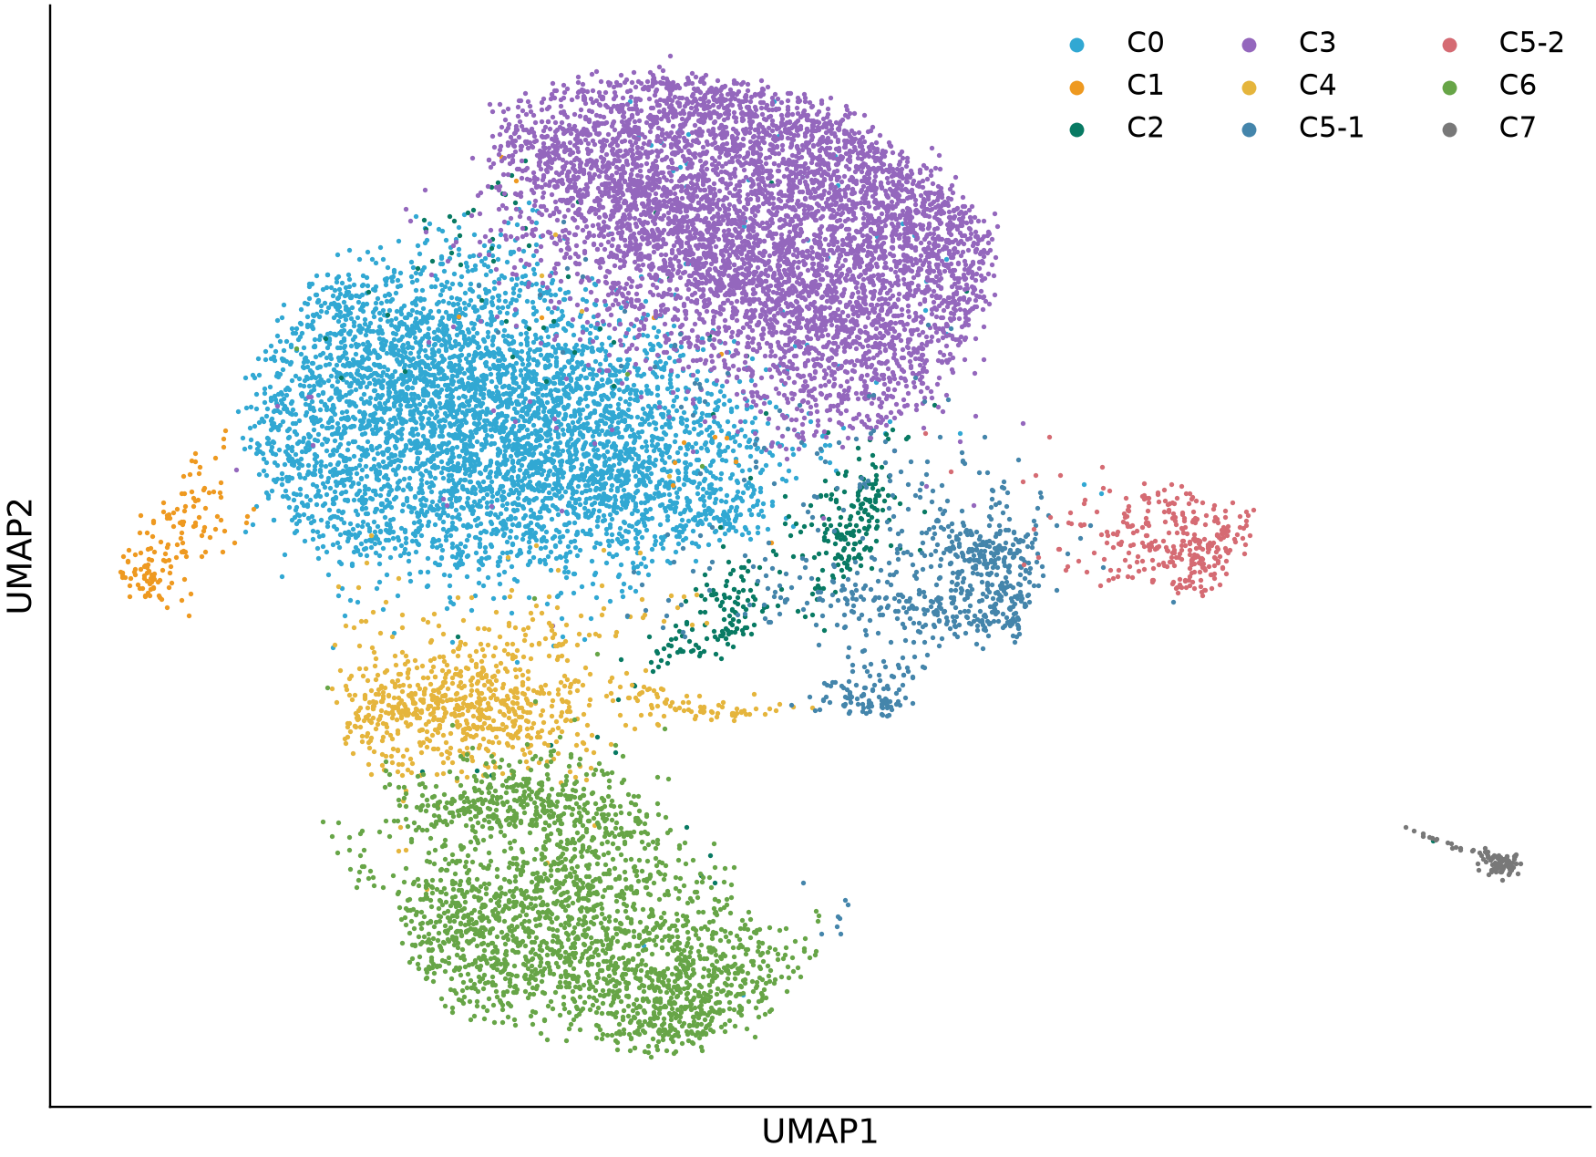
iNKT cytotoxicity and Gene Ontology
Paper-guided analysis on the latest local data | 19 September 2026
15,532 cells | 10,670 measured genes
PAGER: gene modules and temporal profiles
GAFA: cluster-specific GO enrichment
Primary contrasts: tissue x original cluster
Sensitivity: stable tissue reclustering + QC matching
3 tissues | Ctrl and T2 | 9 refined clusters
Exploratory transcriptional results; one sample label per tissue x condition; no animal-level inference.
Huang et al. 2024, PAGER-scFGA, Fig. 5; doi:10.3389/fbinf.2024.1336135; Borra et al. 2026, GAFA, Sec. 3.5 / Fig. 4c; doi:10.3390/biology15070588
1
Notes:
iNKT cytotoxicity and Gene Ontology
本轮新增的是细胞毒性与GO计算。输入来自9月5日最新分析对象；9月15日仅是展示更新。
Huang et al. 2024, PAGER-scFGA, Fig. 5; doi:10.3389/fbinf.2024.1336135; Borra et al. 2026, GAFA, Sec. 3.5 / Fig. 4c; doi:10.3390/biology15070588
Exploratory transcriptional results; one sample label per tissue x condition; no animal-level inference.
Source page: new_01; Main talk
Independent graphics: assets/panels/new_01_*
Native text and tables can be edited directly. SVG/PNG panels can be moved, resized or replaced independently; numeric source tables are in data/.

Slide 2
Analysis design and reference mapping
Methods adapted to mouse iNKT; biological conclusions are derived from these data.
Analysis | Reference | Input / definition | Implementation
Cytotoxicity | PAGER Fig. 5C/D | Core: Prf1, Gzma, Gzmb; E1: +Ctla2a | Mean log1p expression; matched-control score sensitivity
GO cluster identity | GAFA Fig. 4c | Cluster vs rest within each tissue | Wilcoxon, gene BH <= .05 and log2FC >= .25
GO treatment response | GAFA functional comparison | T2-up and Ctrl-up genes tested separately | Hypergeometric; full eligible GO BP/MF/CC families
Local trajectories | PAGER Fig. 5D | Recompute diffusion map on tissue-specific graphs | Precursor-rooted DPT; 20 shared bins; 3-root sensitivity
Robustness | Adaptation to this dataset | Stable clusters; five QC-matched resamples | Effects and direction consistency; no animal replication
GO uses official mouse annotations. An enrichment of upregulated genes does not prove pathway activation.
Exploratory transcriptional results; one sample label per tissue x condition; no animal-level inference.
Huang et al. 2024, PAGER-scFGA, Fig. 5; doi:10.3389/fbinf.2024.1336135; Borra et al. 2026, GAFA, Sec. 3.5 / Fig. 4c; doi:10.3390/biology15070588
2
Notes:
Analysis design and reference mapping
采用论文中的方法和图形组织方式。没有运行SCORPION、随机森林或声称重现PAGER专有网络；GO采用官方MGI小鼠注释。
Huang et al. 2024, PAGER-scFGA, Fig. 5; doi:10.3389/fbinf.2024.1336135; Borra et al. 2026, GAFA, Sec. 3.5 / Fig. 4c; doi:10.3390/biology15070588
Exploratory transcriptional results; one sample label per tissue x condition; no animal-level inference.
Source page: new_02; Main talk
Independent graphics: assets/panels/new_02_*
Native text and tables can be edited directly. SVG/PNG panels can be moved, resized or replaced independently; numeric source tables are in data/.

Slide 3
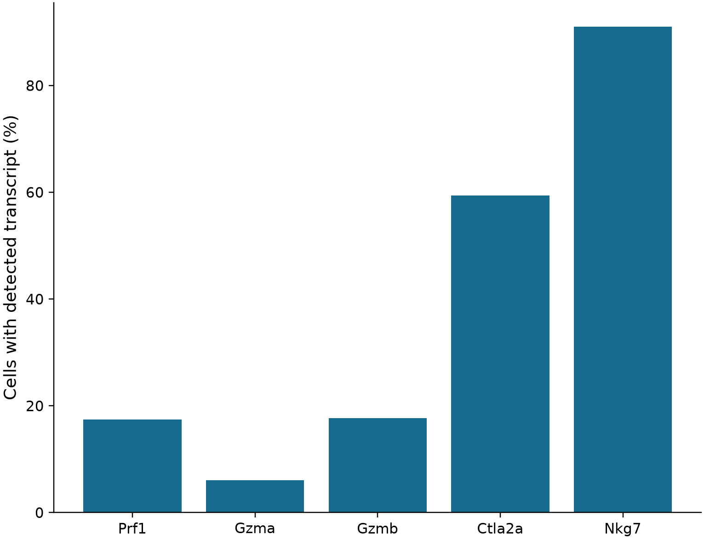
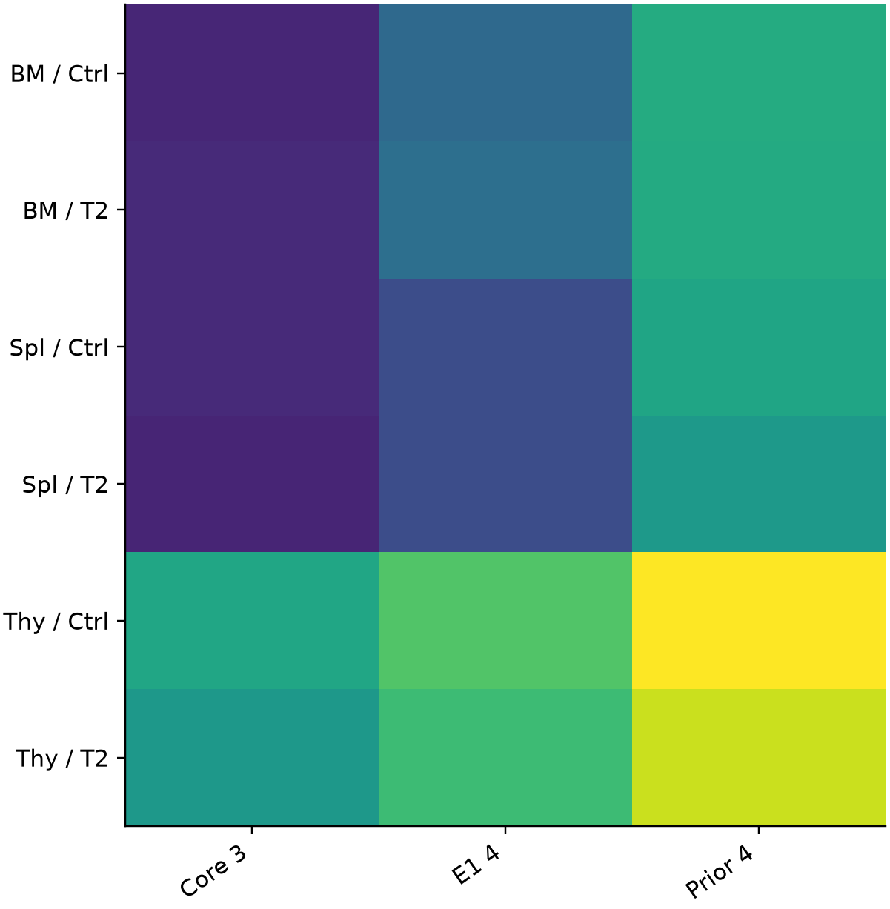
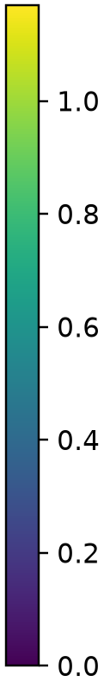
Cytotoxic gene coverage and scoring
Primary endpoint: mean log-normalized expression of Prf1 / Gzma / Gzmb.
A Measured marker coverage
B Sample-level mean expression
Exploratory transcriptional results; one sample label per tissue x condition; no animal-level inference.
Huang et al. 2024, PAGER-scFGA, Fig. 5; doi:10.3389/fbinf.2024.1336135
3
Notes:
Cytotoxic gene coverage and scoring
分数是转录表达而不是杀伤实验读数。不同基因集的绝对分数不可视为相同量纲的功能强弱。
Huang et al. 2024, PAGER-scFGA, Fig. 5; doi:10.3389/fbinf.2024.1336135
Exploratory transcriptional results; one sample label per tissue x condition; no animal-level inference.
Source page: new_03; Main talk
Independent graphics: assets/panels/new_03_*
Native text and tables can be edited directly. SVG/PNG panels can be moved, resized or replaced independently; numeric source tables are in data/.

Slide 4
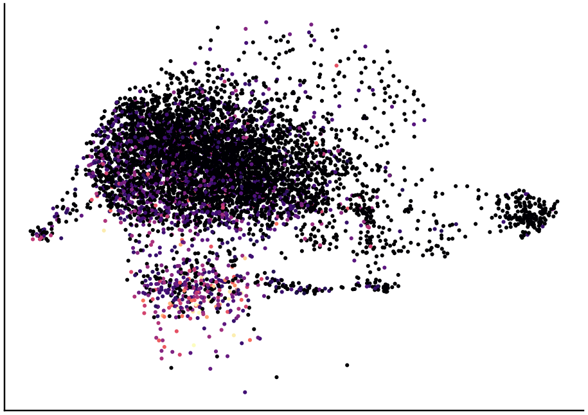
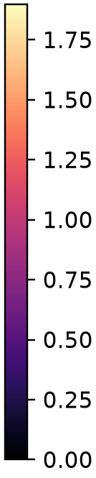
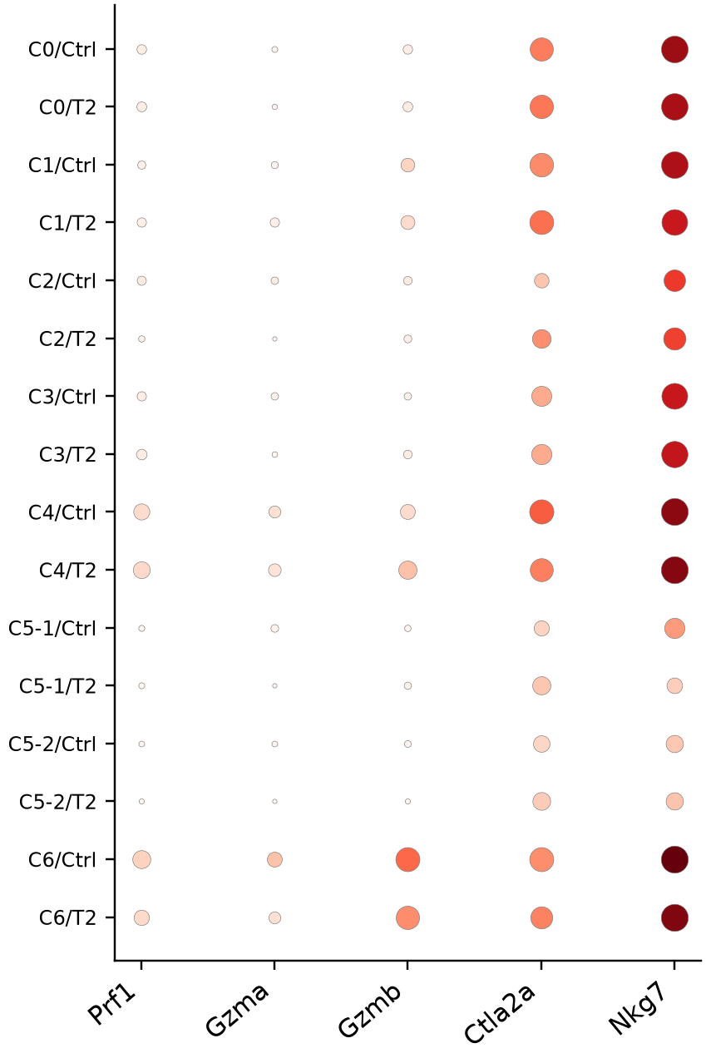
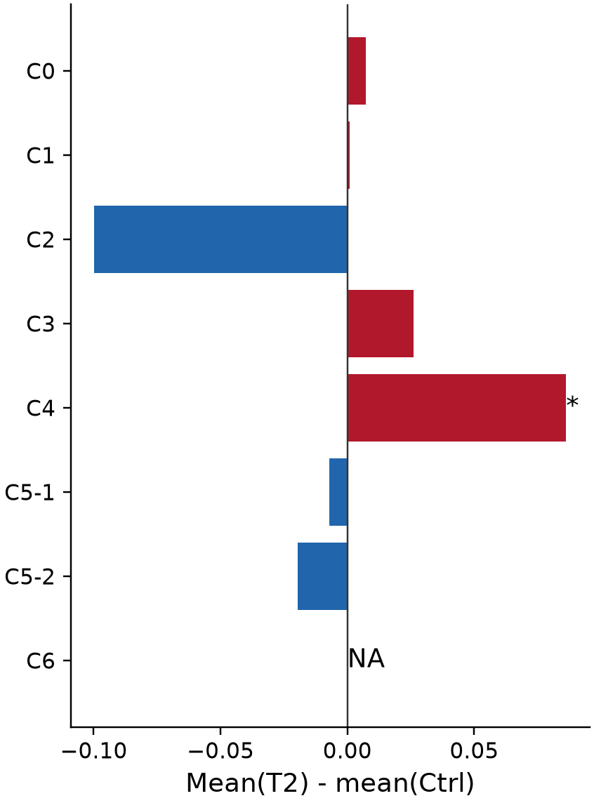
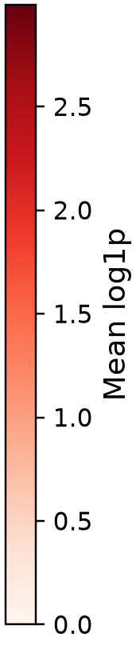
Bone marrow: cytotoxic expression and condition effects
Original refined clusters; T2 - Ctrl within the same tissue and cluster.
A Cytotoxic core expression
B Gene expression
C Core expression difference
Core = mean log1p(Prf1, Gzma, Gzmb)
* Global BH q <= 0.05 across tested
modules, tissues and cluster definitions
NA: fewer than 20 cells in either condition
Dot area: fraction of cells expressing gene
Exploratory transcriptional results; one sample label per tissue x condition; no animal-level inference.
Huang et al. 2024, PAGER-scFGA, Fig. 5; doi:10.3389/fbinf.2024.1336135
4
Notes:
Bone marrow: cytotoxic expression and condition effects
按组织和原分群展示细胞毒性；红色为T2高，蓝色为Ctrl高。星号是细胞层面探索性检验，不能代表动物重复验证。
Huang et al. 2024, PAGER-scFGA, Fig. 5; doi:10.3389/fbinf.2024.1336135
Exploratory transcriptional results; one sample label per tissue x condition; no animal-level inference.
Source page: new_04; Main talk
Independent graphics: assets/panels/new_04_*
Native text and tables can be edited directly. SVG/PNG panels can be moved, resized or replaced independently; numeric source tables are in data/.

Slide 5
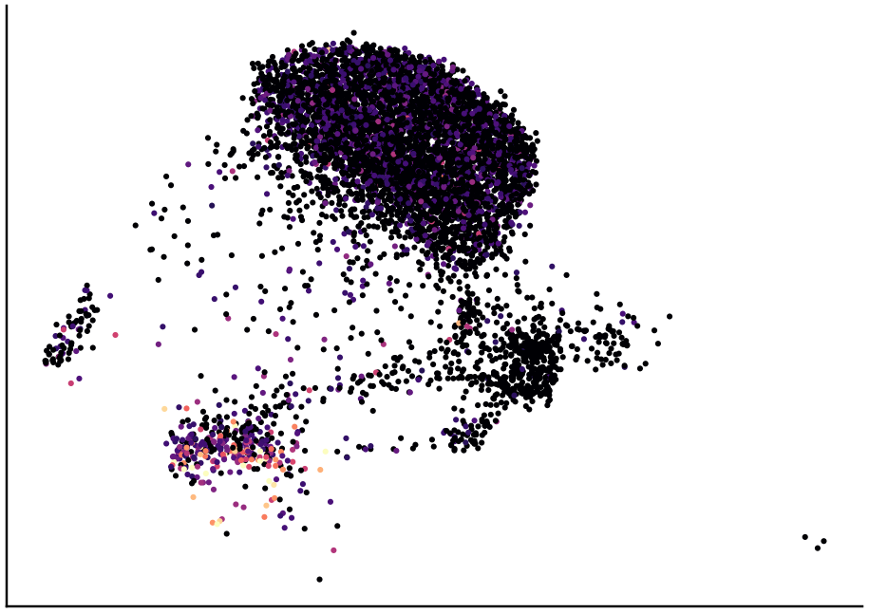
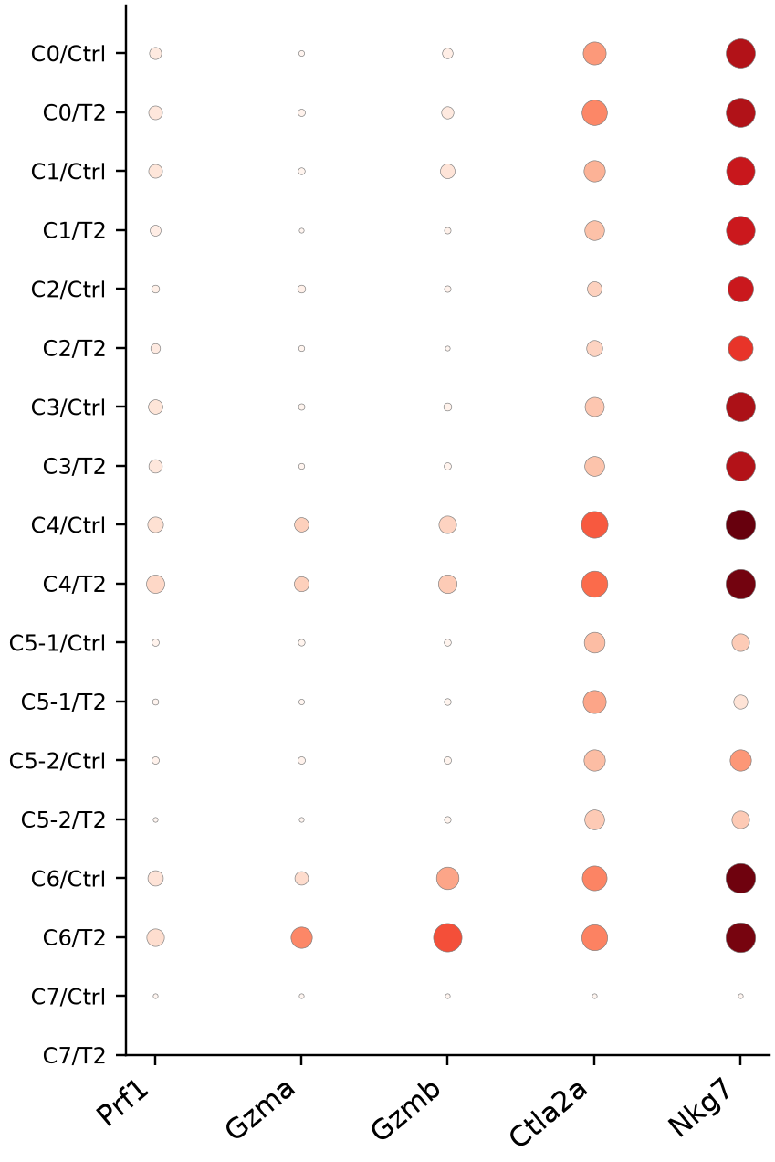
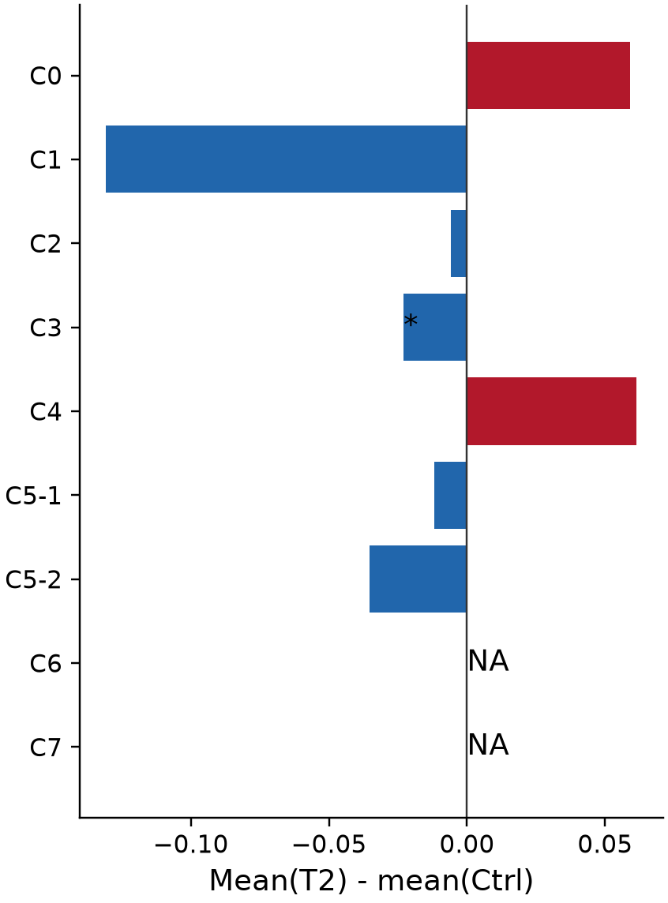
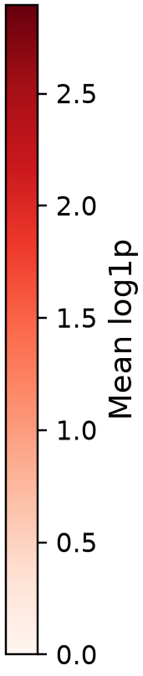
Spleen: cytotoxic expression and condition effects
Original refined clusters; T2 - Ctrl within the same tissue and cluster.
A Cytotoxic core expression
B Gene expression
C Core expression difference
Core = mean log1p(Prf1, Gzma, Gzmb)
* Global BH q <= 0.05 across tested
modules, tissues and cluster definitions
NA: fewer than 20 cells in either condition
Dot area: fraction of cells expressing gene
Exploratory transcriptional results; one sample label per tissue x condition; no animal-level inference.
Huang et al. 2024, PAGER-scFGA, Fig. 5; doi:10.3389/fbinf.2024.1336135
5
Notes:
Spleen: cytotoxic expression and condition effects
按组织和原分群展示细胞毒性；红色为T2高，蓝色为Ctrl高。星号是细胞层面探索性检验，不能代表动物重复验证。
Huang et al. 2024, PAGER-scFGA, Fig. 5; doi:10.3389/fbinf.2024.1336135
Exploratory transcriptional results; one sample label per tissue x condition; no animal-level inference.
Source page: new_05; Main talk
Independent graphics: assets/panels/new_05_*
Native text and tables can be edited directly. SVG/PNG panels can be moved, resized or replaced independently; numeric source tables are in data/.

Slide 6
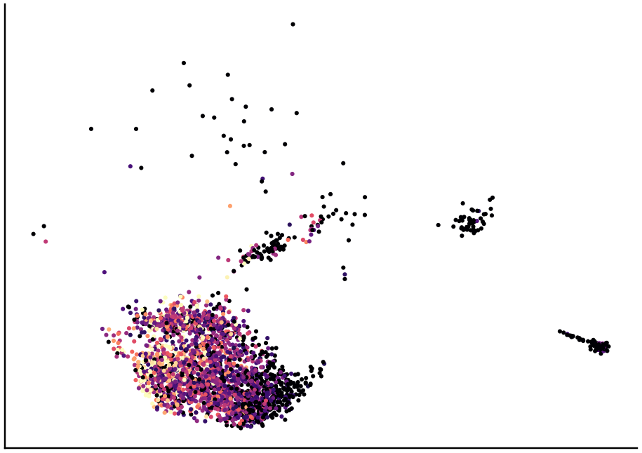
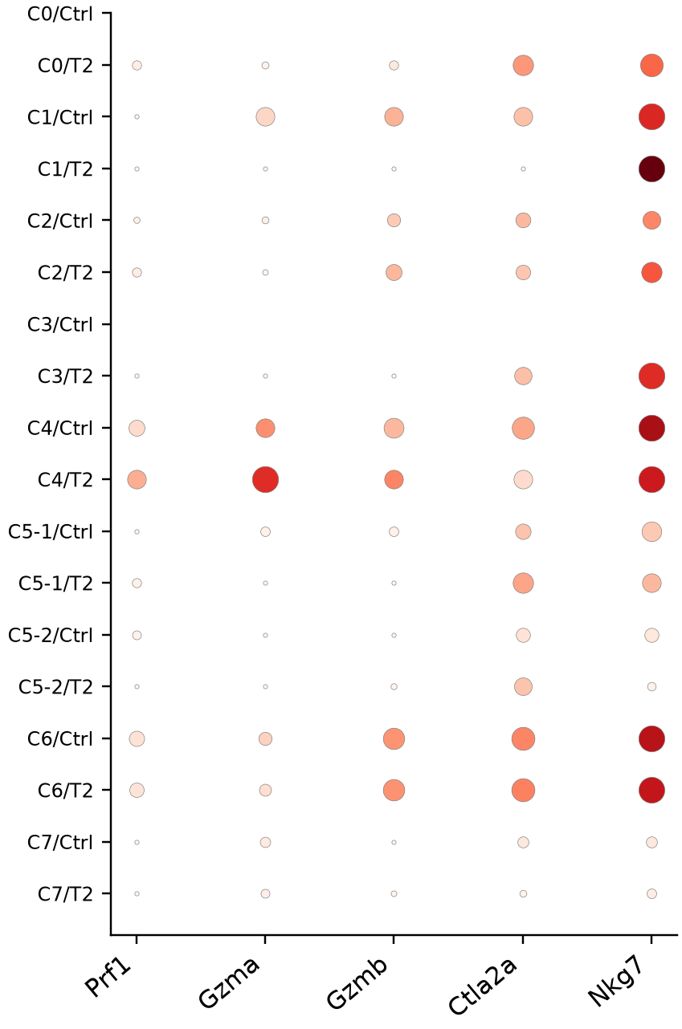
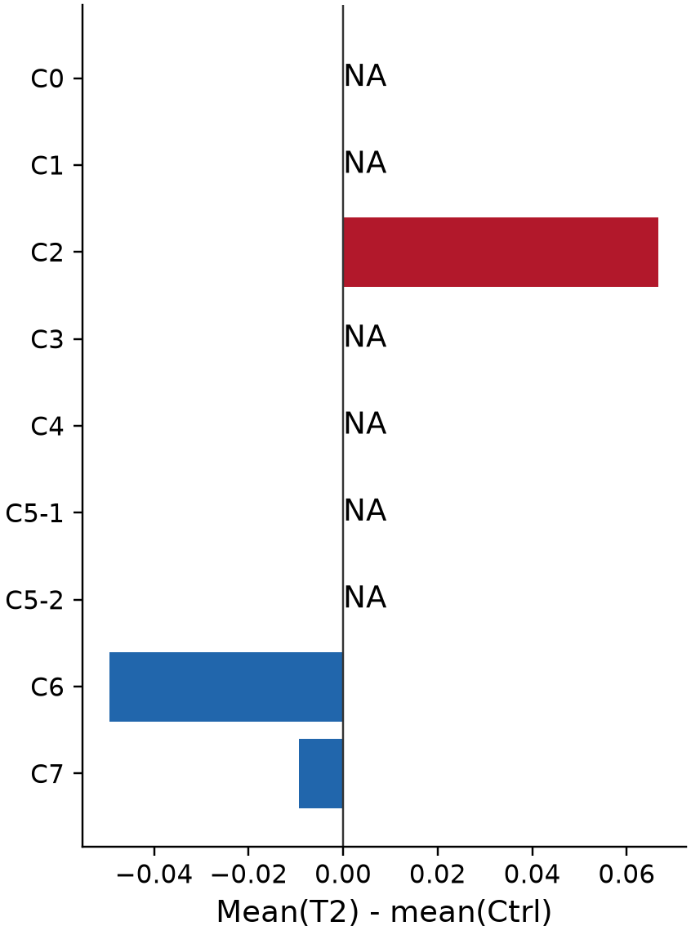

Thymus: cytotoxic expression and condition effects
Original refined clusters; T2 - Ctrl within the same tissue and cluster.
A Cytotoxic core expression
B Gene expression
C Core expression difference
Core = mean log1p(Prf1, Gzma, Gzmb)
* Global BH q <= 0.05 across tested
modules, tissues and cluster definitions
NA: fewer than 20 cells in either condition
Dot area: fraction of cells expressing gene
Exploratory transcriptional results; one sample label per tissue x condition; no animal-level inference.
Huang et al. 2024, PAGER-scFGA, Fig. 5; doi:10.3389/fbinf.2024.1336135
6
Notes:
Thymus: cytotoxic expression and condition effects
按组织和原分群展示细胞毒性；红色为T2高，蓝色为Ctrl高。星号是细胞层面探索性检验，不能代表动物重复验证。
Huang et al. 2024, PAGER-scFGA, Fig. 5; doi:10.3389/fbinf.2024.1336135
Exploratory transcriptional results; one sample label per tissue x condition; no animal-level inference.
Source page: new_06; Main talk
Independent graphics: assets/panels/new_06_*
Native text and tables can be edited directly. SVG/PNG panels can be moved, resized or replaced independently; numeric source tables are in data/.

Slide 7
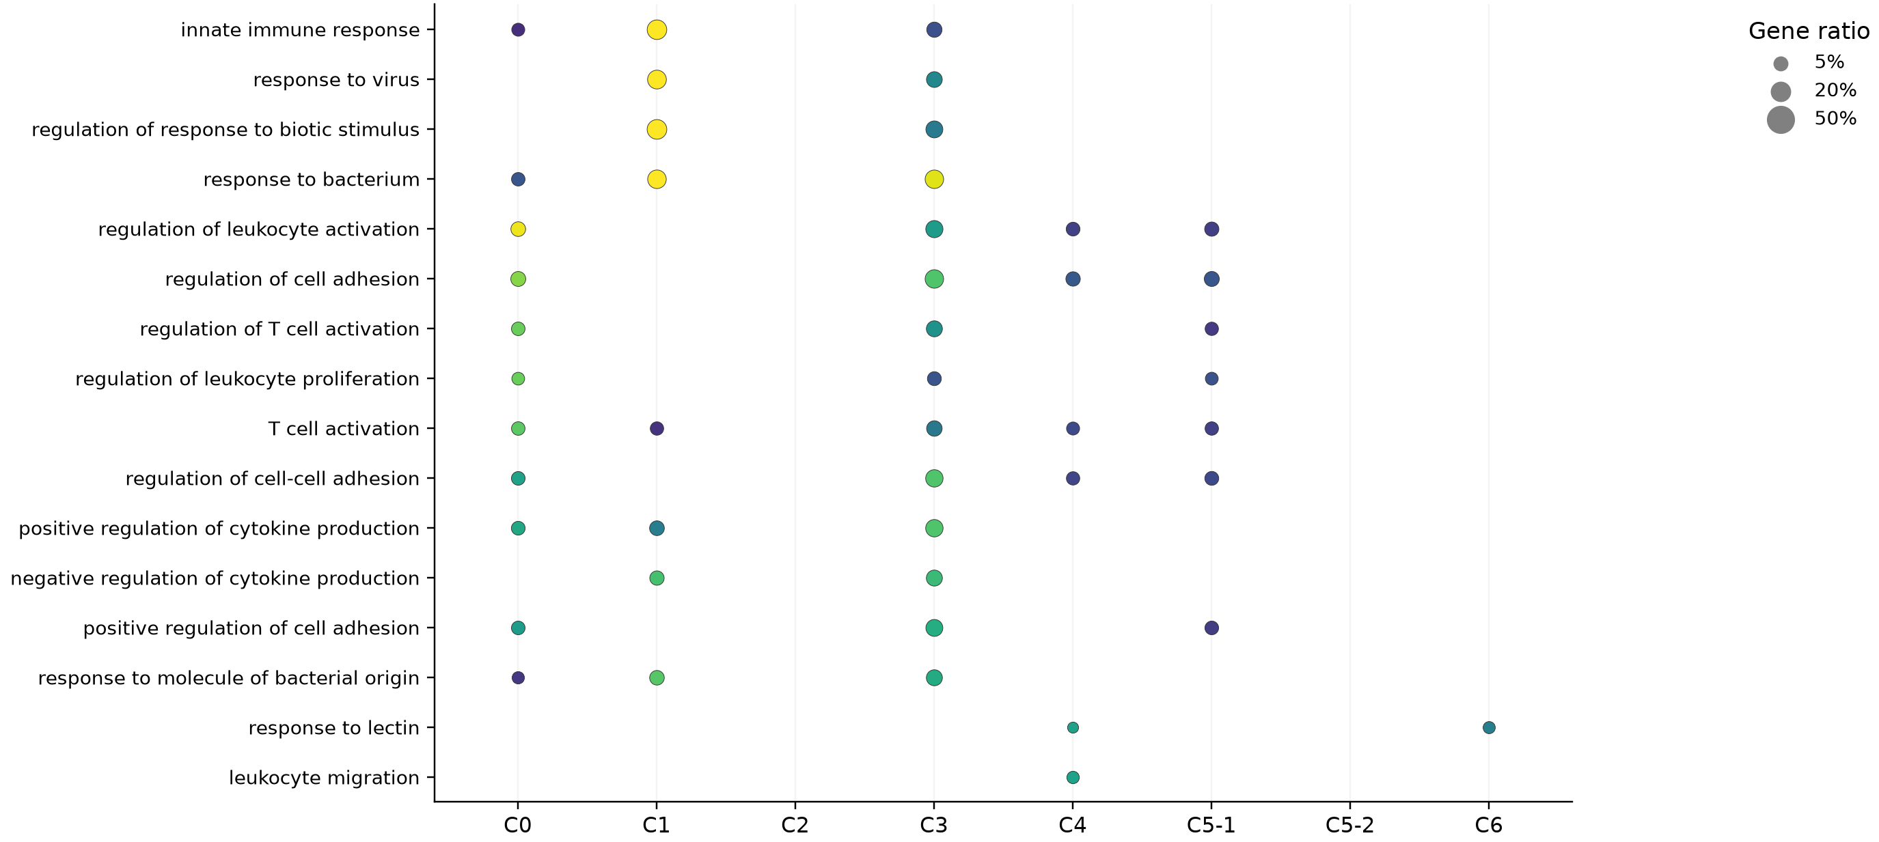
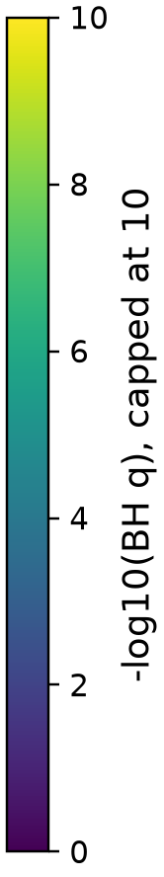
Bone marrow: GO biological processes: cluster identity
Within-tissue comparisons | dot area: query gene ratio | color: enrichment evidence
All BP/MF/CC tests retained. Only clusters with significant BP terms shown; q <= .05; >=2 hits; overlap redundancy reduced.
Exploratory transcriptional results; one sample label per tissue x condition; no animal-level inference. Blank = no displayed significant term, not proof of absence.
Borra et al. 2026, GAFA, Sec. 3.5 / Fig. 4c; doi:10.3390/biology15070588
7
Notes:
Bone marrow: GO biological processes: cluster identity
GO气泡图只展示显著且至少两个命中基因的代表条目。T2/ Ctrl列分别表示该方向上调基因的富集，不把富集直接解释成通路激活。完整BP、MF、CC结果见数据表。
Borra et al. 2026, GAFA, Sec. 3.5 / Fig. 4c; doi:10.3390/biology15070588
Exploratory transcriptional results; one sample label per tissue x condition; no animal-level inference. Blank = no displayed significant term, not proof of absence.
Source page: new_07; Main talk
Independent graphics: assets/panels/new_07_*
Native text and tables can be edited directly. SVG/PNG panels can be moved, resized or replaced independently; numeric source tables are in data/.

Slide 8
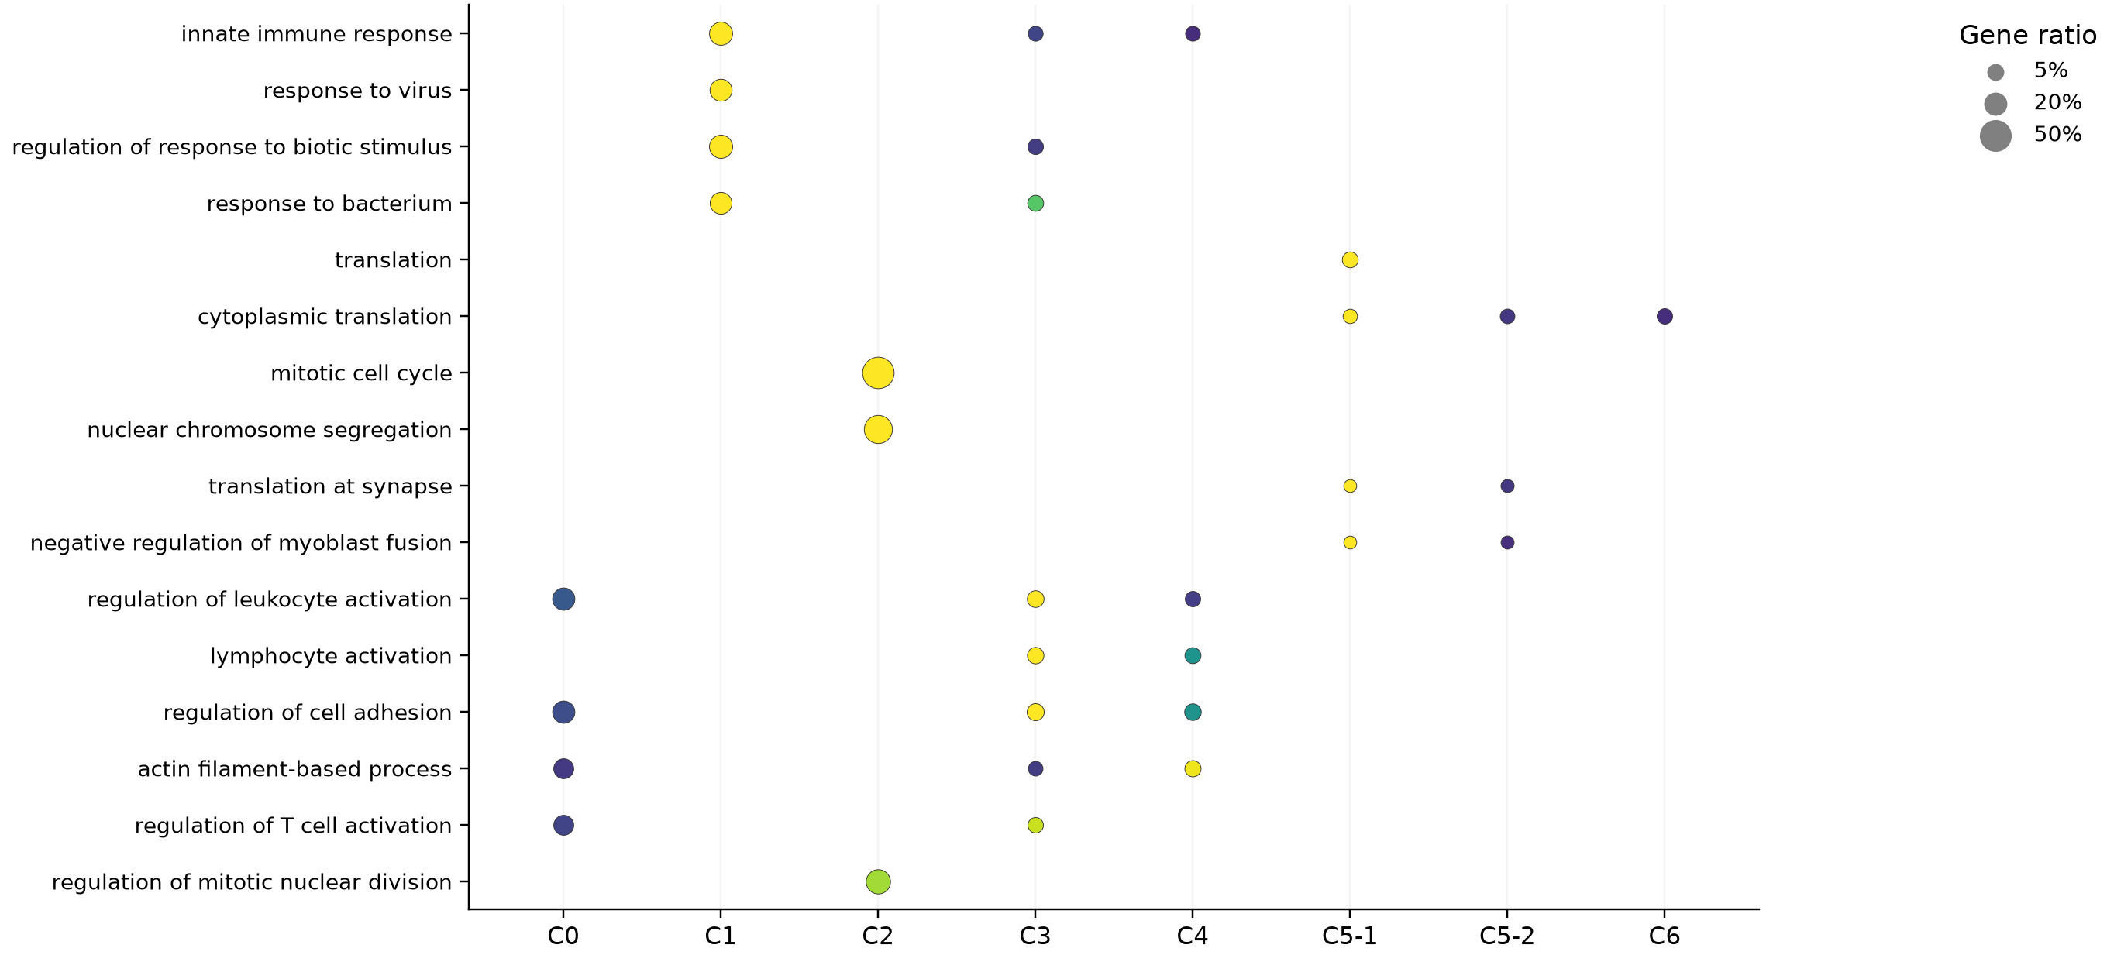
Spleen: GO biological processes: cluster identity
Within-tissue comparisons | dot area: query gene ratio | color: enrichment evidence
All BP/MF/CC tests retained. Only clusters with significant BP terms shown; q <= .05; >=2 hits; overlap redundancy reduced.
Exploratory transcriptional results; one sample label per tissue x condition; no animal-level inference. Blank = no displayed significant term, not proof of absence.
Borra et al. 2026, GAFA, Sec. 3.5 / Fig. 4c; doi:10.3390/biology15070588
8
Notes:
Spleen: GO biological processes: cluster identity
GO气泡图只展示显著且至少两个命中基因的代表条目。T2/ Ctrl列分别表示该方向上调基因的富集，不把富集直接解释成通路激活。完整BP、MF、CC结果见数据表。
Borra et al. 2026, GAFA, Sec. 3.5 / Fig. 4c; doi:10.3390/biology15070588
Exploratory transcriptional results; one sample label per tissue x condition; no animal-level inference. Blank = no displayed significant term, not proof of absence.
Source page: new_08; Main talk
Independent graphics: assets/panels/new_08_*
Native text and tables can be edited directly. SVG/PNG panels can be moved, resized or replaced independently; numeric source tables are in data/.

Slide 9
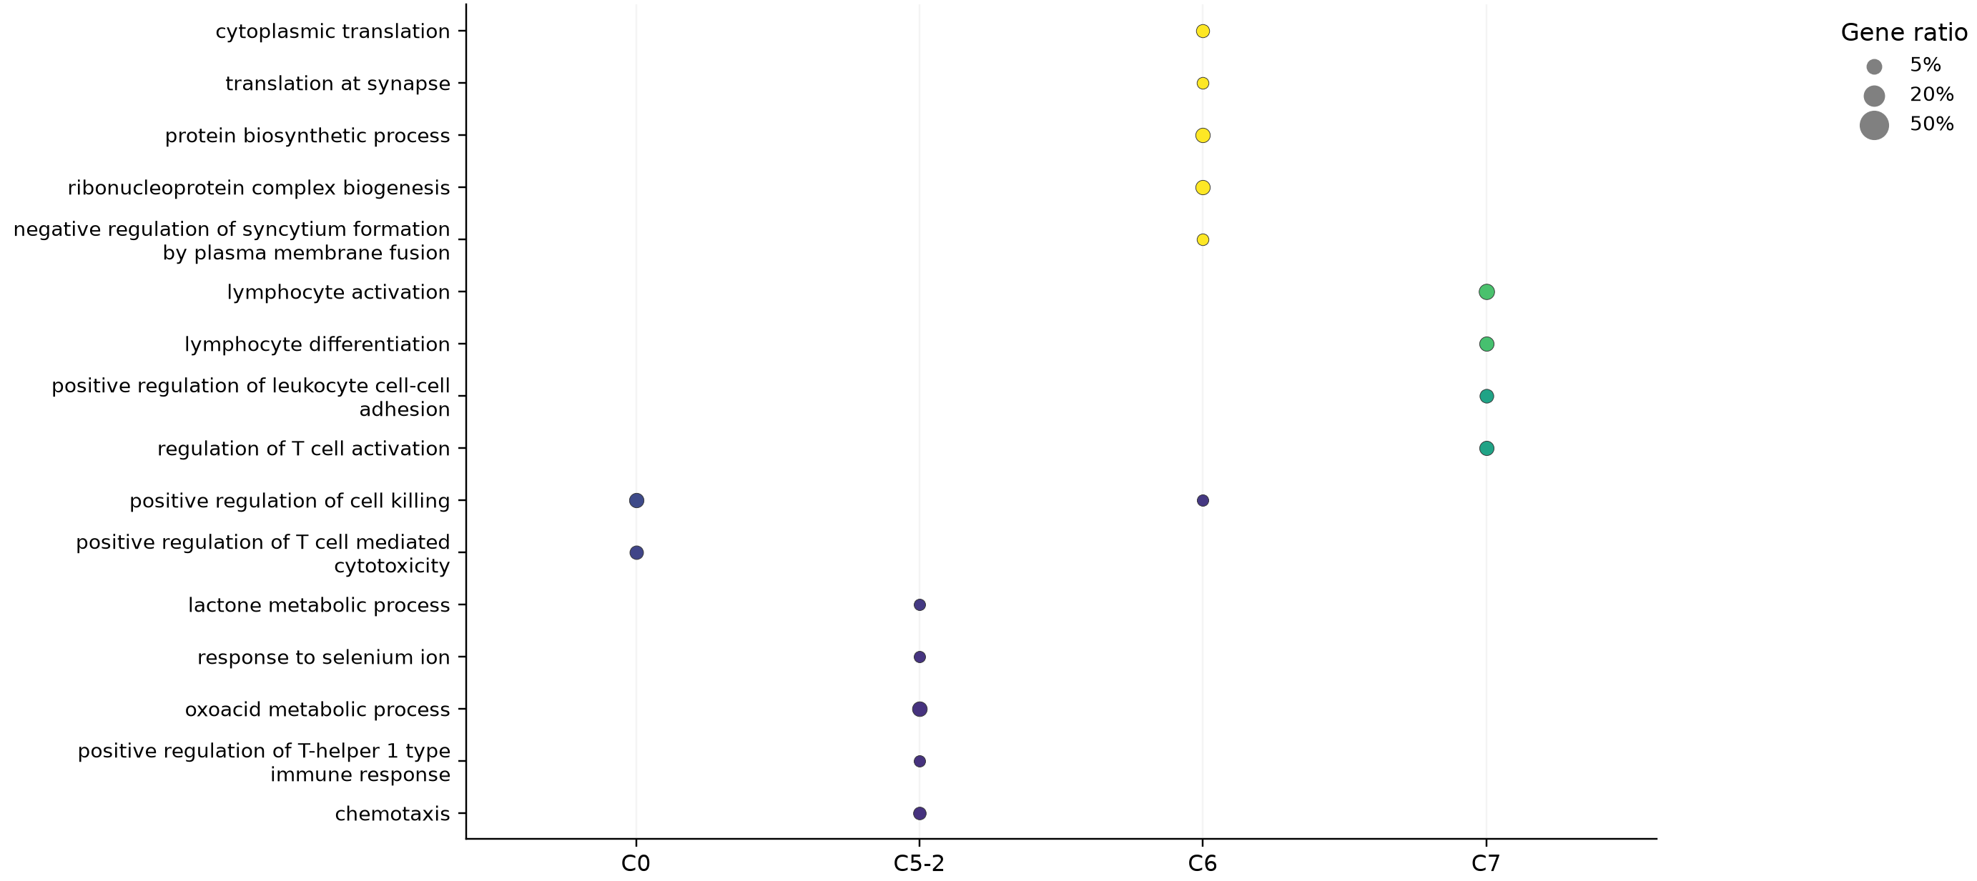
Thymus: GO biological processes: cluster identity
Within-tissue comparisons | dot area: query gene ratio | color: enrichment evidence
All BP/MF/CC tests retained. Only clusters with significant BP terms shown; q <= .05; >=2 hits; overlap redundancy reduced.
Exploratory transcriptional results; one sample label per tissue x condition; no animal-level inference. Blank = no displayed significant term, not proof of absence.
Borra et al. 2026, GAFA, Sec. 3.5 / Fig. 4c; doi:10.3390/biology15070588
9
Notes:
Thymus: GO biological processes: cluster identity
GO气泡图只展示显著且至少两个命中基因的代表条目。T2/ Ctrl列分别表示该方向上调基因的富集，不把富集直接解释成通路激活。完整BP、MF、CC结果见数据表。
Borra et al. 2026, GAFA, Sec. 3.5 / Fig. 4c; doi:10.3390/biology15070588
Exploratory transcriptional results; one sample label per tissue x condition; no animal-level inference. Blank = no displayed significant term, not proof of absence.
Source page: new_09; Main talk
Independent graphics: assets/panels/new_09_*
Native text and tables can be edited directly. SVG/PNG panels can be moved, resized or replaced independently; numeric source tables are in data/.

Slide 10
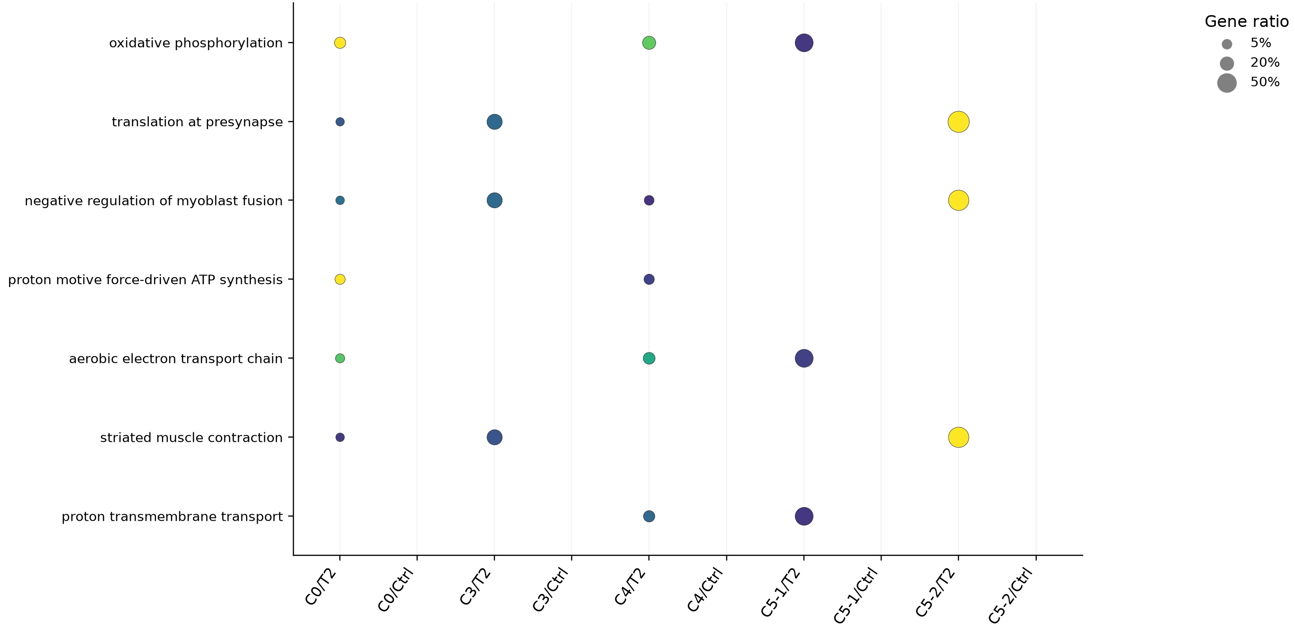
Bone marrow: GO biological processes: condition response
Within-tissue comparisons | dot area: query gene ratio | color: enrichment evidence
All BP/MF/CC tests retained. Only clusters with significant BP terms shown; q <= .05; >=2 hits; overlap redundancy reduced.
Exploratory transcriptional results; one sample label per tissue x condition; no animal-level inference. Blank = no displayed significant term, not proof of absence.
Borra et al. 2026, GAFA, Sec. 3.5 / Fig. 4c; doi:10.3390/biology15070588
10
Notes:
Bone marrow: GO biological processes: condition response
GO气泡图只展示显著且至少两个命中基因的代表条目。T2/ Ctrl列分别表示该方向上调基因的富集，不把富集直接解释成通路激活。完整BP、MF、CC结果见数据表。
Borra et al. 2026, GAFA, Sec. 3.5 / Fig. 4c; doi:10.3390/biology15070588
Exploratory transcriptional results; one sample label per tissue x condition; no animal-level inference. Blank = no displayed significant term, not proof of absence.
Source page: new_10; Main talk
Independent graphics: assets/panels/new_10_*
Native text and tables can be edited directly. SVG/PNG panels can be moved, resized or replaced independently; numeric source tables are in data/.

Slide 11
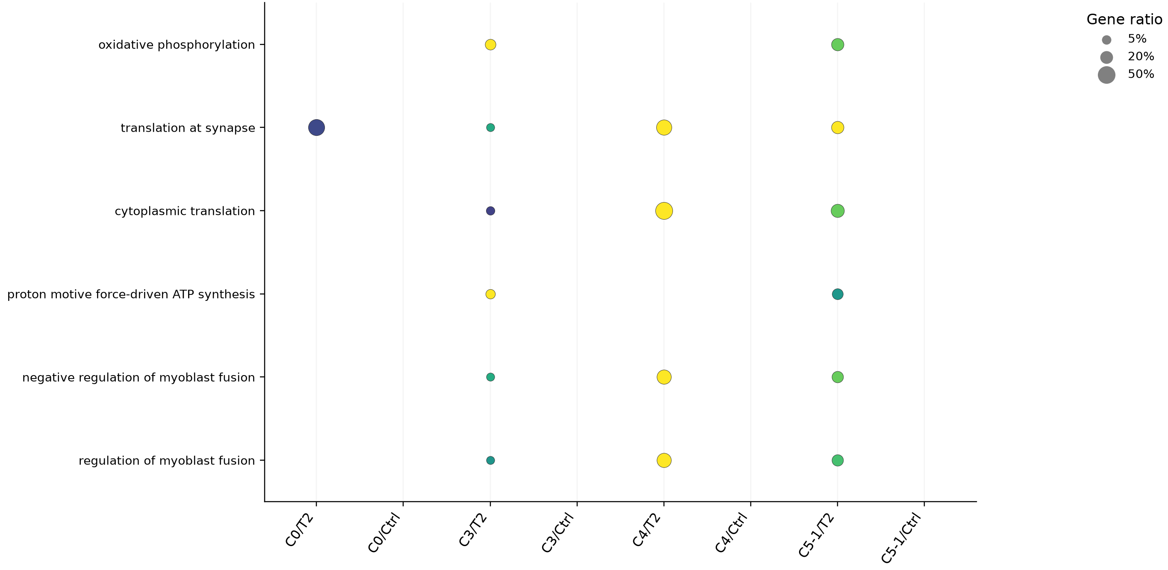
Spleen: GO biological processes: condition response
Within-tissue comparisons | dot area: query gene ratio | color: enrichment evidence
All BP/MF/CC tests retained. Only clusters with significant BP terms shown; q <= .05; >=2 hits; overlap redundancy reduced.
Exploratory transcriptional results; one sample label per tissue x condition; no animal-level inference. Blank = no displayed significant term, not proof of absence.
Borra et al. 2026, GAFA, Sec. 3.5 / Fig. 4c; doi:10.3390/biology15070588
11
Notes:
Spleen: GO biological processes: condition response
GO气泡图只展示显著且至少两个命中基因的代表条目。T2/ Ctrl列分别表示该方向上调基因的富集，不把富集直接解释成通路激活。完整BP、MF、CC结果见数据表。
Borra et al. 2026, GAFA, Sec. 3.5 / Fig. 4c; doi:10.3390/biology15070588
Exploratory transcriptional results; one sample label per tissue x condition; no animal-level inference. Blank = no displayed significant term, not proof of absence.
Source page: new_11; Main talk
Independent graphics: assets/panels/new_11_*
Native text and tables can be edited directly. SVG/PNG panels can be moved, resized or replaced independently; numeric source tables are in data/.

Slide 12
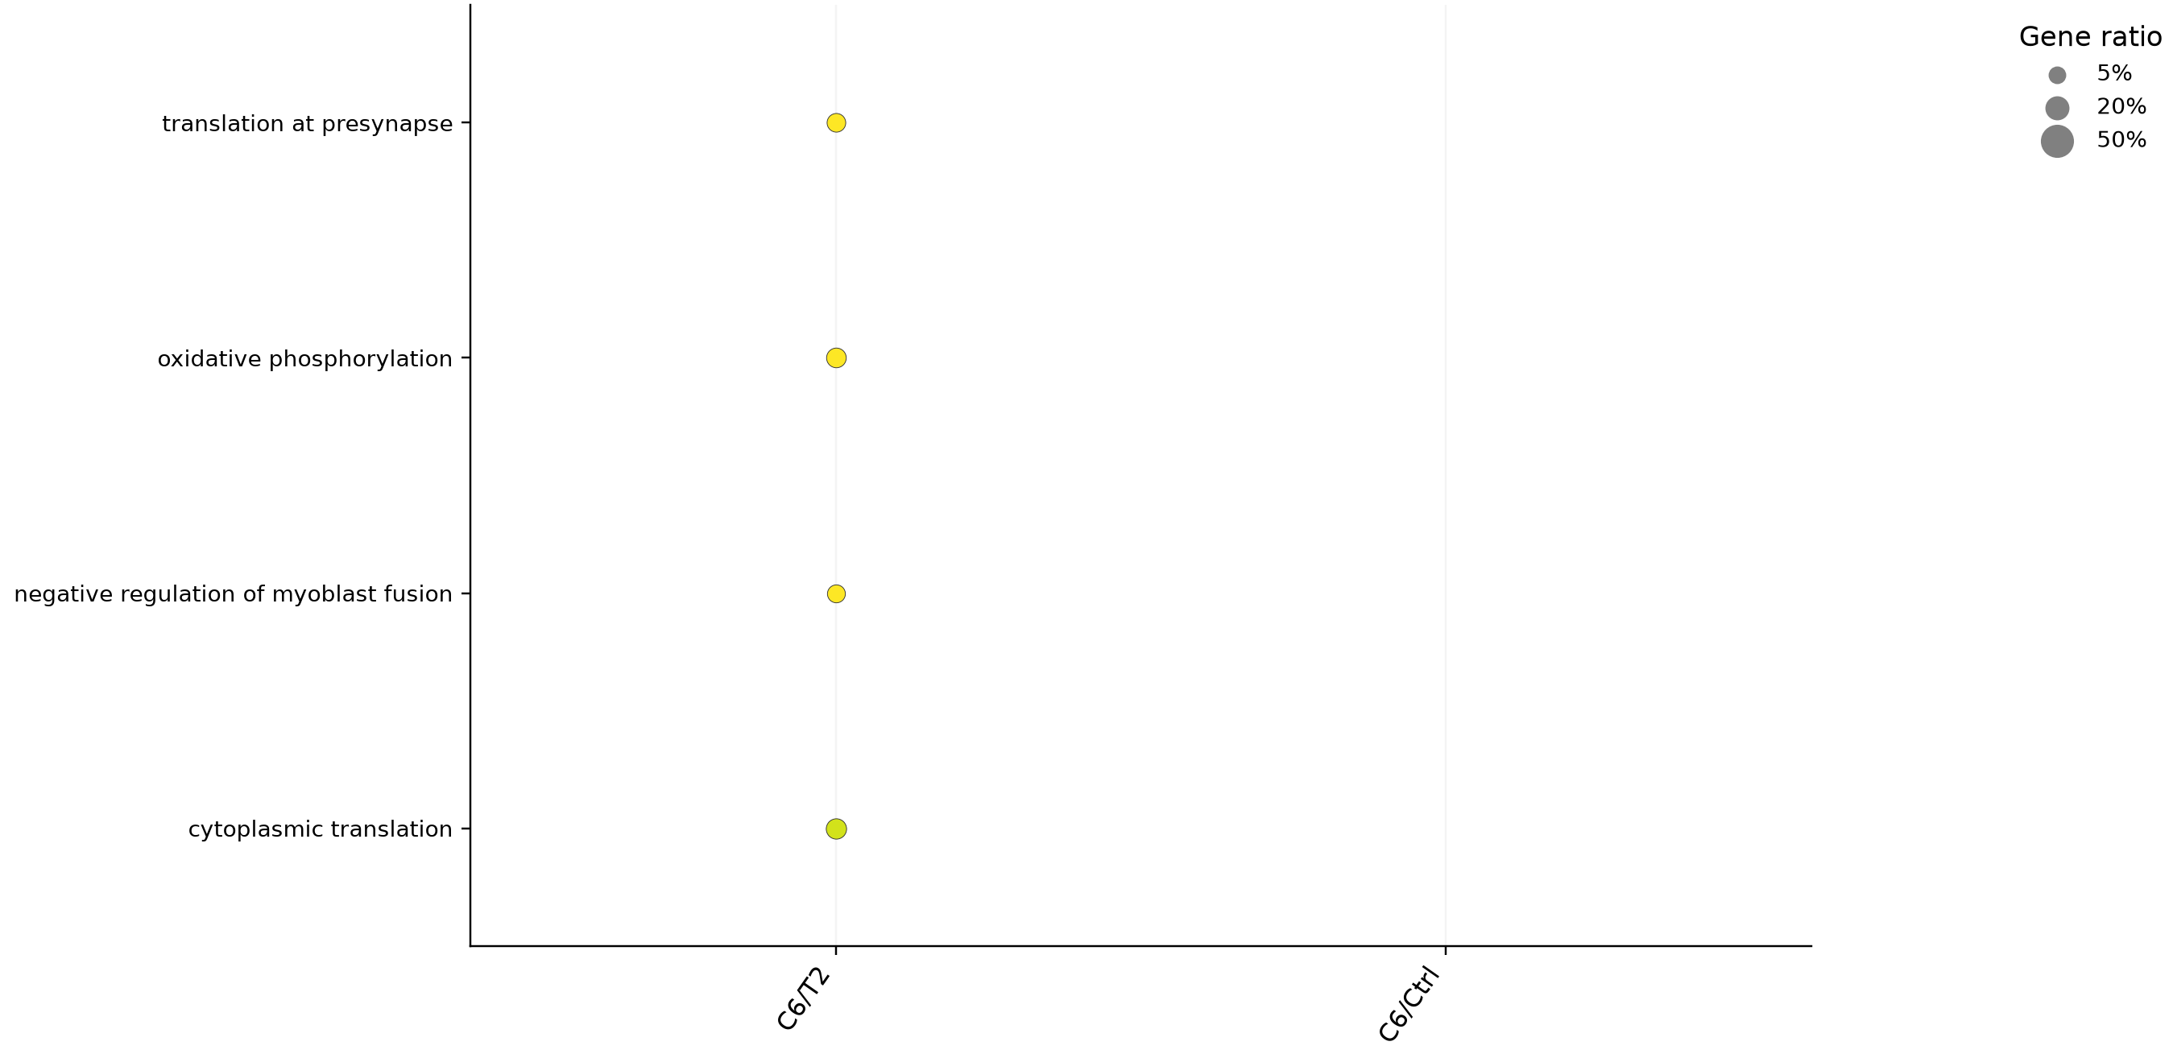
Thymus: GO biological processes: condition response
Within-tissue comparisons | dot area: query gene ratio | color: enrichment evidence
All BP/MF/CC tests retained. Only clusters with significant BP terms shown; q <= .05; >=2 hits; overlap redundancy reduced.
Exploratory transcriptional results; one sample label per tissue x condition; no animal-level inference. Blank = no displayed significant term, not proof of absence.
Borra et al. 2026, GAFA, Sec. 3.5 / Fig. 4c; doi:10.3390/biology15070588
12
Notes:
Thymus: GO biological processes: condition response
GO气泡图只展示显著且至少两个命中基因的代表条目。T2/ Ctrl列分别表示该方向上调基因的富集，不把富集直接解释成通路激活。完整BP、MF、CC结果见数据表。
Borra et al. 2026, GAFA, Sec. 3.5 / Fig. 4c; doi:10.3390/biology15070588
Exploratory transcriptional results; one sample label per tissue x condition; no animal-level inference. Blank = no displayed significant term, not proof of absence.
Source page: new_12; Main talk
Independent graphics: assets/panels/new_12_*
Native text and tables can be edited directly. SVG/PNG panels can be moved, resized or replaced independently; numeric source tables are in data/.

Slide 13
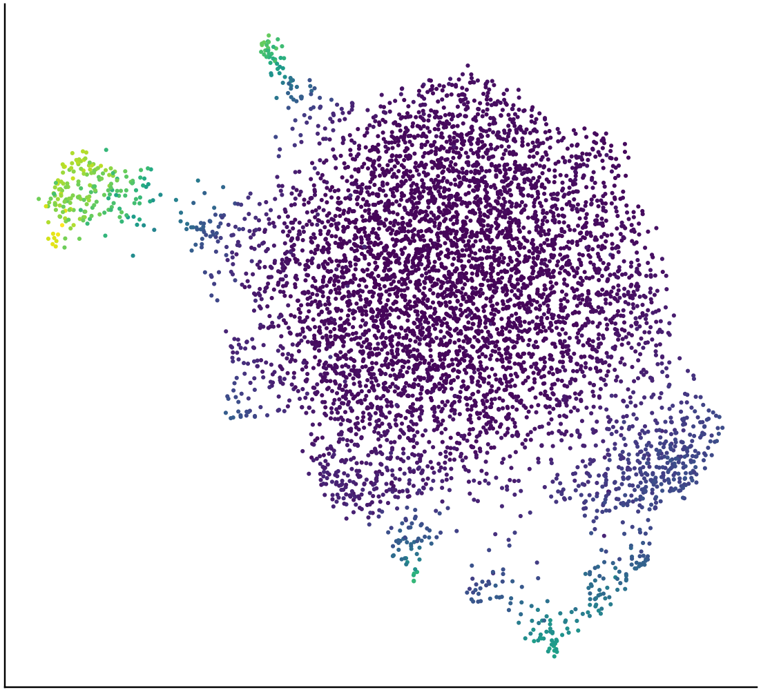
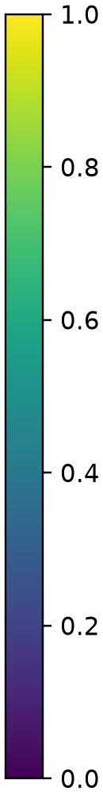
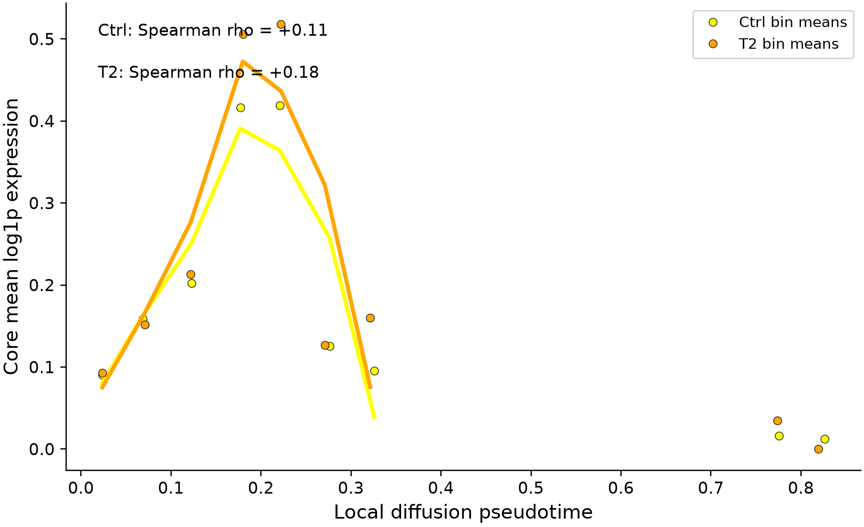
Bone marrow: local cytotoxicity along pseudotime
PAGER-style functional curves on a newly computed within-tissue diffusion map.
A Local DPT on tissue UMAP
B Common 20-bin functional profiles
Root state: bone_marrow_S0; measured root markers: Egr2 / Hivep3 (Cd24a unavailable). Root sensitivity rho: 0.89, 0.76.
Analyzed 6,110/6,110 cells; only bins with >=20 cells shown. Smooth lines are descriptive.
Exploratory transcriptional results; one sample label per tissue x condition; no animal-level inference. Pseudotime is an assumed ordering, not RNA velocity or lineage validation.
Huang et al. 2024, PAGER-scFGA, Fig. 5; doi:10.3389/fbinf.2024.1336135
13
Notes:
Bone marrow: local cytotoxicity along pseudotime
重新计算了组织内diffusion map，避免复用全局轨迹。用前体marker选择根群，三个根细胞做敏感性。平滑曲线不是置信区间，条件曲线差别不等于分化速率差别。
Huang et al. 2024, PAGER-scFGA, Fig. 5; doi:10.3389/fbinf.2024.1336135
Exploratory transcriptional results; one sample label per tissue x condition; no animal-level inference. Pseudotime is an assumed ordering, not RNA velocity or lineage validation.
Source page: new_13; Main talk
Independent graphics: assets/panels/new_13_*
Native text and tables can be edited directly. SVG/PNG panels can be moved, resized or replaced independently; numeric source tables are in data/.

Slide 14
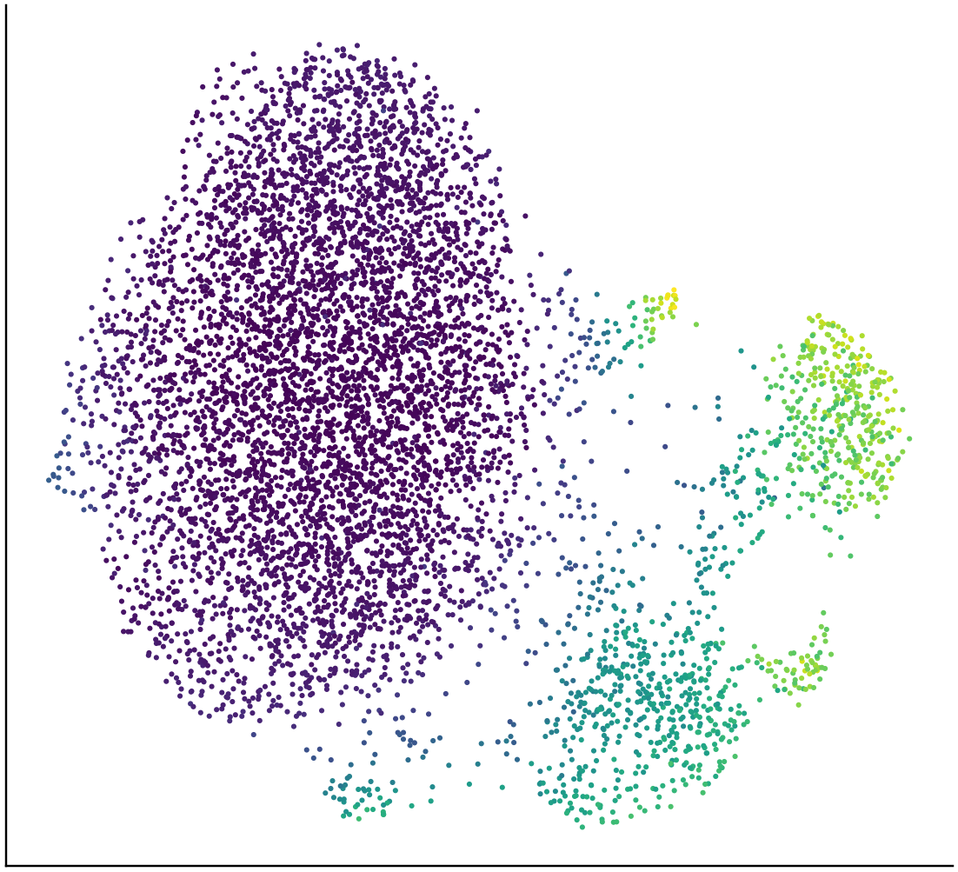
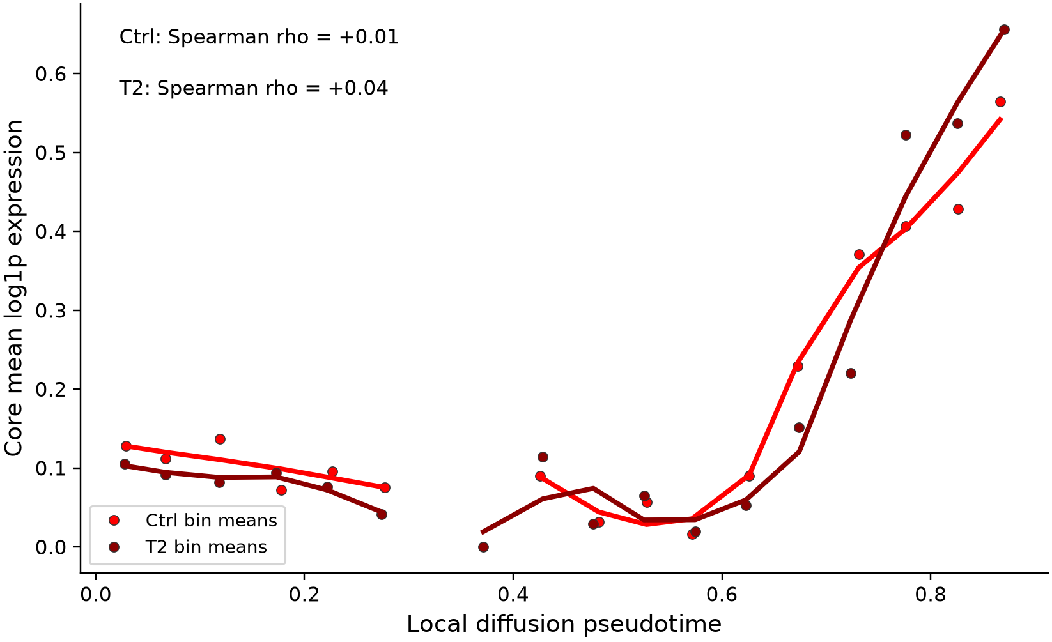
Spleen: local cytotoxicity along pseudotime
PAGER-style functional curves on a newly computed within-tissue diffusion map.
A Local DPT on tissue UMAP
B Common 20-bin functional profiles
Root state: spleen_S0; measured root markers: Egr2 / Hivep3 (Cd24a unavailable). Root sensitivity rho: 0.97, 0.76.
Analyzed 6,793/6,793 cells; only bins with >=20 cells shown. Smooth lines are descriptive.
Exploratory transcriptional results; one sample label per tissue x condition; no animal-level inference. Pseudotime is an assumed ordering, not RNA velocity or lineage validation.
Huang et al. 2024, PAGER-scFGA, Fig. 5; doi:10.3389/fbinf.2024.1336135
14
Notes:
Spleen: local cytotoxicity along pseudotime
重新计算了组织内diffusion map，避免复用全局轨迹。用前体marker选择根群，三个根细胞做敏感性。平滑曲线不是置信区间，条件曲线差别不等于分化速率差别。
Huang et al. 2024, PAGER-scFGA, Fig. 5; doi:10.3389/fbinf.2024.1336135
Exploratory transcriptional results; one sample label per tissue x condition; no animal-level inference. Pseudotime is an assumed ordering, not RNA velocity or lineage validation.
Source page: new_14; Main talk
Independent graphics: assets/panels/new_14_*
Native text and tables can be edited directly. SVG/PNG panels can be moved, resized or replaced independently; numeric source tables are in data/.

Slide 15
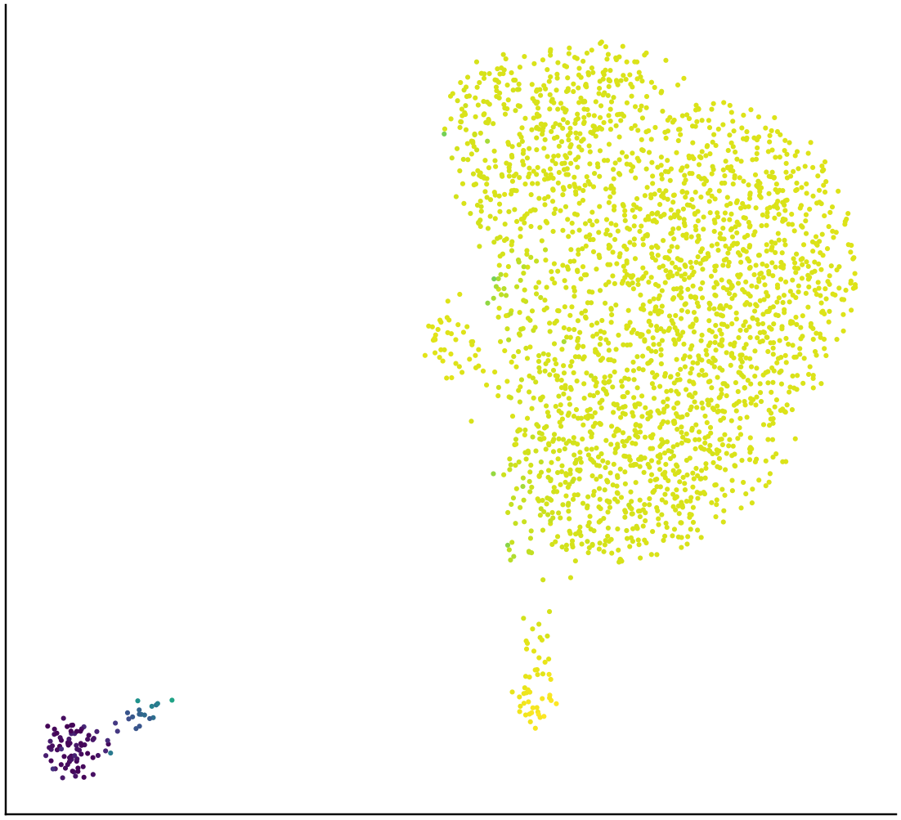
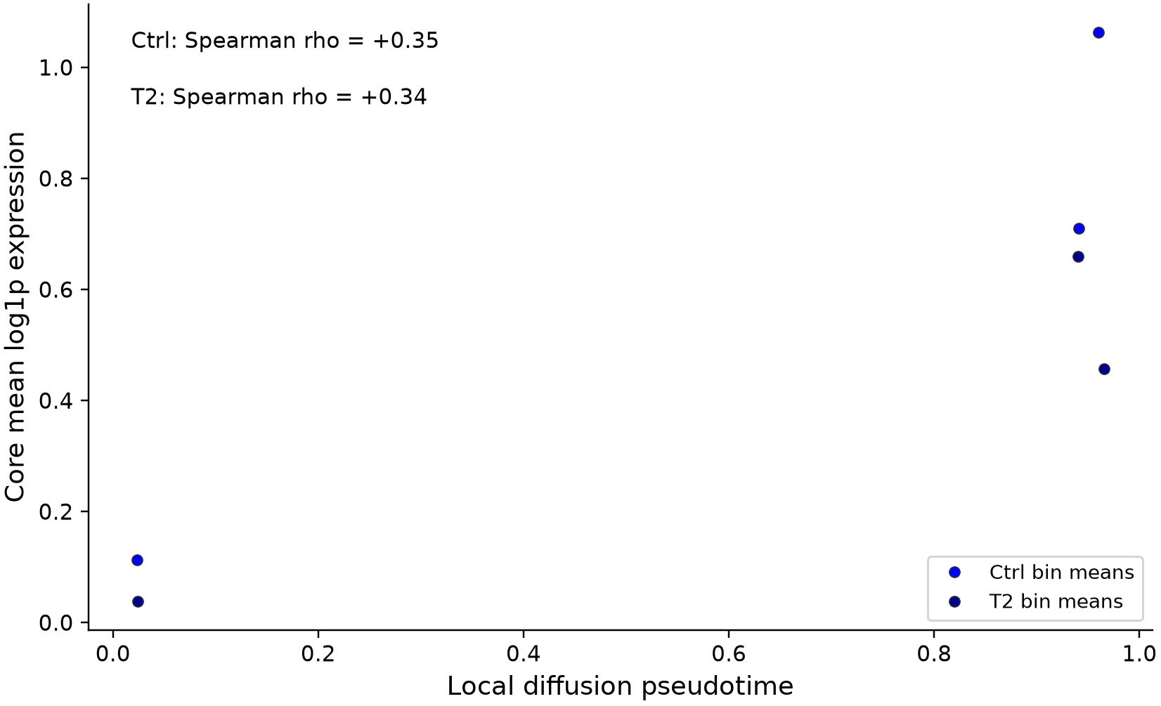
Thymus: local cytotoxicity along pseudotime
PAGER-style functional curves on a newly computed within-tissue diffusion map.
A Local DPT on tissue UMAP
B Common 20-bin functional profiles
Root state: thymus_S5; measured root markers: Egr2 / Hivep3 (Cd24a unavailable). Root sensitivity rho: 1.00, 1.00.
Analyzed 2,629/2,629 cells; only bins with >=20 cells shown. Smooth lines are descriptive.
Exploratory transcriptional results; one sample label per tissue x condition; no animal-level inference. Pseudotime is an assumed ordering, not RNA velocity or lineage validation.
Huang et al. 2024, PAGER-scFGA, Fig. 5; doi:10.3389/fbinf.2024.1336135
15
Notes:
Thymus: local cytotoxicity along pseudotime
重新计算了组织内diffusion map，避免复用全局轨迹。用前体marker选择根群，三个根细胞做敏感性。平滑曲线不是置信区间，条件曲线差别不等于分化速率差别。
Huang et al. 2024, PAGER-scFGA, Fig. 5; doi:10.3389/fbinf.2024.1336135
Exploratory transcriptional results; one sample label per tissue x condition; no animal-level inference. Pseudotime is an assumed ordering, not RNA velocity or lineage validation.
Source page: new_15; Main talk
Independent graphics: assets/panels/new_15_*
Native text and tables can be edited directly. SVG/PNG panels can be moved, resized or replaced independently; numeric source tables are in data/.

Slide 16
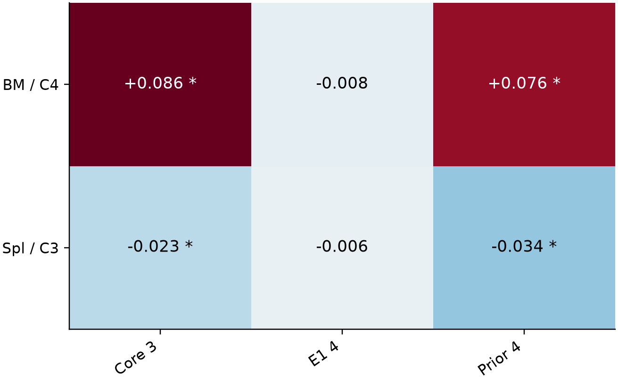
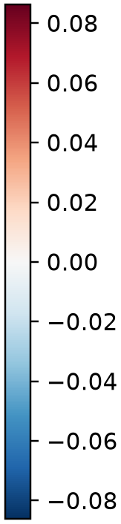
Core signature changes do not imply a full killing pathway
Two reproducible local core signals; the broader E1 signature is not significant.
A Signature sensitivity
B Complementary evidence from the same dataset
Bone marrow C4 core: +0.086; q = 0.025
Spleen C3 core: -0.023; q = 0.0015
Both: same direction in all 5 QC resamples
Stable-cluster effects: +0.111 and -0.022
Original-cell overlap: 98.7% and 99.5%
E1 (+Ctla2a): q = 0.93 and 0.53
Killing-related GO terms: no q <= 0.05
The evidence supports a localized core-effector transcriptional shift.
It does not establish increased/decreased killing activity or coordinated activation of a full cytotoxic pathway.
Exploratory transcriptional results; one sample label per tissue x condition; no animal-level inference.
Huang et al. 2024, PAGER-scFGA, Fig. 5; doi:10.3389/fbinf.2024.1336135; Borra et al. 2026, GAFA, Sec. 3.5 / Fig. 4c; doi:10.3390/biology15070588
16
Notes:
Core signature changes do not imply a full killing pathway
骨髓C4和脾脏C3的核心3基因模块及原4基因效应模块有一致局部变化；加入Ctla2a后的论文E1代表模块不显著。杀伤相关GO也未显著，不能推断整个细胞毒性通路增强或减弱。
Huang et al. 2024, PAGER-scFGA, Fig. 5; doi:10.3389/fbinf.2024.1336135; Borra et al. 2026, GAFA, Sec. 3.5 / Fig. 4c; doi:10.3390/biology15070588
Exploratory transcriptional results; one sample label per tissue x condition; no animal-level inference.
Source page: new_16; Main talk
Independent graphics: assets/panels/new_16_*
Native text and tables can be edited directly. SVG/PNG panels can be moved, resized or replaced independently; numeric source tables are in data/.

Slide 17
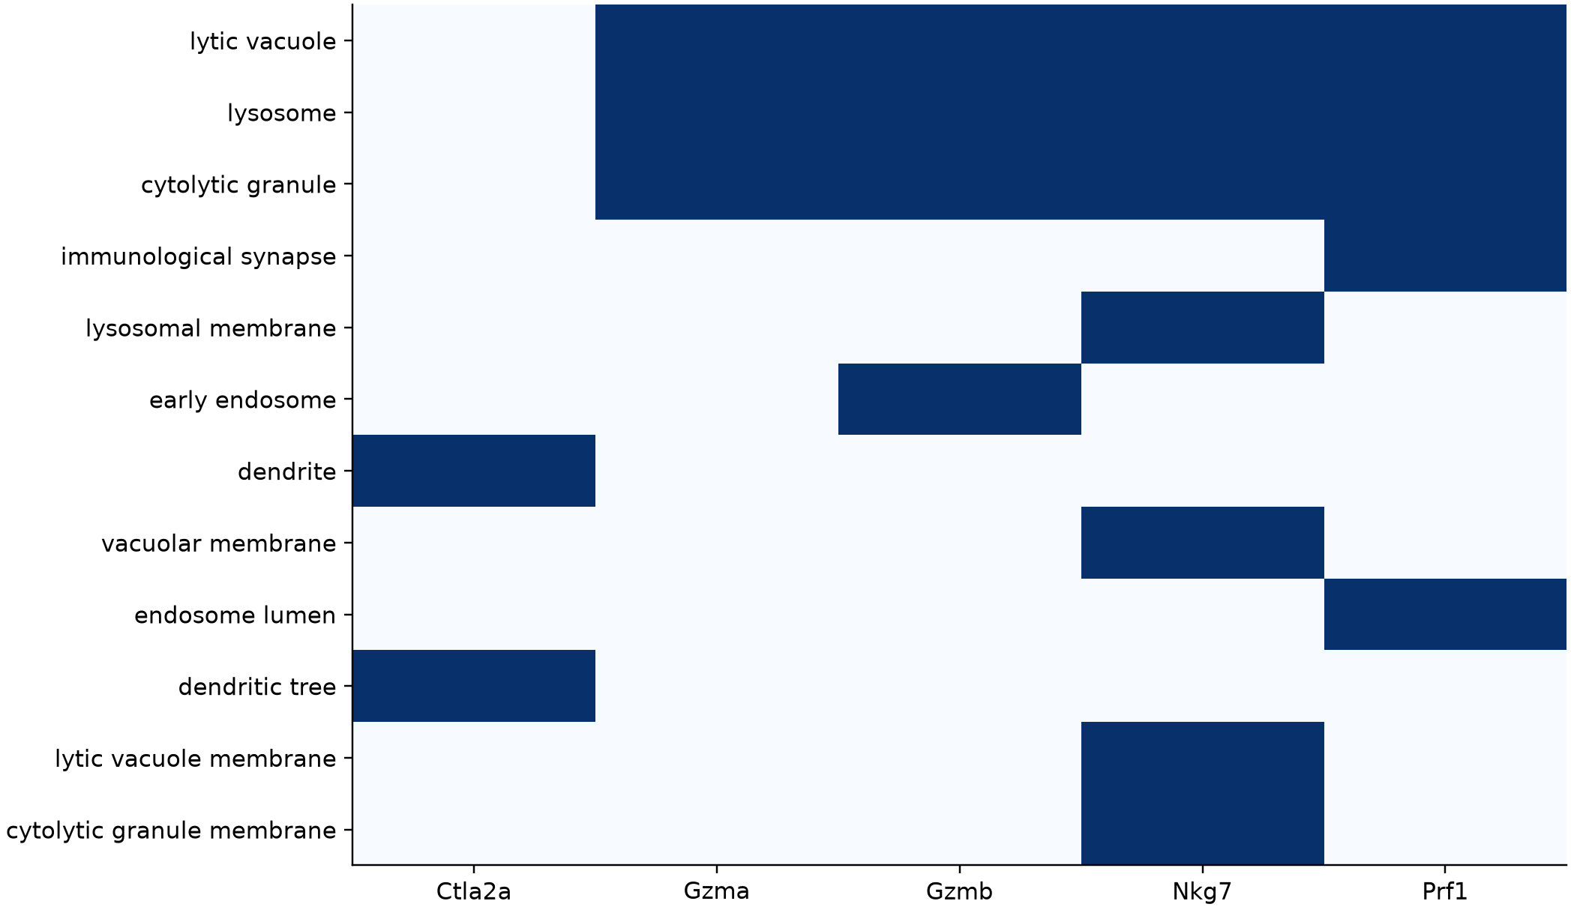
Cellular components of cytotoxic module genes
GO-CC membership supports localization; this is not a protein-interaction network.
Measured genes x propagated GO-CC membership
Exploratory transcriptional results; one sample label per tissue x condition; no animal-level inference.
Huang et al. 2024, PAGER-scFGA, Fig. 5; doi:10.3389/fbinf.2024.1336135; official mouse GO annotations
17
Notes:
Cellular components of cytotoxic module genes
这里只画真实GO细胞组分注释矩阵，不把共同定位误画为PPI相互作用。
Huang et al. 2024, PAGER-scFGA, Fig. 5; doi:10.3389/fbinf.2024.1336135; official mouse GO annotations
Exploratory transcriptional results; one sample label per tissue x condition; no animal-level inference.
Source page: new_17; Main talk
Independent graphics: assets/panels/new_17_*
Native text and tables can be edited directly. SVG/PNG panels can be moved, resized or replaced independently; numeric source tables are in data/.

Slide 18
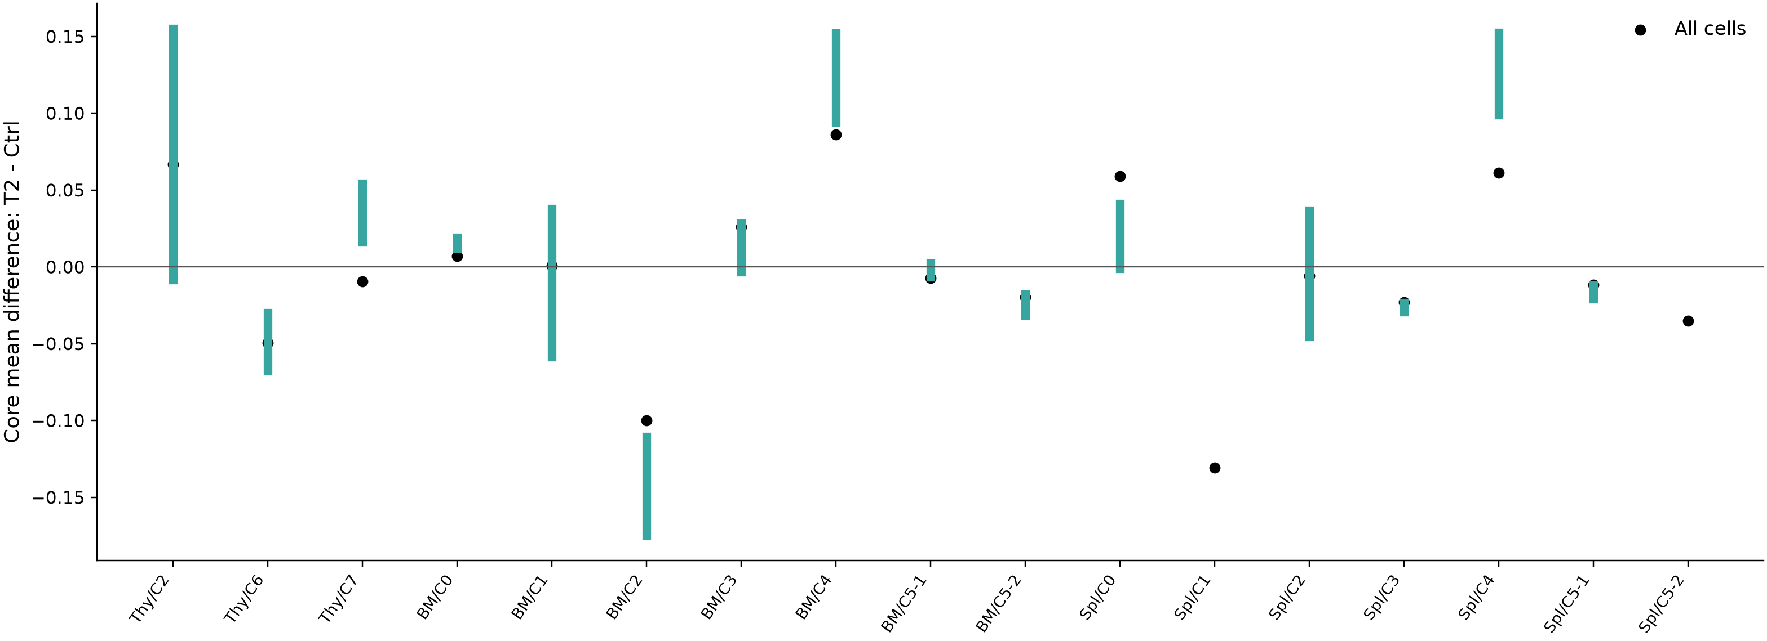
Robustness: QC matching and alternative clustering
Five condition-balanced QC resamples within each tissue x cluster.
Teal range: five QC-matched effect estimates (not a confidence interval).
Stable tissue clusters are a separate sensitivity analysis; their labels are not interchangeable with original C labels.
Exploratory transcriptional results; one sample label per tissue x condition; no animal-level inference.
Huang et al. 2024, PAGER-scFGA, Fig. 5; doi:10.3389/fbinf.2024.1336135; sensitivity analyses added for this dataset
18
Notes:
Robustness: QC matching and alternative clustering
绿色范围表示五次QC匹配结果范围，不是置信区间。完整稳定分群分析保存在表里，不把S群直接等同原来的C群。
Huang et al. 2024, PAGER-scFGA, Fig. 5; doi:10.3389/fbinf.2024.1336135; sensitivity analyses added for this dataset
Exploratory transcriptional results; one sample label per tissue x condition; no animal-level inference.
Source page: new_18; Main talk
Independent graphics: assets/panels/new_18_*
Native text and tables can be edited directly. SVG/PNG panels can be moved, resized or replaced independently; numeric source tables are in data/.

Slide 19
Evidence summary and next interpretation
Cytotoxic module results, GO support and sensitivity are reported separately.
Contrast | Core delta | BH q (cell level) | QC same direction | Control-score agrees | Max QC |SMD|
Spl/C1 | -0.131 | 0.059 | NA | yes | NA
BM/C2 | -0.100 | 0.22 | 5/5 | yes | 0.17
BM/C4 | +0.086 | 0.025 | 5/5 | yes | 0.06
Thy/C2 | +0.067 | 0.49 | 4/5 | yes | 0.18
Spl/C4 | +0.061 | 0.3 | 5/5 | yes | 0.20
Spl/C0 | +0.059 | 0.46 | 4/5 | yes | 0.19
Thy/C6 | -0.049 | 0.4 | 5/5 | yes | 0.08
Spl/C5-2 | -0.035 | 0.34 | NA | yes | NA
Ranked by absolute expression difference, not selected for significance.
A cytotoxic transcript signature is not a killing assay; GO terms can share the same driver genes.
Independent biological replicates and functional assays are required to confirm treatment effects.
Exploratory transcriptional results; one sample label per tissue x condition; no animal-level inference.
Huang et al. 2024, PAGER-scFGA, Fig. 5; doi:10.3389/fbinf.2024.1336135; Borra et al. 2026, GAFA, Sec. 3.5 / Fig. 4c; doi:10.3390/biology15070588
19
Notes:
Evidence summary and next interpretation
总结按表达差异绝对值排序。优先看基因组成、QC匹配、背景校正评分是否同向，再讨论GO机制；不要把转录结果写成已验证杀伤增强或减弱。
Huang et al. 2024, PAGER-scFGA, Fig. 5; doi:10.3389/fbinf.2024.1336135; Borra et al. 2026, GAFA, Sec. 3.5 / Fig. 4c; doi:10.3390/biology15070588
Exploratory transcriptional results; one sample label per tissue x condition; no animal-level inference.
Source page: new_19; Main talk
Independent graphics: assets/panels/new_19_*
Native text and tables can be edited directly. SVG/PNG panels can be moved, resized or replaced independently; numeric source tables are in data/.

