Slide 1
iNKT: cell states, cytotoxic programs and functional changes
Integrated editable presentation | main talk + complete source-page appendix
Research question
How does the T2-associated response differ across tissues and iNKT states?
Presentation sequence
1 Cohort, cell-state markers and tissue composition
2 Differential expression, cytotoxic modules and GO functions
3 Local state ordering, robustness and bounded interpretation
15,532 cells | 3 tissues | Ctrl / T2 | 9 original refined clusters
One sample label per tissue x condition: all biological conclusions remain exploratory.
20 September 2026 | Existing iNKT analyses; no new statistical analysis in this packaging step.
Notes:
iNKT: cell states, cytotoxic programs and functional changes
主报告按数据与细胞状态、差异与功能、轨迹与解释组织。原37页和新增19页均保留，部分进入主报告，其余进入附录。
Blood Fig. 3; PAGER-scFGA Fig. 5; Borra et al. Fig. 4c
Main talk followed by an appendix preserving every previous and current source page.
Source page: custom_01; Main talk
Independent graphics: assets/panels/custom_01_*
Native text and tables can be edited directly. SVG/PNG panels can be moved, resized or replaced independently; numeric source tables are in data/.

Slide 2
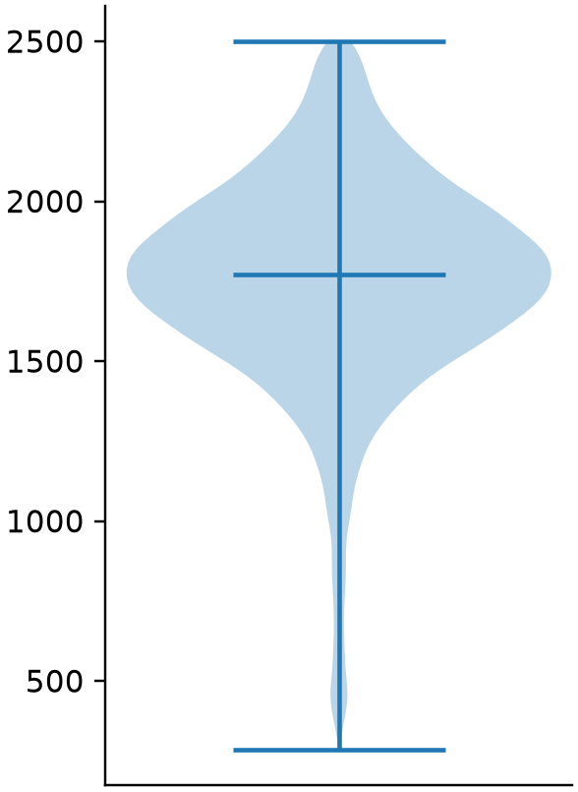
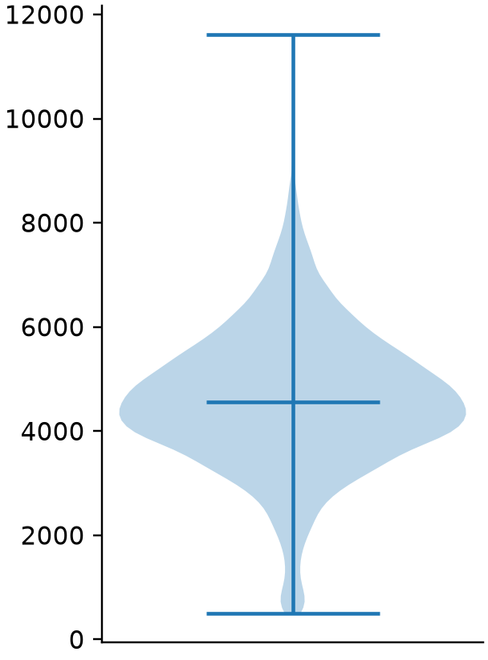
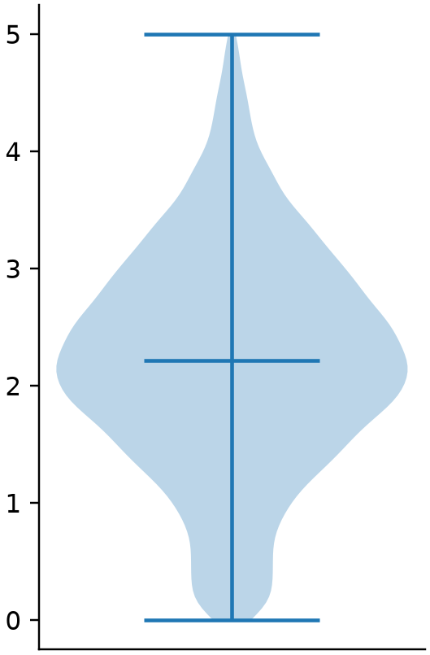
Material, dataset and QC
Six samples • 15,532 retained cells • 10,670 measured genes
Sample | Input cells | Retained
Ctrl_Thymus | 2101 | 1372
Ctrl_BM | 3998 | 3379
Ctrl_Spleen | 3829 | 3422
T2_Thymus | 1639 | 1257
T2_BM | 3131 | 2731
T2_Spleen | 3760 | 3371
Detected genes
UMI counts
Mitochondrial %
Gene min_cells = 100, then
200 ≤ detected genes < 2,500; mitochondrial fraction < 5%.
QC counts match the legacy deck; downstream UMAP, Leiden and gene statistics remain a reanalysis.
Original iNKT deck, slide 2; current object: 20260905 scored_base.h5ad.
2
Notes:
Material, dataset and QC
原综合报告第2页。QC counts match the legacy deck; downstream UMAP, Leiden and gene statistics remain a reanalysis.
Original iNKT deck, slide 2; current object: 20260905 scored_base.h5ad.
QC counts match the legacy deck; downstream UMAP, Leiden and gene statistics remain a reanalysis.
Source page: old_02; Main talk
Independent graphics: assets/panels/old_02_*
Native text and tables can be edited directly. SVG/PNG panels can be moved, resized or replaced independently; numeric source tables are in data/.

Slide 3
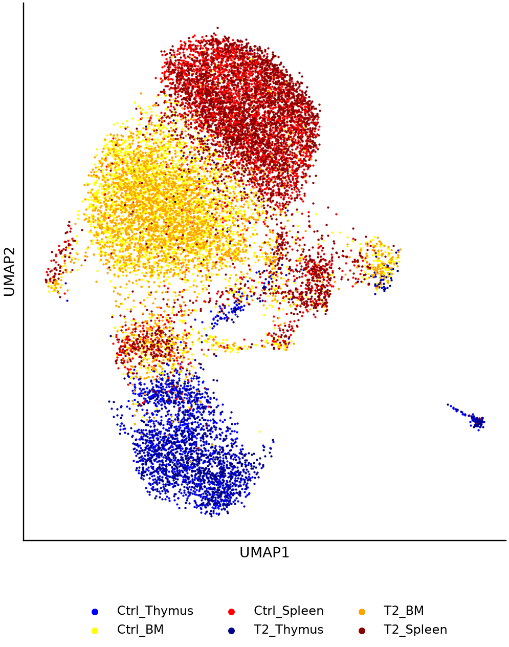
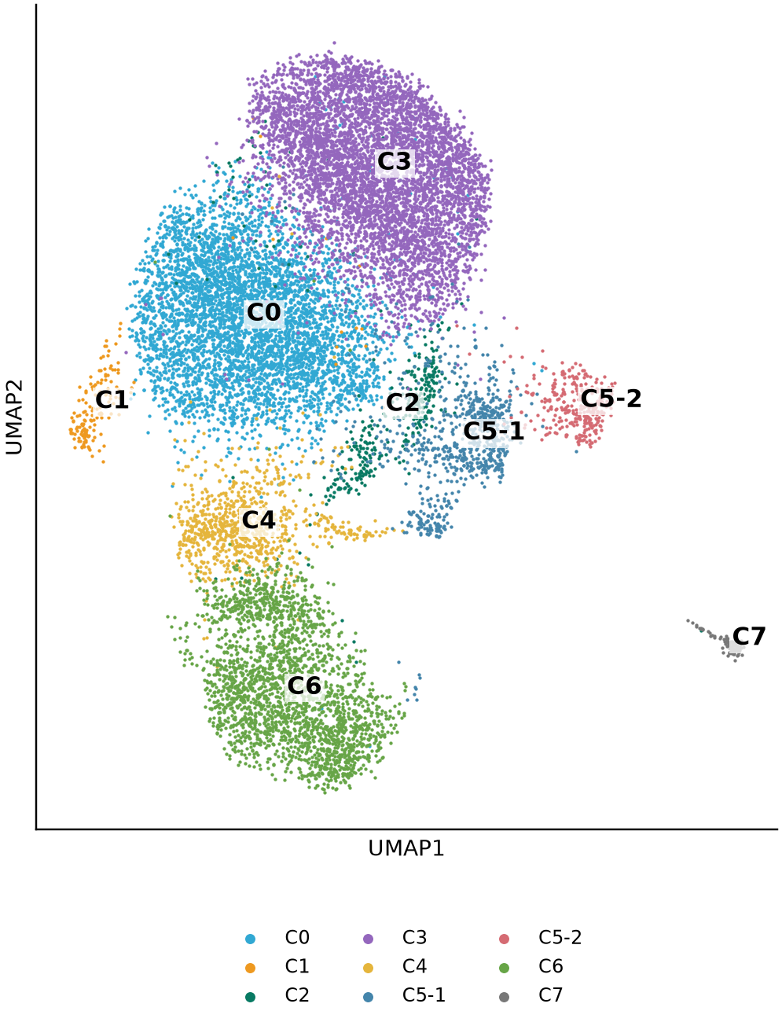
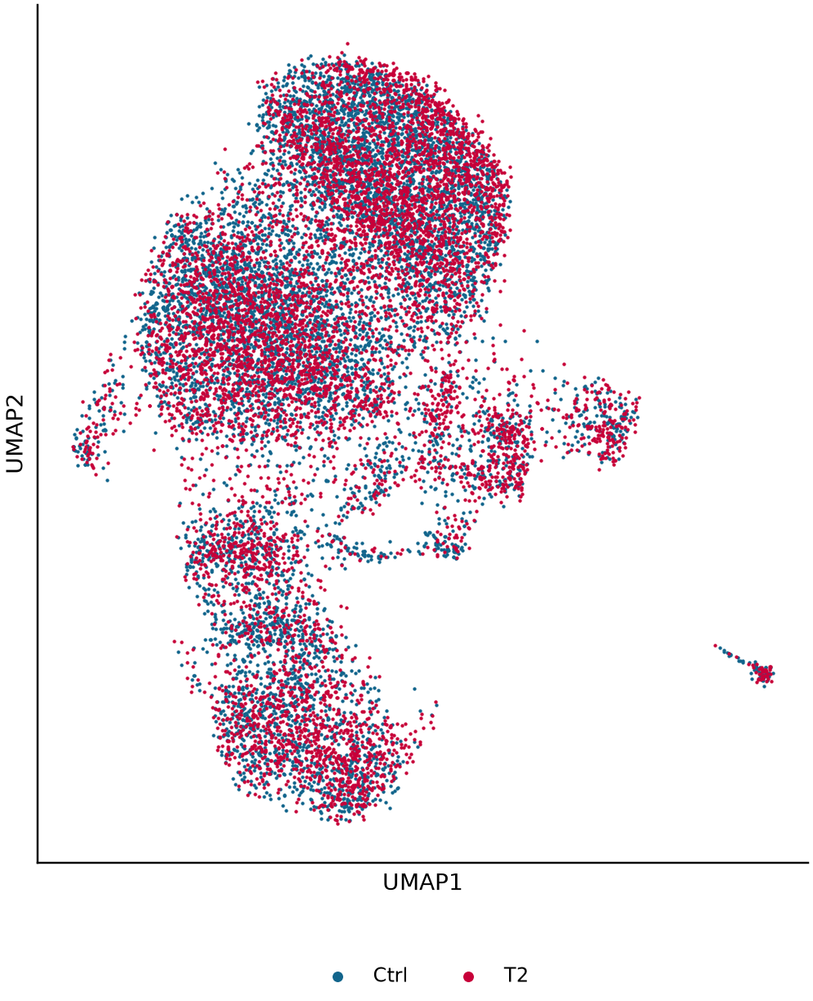
Clusters and tissue composition
Fixed 50-PC UMAP; C5 refined to C5-1 and C5-2
Sample
Current clusters
Condition
Original sample hues retained on the left; Blood-style blue/red encodes condition on the right. Coordinates are unchanged.
Original iNKT slides 4–5/12; Blood Fig. 3B is t-SNE/K-means, so axes and labels are not copied.
3
Notes:
Clusters and tissue composition
原综合报告第3页。Original sample hues retained on the left; Blood-style blue/red encodes condition on the right. Coordinates are unchanged.
Original iNKT slides 4–5/12; Blood Fig. 3B is t-SNE/K-means, so axes and labels are not copied.
Original sample hues retained on the left; Blood-style blue/red encodes condition on the right. Coordinates are unchanged.
Source page: old_03; Main talk
Independent graphics: assets/panels/old_03_*
Native text and tables can be edited directly. SVG/PNG panels can be moved, resized or replaced independently; numeric source tables are in data/.

Slide 4
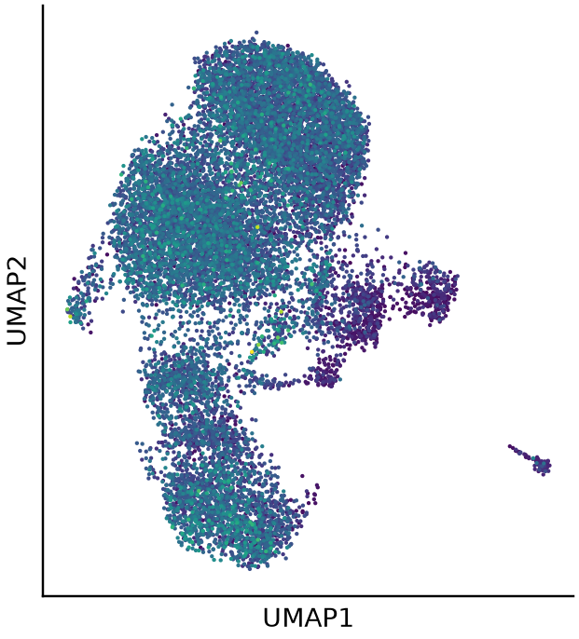
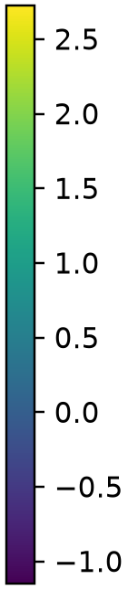
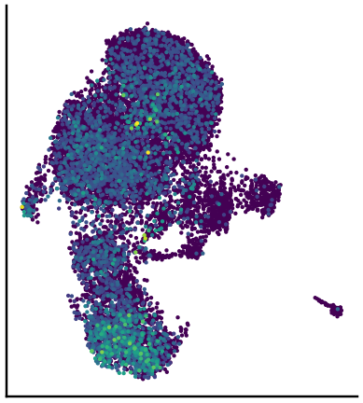

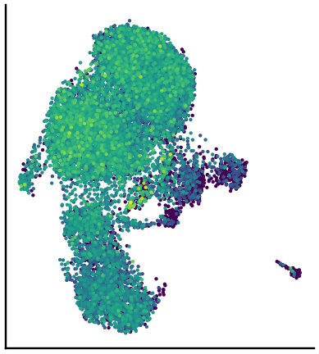

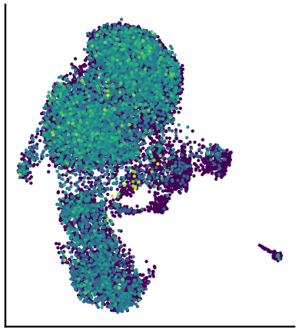

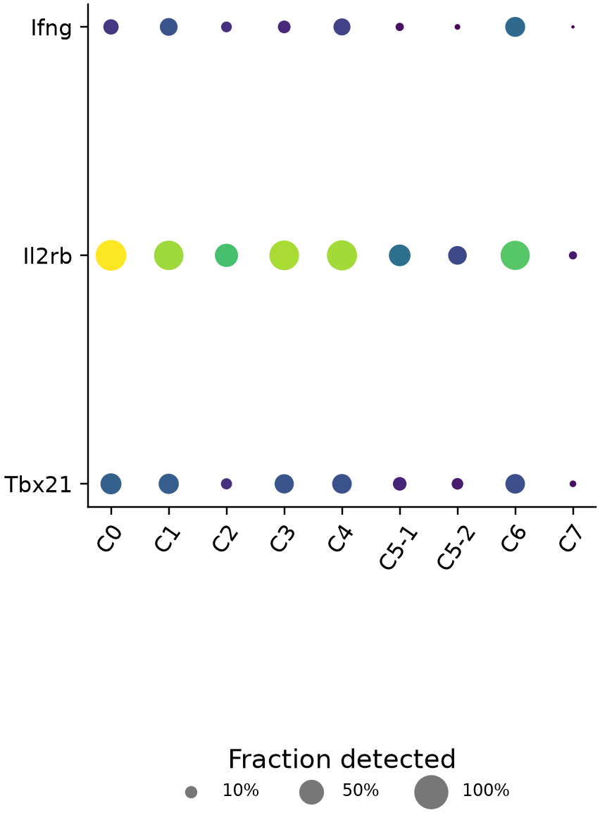
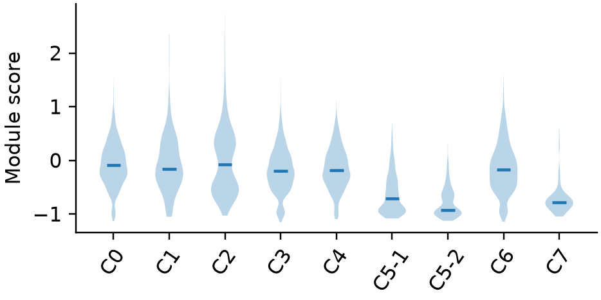
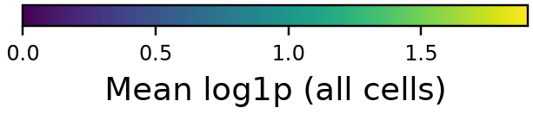
iNKT1 marker program
Score map, cluster distributions, individual markers and expression dotplot
iNKT1 score
Ifng
Il2rb
Tbx21
Marker expression
Current score_genes units differ from legacy summed-marker scores; these panels do not establish discrete subtype identities.
Original iNKT slides 6–8; marker panel and saved continuous scores from the 20260905 state analysis.
4
Notes:
iNKT1 marker program
原综合报告第5页。Current score_genes units differ from legacy summed-marker scores; these panels do not establish discrete subtype identities.
Original iNKT slides 6–8; marker panel and saved continuous scores from the 20260905 state analysis.
Current score_genes units differ from legacy summed-marker scores; these panels do not establish discrete subtype identities.
Source page: old_05; Main talk
Independent graphics: assets/panels/old_05_*
Native text and tables can be edited directly. SVG/PNG panels can be moved, resized or replaced independently; numeric source tables are in data/.

Slide 5
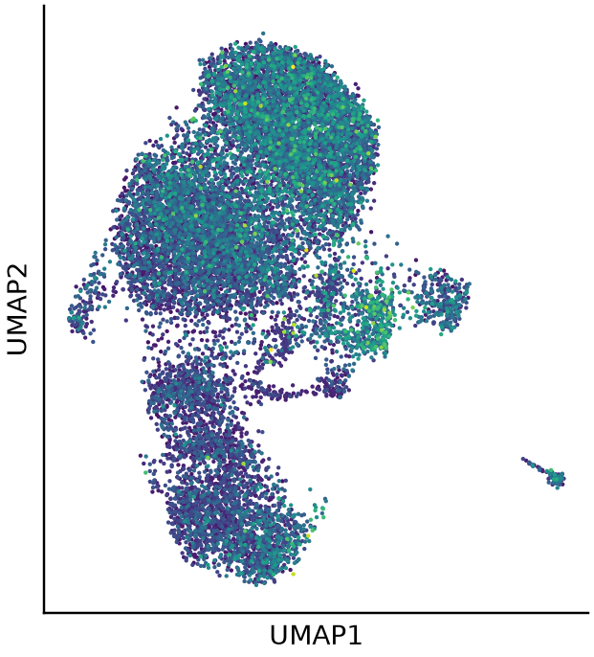
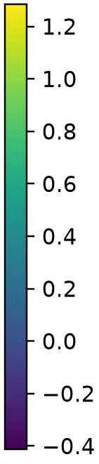
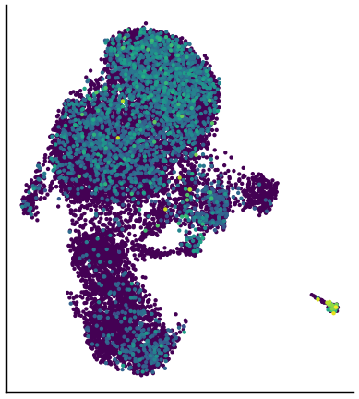

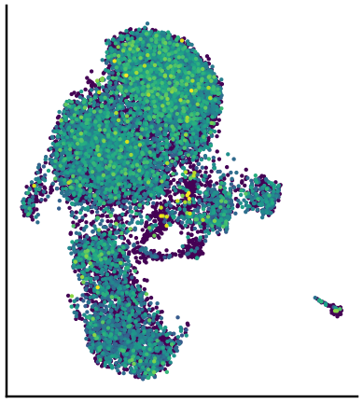

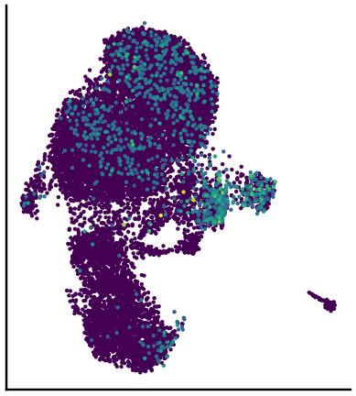

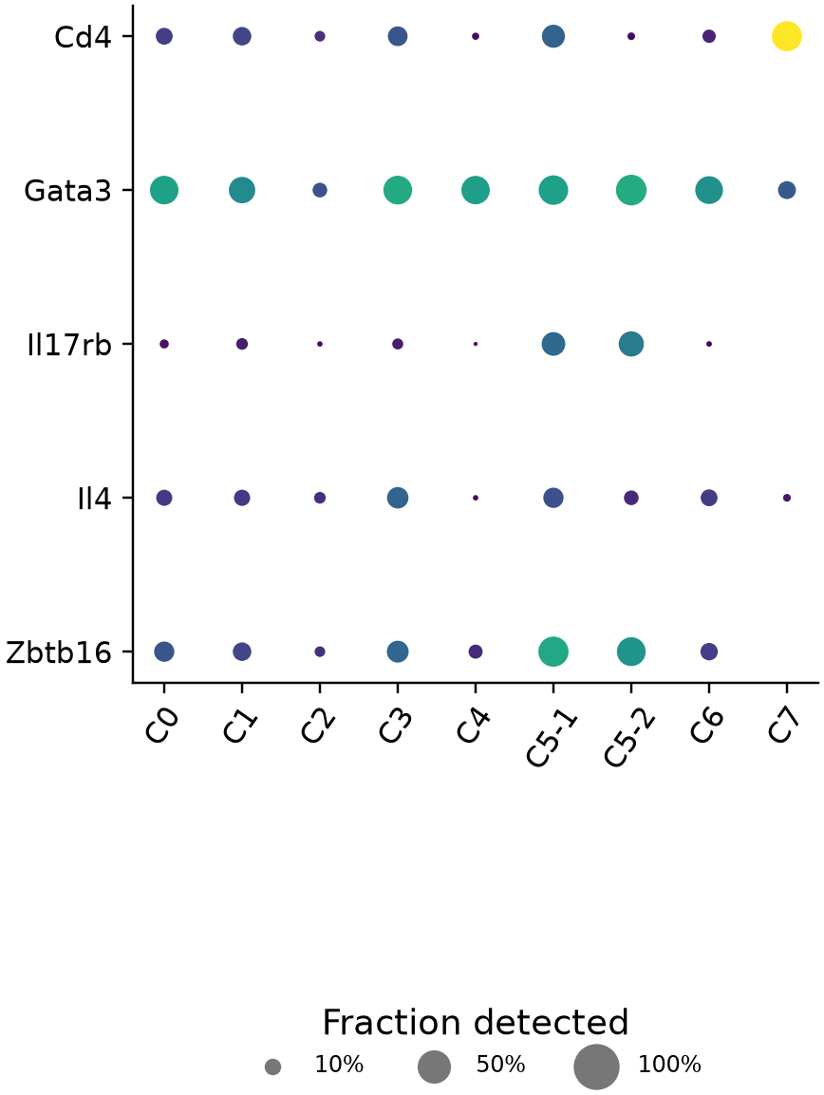
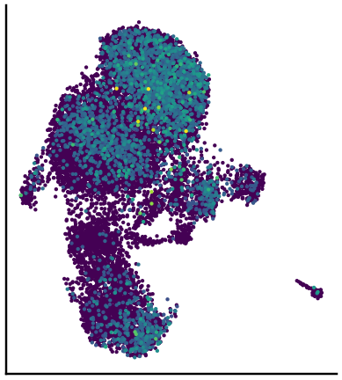

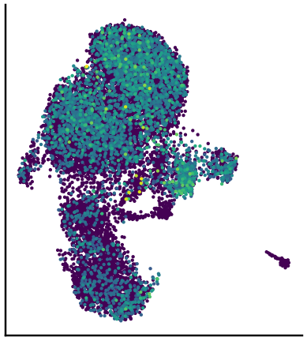

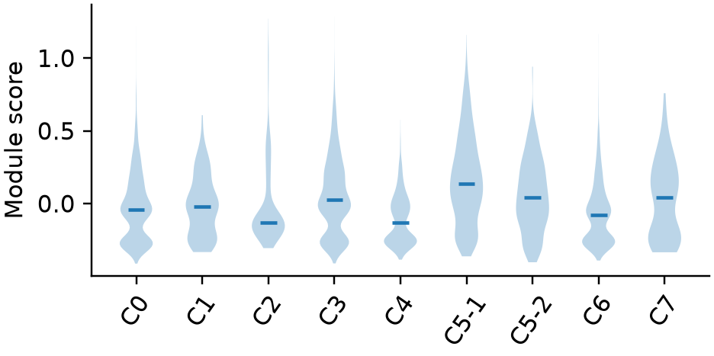
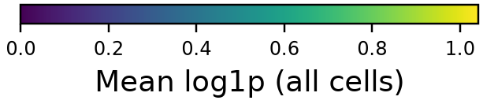
iNKT2 marker program
Score map, cluster distributions, individual markers and expression dotplot
iNKT2 score
Cd4
Gata3
Il17rb
Marker expression
Il4
Zbtb16
Current score_genes units differ from legacy summed-marker scores; these panels do not establish discrete subtype identities.
Original iNKT slides 6–8; marker panel and saved continuous scores from the 20260905 state analysis.
5
Notes:
iNKT2 marker program
原综合报告第6页。Current score_genes units differ from legacy summed-marker scores; these panels do not establish discrete subtype identities.
Original iNKT slides 6–8; marker panel and saved continuous scores from the 20260905 state analysis.
Current score_genes units differ from legacy summed-marker scores; these panels do not establish discrete subtype identities.
Source page: old_06; Main talk
Independent graphics: assets/panels/old_06_*
Native text and tables can be edited directly. SVG/PNG panels can be moved, resized or replaced independently; numeric source tables are in data/.

Slide 6
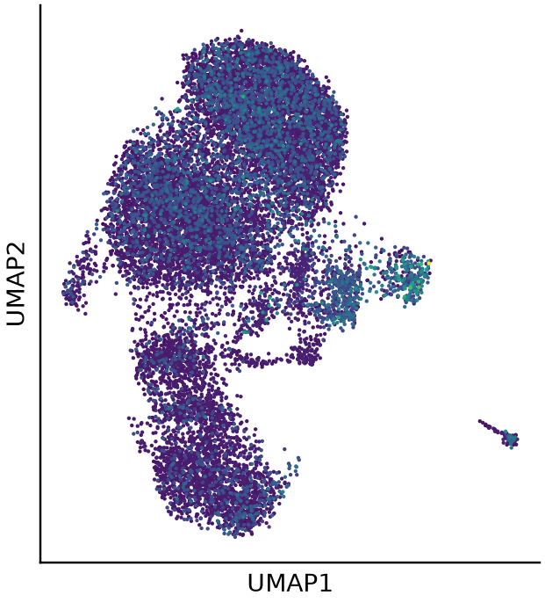
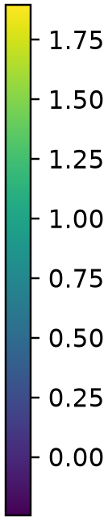
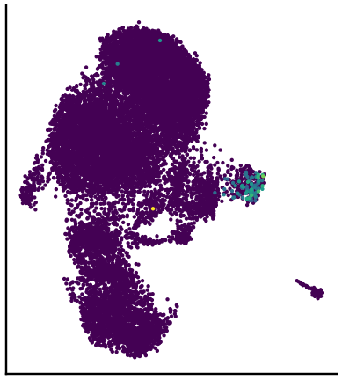

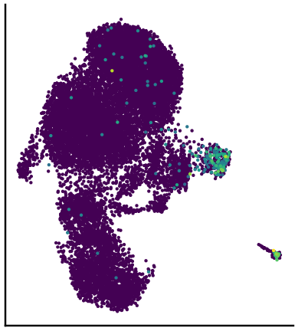

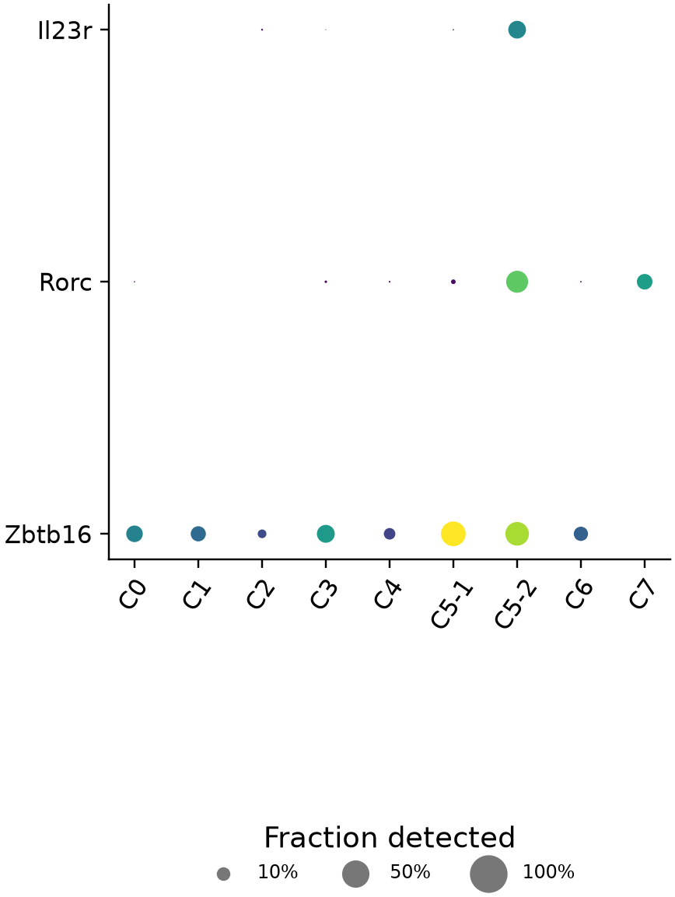
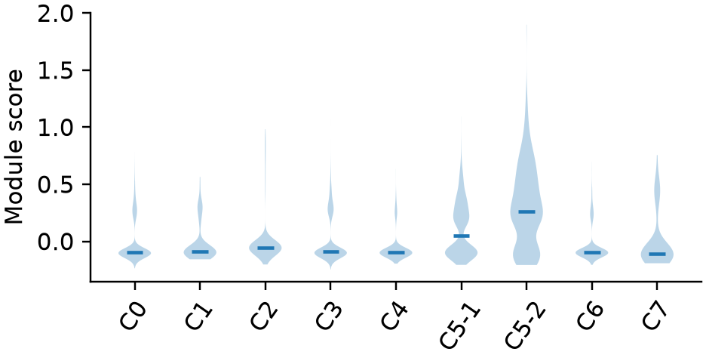
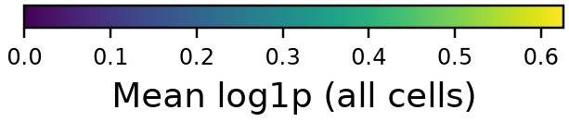
iNKT17 marker program
Score map, cluster distributions, individual markers and expression dotplot
iNKT17 score
Il23r
Rorc
Zbtb16
Marker expression
Ccr6 is absent from the filtered feature set.
Missing markers are not shown as zero expression.
Current score_genes units differ from legacy summed-marker scores; these panels do not establish discrete subtype identities.
Original iNKT slides 6–8; marker panel and saved continuous scores from the 20260905 state analysis.
6
Notes:
iNKT17 marker program
原综合报告第7页。Current score_genes units differ from legacy summed-marker scores; these panels do not establish discrete subtype identities.
Original iNKT slides 6–8; marker panel and saved continuous scores from the 20260905 state analysis.
Current score_genes units differ from legacy summed-marker scores; these panels do not establish discrete subtype identities.
Source page: old_07; Main talk
Independent graphics: assets/panels/old_07_*
Native text and tables can be edited directly. SVG/PNG panels can be moved, resized or replaced independently; numeric source tables are in data/.

Slide 7
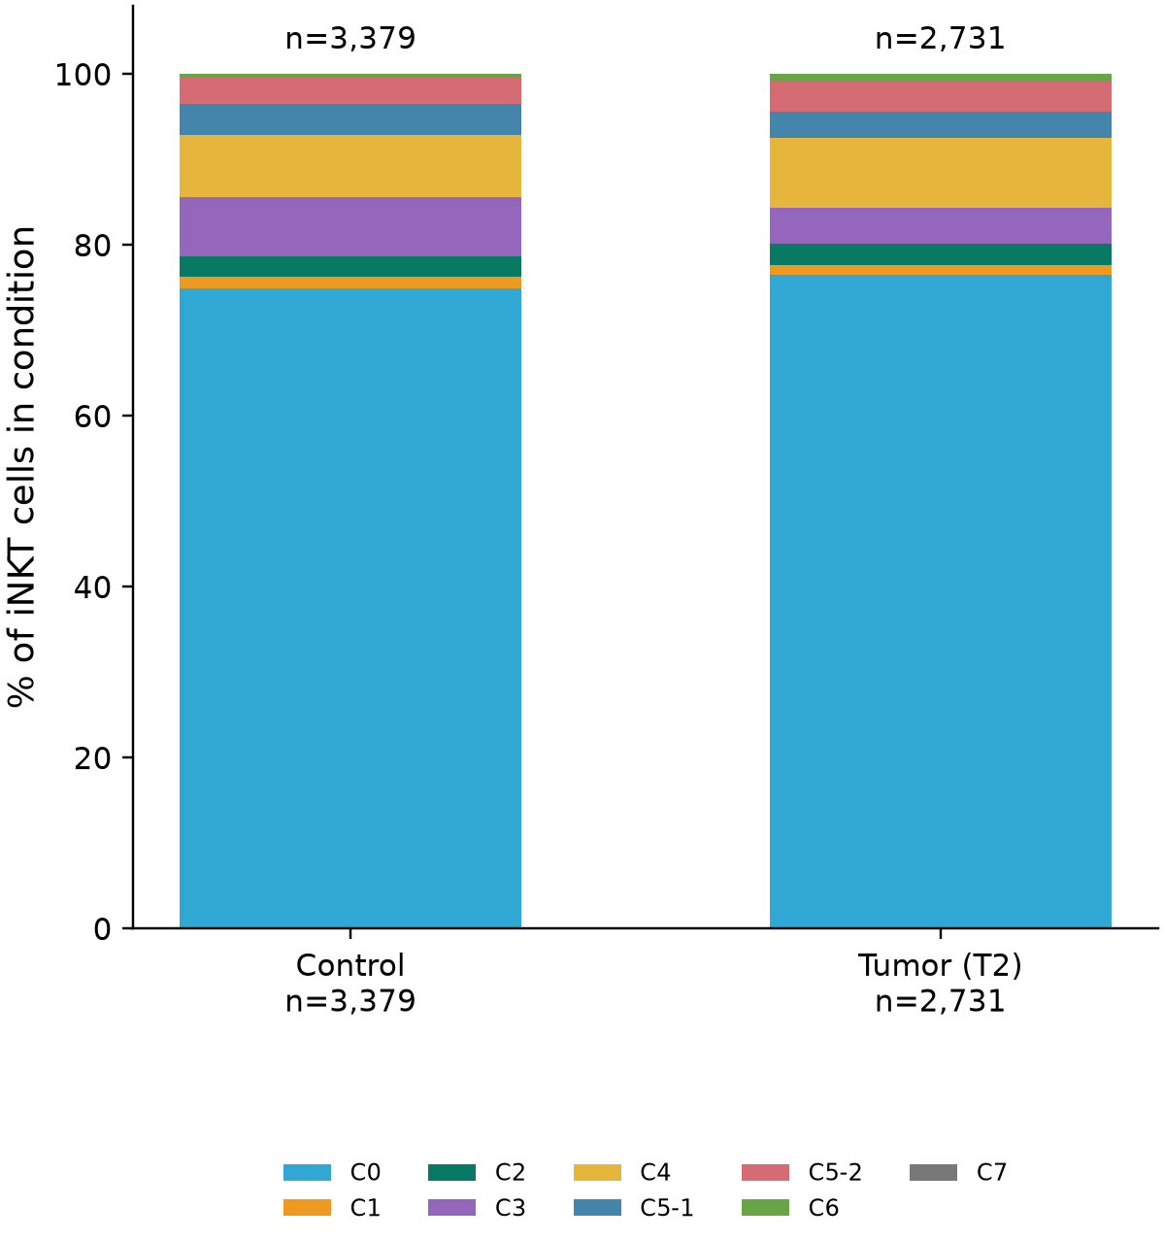
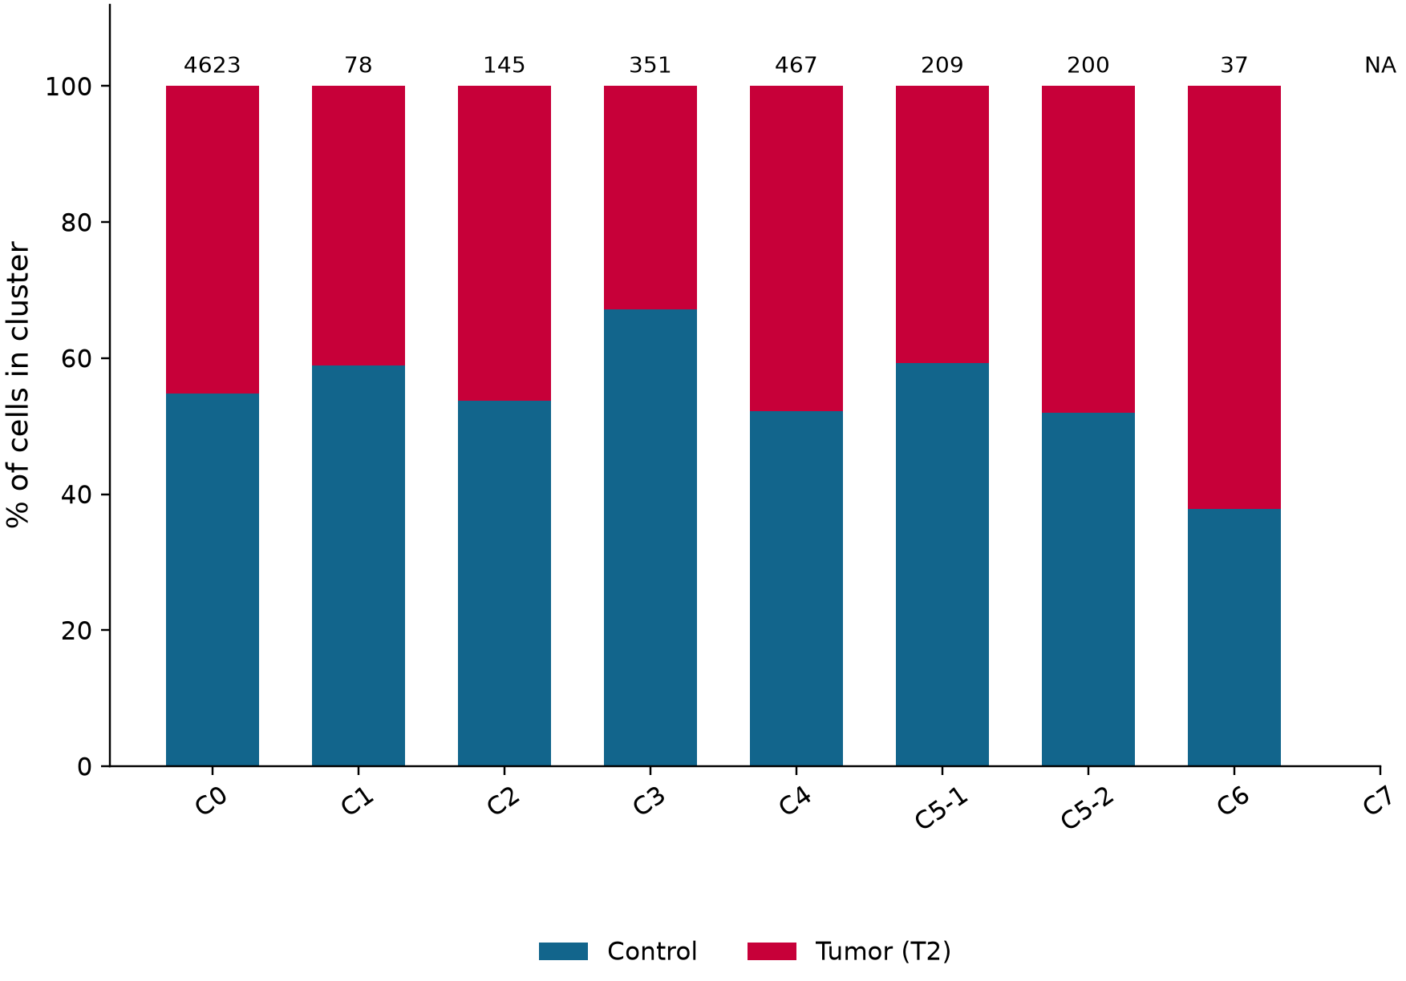
Bone marrow: cluster and condition frequencies
C • The two denominators from Blood Figure 3C, presented side by side
Cluster frequency within condition
Condition share within cluster
Left: n(cluster, condition) / N(condition) | Right: n(condition, cluster) / N(cluster)
Captured-cell proportions only. No mouse-level error bars or significance are inferred from individual cells.
Blood Fig. 3C; saved 20260905 frequency_reconciliation_1.csv.
7
Notes:
Bone marrow: cluster and condition frequencies
原综合报告第8页。Captured-cell proportions only. No mouse-level error bars or significance are inferred from individual cells.
Blood Fig. 3C; saved 20260905 frequency_reconciliation_1.csv.
Captured-cell proportions only. No mouse-level error bars or significance are inferred from individual cells.
Source page: old_08; Main talk
Independent graphics: assets/panels/old_08_*
Native text and tables can be edited directly. SVG/PNG panels can be moved, resized or replaced independently; numeric source tables are in data/.

Slide 8
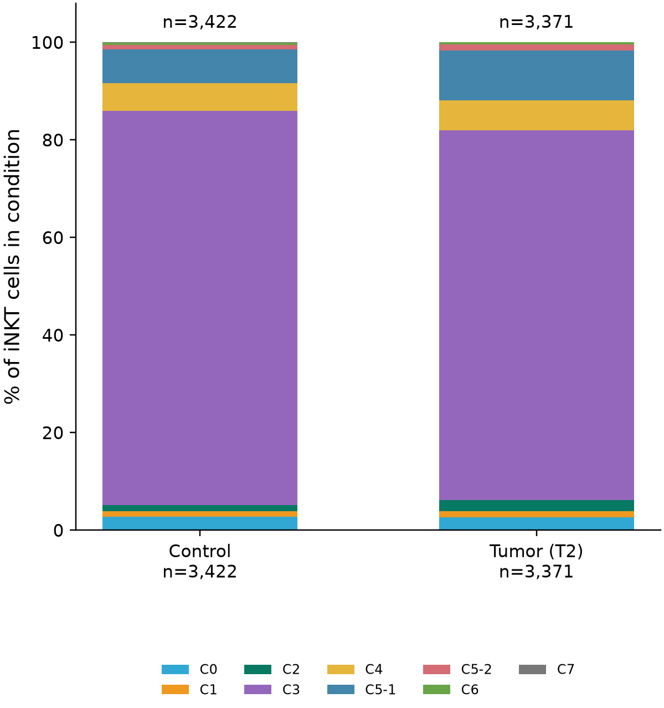
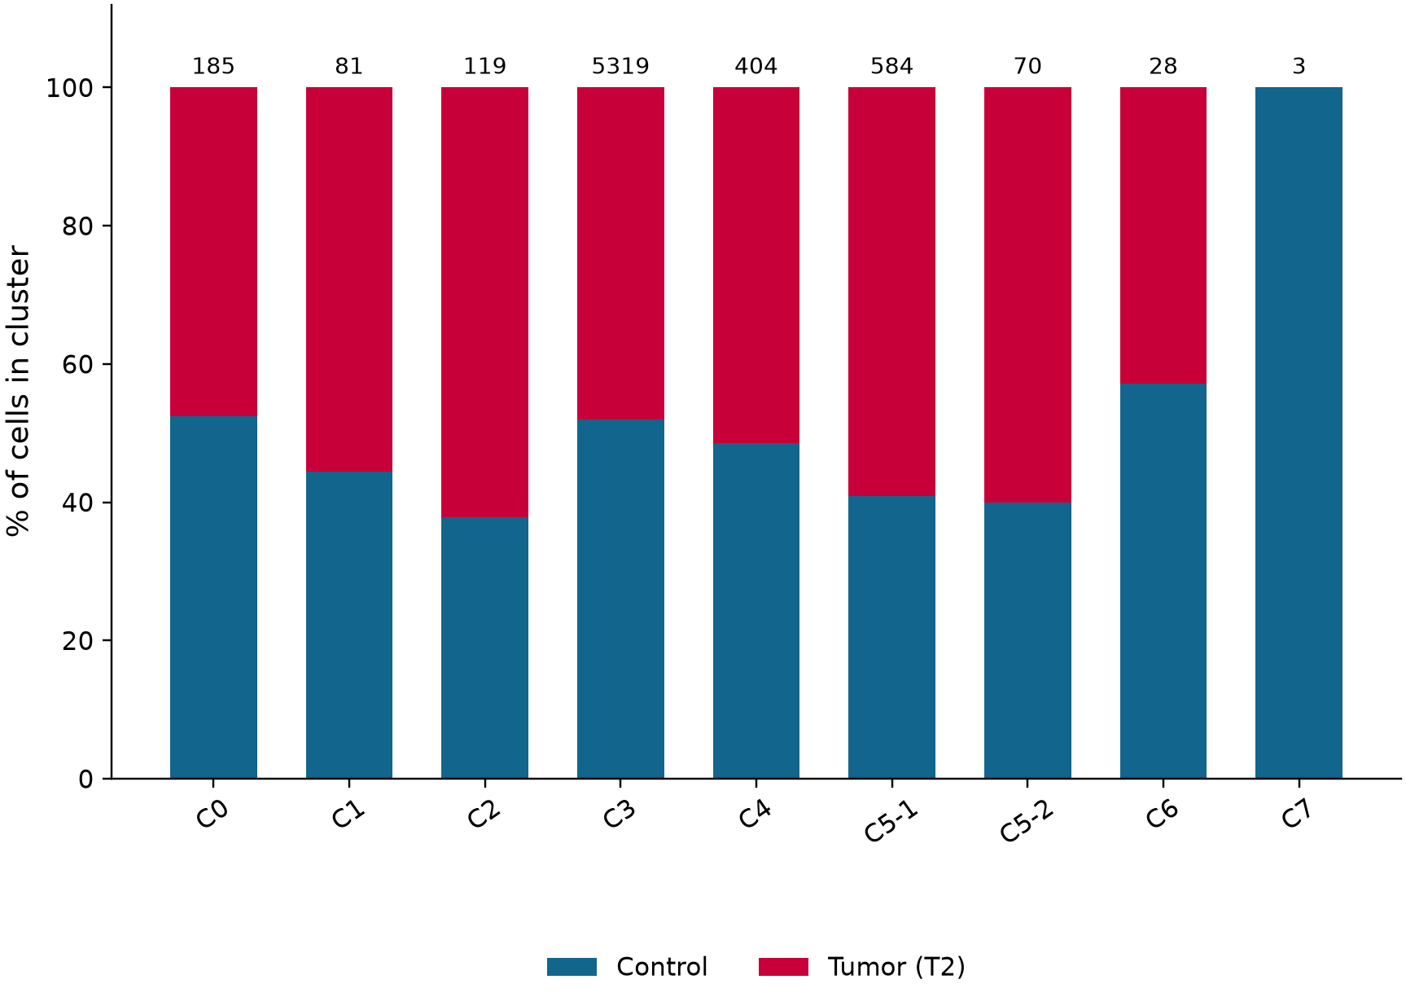
Spleen: cluster and condition frequencies
C • The two denominators from Blood Figure 3C, presented side by side
Cluster frequency within condition
Condition share within cluster
Left: n(cluster, condition) / N(condition) | Right: n(condition, cluster) / N(cluster)
Captured-cell proportions only. No mouse-level error bars or significance are inferred from individual cells.
Blood Fig. 3C; saved 20260905 frequency_reconciliation_1.csv.
8
Notes:
Spleen: cluster and condition frequencies
原综合报告第9页。Captured-cell proportions only. No mouse-level error bars or significance are inferred from individual cells.
Blood Fig. 3C; saved 20260905 frequency_reconciliation_1.csv.
Captured-cell proportions only. No mouse-level error bars or significance are inferred from individual cells.
Source page: old_09; Main talk
Independent graphics: assets/panels/old_09_*
Native text and tables can be edited directly. SVG/PNG panels can be moved, resized or replaced independently; numeric source tables are in data/.

Slide 9
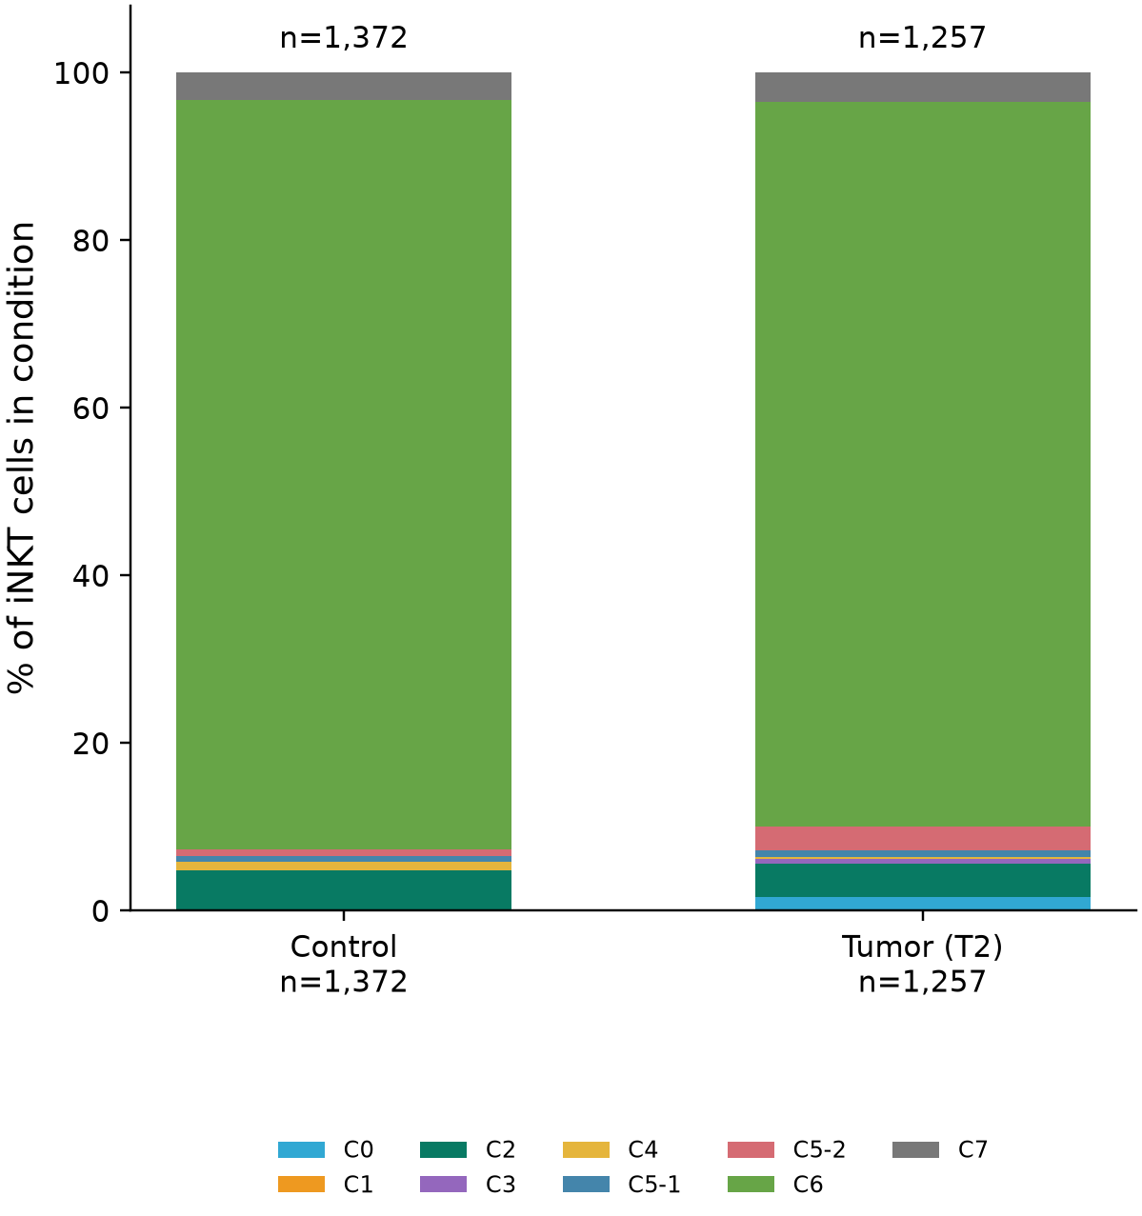
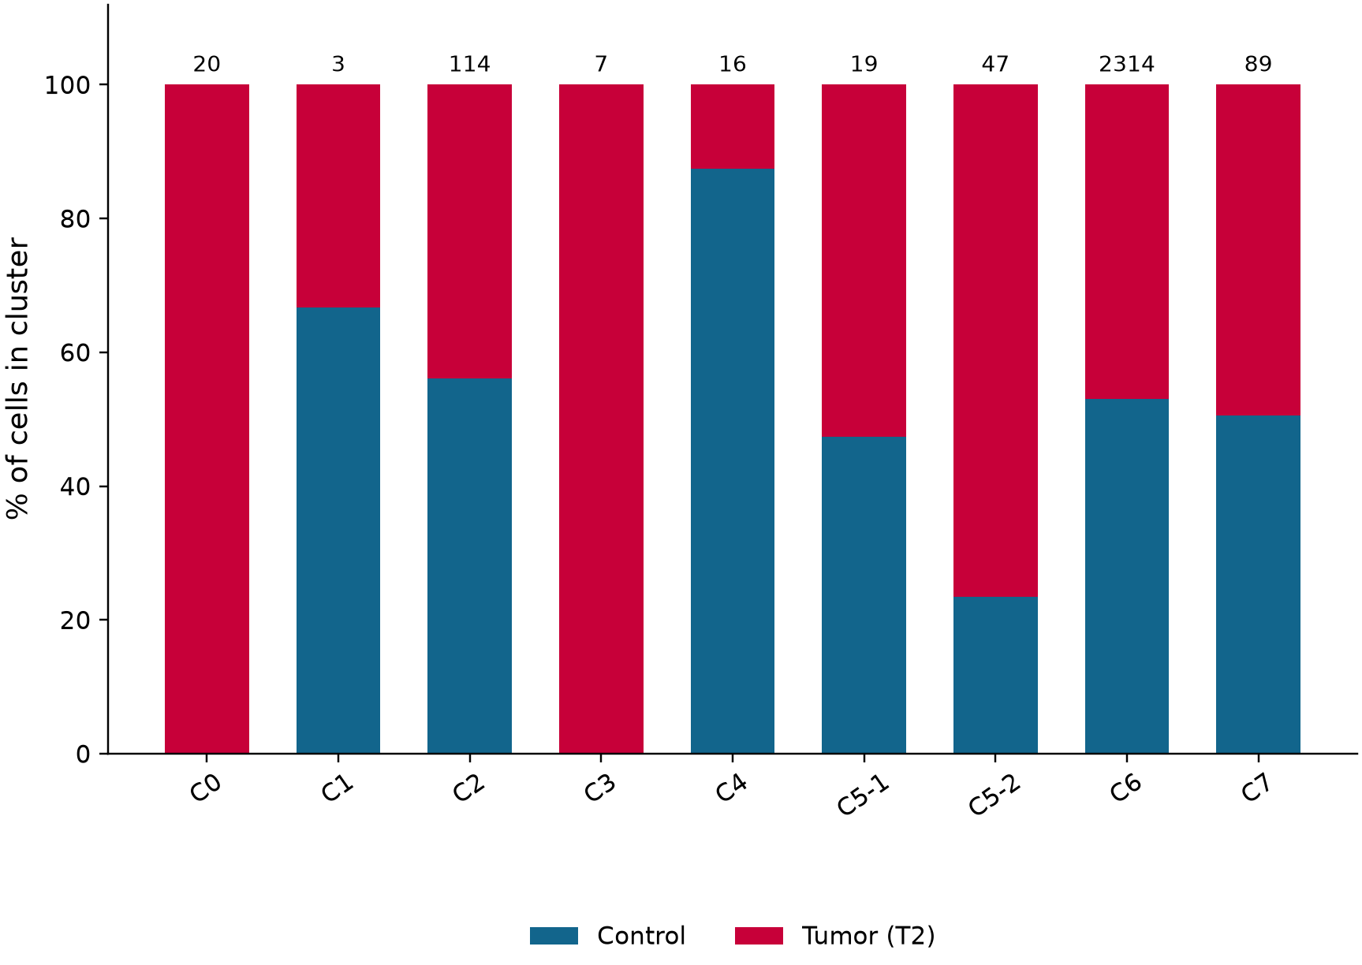
Thymus: cluster and condition frequencies
C • The two denominators from Blood Figure 3C, presented side by side
Cluster frequency within condition
Condition share within cluster
Left: n(cluster, condition) / N(condition) | Right: n(condition, cluster) / N(cluster)
Captured-cell proportions only. No mouse-level error bars or significance are inferred from individual cells.
Blood Fig. 3C; saved 20260905 frequency_reconciliation_1.csv.
9
Notes:
Thymus: cluster and condition frequencies
原综合报告第10页。Captured-cell proportions only. No mouse-level error bars or significance are inferred from individual cells.
Blood Fig. 3C; saved 20260905 frequency_reconciliation_1.csv.
Captured-cell proportions only. No mouse-level error bars or significance are inferred from individual cells.
Source page: old_10; Main talk
Independent graphics: assets/panels/old_10_*
Native text and tables can be edited directly. SVG/PNG panels can be moved, resized or replaced independently; numeric source tables are in data/.

Slide 10
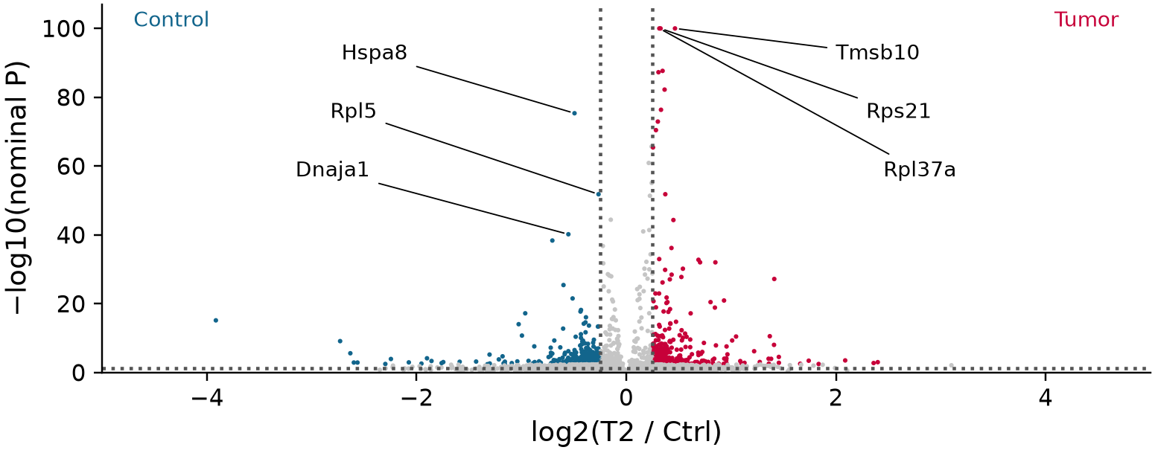
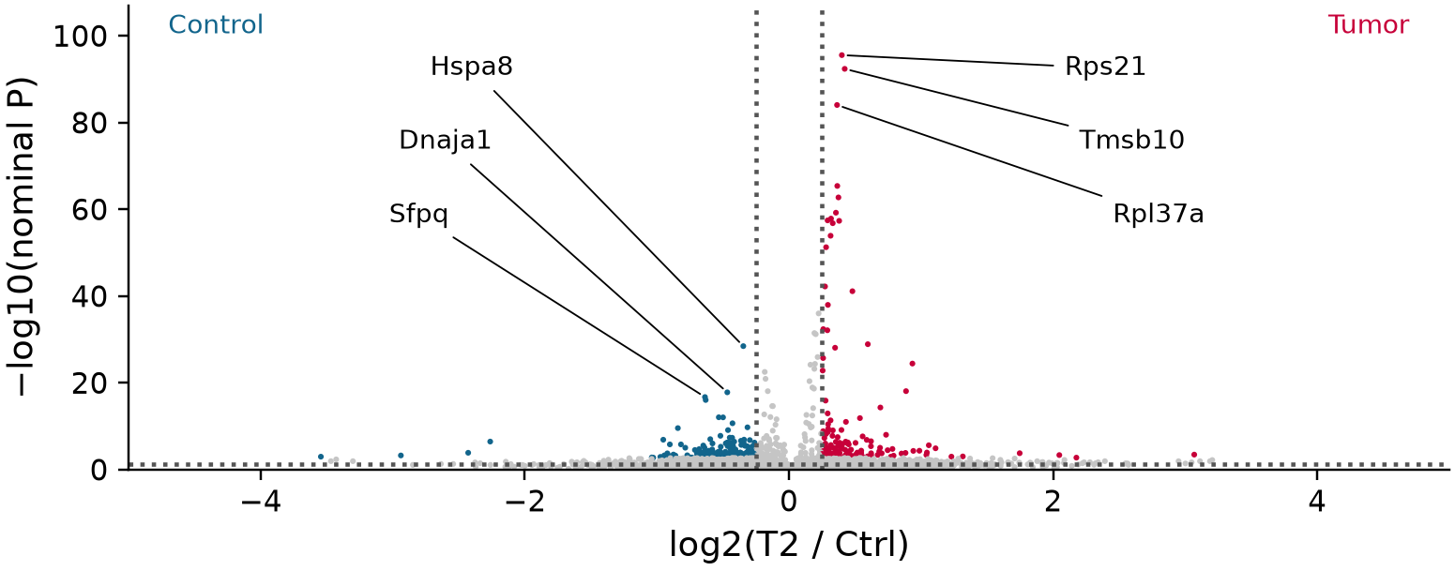
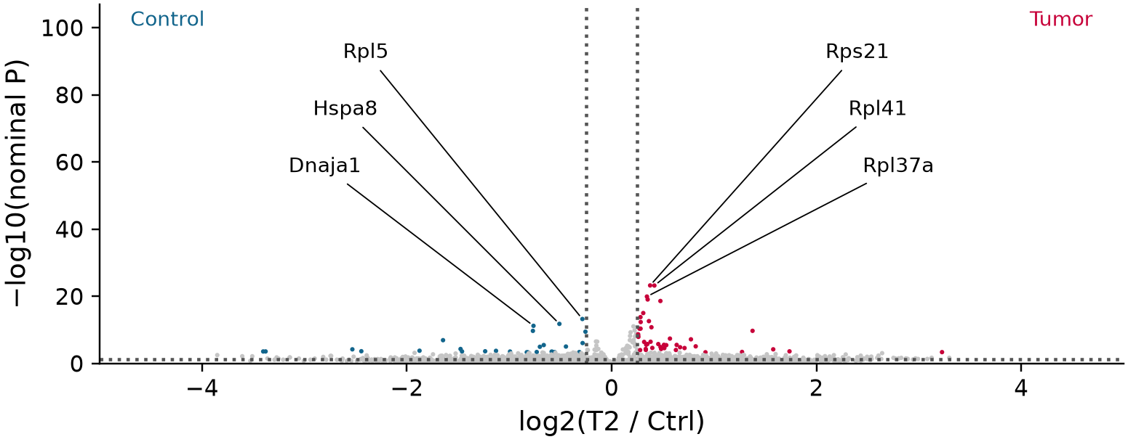
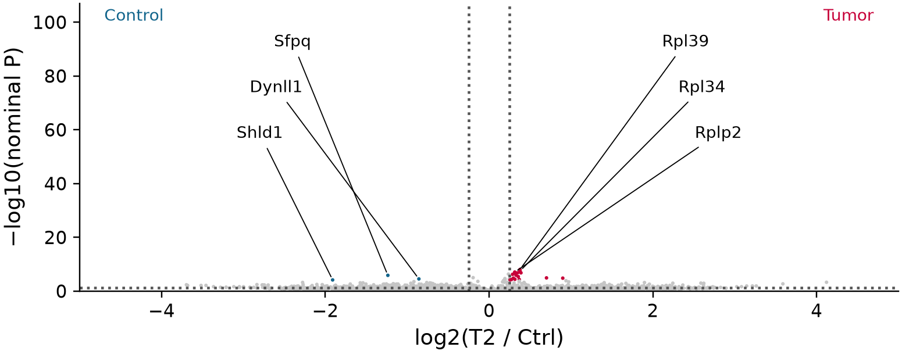
D Differential expression: Control vs. Tumor
Paper axes and blue/red direction; current tissue × cluster comparisons
C0 / BM
C6 / Thy
C5-1 / Spl
C5-2 / BM
Common axes: |log2FC| ≤ 5; −log10(P) capped at 100. All uncapped values and display flags are exported.
Color rule retained: gene BH FDR ≤ 0.05 and |log2FC| ≥ 0.25. Vertical display thresholds are therefore ±0.25.
Blood Fig. 3D; current DE tables (20260905). Paper combines K1+K2; these panels do not claim that population equivalence.
10
Notes:
D Differential expression: Control vs. Tumor
原综合报告第22页。Color rule retained: gene BH FDR ≤ 0.05 and |log2FC| ≥ 0.25. Vertical display thresholds are therefore ±0.25.
Blood Fig. 3D; current DE tables (20260905). Paper combines K1+K2; these panels do not claim that population equivalence.
Color rule retained: gene BH FDR ≤ 0.05 and |log2FC| ≥ 0.25. Vertical display thresholds are therefore ±0.25.
Source page: old_22; Main talk
Independent graphics: assets/panels/old_22_*
Native text and tables can be edited directly. SVG/PNG panels can be moved, resized or replaced independently; numeric source tables are in data/.

Slide 11
Analysis design and reference mapping
Methods adapted to mouse iNKT; biological conclusions are derived from these data.
Analysis | Reference | Input / definition | Implementation
Cytotoxicity | PAGER Fig. 5C/D | Core: Prf1, Gzma, Gzmb; E1: +Ctla2a | Mean log1p expression; matched-control score sensitivity
GO cluster identity | GAFA Fig. 4c | Cluster vs rest within each tissue | Wilcoxon, gene BH <= .05 and log2FC >= .25
GO treatment response | GAFA functional comparison | T2-up and Ctrl-up genes tested separately | Hypergeometric; full eligible GO BP/MF/CC families
Local trajectories | PAGER Fig. 5D | Recompute diffusion map on tissue-specific graphs | Precursor-rooted DPT; 20 shared bins; 3-root sensitivity
Robustness | Adaptation to this dataset | Stable clusters; five QC-matched resamples | Effects and direction consistency; no animal replication
GO uses official mouse annotations. An enrichment of upregulated genes does not prove pathway activation.
Exploratory transcriptional results; one sample label per tissue x condition; no animal-level inference.
Huang et al. 2024, PAGER-scFGA, Fig. 5; doi:10.3389/fbinf.2024.1336135; Borra et al. 2026, GAFA, Sec. 3.5 / Fig. 4c; doi:10.3390/biology15070588
11
Notes:
Analysis design and reference mapping
采用论文中的方法和图形组织方式。没有运行SCORPION、随机森林或声称重现PAGER专有网络；GO采用官方MGI小鼠注释。
Huang et al. 2024, PAGER-scFGA, Fig. 5; doi:10.3389/fbinf.2024.1336135; Borra et al. 2026, GAFA, Sec. 3.5 / Fig. 4c; doi:10.3390/biology15070588
Exploratory transcriptional results; one sample label per tissue x condition; no animal-level inference.
Source page: new_02; Main talk
Independent graphics: assets/panels/new_02_*
Native text and tables can be edited directly. SVG/PNG panels can be moved, resized or replaced independently; numeric source tables are in data/.

Slide 12
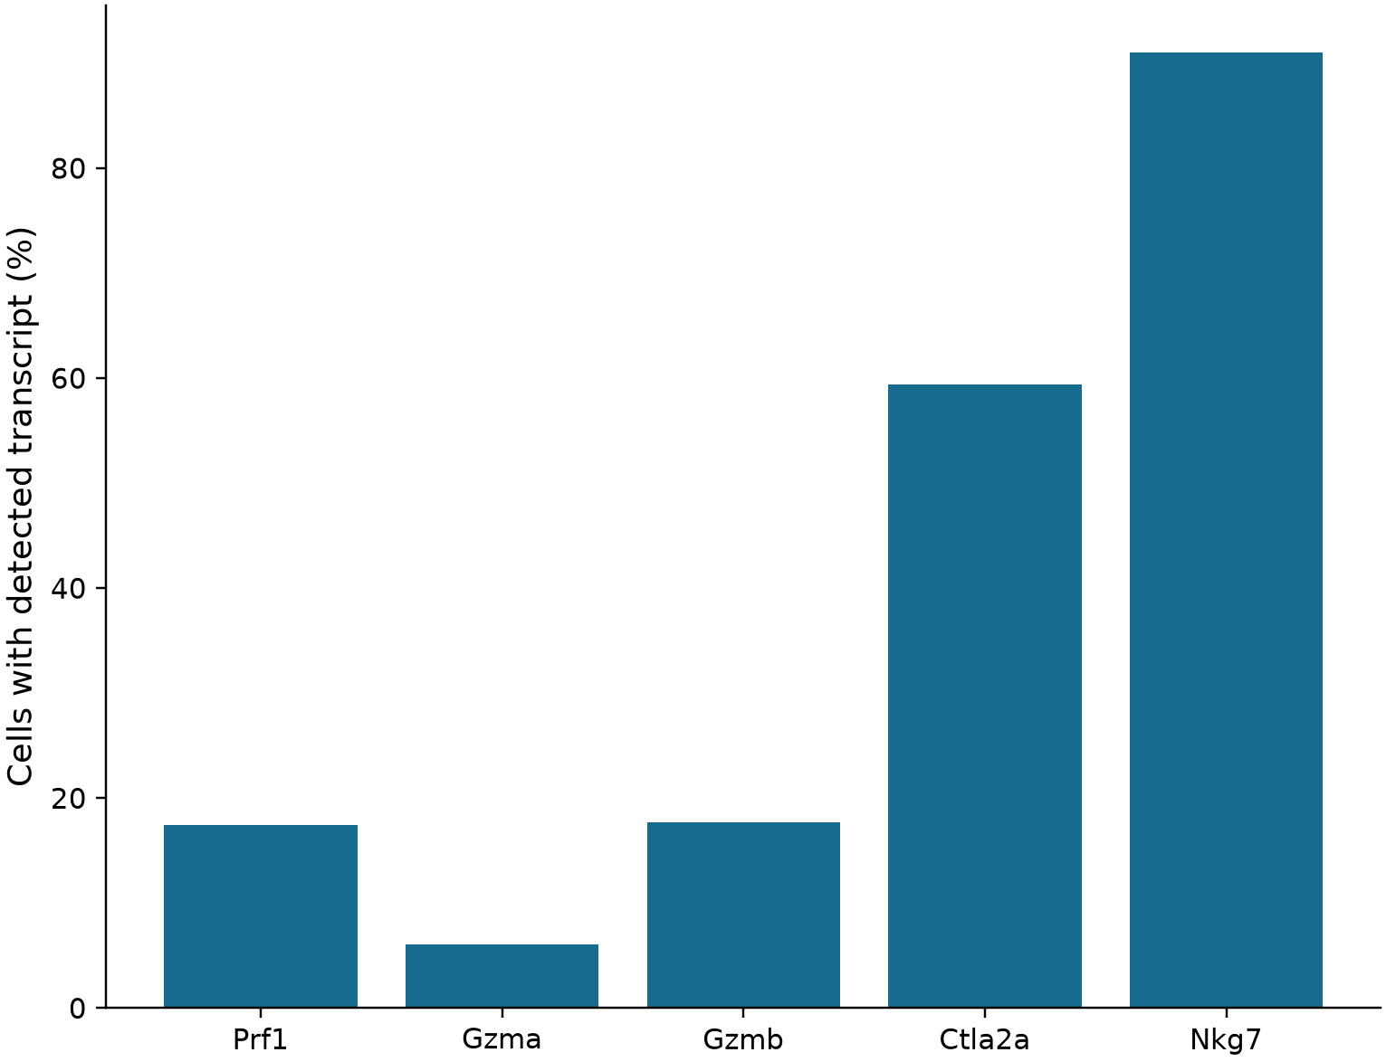
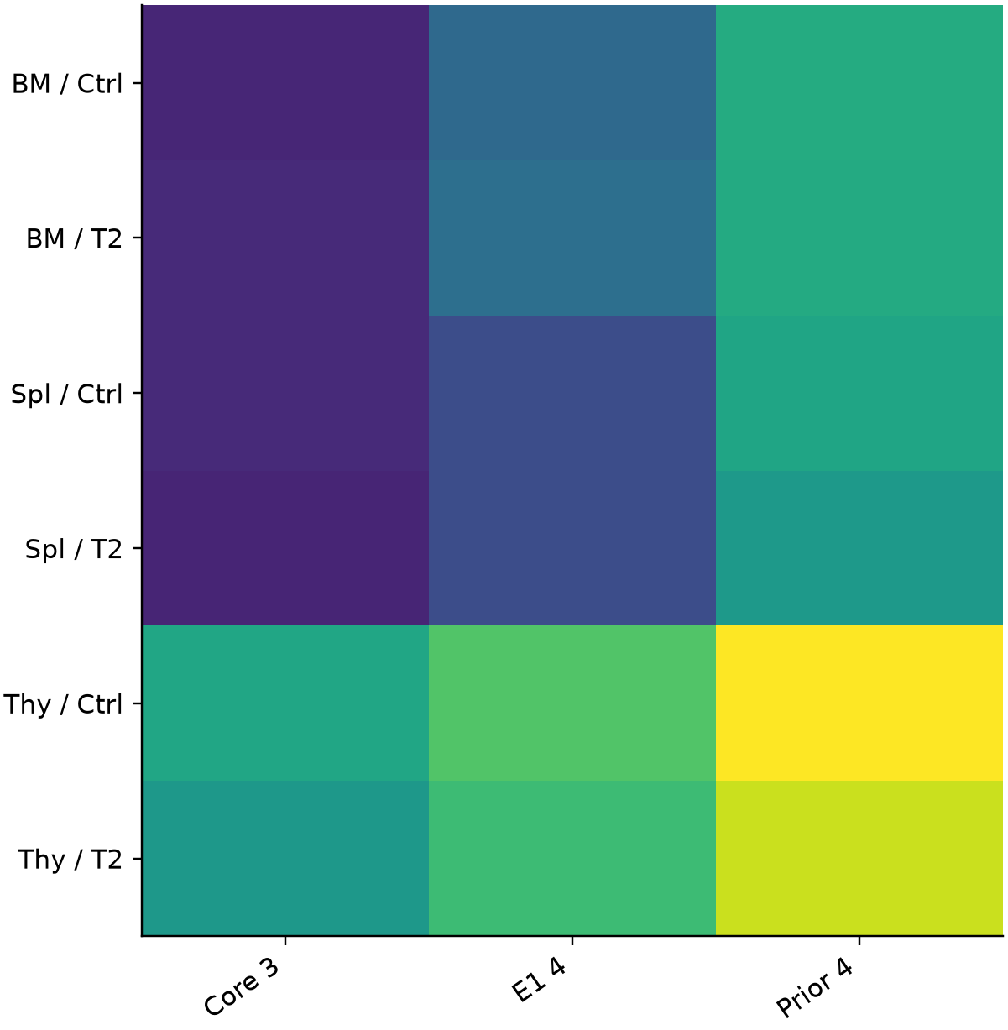
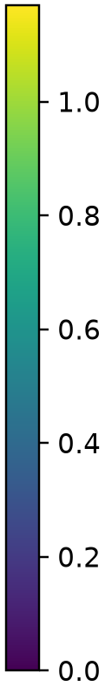
Cytotoxic gene coverage and scoring
Primary endpoint: mean log-normalized expression of Prf1 / Gzma / Gzmb.
A Measured marker coverage
B Sample-level mean expression
Exploratory transcriptional results; one sample label per tissue x condition; no animal-level inference.
Huang et al. 2024, PAGER-scFGA, Fig. 5; doi:10.3389/fbinf.2024.1336135
12
Notes:
Cytotoxic gene coverage and scoring
分数是转录表达而不是杀伤实验读数。不同基因集的绝对分数不可视为相同量纲的功能强弱。
Huang et al. 2024, PAGER-scFGA, Fig. 5; doi:10.3389/fbinf.2024.1336135
Exploratory transcriptional results; one sample label per tissue x condition; no animal-level inference.
Source page: new_03; Main talk
Independent graphics: assets/panels/new_03_*
Native text and tables can be edited directly. SVG/PNG panels can be moved, resized or replaced independently; numeric source tables are in data/.

Slide 13
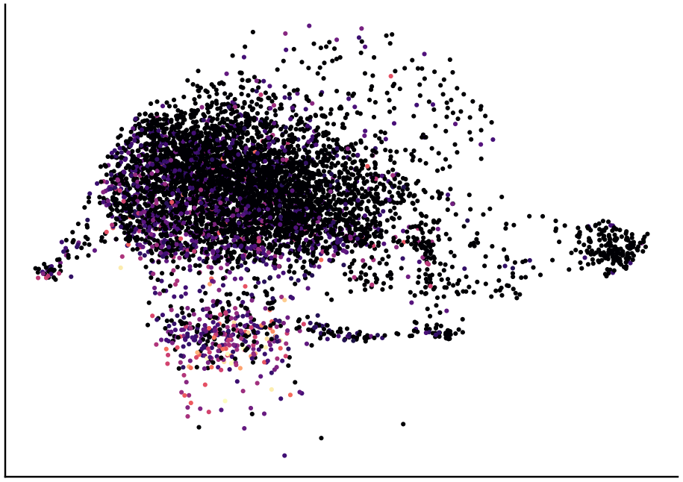
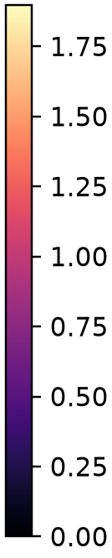
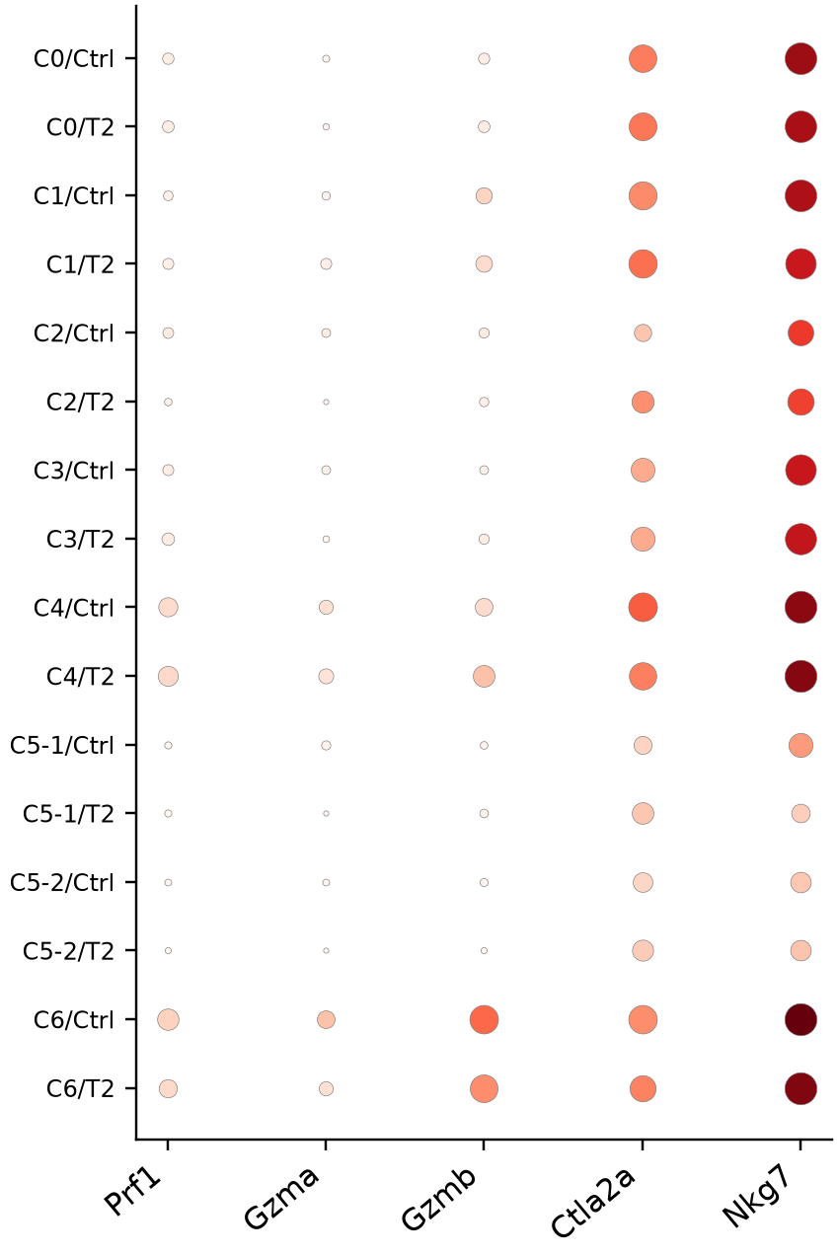
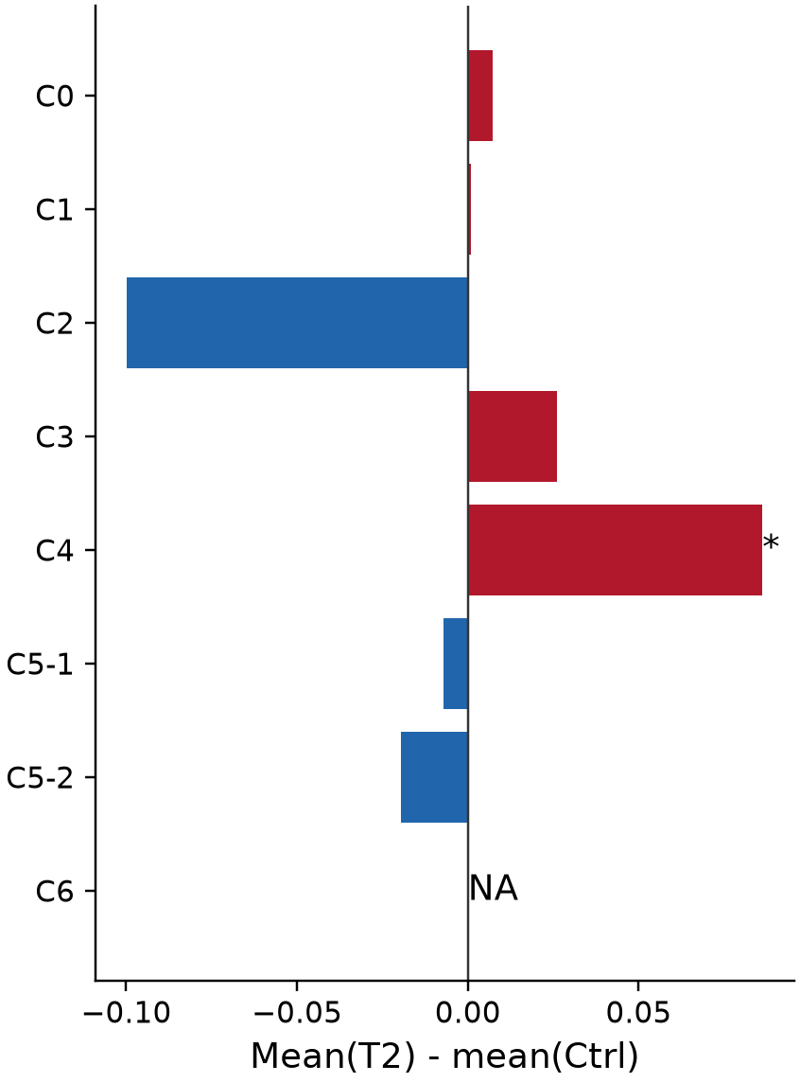
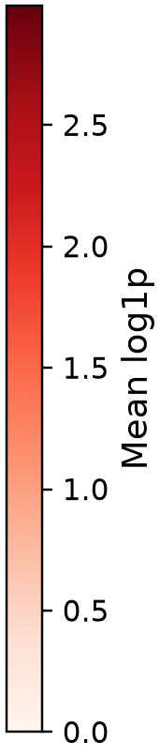
Bone marrow: cytotoxic expression and condition effects
Original refined clusters; T2 - Ctrl within the same tissue and cluster.
A Cytotoxic core expression
B Gene expression
C Core expression difference
Core = mean log1p(Prf1, Gzma, Gzmb)
* Global BH q <= 0.05 across tested
modules, tissues and cluster definitions
NA: fewer than 20 cells in either condition
Dot area: fraction of cells expressing gene
Exploratory transcriptional results; one sample label per tissue x condition; no animal-level inference.
Huang et al. 2024, PAGER-scFGA, Fig. 5; doi:10.3389/fbinf.2024.1336135
13
Notes:
Bone marrow: cytotoxic expression and condition effects
按组织和原分群展示细胞毒性；红色为T2高，蓝色为Ctrl高。星号是细胞层面探索性检验，不能代表动物重复验证。
Huang et al. 2024, PAGER-scFGA, Fig. 5; doi:10.3389/fbinf.2024.1336135
Exploratory transcriptional results; one sample label per tissue x condition; no animal-level inference.
Source page: new_04; Main talk
Independent graphics: assets/panels/new_04_*
Native text and tables can be edited directly. SVG/PNG panels can be moved, resized or replaced independently; numeric source tables are in data/.

Slide 14
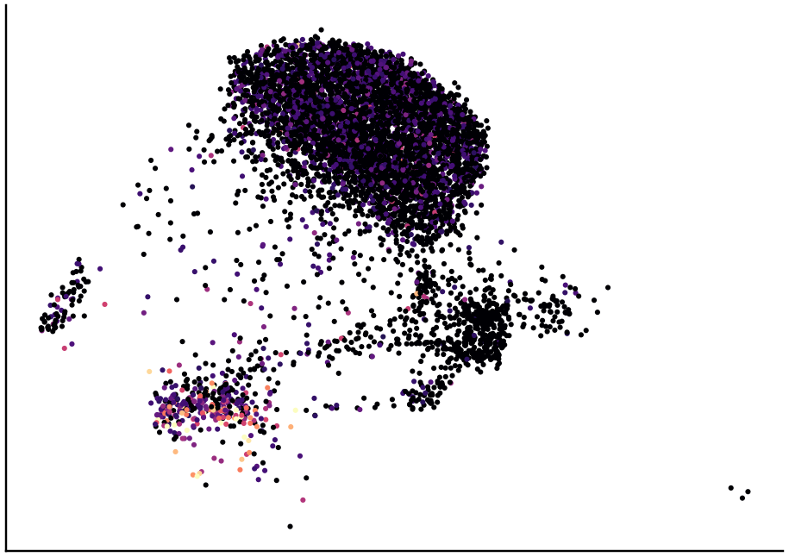



Spleen: cytotoxic expression and condition effects
Original refined clusters; T2 - Ctrl within the same tissue and cluster.
A Cytotoxic core expression
B Gene expression
C Core expression difference
Core = mean log1p(Prf1, Gzma, Gzmb)
* Global BH q <= 0.05 across tested
modules, tissues and cluster definitions
NA: fewer than 20 cells in either condition
Dot area: fraction of cells expressing gene
Exploratory transcriptional results; one sample label per tissue x condition; no animal-level inference.
Huang et al. 2024, PAGER-scFGA, Fig. 5; doi:10.3389/fbinf.2024.1336135
14
Notes:
Spleen: cytotoxic expression and condition effects
按组织和原分群展示细胞毒性；红色为T2高，蓝色为Ctrl高。星号是细胞层面探索性检验，不能代表动物重复验证。
Huang et al. 2024, PAGER-scFGA, Fig. 5; doi:10.3389/fbinf.2024.1336135
Exploratory transcriptional results; one sample label per tissue x condition; no animal-level inference.
Source page: new_05; Main talk
Independent graphics: assets/panels/new_05_*
Native text and tables can be edited directly. SVG/PNG panels can be moved, resized or replaced independently; numeric source tables are in data/.

Slide 15




Thymus: cytotoxic expression and condition effects
Original refined clusters; T2 - Ctrl within the same tissue and cluster.
A Cytotoxic core expression
B Gene expression
C Core expression difference
Core = mean log1p(Prf1, Gzma, Gzmb)
* Global BH q <= 0.05 across tested
modules, tissues and cluster definitions
NA: fewer than 20 cells in either condition
Dot area: fraction of cells expressing gene
Exploratory transcriptional results; one sample label per tissue x condition; no animal-level inference.
Huang et al. 2024, PAGER-scFGA, Fig. 5; doi:10.3389/fbinf.2024.1336135
15
Notes:
Thymus: cytotoxic expression and condition effects
按组织和原分群展示细胞毒性；红色为T2高，蓝色为Ctrl高。星号是细胞层面探索性检验，不能代表动物重复验证。
Huang et al. 2024, PAGER-scFGA, Fig. 5; doi:10.3389/fbinf.2024.1336135
Exploratory transcriptional results; one sample label per tissue x condition; no animal-level inference.
Source page: new_06; Main talk
Independent graphics: assets/panels/new_06_*
Native text and tables can be edited directly. SVG/PNG panels can be moved, resized or replaced independently; numeric source tables are in data/.

Slide 16


Bone marrow: GO biological processes: cluster identity
Within-tissue comparisons | dot area: query gene ratio | color: enrichment evidence
All BP/MF/CC tests retained. Only clusters with significant BP terms shown; q <= .05; >=2 hits; overlap redundancy reduced.
Exploratory transcriptional results; one sample label per tissue x condition; no animal-level inference. Blank = no displayed significant term, not proof of absence.
Borra et al. 2026, GAFA, Sec. 3.5 / Fig. 4c; doi:10.3390/biology15070588
16
Notes:
Bone marrow: GO biological processes: cluster identity
GO气泡图只展示显著且至少两个命中基因的代表条目。T2/ Ctrl列分别表示该方向上调基因的富集，不把富集直接解释成通路激活。完整BP、MF、CC结果见数据表。
Borra et al. 2026, GAFA, Sec. 3.5 / Fig. 4c; doi:10.3390/biology15070588
Exploratory transcriptional results; one sample label per tissue x condition; no animal-level inference. Blank = no displayed significant term, not proof of absence.
Source page: new_07; Main talk
Independent graphics: assets/panels/new_07_*
Native text and tables can be edited directly. SVG/PNG panels can be moved, resized or replaced independently; numeric source tables are in data/.

Slide 17

Spleen: GO biological processes: cluster identity
Within-tissue comparisons | dot area: query gene ratio | color: enrichment evidence
All BP/MF/CC tests retained. Only clusters with significant BP terms shown; q <= .05; >=2 hits; overlap redundancy reduced.
Exploratory transcriptional results; one sample label per tissue x condition; no animal-level inference. Blank = no displayed significant term, not proof of absence.
Borra et al. 2026, GAFA, Sec. 3.5 / Fig. 4c; doi:10.3390/biology15070588
17
Notes:
Spleen: GO biological processes: cluster identity
GO气泡图只展示显著且至少两个命中基因的代表条目。T2/ Ctrl列分别表示该方向上调基因的富集，不把富集直接解释成通路激活。完整BP、MF、CC结果见数据表。
Borra et al. 2026, GAFA, Sec. 3.5 / Fig. 4c; doi:10.3390/biology15070588
Exploratory transcriptional results; one sample label per tissue x condition; no animal-level inference. Blank = no displayed significant term, not proof of absence.
Source page: new_08; Main talk
Independent graphics: assets/panels/new_08_*
Native text and tables can be edited directly. SVG/PNG panels can be moved, resized or replaced independently; numeric source tables are in data/.

Slide 18

Thymus: GO biological processes: cluster identity
Within-tissue comparisons | dot area: query gene ratio | color: enrichment evidence
All BP/MF/CC tests retained. Only clusters with significant BP terms shown; q <= .05; >=2 hits; overlap redundancy reduced.
Exploratory transcriptional results; one sample label per tissue x condition; no animal-level inference. Blank = no displayed significant term, not proof of absence.
Borra et al. 2026, GAFA, Sec. 3.5 / Fig. 4c; doi:10.3390/biology15070588
18
Notes:
Thymus: GO biological processes: cluster identity
GO气泡图只展示显著且至少两个命中基因的代表条目。T2/ Ctrl列分别表示该方向上调基因的富集，不把富集直接解释成通路激活。完整BP、MF、CC结果见数据表。
Borra et al. 2026, GAFA, Sec. 3.5 / Fig. 4c; doi:10.3390/biology15070588
Exploratory transcriptional results; one sample label per tissue x condition; no animal-level inference. Blank = no displayed significant term, not proof of absence.
Source page: new_09; Main talk
Independent graphics: assets/panels/new_09_*
Native text and tables can be edited directly. SVG/PNG panels can be moved, resized or replaced independently; numeric source tables are in data/.

Slide 19

Bone marrow: GO biological processes: condition response
Within-tissue comparisons | dot area: query gene ratio | color: enrichment evidence
All BP/MF/CC tests retained. Only clusters with significant BP terms shown; q <= .05; >=2 hits; overlap redundancy reduced.
Exploratory transcriptional results; one sample label per tissue x condition; no animal-level inference. Blank = no displayed significant term, not proof of absence.
Borra et al. 2026, GAFA, Sec. 3.5 / Fig. 4c; doi:10.3390/biology15070588
19
Notes:
Bone marrow: GO biological processes: condition response
GO气泡图只展示显著且至少两个命中基因的代表条目。T2/ Ctrl列分别表示该方向上调基因的富集，不把富集直接解释成通路激活。完整BP、MF、CC结果见数据表。
Borra et al. 2026, GAFA, Sec. 3.5 / Fig. 4c; doi:10.3390/biology15070588
Exploratory transcriptional results; one sample label per tissue x condition; no animal-level inference. Blank = no displayed significant term, not proof of absence.
Source page: new_10; Main talk
Independent graphics: assets/panels/new_10_*
Native text and tables can be edited directly. SVG/PNG panels can be moved, resized or replaced independently; numeric source tables are in data/.

Slide 20

Spleen: GO biological processes: condition response
Within-tissue comparisons | dot area: query gene ratio | color: enrichment evidence
All BP/MF/CC tests retained. Only clusters with significant BP terms shown; q <= .05; >=2 hits; overlap redundancy reduced.
Exploratory transcriptional results; one sample label per tissue x condition; no animal-level inference. Blank = no displayed significant term, not proof of absence.
Borra et al. 2026, GAFA, Sec. 3.5 / Fig. 4c; doi:10.3390/biology15070588
20
Notes:
Spleen: GO biological processes: condition response
GO气泡图只展示显著且至少两个命中基因的代表条目。T2/ Ctrl列分别表示该方向上调基因的富集，不把富集直接解释成通路激活。完整BP、MF、CC结果见数据表。
Borra et al. 2026, GAFA, Sec. 3.5 / Fig. 4c; doi:10.3390/biology15070588
Exploratory transcriptional results; one sample label per tissue x condition; no animal-level inference. Blank = no displayed significant term, not proof of absence.
Source page: new_11; Main talk
Independent graphics: assets/panels/new_11_*
Native text and tables can be edited directly. SVG/PNG panels can be moved, resized or replaced independently; numeric source tables are in data/.

Slide 21

Thymus: GO biological processes: condition response
Within-tissue comparisons | dot area: query gene ratio | color: enrichment evidence
All BP/MF/CC tests retained. Only clusters with significant BP terms shown; q <= .05; >=2 hits; overlap redundancy reduced.
Exploratory transcriptional results; one sample label per tissue x condition; no animal-level inference. Blank = no displayed significant term, not proof of absence.
Borra et al. 2026, GAFA, Sec. 3.5 / Fig. 4c; doi:10.3390/biology15070588
21
Notes:
Thymus: GO biological processes: condition response
GO气泡图只展示显著且至少两个命中基因的代表条目。T2/ Ctrl列分别表示该方向上调基因的富集，不把富集直接解释成通路激活。完整BP、MF、CC结果见数据表。
Borra et al. 2026, GAFA, Sec. 3.5 / Fig. 4c; doi:10.3390/biology15070588
Exploratory transcriptional results; one sample label per tissue x condition; no animal-level inference. Blank = no displayed significant term, not proof of absence.
Source page: new_12; Main talk
Independent graphics: assets/panels/new_12_*
Native text and tables can be edited directly. SVG/PNG panels can be moved, resized or replaced independently; numeric source tables are in data/.

Slide 22

Cellular components of cytotoxic module genes
GO-CC membership supports localization; this is not a protein-interaction network.
Measured genes x propagated GO-CC membership
Exploratory transcriptional results; one sample label per tissue x condition; no animal-level inference.
Huang et al. 2024, PAGER-scFGA, Fig. 5; doi:10.3389/fbinf.2024.1336135; official mouse GO annotations
22
Notes:
Cellular components of cytotoxic module genes
这里只画真实GO细胞组分注释矩阵，不把共同定位误画为PPI相互作用。
Huang et al. 2024, PAGER-scFGA, Fig. 5; doi:10.3389/fbinf.2024.1336135; official mouse GO annotations
Exploratory transcriptional results; one sample label per tissue x condition; no animal-level inference.
Source page: new_17; Main talk
Independent graphics: assets/panels/new_17_*
Native text and tables can be edited directly. SVG/PNG panels can be moved, resized or replaced independently; numeric source tables are in data/.

Slide 23



Bone marrow: local cytotoxicity along pseudotime
PAGER-style functional curves on a newly computed within-tissue diffusion map.
A Local DPT on tissue UMAP
B Common 20-bin functional profiles
Root state: bone_marrow_S0; measured root markers: Egr2 / Hivep3 (Cd24a unavailable). Root sensitivity rho: 0.89, 0.76.
Analyzed 6,110/6,110 cells; only bins with >=20 cells shown. Smooth lines are descriptive.
Exploratory transcriptional results; one sample label per tissue x condition; no animal-level inference. Pseudotime is an assumed ordering, not RNA velocity or lineage validation.
Huang et al. 2024, PAGER-scFGA, Fig. 5; doi:10.3389/fbinf.2024.1336135
23
Notes:
Bone marrow: local cytotoxicity along pseudotime
重新计算了组织内diffusion map，避免复用全局轨迹。用前体marker选择根群，三个根细胞做敏感性。平滑曲线不是置信区间，条件曲线差别不等于分化速率差别。
Huang et al. 2024, PAGER-scFGA, Fig. 5; doi:10.3389/fbinf.2024.1336135
Exploratory transcriptional results; one sample label per tissue x condition; no animal-level inference. Pseudotime is an assumed ordering, not RNA velocity or lineage validation.
Source page: new_13; Main talk
Independent graphics: assets/panels/new_13_*
Native text and tables can be edited directly. SVG/PNG panels can be moved, resized or replaced independently; numeric source tables are in data/.

Slide 24


Spleen: local cytotoxicity along pseudotime
PAGER-style functional curves on a newly computed within-tissue diffusion map.
A Local DPT on tissue UMAP
B Common 20-bin functional profiles
Root state: spleen_S0; measured root markers: Egr2 / Hivep3 (Cd24a unavailable). Root sensitivity rho: 0.97, 0.76.
Analyzed 6,793/6,793 cells; only bins with >=20 cells shown. Smooth lines are descriptive.
Exploratory transcriptional results; one sample label per tissue x condition; no animal-level inference. Pseudotime is an assumed ordering, not RNA velocity or lineage validation.
Huang et al. 2024, PAGER-scFGA, Fig. 5; doi:10.3389/fbinf.2024.1336135
24
Notes:
Spleen: local cytotoxicity along pseudotime
重新计算了组织内diffusion map，避免复用全局轨迹。用前体marker选择根群，三个根细胞做敏感性。平滑曲线不是置信区间，条件曲线差别不等于分化速率差别。
Huang et al. 2024, PAGER-scFGA, Fig. 5; doi:10.3389/fbinf.2024.1336135
Exploratory transcriptional results; one sample label per tissue x condition; no animal-level inference. Pseudotime is an assumed ordering, not RNA velocity or lineage validation.
Source page: new_14; Main talk
Independent graphics: assets/panels/new_14_*
Native text and tables can be edited directly. SVG/PNG panels can be moved, resized or replaced independently; numeric source tables are in data/.

Slide 25


Thymus: local cytotoxicity along pseudotime
PAGER-style functional curves on a newly computed within-tissue diffusion map.
A Local DPT on tissue UMAP
B Common 20-bin functional profiles
Root state: thymus_S5; measured root markers: Egr2 / Hivep3 (Cd24a unavailable). Root sensitivity rho: 1.00, 1.00.
Analyzed 2,629/2,629 cells; only bins with >=20 cells shown. Smooth lines are descriptive.
Exploratory transcriptional results; one sample label per tissue x condition; no animal-level inference. Pseudotime is an assumed ordering, not RNA velocity or lineage validation.
Huang et al. 2024, PAGER-scFGA, Fig. 5; doi:10.3389/fbinf.2024.1336135
25
Notes:
Thymus: local cytotoxicity along pseudotime
重新计算了组织内diffusion map，避免复用全局轨迹。用前体marker选择根群，三个根细胞做敏感性。平滑曲线不是置信区间，条件曲线差别不等于分化速率差别。
Huang et al. 2024, PAGER-scFGA, Fig. 5; doi:10.3389/fbinf.2024.1336135
Exploratory transcriptional results; one sample label per tissue x condition; no animal-level inference. Pseudotime is an assumed ordering, not RNA velocity or lineage validation.
Source page: new_15; Main talk
Independent graphics: assets/panels/new_15_*
Native text and tables can be edited directly. SVG/PNG panels can be moved, resized or replaced independently; numeric source tables are in data/.

Slide 26

Robustness: QC matching and alternative clustering
Five condition-balanced QC resamples within each tissue x cluster.
Teal range: five QC-matched effect estimates (not a confidence interval).
Stable tissue clusters are a separate sensitivity analysis; their labels are not interchangeable with original C labels.
Exploratory transcriptional results; one sample label per tissue x condition; no animal-level inference.
Huang et al. 2024, PAGER-scFGA, Fig. 5; doi:10.3389/fbinf.2024.1336135; sensitivity analyses added for this dataset
26
Notes:
Robustness: QC matching and alternative clustering
绿色范围表示五次QC匹配结果范围，不是置信区间。完整稳定分群分析保存在表里，不把S群直接等同原来的C群。
Huang et al. 2024, PAGER-scFGA, Fig. 5; doi:10.3389/fbinf.2024.1336135; sensitivity analyses added for this dataset
Exploratory transcriptional results; one sample label per tissue x condition; no animal-level inference.
Source page: new_18; Main talk
Independent graphics: assets/panels/new_18_*
Native text and tables can be edited directly. SVG/PNG panels can be moved, resized or replaced independently; numeric source tables are in data/.

Slide 27


Core signature changes do not imply a full killing pathway
Two reproducible local core signals; the broader E1 signature is not significant.
A Signature sensitivity
B Complementary evidence from the same dataset
Bone marrow C4 core: +0.086; q = 0.025
Spleen C3 core: -0.023; q = 0.0015
Both: same direction in all 5 QC resamples
Stable-cluster effects: +0.111 and -0.022
Original-cell overlap: 98.7% and 99.5%
E1 (+Ctla2a): q = 0.93 and 0.53
Killing-related GO terms: no q <= 0.05
The evidence supports a localized core-effector transcriptional shift.
It does not establish increased/decreased killing activity or coordinated activation of a full cytotoxic pathway.
Exploratory transcriptional results; one sample label per tissue x condition; no animal-level inference.
Huang et al. 2024, PAGER-scFGA, Fig. 5; doi:10.3389/fbinf.2024.1336135; Borra et al. 2026, GAFA, Sec. 3.5 / Fig. 4c; doi:10.3390/biology15070588
27
Notes:
Core signature changes do not imply a full killing pathway
骨髓C4和脾脏C3的核心3基因模块及原4基因效应模块有一致局部变化；加入Ctla2a后的论文E1代表模块不显著。杀伤相关GO也未显著，不能推断整个细胞毒性通路增强或减弱。
Huang et al. 2024, PAGER-scFGA, Fig. 5; doi:10.3389/fbinf.2024.1336135; Borra et al. 2026, GAFA, Sec. 3.5 / Fig. 4c; doi:10.3390/biology15070588
Exploratory transcriptional results; one sample label per tissue x condition; no animal-level inference.
Source page: new_16; Main talk
Independent graphics: assets/panels/new_16_*
Native text and tables can be edited directly. SVG/PNG panels can be moved, resized or replaced independently; numeric source tables are in data/.

Slide 28
Interpretation: localized effector changes with shared metabolic signals
Separate direct observations, working hypotheses and unresolved evidence
Population / scope | Observation | Interpretation
Bone marrow C4 | Core score +0.086; q=0.025. Gzmb detection 29% to 44%. | Selective Gzmb-associated effector transcriptional shift.
Spleen C3 | Core score -0.023; q=0.0015. Prf1 and Nkg7 decrease. | Small reduction in effector-associated transcripts.
Both populations | T2-up genes enriched for oxidative phosphorylation. | Respiration-related gene expression shifts; no metabolic flux measured.
Limits | Broader E1 signature and killing-related GO are not significant. | No demonstrated change in killing capacity or animal-level treatment effect.
Both core effects persist under QC matching and overlapping stable clusters.
These same-data checks support candidates; independent animals and functional assays remain necessary.
20 September 2026 | Existing iNKT analyses; no new statistical analysis in this packaging step.
Notes:
Interpretation: localized effector changes with shared metabolic signals
骨髓C4主要是Gzmb相关变化；脾脏C3效应较小。两群均有氧化磷酸化基因富集，但细胞毒性分数方向不同。扩展E1与杀伤GO不显著，因此限制在转录状态变化。
20260919 numeric results; gene-level follow-up reviewed 20260919
No exhaustion, lineage direction or killing-function claim is established.
Source page: custom_02; Main talk
Independent graphics: assets/panels/custom_02_*
Native text and tables can be edited directly. SVG/PNG panels can be moved, resized or replaced independently; numeric source tables are in data/.

