Slide 1
iNKT: results in the reference presentation formats
Existing analyses from July–September 2026 • presentation revision: 15 September 2026
Analysis | Reference | Presentation used here
Sample/QC, markers, DEG and pathway pages | Original iNKT deck | Counts + plots; gene dotplots + numerical tables
Cluster composition | Blood Fig. 3C | Two 100% stacked-bar plots, each with its own denominator
Differential expression | Blood Fig. 3D | Volcano: log2FC vs −log10 nominal P; blue/red direction
Up-DEG pathway enrichment | Blood Fig. 3E | Single score column, −ln(P), with driver-gene callouts
Shared upregulated genes | Blood Fig. 3F | Four-set Venn; identical saved membership and exact counts
Signed GSEA; batch/state sensitivity | Additional analyses | Separate figures; NES is not the paper enrichment score
Our cells are iNKT; the Blood paper studies NK cells. Current C# labels are not paper K# or legacy c# identities.
Same analytical question → same figure grammar. Different algorithms, populations and thresholds are stated explicitly.
References: original iNKT.pptx (33 slides); Kuznetsova et al., Blood Advances 2025, Figure 3 and Tables S3/S5.
1
Notes:
iNKT: results in the reference presentation formats
原综合报告第1页。Same analytical question → same figure grammar. Different algorithms, populations and thresholds are stated explicitly.
References: original iNKT.pptx (33 slides); Kuznetsova et al., Blood Advances 2025, Figure 3 and Tables S3/S5.
Same analytical question → same figure grammar. Different algorithms, populations and thresholds are stated explicitly.
Source page: old_01; Main talk
Independent graphics: assets/panels/old_01_*
Native text and tables can be edited directly. SVG/PNG panels can be moved, resized or replaced independently; numeric source tables are in data/.

Slide 2
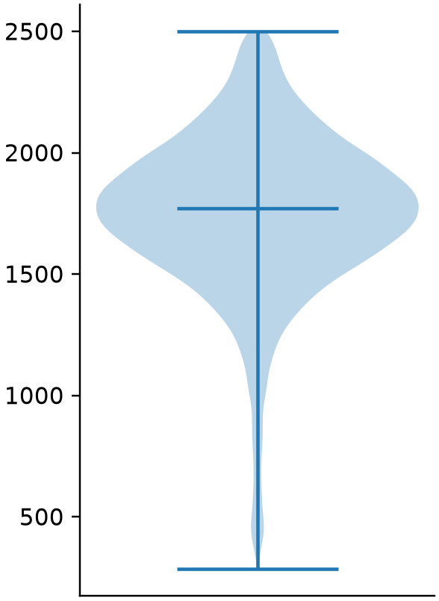
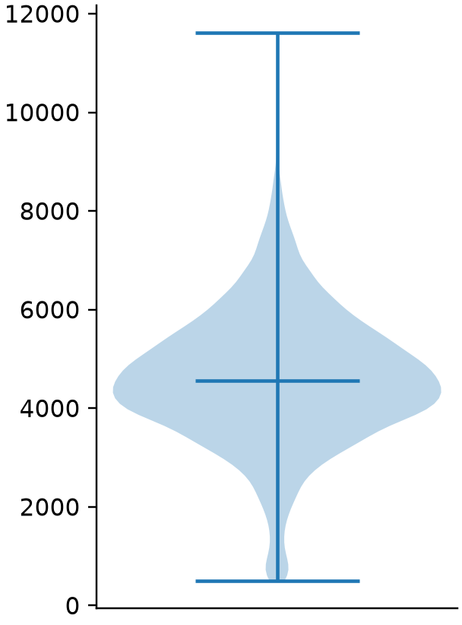
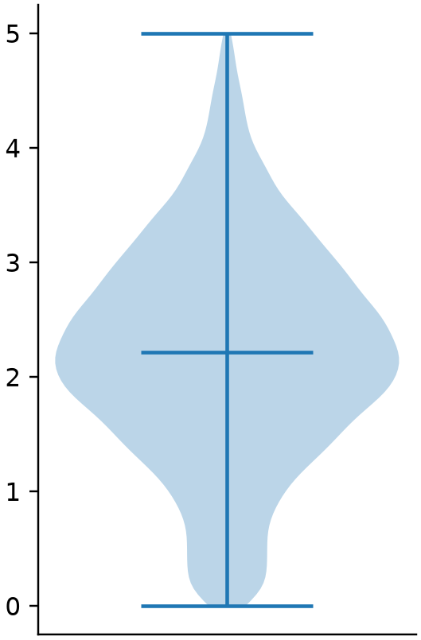
Material, dataset and QC
Six samples • 15,532 retained cells • 10,670 measured genes
Sample | Input cells | Retained
Ctrl_Thymus | 2101 | 1372
Ctrl_BM | 3998 | 3379
Ctrl_Spleen | 3829 | 3422
T2_Thymus | 1639 | 1257
T2_BM | 3131 | 2731
T2_Spleen | 3760 | 3371
Detected genes
UMI counts
Mitochondrial %
Gene min_cells = 100, then
200 ≤ detected genes < 2,500; mitochondrial fraction < 5%.
QC counts match the legacy deck; downstream UMAP, Leiden and gene statistics remain a reanalysis.
Original iNKT deck, slide 2; current object: 20260905 scored_base.h5ad.
2
Notes:
Material, dataset and QC
原综合报告第2页。QC counts match the legacy deck; downstream UMAP, Leiden and gene statistics remain a reanalysis.
Original iNKT deck, slide 2; current object: 20260905 scored_base.h5ad.
QC counts match the legacy deck; downstream UMAP, Leiden and gene statistics remain a reanalysis.
Source page: old_02; Main talk
Independent graphics: assets/panels/old_02_*
Native text and tables can be edited directly. SVG/PNG panels can be moved, resized or replaced independently; numeric source tables are in data/.

Slide 3
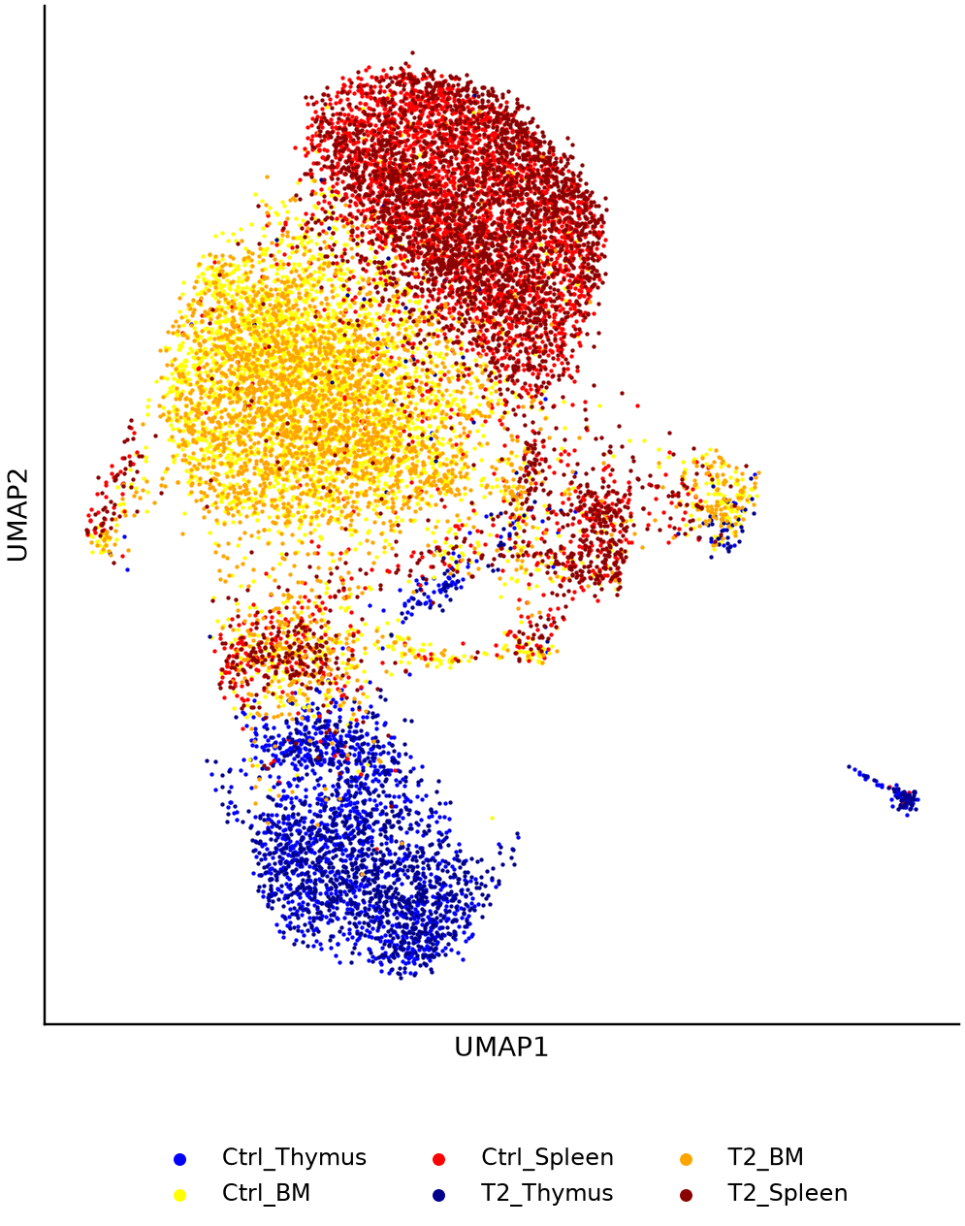
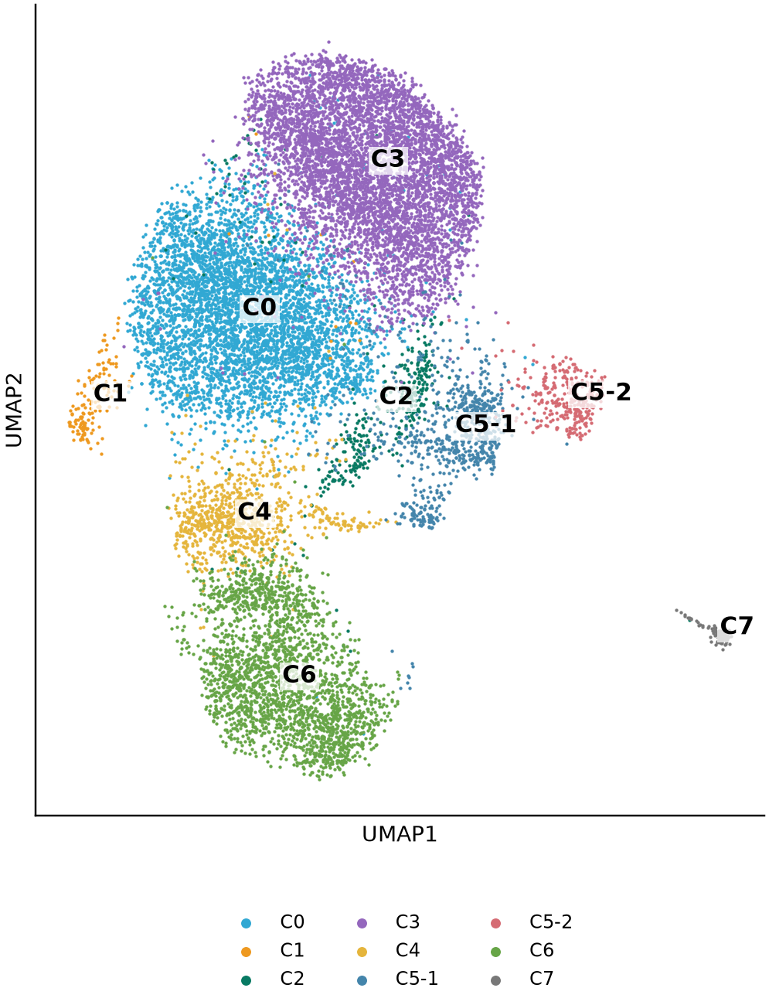
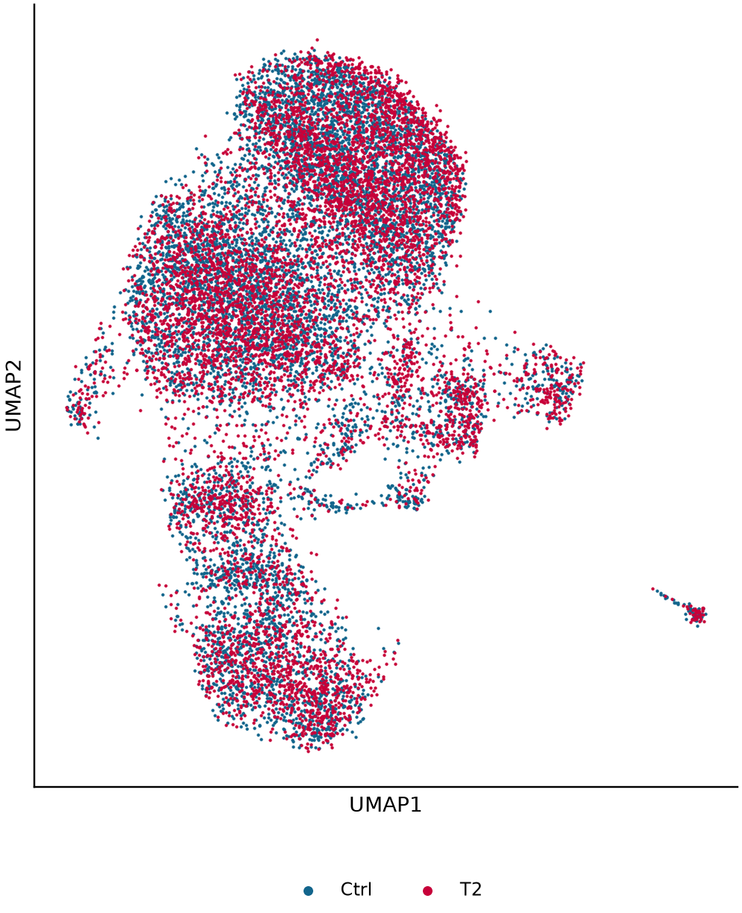
Clusters and tissue composition
Fixed 50-PC UMAP; C5 refined to C5-1 and C5-2
Sample
Current clusters
Condition
Original sample hues retained on the left; Blood-style blue/red encodes condition on the right. Coordinates are unchanged.
Original iNKT slides 4–5/12; Blood Fig. 3B is t-SNE/K-means, so axes and labels are not copied.
3
Notes:
Clusters and tissue composition
原综合报告第3页。Original sample hues retained on the left; Blood-style blue/red encodes condition on the right. Coordinates are unchanged.
Original iNKT slides 4–5/12; Blood Fig. 3B is t-SNE/K-means, so axes and labels are not copied.
Original sample hues retained on the left; Blood-style blue/red encodes condition on the right. Coordinates are unchanged.
Source page: old_03; Main talk
Independent graphics: assets/panels/old_03_*
Native text and tables can be edited directly. SVG/PNG panels can be moved, resized or replaced independently; numeric source tables are in data/.

Slide 4
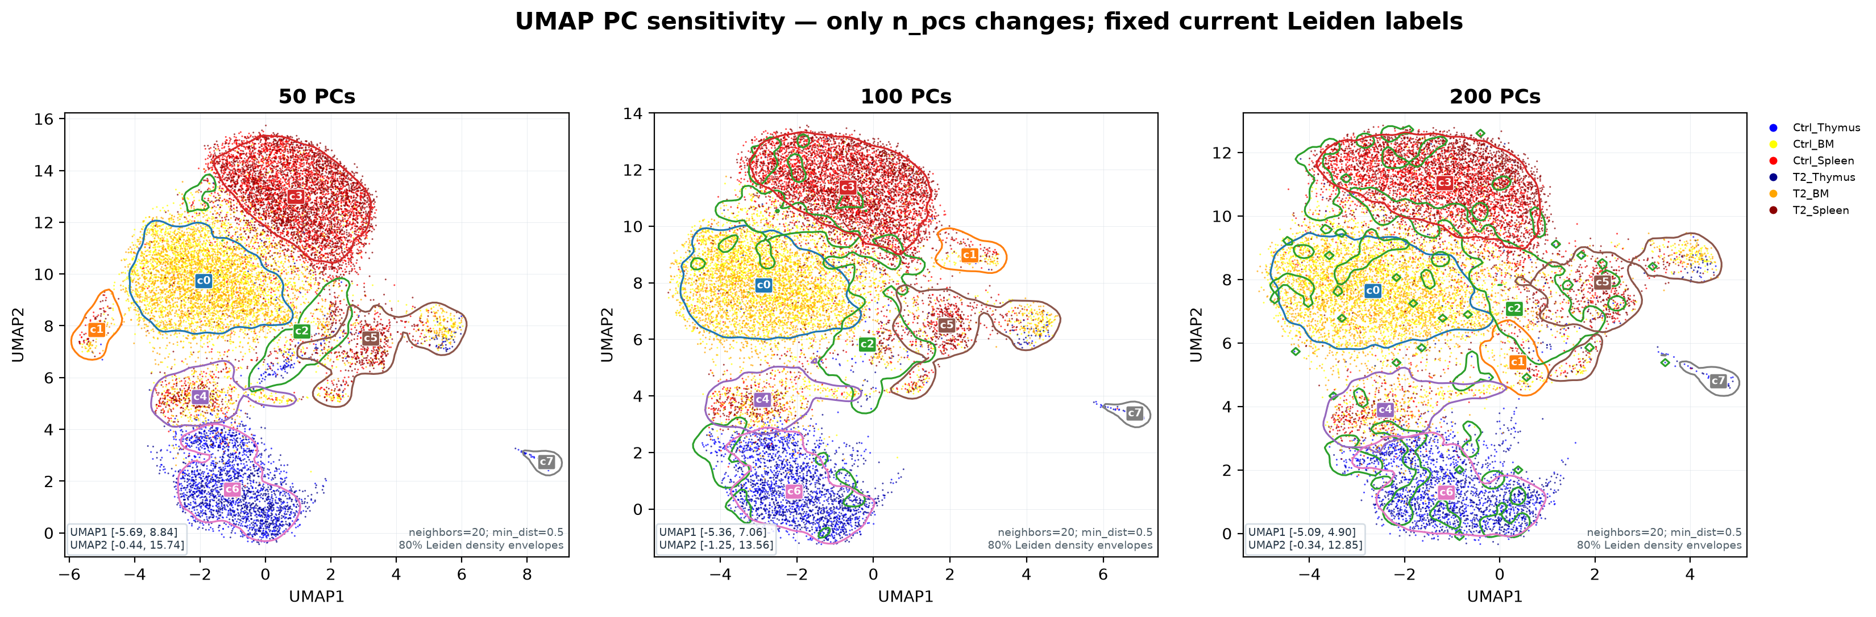
UMAP: 50, 100 and 200 principal components
Controlled sensitivity comparison; selected 50 PCs
PC number varies; all other settings are fixed. Labels are fixed reference clusters, not separate reclustering outcomes.
Original iNKT slide 4; frozen 20260825 PC-sweep result.
4
Notes:
UMAP: 50, 100 and 200 principal components
原综合报告第4页。PC number varies; all other settings are fixed. Labels are fixed reference clusters, not separate reclustering outcomes.
Original iNKT slide 4; frozen 20260825 PC-sweep result.
PC number varies; all other settings are fixed. Labels are fixed reference clusters, not separate reclustering outcomes.
Source page: old_04; Main talk
Independent graphics: assets/panels/old_04_*
Native text and tables can be edited directly. SVG/PNG panels can be moved, resized or replaced independently; numeric source tables are in data/.

Slide 5
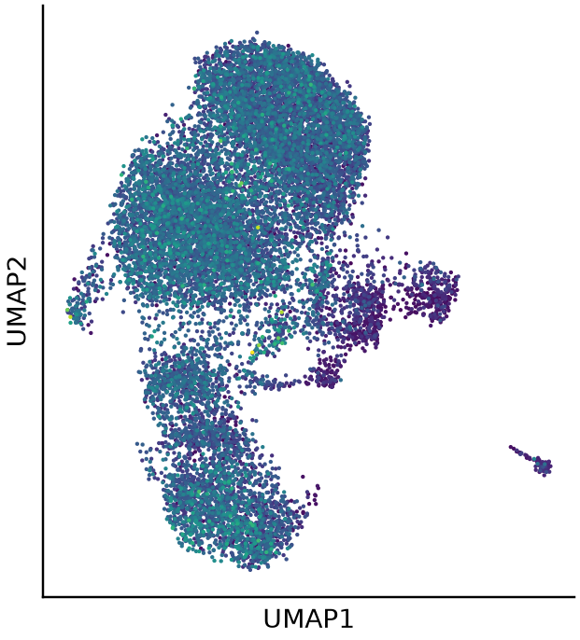
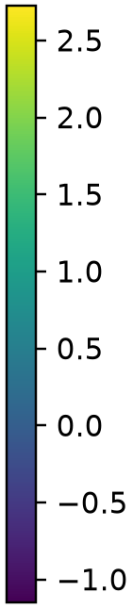
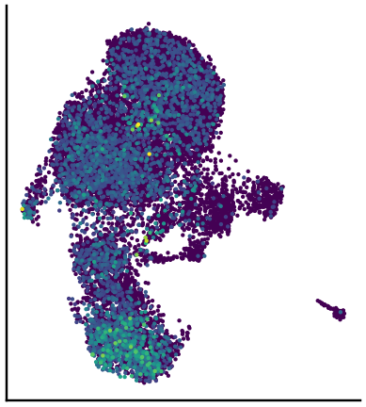

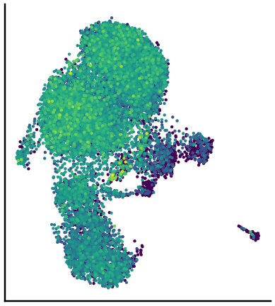

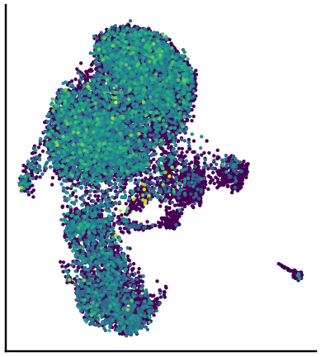

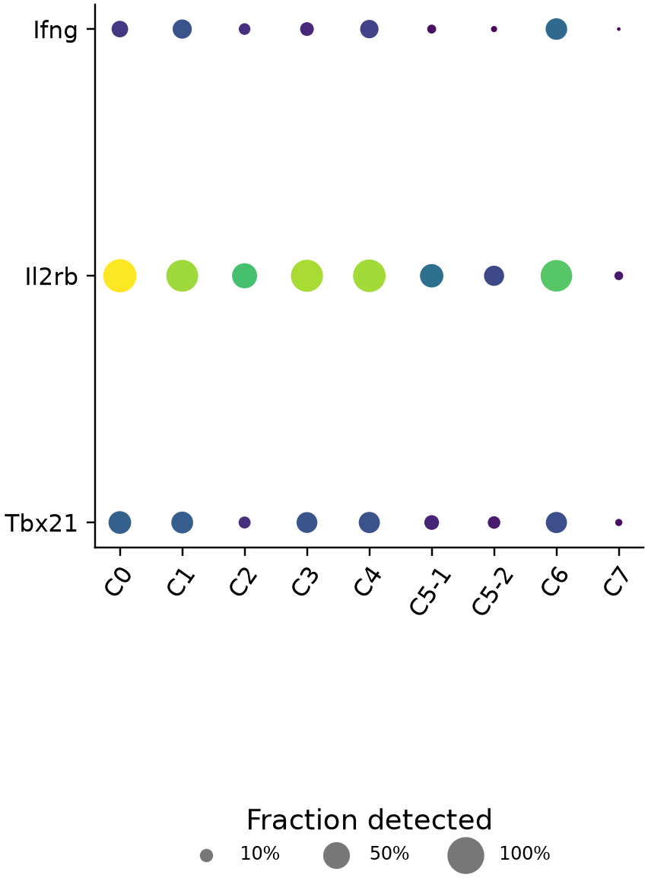
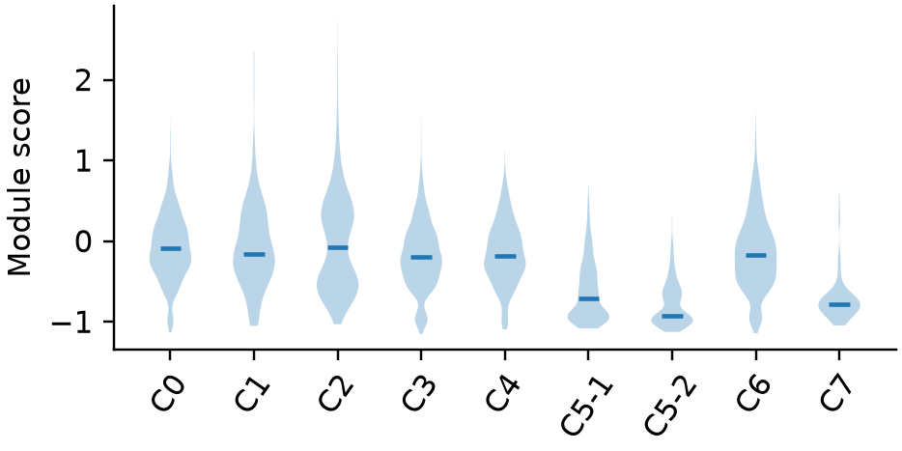
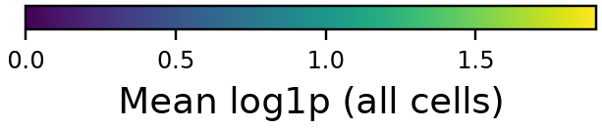
iNKT1 marker program
Score map, cluster distributions, individual markers and expression dotplot
iNKT1 score
Ifng
Il2rb
Tbx21
Marker expression
Current score_genes units differ from legacy summed-marker scores; these panels do not establish discrete subtype identities.
Original iNKT slides 6–8; marker panel and saved continuous scores from the 20260905 state analysis.
5
Notes:
iNKT1 marker program
原综合报告第5页。Current score_genes units differ from legacy summed-marker scores; these panels do not establish discrete subtype identities.
Original iNKT slides 6–8; marker panel and saved continuous scores from the 20260905 state analysis.
Current score_genes units differ from legacy summed-marker scores; these panels do not establish discrete subtype identities.
Source page: old_05; Main talk
Independent graphics: assets/panels/old_05_*
Native text and tables can be edited directly. SVG/PNG panels can be moved, resized or replaced independently; numeric source tables are in data/.

Slide 6
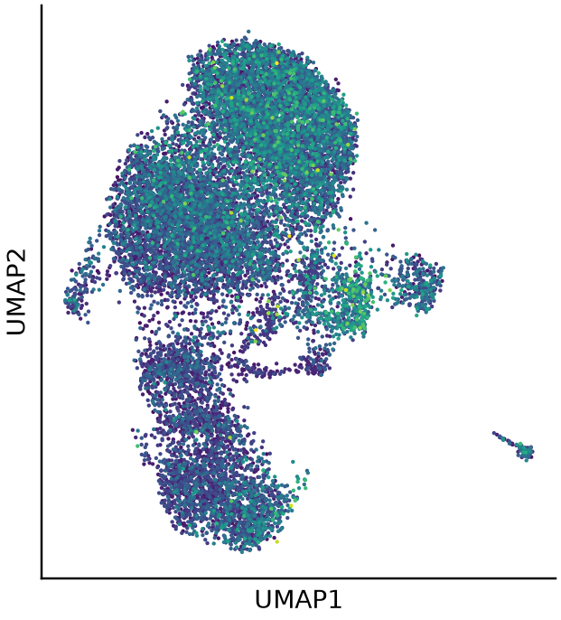
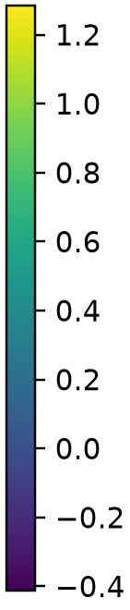
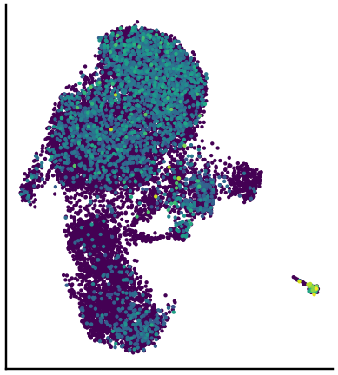

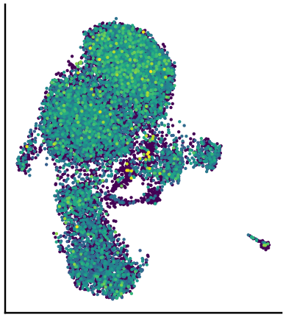

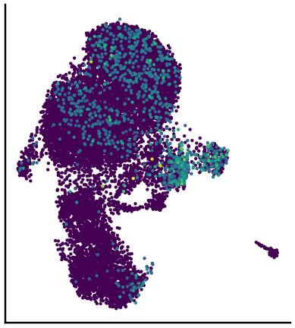

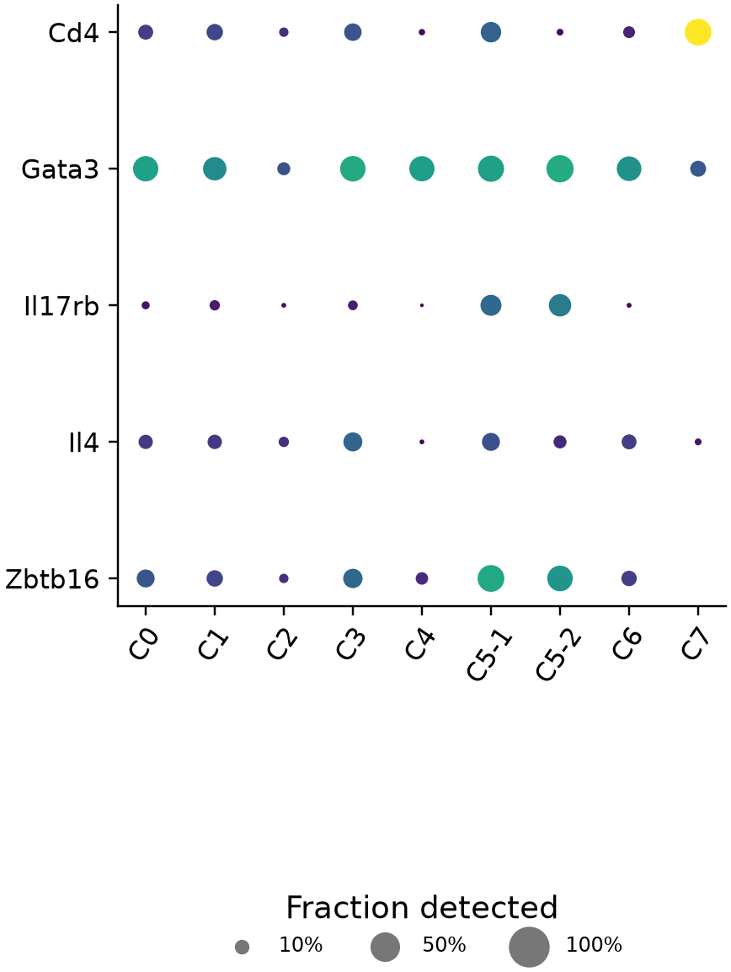
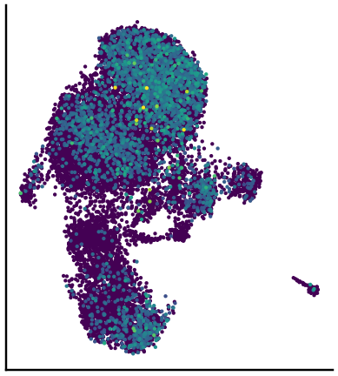

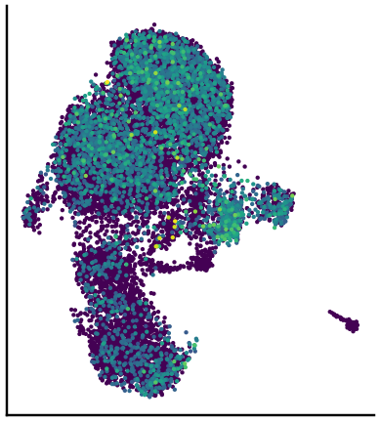

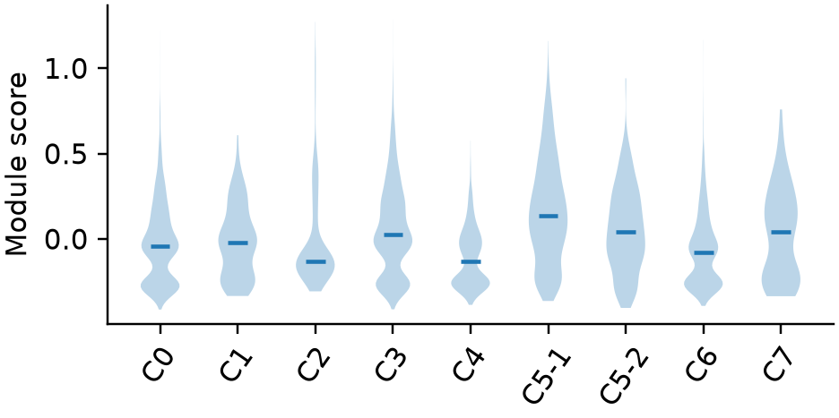
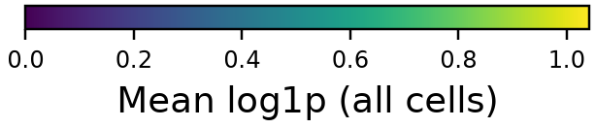
iNKT2 marker program
Score map, cluster distributions, individual markers and expression dotplot
iNKT2 score
Cd4
Gata3
Il17rb
Marker expression
Il4
Zbtb16
Current score_genes units differ from legacy summed-marker scores; these panels do not establish discrete subtype identities.
Original iNKT slides 6–8; marker panel and saved continuous scores from the 20260905 state analysis.
6
Notes:
iNKT2 marker program
原综合报告第6页。Current score_genes units differ from legacy summed-marker scores; these panels do not establish discrete subtype identities.
Original iNKT slides 6–8; marker panel and saved continuous scores from the 20260905 state analysis.
Current score_genes units differ from legacy summed-marker scores; these panels do not establish discrete subtype identities.
Source page: old_06; Main talk
Independent graphics: assets/panels/old_06_*
Native text and tables can be edited directly. SVG/PNG panels can be moved, resized or replaced independently; numeric source tables are in data/.

Slide 7
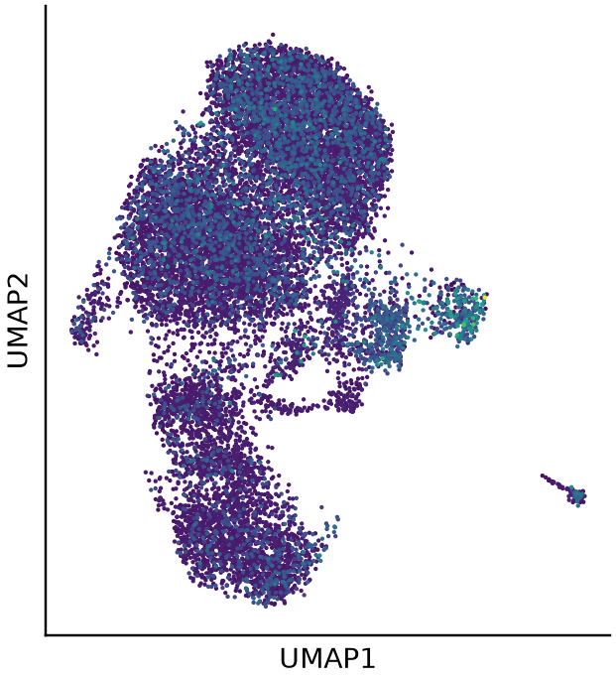
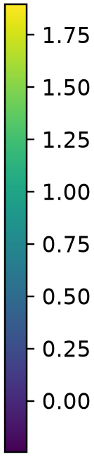
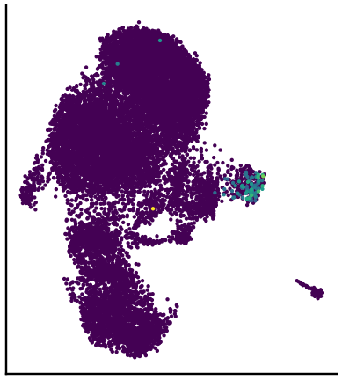

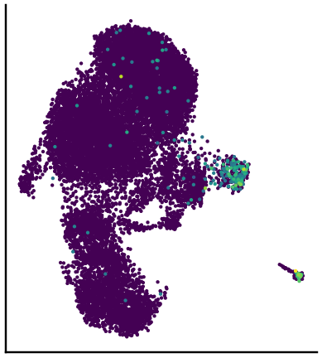

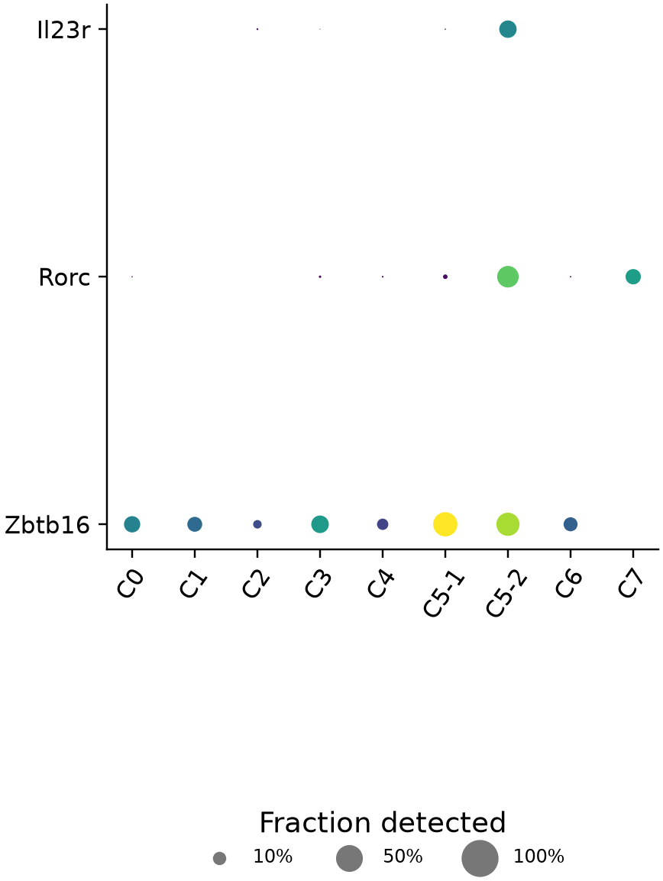
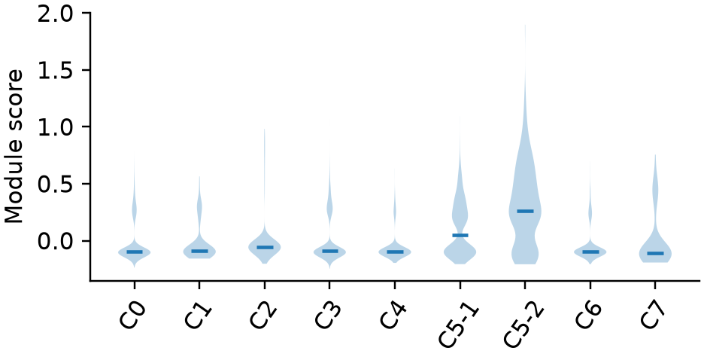
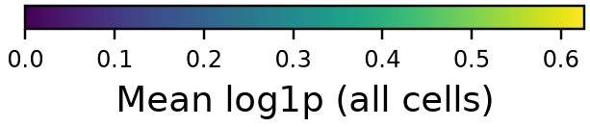
iNKT17 marker program
Score map, cluster distributions, individual markers and expression dotplot
iNKT17 score
Il23r
Rorc
Zbtb16
Marker expression
Ccr6 is absent from the filtered feature set.
Missing markers are not shown as zero expression.
Current score_genes units differ from legacy summed-marker scores; these panels do not establish discrete subtype identities.
Original iNKT slides 6–8; marker panel and saved continuous scores from the 20260905 state analysis.
7
Notes:
iNKT17 marker program
原综合报告第7页。Current score_genes units differ from legacy summed-marker scores; these panels do not establish discrete subtype identities.
Original iNKT slides 6–8; marker panel and saved continuous scores from the 20260905 state analysis.
Current score_genes units differ from legacy summed-marker scores; these panels do not establish discrete subtype identities.
Source page: old_07; Main talk
Independent graphics: assets/panels/old_07_*
Native text and tables can be edited directly. SVG/PNG panels can be moved, resized or replaced independently; numeric source tables are in data/.

Slide 8
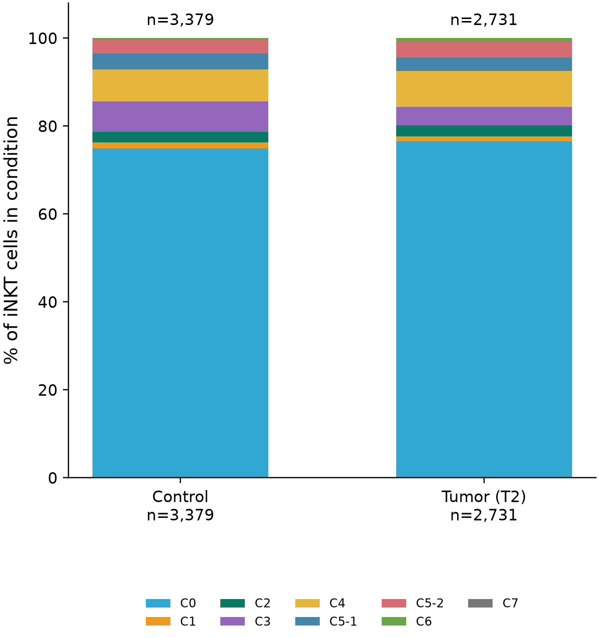
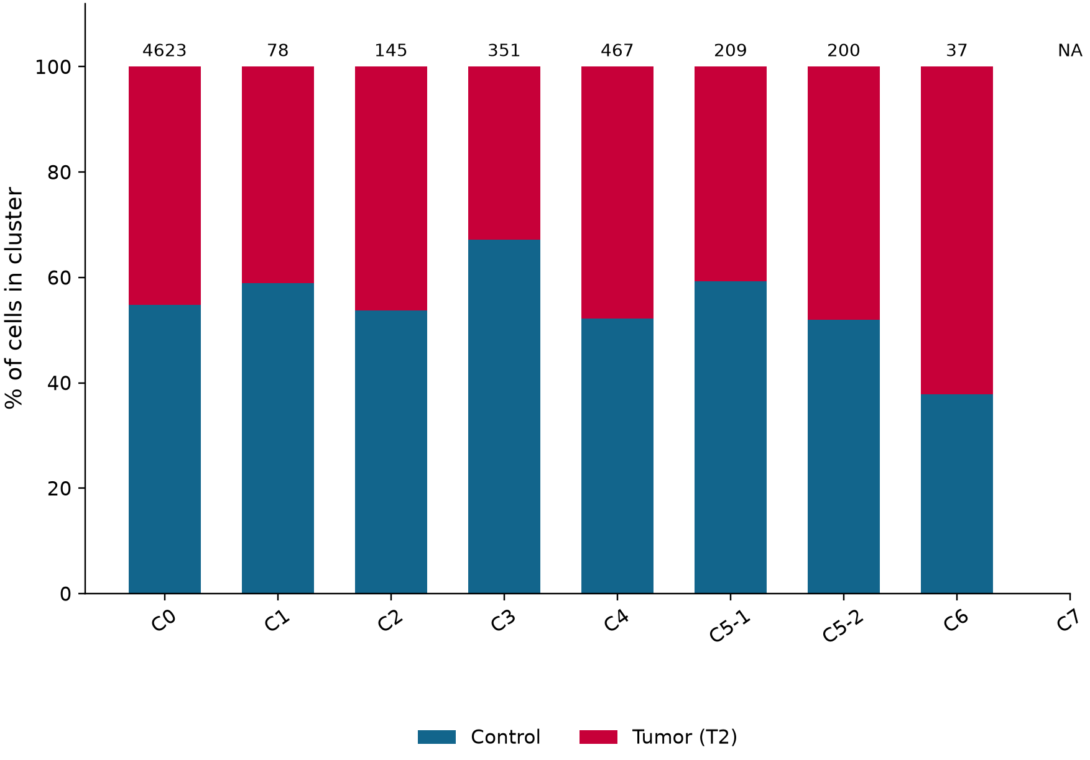
Bone marrow: cluster and condition frequencies
C • The two denominators from Blood Figure 3C, presented side by side
Cluster frequency within condition
Condition share within cluster
Left: n(cluster, condition) / N(condition) | Right: n(condition, cluster) / N(cluster)
Captured-cell proportions only. No mouse-level error bars or significance are inferred from individual cells.
Blood Fig. 3C; saved 20260905 frequency_reconciliation_1.csv.
8
Notes:
Bone marrow: cluster and condition frequencies
原综合报告第8页。Captured-cell proportions only. No mouse-level error bars or significance are inferred from individual cells.
Blood Fig. 3C; saved 20260905 frequency_reconciliation_1.csv.
Captured-cell proportions only. No mouse-level error bars or significance are inferred from individual cells.
Source page: old_08; Main talk
Independent graphics: assets/panels/old_08_*
Native text and tables can be edited directly. SVG/PNG panels can be moved, resized or replaced independently; numeric source tables are in data/.

Slide 9
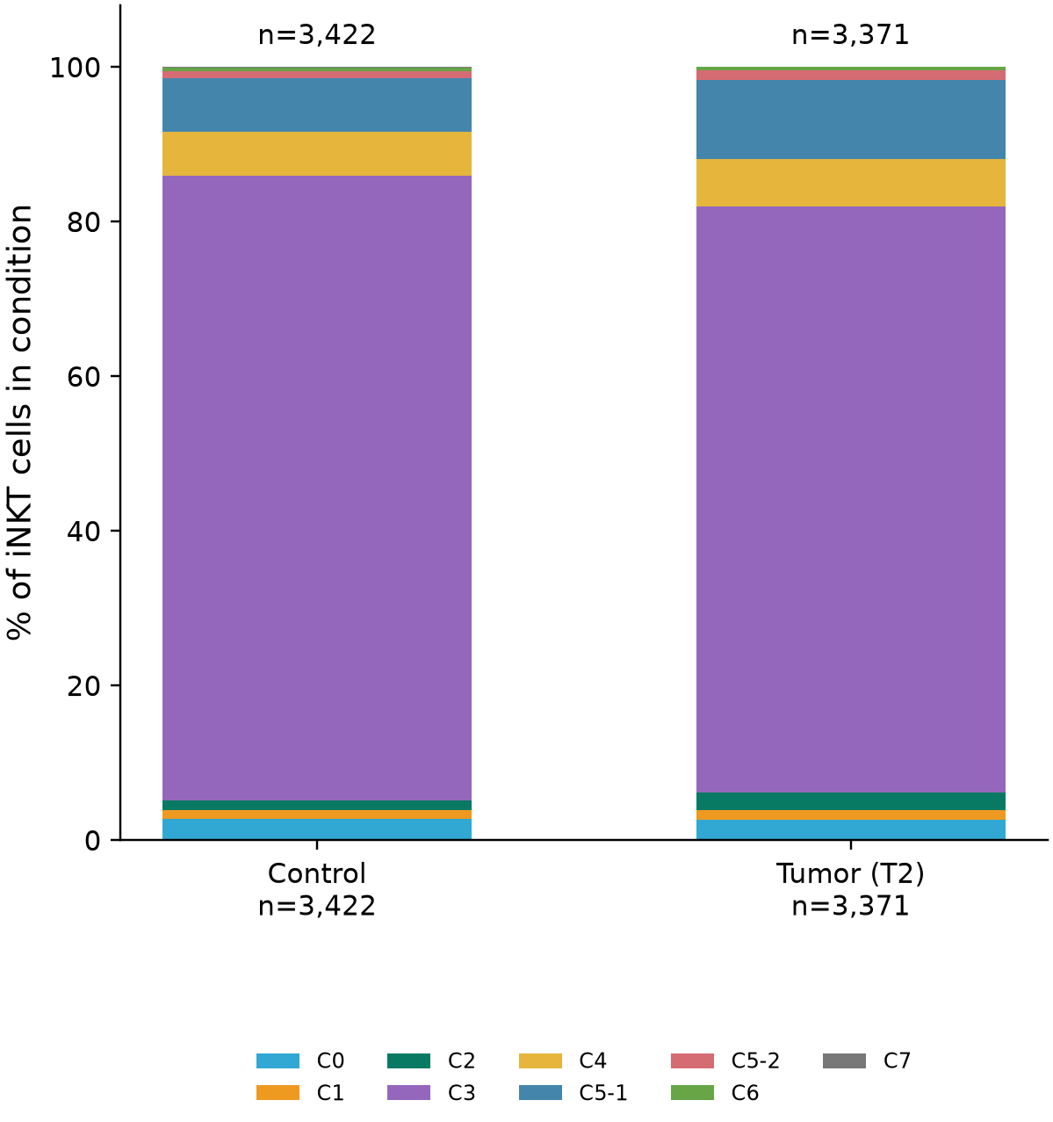
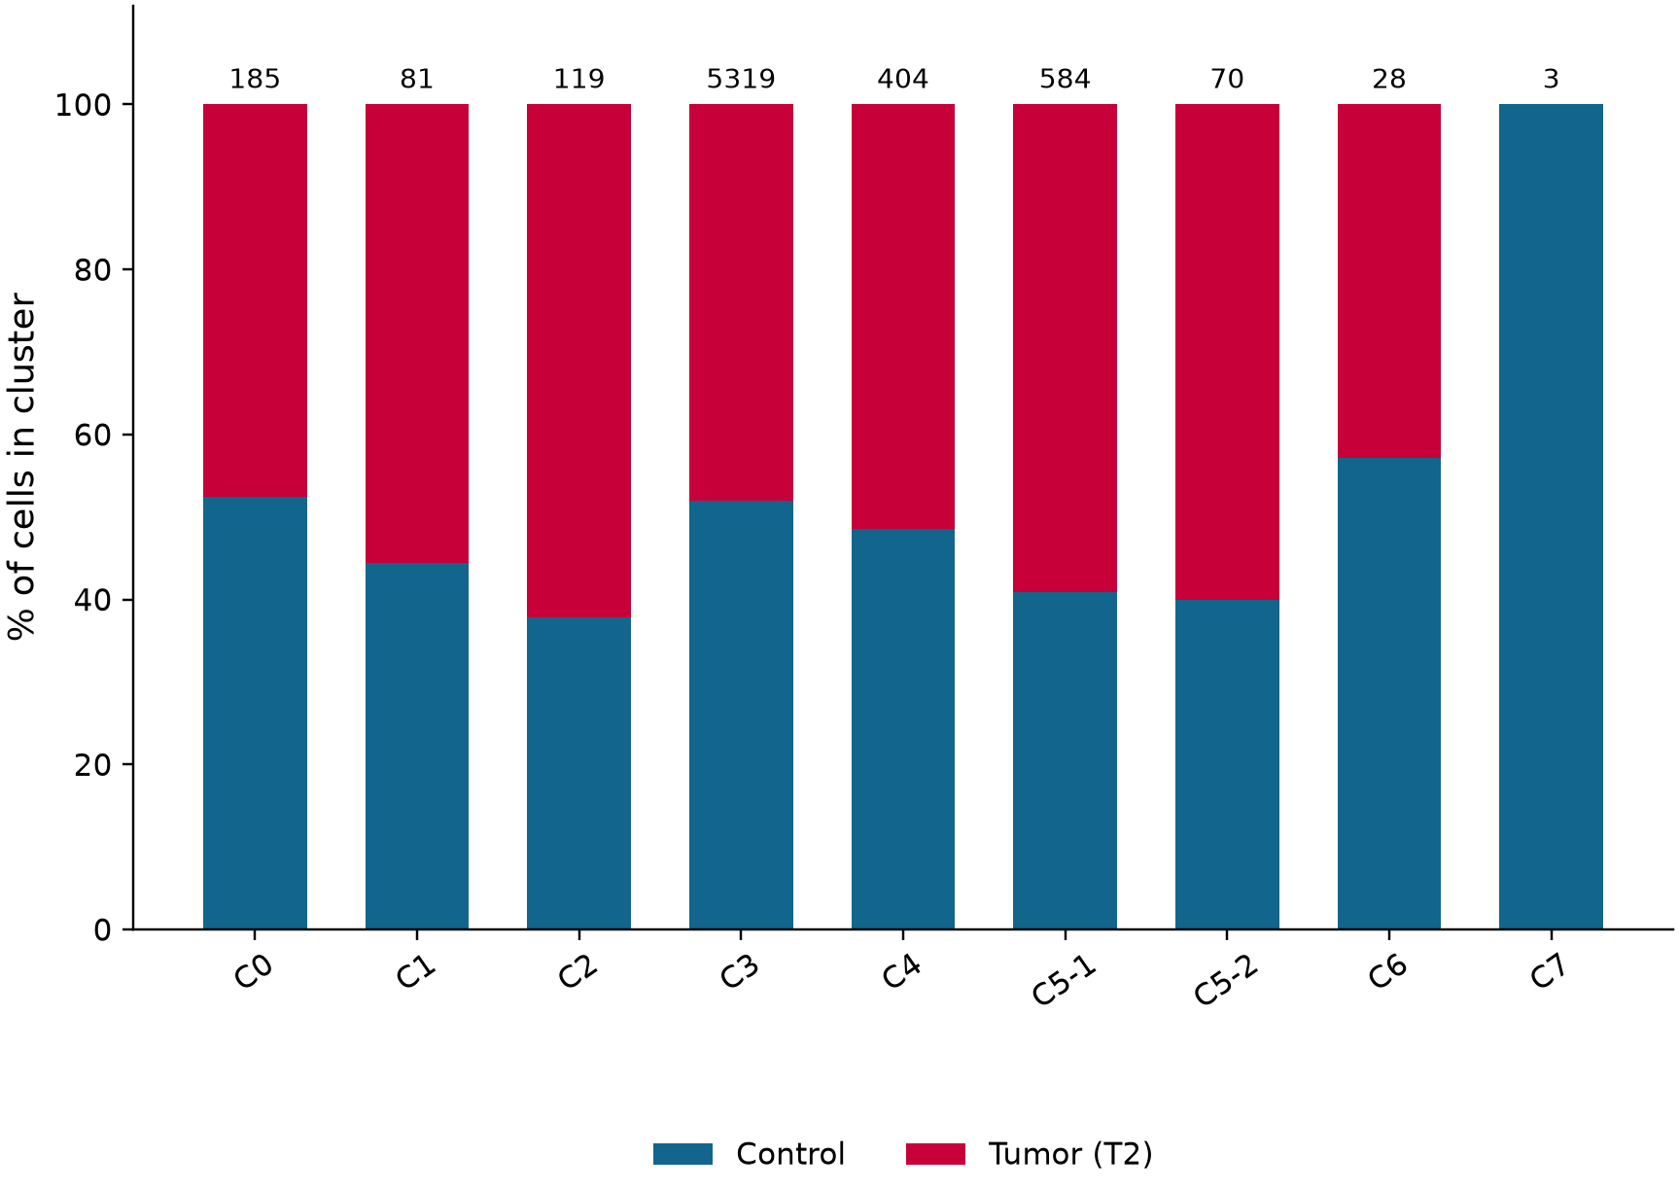
Spleen: cluster and condition frequencies
C • The two denominators from Blood Figure 3C, presented side by side
Cluster frequency within condition
Condition share within cluster
Left: n(cluster, condition) / N(condition) | Right: n(condition, cluster) / N(cluster)
Captured-cell proportions only. No mouse-level error bars or significance are inferred from individual cells.
Blood Fig. 3C; saved 20260905 frequency_reconciliation_1.csv.
9
Notes:
Spleen: cluster and condition frequencies
原综合报告第9页。Captured-cell proportions only. No mouse-level error bars or significance are inferred from individual cells.
Blood Fig. 3C; saved 20260905 frequency_reconciliation_1.csv.
Captured-cell proportions only. No mouse-level error bars or significance are inferred from individual cells.
Source page: old_09; Main talk
Independent graphics: assets/panels/old_09_*
Native text and tables can be edited directly. SVG/PNG panels can be moved, resized or replaced independently; numeric source tables are in data/.

Slide 10
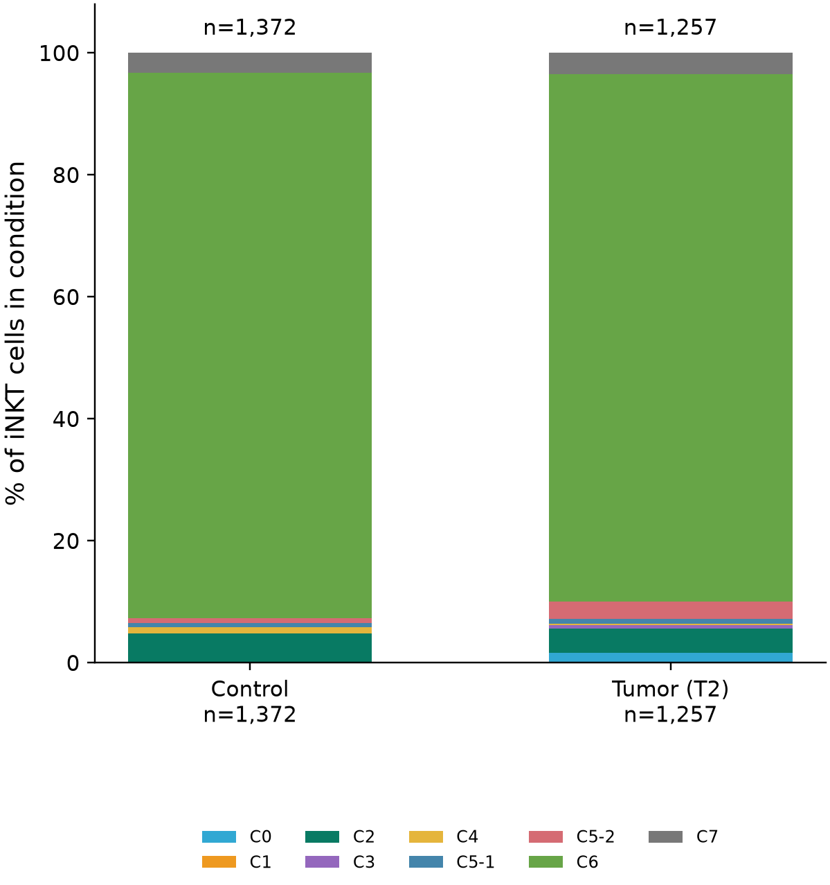
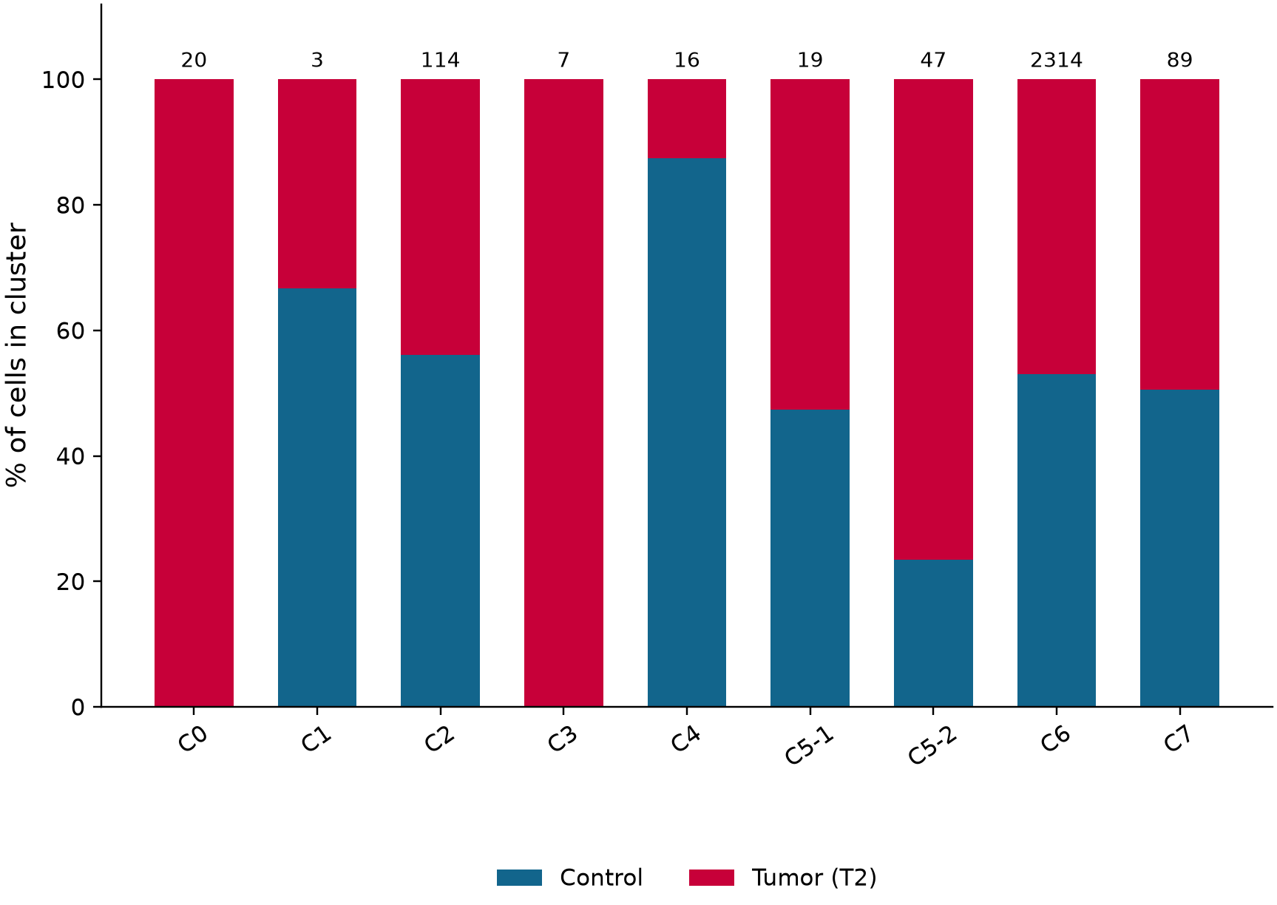
Thymus: cluster and condition frequencies
C • The two denominators from Blood Figure 3C, presented side by side
Cluster frequency within condition
Condition share within cluster
Left: n(cluster, condition) / N(condition) | Right: n(condition, cluster) / N(cluster)
Captured-cell proportions only. No mouse-level error bars or significance are inferred from individual cells.
Blood Fig. 3C; saved 20260905 frequency_reconciliation_1.csv.
10
Notes:
Thymus: cluster and condition frequencies
原综合报告第10页。Captured-cell proportions only. No mouse-level error bars or significance are inferred from individual cells.
Blood Fig. 3C; saved 20260905 frequency_reconciliation_1.csv.
Captured-cell proportions only. No mouse-level error bars or significance are inferred from individual cells.
Source page: old_10; Main talk
Independent graphics: assets/panels/old_10_*
Native text and tables can be edited directly. SVG/PNG panels can be moved, resized or replaced independently; numeric source tables are in data/.

Slide 11
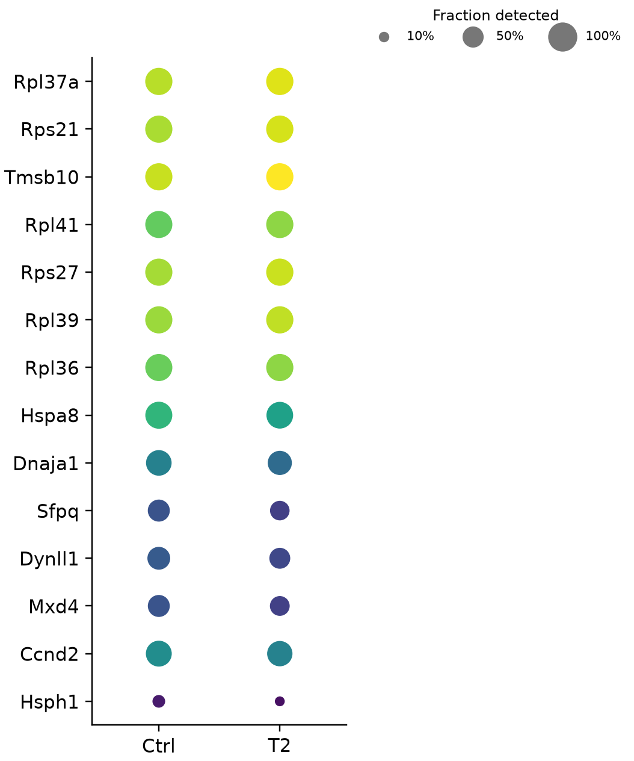
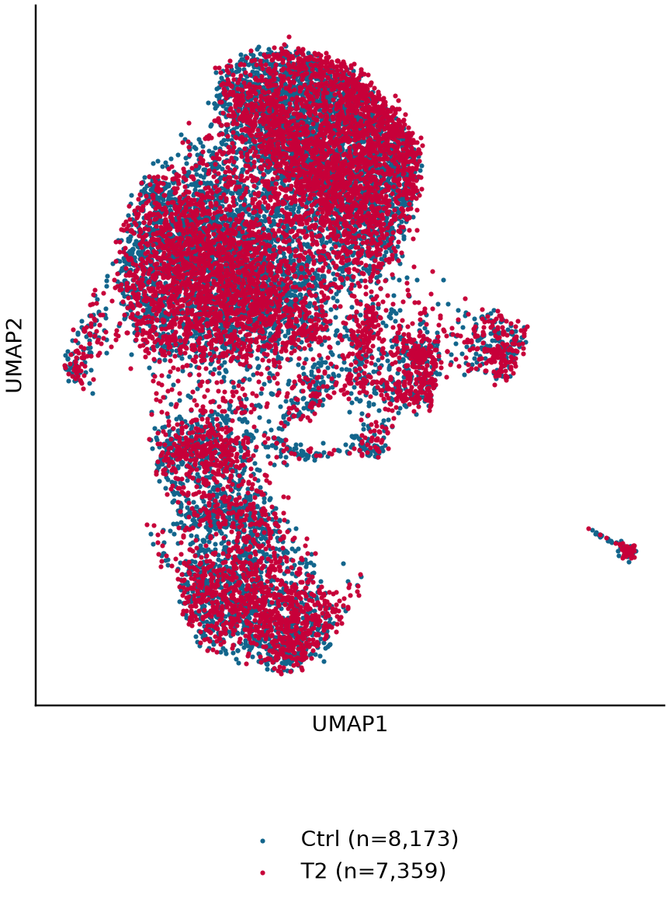
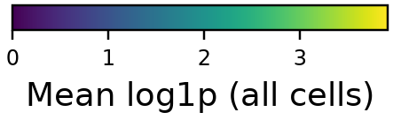
T2 vs. Control DEGs: global
Expression/detection dotplot alongside the exact same genes in a signed DEG table
Expression
Compared cells
Gene | Score | log2FC | P | BH FDR
Rpl37a | +43.15 | +0.358 | <machine limit | <machine limit
Rps21 | +42.82 | +0.369 | <machine limit | <machine limit
Tmsb10 | +53.10 | +0.481 | <machine limit | <machine limit
Rpl41 | +37.36 | +0.398 | 1.8e-305 | 4.9e-302
Rps27 | +35.32 | +0.310 | 3.2e-273 | 6.8e-270
Rpl39 | +34.73 | +0.328 | 3.3e-264 | 5e-261
Rpl36 | +34.03 | +0.339 | 9e-254 | 1.2e-250
Hspa8 | -35.08 | -0.536 | 1.3e-269 | 2.3e-266
Dnaja1 | -28.29 | -0.660 | 4.3e-176 | 2.8e-173
Sfpq | -22.25 | -0.697 | 1e-109 | 3.7e-107
Dynll1 | -21.29 | -0.621 | 1.5e-100 | 4.6e-98
Mxd4 | -19.73 | -0.630 | 1.3e-86 | 3.3e-84
Ccnd2 | -14.57 | -0.319 | 4.2e-48 | 5.9e-46
Hsph1 | -14.37 | -0.840 | 7.9e-47 | 1.1e-44
Selection: BH FDR ≤ 0.05, |log2FC| ≥ 0.25. * Not passing the same rule in the global comparison; not an interaction test.
Displayed: 7 strongest FDR-ranked genes per direction, when available; full gene table linked in the source index.
Original iNKT slide 10; current 20260905 DE.
11
Notes:
T2 vs. Control DEGs: global
原综合报告第11页。Displayed: 7 strongest FDR-ranked genes per direction, when available; full gene table linked in the source index.
Original iNKT slide 10; current 20260905 DE.
Displayed: 7 strongest FDR-ranked genes per direction, when available; full gene table linked in the source index.
Source page: old_11; Main talk
Independent graphics: assets/panels/old_11_*
Native text and tables can be edited directly. SVG/PNG panels can be moved, resized or replaced independently; numeric source tables are in data/.

Slide 12
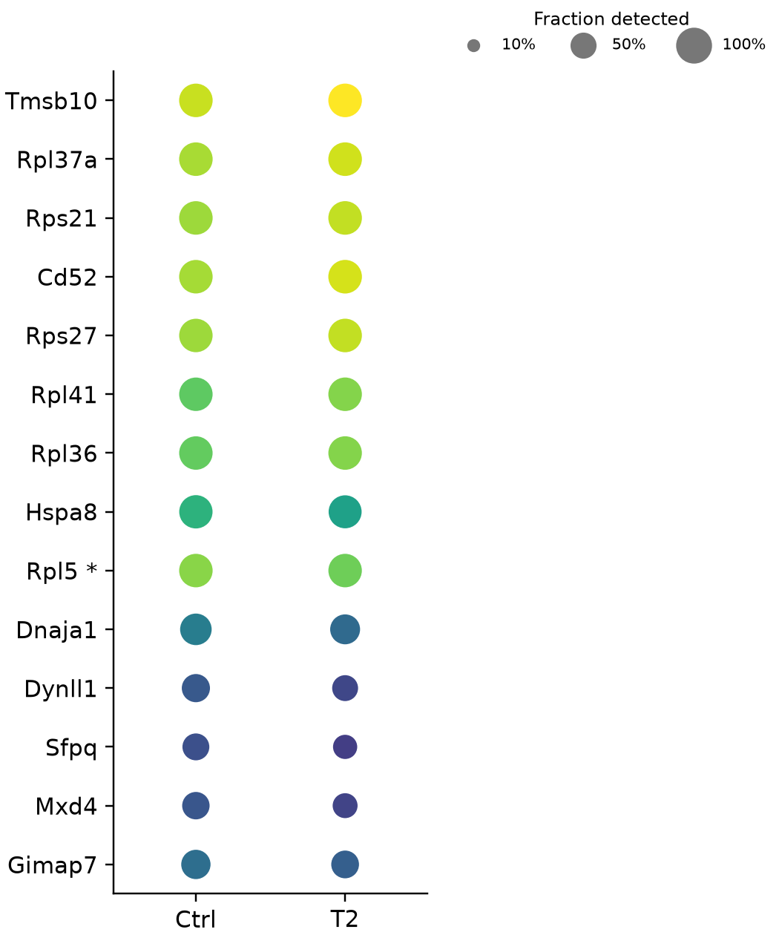
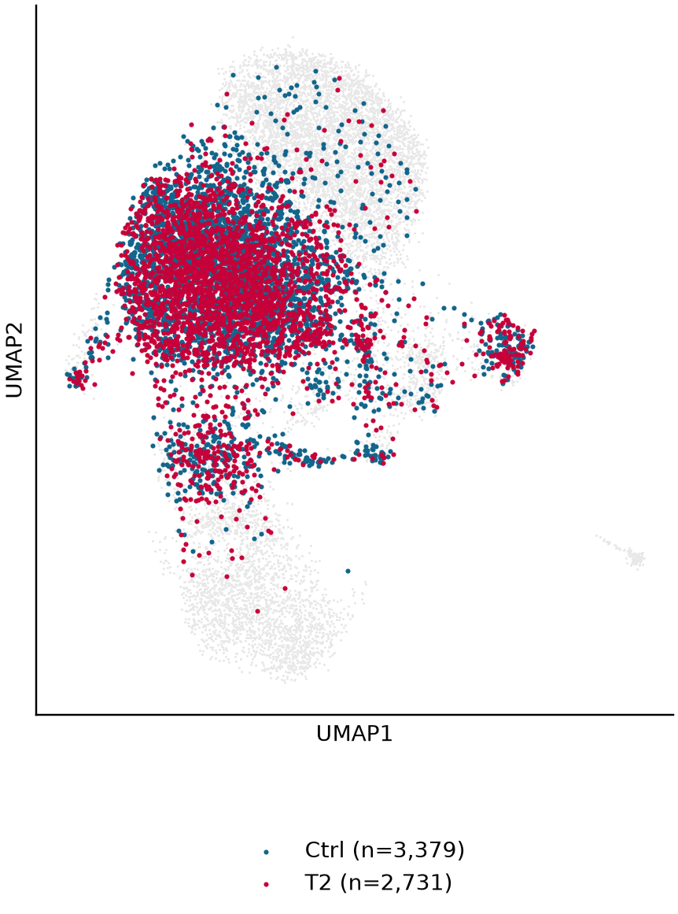

T2 vs. Control DEGs: BM
Expression/detection dotplot alongside the exact same genes in a signed DEG table
Expression
Compared cells
Gene | Score | log2FC | P | BH FDR
Tmsb10 | +33.63 | +0.483 | 6.9e-248 | 7.3e-244
Rpl37a | +24.56 | +0.331 | 3.3e-133 | 1.7e-129
Rps21 | +24.12 | +0.331 | 1.6e-128 | 5.8e-125
Cd52 | +22.88 | +0.402 | 7.1e-116 | 1.9e-112
Rps27 | +21.61 | +0.316 | 1.6e-103 | 3.4e-100
Rpl41 | +21.47 | +0.362 | 2.7e-102 | 4.8e-99
Rpl36 | +20.69 | +0.323 | 4.3e-95 | 6.5e-92
Hspa8 | -19.84 | -0.470 | 1.5e-87 | 1.7e-84
Rpl5 | -16.84 | -0.254 | 1.3e-63 | 8.8e-61
Dnaja1 | -15.27 | -0.566 | 1.2e-52 | 6e-50
Dynll1 | -12.36 | -0.573 | 4.1e-35 | 1e-32
Sfpq | -12.31 | -0.619 | 8e-35 | 1.9e-32
Mxd4 | -12.19 | -0.612 | 3.5e-34 | 7.9e-32
Gimap7 | -9.71 | -0.453 | 2.9e-22 | 4e-20
Selection: BH FDR ≤ 0.05, |log2FC| ≥ 0.25. * Not passing the same rule in the global comparison; not an interaction test.
Displayed: 7 strongest FDR-ranked genes per direction, when available; full gene table linked in the source index.
Original iNKT slide 11; current 20260905 DE.
12
Notes:
T2 vs. Control DEGs: BM
原综合报告第12页。Displayed: 7 strongest FDR-ranked genes per direction, when available; full gene table linked in the source index.
Original iNKT slide 11; current 20260905 DE.
Displayed: 7 strongest FDR-ranked genes per direction, when available; full gene table linked in the source index.
Source page: old_12; Main talk
Independent graphics: assets/panels/old_12_*
Native text and tables can be edited directly. SVG/PNG panels can be moved, resized or replaced independently; numeric source tables are in data/.

Slide 13
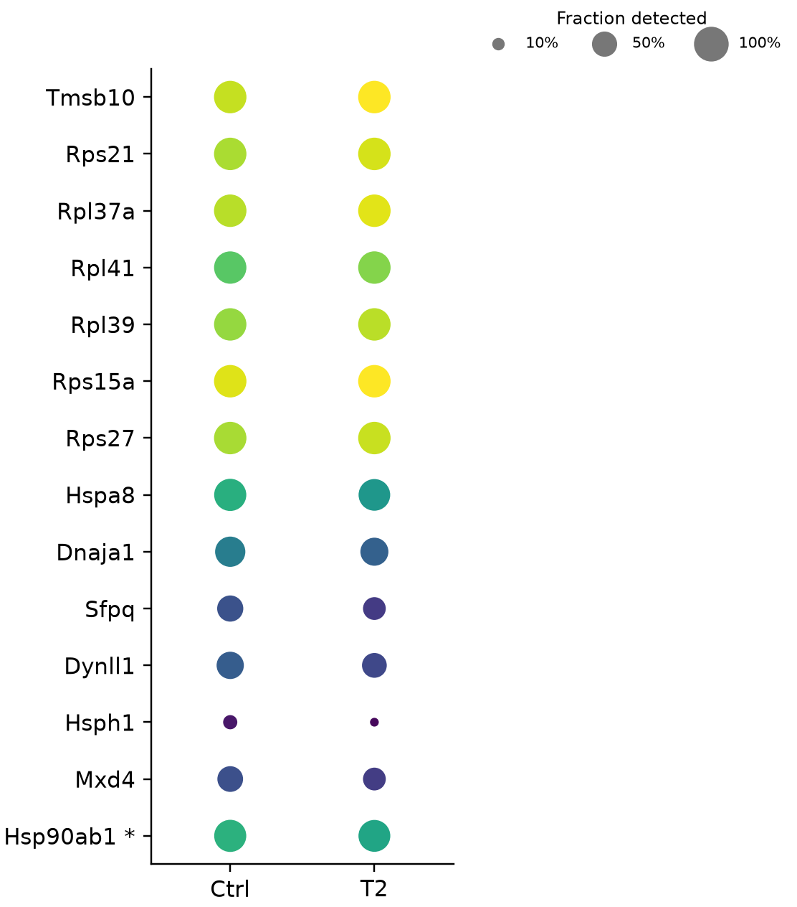
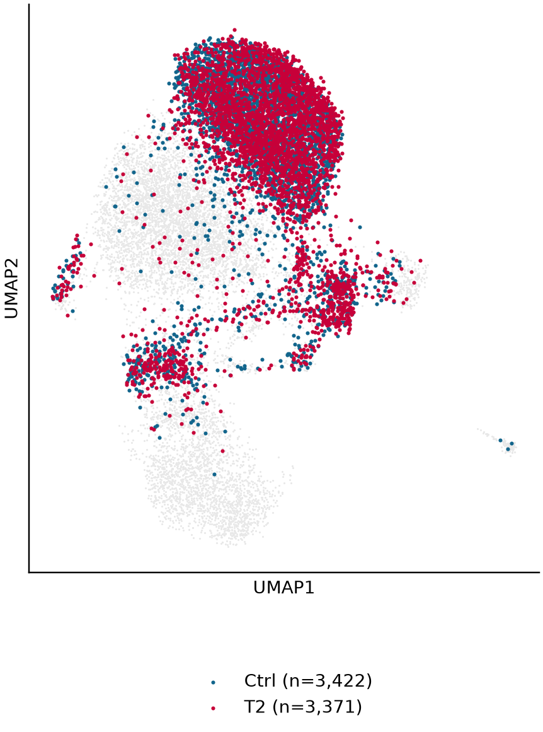

T2 vs. Control DEGs: Spl
Expression/detection dotplot alongside the exact same genes in a signed DEG table
Expression
Compared cells
Gene | Score | log2FC | P | BH FDR
Tmsb10 | +38.05 | +0.515 | <machine limit | <machine limit
Rps21 | +29.88 | +0.371 | 3.6e-196 | 1.9e-192
Rpl37a | +29.69 | +0.358 | 1.1e-193 | 4e-190
Rpl41 | +27.05 | +0.433 | 3.8e-161 | 8.2e-158
Rpl39 | +23.65 | +0.335 | 1.1e-123 | 1.7e-120
Rps15a | +23.65 | +0.280 | 1.1e-123 | 1.7e-120
Rps27 | +23.18 | +0.286 | 7.9e-119 | 9.4e-116
Hspa8 | -27.53 | -0.655 | 8.6e-167 | 2.3e-163
Dnaja1 | -23.43 | -0.844 | 2.1e-121 | 2.8e-118
Sfpq | -16.73 | -0.802 | 7.7e-63 | 3.4e-60
Dynll1 | -15.97 | -0.695 | 2.1e-57 | 7.2e-55
Hsph1 | -14.78 | -1.669 | 2.1e-49 | 5.7e-47
Mxd4 | -13.38 | -0.668 | 8e-41 | 1.7e-38
Hsp90ab1 | -13.20 | -0.317 | 8.3e-40 | 1.6e-37
Selection: BH FDR ≤ 0.05, |log2FC| ≥ 0.25. * Not passing the same rule in the global comparison; not an interaction test.
Displayed: 7 strongest FDR-ranked genes per direction, when available; full gene table linked in the source index.
Original iNKT slide 11; current 20260905 DE.
13
Notes:
T2 vs. Control DEGs: Spl
原综合报告第13页。Displayed: 7 strongest FDR-ranked genes per direction, when available; full gene table linked in the source index.
Original iNKT slide 11; current 20260905 DE.
Displayed: 7 strongest FDR-ranked genes per direction, when available; full gene table linked in the source index.
Source page: old_13; Main talk
Independent graphics: assets/panels/old_13_*
Native text and tables can be edited directly. SVG/PNG panels can be moved, resized or replaced independently; numeric source tables are in data/.

Slide 14
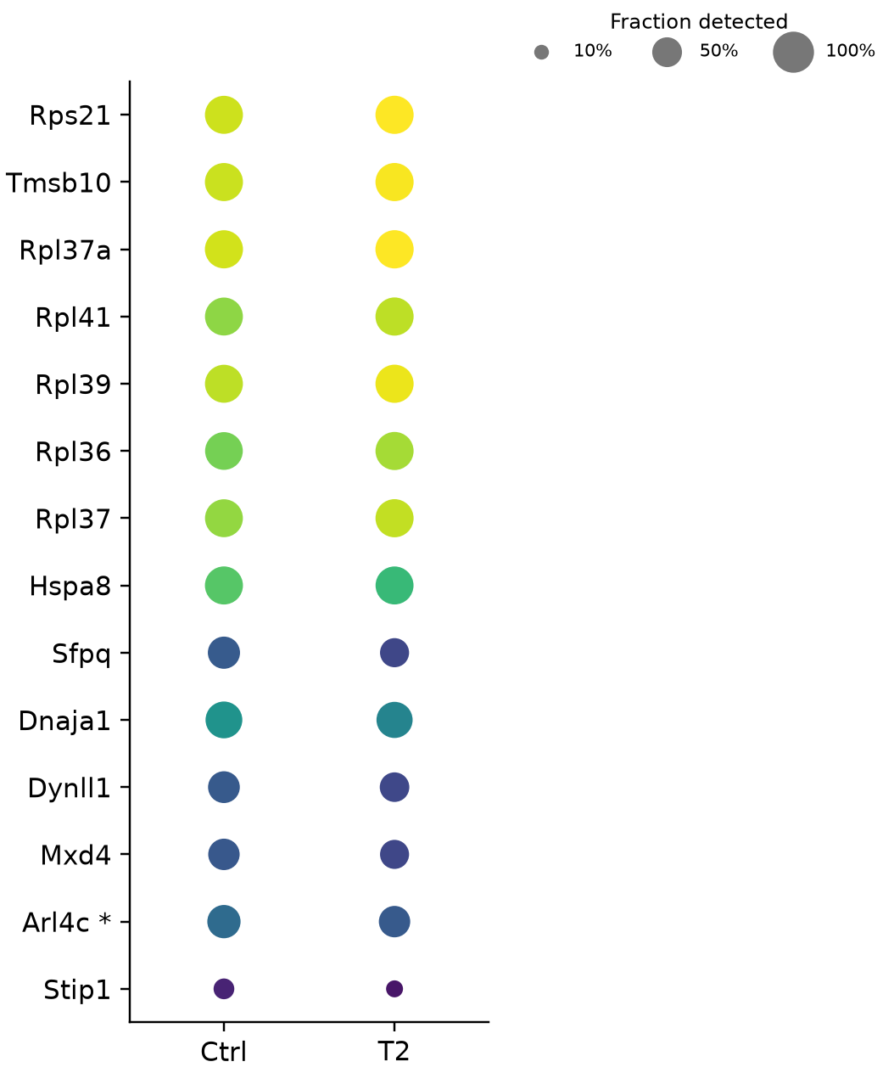
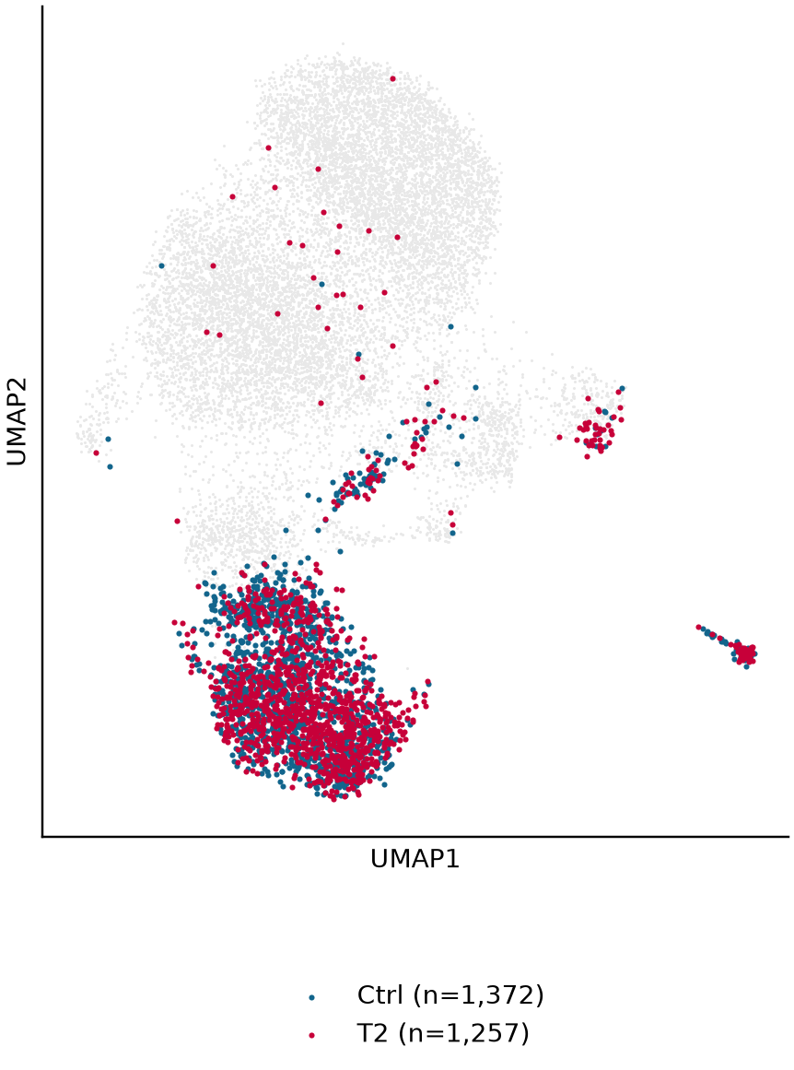
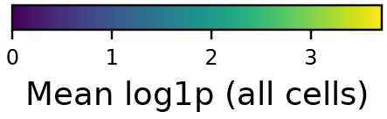
T2 vs. Control DEGs: Thy
Expression/detection dotplot alongside the exact same genes in a signed DEG table
Expression
Compared cells
Gene | Score | log2FC | P | BH FDR
Rps21 | +19.26 | +0.416 | 1.1e-82 | 1.1e-78
Tmsb10 | +19.06 | +0.399 | 5.6e-81 | 3e-77
Rpl37a | +18.78 | +0.381 | 1.1e-78 | 3.8e-75
Rpl41 | +15.97 | +0.392 | 2e-57 | 5.2e-54
Rpl39 | +15.89 | +0.373 | 7.7e-57 | 1.6e-53
Rpl36 | +15.83 | +0.418 | 2e-56 | 3.6e-53
Rpl37 | +15.76 | +0.383 | 6.1e-56 | 9.2e-53
Hspa8 | -11.48 | -0.359 | 1.7e-30 | 9.1e-28
Sfpq | -8.50 | -0.614 | 1.9e-17 | 5.7e-15
Dnaja1 | -8.08 | -0.416 | 6.3e-16 | 1.7e-13
Dynll1 | -7.42 | -0.554 | 1.1e-13 | 2.4e-11
Mxd4 | -7.19 | -0.530 | 6.6e-13 | 1.3e-10
Arl4c | -7.19 | -0.498 | 6.7e-13 | 1.3e-10
Stip1 | -6.26 | -0.799 | 3.8e-10 | 6.3e-08
Selection: BH FDR ≤ 0.05, |log2FC| ≥ 0.25. * Not passing the same rule in the global comparison; not an interaction test.
Displayed: 7 strongest FDR-ranked genes per direction, when available; full gene table linked in the source index.
Original iNKT slide 11; current 20260905 DE.
14
Notes:
T2 vs. Control DEGs: Thy
原综合报告第14页。Displayed: 7 strongest FDR-ranked genes per direction, when available; full gene table linked in the source index.
Original iNKT slide 11; current 20260905 DE.
Displayed: 7 strongest FDR-ranked genes per direction, when available; full gene table linked in the source index.
Source page: old_14; Main talk
Independent graphics: assets/panels/old_14_*
Native text and tables can be edited directly. SVG/PNG panels can be moved, resized or replaced independently; numeric source tables are in data/.

Slide 15

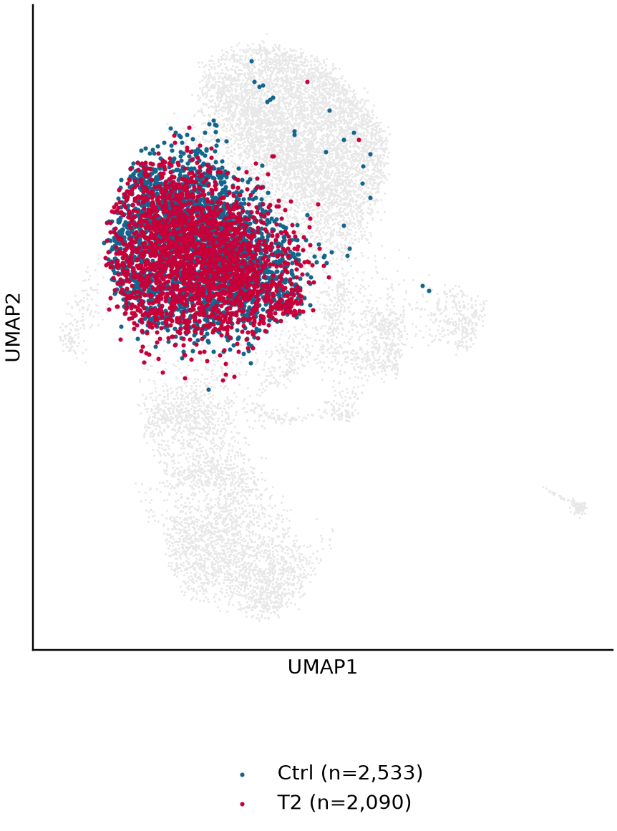

T2 vs. Control DEGs: C0 / BM
Expression/detection dotplot alongside the exact same genes in a signed DEG table
Expression
Compared cells
Gene | Score | log2FC | P | BH FDR
Tmsb10 | +30.58 | +0.465 | 2e-205 | 2.2e-201
Rps21 | +22.11 | +0.327 | 2.7e-108 | 1.5e-104
Rpl37a | +21.81 | +0.315 | 1.9e-105 | 6.7e-102
Cd52 | +19.93 | +0.346 | 2.2e-88 | 5.8e-85
Rps27 | +19.89 | +0.307 | 5.3e-88 | 1.1e-84
Rpl41 | +19.29 | +0.365 | 6e-83 | 1.1e-79
Rpl37 | +18.58 | +0.331 | 4.4e-77 | 6.7e-74
Hspa8 | -18.46 | -0.494 | 4.4e-76 | 5.9e-73
Rpl5 | -15.25 | -0.265 | 1.5e-52 | 1e-49
Dnaja1 | -13.39 | -0.552 | 6.5e-41 | 3.2e-38
Mxd4 | -13.08 | -0.705 | 4.3e-39 | 2e-36
Sfpq | -10.58 | -0.599 | 3.8e-26 | 8.2e-24
Dynll1 | -9.70 | -0.512 | 2.9e-22 | 5.3e-20
Gimap7 | -8.88 | -0.432 | 6.6e-19 | 9.5e-17
Selection: BH FDR ≤ 0.05, |log2FC| ≥ 0.25. * Not passing the same rule in the global comparison; not an interaction test.
Displayed: 7 strongest FDR-ranked genes per direction, when available; full gene table linked in the source index.
Original iNKT slide 17 layout; current BM C0; current 20260905 DE.
15
Notes:
T2 vs. Control DEGs: C0 / BM
原综合报告第15页。Displayed: 7 strongest FDR-ranked genes per direction, when available; full gene table linked in the source index.
Original iNKT slide 17 layout; current BM C0; current 20260905 DE.
Displayed: 7 strongest FDR-ranked genes per direction, when available; full gene table linked in the source index.
Source page: old_15; Main talk
Independent graphics: assets/panels/old_15_*
Native text and tables can be edited directly. SVG/PNG panels can be moved, resized or replaced independently; numeric source tables are in data/.

Slide 16
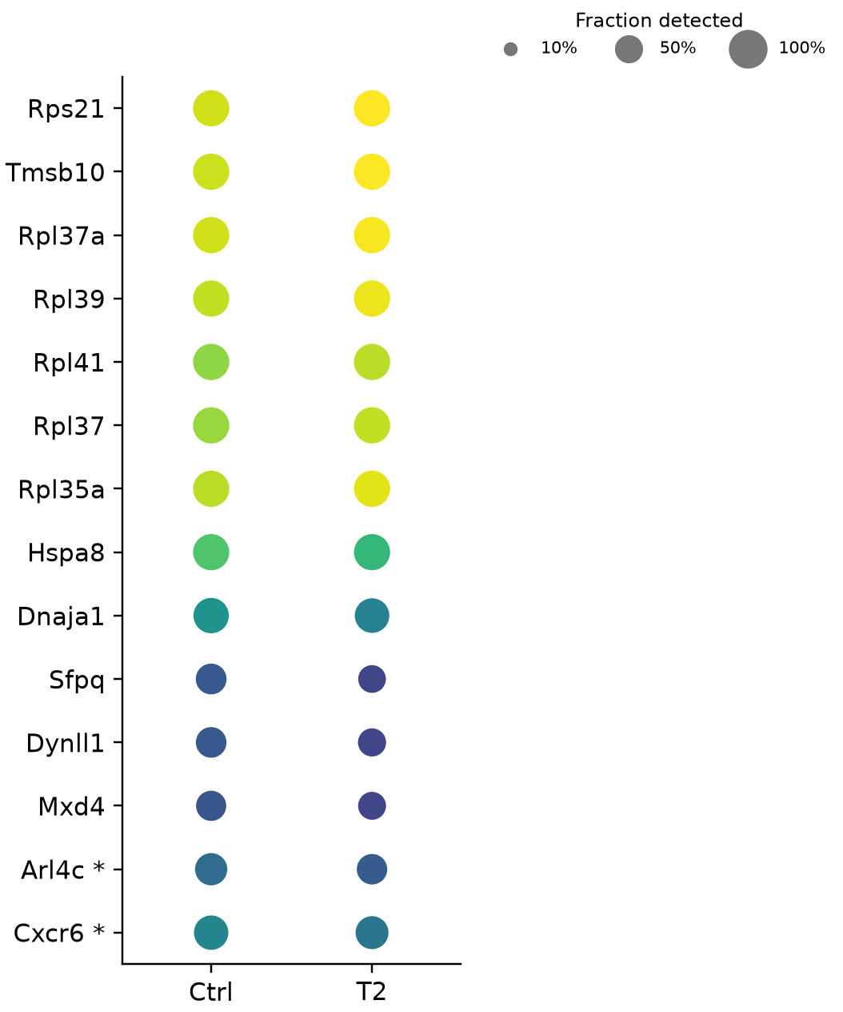


T2 vs. Control DEGs: C6 / Thy
Expression/detection dotplot alongside the exact same genes in a signed DEG table
Expression
Compared cells
Gene | Score | log2FC | P | BH FDR
Rps21 | +20.82 | +0.400 | 2.8e-96 | 3e-92
Tmsb10 | +20.47 | +0.422 | 4.1e-93 | 2.2e-89
Rpl37a | +19.51 | +0.364 | 8.8e-85 | 3.1e-81
Rpl39 | +17.18 | +0.366 | 4.1e-66 | 1.1e-62
Rpl41 | +16.82 | +0.375 | 1.8e-63 | 3.8e-60
Rpl37 | +16.33 | +0.356 | 6e-60 | 1.1e-56
Rpl35a | +16.14 | +0.318 | 1.4e-58 | 2.1e-55
Hspa8 | -11.21 | -0.346 | 3.5e-29 | 1.7e-26
Dnaja1 | -8.79 | -0.467 | 1.5e-18 | 4.3e-16
Sfpq | -8.50 | -0.636 | 1.9e-17 | 5.2e-15
Dynll1 | -8.32 | -0.630 | 9e-17 | 2.4e-14
Mxd4 | -7.15 | -0.531 | 8.8e-13 | 1.8e-10
Arl4c | -7.14 | -0.499 | 9.2e-13 | 1.8e-10
Cxcr6 | -6.70 | -0.427 | 2.1e-11 | 3.8e-09
Selection: BH FDR ≤ 0.05, |log2FC| ≥ 0.25. * Not passing the same rule in the global comparison; not an interaction test.
Displayed: 7 strongest FDR-ranked genes per direction, when available; full gene table linked in the source index.
Original iNKT slide 13 layout; current Thy C6; current 20260905 DE.
16
Notes:
T2 vs. Control DEGs: C6 / Thy
原综合报告第16页。Displayed: 7 strongest FDR-ranked genes per direction, when available; full gene table linked in the source index.
Original iNKT slide 13 layout; current Thy C6; current 20260905 DE.
Displayed: 7 strongest FDR-ranked genes per direction, when available; full gene table linked in the source index.
Source page: old_16; Main talk
Independent graphics: assets/panels/old_16_*
Native text and tables can be edited directly. SVG/PNG panels can be moved, resized or replaced independently; numeric source tables are in data/.

Slide 17



T2 vs. Control DEGs: C5-1 / Spl
Expression/detection dotplot alongside the exact same genes in a signed DEG table
Expression
Compared cells
Gene | Score | log2FC | P | BH FDR
Rpl41 | +10.09 | +0.417 | 6e-24 | 3.2e-20
Rps21 | +10.10 | +0.376 | 5.7e-24 | 3.2e-20
Rpl37a | +9.32 | +0.344 | 1.2e-20 | 4.1e-17
Rpl39 | +9.11 | +0.352 | 8.5e-20 | 2.3e-16
Tmsb10 | +8.99 | +0.476 | 2.4e-19 | 5.2e-16
Rpl35a | +8.03 | +0.309 | 9.5e-16 | 1.7e-12
Rps15a | +7.68 | +0.281 | 1.5e-14 | 2.4e-11
Rpl5 | -7.52 | -0.286 | 5.6e-14 | 7.5e-11
Hspa8 | -7.07 | -0.510 | 1.6e-12 | 1.5e-09
Dnaja1 | -6.88 | -0.763 | 6e-12 | 5.3e-09
Dynll1 | -6.37 | -0.769 | 1.9e-10 | 1.1e-07
Rps6 | -6.28 | -0.256 | 3.4e-10 | 1.8e-07
Hsph1 | -5.30 | -1.647 | 1.1e-07 | 3.8e-05
Hsp90ab1 | -4.93 | -0.284 | 8.2e-07 | 0.00023
Selection: BH FDR ≤ 0.05, |log2FC| ≥ 0.25. * Not passing the same rule in the global comparison; not an interaction test.
Displayed: 7 strongest FDR-ranked genes per direction, when available; full gene table linked in the source index.
Original iNKT slide 19 layout; current Spl C5-1; current 20260905 DE.
17
Notes:
T2 vs. Control DEGs: C5-1 / Spl
原综合报告第17页。Displayed: 7 strongest FDR-ranked genes per direction, when available; full gene table linked in the source index.
Original iNKT slide 19 layout; current Spl C5-1; current 20260905 DE.
Displayed: 7 strongest FDR-ranked genes per direction, when available; full gene table linked in the source index.
Source page: old_17; Main talk
Independent graphics: assets/panels/old_17_*
Native text and tables can be edited directly. SVG/PNG panels can be moved, resized or replaced independently; numeric source tables are in data/.

Slide 18



T2 vs. Control DEGs: C5-2 / BM
Expression/detection dotplot alongside the exact same genes in a signed DEG table
Expression
Compared cells
Gene | Score | log2FC | P | BH FDR
Rpl39 | +5.75 | +0.377 | 8.9e-09 | 9.5e-05
Rpl34 | +5.52 | +0.377 | 3.3e-08 | 0.00018
Rplp2 | +5.36 | +0.313 | 8.3e-08 | 0.00029
Rpl36 | +5.24 | +0.389 | 1.6e-07 | 0.00033
Rps15a | +5.21 | +0.312 | 1.8e-07 | 0.00033
Tmsb10 | +5.25 | +0.347 | 1.6e-07 | 0.00033
Rpl37a | +5.01 | +0.287 | 5.5e-07 | 0.00074
Sfpq | -4.83 | -1.237 | 1.4e-06 | 0.0014
Dynll1 | -4.19 | -0.858 | 2.8e-05 | 0.018
Shld1 | -3.98 | -1.911 | 6.9e-05 | 0.031
Selection: BH FDR ≤ 0.05, |log2FC| ≥ 0.25. * Not passing the same rule in the global comparison; not an interaction test.
Displayed: 7 strongest FDR-ranked genes per direction, when available; full gene table linked in the source index.
Original iNKT cluster-DE layout; current BM C5-2; current 20260905 DE.
18
Notes:
T2 vs. Control DEGs: C5-2 / BM
原综合报告第18页。Displayed: 7 strongest FDR-ranked genes per direction, when available; full gene table linked in the source index.
Original iNKT cluster-DE layout; current BM C5-2; current 20260905 DE.
Displayed: 7 strongest FDR-ranked genes per direction, when available; full gene table linked in the source index.
Source page: old_18; Main talk
Independent graphics: assets/panels/old_18_*
Native text and tables can be edited directly. SVG/PNG panels can be moved, resized or replaced independently; numeric source tables are in data/.

Slide 19
Pathways: C6 / Thy
Legacy c1_thymus pathway vocabulary; current full-member ORA with explicit up/down direction
Pathway / reaction | Legacy source | Old FDR | T2-up FDR | Ctrl-up FDR | Current overlapping genes
hsa05020 Prion disease - Homo sapiens (human) | KEGG 2021 HUMAN | 5.9e-05 | 2.6e-10 | 0.44 | T2: Cox5b, Cox6c, Cox8a +16 more Ctrl: Bax, Ccl5, Csnk2a2 +6 more
p23 (PTGES3) binds HSP90:ATP:FKBP5:nascent protein | Reactome 2021 | 4.2e-06 | 0.0047 | 0.00066 | T2: Hspa1a, Hspa1b Ctrl: Hspa8, Ptges3, Stip1
p23 (PTGES3) binds HSP90:ATP:FKBP4:nascent protein | Reactome 2021 | 4.2e-06 | 0.0047 | 0.00066 | T2: Hspa1a, Hspa1b Ctrl: Hspa8, Ptges3, Stip1
HSP40s activate intrinsic ATPase activity of HSP70s in the cytosol | Reactome 2021 | 2.8e-05 | 0.0018 | 0.00066 | T2: Dnajb1, Hspa1a, Hspa1b Ctrl: Dnajc2, Hspa14, Hspa5 +1 more
HSP40s activate intrinsic ATPase activity of HSP70s in the nucleoplasm | Reactome 2021 | 3.3e-05 | 0.0018 | 0.00066 | T2: Dnajb1, Hspa1a, Hspa1b Ctrl: Dnajc2, Hspa14, Hspa5 +1 more
STIP1(HOP) binds HSP90 and HSP70:HSP40:nascent protein | Reactome 2021 | 7.2e-09 | 0.0013 | 0.0012 | T2: Dnajb1, Hspa1a, Hspa1b Ctrl: Dnaja1, Hspa8, Stip1
ATP hydrolysis by HSP70 | Reactome 2021 | 1.9e-09 | 0.0013 | 0.011 | T2: Dnajb1, Hspa1a, Hspa1b Ctrl: Dnaja1, Hspa8
HSP70 binds to HSP40:nascent protein | Reactome 2021 | 1.8e-09 | 0.0013 | 0.011 | T2: Dnajb1, Hspa1a, Hspa1b Ctrl: Dnaja1, Hspa8
Shown: 8 strongest current min(up-FDR, down-FDR), retaining original names; first 3 drivers per direction shown; complete records in exported table.
Legacy/current cluster correspondence is a response comparison, not an identity claim; pathway versions and thresholds differ.
Original iNKT slide 14; 20260905 PPT_pathway_validation_every_row.csv.
19
Notes:
Pathways: C6 / Thy
原综合报告第19页。Legacy/current cluster correspondence is a response comparison, not an identity claim; pathway versions and thresholds differ.
Original iNKT slide 14; 20260905 PPT_pathway_validation_every_row.csv.
Legacy/current cluster correspondence is a response comparison, not an identity claim; pathway versions and thresholds differ.
Source page: old_19; Main talk
Independent graphics: assets/panels/old_19_*
Native text and tables can be edited directly. SVG/PNG panels can be moved, resized or replaced independently; numeric source tables are in data/.

Slide 20
Pathways: C0 / BM
Legacy c5_bone_marrow pathway vocabulary; current full-member ORA with explicit up/down direction
Pathway / reaction | Legacy source | Old FDR | T2-up FDR | Ctrl-up FDR | Current overlapping genes
hsa05020 Prion disease - Homo sapiens (human) | KEGG 2021 HUMAN | 3.9e-11 | 5.3e-13 | 1 | T2: Atp5j, Cox5b, Cox6b1 +26 more Ctrl: Hspa8, Psmd2, Psmd6 +3 more
FKBP4 binds HSP90:ATP:STIP1:HSP70:nascent protein | Reactome 2021 | 3e-05 | 0.046 | 0.0062 | T2: Hspa1a, Hspa1b Ctrl: Fkbp4, Hspa8, Stip1
HSF1 acetylation at Lys80 | Reactome 2021 | 3e-05 | 0.067 | 0.0062 | T2: Hspa1a, Hspa1b Ctrl: Ep300, Fkbp4, Hspa8 +1 more
p23 (PTGES3) binds HSP90:ATP:FKBP4:nascent protein | Reactome 2021 | 4.3e-05 | 0.046 | 0.0062 | T2: Hspa1a, Hspa1b Ctrl: Fkbp4, Hspa8, Stip1
STIP1(HOP) binds HSP90 and HSP70:HSP40:nascent protein | Reactome 2021 | 1.6e-07 | 0.051 | 0.011 | T2: Hspa1a, Hspa1b Ctrl: Dnaja1, Hspa8, Stip1
Acetylated HSF1 dissociates from DNA | Reactome 2021 | 1.3e-05 | 0.062 | 0.015 | T2: Hspa1a, Hspa1b Ctrl: Fkbp4, Hspa8, Hsph1
HSP70:DNAJB1 binds HSF1 | Reactome 2021 | 1.3e-05 | 0.062 | 0.015 | T2: Hspa1a, Hspa1b Ctrl: Fkbp4, Hspa8, Hsph1
HSF1-mediated gene expression | Reactome 2021 | 5.9e-05 | 0.062 | 0.015 | T2: Hspa1a, Hspa1b Ctrl: Fkbp4, Hspa8, Hsph1
Shown: 8 strongest current min(up-FDR, down-FDR), retaining original names; first 3 drivers per direction shown; complete records in exported table.
Legacy/current cluster correspondence is a response comparison, not an identity claim; pathway versions and thresholds differ.
Original iNKT slide 18; 20260905 PPT_pathway_validation_every_row.csv.
20
Notes:
Pathways: C0 / BM
原综合报告第20页。Legacy/current cluster correspondence is a response comparison, not an identity claim; pathway versions and thresholds differ.
Original iNKT slide 18; 20260905 PPT_pathway_validation_every_row.csv.
Legacy/current cluster correspondence is a response comparison, not an identity claim; pathway versions and thresholds differ.
Source page: old_20; Main talk
Independent graphics: assets/panels/old_20_*
Native text and tables can be edited directly. SVG/PNG panels can be moved, resized or replaced independently; numeric source tables are in data/.

Slide 21
Pathways: C5-1 / Spl
Legacy c6_spleen pathway vocabulary; current full-member ORA with explicit up/down direction
Pathway / reaction | Legacy source | Old FDR | T2-up FDR | Ctrl-up FDR | Current overlapping genes
hsa05020 Prion disease - Homo sapiens (human) | KEGG 2021 HUMAN | 0.046 | 2e-07 | 1 | T2: Cox6c, Hspa1b, Ndufa13 +7 more Ctrl: Hspa8
STIP1(HOP) binds HSP90 and HSP70:HSP40:nascent protein | Reactome 2021 | 4e-06 | 0.074 | 0.0015 | T2: Hspa1b Ctrl: Dnaja1, Hspa8
ATP hydrolysis by HSP70 | Reactome 2021 | 0.0018 | 0.074 | 0.0015 | T2: Hspa1b Ctrl: Dnaja1, Hspa8
HSP70 binds to HSP40:nascent protein | Reactome 2021 | 0.0018 | 0.074 | 0.0015 | T2: Hspa1b Ctrl: Dnaja1, Hspa8
HSF1-mediated gene expression | Reactome 2021 | 0.0027 | 0.074 | 0.0015 | T2: Hspa1b Ctrl: Hspa8, Hsph1
ATP binding to HSP90 triggers conformation change | Reactome 2021 | 0.0014 | 0.074 | 0.023 | T2: Hspa1b Ctrl: Hspa8
FKBP4 binds HSP90:ATP:STIP1:HSP70:nascent protein | Reactome 2021 | 0.0018 | 0.074 | 0.024 | T2: Hspa1b Ctrl: Hspa8
FKBP5 binds HSP90:ATP:STIP1:HSP70:nascent protein | Reactome 2021 | 0.0018 | 0.074 | 0.024 | T2: Hspa1b Ctrl: Hspa8
Shown: 8 strongest current min(up-FDR, down-FDR), retaining original names; first 3 drivers per direction shown; complete records in exported table.
Legacy/current cluster correspondence is a response comparison, not an identity claim; pathway versions and thresholds differ.
Original iNKT slide 20; 20260905 PPT_pathway_validation_every_row.csv.
21
Notes:
Pathways: C5-1 / Spl
原综合报告第21页。Legacy/current cluster correspondence is a response comparison, not an identity claim; pathway versions and thresholds differ.
Original iNKT slide 20; 20260905 PPT_pathway_validation_every_row.csv.
Legacy/current cluster correspondence is a response comparison, not an identity claim; pathway versions and thresholds differ.
Source page: old_21; Main talk
Independent graphics: assets/panels/old_21_*
Native text and tables can be edited directly. SVG/PNG panels can be moved, resized or replaced independently; numeric source tables are in data/.

Slide 22




D Differential expression: Control vs. Tumor
Paper axes and blue/red direction; current tissue × cluster comparisons
C0 / BM
C6 / Thy
C5-1 / Spl
C5-2 / BM
Common axes: |log2FC| ≤ 5; −log10(P) capped at 100. All uncapped values and display flags are exported.
Color rule retained: gene BH FDR ≤ 0.05 and |log2FC| ≥ 0.25. Vertical display thresholds are therefore ±0.25.
Blood Fig. 3D; current DE tables (20260905). Paper combines K1+K2; these panels do not claim that population equivalence.
22
Notes:
D Differential expression: Control vs. Tumor
原综合报告第22页。Color rule retained: gene BH FDR ≤ 0.05 and |log2FC| ≥ 0.25. Vertical display thresholds are therefore ±0.25.
Blood Fig. 3D; current DE tables (20260905). Paper combines K1+K2; these panels do not claim that population equivalence.
Color rule retained: gene BH FDR ≤ 0.05 and |log2FC| ≥ 0.25. Vertical display thresholds are therefore ±0.25.
Source page: old_22; Main talk
Independent graphics: assets/panels/old_22_*
Native text and tables can be edited directly. SVG/PNG panels can be moved, resized or replaced independently; numeric source tables are in data/.

Slide 23


E Paper pathways: C0 / BM
Single enrichment-score columns with actual driver genes; all 17 reference pathways remain visible
Our T2-up overlapping genes
Cd8a, Il1r1, Il6ra
Cd8a, Ciita, Hspa1a, Hspa1b, Hspa2
—
Il1r1, Il6ra, Osm
Ciita, Hspa1a, Hspa1b, Hspa2, Ldlr
Atp6v0a1, Fos, Jun
—
—
Ahr, Fos, Il1r1, Il6ra, Jun
Fos, Fosb, Jun
—
Il1r1
Fos, Fosb, Fosl2, Il1r1, Jun, Junb
Cd8a, Sdc4
Fos, Hspa1a, Hspa1b, Hspa2, Jun, Tlr7
Hist1h3f, Hist2h4
Il6ra, Osm
Score = −ln(nominal enrichment P), verified against Table S3; * pathway BH FDR ≤ 0.05. Scale does not remove method/library differences.
Blood Fig. 3E/Table S3; our ORA: nominal DEG P ≤ 0.05, linear FC ≥ 1.5; frozen KEGG_2019_Mouse.
23
Notes:
E Paper pathways: C0 / BM
原综合报告第23页。Score = −ln(nominal enrichment P), verified against Table S3; * pathway BH FDR ≤ 0.05. Scale does not remove method/library differences.
Blood Fig. 3E/Table S3; our ORA: nominal DEG P ≤ 0.05, linear FC ≥ 1.5; frozen KEGG_2019_Mouse.
Score = −ln(nominal enrichment P), verified against Table S3; * pathway BH FDR ≤ 0.05. Scale does not remove method/library differences.
Source page: old_23; Main talk
Independent graphics: assets/panels/old_23_*
Native text and tables can be edited directly. SVG/PNG panels can be moved, resized or replaced independently; numeric source tables are in data/.

Slide 24

E Paper pathways: C5-1 / Spl
Single enrichment-score columns with actual driver genes; all 17 reference pathways remain visible
Our T2-up overlapping genes
Itga6
Hspa1a, Hspa1b
—
Acvr1b, Il17re
Hspa1a, Hspa1b, Itga6
Atp6v0d2, Fos, Jun
Klra1
—
Fos, Jun
Fos, Fosb, Il17re, Jun
—
—
Fos, Fosb, Jun, Junb, Map2k7
Itga6
Fos, Hspa1a, Hspa1b, Jun
Hist1h4d, Hist3h2ba
—
Score = −ln(nominal enrichment P), verified against Table S3; * pathway BH FDR ≤ 0.05. Scale does not remove method/library differences.
Blood Fig. 3E/Table S3; our ORA: nominal DEG P ≤ 0.05, linear FC ≥ 1.5; frozen KEGG_2019_Mouse.
24
Notes:
E Paper pathways: C5-1 / Spl
原综合报告第24页。Score = −ln(nominal enrichment P), verified against Table S3; * pathway BH FDR ≤ 0.05. Scale does not remove method/library differences.
Blood Fig. 3E/Table S3; our ORA: nominal DEG P ≤ 0.05, linear FC ≥ 1.5; frozen KEGG_2019_Mouse.
Score = −ln(nominal enrichment P), verified against Table S3; * pathway BH FDR ≤ 0.05. Scale does not remove method/library differences.
Source page: old_24; Main talk
Independent graphics: assets/panels/old_24_*
Native text and tables can be edited directly. SVG/PNG panels can be moved, resized or replaced independently; numeric source tables are in data/.

Slide 25

E Paper pathways: C6 / Thy
Single enrichment-score columns with actual driver genes; all 17 reference pathways remain visible
Our T2-up overlapping genes
—
Hspa1a, Hspa1b
—
Ccr4
Hspa1a, Hspa1b
—
—
—
—
—
—
—
—
Pecam1
Cd46, Hspa1a, Hspa1b
—
—
Score = −ln(nominal enrichment P), verified against Table S3; * pathway BH FDR ≤ 0.05. Scale does not remove method/library differences.
Blood Fig. 3E/Table S3; our ORA: nominal DEG P ≤ 0.05, linear FC ≥ 1.5; frozen KEGG_2019_Mouse.
25
Notes:
E Paper pathways: C6 / Thy
原综合报告第25页。Score = −ln(nominal enrichment P), verified against Table S3; * pathway BH FDR ≤ 0.05. Scale does not remove method/library differences.
Blood Fig. 3E/Table S3; our ORA: nominal DEG P ≤ 0.05, linear FC ≥ 1.5; frozen KEGG_2019_Mouse.
Score = −ln(nominal enrichment P), verified against Table S3; * pathway BH FDR ≤ 0.05. Scale does not remove method/library differences.
Source page: old_25; Main talk
Independent graphics: assets/panels/old_25_*
Native text and tables can be edited directly. SVG/PNG panels can be moved, resized or replaced independently; numeric source tables are in data/.

Slide 26

E Current top pathways: C0 / BM
Full-library top 10 T2-up ORA pathways, using the same score-column and gene-callout format
T2-up driver genes
Dusp1, Fos, Gadd45g, Hspa1a, Hspa1b, Hspa2, Il1r1, Jun,
Nr4a1, Ptpn5
Fos, Hspa1a, Hspa1b, Hspa2, Jun, Pomc
Cd8a, Ciita, Hspa1a, Hspa1b, Hspa2
Fos, Fosb, Fosl2, Il1r1, Jun, Junb
Ciita, Hspa1a, Hspa1b, Hspa2, Ldlr
Fos, Hspa1a, Hspa1b, Hspa2, Jun, Tlr7
Ldlr, Nr4a1, Nr4a2, Pomc
Ciita, Hspa1a, Hspa1b, Hspa2, Jun, Tlr7
Ahr, Fos, Il1r1, Il6ra, Jun
Dusp1, Fos, Il1r1, Jun, Sdc4
Top 10 by pathway BH FDR, then nominal P and term name; rows without * are not FDR-significant. No post-hoc pathway renaming.
Blood Fig. 3E presentation adapted to current data; exact tested KEGG terms retained.
26
Notes:
E Current top pathways: C0 / BM
原综合报告第26页。Top 10 by pathway BH FDR, then nominal P and term name; rows without * are not FDR-significant. No post-hoc pathway renaming.
Blood Fig. 3E presentation adapted to current data; exact tested KEGG terms retained.
Top 10 by pathway BH FDR, then nominal P and term name; rows without * are not FDR-significant. No post-hoc pathway renaming.
Source page: old_26; Main talk
Independent graphics: assets/panels/old_26_*
Native text and tables can be edited directly. SVG/PNG panels can be moved, resized or replaced independently; numeric source tables are in data/.

Slide 27

E Current top pathways: C5-1 / Spl
Full-library top 10 T2-up ORA pathways, using the same score-column and gene-callout format
T2-up driver genes
Cdk5r1, Dlg4, Fosb, Jun
Ebag9, Fos, Hspa1a, Hspa1b, Itpr1, Jun
Ercc1, Mlh1, Rmi1, Top3b
C1galt1c1, Galnt11
Fos, Fosb, Il17re, Jun
Akr1b10, Mocs1
Pomgnt1, Rxylt1
Fos, Fosb, Jun, Junb, Map2k7
Fos, Fosb, Jun
Fos, Gstp1, Jun, Map2k7, Sumo3
Top 10 by pathway BH FDR, then nominal P and term name; rows without * are not FDR-significant. No post-hoc pathway renaming.
Blood Fig. 3E presentation adapted to current data; exact tested KEGG terms retained.
27
Notes:
E Current top pathways: C5-1 / Spl
原综合报告第27页。Top 10 by pathway BH FDR, then nominal P and term name; rows without * are not FDR-significant. No post-hoc pathway renaming.
Blood Fig. 3E presentation adapted to current data; exact tested KEGG terms retained.
Top 10 by pathway BH FDR, then nominal P and term name; rows without * are not FDR-significant. No post-hoc pathway renaming.
Source page: old_27; Main talk
Independent graphics: assets/panels/old_27_*
Native text and tables can be edited directly. SVG/PNG panels can be moved, resized or replaced independently; numeric source tables are in data/.

Slide 28

E Current top pathways: C6 / Thy
Full-library top 10 T2-up ORA pathways, using the same score-column and gene-callout format
T2-up driver genes
Rdh5, Retsat
Chdh, Sardh
Nmnat2, Nnt
Abcb1b, Abcd3
Abcb1b, Ephx1
Camk2b, Erbb3, Hbegf
Acox1
Abcd3, Acox1, Hacl1
Acox1, Sorbs1
Cd46
Top 10 by pathway BH FDR, then nominal P and term name; rows without * are not FDR-significant. No post-hoc pathway renaming.
Blood Fig. 3E presentation adapted to current data; exact tested KEGG terms retained.
28
Notes:
E Current top pathways: C6 / Thy
原综合报告第28页。Top 10 by pathway BH FDR, then nominal P and term name; rows without * are not FDR-significant. No post-hoc pathway renaming.
Blood Fig. 3E presentation adapted to current data; exact tested KEGG terms retained.
Top 10 by pathway BH FDR, then nominal P and term name; rows without * are not FDR-significant. No post-hoc pathway renaming.
Source page: old_28; Main talk
Independent graphics: assets/panels/old_28_*
Native text and tables can be edited directly. SVG/PNG panels can be moved, resized or replaced independently; numeric source tables are in data/.

Slide 29


F Shared T2-up genes across state × tissue
Four-set Venn diagrams with exact counts from the existing membership tables
Paper rule: P < 0.05, log2FC ≥ 1
Sensitivity: BH FDR ≤ 0.05, log2FC ≥ 0.25
Cell counts (Ctrl/T2): C5-1 BM 124/85; C5-1 Spl 239/345; C5-2 BM 104/96; C5-2 Spl 28/42.
Paper K1/K2 and our C5-1/C5-2 are different populations. Thymus is excluded here because C5-2 Ctrl n=11.
All-four intersection = 0 in both rules. This does not establish absence of shared biology; set membership depends on thresholds.
Blood Fig. 3F; original C5 overlap memberships from 20260830; geometry is schematic, not area-proportional.
29
Notes:
F Shared T2-up genes across state × tissue
原综合报告第29页。All-four intersection = 0 in both rules. This does not establish absence of shared biology; set membership depends on thresholds.
Blood Fig. 3F; original C5 overlap memberships from 20260830; geometry is schematic, not area-proportional.
All-four intersection = 0 in both rules. This does not establish absence of shared biology; set membership depends on thresholds.
Source page: old_29; Main talk
Independent graphics: assets/panels/old_29_*
Native text and tables can be edited directly. SVG/PNG panels can be moved, resized or replaced independently; numeric source tables are in data/.

Slide 30



Batch sensitivity: show the actual UMAPs
Original graph, Harmony by tissue and Harmony by sample
Original
Harmony Tissue
Harmony Sample
All panels colored by the same condition labels; UMAP coordinates differ between fits. Expression DE still uses uncorrected counts.
Integration increases mixing but changes condition/cluster structure. An independently identified technical batch is unavailable.
R01 from the 20260906 report; embedding objects and metrics generated on 20260905.
30
Notes:
Batch sensitivity: show the actual UMAPs
原综合报告第30页。Integration increases mixing but changes condition/cluster structure. An independently identified technical batch is unavailable.
R01 from the 20260906 report; embedding objects and metrics generated on 20260905.
Integration increases mixing but changes condition/cluster structure. An independently identified technical batch is unavailable.
Source page: old_30; Main talk
Independent graphics: assets/panels/old_30_*
Native text and tables can be edited directly. SVG/PNG panels can be moved, resized or replaced independently; numeric source tables are in data/.

Slide 31

Additional analysis: signed GSEA and heat-shock sensitivity
Keep the signed NES heatmap as a separate analysis
Red/blue represent signed NES; symbols use GSEA q. Hsp/Dnaj masking changes the ranking and tested gene sets.
20260905 existing GSEA; this is not the enrichment-score plot of Blood Fig. 3E.
31
Notes:
Additional analysis: signed GSEA and heat-shock sensitivity
原综合报告第31页。Red/blue represent signed NES; symbols use GSEA q. Hsp/Dnaj masking changes the ranking and tested gene sets.
20260905 existing GSEA; this is not the enrichment-score plot of Blood Fig. 3E.
Red/blue represent signed NES; symbols use GSEA q. Hsp/Dnaj masking changes the ranking and tested gene sets.
Source page: old_31; Main talk
Independent graphics: assets/panels/old_31_*
Native text and tables can be edited directly. SVG/PNG panels can be moved, resized or replaced independently; numeric source tables are in data/.

Slide 32

Additional analysis: reference NK state coverage
Full-feature sensitivity for the requested state mapping
Adaptive state is not reliably scoreable. These continuous programs do not establish the paper NK cluster identities.
R02; original 20260905 full-feature state-score output.
32
Notes:
Additional analysis: reference NK state coverage
原综合报告第32页。Adaptive state is not reliably scoreable. These continuous programs do not establish the paper NK cluster identities.
R02; original 20260905 full-feature state-score output.
Adaptive state is not reliably scoreable. These continuous programs do not establish the paper NK cluster identities.
Source page: old_32; Main talk
Independent graphics: assets/panels/old_32_*
Native text and tables can be edited directly. SVG/PNG panels can be moved, resized or replaced independently; numeric source tables are in data/.

Slide 33

Additional analysis: bone marrow separately
Within-tissue clustering, condition and state maps
New within-tissue labels differ from original C# labels; use saved cell-overlap tables for correspondence.
R03; 20260905 stability-selected bone marrow output.
33
Notes:
Additional analysis: bone marrow separately
原综合报告第33页。New within-tissue labels differ from original C# labels; use saved cell-overlap tables for correspondence.
R03; 20260905 stability-selected bone marrow output.
New within-tissue labels differ from original C# labels; use saved cell-overlap tables for correspondence.
Source page: old_33; Main talk
Independent graphics: assets/panels/old_33_*
Native text and tables can be edited directly. SVG/PNG panels can be moved, resized or replaced independently; numeric source tables are in data/.

Slide 34

IL-4 and CD94: condition-masked expression
Both conditions shown using the same saved embedding
Complementarity is weak, not strict exclusivity. UMAP positions are not physical tissue locations or RNA velocity.
20260830 condition-mask output; marker display requested in the earlier meeting.
34
Notes:
IL-4 and CD94: condition-masked expression
原综合报告第34页。Complementarity is weak, not strict exclusivity. UMAP positions are not physical tissue locations or RNA velocity.
20260830 condition-mask output; marker display requested in the earlier meeting.
Complementarity is weak, not strict exclusivity. UMAP positions are not physical tissue locations or RNA velocity.
Source page: old_34; Main talk
Independent graphics: assets/panels/old_34_*
Native text and tables can be edited directly. SVG/PNG panels can be moved, resized or replaced independently; numeric source tables are in data/.

Slide 35

Local information: bone marrow C4
Current candidate expression effects across sensitivity analyses
Same-data sensitivity checks support a candidate, not an independent replicate or established mechanism.
R13; 20260905 discovery results; relates to the local-vs-global question in original iNKT slides 27–28.
35
Notes:
Local information: bone marrow C4
原综合报告第35页。Same-data sensitivity checks support a candidate, not an independent replicate or established mechanism.
R13; 20260905 discovery results; relates to the local-vs-global question in original iNKT slides 27–28.
Same-data sensitivity checks support a candidate, not an independent replicate or established mechanism.
Source page: old_35; Main talk
Independent graphics: assets/panels/old_35_*
Native text and tables can be edited directly. SVG/PNG panels can be moved, resized or replaced independently; numeric source tables are in data/.

Slide 36

Local information: spleen C3 CCT/TriC program
Specific driver genes and current enrichment evidence
Shared driver genes link several pathway names. Expression evidence does not directly measure protein-folding or killing function.
R13; 20260905 discovery output.
36
Notes:
Local information: spleen C3 CCT/TriC program
原综合报告第36页。Shared driver genes link several pathway names. Expression evidence does not directly measure protein-folding or killing function.
R13; 20260905 discovery output.
Shared driver genes link several pathway names. Expression evidence does not directly measure protein-folding or killing function.
Source page: old_36; Main talk
Independent graphics: assets/panels/old_36_*
Native text and tables can be edited directly. SVG/PNG panels can be moved, resized or replaced independently; numeric source tables are in data/.

Slide 37
What is comparable, and what remains different
Presentation changes preserve the measured quantity and the population being compared
Category | Interpretation
Matched presentation | Dotplot + DEG table; two composition denominators; volcano axes; ORA score strip; exact four-set Venn.
Different computation | Current UMAP/Leiden vs paper t-SNE/K-means; current module scores vs legacy summed scores.
Different pathway statistics | ORA uses −ln(P); signed GSEA uses NES. Displaying a term does not imply BH FDR significance.
Different populations | iNKT vs paper NK; C# vs legacy c# or K#. No one-to-one identity assumed.
Not performed / unsupported | RNA velocity, paper qPCR/flow/function assays, PAGER interaction network replication; no replacement figures invented.
Current state of completion | R01–R13 remains as documented: velocity input gap, incomplete state coverage, old-library limitations and no animal-level replication.
Current priority: BM C4 expression-state candidates and Spl C3 CCT/TriC-related expression; independent validation remains pending.
Original iNKT deck and Blood main/supplementary figures reviewed; see presentation_audit.md for the full mapping.
37
Notes:
What is comparable, and what remains different
原综合报告第37页。Current priority: BM C4 expression-state candidates and Spl C3 CCT/TriC-related expression; independent validation remains pending.
Original iNKT deck and Blood main/supplementary figures reviewed; see presentation_audit.md for the full mapping.
Current priority: BM C4 expression-state candidates and Spl C3 CCT/TriC-related expression; independent validation remains pending.
Source page: old_37; Main talk
Independent graphics: assets/panels/old_37_*
Native text and tables can be edited directly. SVG/PNG panels can be moved, resized or replaced independently; numeric source tables are in data/.

