Slide 1
Follow-up to the 24 Sept meeting
AP-1 / MAPK, iNKT17 and GO functional grouping — continuing after the cytotoxicity and ontology analysis
Same data: 15,532 iNKT cells · BM / spleen / thymus · Ctrl vs T2 · analysis of 25 Sept 2026
Notes:
This section continues directly after the 19 cytotoxicity and GO slides. Everything here uses the same dataset; what changed is the question: we followed Rob's advice to focus on MAPK, AP-1 and the iNKT17 signature, and Yue's advice to use the full candidate lists and group GO terms into functional modules.

Slide 2
What the meeting asked for, and what we did
Rob: focus on biology seen at the bench · Yue: use full candidate lists and group ontology terms
From | Request | Done
Rob | Focus on MAPK, AP-1 (Fos/Jun family), iNKT17 | Gene panel across 17 clusters; exact-ID GO for AP-1 complex; MAPK re-tested
Rob | Ribosome / stress may reflect an inflamed niche | 20 QC-matched resamples; GO re-run excluding Rpl/Rps/Hsp/Dnaj genes
Rob | Samples: 3 mice pooled per label | Recorded as design; still n = 1 pool per tissue × condition
Yue | Look beyond top genes; count pathway coverage | All 26 DE tables kept; coverage of every T2-up candidate
Yue | Group GO terms; GOLDEN / Fusion / GNN | 97 BP nodes, 577 edges → 7 exploratory functional groups
Yue | Keep ontology + cytotoxicity direction | Integrated with BM C4 / spleen C3 cytotoxic signals
Pending (external): AML NK data via Box, FASTQ for RNA velocity, wet-lab validation.
Exploratory cell-level results · 3 mice pooled per tissue × condition label (n = 1 pool)
21
Notes:
Left column is who raised it, middle is the request, right is what was actually computed. Three items depend on data or experiments we do not have yet: the AML dataset Rob offered, FASTQ files needed for RNA velocity, and any wet-lab validation.

Slide 3
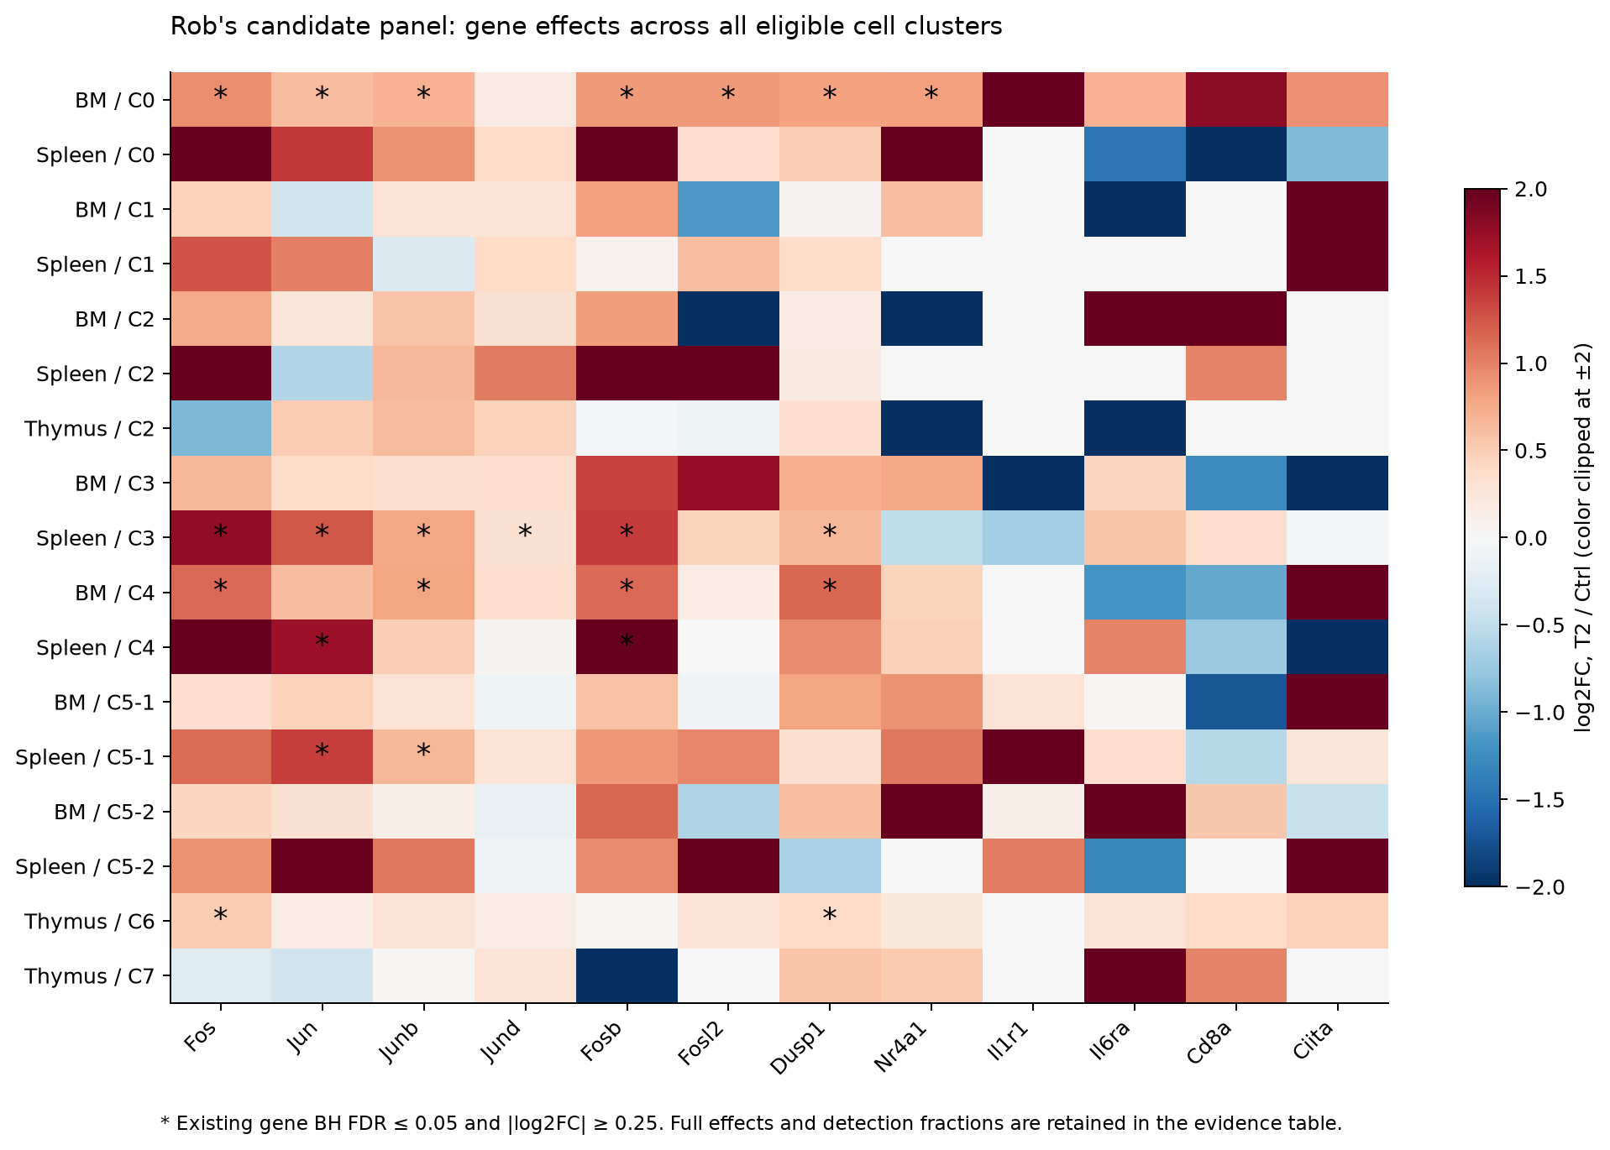
Rob's candidate genes across every eligible cluster
log2FC T2 / Ctrl; * = gene BH FDR ≤ 0.05 and |log2FC| ≥ 0.25
Reading
AP-1 family (Fos, Jun, Junb, Fosb, Fosl2) and Dusp1 rise in T2 in BM C0 and spleen C3
Same direction, fewer passing genes, in BM C4, spleen C4 / C5-1, thymus C6
Il1r1, Il6ra, Cd8a, Ciita: large colours but no FDR support — sparse detection
Exploratory cell-level results · 3 mice pooled per tissue × condition label (n = 1 pool)
22
Notes:
Rows are tissue by cluster, columns are the genes Rob named. Red means higher in T2. Stars mark genes that pass the same DE rule as before. The AP-1 block is consistent in BM C0 and spleen C3. Some of the non-AP-1 genes Rob mentioned show strong colours but these come from very few expressing cells and do not pass FDR, so we do not list them as significant.

Slide 4
AP-1 complex is enriched; MAPK cascade is not
GO:0035976 'transcription factor AP-1 complex' — T2-up genes, exact GO ID (not 'AP-1 adaptor complex')
BM C0
Spleen C3
MAPK
q = 0.0029
q = 0.0023
q = 1
global FDR (family 0.00026)
global FDR (family 0.00019)
GO 'MAPK cascade', BM C0
Fos · Fosl2 · Jun · Junb
Fos · Jun · Junb · Jund
KEGG MAPK: q = 0.078 (legacy rule), not significant under the robust rule
Supports an AP-1 transcriptional programme in T2 — not protein activation or DNA binding
AP-1 enrichment should not be used to relabel MAPK as significant; p-ERK / p-p38 would be the bench test
Only 6 genes annotate the AP-1 complex, so this is a focused, small-term result
Exploratory cell-level results · 3 mice pooled per tissue × condition label (n = 1 pool)
23
Notes:
This is the strongest new result. The AP-1 complex term is enriched among T2-up genes in both BM C0 and spleen C3, and survives the global correction across all comparisons. However, the MAPK cascade term itself is not significant. So the honest statement is: an AP-1 transcriptional response in T2, consistent with Rob's bench experience, while MAPK activation remains to be tested at the protein level.

Slide 5
AP-1 genes keep their direction after QC matching
Mean log1p expression difference (T2 − Ctrl) in the full data; all 20 QC-matched resamples agree in direction
20 / 20
resamples same direction for every gene shown
Ctrl and T2 matched on QC metrics (max SMD ≈ 0.06)
Rules out a simple QC-depth artefact
Cannot separate niche biology from dissociation / processing time
Exploratory cell-level results · 3 mice pooled per tissue × condition label (n = 1 pool)
24
Notes:
Rob pointed out that some signals may just reflect the stressful tumour environment. Immediate-early genes like Fos and Jun are also known to rise with dissociation. Matching cells on QC metrics does not change the direction, which rules out a sequencing-depth artefact, but it cannot tell niche biology from processing effects. Processing records per sample would help.

Slide 6
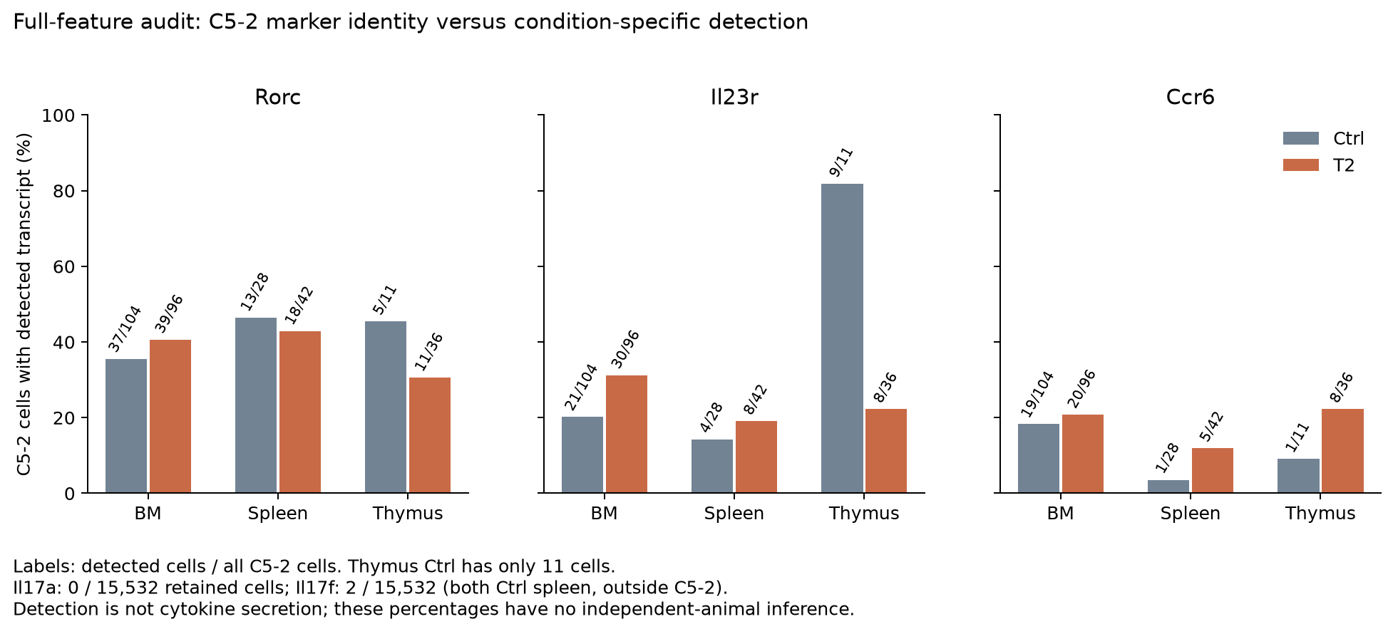
iNKT17: identity markers in C5-2, but no IL-17 transcript
Re-read all 32,285 features from the six raw matrices to recover genes dropped by the min_cells filter
60
retained cells express Ccr6
54
of these are in C5-2
0
cells with Il17a
Ccr6 was missing only because of the min_cells = 100 filter (92 raw cells), not absent from the data
Rorc / Il23r / Ccr6 support an iNKT17 identity for C5-2; Il17f in 2 cells, both outside C5-2
Transcript detection ≠ secretion: IL-17 capacity needs stimulation assays; thymus Ctrl C5-2 has only 11 cells
Exploratory cell-level results · 3 mice pooled per tissue × condition label (n = 1 pool)
25
Notes:
Rob highlighted the Th17-like signature. Rorc and Il23r were already there; Ccr6 had been filtered out and is now recovered, with almost all expressing cells in C5-2. Il17a and Il17f are essentially undetected, which is typical for unstimulated cells, so we cannot comment on IL-17 secretion. That is exactly the kind of thing Rob's stimulation experiments can answer.

Slide 7
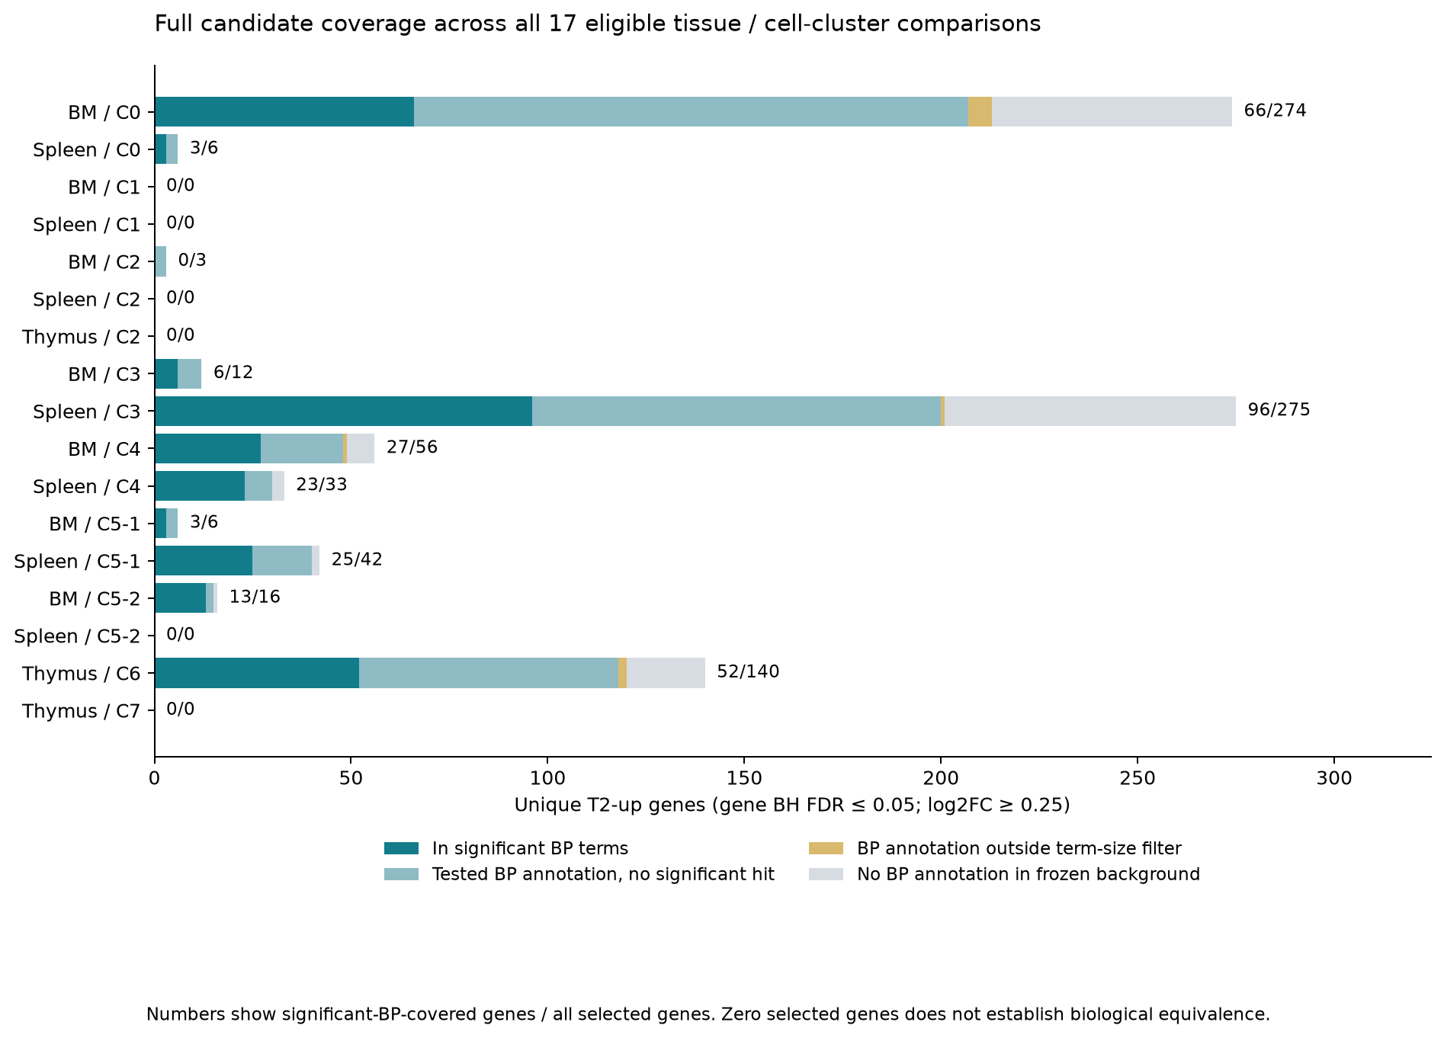
Most T2-up genes are not explained by significant GO terms
Yue: look past the top genes — coverage of every selected candidate (gene BH FDR ≤ 0.05, log2FC ≥ 0.25)
66 / 274
BM C0 T2-up genes inside 52 significant BP terms
96 / 275
Spleen C3
Many terms reuse the same genes
Uncovered genes stay in the full tables for follow-up
Exploratory cell-level results · 3 mice pooled per tissue × condition label (n = 1 pool)
26
Notes:
For each comparison, the bar is all selected T2-up genes. Dark teal is genes inside at least one significant biological-process term. In BM C0 only 66 of 274 genes are covered: the 52 significant terms reuse the same genes. Light grey genes have no BP annotation at all. This is why grouping terms, rather than listing them, is useful.

Slide 8
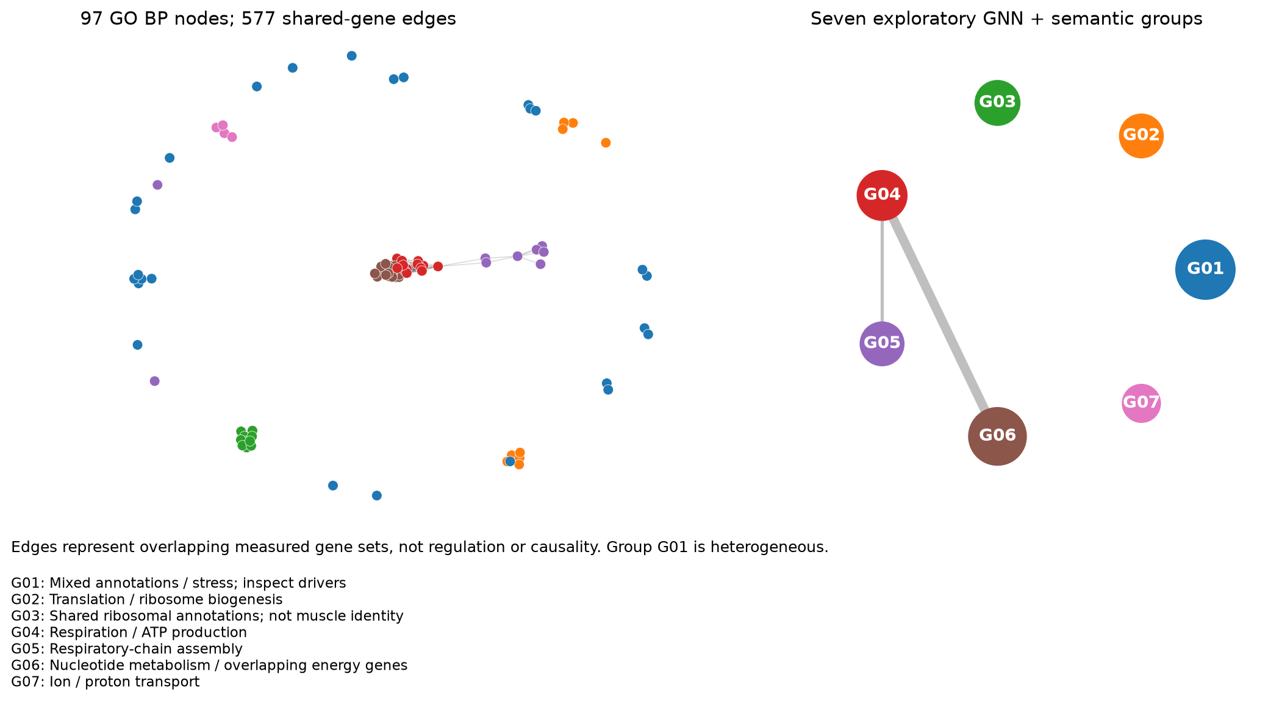
Grouping GO terms into functional modules
97 significant BP terms · edges = shared measured genes (Jaccard) · GOLDEN-style fusion + 3 GraphSAGE seeds
G02 / G03
Translation, ribosome
G04 / G05 / G06
Respiration, ATP, OXPHOS
G07
Ion / proton transport
G01
Mixed — inspect drivers
Semantic / GNN agreement ARI 0.91 / 0.80. Mouse GO adaptation of GOLDEN — not a full reproduction of the published model; edges are shared genes, not regulation.
Exploratory cell-level results · 3 mice pooled per tissue × condition label (n = 1 pool)
27
Notes:
Following Yue's suggestion we built a network of the significant GO terms, linked when they share genes, then grouped them with a GOLDEN-style fusion of term descriptions and graph structure, plus three GraphSAGE runs. Seven groups emerge. Labels like 'synapse' or 'muscle' appear inside ribosome groups because they share ribosomal genes; they are not iNKT functions.

Slide 9
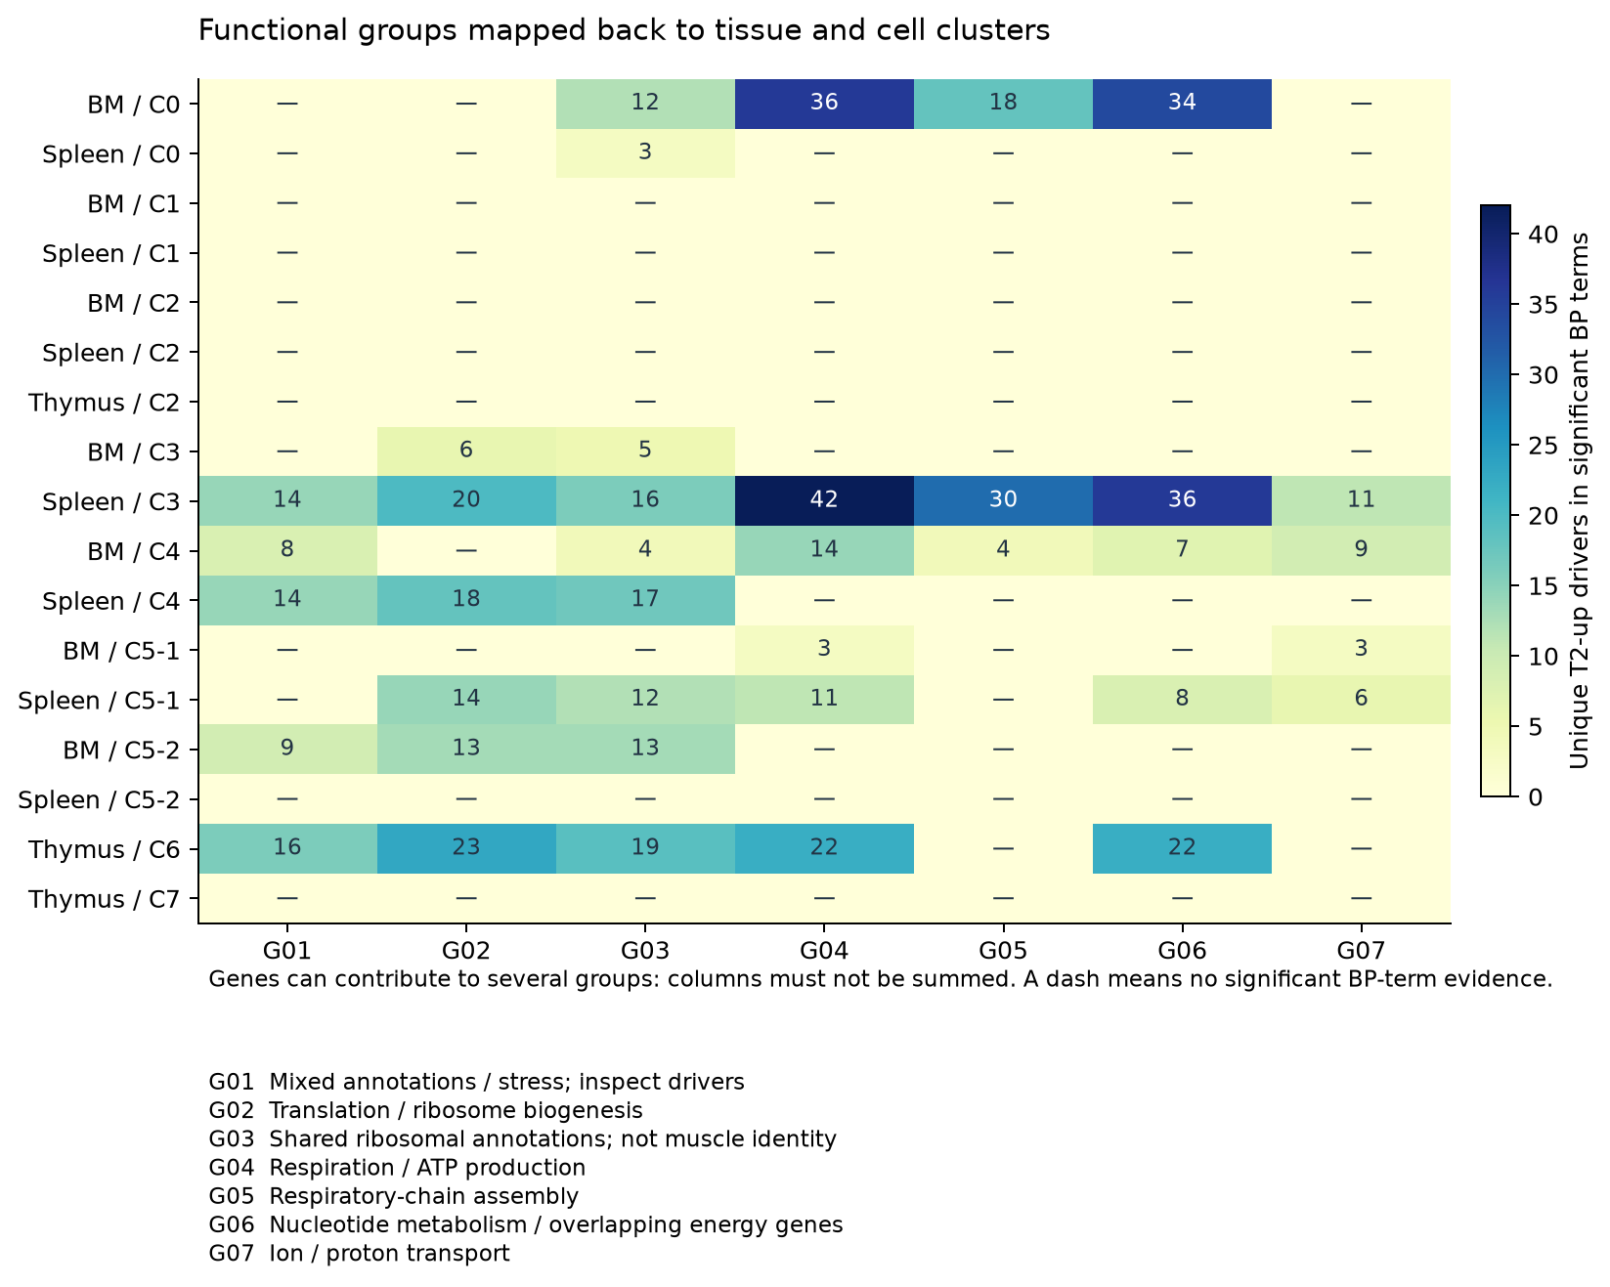
BM C0 and spleen C3 carry energy-metabolism groups
Unique T2-up driver genes per functional group; dash = no significant evidence
Ribosome / chaperone exclusion test
After removing Rpl / Rps / Hsp / Dnaj genes, OXPHOS stays enriched in BM C0 (29 genes: Atp5, Cox, Nduf, Uqcr). Cytoplasmic translation and protein folding drop out.
BM C0 and spleen C3 load on respiration / OXPHOS groups (G04–G06)
Thymus C6, BM C5-2, spleen C4 are dominated by ribosome groups — consistent with Rob's 'stressed cell' reading
OXPHOS is a supplementary lead, below AP-1 and iNKT17 in priority
Exploratory cell-level results · 3 mice pooled per tissue × condition label (n = 1 pool)
28
Notes:
Mapping groups back to clusters: BM C0 and spleen C3, the same populations with the AP-1 signal, also carry respiration and ATP-production groups. When we remove ribosomal and chaperone genes, the OXPHOS enrichment remains while translation and folding disappear, so the energy signal is not an artefact of the stress genes Rob warned about. We keep it as a supplementary lead.

Slide 10
Putting it together with the cytotoxicity results
Same populations, different readouts — candidates for the bench
Population | AP-1 (this section) | Cytotoxic core (Prf1/Gzma/Gzmb) | Other
BM C0 | Enriched, q = 0.003 | n.s. | OXPHOS up; MAPK n.s.
Spleen C3 | Enriched, q = 0.002 | Down, Δ −0.023, q = 0.0015 | CCT / folding down in T2
BM C4 | Fos / Junb / Fosb / Dusp1 up | Up, Δ +0.086, q = 0.025 | Tcf7 / Itga4 / Emb down
C5-2 | — | n.s. | iNKT17 identity; IL-17 undetected
Spleen C3 is the interesting case: AP-1 transcription up while the cytotoxic core goes down. Whether activation and effector function diverge needs protein / killing readouts in matched cells — no causal claim from RNA.
Exploratory cell-level results · 3 mice pooled per tissue × condition label (n = 1 pool)
29
Notes:
Combining this section with the cytotoxicity slides: spleen C3 shows an AP-1 increase together with a small decrease in the Prf1/Gzma/Gzmb core. BM C4 shows the opposite pattern for cytotoxicity. These are candidates for experiments; the RNA alone does not show that AP-1 changes killing.

Slide 11
Proposed questions for the bench
Discussion list — not experiments already done; unit of analysis = independent animal or pool
A
AP-1 in BM C0 / spleen C3
B
iNKT17 (C5-2)
Sortable phenotype → AP-1 protein, p-ERK / p-p38 with and without standard stimulation
Separate identity, abundance and per-cell IL-17 secretion; align with existing IL-17 assays
C
AP-1 vs effector function
D
Energy metabolism (supplementary)
Spleen C3 and BM C4: degranulation / killing readout in the same phenotype
Mitochondrial / metabolic readouts if cell numbers allow
Exploratory cell-level results · 3 mice pooled per tissue × condition label (n = 1 pool)
30
Notes:
These are questions for Rob's team to choose from, ordered by priority. A and B follow directly from Rob's comments; C connects to the cytotoxicity analysis; D is a supplementary lead from the GO network.

Slide 12
What we need next
Items that block the next analysis or validation stage
Sample metadata
Which 3 mice form each label; any independent pools; T2 time point, dissociation time, sequencing batch
IL-17 assay details
Cell source, gating, stimulation, time point and replicates of existing experiments
AML NK / patient data
Box access; species, disease / control definitions, NK-only vs whole marrow, FASTQ
RNA velocity
FASTQ → spliced / unspliced counts (current DPT is ordering only, not velocity)
Exploratory cell-level results · 3 mice pooled per tissue × condition label (n = 1 pool)
31
Notes:
To move from exploratory cell-level results to animal-level conclusions we need the pool composition and processing records. For the new directions Rob offered, we need Box access to the AML datasets and FASTQ files, which also enable RNA velocity.

