Slide 1
Pathway network drill-down
GO MF + full KEGG network, anchor grouping, and gene-level bridges between AP-1, MAPK, IL-17 and TCR
Answering Yue's question of 29 Sept · analysis of 30 Sept 2026 · no new data, no recomputation of DE
Notes:
Continues the numbering after the 25 Sept deck (slides 20-31). Source: 2026-09-30/README.md. This section answers Yue's question of 29 Sept: do the anchor pathways (AP-1, MAPK, IL-17, TCR, TNF) group together in a functional network, and what is the gene-level basis if they do?

Slide 2
What Yue asked on 29 Sept, and what we did
Same DE tables (20 eligible comparisons) and frozen GO; KEGG_2019_Mouse added
Request | Done
Add GO MF and the full KEGG | ORA on GO BP, GO MF, KEGG; term size 5–500; BH within comparison × direction × source
Keep every significant term | All terms with q ≤ 0.05 and ≥ 3 hit genes enter the network (no top-N cut)
Mixed-source network | GO BP / MF and KEGG nodes in one graph; edges = Jaccard ≥ 0.25 and ≥ 3 shared genes
Encode significance and group | Node size = best −log10 q; colour = group (GNN + semantic)
Do anchors group together? | Louvain, semantic, GOLDEN fusion, GNN + semantic; k by silhouette (2–15)
Go below pathway level | Gene-level drill-down and an interactive HTML explorer (pathway ↔ gene)
Not done: no new datasets, no ORA/GNN/DE recomputation for the drill-down; no STRING/PPI edges.
Exploratory cell-level results · 3 mice pooled per tissue × condition label (n = 1 pool)
33
Notes:
Sources: 2026-09-30/README.md ('What was done', 'Drill-down'). ORA reuse check vs the 19 Sept GO results agreed term by term (results/tables/ORA_reuse_check_vs_0919.csv; 312,550 rows, max q difference 1e-16). Yue's request is paraphrased from the 29 Sept discussion.

Slide 3
Three design choices to agree on
All are visible in the figure legends and can be toggled in the HTML explorer
1. Primary version excludes ribo / mito / Hsp
2. Fixed anchor nodes
3. Redundancy collapse
Regex ^(Rp[ls]\d|Rplp\d|Rpsa$|Mrp[ls]\d|mt-|Hsp(?!g)|Dnaj) removes 242 of 10,670 genes from both query and background. Rps6k* kinases and Hspg2 are kept. Version (a) with all genes is kept for comparison.
12 anchors are always drawn, even if not significant: KEGG MAPK, IL-17, TCR, Th17, TNF; GO AP-1 complex, MAPK / ERK / p38 / JNK cascades, Th17 response, IL-17 production. Anchors are never merged into other nodes.
Non-anchor terms with Jaccard ≥ 0.75 to a more significant term are merged, so near-identical GO terms do not inflate the graph. Merged members stay listed in node_attributes.
Exploratory cell-level results · 3 mice pooled per tissue × condition label (n = 1 pool)
34
Notes:
Sources: README.md 'What was done'; code/common.py (EXCL_REGEX, ANCHOR_KEGG, ANCHOR_GO); results/network/network_summary.json (242/10,670 excluded genes is from README; anchors n_anchor_nodes = 12); results/tables/redundancy_merges_excl.csv. The exclusion is the primary version because ribosomal, mitochondrial-encoded and heat-shock genes are the classic dissociation / QC signature; Rob raised this on 24 Sept.

Slide 4
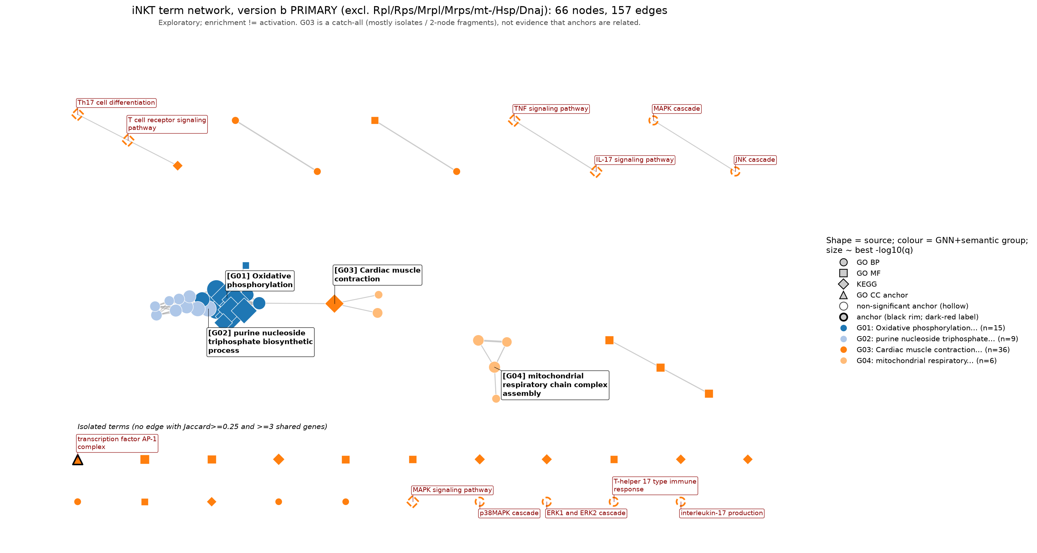
The network (primary version b)
66 nodes, 157 edges after excluding ribo / mito / Hsp genes
Counts
Version b: 94 → 66 nodes after collapse, 157 edges, 21 isolated nodes
Version a (all genes): 159 → 112 nodes, 231 edges, 32 isolated
Groups b (Louvain / semantic / GOLDEN / GNN + semantic): 31 / 15 / 3 / 4
One large connected block is energy metabolism; anchors are mostly isolated nodes
Exploratory cell-level results · 3 mice pooled per tissue × condition label (n = 1 pool)
35
Notes:
Sources: results/network/network_summary.json (excl: n_nodes_before_collapse 94, n_nodes 66, n_edges 157, n_isolates 21; all: 159, 112, 231, 32); README.md key-number table for group counts (a: 49/15/2/15; b: 31/15/3/4). Figure: drilldown/figures/network_full_b_primary_excl_ribo_mito_hsp_v2.png (label-avoidance version of the 09-30 figure; labels no longer overlap each other, a few still sit on the dense energy cluster).

Slide 5
The significant core is energy metabolism
It survives the exclusion: six strongest terms, version b (ribo / mito-encoded / Hsp genes already removed)
OXPHOS / ATP synthesis / respiratory chain terms dominate; the driver genes are nuclear-encoded (Ndu*, Cox*, Atp5*, Uqcr*)
Strongest in BM C0 and Spleen C3 (T2-up); BM and spleen C5-2 have no significant term
Honest framing: energy metabolism is not new for the bench, but it is a broader signal than the G01 stress program (ribo / Hsp) from 25 Sept
Enrichment of a large, well-annotated pathway is not evidence of increased activity
Exploratory cell-level results · 3 mice pooled per tissue × condition label (n = 1 pool)
36
Notes:
Sources: results/tables/node_attributes_excl.csv (best_q: 1.68e-26, 1.32e-24, 2.85e-23, 1.09e-20, 3.94e-20, 6.82e-19; chart shows -log10 of these). Group L01/G01 in results/tables/group_summary_excl.csv. Comparison statements about C0/C3 and C5-2: README.md ('热图显示...') and drilldown/tables/pathway_drill_summary.csv (Energy module DEG counts BM C0 31, Spleen C3 36, BM C5-2 1). Note that Parkinson disease is a KEGG term that is essentially a respiratory-chain gene list here.

Slide 6
Anchors: only AP-1 is significant
Best q across comparisons, version b (BH within comparison × direction × source)
Anchor | Best q | Measured genes | Significant?
GO AP-1 complex (GO:0035976) | 1.7e-4 | 6 | Yes: BM C0, Spleen C3
KEGG IL-17 signaling | 0.071 | 51 | Trend only
KEGG TNF signaling | 0.56 | 78 | No
KEGG MAPK signaling | 0.64 | 159 | No
KEGG TCR, KEGG Th17, GO MAPK / ERK / p38 / JNK, GO Th17 response | 1.0 | 16–114 | No
GO interleukin-17 production | n/a | 0 | No measured genes in frozen annotation
AP-1 is the only anchor with statistical support, and it rests on five genes: Fos, Fosl2, Jun, Junb, Jund. MAPK is not enriched among T2-up genes even though 23 of its members are DE (next slides).
Exploratory cell-level results · 3 mice pooled per tissue × condition label (n = 1 pool)
37
Notes:
Source: results/tables/anchor_by_method_excl.csv (best_q, n_measured_genes: AP-1 0.000170, 6 genes; IL-17 0.0712, 51; TNF 0.561, 78; MAPK 0.636, 159; GO MAPK cascade 1.0, 114; JNK 30; p38 22; ERK 22; Th17 response 16; TCR 92; Th17 KEGG 79; IL-17 production no q, 0 measured genes). The AP-1 members in the hit list are from README.md. The '16-114' range covers the GO anchors, TCR (92) and Th17 (79).

Slide 7
Do the anchors group together? At pathway level: it depends
Group of each anchor by method, version b (letter + number = group id)
Anchor | Louvain | Semantic | GOLDEN fusion | GNN + semantic
AP-1 complex | L05 | S11 | F03 | G03
IL-17 signaling | L25 | S14 | F03 | G03
MAPK signaling | L26 | S15 | F03 | G03
TCR signaling | L17 | S09 | F03 | G03
Th17 differentiation | L17 | S14 | F03 | G03
TNF signaling | L25 | S09 | F03 | G03
k-sensitivity (GNN + semantic)
k ≤ 6: all anchors in one group (k chosen by silhouette = 4)
k ≥ 7: MAPK separates from AP-1 / IL-17 / TCR
Semantic-only separates them already at k ≥ 5
Version a at k = 15: AP-1, MAPK, and IL-17 / TCR are three separate places
Louvain and semantic scatter them; GOLDEN and GNN at the silhouette k put all in G03, a 36-node catch-all of isolates and 2-node fragments.
Honest message: the question cannot be answered at pathway level. Co-grouping reflects k and method, not biology.
Exploratory cell-level results · 3 mice pooled per tissue × condition label (n = 1 pool)
38
Notes:
Sources: results/tables/anchor_by_method_excl.csv (overlap_louvain, semantic_only, golden_fusion, gnn_semantic columns); results/tables/anchor_k_sensitivity_excl.csv (gnn_semantic rows: AP1_with_MAPK True for k=2..6, False for k>=7; silhouette peak at k=4, 0.261; semantic_only False from k=5); version a statement from README.md. G03 composition: results/tables/group_summary_excl.csv. Therefore the co-grouping in the primary version is not evidence of a functional relationship.

Slide 8
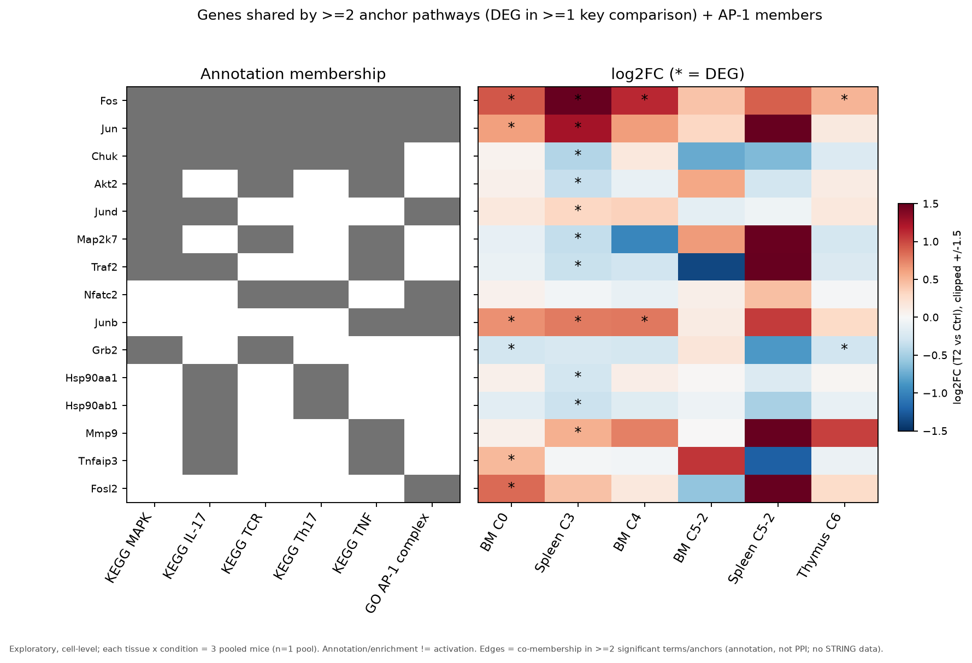
Gene level: only Fos and Jun bridge the anchors
Genes in ≥ 2 anchor pathways and DE in ≥ 1 key comparison, plus AP-1 members (* = DEG)
Fos and Jun (plus Junb / Jund) are the only DE-driven bridge between AP-1 and all KEGG anchors; up in BM C0, Spleen C3, BM C4
Other shared genes are non-DE scaffolds: Mapk1 / 3 / 14, Nfkb1, Rela, Ikbkb
Chuk, Traf2, Akt2, Map2k7, Grb2 go down in Spleen C3
Fosb, Dusp1, Nr4a1, Egr1 are strongly DE but do not bridge (Fosb only IL-17; Dusp1 / Nr4a1 only MAPK)
The energy module shares 0 genes with AP-1 and 0–3 non-DE genes with each KEGG anchor
Exploratory cell-level results · 3 mice pooled per tissue × condition label (n = 1 pool)
39
Notes:
Sources: drilldown/tables/anchor_bridge_genes.csv (AP-1 vs each KEGG pathway share 3 genes: Fos/Jun + Jund, Junb or Nfatc2; energy module vs AP-1 0 shared, vs KEGG 0-3, none DEG), drilldown/tables/bridge_candidate_genes.csv (per-gene log2FC/FDR in six key comparisons; Fos BM C0 +0.93, Spleen C3 +1.78; Fosb and Dusp1 / Nr4a1 pathway membership), drilldown/figures/bridge_genes_heatmap_v2.png (v2 adds a log2FC colour bar and moves the footer; original kept). Spleen C5-2 columns show large log2FC without significance; BM and spleen C5-2 have no DEG in any drilled set. Direction of Chuk / Traf2 / Akt2 / Map2k7 / Grb2 down in Spleen C3 is from README.md and the heatmap.

Slide 9
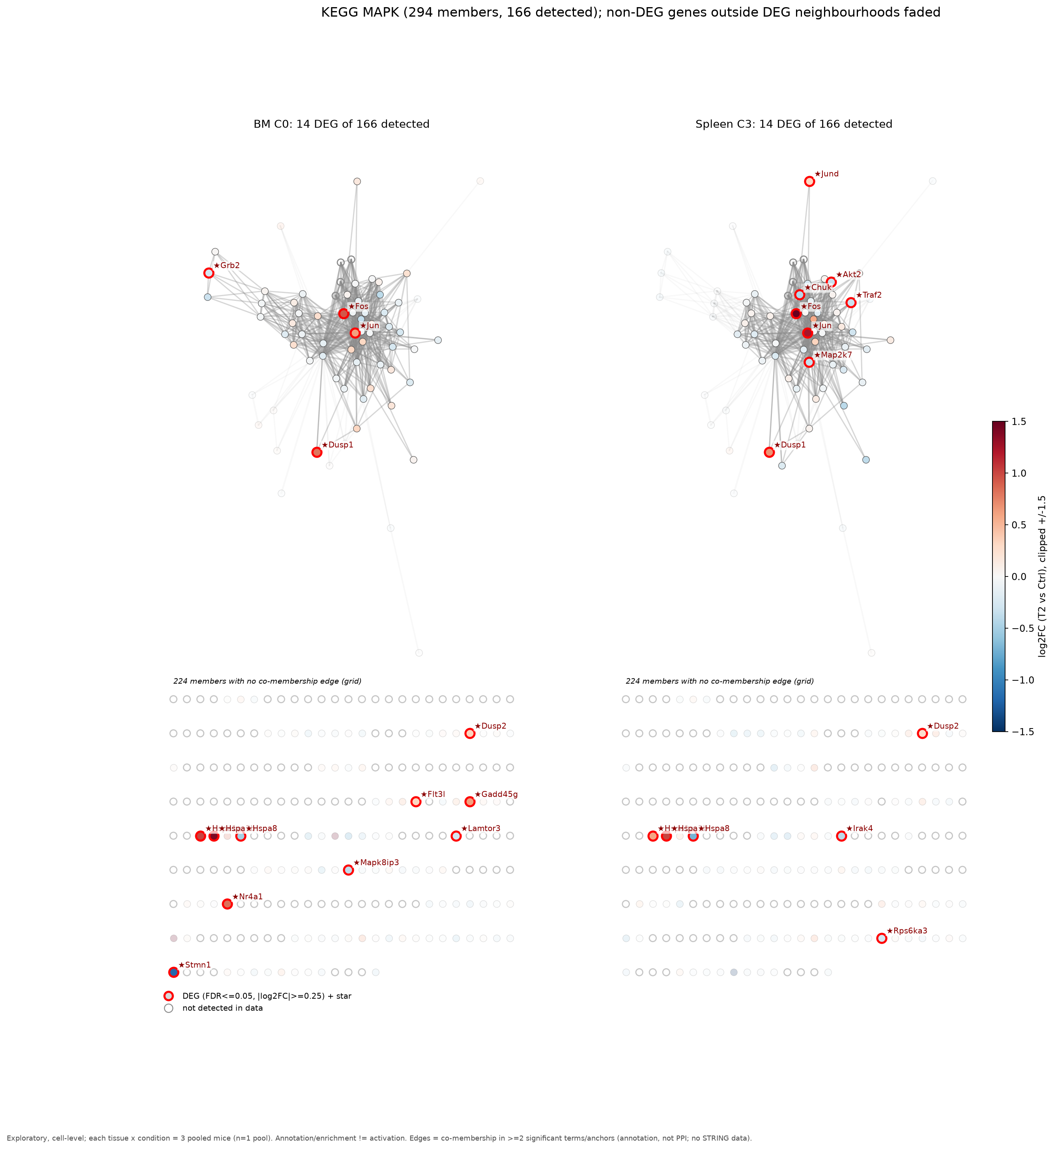
Drill-down example: KEGG MAPK signaling
294 annotated members · 166 detected in the data · 23 DEG in at least one key comparison
Comparison | DEG among MAPK members
BM C0 | 14
Spleen C3 | 14
BM C4 | 6
BM C5-2 | 0
Spleen C5-2 | 0
Thymus C6 | 7
Red-boxed stars = DEG; grey hollow = not detected (128 members); panels show BM C0 and Spleen C3
The 23 DEG mix immediate-early genes (Fos, Jun, Jund, Dusp1/2, Nr4a1, Gadd45g) with a few signalling genes (Chuk, Traf2, Map2k7, Grb2, Akt2); the core kinases (Mapk1/3/14) are not DE
Pathway-level q = 0.64: a few DEG among many unchanged members
Exploratory cell-level results · 3 mice pooled per tissue × condition label (n = 1 pool)
40
Notes:
Sources: drilldown/tables/pathway_drill_summary.csv (KEGG MAPK: n_members 294, n_detected 166, DEG BM C0 14, Spleen C3 14, BM C4 6, BM C5-2 0, Spleen C5-2 0, Thymus C6 7, DEG_any_key 23); figure drilldown/figures/gene_network_KEGG_MAPK.png; q = 0.636 from results/tables/anchor_by_method_excl.csv. 294 - 166 = 128 undetected. Note that the pathway-level q is computed per comparison and direction on the enrichment universe, so it is not directly derived from the 23 DEG count; treat that last bullet as an interpretation. Per-pathway figures for IL-17, TCR, Th17, TNF, AP-1 and the energy module are in drilldown/figures/.

Slide 10
GNN ablation: it adds little on a graph this small
Held-out edge prediction, mean of seeds 42 / 43 / 44
Cluster stability across seeds (ARI)
Seed pair | (a) all genes | (b) primary
42 vs 43 | 0.71 | 0.32
42 vs 44 | 0.62 | 0.55
43 vs 44 | 0.61 | 0.36
GNN AUC beats graph baselines by ~0.05 but on tiny test sets
In (b) the GNN grouping agrees with GOLDEN fusion (ARI 0.70) and is unstable across seeds (0.32–0.55)
Conclusion: on ~100 nodes the GNN adds little beyond common neighbours and is less stable; groups are exploratory
Test edges: 23 positive + 23 negative (a), 15 + 15 (b). AUC differences of ~0.05 on so few edges are within seed-to-seed noise.
Exploratory cell-level results · 3 mice pooled per tissue × condition label (n = 1 pool)
41
Notes:
Sources: results/tables/gnn_vs_baselines_all.csv and gnn_vs_baselines_excl.csv (AUC means over seeds 42/43/44 - all: GNN 0.973, semantic 0.840, common neighbours 0.922, Adamic-Adar 0.928; excl: 0.981, 0.723, 0.922, 0.922; n_test_pos 23 / 15); results/tables/ARI_across_gnn_seeds_all.csv (0.710, 0.623, 0.614) and ARI_across_gnn_seeds_excl.csv (0.325, 0.549, 0.364); GOLDEN-GNN ARI 0.70 in version b from README.md (results/tables/ARI_between_methods_excl.csv). Transductive link reconstruction on a small graph, not biological validation.

Slide 11
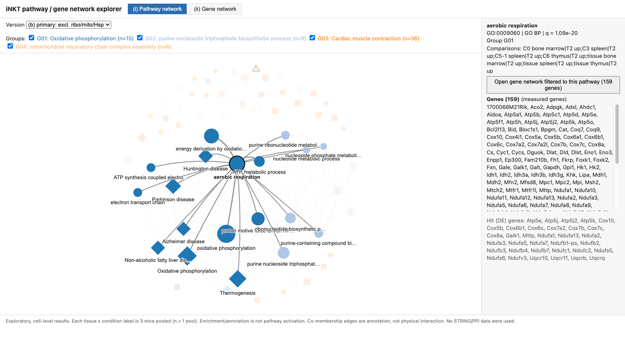
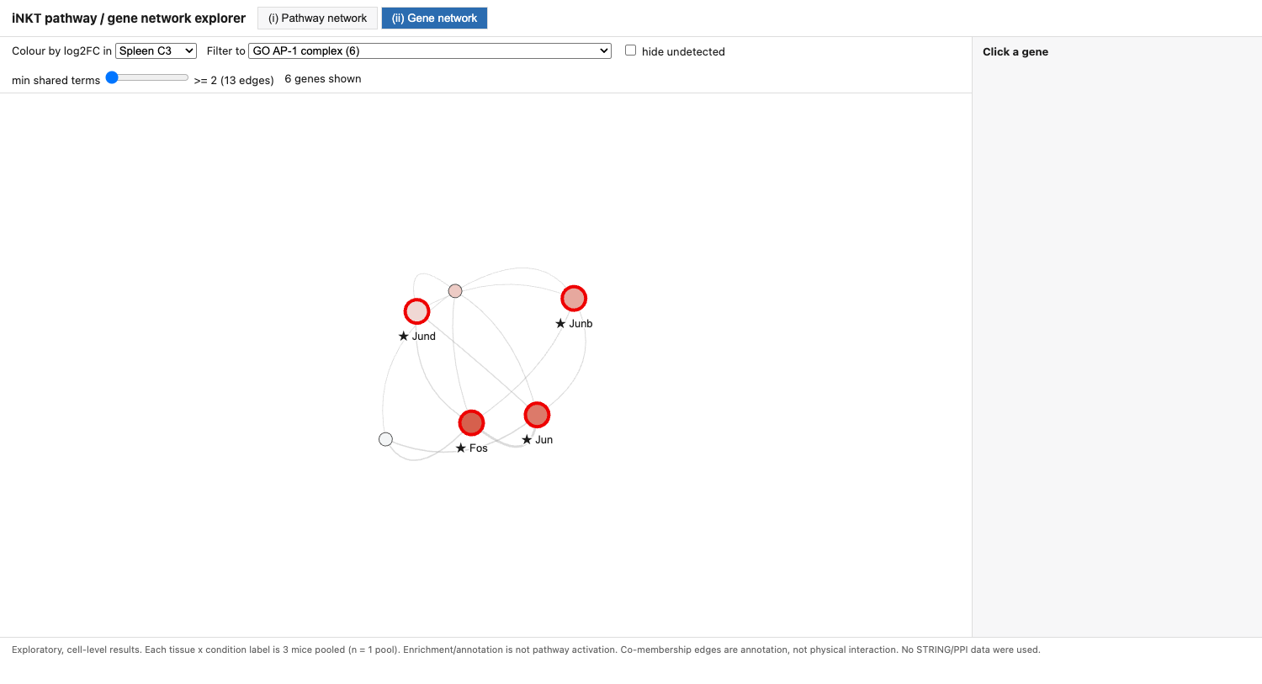
Interactive explorer
One HTML file: pathway network ↔ gene network
(i) Pathway view: click a node to highlight neighbours; anchor labels visible at load
(ii) Gene view: opened from the AP-1 node; stars = DEG in the chosen comparison
Open drilldown/html/inkt_network_explorer.html in a browser (needs internet: vis-network loads from a CDN); Esc or an empty click resets
Version a / b switch, group filters; button opens the gene view filtered to that pathway; comparison dropdown recolours genes by log2FC; slider sets minimum shared terms
Exploratory cell-level results · 3 mice pooled per tissue × condition label (n = 1 pool)
42
Notes:
Source: drilldown/html/inkt_network_explorer.html (built by drilldown/code/08_html.py from explorer_template.html); screenshots from headless-Chrome QA in drilldown/html/qa/ (terms_after_click_hub.png, genes_from_AP1.png). Tested: node click highlight and side panel, AP-1 and KEGG MAPK buttons open the filtered gene view (6 and 294 genes), comparison dropdown recolours, edge slider, Esc / empty click reset, no console errors. Fixes on 30 Sept: anchor labels were invisible at load (zoom too small), Esc did not reset. Not tested on Safari/Firefox or offline.

Slide 12
Interpretation and next steps
What the T2 signature is, and what would test it
Interpretation
Next steps
The T2 signature in BM C0 and Spleen C3 is an immediate-early / AP-1 (Fos–Jun) response
It could reflect niche activation in vivo or tissue dissociation stress; these data cannot separate the two
Pathway networks add no support for a linked MAPK–IL-17–TCR program; gene-level evidence is Fos / Jun only
Energy metabolism is the statistically strongest but least specific signal
Bench test (Rob): p-ERK, p-p38 and AP-1 (c-Fos / c-Jun) protein in sorted BM C0 and Spleen C3 iNKT cells, with dissociation controls (e.g. transcription-inhibitor during digestion)
Needed from the collaborators: pool metadata (mouse / batch per pool), the AML dataset, FASTQ for velocity
Until then all statements stay exploratory (n = 1 pool per label)
Exploratory cell-level results · 3 mice pooled per tissue × condition label (n = 1 pool)
43
Notes:
Sources: synthesis of slides 37-40; Fos/Jun direction and magnitude from drilldown/tables/bridge_candidate_genes.csv. The dissociation-stress vs niche-activation distinction and the proposed bench design are proposals for discussion, not results. No numbers on this slide are new.

