Slide 1
Statistical Inference & Hypothesis Testing
Slides by Jacob LaRiviere, Research Economist
(some content from Justin Rao)

Slide 2
Outline
Random Variables
What’s a statistic?
Sampling theory, IID assumptions and departures
Regression: linear and non-parametric

Slide 3
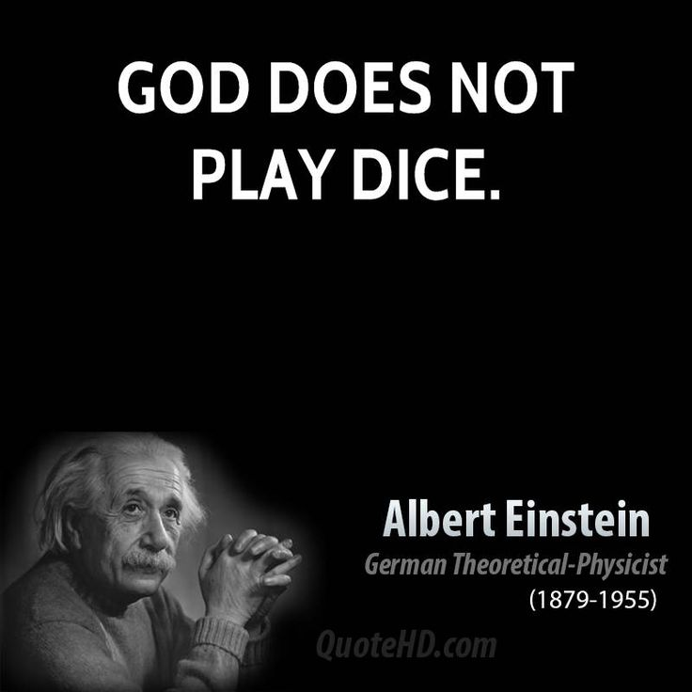
Random Variable
Definition: a random variable is the outcome of an experiment.
example: toss two dice. A random variable could be…
1) The sum of the two dice {2,3,…,12}
2) The difference of the two dice {0,1,…,5}
3) A one if it’s a pair, zero if its not {1,0}
4) The product of the two dice {1,2,…,25,30,36}
Set of things a random variable could be is called “the support”

Slide 4
What is a “random variable”
Deterministic: not influenced by chance
In measurement: every time you measure, you get the same answer.
In models: for same input, you always get same output. Ex. Planetary motion
Stochastic: there is some element of randomness
In measurement: every time you “measure”, you expect a different outcome
In models: the same input leads to different output. Ex. Identical twins tend can have different medical outcomes due to differential gene expression and different environment
In both cases: you cannot perfectly predict what will happen with stochasticity

Slide 5
Examples: deterministic vs. stochastic
Baseball: outcome (hit or not)
Stochastic: batting avg. gives probability of a hit. Batting avg. can be modeled for specific conditions (e.g. facing pitcher X, in ballpark Y, with conditions Z).
Subway: trip time between Station X and Station Y
Stochastic: delays lead to small departures from schedule
Weight of a randomly selected quarter
Technically stochastic: all quarters differ by microscopic amounts
Weight of a particular quarter
Deterministic: we don’t expect the weight of any given quarter to vary
Length of a day
Deterministic: although days are getting slightly longer, this can be predicted perfectly

Slide 6

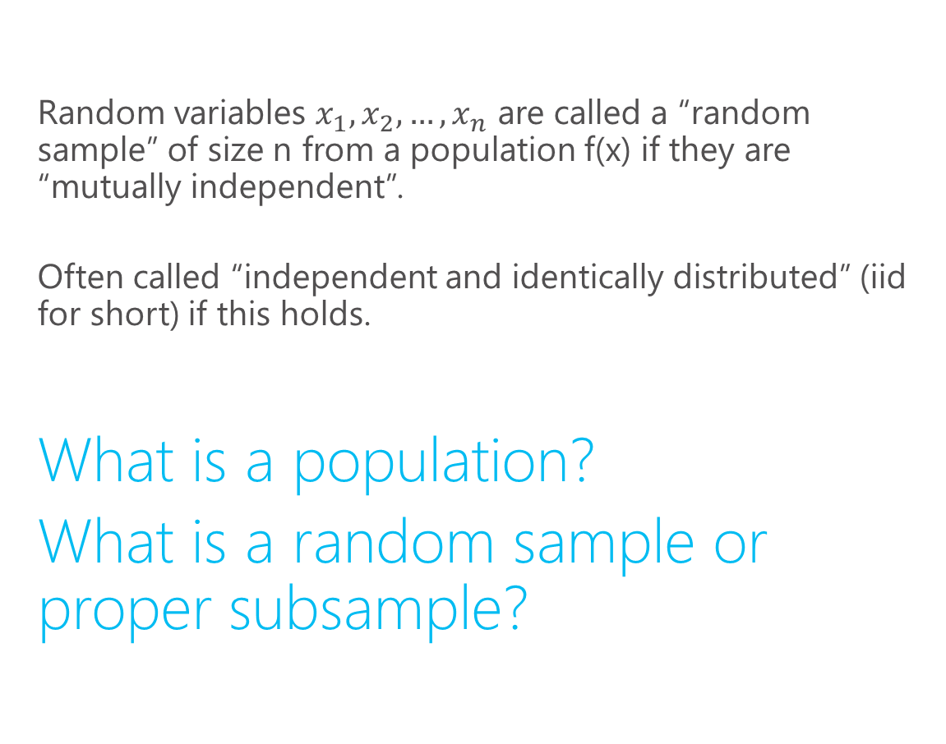
Random Variables
Random variables $x_{1}, x_{2}, …, x_{n}$ are called a “random sample” of size n from a population f(x) if they are “mutually independent”.
Often called “independent and identically distributed” (iid for short) if this holds.
What is a population?
What is a random sample or proper subsample?
Looks at these outfits. Wow.

Slide 7
Population vs. samples
Population: every object in a specified set
Set must be well-defined.
Ex: North Americans, all internet users, all lab rats with lymphoma, all high school students, all fair dice, etc.
Sample: a subset of the population selected in some way
http://students.brown.edu/seeing-theory/probability-distributions/index.html#section1
http://students.brown.edu/seeing-theory/basic-probability/index.html

Slide 8
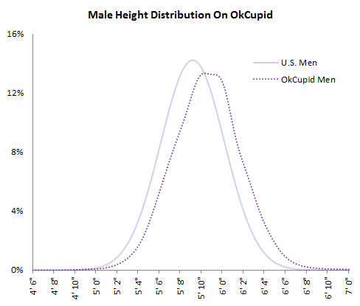
Ex. Population vs. samples
Population: height of everyone in US aged 18-65
Some samples:
Heights of instructors
Heights of all the ppl in this room
Stop people on street & measure.
Scrape male data from OkCupid
How do these samples differ from the population?

Slide 9
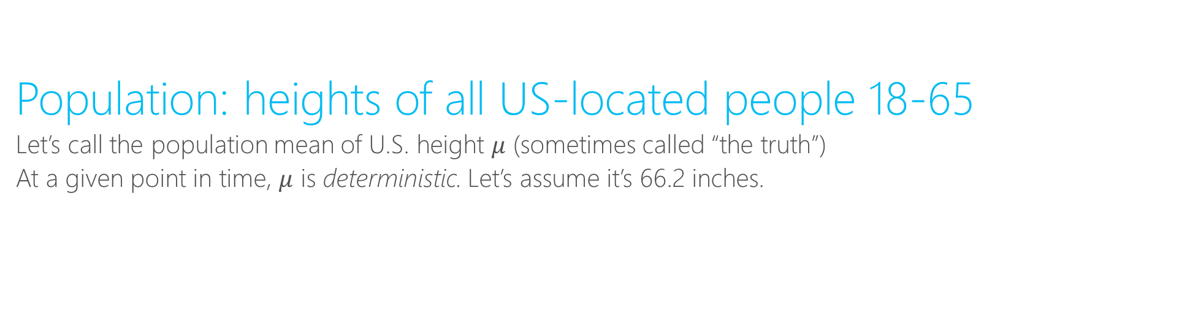
Population mean vs. sample mean
Population: heights of all US-located people 18-65
Let’s call the population mean of U.S. height $μ$ (sometimes called “the truth”)
At a given point in time, $μ$ is deterministic. Let’s assume it’s 66.2 inches.

Slide 10
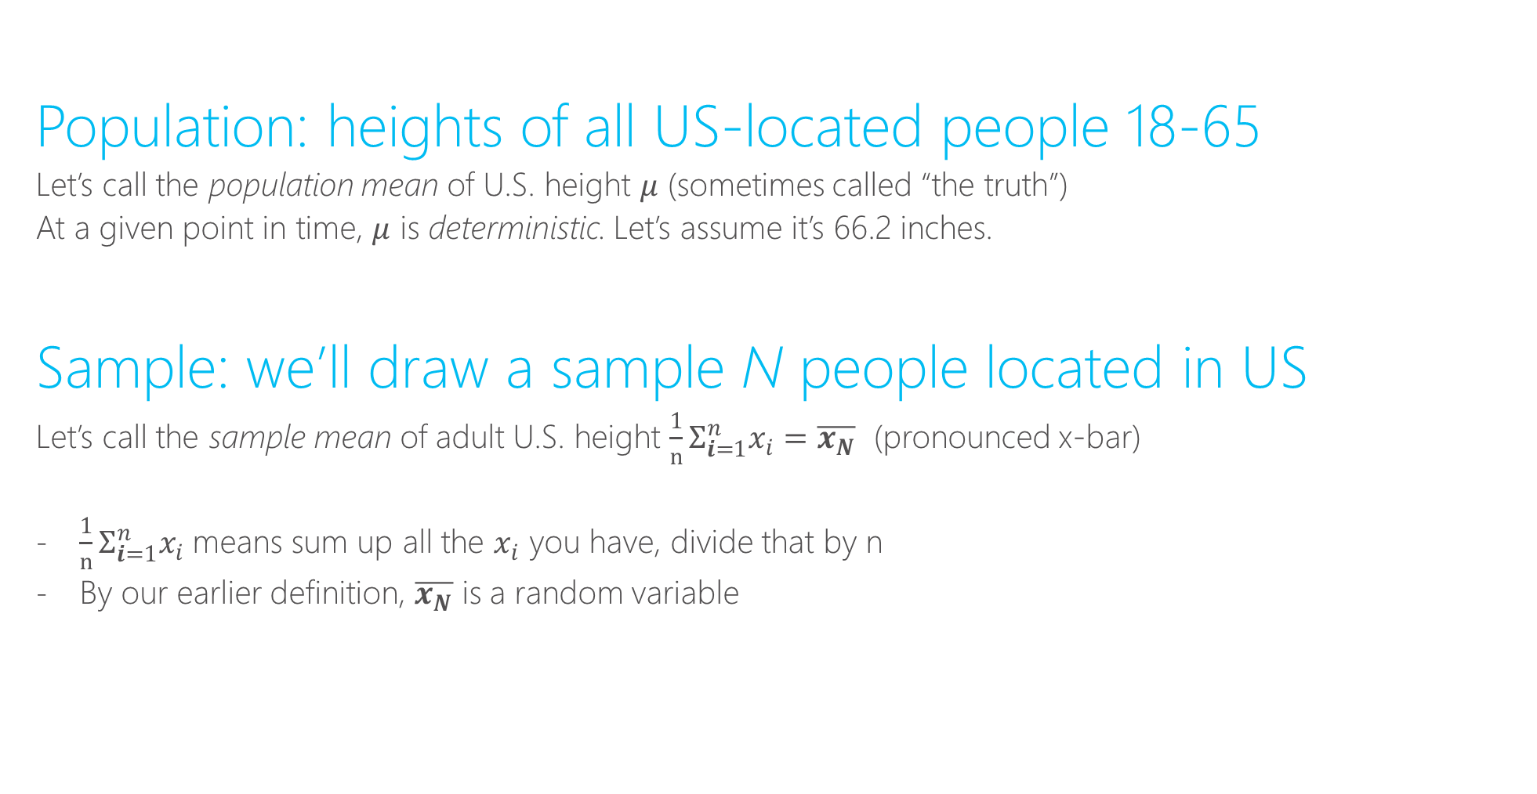
Population mean vs. sample mean
Population: heights of all US-located people 18-65
Let’s call the population mean of U.S. height $μ$ (sometimes called “the truth”)
At a given point in time, $μ$ is deterministic. Let’s assume it’s 66.2 inches.
Sample: we’ll draw a sample N people located in US
Let’s call the sample mean of adult U.S. height ${{\frac{1}{n}Σ}_{i=1}^{n}x}_{i}=\overline{x_{N}}$ (pronounced x-bar)
${{\frac{1}{n}Σ}_{i=1}^{n}x}_{i}$ means sum up all the $x_{i}$ you have, divide that by n
By our earlier definition, $\overline{x_{N}}$ is a random variable

Slide 11
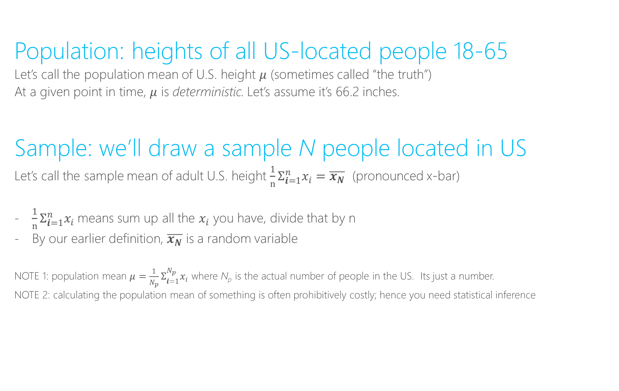
Population mean vs. sample mean
Population: heights of all US-located people 18-65
Let’s call the population mean of U.S. height $μ$ (sometimes called “the truth”)
At a given point in time, $μ$ is deterministic. Let’s assume it’s 66.2 inches.
Sample: we’ll draw a sample N people located in US
Let’s call the sample mean of adult U.S. height ${{\frac{1}{n}Σ}_{i=1}^{n}x}_{i}=\overline{x_{N}}$ (pronounced x-bar)
${{\frac{1}{n}Σ}_{i=1}^{n}x}_{i}$ means sum up all the $x_{i}$ you have, divide that by n
By our earlier definition, $\overline{x_{N}}$ is a random variable
NOTE 1: population mean $μ={{\frac{1}{N_{p}}Σ}_{i=1}^{N_{p}}x}_{i}$ where N_{p} is the actual number of people in the US. Its just a number.
NOTE 2: calculating the population mean of something is often prohibitively costly; hence you need statistical inference

Slide 12
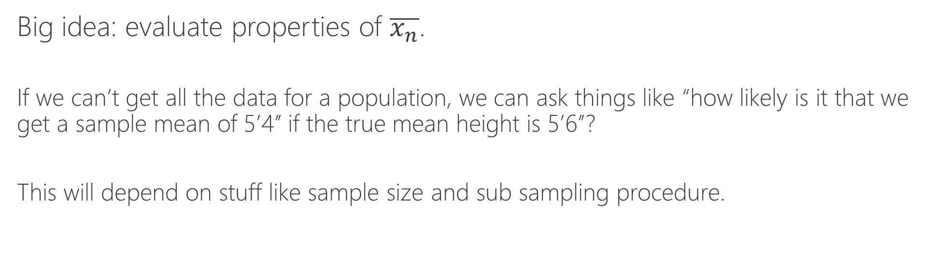
$\overline{x}$ is an estimator for $μ$
Big idea: evaluate properties of $\overline{x_{n}}$.
If we can’t get all the data for a population, we can ask things like “how likely is it that we get a sample mean of 5’4’’ if the true mean height is 5’6’’?
This will depend on stuff like sample size and sub sampling procedure.

Slide 13
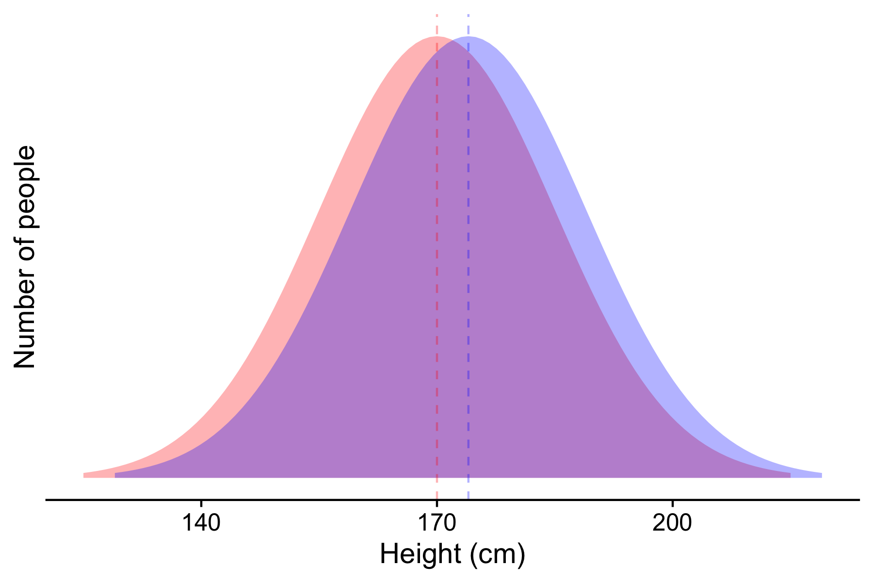
Cohen’s height example (1988)
Effect size: d = 0.27, Prob superiority = 57%
Imagine a full population where:
Average height for 15 year-olds is 170cm (standard deviation of 15 cm)
Average height for 16 year-olds is 174cm (standard deviation of 15 cm)
Cohen’s d = (174 – 170) / 15 = 0.27
57% chance a randomly selected 16 year-old is taller than a randomly selected 15 year-old (Probability of superiority)

Slide 14
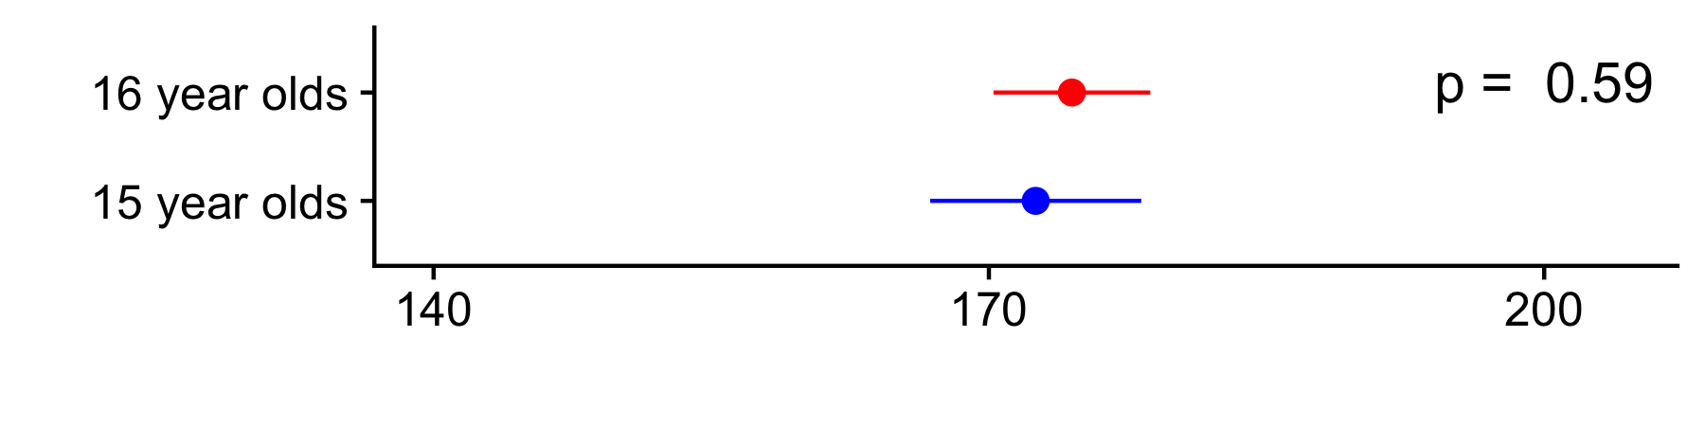
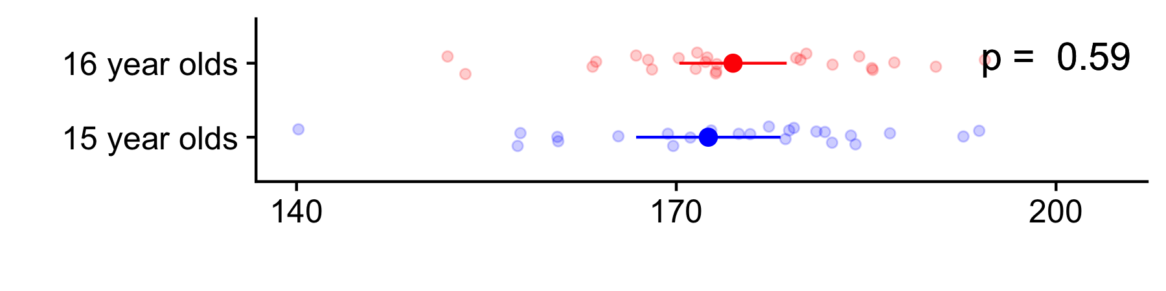
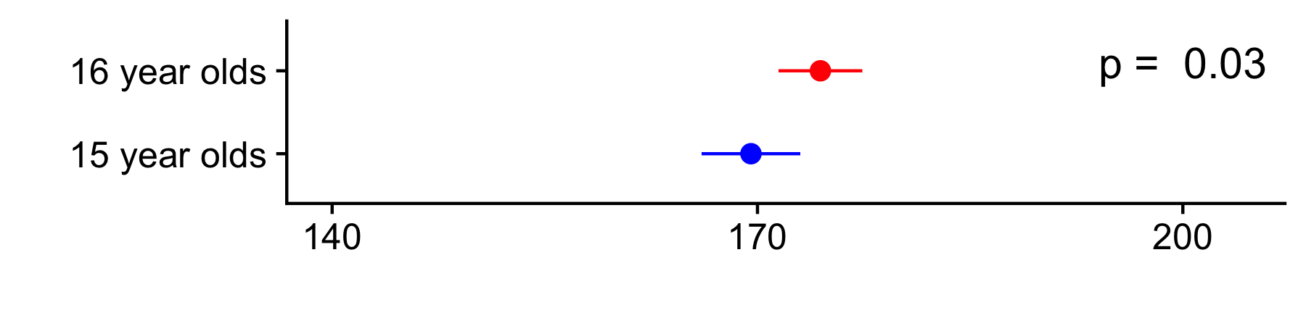
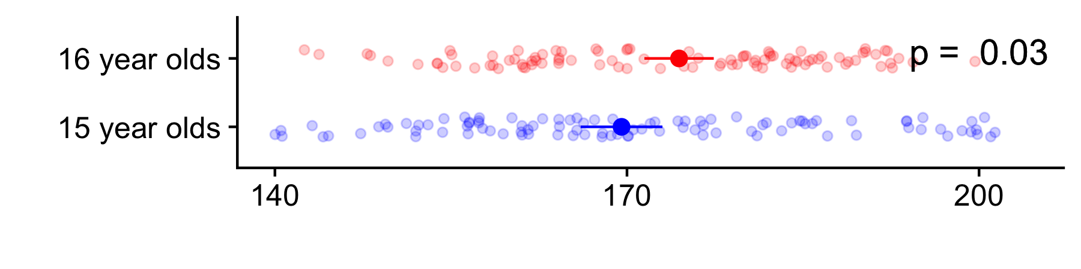
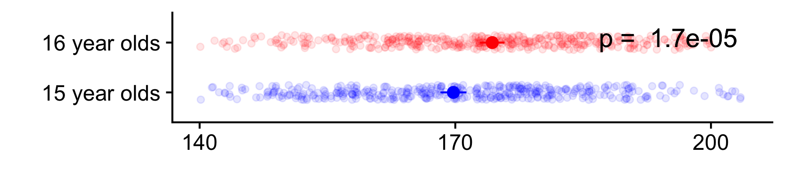
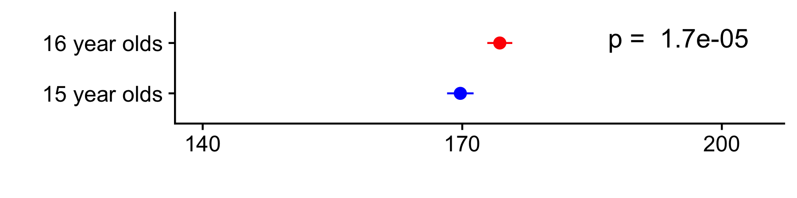
Cohen’s height example (1988)
Now randomly sample and estimate averages
Effect size: d = 0.27, Prob superiority = 57%
Sample 25
people
Standard errors and p-values decrease with more data despite
same underlying effect size
Sample 100
people
Sample 400
people
Bars show 95% CI (+/- two standard errors)
Notes:
Maybe we should put the t-stat here instead?
There’s something silly about the N = 10 sampling because we wouldn’t nail the means exactly …

Slide 15
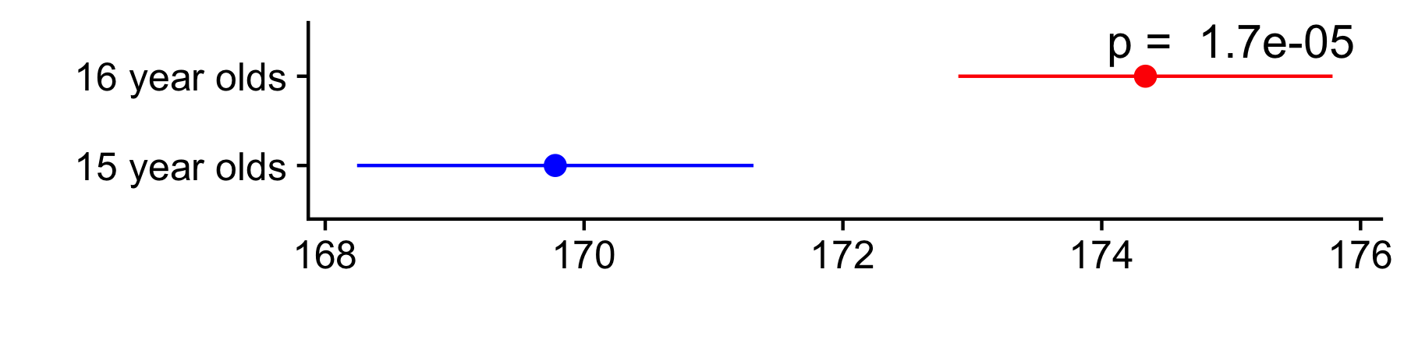
Cohen’s height example (1988)
What might a published paper show?
N = 400
VS.
Notes:
Maybe we should put the t-stat here instead?
There’s something silly about the N = 10 sampling because we wouldn’t nail the means exactly …

Slide 16
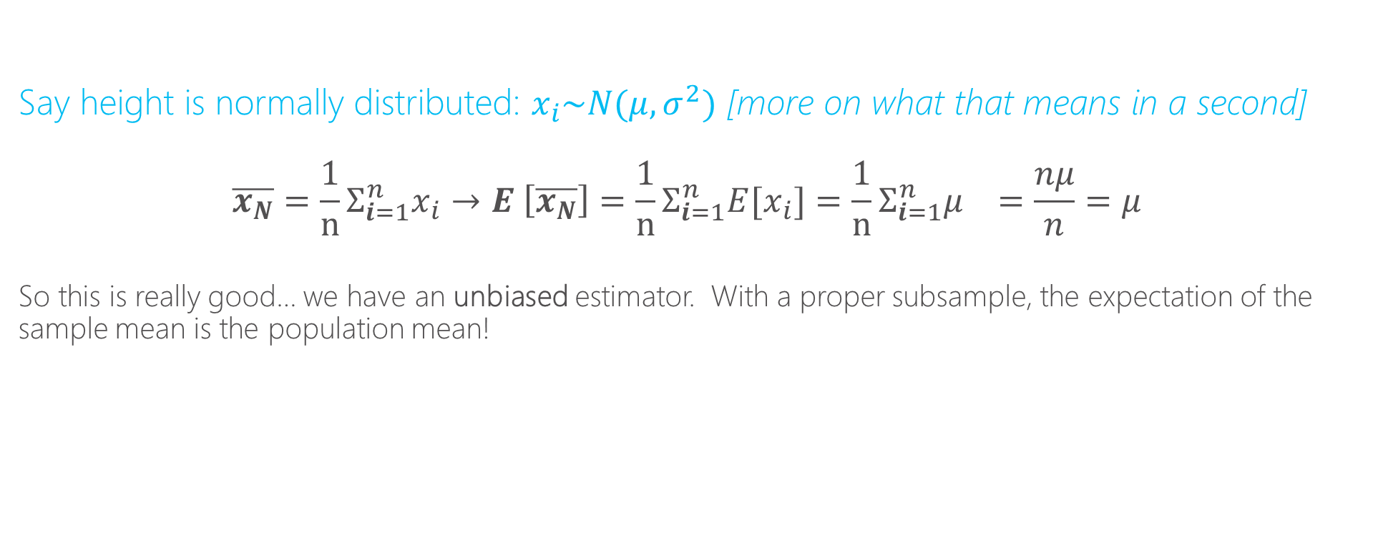
Properties of the sample mean
Say height is normally distributed: $x_{i}\sim N(μ,σ^{2})$ [more on what that means in a second]
$${\overline{x_{N}}={\frac{1}{n}Σ}_{i=1}^{n}x}_{i}→E \left[\overline{x_{N}}\right]={{\frac{1}{n}Σ}_{i=1}^{n}E[x}_{i}]={{\frac{1}{n}Σ}_{i=1}^{n}μ}_{}=\frac{nμ}{n}=μ$$
So this is really good… we have an unbiased estimator. With a proper subsample, the expectation of the sample mean is the population mean!

Slide 17
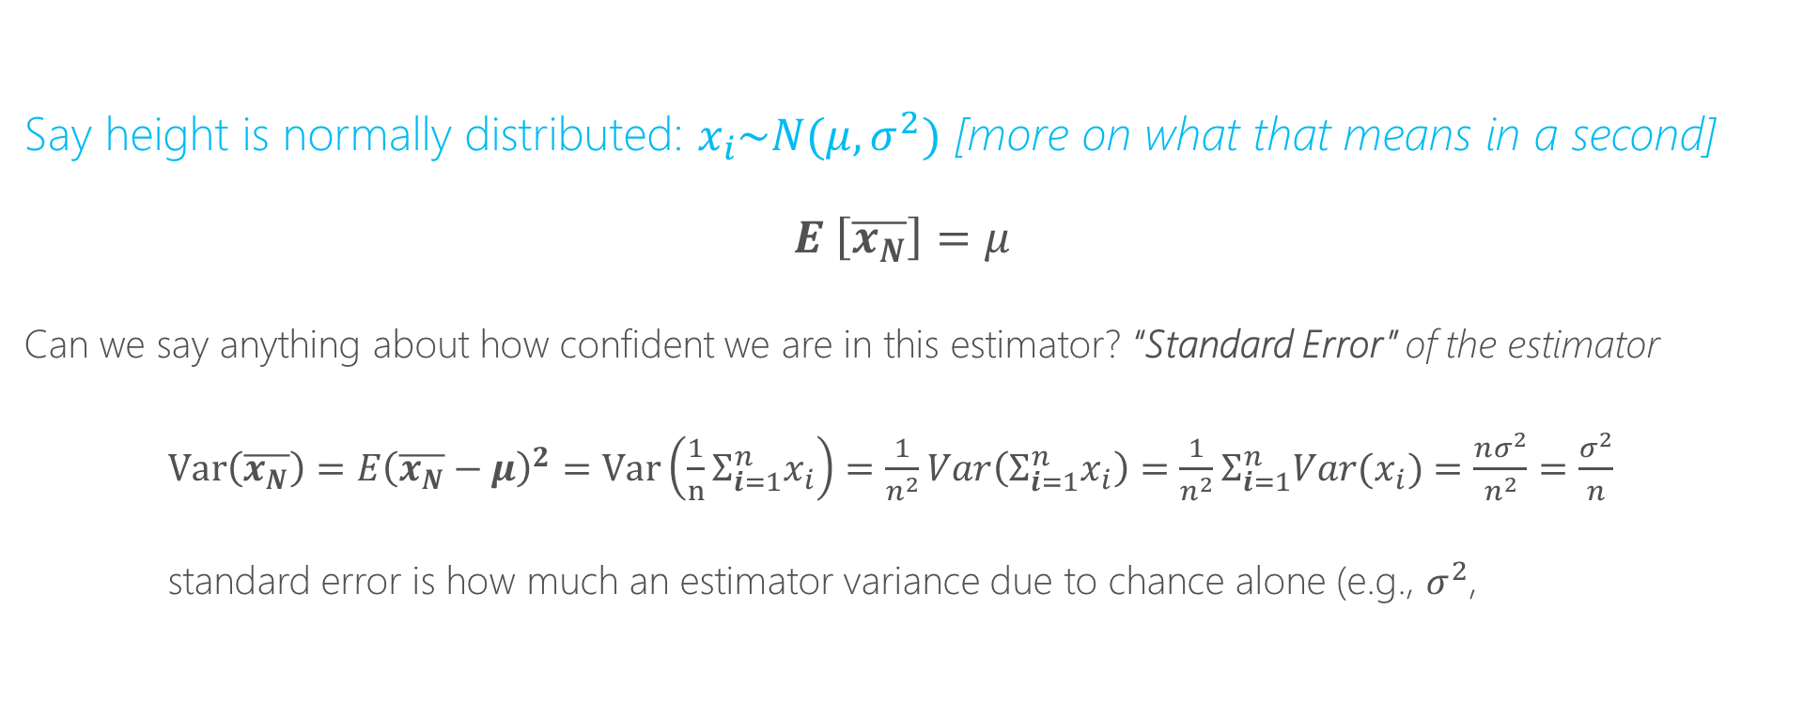
Properties of the sample mean
Say height is normally distributed: $x_{i}\sim N(μ,σ^{2})$ [more on what that means in a second]
$$E \left[\overline{x_{N}}\right]=μ$$
Can we say anything about how confident we are in this estimator? “Standard Error” of the estimator
$Var\left(\overline{x_{N}}\right)=E{\left(\overline{x_{N}}−μ\right)}^{2}=Var\left({{\frac{1}{n}Σ}_{i=1}^{n}x}_{i}\right)=\frac{1}{n^{2}}Var\left({Σ_{i=1}^{n}x}_{i}\right)=\frac{1}{n^{2}}{Σ_{i=1}^{n}Var(x}_{i})=\frac{nσ^{2}}{n^{2}}=\frac{σ^{2}}{n}$
standard error is how much an estimator variance due to chance alone (e.g., $σ^{2}$,

Slide 18
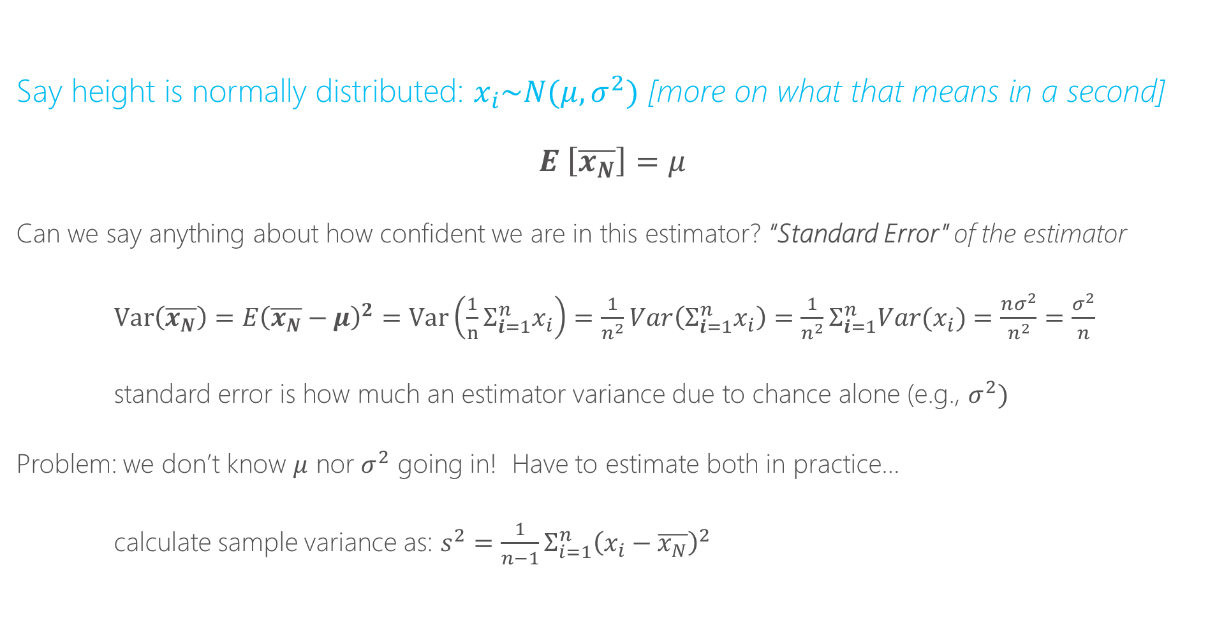
Properties of the sample mean
Say height is normally distributed: $x_{i}\sim N(μ,σ^{2})$ [more on what that means in a second]
$$E \left[\overline{x_{N}}\right]=μ$$
Can we say anything about how confident we are in this estimator? “Standard Error” of the estimator
$Var\left(\overline{x_{N}}\right)=E{\left(\overline{x_{N}}−μ\right)}^{2}=Var\left({{\frac{1}{n}Σ}_{i=1}^{n}x}_{i}\right)=\frac{1}{n^{2}}Var\left({Σ_{i=1}^{n}x}_{i}\right)=\frac{1}{n^{2}}{Σ_{i=1}^{n}Var(x}_{i})=\frac{nσ^{2}}{n^{2}}=\frac{σ^{2}}{n}$
standard error is how much an estimator variance due to chance alone (e.g., $σ^{2})$
Problem: we don’t know $μ$ nor $σ^{2}$ going in! Have to estimate both in practice…
calculate sample variance as: $s^{2}=\frac{1}{n−1}Σ_{i=1}^{n}{\left(x_{i}−\overline{x_{N}}\right)}^{2}$
NOTE: standard error ≠standard deviation
st error is about estimator, st dev
is about the population (sq rt of variance)

Slide 19
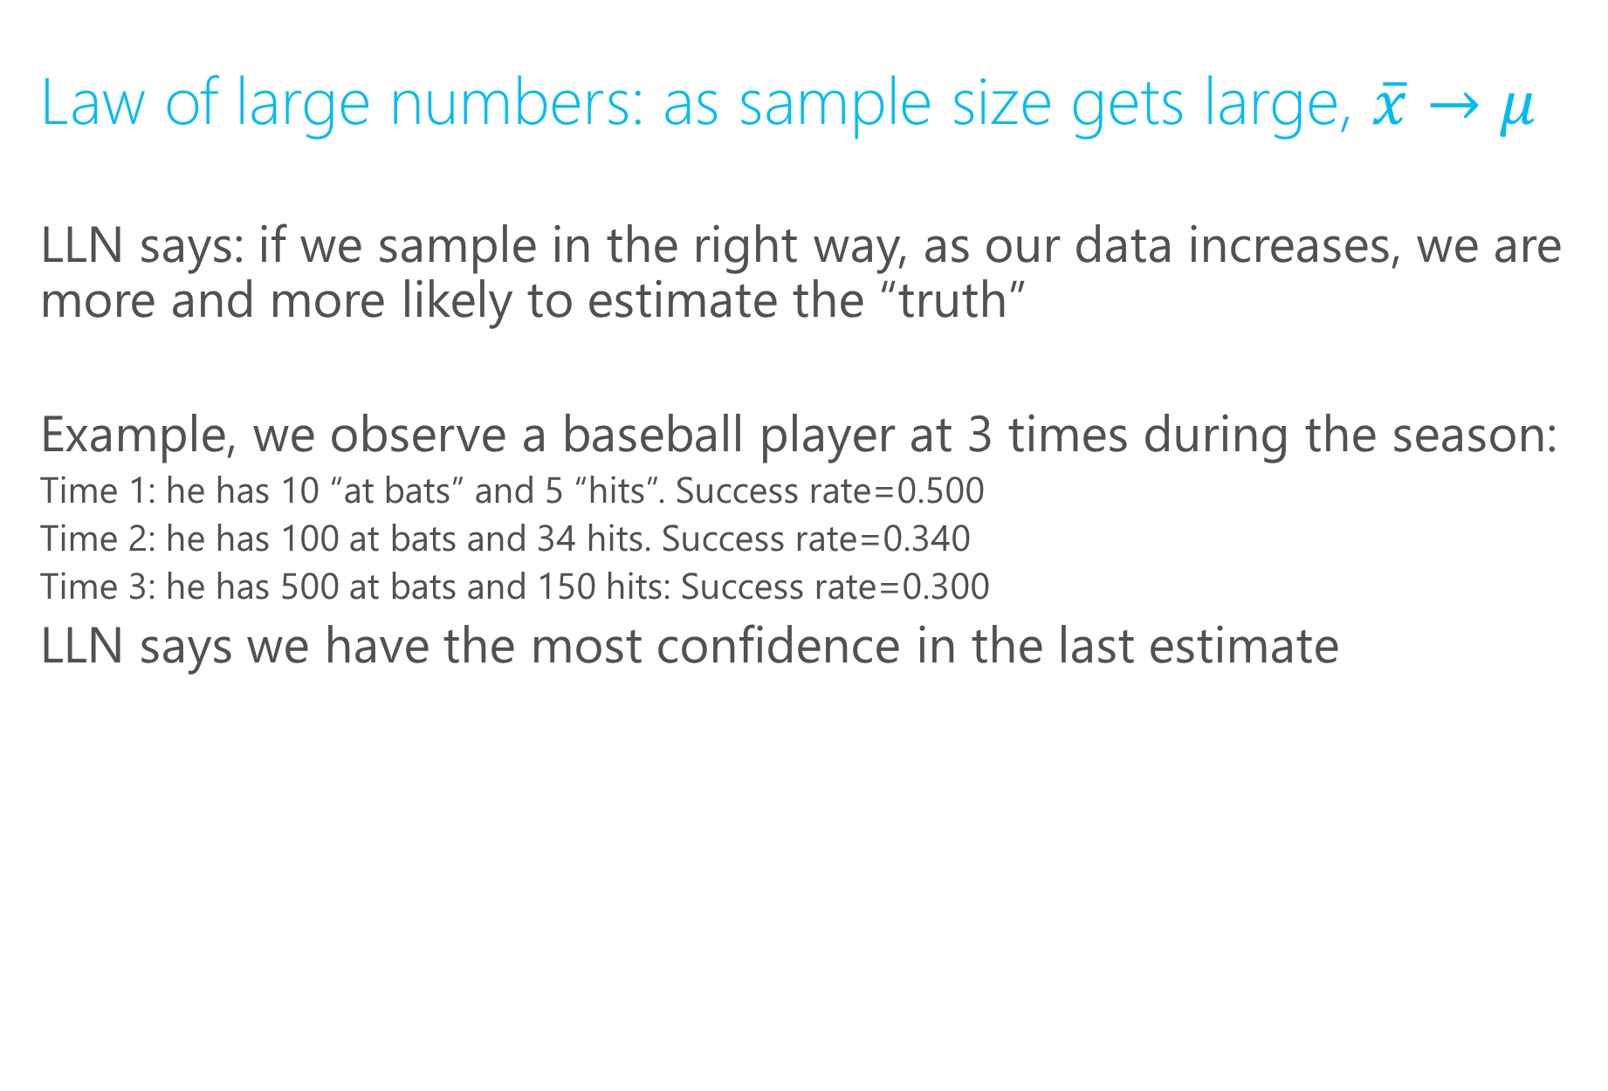
Properties of the sample mean
Law of large numbers: as sample size gets large, $\overline{x}→μ$
LLN says: if we sample in the right way, as our data increases, we are more and more likely to estimate the “truth”
Example, we observe a baseball player at 3 times during the season:
Time 1: he has 10 “at bats” and 5 “hits”. Success rate=0.500
Time 2: he has 100 at bats and 34 hits. Success rate=0.340
Time 3: he has 500 at bats and 150 hits: Success rate=0.300
LLN says we have the most confidence in the last estimate

Slide 20
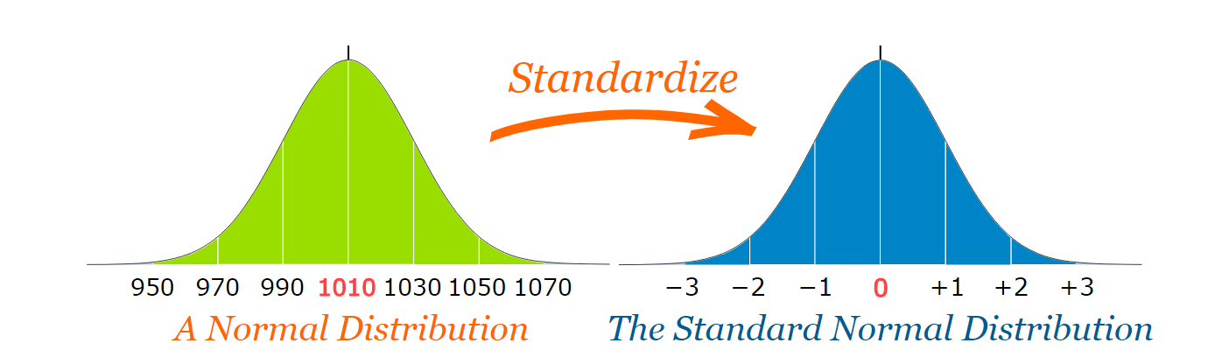

Normal versus Standard Normal
Can “standardize” any normal distribution
$y\sim N\left(μ,σ^{2}\right)$ define $z=\frac{y−μ}{σ} z\sim N(0,1)$
Ex with sample mean: $z_{n}=\frac{\overline{x_{N}}−E[\overline{x_{N}}]}{√(var\left(\overline{x_{N}}\right))}= \frac{\overline{x_{N}}−μ}{σ/√N}$

Slide 21
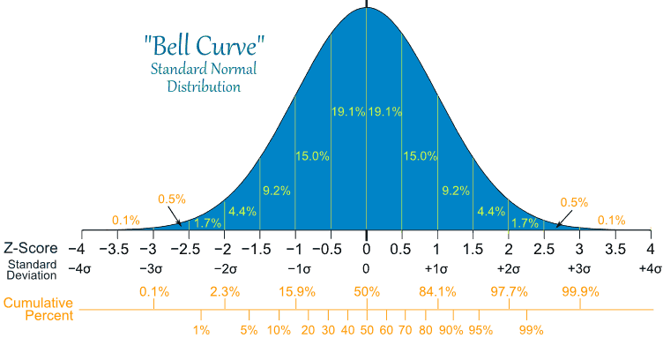
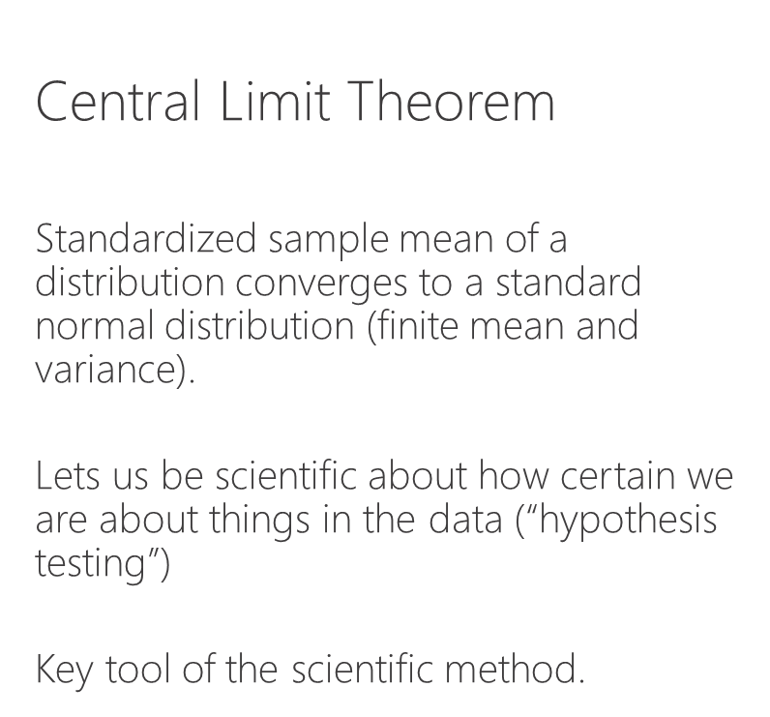
Normal versus Standard Normal
Central Limit Theorem
Standardized sample mean of a distribution converges to a standard normal distribution (finite mean and variance).
Lets us be scientific about how certain we are about things in the data (“hypothesis testing”)
Key tool of the scientific method.

Slide 22

Hypothesis testing
$$H_{o}:null hypothesis −→population parameter=μ_{0}$$
$$t=\frac{\overline{x}−μ_{0}}{s/\sqrt{N}}$$
$s$=sample standard deviation
$\overline{x}$=sample mean or anything that “behaves like a sample mean”
http://rpsychologist.com/d3/tdist/

Slide 23

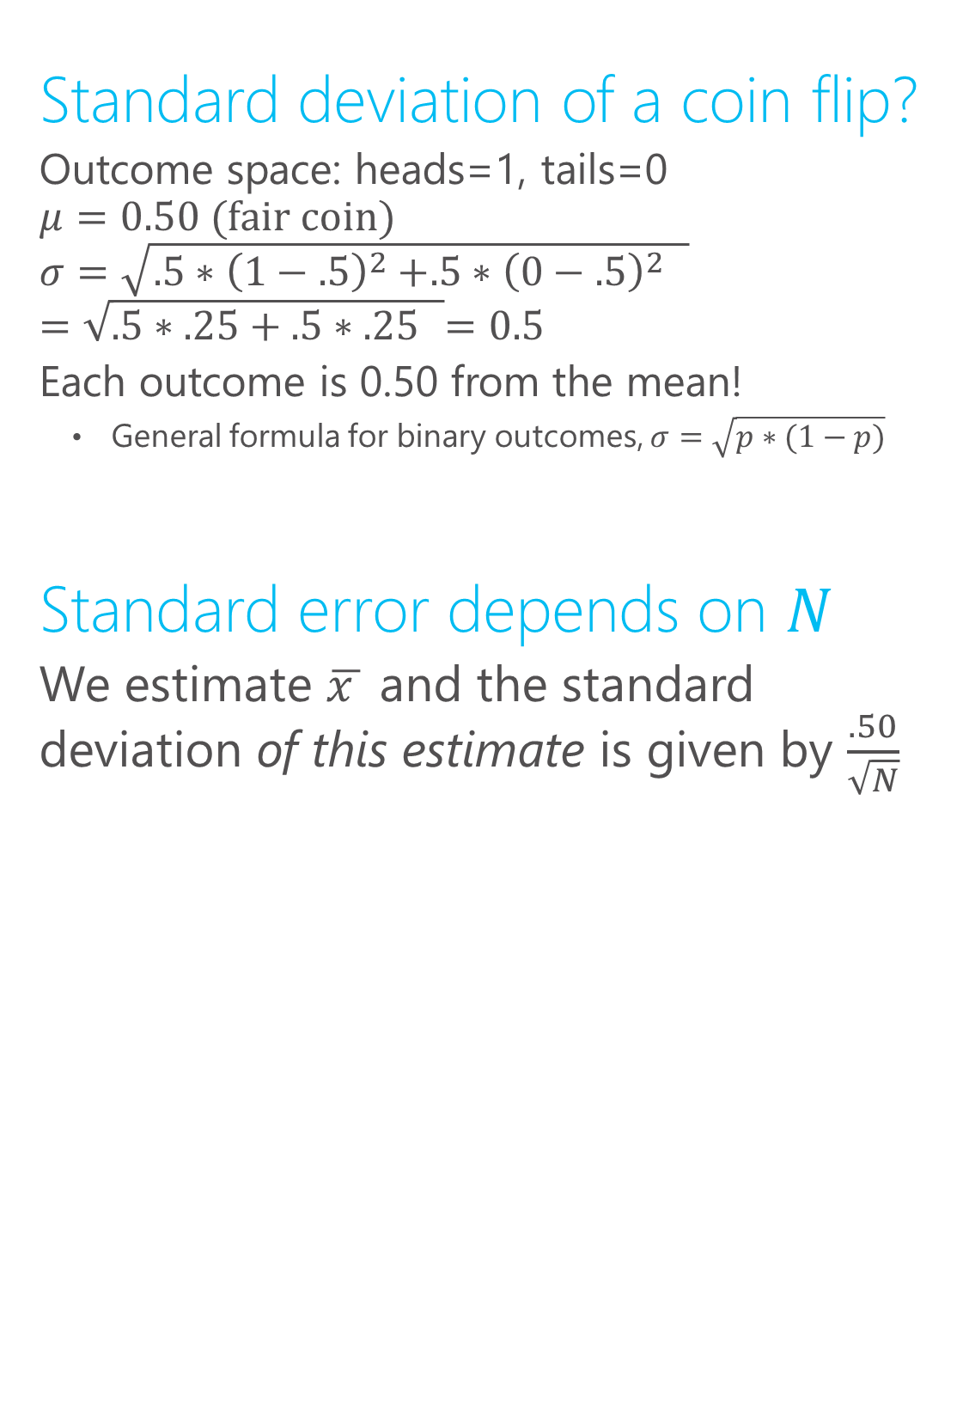
Coin flipping: s.e. vs. s.d.
Standard deviation of a coin flip?
Outcome space: heads=1, tails=0
$$μ=0.50 (\text{fair} \text{coin})$$
$$σ=\sqrt{.5{∗\left(1−.5\right)}^{2}+.5{∗{\left(0−.5\right)}^{2} }^{ }}$$
$$=\sqrt{.5∗.25+.5{∗.25 }^{ }}=0.5$$
Each outcome is 0.50 from the mean!
General formula for binary outcomes, $σ=\sqrt{p∗(1−p)}$
Standard error depends on $N$
We estimate $\overline{x }$ and the standard deviation of this estimate is given by $\frac{.50}{\sqrt{N}}$

Slide 24

Standard error vs. standard deviation
Standard error measures the dispersion in the estimator (ex. sample mean) for a given sample size
The central limit theorem tells us how the variance in the population links up with the standard error in our estimator: $\frac{σ}{\sqrt{N}}$
Ex. fair coin flip. Heads=1, Tails=0.
$μ$=0.5 $σ=0.5$
s.e. = 0.5/$\sqrt{N}$
$N$=4 → 0.25
$N$=25 → 0.1
$N$=100 → 0.05

Slide 25

s.e. vs. s.d.
Central limit theorem says the distribution of the estimator will be Guassian for any population distribution with finite mean and variance
The distribution of the sample mean is bell-shaped, “no matter what” the distribution of the underlying variable
As $N$ increases, the distribution will “collapse” to the true population mean

Slide 26

Statistical uncertainty and $\sqrt{N}$
Ex. fair coin flip. Heads=1, Tails=0.
$μ$=0.5 $σ=0.5$
s.e. = 0.5/$\sqrt{N}$
Ex. Points
$$\sqrt{100}=10$$
$$\sqrt{400}=20$$
$$\sqrt{1000}=33$$

Slide 27

Standard error and sample size
Ex. fair coin flip. Heads=1, Tails=0.
$μ$=0.5 $σ=0.5$
s.e. = 0.5/$\sqrt{N}$
To reduce my standard error
factor 2, I need to increase
sample size by $2^{2}$
Ex.
s.e.(N=40)=0.04
s.e.(N=160)=0.02
s.e.(N=640)=0.01

Slide 28
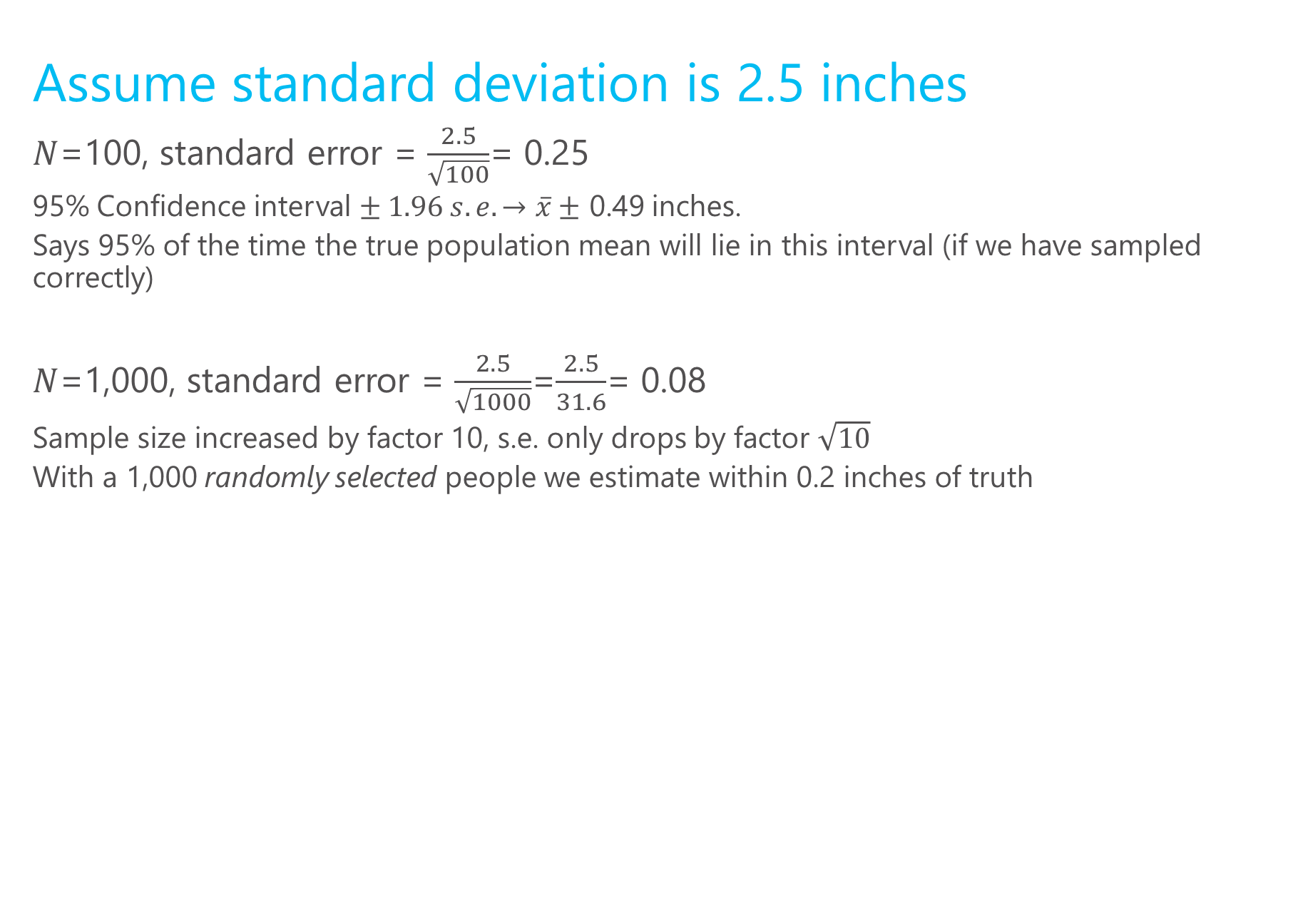
Height example cont.
Assume standard deviation is 2.5 inches
$N$=100, standard error = $\frac{2.5}{\sqrt{100}}$= 0.25
95% Confidence interval $± 1.96 s.e. →\overline{x}±$ 0.49 inches.
Says 95% of the time the true population mean will lie in this interval (if we have sampled correctly)
$N$=1,000, standard error = $\frac{2.5}{\sqrt{1000}}$=$\frac{2.5}{31.6}$= 0.08
Sample size increased by factor 10, s.e. only drops by factor $\sqrt{10}$
With a 1,000 randomly selected people we estimate within 0.2 inches of truth

Slide 29
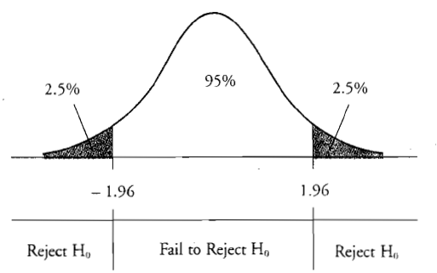

Constructing confidence intervals
1) Estimate sigma: $s$ =$\sqrt{{\frac{1}{N−1}\sum_{i=1}^{N}{{(x}_{i}−\overline{x}})}^{2}}$
Intuition, use average differences from the sample mean.
2) Compute standard error= $\frac{s}{\sqrt{N}}$
3) +/- 1.96 captures 95% of
the Normal distribution
http://students.brown.edu/seeing-theory/frequentist-inference/index.html#section2

Slide 30
What does this mean?
1) Your estimate is your best guess of the truth
2) 95% confidence interval: 95% of the time the truth is in this range from a statistics perspective
3) If wide, indicates lots of uncertainty in estimator; can’t be too sure
4) In practice, you only have 1 sample. Statistical theory quantifies your uncertainty in this estimate

Slide 31
Visualizing the CLT
N=4
Fair coin
http://blog.vctr.me/posts/central-limit-theorem.html
http://students.brown.edu/seeing-theory/probability-distributions/index.html

Slide 32
What does standard error capture?
Standard error captures how much our estimator will move around due the chance involved in sampling
This is known as sampling variation, it captures the degree to which small samples are different from the population.
It does not capture model uncertainty or bias in the sampling procedure
What if I have a non-random sample?
The “margin for error” you see on polls usually assumes they have a representative sample, and thus only reports sampling variation

Slide 33
Sampling and estimation
Sampling is the way we generate “observations”
Generate “observations” = constructing datasets
Any dataset that is not a “complete census” is a sample
even a complete census only represents one point in time, so can be view as a sample too

Slide 34
Returning to our example
Some samples:
Heights of the course instructors
Heights of all the people in the room
All MSFT employees
MSFT employees that will stop and talk to us
The samples are not random subsamples, (3) will have the lowest s.e. because n is largest

Slide 35
Random sampling for unbiasedness
s.e.’s are not very meaningful if the estimator is biased
Random sampling ensures that the sample mean will equal the population mean in expectation
In big data applications, bias is much more important than sampling variation!

Slide 36
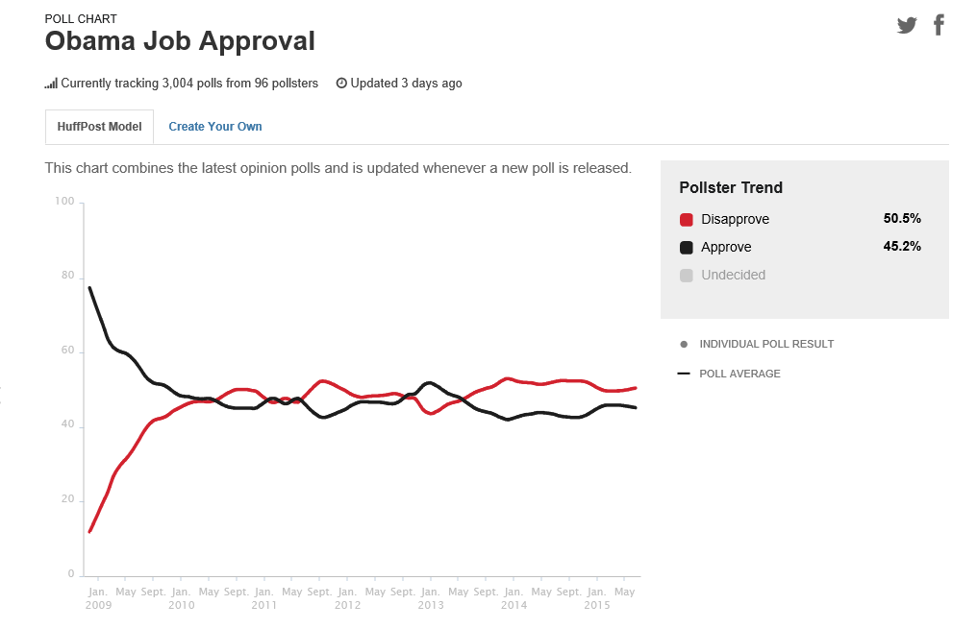
Example: polls

Slide 37
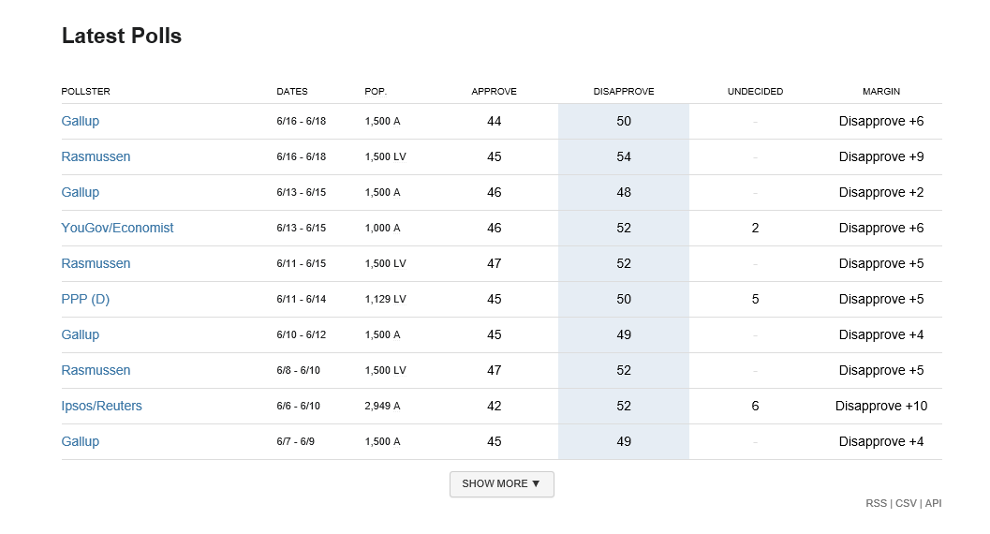
Why do these numbers differ?
See this interactive explainer on sampling variability in polls: http://rocknpoll.graphics

Slide 38
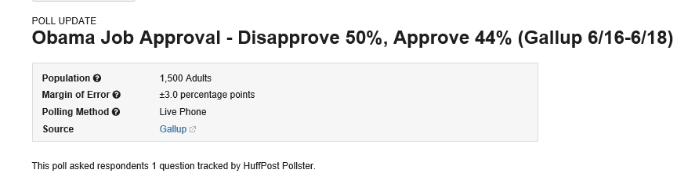
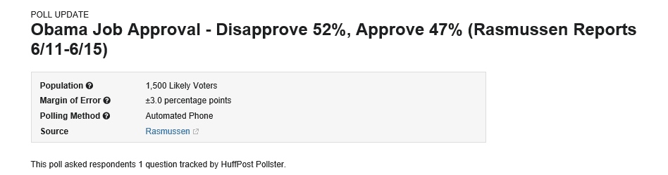

Different target populations
Different methods → different biases in sample selection
Different times → different “populations”
Different random samples→ sampling variation

Slide 39

Two key properties of an estimator
Bias: if $E\left[\hat{β}\right]=β$ then the estimator is said to be unbiased. “with a very large sample we expect to uncover the truth”
Variance: the degree to which the estimator jumps around
In more complicated settings, different estimators of the same underlying quantity can have different s.e.’s

Slide 40
Returning to the height example
A fully random sample of 25 U.S. adults will be unbiased but have relatively high variance
A large sample of all MSFT employees will have a very low variance, but is likely biased
Later in the course, we will see how methods trade-off bias vs. variance

Slide 41
What determines properties of an estimator?
The estimation method or algorithm
The sample mean is an estimator that is unbiased if the sampling is done correctly
Other more complicated estimators have different properties, we will see this in later lectures
How the sample was drawn
Even “good estimators” are lousy with poor samples.

Slide 42
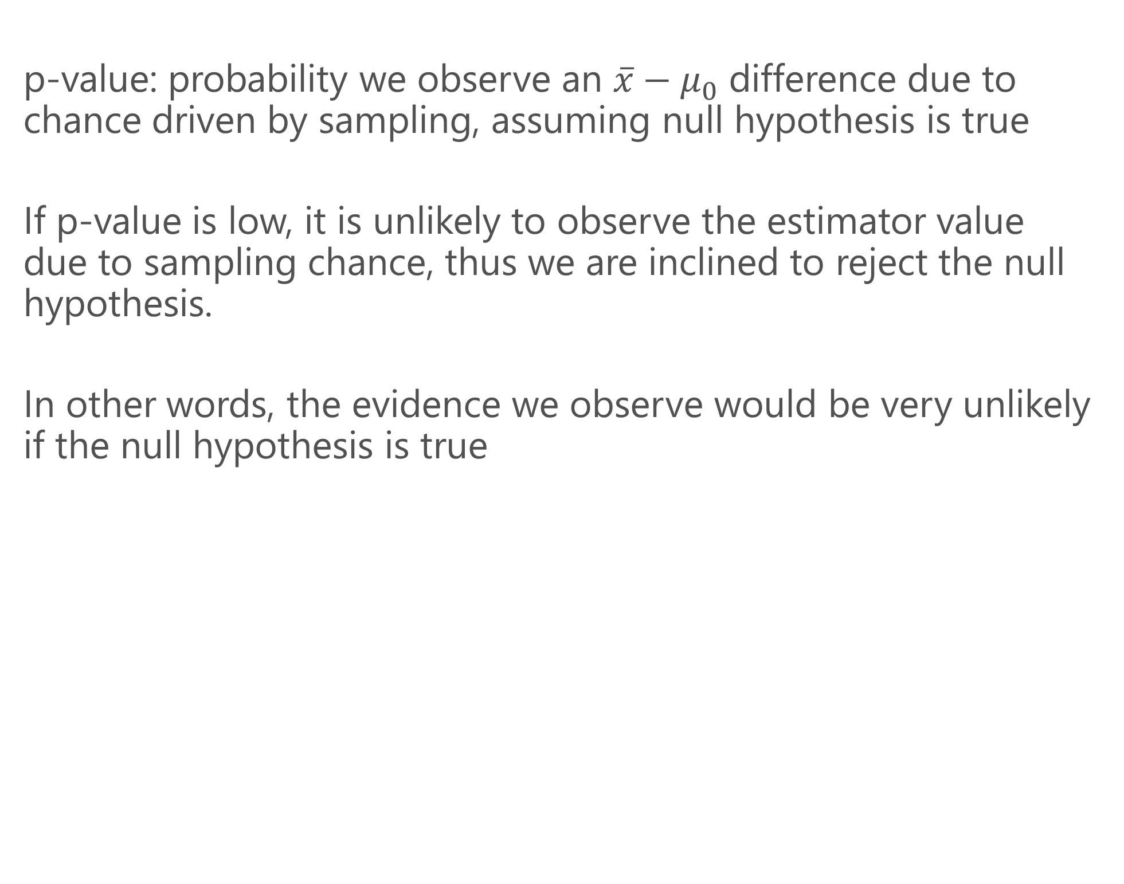
Hypothesis testing: p values
p-value: probability we observe an $\overline{x}−μ_{0}$ difference due to chance driven by sampling, assuming null hypothesis is true
If p-value is low, it is unlikely to observe the estimator value due to sampling chance, thus we are inclined to reject the null hypothesis.
In other words, the evidence we observe would be very unlikely if the null hypothesis is true

Slide 43

Hypothesis testing
$$H_{o}:null hypothesis −→population parameter=μ_{0}$$
$$t=\frac{\overline{x}−μ_{0}}{s/\sqrt{N}}$$

