Slide 1
Q#

Slide 2
Intro

Slide 3
Basic Gates
Shows how Jupyter katas work

Slide 4
Deutsch-Jozsa
Given a classical function 𝑓(𝑥):{0,1}𝑁→{0,1} . You are guaranteed that the function 𝑓 is
either constant (has the same value for all inputs)or balanced (has value 0 for half of the inputs and 1 for the other half of the inputs).
The task is to figure out whether the function is constant or balanced.
Leverage super position to find the answer in just one application of the oracle.

Slide 5
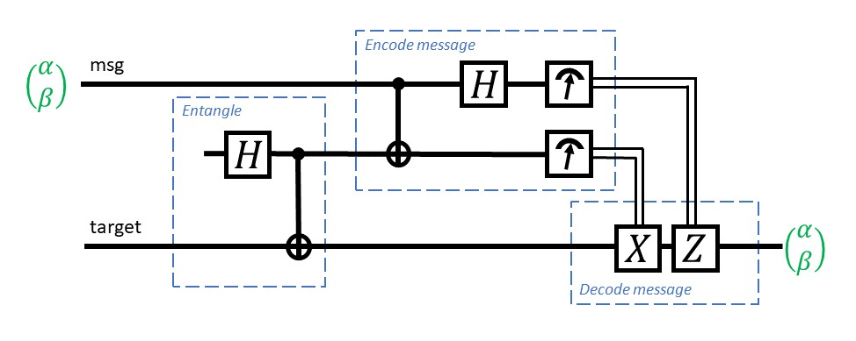
Teleport
Leverage entanglement to transport a quantum state from one qubit to another

Slide 6
Grover Search

Slide 7


$$target state$$
$$initial state$$

Slide 8


$$target state$$
$$initial state$$

Slide 9
$$target state$$
$$initial state$$

Slide 10


$$target state$$
$$initial state$$

Slide 11
$$target state$$
$$initial state$$

Slide 12
$$target state$$
$$initial state$$

Slide 13
$$target state$$
$$initial state$$

Slide 14
$$target state$$
$$initial state$$

Slide 15
$$target state$$
$$initial state$$

Slide 16
Grover Search
Approach:
Create an oracle that marks a qubit on only if f(x) is true
Convert the qubit oracle into phase oracle
Apply mirror (inverse on mean)

Slide 17

Sweet spot:
$k≈\frac{π}{4}\sqrt{\frac{N}{M}}$
where
N : $2^{n}$ (number of qubits)
M : number of solutions

Slide 18
SAT Solver
Solve boolean satisfiability problems (SAT) using Grover.
A propositional logic formula, also called Boolean expression, is built from variables, operators AND (conjunction, denoted by ∧), OR (disjunction, ∨), NOT (negation, ¬), and parentheses.
A formula is said to be satisfiable if it can be made TRUE by assigning appropriate logical values (i.e. TRUE, FALSE) to its variables.
We can create Oracle for all Boolean operators, and use Grover to solve the problem.

Slide 19
a
b
a ∧ b
a ∨ b
¬ a

Slide 20
Why Q#
 | Circuits
Expressing Computation | X
Parameters
Portability
Domain Separation
Optimize instructions

Slide 21
Why Q#
 | Circuits | Host Language w/Libraries
Expressing Computation | X | X
Parameters |  | X
Portability |  | X
Domain Separation
Optimize instructions

Slide 22
Why Q#
 | Circuits | Host Language w/Libraries | Custom Domain Language
Expressing Computation | X | X | X
Parameters |  | X | X
Portability |  | X | X
Domain Separation |  |  | X
Optimize instructions |  |  | X

Slide 23
Phase Estimation
The task of estimating the eigenvalue of an eigenvector of a unitary operator.
Since the absolute value of the eigenvalue is always 1, the eigenvalue can be represented as exp(2iπφ), and phase estimation algorithms are usually formulated in terms of estimating the phase φ.

Slide 24
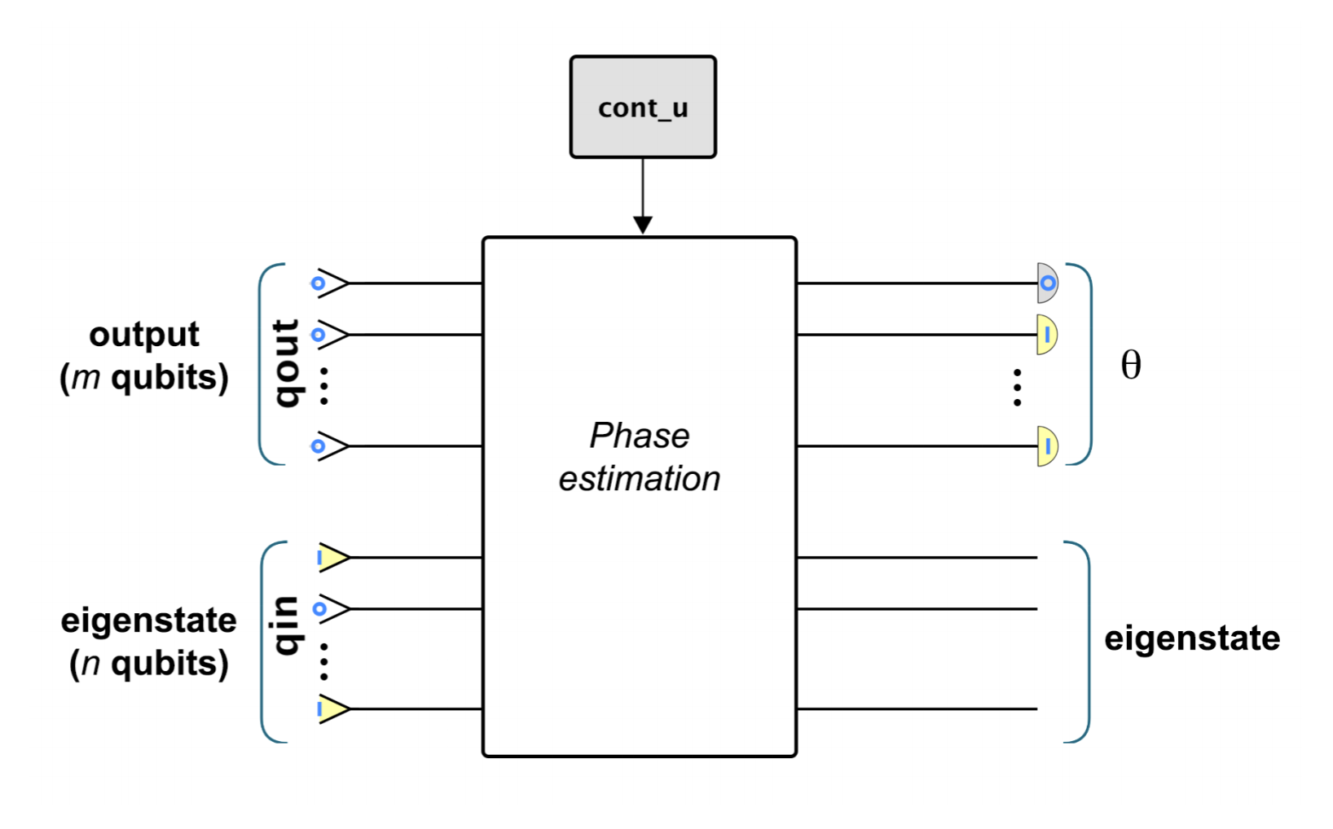

Slide 25
Other QDK components
More Katas
Other Samples
Other Libraries
Chemistry
Numerics
Resources estimation
Toffoli simulator

Slide 26
Repositories
Compiler: https://github.com/microsoft/qsharp-compiler.git
Simulator: https://github.com/microsoft/qsharp-runtime.git
IQ# (Q# Jupyter Kernel): https://github.com/microsoft/iqsharp.git
Libraries: https://github.com/Microsoft/QuantumLibraries.git
Samples: https://github.com/Microsoft/Quantum.git
All Katas: https://github.com/Microsoft/QuantumKatas.git
Docs: https://github.com/microsoftdocs/quantum-docs-pr
This workshop: https://github.com/msr-quarc/qldi-workshop-2019.git

