Slide 1

S7 PROJECT MID REVIEW
Runtime Computational Memory:
Understanding Emergent Behaviour through
KV-Cache Dynamics in Transformer Language Models
Guided by Dr Thara Shyam
S Kunal Achintya Reddy AM.SC.U4CSE23352
V Sriman Vashishta AM.SC.U4CSE23368
Raaghavan M S AM.SC.U4CSE23330
B Nithilesh AM.SC.U4CSE23311

Slide 2
Outline
1
Introduction
6
Design / Architecture
2
Problem Definition
7
Algorithms
3
Literature Review Summary
8
Result Analysis
4
Research Gap
9
Project Timeline (Plan)
5
Methodology
10
References
Runtime Computational Memory — KV-Cache Dynamics in Transformer Language Models

Slide 3
Introduction
While a language model writes, it keeps a growing scratch-memory called the Key–Value (KV) cache. We study what that memory computes.
Every word written
Every later word
So the cache is
goes into the KV cache and is never recomputed.
reads that cache before choosing what to say next.
a second state of the model — it grows during the conversation, while the weights never change.
What research does with it today
What we do with it
• Treats it as an engineering cost — compress it, evict it, stream it.
• Studies weights and single forward passes, not the evolving memory.
• Label every entry, measure what it does to behaviour.
• Edit the cache at inference time to change behaviour — no retraining.
In one line
We turn the KV cache from a speed optimisation into a measurable, editable object — and use social bias as the case study to prove it matters.
Runtime Computational Memory — KV-Cache Dynamics in Transformer Language Models

Slide 4
Problem Definition
Motivation
Objectives
• LLMs now mediate hiring, healthcare triage, education and public services.
• They still show bias, hallucinations that persist, and opinion reinforcement between agents.
• Today the only fix is retraining or fine-tuning — expensive, opaque, out of reach for small deployments.
Build a runtime-memory instrumentation framework with full provenance (layer, head, token, turn, agent).
1
2
Detect and characterise persistent Memory Attractors in long conversations.
3
Analyse whether bias is localised into identifiable Bias Reservoirs.
Problem Statement
• No framework observes how runtime memory evolves over long, multi-agent conversations.
• No way to attribute emergent behaviour to identifiable structures inside that memory.
• No way to intervene on runtime memory alone to change behaviour.
4
Evaluate Memory Contagion and phase-transition behaviour across agents.
5
Demonstrate causal control through KV-cache-only interventions.
Scope (kept feasible for the academic year)
Open-weight models of 7–8B parameters, controlled two-agent conversations, social bias as the primary case study. No model weights are ever modified.
Runtime Computational Memory — KV-Cache Dynamics in Transformer Language Models

Slide 5
Literature Review Summary
Year | Work | Key contribution | Demerit / limitation | Dataset used | Evaluation metrics
2024 | Xiao et al., StreamingLLM (ICLR) | Initial-token “attention sinks” must be retained for stable long-context decoding | Sinks studied only for efficiency; their semantic content and behavioural effect are never analysed | PG-19, long-text streaming | Perplexity, throughput
2023 | Zhang et al., H2O (NeurIPS) | A small set of “heavy-hitter” KV entries dominates attention and can guide eviction | Dominant entries identified purely for compression; no link to bias, hallucination or reasoning | OpenBookQA, XSUM | Accuracy, ROUGE, memory saved
2024 | Oren et al., Multi-State RNNs (EMNLP) | Reframes decoder-only LLMs as RNNs whose hidden state is the KV cache; TOVA policy | Conceptual / efficiency focus; does not track how the state evolves semantically | Long-range LM benchmarks | Perplexity, cache size
2024 | Todd et al., Function Vectors (ICLR) | Compact, causally effective task vectors exist in activations and can be transplanted | Operates within single forward passes; no temporal KV evolution, no multi-turn effects | In-context learning task suites | Task accuracy, causal effect
2024 | Du et al., Multiagent Debate (ICML) | Interaction between LLM agents systematically shifts individual agents’ answers | Measures text-level outcomes only; offers no memory-level mechanism and ignores bias | GSM8K, MMLU, biography tasks | Accuracy, factuality
All five establish that runtime memory is highly structured — none asks what those structures compute or how they shape behaviour.
Runtime Computational Memory — KV-Cache Dynamics in Transformer Language Models

Slide 6
Research Gap
Across the reviewed work the KV cache is treated only as an efficiency problem.
Efficiency, not meaning
Static, not temporal
Sinks [1] and heavy hitters [2] show runtime memory is structured — but nobody asks what those entries compute.
Function vectors [4] find causal structure inside one forward pass, never in the evolving KV state of a long conversation.
Text, not memory
No provenance, no intervention
Multi-agent studies [5] show interaction changes outputs, but measure only surface text — no memory-level mechanism.
No existing work labels KV entries by layer/head/turn/agent, or edits the cache alone to change behaviour.
The gap this project fills
We elevate runtime memory to a first-class research object: instrument the KV cache with full provenance, test for persistent Memory Attractors and localised Bias Reservoirs, trace cross-agent Memory Contagion, and intervene causally — without any parameter update.
Provenance-labelled KV traces
Attractors & Bias Reservoirs
Memory Contagion across agents
KV-only causal interventions
Runtime Computational Memory — KV-Cache Dynamics in Transformer Language Models

Slide 7
Methodology
Component | What we use
Dataset — consumed | BBQ (58,492 QA items, 9 bias categories), StereoSet, CrowS-Pairs (1,508 pairs) for bias; TruthfulQA (817 questions) for hallucination persistence
Dataset — produced | Our own deliverable: provenance-labelled runtime-memory traces (135 conversations this run) — SQLite index + Parquet fact table + 5 % raw-KV sample
Models (object of study) | Frozen open-weight LLMs: Llama-3-8B-Instruct, Mistral-7B-Instruct-v0.3, Qwen2.5-7B. Weights are never trained; only the cache is observed and edited
Current platform | CPU-only validation testbed: a 4-layer GQA + RoPE reference transformer trained on a corpus with a known, planted bias structure, so every metric has a checkable answer
Hardware | Now: Windows 11 laptop, 6-thread CPU, no GPU (full run = 11 min). Target: NVIDIA A100 40/80 GB (min. 16 GB VRAM, 4-bit) via SLURM
Technology stack | Python 3.11 · PyTorch · Hugging Face Transformers (DynamicCache) · NumPy · SciPy · scikit-learn · NetworkX · pandas · PyArrow/Parquet · SQLite/DuckDB · Plotly · Matplotlib · FastAPI · pytest
Methods | Four stages — Instrument (provenance + attention taps) → Measure (attractor metrics) → Attribute (probes, contagion, phase fit) → Intervene (ablate / perturb / gate on replay)
Evaluation metrics | Bias index B ∈ [−1,1] (pseudo-log-likelihood preference) · probe AUC with BH-FDR · memory contagion MC · critical pressure π_c · average causal effect ACE · ΔPerplexity · Δaccuracy
Runtime Computational Memory — KV-Cache Dynamics in Transformer Language Models

Slide 8
Design / Architecture
Four stages; the model's weights stay frozen throughout — only the KV cache is read and written.
1 INSTRUMENT
2 MEASURE
3 ATTRIBUTE
4 INTERVENE
• TracingCache stamps every KV write:
• layer · head · position · turn · agent · channel
• AttentionTap reduces per-head attention online
• Reuse R(t) · Lifetime L(t)
• Persistence P(t) · PageRank c(t)
• → Memory Attractors (sinks held out)
• Per-head probes on attractor values
• → Bias Reservoirs (BH-FDR)
• 3 arms → Contagion; π-sweep → phase
• Ablate / Perturb / Gate the cache
• Seed-matched replay → ACE
• Negative controls + coherence budget
CLOSED LOOP — the intervention writes back into the cache and the conversation is replayed under the same seed
NOVELTY / INNOVATION
Provenance-stamped cache
Contagion as a residual
Causality without training
Every KV entry knows which layer, head, turn, agent and channel produced it — no prior work records this, and without it nothing can be attributed.
Shared-memory minus text-only isolates the component of bias transfer that exchanged text cannot explain — a definition that can fail.
Ablate / perturb / gate during a seed-matched replay: behaviour changes at inference cost, with zero parameter updates.
Runtime Computational Memory — KV-Cache Dynamics in Transformer Language Models

Slide 9
Algorithms
Three algorithms from the design document; the only thing ever trained is a tiny diagnostic probe, never the model under study.
Algorithm 1 — Instrumented conversation
Algorithm 2 — Attractors & reservoirs
Algorithm 3 — Causal intervention
• Seed context from a bias probe; fix arm and pressure π
• Each turn: generate under instrumentation, log provenance + attention mass
• Score turn: bias index B, hallucination flag, coherence
• Shared-KV arm: graft peer segment, RoPE re-indexed
• Compute R(t), L(t), P(t) and PageRank c(t)
• Attractor if z_R > z* ∧ L > λT ∧ P > p* (sinks t ≤ 4 held out)
• Pool value vectors at attractors per (layer, head)
• S(ℓ,h) = AUC × measured ablation effect; keep BH-FDR survivors
• Replay the same (arm, π, seed) with and without the KV edit
• ablate: logit → −∞ · perturb: v ← v − ε(ŵᵀv)ŵ · gate: α × g
• ACE = E[B | do(S)] − E[B] by paired replay
• Accept only if ACE beats zero and both controls, inside the budget
Training and testing steps
Hyperparameters used
Train (once, offline)
Reference transformer is fitted on the controlled corpus — 1,500 steps, batch 16, AdamW, one-cycle LR. Then frozen.
Parameter | Value | Parameter | Value
Attractor z*, λ, p* | 1.0, 0.30, 0.10 | Probe folds / FDR α | 5, 0.05
Top-k, window w, κ | 8, 8, 1.0 | Perturbation ε | 1.0
PageRank damping d | 0.85 | Gate factor g | 0.10
Sink class | t ≤ 4 | Coherence budget | ΔPPL ≤ 5 %, ΔAcc ≤ 2 pt
Pressure levels π | 0 → 1 in 9 steps | Seeds / turns per conv. | 5 / 8
Reference model | 4 layers, 8 q-heads, 2 KV heads, d = 128 | Bootstrap samples | 2,000 (CI) / 400 (fit)
Test / measure
135 conversations over 3 arms × 9 pressure levels × 5 seeds. Probes are 5-fold cross-validated; nothing is fitted on test conversations.
Verify
20 unit tests on synthetic caches with analytically known structure; PageRank checked against NetworkX; replay determinism asserted.
Runtime Computational Memory — KV-Cache Dynamics in Transformer Language Models

Slide 10
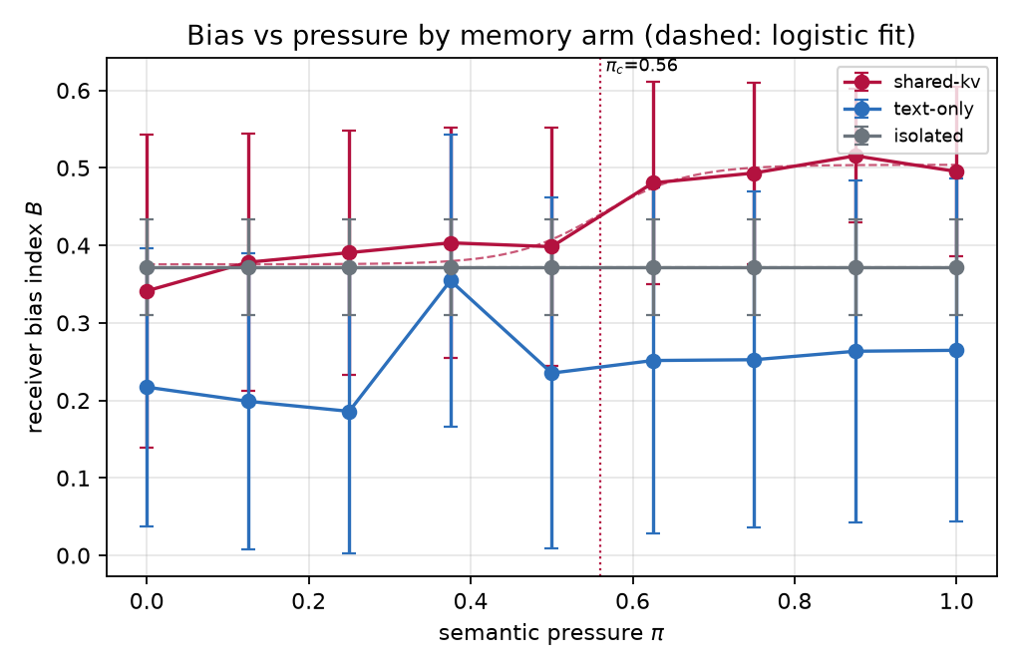
Result Analysis
Quantitative results (this run, 135 conversations)
Measured quantity | Value | Test / basis
Memory contagion MC | +0.186 | 95 % CI [+0.034, +0.340]
Text contagion TC | -0.125 | MC positive at all 9 pressure levels
Novel attractors / conv. | 2.51 | vs 0.29 text-only; sinks held out
Best Bias-Reservoir head | AUC 0.922 | 5-fold CV probe, q = 0.024 (BH-FDR)
Causal effect (ablation) | -0.102 (20.3 % ↓) | p < 0.001 vs 0; beats both controls
Coherence budget | ΔPPL -2.5 %, ΔAcc -6.7 pt | REJECTED — over the 2-point budget
Comparison with existing work (SOTA)
Aspect | StreamingLLM / H2O / TOVA | This work
Role of the KV cache | Efficiency: compress, evict | Object of study: measure & edit
Provenance per entry | None | layer · head · turn · agent · channel
Behavioural claim | Perplexity preserved | Bias moved 20.3 % causally
Receiver bias vs pressure π. Grey = no contact (the model's built-in bias). Red = shared memory: rises 0.341 → 0.495 although the receiver never saw a single biased sentence.
Runtime Computational Memory — KV-Cache Dynamics in Transformer Language Models

Slide 11
Project Timeline (Plan)
S6 — Foundation
S7 — Submissions 1 & 2
S7 — Mid review (now)
S8 — Completion
Feb – Apr 2026
Jul – Aug 2026
Sep – Dec 2026
Jan – Apr 2027
✓ Problem domain identified
✓ Comprehensive survey
✓ Prototype: all 4 modules
✗ 3-model GPU sweep
✓ Literature survey
✓ Research gap + objectives
✓ 20 unit tests passing
✗ Web dashboard release
✓ Baseline implementation
✓ System design & architecture
✓ First full run: 135 conv.
✗ Trace dataset + toolkit
▶ Module integration
✗ Paper submission
▶ GPU testing & validation
✗ Dissertation & viva
▲ WE ARE HERE
Current status
Immediate next step
All four modules implemented and tested end-to-end on CPU; contagion result positive, causal machinery working and validated.
Move to GPU and re-run the identical pipeline on Llama-3-8B, Mistral-7B and Qwen2.5-7B — one config flag (backend: hf).
Runtime Computational Memory — KV-Cache Dynamics in Transformer Language Models

Slide 12
References
[1]
G. Xiao, Y. Tian, B. Chen, S. Han and M. Lewis, “Efficient streaming language models with attention sinks,” in Proc. Int. Conf. Learning Representations (ICLR), 2024.
[2]
Z. Zhang et al., “H2O: Heavy-hitter oracle for efficient generative inference of large language models,” in Advances in Neural Information Processing Systems (NeurIPS), vol. 36, 2023.
[3]
M. Oren, M. Hassid, N. Yarden, Y. Adi and R. Schwartz, “Transformers are multi-state RNNs,” in Proc. Conf. Empirical Methods in Natural Language Processing (EMNLP), 2024, pp. 18724–18741.
[4]
E. Todd, M. L. Li, A. S. Sharma, A. Mueller, B. C. Wallace and D. Bau, “Function vectors in large language models,” in Proc. Int. Conf. Learning Representations (ICLR), 2024.
[5]
Y. Du, S. Li, A. Torralba, J. B. Tenenbaum and I. Mordatch, “Improving factuality and reasoning in language models through multiagent debate,” in Proc. 41st Int. Conf. Machine Learning (ICML), PMLR vol. 235, 2024, pp. 11733–11763.
[6]
I. O. Gallegos et al., “Bias and fairness in large language models: A survey,” Computational Linguistics, vol. 50, no. 3, pp. 1097–1179, 2024.
[7]
A. Parrish et al., “BBQ: A hand-built bias benchmark for question answering,” in Findings of the Association for Computational Linguistics: ACL, 2022, pp. 2086–2105.
[8]
S. Lin, J. Hilton and O. Evans, “TruthfulQA: Measuring how models mimic human falsehoods,” in Proc. 60th Annu. Meeting Assoc. Computational Linguistics (ACL), 2022, pp. 3214–3252.
Runtime Computational Memory — KV-Cache Dynamics in Transformer Language Models

