Slide 1
Runtime Computational Memory
Understanding Emergent Behaviour through KV-Cache Dynamics in Transformer Language Models
Code Review · 23CSE498 Project Phase II · Team D10
S Kunal Achintya Reddy · V Sriman Vashishta · Raaghavan M S · B Nithilesh
Guide: Dr Thara Shyam · Department of Computer Science and Engineering, Amrita School of Computing, Amritapuri

Slide 2
Module 1 · TracingCache: provenance on every write
A stock KV cache is an anonymous tensor — nothing downstream can be attributed without this stamp
class TracingCache(ProvenanceMixin):
def update(self, key_states, value_states, layer_idx):
# same signature as transformers.DynamicCache.update
self._keys[l] = cat(self._keys[l], key_states)
self._values[l] = cat(self._values[l], value_states)
return self._keys[l], self._values[l]
def stamp(self, token_ids, start_position):
for i, tok in enumerate(token_ids):
self.provenance.append(KVProvenance(
position=start_position + i,
turn_idx=self._turn_idx, # which turn wrote it
agent_id=self._agent_id, # which agent
channel=self._channel, # system|probe|agent|peer
token_id=tok))
def graft(self, peer, positions, adapter):
# shared-KV arm: transplant, RoPE re-indexed
rotated = adapter.rope_reindex(peer.keys(l)[:, positions],
positions, new_positions)
What is stamped
p_{ℓ,h,t} = (layer, head, position, turn τ, agent a, channel c) — Stage 1 of the methodology, verbatim.
Layer / head are implied by the slot; materialised when the kvRecord row is written.
HFTracingCache subclasses DynamicCache and stamps inside update() — the production model needs no other change.
Why RoPE re-indexing matters
A key's rotary phase encodes its absolute position; a transplanted entry must be rotated by Δpos or it lands in the wrong attention geometry.
rotate(p) ∘ rotate(d) = rotate(p+d): one routine both applies RoPE and re-indexes. Verified exact in tests (layer-0 keys match a native write).

Slide 3
Module 1 · Attention tap & the trace store
Store statistics for every run, raw tensors for a 5 % sample — a Llama-3-8B cache is ~130 KB per token
AttentionTap: reduce as you go
relation | key columns | where
conversation | convId PK, model, arm, probeSuite, pressure, seed, nTurns, gitCommit | SQLite
turn | convId FK, turnIdx, agentId, role, tokenStart/End, biasScore, ppl | SQLite
kvRecord (fact) | convId, layer, head, position, turnIdx, agentId, channel, attnMassRecv, reuse, lifetime, persistence, centrality, kNorm, vNorm | Parquet, partitioned by (model, convId)
attnEdge | convId, qPos, kPos, weight — sampled conversations only | Parquet
intervention | runId PK, mode, targetSet, epsilon, deltaBias, deltaPpl, deltaAcc, pValue | SQLite
Storing L·H·T² attention weights is impossible; the tap keeps only what Module 2 needs:
alpha_bar[q,t] (head/layer-averaged, T×T) · topk_count[t] · mass[ℓ,h,t] — accumulated per forward step on the compute device.
Eager attention only where weights must be materialised; FlashAttention / SDPA never expose αᵍ,ʰ_q,t.
Integrity
manifest.json: config SHA-256, git commit, seeds, library versions.
checksums.json: SHA-256 of every Parquet / SQLite / raw-KV file written.
This run: 135 conversations, 8 store files, 0.99 s per conversation on CPU.
Cardinalities: conversation 1:N turn, conversation 1:N kvRecord, turn 1:N kvRecord, conversation 1:N intervention. DuckDB queries the Parquet directly.

Slide 4
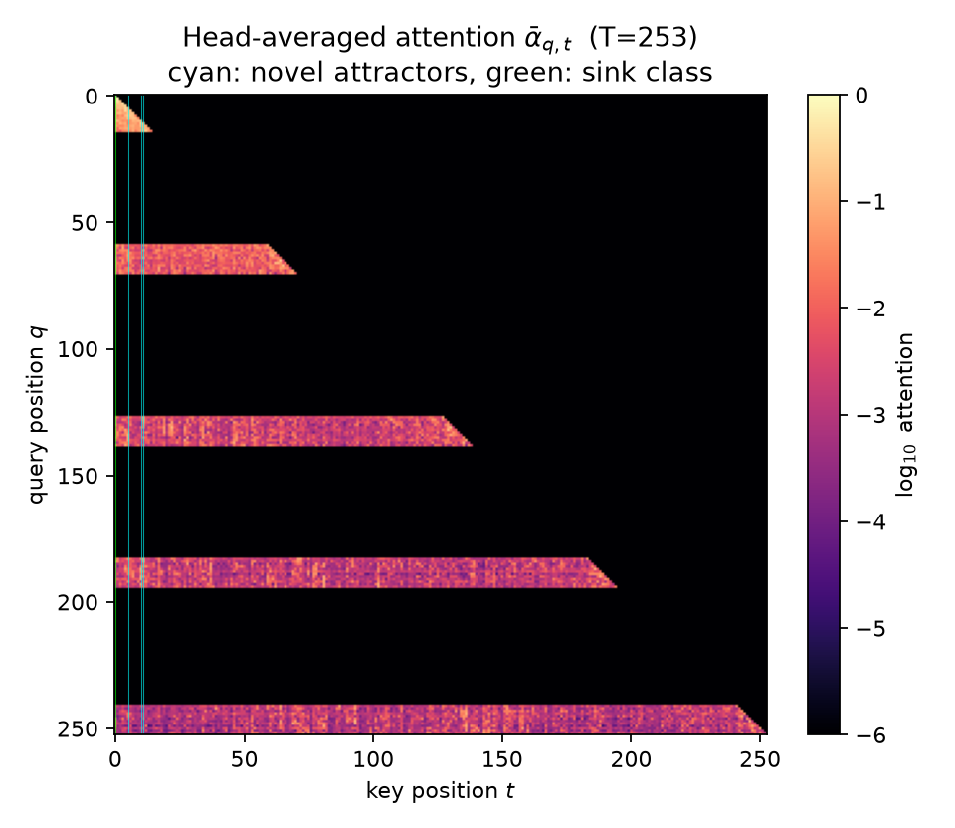
Module 1 · Multi-agent harness: three memory arms
The receiver never sees stereotype content directly — only what the arm lets through
shared-kv
135
Sender's KV segment for the turn is grafted into the receiver's cache (RoPE re-indexed, channel = peer).
conversations
text-only
248
Only the sender's generated text tokens are appended to the receiver.
tokens / receiver cache
isolated
Control: the agents never interact.
1.0s
per conversation (CPU)
Semantic pressure π
Head-averaged attention of one shared-KV conversation (π = 1). Cyan: novel attractors, green: sink class.
Fraction of the sender's context items that are stereotype-consistent — realised exactly (16 items → 1/16 resolution), not in expectation.

Slide 5
Module 2 · Four metrics and the attractor criterion
All three conditions must hold jointly; early positions (t ≤ 4) are reported as the known attention-sink class
KV reuse score
R(t) = 1/(T−t) · Σ_{q>t} (q+1)·ᾱ_{q,t}
Uniform attention scores exactly 1 (0-indexed baseline 1/(q+1)). Attractors score ≫ 1. Unit test: uniform cache → 1.000.
Memory Attractor
A = { t : z_R(t) > z* ∧ L(t) > λT ∧ P(t) > p* }
Pre-registered: z* = 1.0, λ = 0.30, p* = 0.10 — fixed in config before the runs, never tuned after.
Memory lifetime
L(t) = max{ q−t : α̃_q(t) > κ · baseline_w(q) }
Trailing window w = 8; baseline smoothed with the same window so uniform attention scores exactly the threshold (lifetime 0).
Attention persistence
P(t) = 1/((T−t)·L·H) · Σ_q Σ_{ℓ,h} 1[t ∈ TopK_k(αᵍ,ʰ_q,·)]
k = 8; counted online by the tap with a scatter over the top-k indices, strictly for q > t.
Sink class held out
PageRank alone crowns position 0 (a self-loop absorbing node). That is Xiao et al.'s attention sink — already known, so only structures outside t ≤ 4 count as a finding.
Centrality
c(t) = (1−d)/T + d · Σ_q ᾱ_{q,t}/Σ_{t'} ᾱ_{q,t'} · c(q)
PageRank, d = 0.85, dangling nodes redistributed. Verified against networkx to 1e-6.

Slide 6
Module 2 · Attractors found in the receiver's cache
Where do persistent structures sit, and are they the sink or something new?
Channel of novel attractors
Sink vs non-sink (mean reuse score)
system: 12 · probe: 47 · peer: 51 · agent: 61
80.0% of shared-KV conversations contain at least one novel attractor.
sink class R = 1.45 vs non-sink R = 1.11; persistence 0.28 vs 0.12. Sinks are a different regime, not a stronger version of the same thing.

Slide 7
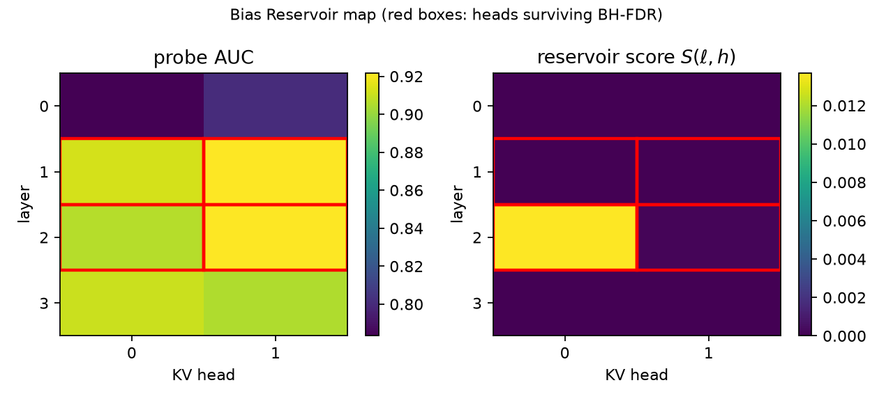
Module 2 · Bias Reservoir localisation
Predictive evidence alone is not enough — a head must also causally carry the bias
u[l,h] = mean_{t in A_n} v[l,h,t] # pool
AUC = 5-fold CV logistic probe(u->y) # y = polarity
p = permutation test (random-head null)
S(l,h) = AUC * max(0, (B - B_abl)/B) # measured
reservoirs = top-m by S among FDR survivors
head | AUC | q (BH) | ablation effect | score S | reservoir
L2 H0 | 0.906 | 0.024 | 0.015 | 0.014 | yes
L2 H1 | 0.922 | 0.024 | 0.000 | 0.000 | yes
L1 H1 | 0.921 | 0.024 | 0.000 | 0.000 | yes
L1 H0 | 0.913 | 0.024 | 0.000 | 0.000 | yes
L3 H0 | 0.911 | 0.024 | 0.000 | 0.000 | no
L3 H1 | 0.905 | 0.024 | 0.000 | 0.000 | no
Result
4 of 8 (layer, KV-head) pairs survive BH-FDR and form the reservoir set (labels: B > median(B), n = 135).
Ablation effect is measured by replaying 3 top-pressure shared-KV cells with each head ablated at the 13 novel-attractor target positions.

Slide 8
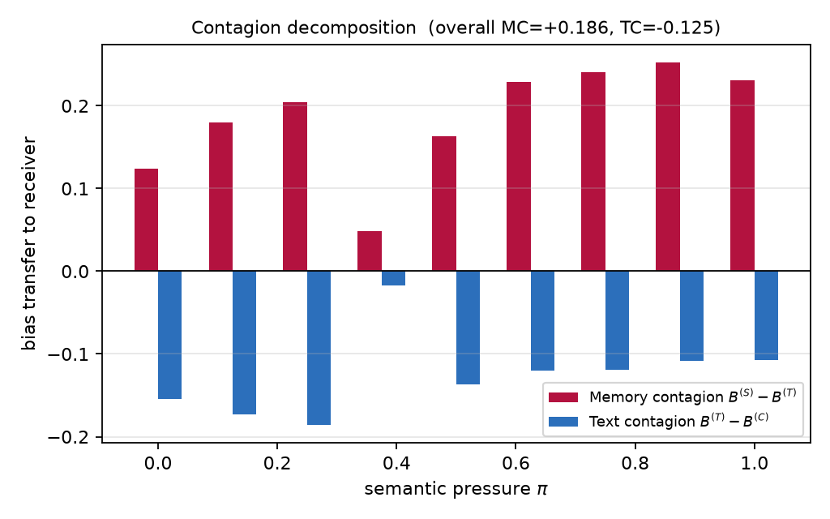
Module 3 · Memory Contagion, defined as a residual
If everything the receiver picks up is explainable by the text it saw, MC is zero by construction
MC(pi) = B_j(S) - B_j(T) # memory-mediated
TC(pi) = B_j(T) - B_j(C) # text-mediated
# S shared-KV, T text-only, C isolated; j = receiver
+0.231
+0.124
MC at π = 1 (all stereotype)
MC at π = 0 (all counter)
Statistics
Memory contagion is signed by what the sender saw: shared-KV bias runs +0.341 → +0.495 across π while text-only stays +0.217 → +0.265 and isolated +0.372.
Pooled over π: MC = +0.186 [+0.034, +0.340], TC = -0.125 (Mann-Whitney p = 8.54e-2, n = 45 vs 45).
Corroboration — transfer entropy sender→receiver (bits): shared 0.005, text-only 0.117, isolated 0.219. Attractor-set Jaccard overlap (shared-KV, via provenance sourcePosition): 0.105.

Slide 9
Module 3 · Bias versus semantic pressure
Receiver bias index B as the sender's context becomes more stereotype-consistent (mean ± s.e.m. over 5 seeds)
Logistic fit (shared-KV)
B(π) = B₀ + (B₁ − B₀) / (1 + e^{−κ(π − π_c)})
B₀ = 0.376, B₁ = 0.504
κ = 18.45 [1.17, 166.53]
π_c = 0.560 [-0.500, 1.449]
R² = 0.926
Reading the curve
isolated is flat by construction — it is the weight-level prior.
The gap between shared-KV and text-only at each π is the memory-mediated part.
Peak susceptibility χ = dB/dπ = 0.44 at π_c.

Slide 10
Module 3 · Is it a phase transition? Pre-registered criteria
A transition is claimed only if every criterion holds — the checklist was fixed before the runs
✗ fail
Logistic beats linear null (AIC)
AIC -66.27 vs -67.31
✗ fail
Logistic beats linear null (BIC)
BIC -65.48 vs -66.92
✗ fail
κ CI excludes the linear regime (κ ≤ 2)
κ ∈ [1.17, 166.53]
✓ pass
Independent changepoint inside CI(π_c)
changepoint at π = 0.563; CI(π_c) = [-0.500, 1.449]
✓ pass
Agreement across ≥ 3 seeds
3 of 5 seeds support the logistic fit individually
✗ fail
Replication across ≥ 2 models
1 model in the testbed run — requires the Llama / Mistral / Qwen sweep
Verdict on this testbed: not all criteria hold → no transition claimed. Negative results are reported, not discarded (design §11.7).

Slide 11
Module 4 · Three KV-only edits, seed-matched replay
No gradient is taken, no parameter is written — the whole method runs at inference cost
ablate
Seed-matched replay
scores[h][:, S] = -inf
Pre-softmax logit of every target entry → −∞, then renormalise.
Every conversation is a pure function of (arm, π, seed): the baseline and intervened runs see identical seeds, schedules and context — they differ only in the KV edit.
ACE(S) = E[B | do(S)] − E[B], estimated by paired replay over 15 cells (shared-KV, the three highest pressure levels × 5 seeds).
perturb
v_eff[kv, S] = v - eps*(v@w_hat)*w_hat
Project the probe direction out of target value vectors: v ← v − ε(ŵᵀv)ŵ.
gate
Two negative controls, one budget
attn[h][:, S] *= g ; attn /= attn.sum()
Rescale attention to the target set by g ∈ [0,1], renormalise. Equivalent to adding log g pre-softmax.
random-head: same size, heads drawn from the non-reservoir pool.
sink-only: reservoir heads, but only positions t ≤ 4.
Coherence budget: ΔPPL ≤ 5 % and factual accuracy within 2 points — a rejection criterion, never a reported success.
Target set S
heads = reservoir set (4 heads), positions = novel attractors (13) first, then the 32 positions the reservoir heads read most (Figure 2 refinement); GQA-mapped to query heads.

Slide 12
Module 4 · Causal effect vs. negative controls
Target set 'reservoir-read' (4 heads × 32 positions), 15 paired replay cells; accept only vs. zero, both controls (p < 0.05) and inside the budget
mode | ACE | rel. Δ | p vs 0 | p vs random | p vs sink | ΔPPL | ΔAcc | verdict
ablate | -0.102 | 20.3% | 0.000 | 0.002 | 0.015 | -2.5% | -6.7 pt | REJECT
perturb | -0.013 | 2.6% | 0.184 | 0.993 | 0.169 | -0.8% | -1.7 pt | REJECT
gate | -0.035 | 6.9% | 0.032 | 0.088 | 0.572 | -1.4% | -8.3 pt | REJECT
Reading the table
Strongest edit: ablate, ACE -0.102 (20.3% relative reduction of the receiver's bias index; design target ≥ 20 %).
ablate — budget: dAcc=-0.067
perturb — n.s. vs zero (p=0.184); ≈ random control (p=0.993); ≈ sink control (p=0.169)
gate — ≈ random control (p=0.088); ≈ sink control (p=0.572); budget: dAcc=-0.083
Figure 2 refinement loop: 2 target set(s) tried (novel-attractors ✗, reservoir-read ✗). Under the pre-registered rule this is a reported negative result, not a failure of the method.
Left: ACE per mode against both negative controls (paired replay). Table: the full acceptance test — the budget columns are rejection criteria, so a bias drop bought with lost factual accuracy is rejected.

Slide 13
Module 4 · Verification, reporting and reproducibility
What we tested, what we ship, how a reviewer re-runs it
20 unit tests on synthetic caches
Deliverables written by run_all.py
Reproduce
Uniform cache → R = 1, L = 0; planted attractor → found, sink excluded.
PageRank equals networkx to 1e-6.
Batched training forward == sequential cached forward (3.6e-7).
RoPE re-index exact; graft == native write at layer 0.
Replay determinism: identical tokens and attention on re-run.
gate(g) ≡ + log g pre-softmax; ablate zeroes only the GQA-mapped heads.
HF path on a random Llama config: HFTracingCache stamps, hooks ablate per head.
Phase fit recovers a planted π_c; rejects linear data; BH-FDR; budget rejection.
results/manifest.json — config SHA-256, git commit, seeds, versions.
results/traces/ — Parquet fact table, SQLite index, checksums.json, 5 % raw-KV sample.
results/results.json — every number in this deck.
results/figures/*.png — 6 publication figures.
results/dashboard.html — Plotly dashboard: attention flow, attractor timeline, reservoir map, curves, interventions.
rcm/report/api.py — FastAPI read-only service (/conversations, /heads/reservoir-ranking, /contagion, /replay), localhost only.
python -m pytest tests -q
python run_all.py
Total wall-clock this run: 11 min on a 6-thread CPU, no GPU.
Non-functional (design §10)
Reliability: all RNG sources seeded; deterministic algorithms on.
Security: no public listener; hashed manifests; no secrets in code.
Maintainability: one adapter file per architecture; Hydra-style YAML config.

