Slide 1
23CSE451 GRAPH MINING · CASE STUDY
Analyzing Global Arms Trade using Spectral Partitioning
SIPRI weapons data, 1950 to 2025
Raaghavan M S
V Sriman Vashishta
CSE-D · Amrita School of Computing, Amritapuri
Academic Year 2026–27 · Semester VII
AM.SC.U4CSE23330
AM.SC.U4CSE23368
Notes:
Both: Good morning. We are Raaghavan and Sriman from CSE-D. Our case study is "Analyzing Global Arms Trade using Spectral Partitioning". In short: we took 75 years of weapons deals between countries, drew them as a graph, and let a graph-mining method find the sides of world politics by itself. Raaghavan will explain the problem, the data and the method. Sriman will explain the results and how we checked them. We will finish together.

Slide 2
INTRODUCTION
Why the weapons trade?
1
A deal is a long friendship
PROBLEM STATEMENT
The buyer needs spare parts, training and repairs from the seller for many years. So countries only buy weapons from countries they trust, and the trade shows who is on whose side.
Find the groups of countries in the world weapons trade, using only the list of deals. Countries are nodes, deals are weighted edges. Cut the graph into groups that trade a lot inside and little outside, then check that the groups are real and not luck.
2
Deals are public
Friendships between countries are often secret. Weapons deals are not. SIPRI, a research institute in Sweden, has counted every major deal since 1950, a good map of world politics.
OBJECTIVES
1 Turn the weapons trade into a weighted graph
2 Clean the raw SIPRI data
3 Write spectral partitioning from scratch
4 Let the data choose how many groups there are
5 Find the countries that trade with both sides
6 Prove the groups are not luck
7 Build a website that explains all this simply
3
A graph fits
We care about who is joined to whom, and that is exactly what a graph stores. Finding the sides is a standard graph task called community detection.
Notes:
Raaghavan: Why weapons? A weapons deal is a long friendship: the buyer depends on the seller for spare parts, training and repairs for years, so countries only buy weapons from friends. Friendships between countries are often secret, but weapons deals are not. SIPRI, a research institute in Sweden, has recorded every major deal since 1950. So the weapons trade is a good map of world politics. A graph is the natural tool, because we care about who is joined to whom, and finding sides is a standard graph task called community detection. Our problem: using only the list of deals, split the countries into groups that trade a lot inside and little outside, and then prove those groups are real and not luck.

Slide 3
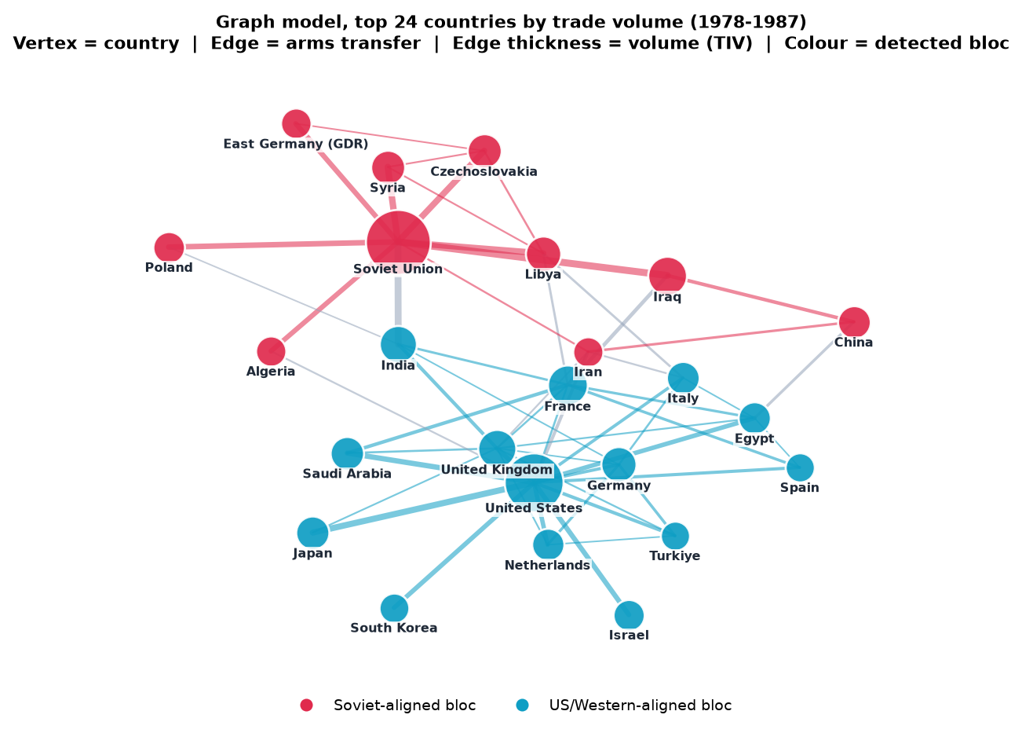
DATA & GRAPH MODEL
From 28,108 deals to 67 graphs
• Data: SIPRI Arms Transfers Database, real data (downloaded 3 August 2026). 29,916 rows, 28,108 kept after cleaning.
• Cleaning: skipped 10 lines of notes; removed 63 names that are not countries (rebels, NATO, UN) and 1,196 rows with no year.
• Deals spread over many years: the amount is shared equally between those years.
• One year has too few deals, so each graph uses 10 years: the 1987 graph holds all deals from 1978 to 1987. This gives 67 graphs (1959–2025).
• Graph: node = country (194), edge = weapons sold (2,847 seller–buyer pairs), weight = amount in TIV (military value, not money).
• Two-way lines: W = (A + Aᵀ) / 2, because friendship goes both ways.
Key fix: weight = log(1 + TIV). A few giant deals are 75,000× bigger than small ones. With raw numbers they drowned out everything and the result was worse than random. Now trading often counts more than one huge deal.
The 1978–1987 graph (top 24 countries). Colour = group found. Most lines stay inside one colour; India sits in the middle, linked to both sides.
Notes:
Raaghavan: Our data is the SIPRI Arms Transfers Database, downloaded on 3 August 2026. The file has 29,916 rows; after cleaning we kept 28,108 deals. We removed 63 names that are not countries, like rebel groups, NATO and the UN, and 1,196 rows with no year. Deals delivered over many years were shared equally between those years. One year has too few deals, so each graph uses a 10-year window: the 1987 graph holds all deals from 1978 to 1987. That gives 67 graphs from 1959 to 2025, with 194 countries and 2,847 seller-buyer pairs in total. A node is a country, an edge is weapons sold, and the weight is the amount in TIV, SIPRI's unit of military value. We made the lines two-way, because friendship goes both ways. The key fix: a few giant deals are 75,000 times bigger than small ones, and with raw numbers the result was worse than random. Taking log of 1 plus TIV fixed it. The picture shows the 1978 to 1987 graph; the colours are the groups we found, and India sits between them.

Slide 4

METHOD · SPECTRAL PARTITIONING
Shake the graph, cut where it splits
Goal: cut the graph into two groups, cutting as few strong lines as possible. Trying every cut is impossible: 155 countries have about 2^154 ways to split. Spectral partitioning finds a good cut in one step.
Idea: think of the lines as ropes and shake the whole graph. Countries tied tightly together move together. The slowest wobble moves one group up and the other group down.
That slowest wobble is the Fiedler vector, the 2nd eigenvector of the Laplacian. Each country gets one number: positive is one group, negative is the other.
Why this method: it keeps strong links inside groups, uses the weights directly, and tells us how many groups there are. Normalised version by Ng, Jordan and Weiss (2002).
Our website’s toy village of 15 houses: after the shake, only 2 ropes are cut, the fewest possible.
1 Draw the map: countries are dots, deals are ropes
2 Shake it: countries tied tightly move together
3 Each country gets a number: how it moved
4 Plus number = one side, minus number = the other
5 Result: two sides, with the fewest ropes cut
Notes:
Raaghavan: Our method is spectral partitioning, the normalised version by Ng, Jordan and Weiss, 2002. We want to cut the graph into two groups while cutting as few strong lines as possible. Trying every cut is impossible: 155 countries have about 2 to the power 154 ways to split. So here is the trick: think of the lines as ropes and shake the whole graph. Countries tied tightly together move together. The slowest wobble moves one group up and the other down. That wobble is the second eigenvector of the Laplacian, called the Fiedler vector. Each country gets one number, and the sign tells its group. The picture is our website's toy village: after the shake only 2 ropes are cut, the fewest possible. The steps at the bottom: build the weight table W and degrees D, make the normalised Laplacian, find its eigenvalues and eigenvectors, choose the number of groups at the biggest eigenvalue jump, and run k-means on the first k eigenvectors. We wrote this ourselves in Python with NumPy, SciPy and scikit-learn. The slowest step is finding eigenvalues, O(n cubed), but n is at most 174, so all 67 years plus the tests run in about 97 seconds. Now Sriman will show the results.

Slide 5
RESULTS
The world splits into two sides
Years | Group A · Soviet / Russia side | Group B · US side
1956–1965 | Soviet Union, China, Poland, East Germany, Czechoslovakia, Hungary | United States, United Kingdom, Germany, France, Italy, Japan
2016–2025 | Russia, India, China, Egypt, Pakistan, Algeria | United States, France, Saudi Arabia, Germany, South Korea, Ukraine
Never told about alliances
India sits in the middle
The program only saw who sold weapons to whom. Yet in the 1960s Group A is the Warsaw Pact and Group B is NATO. The two sides last the whole time from 1959 to 2025: one led by the Soviet Union (later Russia), one led by the United States.
Some countries trade with both sides. We find them with betweenness centrality: how often a country lies on the path between two others. India is the clearest: in 1978–1987 its biggest seller was the Soviet Union, but it also bought from Britain, France and West Germany. 43% of its trade crossed sides.
Notes:
Sriman: So who ended up together? In 1956 to 1965, Group A is the Soviet Union, China, Poland, East Germany, Czechoslovakia and Hungary. Group B is the United States, United Kingdom, Germany, France, Italy and Japan. The program was never told about any alliance, yet Group A is the Warsaw Pact and Group B is NATO. In 2016 to 2025, Group A is led by Russia with India, China, Egypt, Pakistan and Algeria; Group B is led by the United States with France, Saudi Arabia, Germany, South Korea and Ukraine. Some countries trade with both sides; we found them using betweenness centrality, which measures how often a country lies on the path between two others. The clearest is India: in 1978 to 1987 its biggest seller was the Soviet Union, but it also bought from Britain, France and West Germany, so 43 percent of its trade crossed sides.

Slide 6
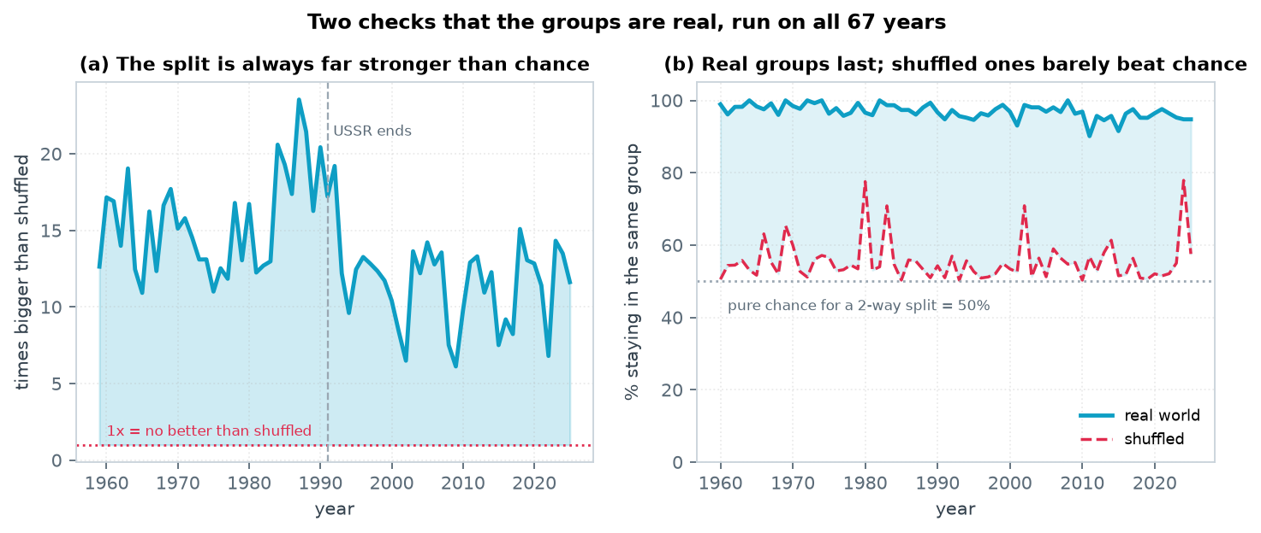
CHECKING THE RESULT
Is it real, or just luck?
The test: we made fake copies of the world: the same countries and the same number of deals, but joined at random, like shuffling a pack of cards. Then we ran the same steps on the fake copies, 10 times for every year.
14×
The real sides are about 14 times clearer than in the fake copies, and much clearer in every single year from 1959 to 2025.
97 vs 55
Out of 100 countries, 97 stay on the same side the next year. In the fake copies only 55 do, close to tossing a coin.
18% vs 34%
Left: how many times clearer the real sides are than the fake ones, for every year. Right: how many countries stay on the same side the next year (blue = real world, red = fake copies).
In 1987 only 18 out of 100 trade links crossed between the two sides. In a fake copy, 34 did.
Notes:
Sriman: How do we know this is not just luck? We made fake copies of the world: the same countries and the same number of deals, but joined at random, like shuffling a pack of cards. We ran the same steps on them, 10 times for every year, and compared. First, the real sides are about 14 times clearer than in the fake copies, and much clearer in every single year. Second, out of 100 countries, 97 stay on the same side the next year; in the fake copies only 55 do, which is close to tossing a coin. Third, in 1987 only 18 out of 100 trade links crossed between the two sides, against 34 in a fake copy. So the two sides really come from the data, not from luck.

Slide 7
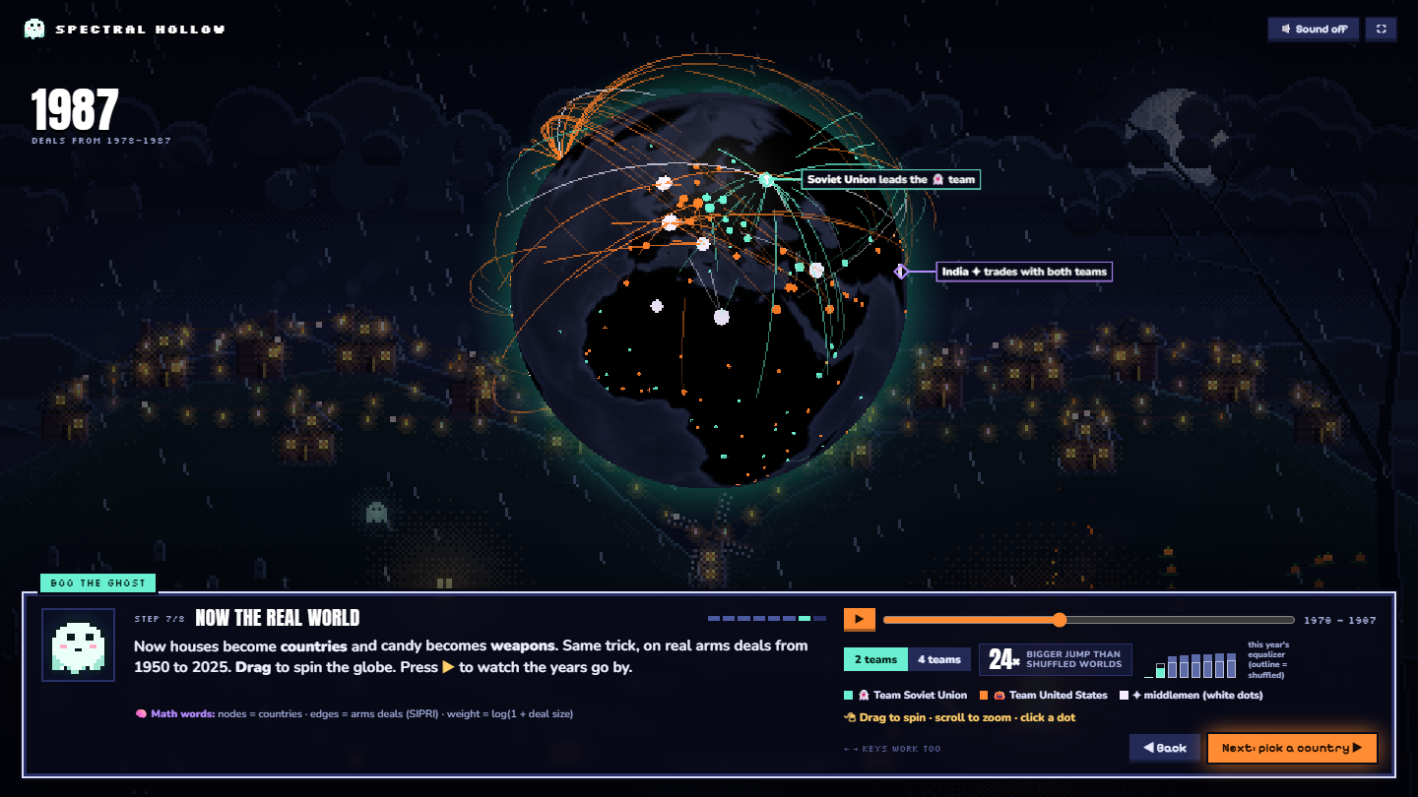
CONCLUSION · BOTH SPEAKERS
What we learned
We modelled the world weapons trade as a graph, with countries as nodes and deals as weighted edges. Spectral partitioning split it into two sides in every year, matching the real Cold War blocs and far stronger than random. Graph mining can find real political groups from trade data alone.
Biggest lesson: how you build the graph matters more than the algorithm. Raw weights failed; one small change, the logarithm, made it work.
Testing against shuffled networks taught us to prove a result, not just show it.
Limits
• Every country gets exactly one group, even neutral ones
• SIPRI counts only major weapons, not small arms
• The 10-year window makes changes show up slowly
Our website explains it all: a toy village first, then the real data on a 3D globe.
Try it: arms.armstrade.workers.dev
Cost: time O(n³), space O(n²). With n ≤ 174, all 67 years plus the shuffled tests run in about 97 seconds (Python, NumPy, SciPy, scikit-learn).
References: SIPRI Arms Transfers Database · von Luxburg 2007 · Ng, Jordan & Weiss 2002 · Shi & Malik 2000 · Fiedler 1973
Notes:
Sriman: To conclude: we modelled the world weapons trade as a graph, with countries as nodes and deals as weighted edges. Spectral partitioning split it into two sides in every year, matching the real Cold War blocs, and the split is far stronger than in random networks. So graph mining can find real political groups from trade data alone. Raaghavan: Our biggest lesson is that how you build the graph matters more than the algorithm. With raw weights the method failed; one small change, taking the logarithm, made it work. Testing against shuffled networks also taught us to prove a result, not just show it. Our limits: every country gets exactly one group, even neutral ones; SIPRI counts only major weapons, not small arms; and the 10-year window makes changes show up slowly. We also built a website that explains all of this with a toy village and a 3D globe of the real data. Both: Thank you. We are happy to take questions.

