Slide 1
PHP Data Object (PDO)
Ekta Makawama
Notes:
‹#›

Slide 2
What is PDO?
PDO is a PHP extension to formalise PHP's database connections by creating a uniform interface. This allows developers to create code which is portable across many databases and platforms.
PDO is not just another abstraction layer like PEAR DB or ADOdb.
Notes:
‹#›

Slide 3
Why use PDO?
Portability
Performance
Power
Easy
Runtime Extensible
Notes:
‹#›

Slide 4
What databases does it support?
Microsoft SQL Server / Sybase
Firebird / Interbase
DB2 / INFORMIX (IBM)
MySQL
OCI (Oracle Call Interface)
ODBC
PostgreSQL
SQLite
Notes:
‹#›

Slide 5
DSNs
In general
drivername:<driver-specific-stuff>
mysql:host=name;dbname=dbname
odbc:odbc_dsn
oci:dbname=dbname;charset=charset
sqlite:/path/to/db/file
sqlite::memory:
Notes:
‹#›

Slide 6
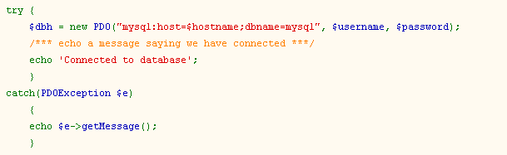
Connect to MySQL
Notes:
‹#›

Slide 7
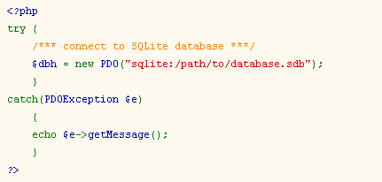
Connect to SQLite (file)
Notes:
‹#›

Slide 8
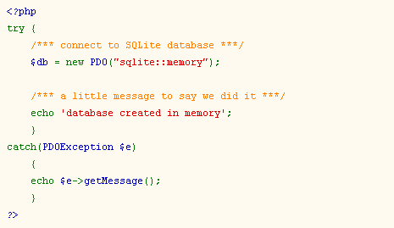
Connect to SQLite (memory)
Notes:
‹#›

Slide 9
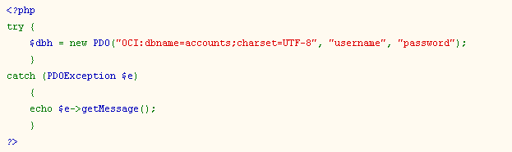
Connect to Oracle
Notes:
‹#›

Slide 10
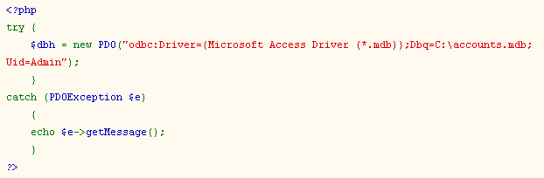
Connect to ODBC
Notes:
‹#›

Slide 11
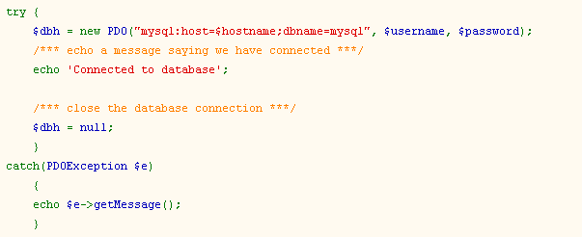
Close a Database Connection
Notes:
‹#›

Slide 12
Persistent PDO Connection
Connection stays alive between requests
$dbh = new PDO($dsn, $user, $pass,
array(
PDO_ATTR_PERSISTENT => true
)
);
Notes:
‹#›

Slide 13
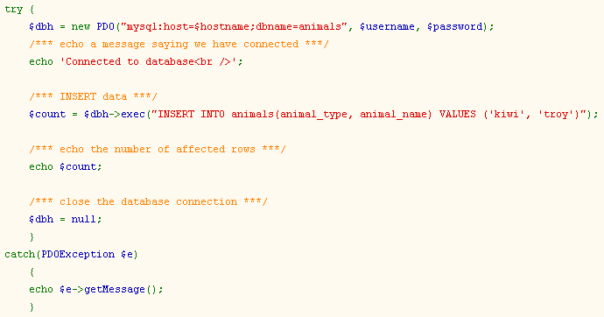
PDO Query (INSERT)
Notes:
‹#›

Slide 14
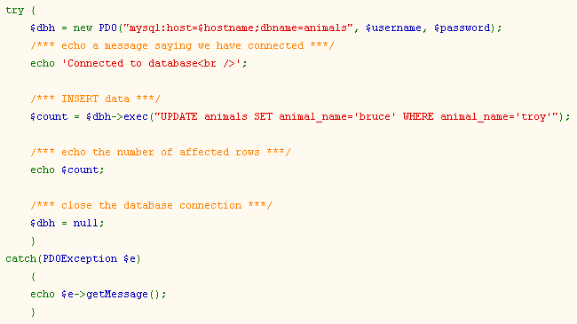
PDO Query (UPDATE)
Notes:
‹#›

Slide 15
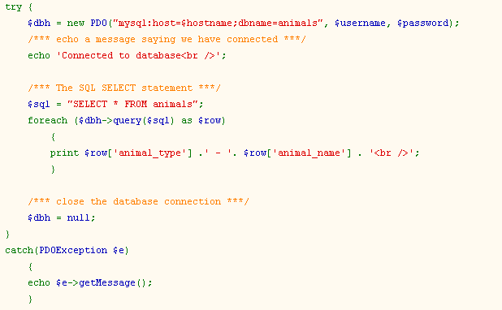
PDO Query (SELECT)
Notes:
‹#›

Slide 16
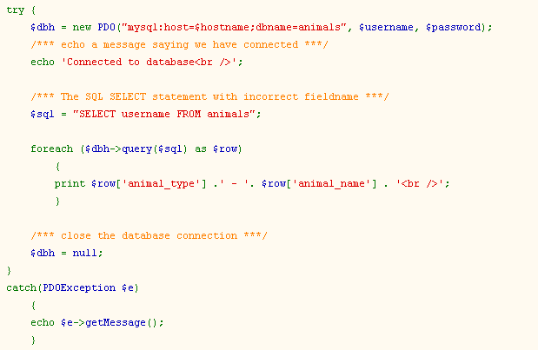
Error Handling (1)
Notes:
‹#›

Slide 17

Error Handling (2)
Notes:
‹#›

Slide 18
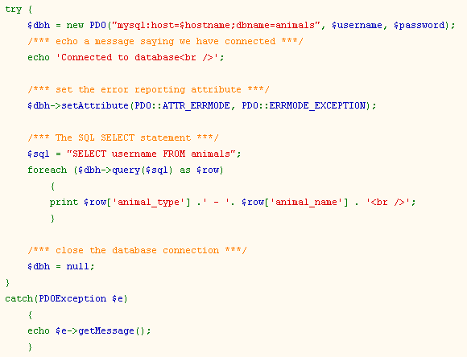
Error Handling (3)
Notes:
‹#›

Slide 19

Error Handling (4)
Notes:
‹#›

Slide 20
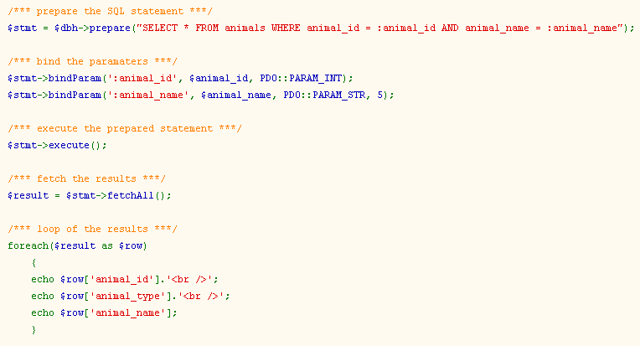
Prepared statements
Notes:
‹#›

Slide 21
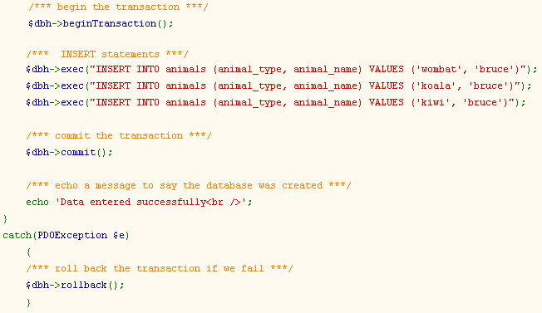
Transactions
Notes:
‹#›

Slide 22
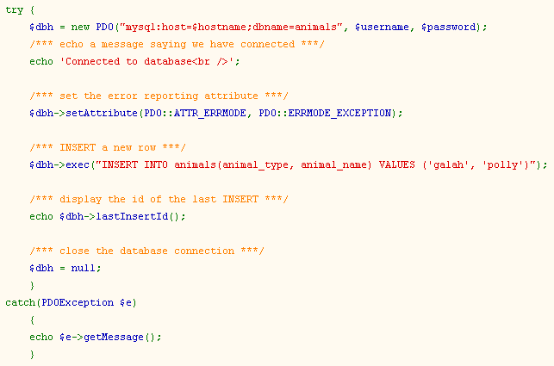
Get Last Insert Id
Notes:
‹#›

Slide 23
Benchmark
MySQL SELECT Benchmark Results, 1000 Requests
Library | Concurrency | Total Time | Requests/Sec. | Speedup
ADOdb | 1 | 20.90/sec | 47.84 | -
PDO | 1 | 0.73/sec | 1358.62 | +2840%
ADOdb | 50 | 10.78/sec | 99.23 | -
PDO | 50 | 0.54/sec | 1850.90 | +1865%
ADOdb | 100 | 10.44/sec | 95.78 | -
PDO | 100 | 0.53/sec | 1869.33 | +1952%
Notes:
‹#›

Slide 24

Questions
Notes:
‹#›

