Slide 1

Accessing MySQL Using PDO
Charles Severance
www.wa4e.com
http://www.wa4e.com/code/pdo.zip

Slide 2


Time
Browser
Web Server
Database Server
DOM
MySql
Send
Request
Apache
Parse
Response
PHP
first.php
PDO
JavaScript
RRC/HTTP
SQL

Slide 3
Application
Software
(PHP)
Database
Data Model
End
User
SQL
SQL
Developer
Database
Tools (phpMyAdmin)
DBA

Slide 4
Multiple Ways to Access MySql
PHP is evolving - there are three ways to access MySql
- Legacy non-OO mysql_ routines (deprecated)
- New mysqli (OO version that is similar to mysql_)
- PDO - Portable Data Objects
A perfect topic for debate
http://php.net/manual/en/mysqlinfo.api.choosing.php

Slide 5
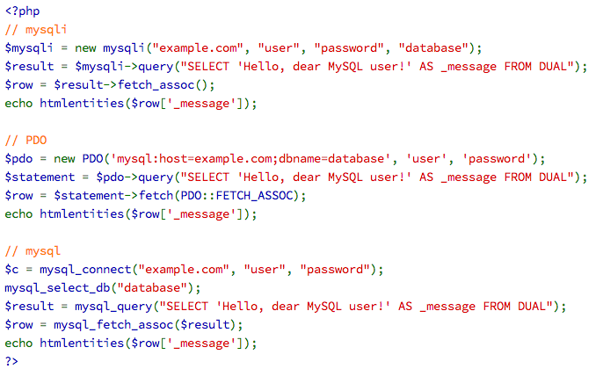
http://php.net/manual/en/mysqlinfo.api.choosing.php

Slide 6
Creating a Database and User
CREATE DATABASE misc;
GRANT ALL ON misc.* TO 'fred'@'localhost' IDENTIFIED BY 'zap';
GRANT ALL ON misc.* TO 'fred'@'127.0.0.1' IDENTIFIED BY 'zap';
USE misc; (if you are at the command line)
/Applications/MAMP/Library/bin/mysql -u root -P 8889 -p
/Applications/xampp/xamppfiles/bin/mysql -u root -p
c:\xampp\mysql\bin\mysql.exe

Slide 7
Creating a Table
CREATE TABLE users (
user_id INTEGER NOT NULL AUTO_INCREMENT,
name VARCHAR(128),
email VARCHAR(128),
password VARCHAR(128),
PRIMARY KEY(user_id),
INDEX(email)
) ENGINE=InnoDB CHARSET=utf8;
mysql> describe users;
+----------+------------------+------+-----+---------+----------------+
| Field | Type | Null | Key | Default | Extra |
+----------+------------------+------+-----+---------+----------------+
| user_id | int(11) | NO | PRI | NULL | auto_increment |
| name | varchar(128) | YES | | NULL | |
| email | varchar(128) | YES | MUL | NULL | |
| password | varchar(128) | YES | | NULL | |
+----------+------------------+------+-----+---------+----------------+

Slide 8
Inserting a Few Records
INSERT INTO users (name,email,password) VALUES ('Chuck','csev@umich.edu','123');
INSERT INTO users (name,email,password) VALUES ('Glenn','gg@umich.edu','456');
mysql> select * from users;
+---------+-------+----------------+----------+
| user_id | name | email | password |
+---------+-------+----------------+----------+
| 1 | Chuck | csev@umich.edu | 123 |
| 2 | Glenn | gg@umich.edu | 456 |
+---------+-------+----------------+----------+

Slide 9
Database Connection
Hostname
misc
sakai
users
http://www.wa4e.com/code/pdo.zip

Slide 10
Database Connection
pdo.php
Hostname
PHP
Software
SQL
misc
sakai
users
id / password
3306 for xampp/linux
$pdo = new PDO('mysql:host=localhost;port=8889;dbname=misc',
'fred', 'zap');

Slide 11
<?php
echo "<pre>\n";
$pdo=new PDO('mysql:host=localhost;port=8889;dbname=misc',
'fred', 'zap');
$stmt = $pdo->query("SELECT * FROM users");
$rows = $stmt->fetchAll(PDO::FETCH_ASSOC);
print_r($rows);
echo "</pre>\n";?>
first.php
Array(
[user_id] => 1
[name] => Chuck
[email] => csev@umich.edu
[password] => 123
)
Array(
[user_id] => 2
[name] => Glenn
[email] => gg@umich.edu
[password] => 456
)
mysql> select * from users;
+---------+-------+----------------+----------+ | user_id | name | email | password |
+---------+-------+----------------+----------+
| 1 | Chuck | csev@umich.edu | 123 |
| 2 | Glenn | gg@umich.edu | 456 |
+---------+-------+----------------+----------+

Slide 12

<?php
$pdo = new PDO('mysql:host=localhost;port=8889;dbname=misc',
'fred', 'zap');
$stmt = $pdo->query("SELECT name, email, password FROM users");
$rows = $stmt->fetchAll(PDO::FETCH_ASSOC);
echo '<table border="1">'."\n";
foreach ( $rows as $row ) {
echo "<tr><td>";
echo($row['name']);
echo("</td><td>");
echo($row['email']);
echo("</td><td>");
echo($row['password']);
echo("</td></tr>\n");
}
echo "</table>\n";?>
second.php
<table border="1">
<tr><td>Chuck</td><td>csev@umich.edu</td><td>123</td></tr>
<tr><td>Glenn</td><td>gg@umich.edu</td><td>456</td></tr>
</table>

Slide 13
Pattern
Put database connection information in a single file and include it in all your other files.
Helps make sure to not to mistakenly reveal id / pw
Don’t check it into a public source repository :)

Slide 14
pdo.php
3306 for xampp/linux
<?php
$pdo = new PDO('mysql:host=localhost;port=8889;dbname=misc',
'fred', 'zap');
// See the "errors" folder for details...
$pdo->setAttribute(PDO::ATTR_ERRMODE, PDO::ERRMODE_EXCEPTION);
third.php
Array(
[user_id] => 1
[name] => Chuck
[email] => csev@umich.edu
[password] => 123
)
Array(
[user_id] => 2
[name] => Glenn
[email] => gg@umich.edu
[password] => 456
)
<?php
require_once "pdo.php";
echo "<pre>\n";
$stmt = $pdo->query("SELECT * FROM users");
$rows = $stmt->fetchAll(PDO::FETCH_ASSOC);
print_r($rows);
echo "</pre>\n";?>

Slide 15
Let’s Put Some Data in a Database!

Slide 16
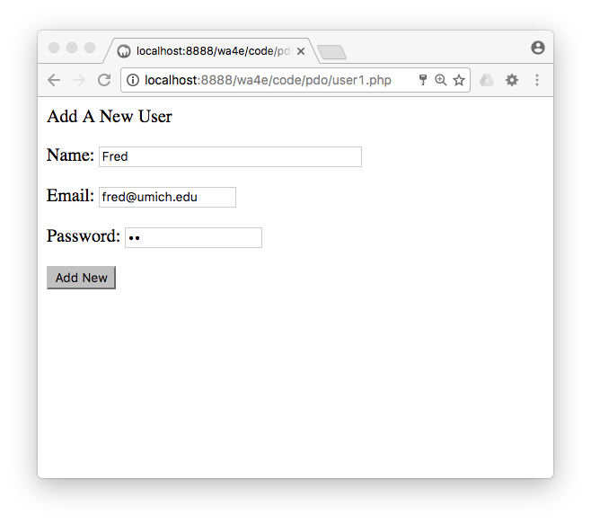
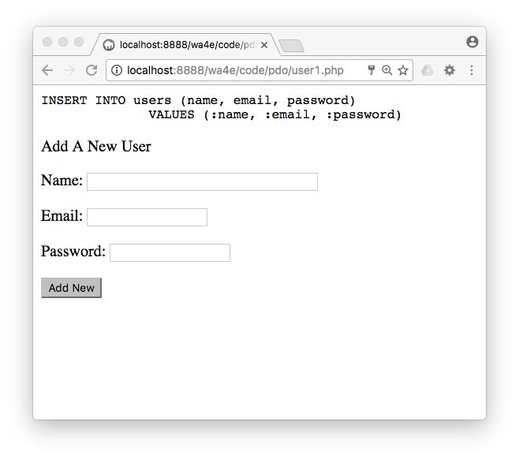
<?php
require_once "pdo.php";
if ( isset($_POST['name']) && isset($_POST['email'])
&& isset($_POST['password'])) {
$sql = "INSERT INTO users (name, email, password)
VALUES (:name, :email, :password)";
echo("<pre>\n".$sql."\n</pre>\n");
$stmt = $pdo->prepare($sql);
$stmt->execute(array(
':name' => $_POST['name'],
':email' => $_POST['email'],
':password' => $_POST['password']));
}
?><html><head></head><body>
<p>Add A New User</p>
<form method="post">
<p>Name:<input type="text" name="name" size="40"></p>
<p>Email:<input type="text" name="email"></p>
<p>Password:<input type="password" name="password"></p>
<p><input type="submit" value="Add New"/></p>
</form>
</body>
user1.php

Slide 17
user1.php
mysql> select * from users;
+---------+-------+----------------+----------+
| user_id | name | email | password |
+---------+-------+----------------+----------+
| 1 | Chuck | csev@umich.edu | 123 |
| 2 | Glenn | gg@umich.edu | 456 |
| 3 | Sally | sally@uiuc.edu | 123 |
| 4 | Fred | fred@umich.edu | YO |
+---------+-------+----------------+----------+

Slide 18
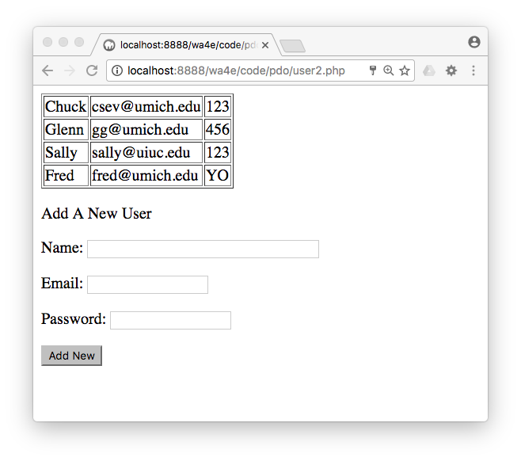
if ( isset($_POST['name']) && isset($_POST['email'])
&& isset($_POST['password'])) {
$sql = "INSERT INTO users (name, email, password)
VALUES (:name, :email, :password)";
echo("<pre>\n".$sql."\n</pre>\n");
$stmt = $pdo->prepare($sql);
$stmt->execute(array(
':name' => $_POST['name'],
':email' => $_POST['email'],
':password' => $_POST['password']));
}
$stmt = $pdo->query("SELECT name, email, password FROM users");
$rows = $stmt->fetchAll(PDO::FETCH_ASSOC);
?>
<html>
<head></head><body><table border="1">
<?php
foreach ( $rows as $row ) {
echo "<tr><td>";
echo($row['name']);
echo("</td><td>");
echo($row['email']);
echo("</td><td>");
echo($row['password']);
echo("</td></tr>\n");
}
?>
</table>
<p>Add A New User</p>
user2.php

Slide 19
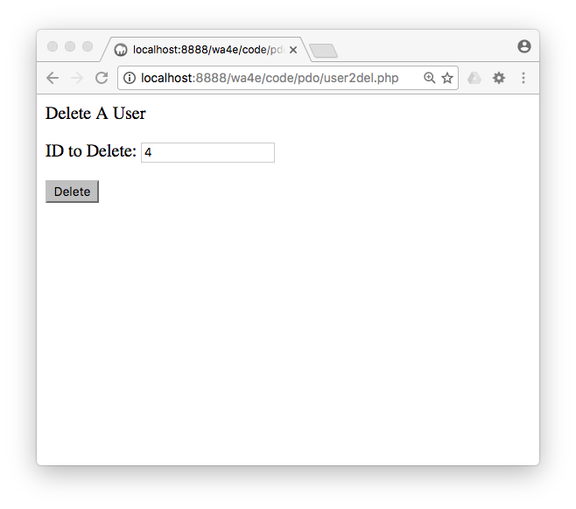
<?php
require_once "pdo.php";
if ( isset($_POST['user_id']) ) {
$sql="DELETE FROM users WHERE user_id = :zip";
echo "<pre>\n$sql\n</pre>\n";
$stmt = $pdo->prepare($sql);
$stmt->execute(array(':zip'=>$_POST['user_id']));
}
?>
<p>Delete A User</p>
<form method="post"><p>ID to Delete:
<input type="text" name="user_id"></p>
<p><input type="submit" value="Delete"/></p>
</form>
user2del.php

Slide 20
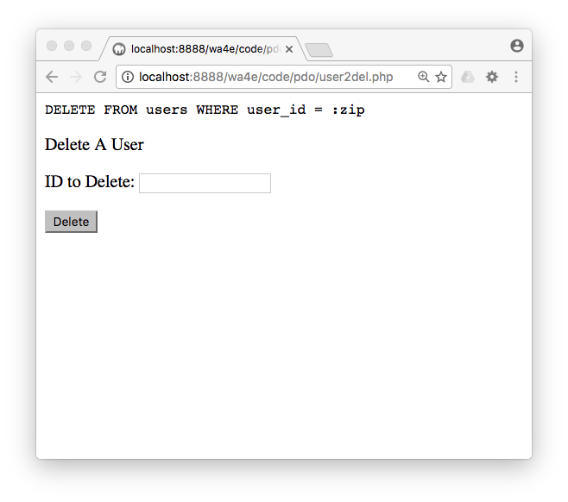
<?php
require_once "pdo.php";
if ( isset($_POST['user_id']) ) {
$sql="DELETE FROM users WHERE user_id = :zip";
echo "<pre>\n$sql\n</pre>\n";
$stmt = $pdo->prepare($sql);
$stmt->execute(array(':zip'=>$_POST['user_id']));
}
?>
<p>Delete A User</p>
<form method="post"><p>ID to Delete:
<input type="text" name="user_id"></p>
<p><input type="submit" value="Delete"/></p>
</form>
user2del.php

Slide 21
mysql> select * from users;
+---------+-------+----------------+----------+
| user_id | name | email | password |
+---------+-------+----------------+----------+
| 1 | Chuck | csev@umich.edu | 123 |
| 2 | Glenn | gg@umich.edu | 456 |
| 3 | Sally | sally@uiuc.edu | 123 |
+---------+-------+----------------+----------+

Slide 22
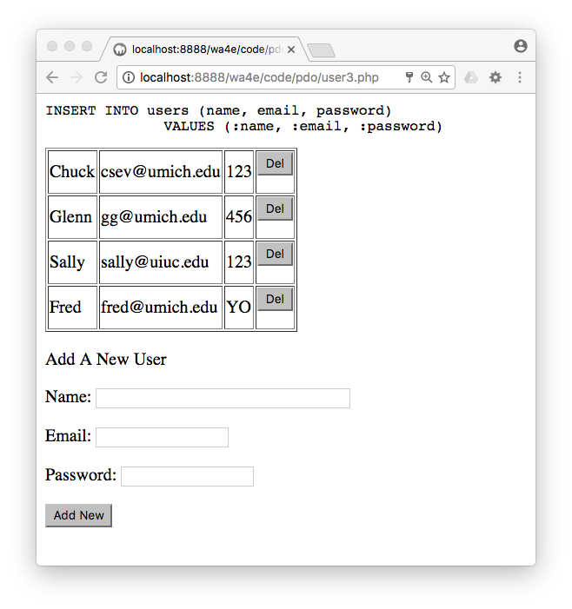
user3.php

Slide 23
if ( isset($_POST['delete']) && isset($_POST['user_id']) ) {
$sql = "DELETE FROM users WHERE user_id = :zip";
echo "<pre>\n$sql\n</pre>\n";
$stmt = $pdo->prepare($sql);
$stmt->execute(array(':zip' => $_POST['user_id']));
}
$stmt = $pdo->query("SELECT name, email, password, user_id FROM users");
$rows = $stmt->fetchAll(PDO::FETCH_ASSOC);
?><html><head></head>
<body>
<table border="1">
<?php
foreach ( $rows as $row ) {
echo "<tr><td>";
echo($row['name']);
echo("</td><td>");
echo($row['email']);
echo("</td><td>");
echo($row['password']);
echo("</td><td>");
echo('<form method="post"><input type="hidden" ');
echo('name="user_id" value="'.$row['user_id'].'">'."\n");
echo('<input type="submit" value="Del" name="delete">');
echo("\n</form>\n");
echo("</td></tr>\n");
}
user3.php

Slide 24
echo('<form method="post"><input type="hidden" ');
echo('name="user_id" value="'.$row['user_id'].'">'."\n");
echo('<input type="submit" value="Del" name="delete">');
echo("\n</form>\n");
<tr><td>Fred</td><td>fred@umich.edu</td>
<td>YO</td>
<td><form method="post">
<input type="hidden" name="user_id" value="5">
<input type="submit" value="Del" name="delete">
</form></td>
</tr>
if ( isset($_POST['delete']) &&
isset($_POST['user_id']) ) {
$sql = "DELETE FROM users WHERE user_id = :zip";
echo "<pre>\n$sql\n</pre>\n";
$stmt = $pdo->prepare($sql);
$stmt->execute(array(':zip' => $_POST['user_id']));
}

Slide 25
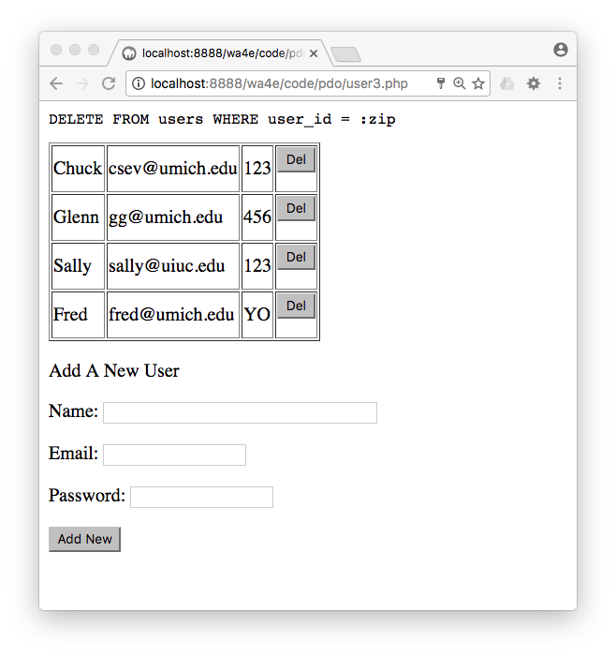
if ( isset($_POST['delete']) && isset($_POST['user_id']) ) {
$sql = "DELETE FROM users WHERE user_id = :zip";
echo "<pre>\n$sql\n</pre>\n";
$stmt = $pdo->prepare($sql);
$stmt->execute(array(':zip' => $_POST['user_id']));
}

Slide 26
Program Outline
<?php
require_once "pdo.php";
if ( isset($_POST['name']) && isset($_POST['email'])
&& isset($_POST['password'])) {
$sql = "INSERT INTO users (name, email, password)
VALUES (:name, :email, :password)";
echo("<pre>\n".$sql."\n</pre>\n");
$stmt = $pdo->prepare($sql);
$stmt->execute(array(
':name' => $_POST['name'],
':email' => $_POST['email'],
':password' => $_POST['password']));
}
if ( isset($_POST['delete']) && isset($_POST['user_id']) ) {
$sql = "DELETE FROM users WHERE user_id = :zip";
echo "<pre>\n$sql\n</pre>\n";
$stmt = $pdo->prepare($sql);
$stmt->execute(array(':zip' => $_POST['user_id']));
}
$stmt = $pdo->query("SELECT name, email, password, user_id FROM users");
$rows = $stmt->fetchAll(PDO::FETCH_ASSOC);
?>
<?php
require_once "pdo.php";I
f ( isset($_POST['name']) && isset($_POST['email'])
&& isset($_POST['password'])) {
$sql = "INSERT INTO users (name, email, password)
VALUES (:name, :email, :password)";
echo("<pre>\n".$sql."\n</pre>\n");
$stmt = $pdo->prepare($sql);
$stmt->execute(array(
':name' => $_POST['name'],
':email' => $_POST['email'],
':password' => $_POST['password']));
}
if ( isset($_POST['delete']) && isset($_POST['user_id']) ) {
$sql = "DELETE FROM users WHERE user_id = :zip";
echo "<pre>\n$sql\n</pre>\n";
$stmt = $pdo->prepare($sql);
$stmt->execute(array(':zip' => $_POST['user_id']));
}
?>
<html><head></head>
<body>
<table border="1">
<?php
$stmt = $pdo->query("SELECT name, email, password, user_id FROM users");
while ( $row = $stmt->fetch(PDO::FETCH_ASSOC) ) {
echo "<tr><td>";
echo($row['name']);
echo("</td><td>");
echo($row['email']);
echo("</td><td>");
echo($row['password']);
echo("</td><td>");
echo('<form method="post"><input type="huser_idden" ');
echo('name="user_id" value="'.$row['user_id'].'">'."\n");
echo('<input type="submit" value="Del" name="delete">');
echo("\n</form>\n");
echo("</td></tr>\n");
}
?>
</table>
<p>Add A New User</p><form method="post">
<p>Name:<input type="text" name="name" size="40"></p>
<p>Email:<input type="text" name="email"></p>
<p>Password:<input type="password" name="password"></p><
p><input type="submit" value="Add New"/></p>
</form>
</body>

Slide 27
<html><head></head>
<body><table border="1">
<?php
foreach ( $rows as $row ) {
echo "<tr><td>";
echo($row['name']);
echo("</td><td>");
echo($row['email']);
echo("</td><td>");
echo($row['password']);
echo("</td><td>");
echo('<form method="post"><input type="hidden" ');
echo('name="user_id" value="'.$row['user_id'].'">'."\n");
echo('<input type="submit" value="Del" name="delete">');
echo("\n</form>\n");
echo("</td></tr>\n");
}
?>
</table>
<?php
require_once "pdo.php";I
f ( isset($_POST['name']) && isset($_POST['email'])
&& isset($_POST['password'])) {
$sql = "INSERT INTO users (name, email, password)
VALUES (:name, :email, :password)";
echo("<pre>\n".$sql."\n</pre>\n");
$stmt = $pdo->prepare($sql);
$stmt->execute(array(
':name' => $_POST['name'],
':email' => $_POST['email'],
':password' => $_POST['password']));
}
if ( isset($_POST['delete']) && isset($_POST['user_id']) ) {
$sql = "DELETE FROM users WHERE user_id = :zip";
echo "<pre>\n$sql\n</pre>\n";
$stmt = $pdo->prepare($sql);
$stmt->execute(array(':zip' => $_POST['user_id']));
}
?>
<html><head></head>
<body>
<table border="1">
<?php
$stmt = $pdo->query("SELECT name, email, password, user_id FROM users");
while ( $row = $stmt->fetch(PDO::FETCH_ASSOC) ) {
echo "<tr><td>";
echo($row['name']);
echo("</td><td>");
echo($row['email']);
echo("</td><td>");
echo($row['password']);
echo("</td><td>");
echo('<form method="post"><input type="huser_idden" ');
echo('name="user_id" value="'.$row['user_id'].'">'."\n");
echo('<input type="submit" value="Del" name="delete">');
echo("\n</form>\n");
echo("</td></tr>\n");
}
?>
</table>
<p>Add A New User</p><form method="post">
<p>Name:<input type="text" name="name" size="40"></p>
<p>Email:<input type="text" name="email"></p>
<p>Password:<input type="password" name="password"></p><
p><input type="submit" value="Add New"/></p>
</form>
</body>

Slide 28
Program Outline
<p>Add A New User</p>
<form method="post">
<p>Name:<input type="text" name="name" size="40"></p>
<p>Email:<input type="text" name="email"></p>
<p>Password:<input type="password" name="password"></p>
<p><input type="submit" value="Add New"/></p>
</form>
</body>
<?php
require_once "pdo.php";I
f ( isset($_POST['name']) && isset($_POST['email'])
&& isset($_POST['password'])) {
$sql = "INSERT INTO users (name, email, password)
VALUES (:name, :email, :password)";
echo("<pre>\n".$sql."\n</pre>\n");
$stmt = $pdo->prepare($sql);
$stmt->execute(array(
':name' => $_POST['name'],
':email' => $_POST['email'],
':password' => $_POST['password']));
}
if ( isset($_POST['delete']) && isset($_POST['user_id']) ) {
$sql = "DELETE FROM users WHERE user_id = :zip";
echo "<pre>\n$sql\n</pre>\n";
$stmt = $pdo->prepare($sql);
$stmt->execute(array(':zip' => $_POST['user_id']));
}
?>
<html><head></head>
<body>
<table border="1">
<?php
$stmt = $pdo->query("SELECT name, email, password, user_id FROM users");
while ( $row = $stmt->fetch(PDO::FETCH_ASSOC) ) {
echo "<tr><td>";
echo($row['name']);
echo("</td><td>");
echo($row['email']);
echo("</td><td>");
echo($row['password']);
echo("</td><td>");
echo('<form method="post"><input type="huser_idden" ');
echo('name="user_id" value="'.$row['user_id'].'">'."\n");
echo('<input type="submit" value="Del" name="delete">');
echo("\n</form>\n");
echo("</td></tr>\n");
}
?>
</table>
<p>Add A New User</p><form method="post">
<p>Name:<input type="text" name="name" size="40"></p>
<p>Email:<input type="text" name="email"></p>
<p>Password:<input type="password" name="password"></p><
p><input type="submit" value="Add New"/></p>
</form>
</body>

Slide 29
SQL Injection

Slide 30
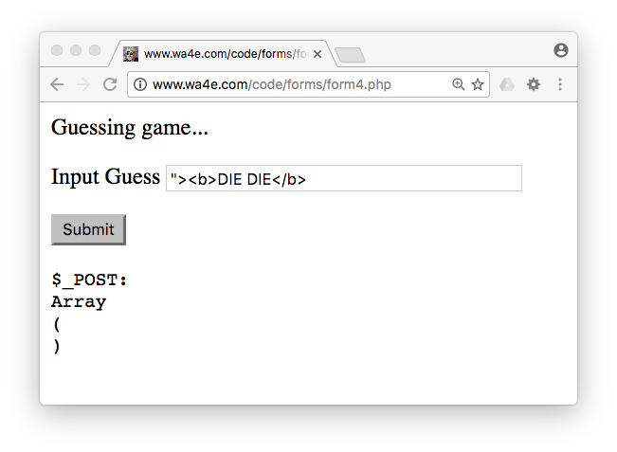
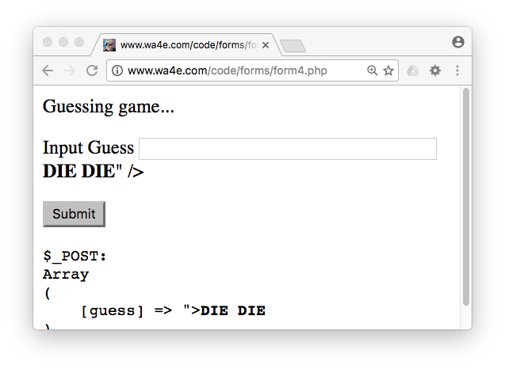
Recall HTML Injection ...

Slide 31
<form method="post">
<p><label for="guess">Input Guess</label>
<input type="text" name="guess" id="guess"
value=""><b>DIE DIE</b>" /></p>
<input type="submit"/>
</form>

Slide 32
SQL Injection
SQL injection or SQLi is a code injection technique that exploits a security vulnerability in some computer software. An injection occurs at the database level of an application (like queries). The vulnerability is present when user input is either incorrectly filtered for string literal escape characters embedded in SQL statements or user input is not strongly typed and unexpectedly executed. Using well-designed query language interpreters can prevent SQL injections.
http://en.wikipedia.org/wiki/SQL_injection

Slide 33
SQL Injection
This code does it all in a select instead of a prepare/execute pattern, but it is prone to SQL Injection – where and why?
if ( isset($_POST['email']) && isset($_POST['password']) ) {
$e = $_POST['email'];
$p = $_POST['password'];
$sql = "SELECT name FROM users
WHERE email = '$e'
AND password = '$p'";
$stmt = $pdo->query($sql);
login1.php

Slide 34
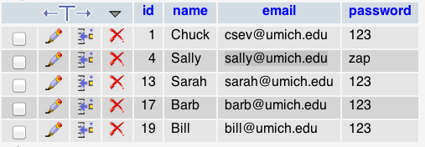
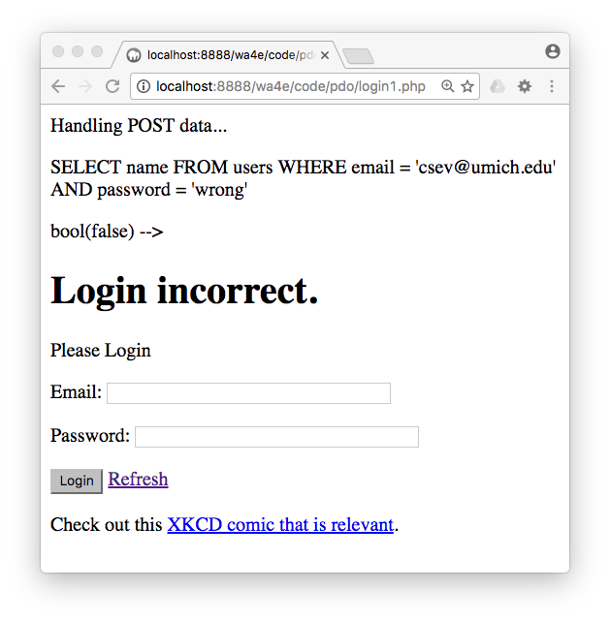
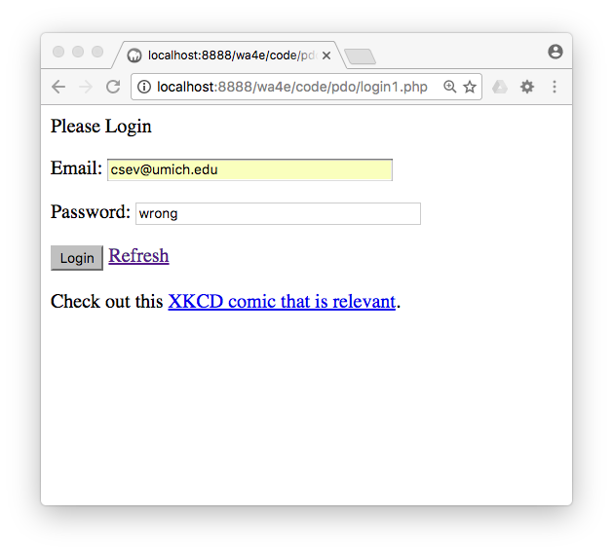
What Could Go Wrong?
login1.php

Slide 35
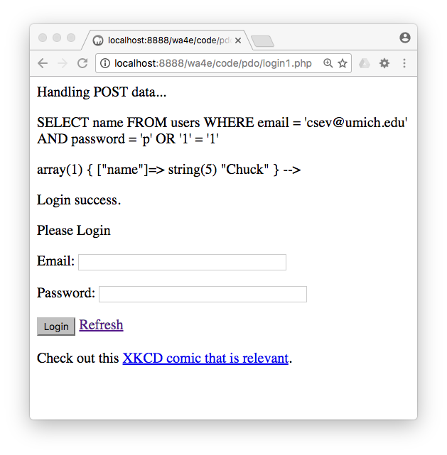
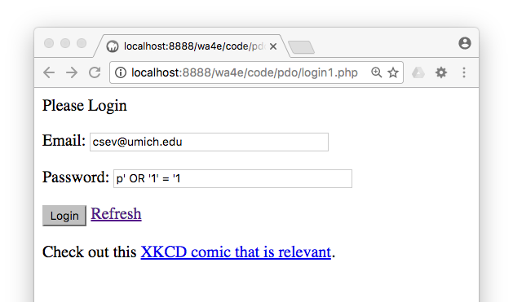
if ( isset($_POST['email']) && isset($_POST['password']) ) {
$e = $_POST['email'];
$p = $_POST['password'];
$sql = "SELECT name FROM users
WHERE email = '$e'
AND password = '$p'";
$stmt = $pdo->query($sql);
login1.php

Slide 36

http://xkcd.com/327/

Slide 37
Use Prepared Statements Properly
if ( isset($_POST['email']) && isset($_POST['password']) ) {
echo("Handling POST data...\n");
$sql = "SELECT name FROM users
WHERE email = :em AND password = :pw";
echo "<pre>\n$sql\n</pre>\n";
$stmt = $pdo->prepare($sql);
$stmt->execute(array(
':em' => $_POST['email'],
':pw' => $_POST['password']));
$row = $stmt->fetch(PDO::FETCH_ASSOC);
login2.php
When the statement is executed, the placeholders get replaced with the actual strings and everything is automatically escaped!

Slide 38
PDO Error Handling: What Could Go Wrong?

Slide 39
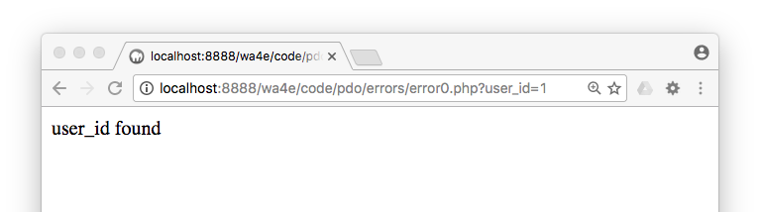
$pdo->setAttribute(PDO::ATTR_ERRMODE, PDO::ERRMODE_WARNING);
$stmt = $pdo->prepare("SELECT * FROM users where user_id = :xyz");
$stmt->execute(array(":xyz" => $_GET['user_id']));
$row = $stmt->fetch(PDO::FETCH_ASSOC);
if ( $row === false ) {
echo("<p>user_id not found</p>\n");
} else {
echo("<p>user_id found</p>\n");
}
errors/error0.php

Slide 40
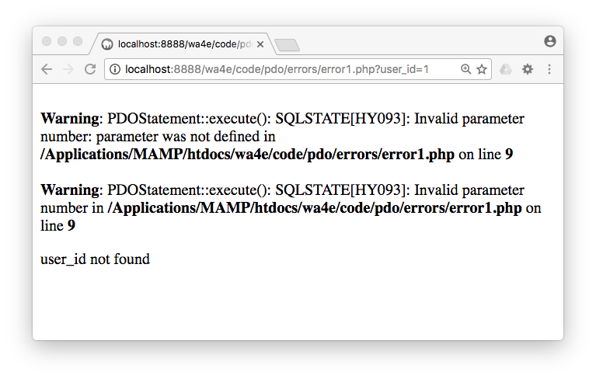
$pdo->setAttribute(PDO::ATTR_ERRMODE, PDO::ERRMODE_WARNING);
$stmt = $pdo->prepare("SELECT * FROM users where user_id = :xyz");
$stmt->execute(array(":pizza" => $_GET['user_id']));
$row = $stmt->fetch(PDO::FETCH_ASSOC);
if ( $row === false ) {
echo("<p>user_id not found</p>\n");
} else {
echo("<p>user_id found</p>\n");
}
errors/error1.php

Slide 41
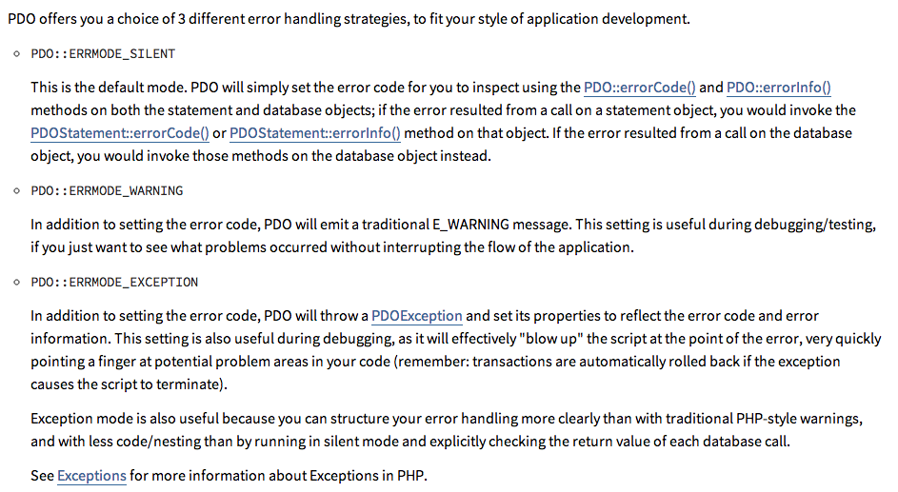
http://php.net/manual/en/pdo.error-handling.php

Slide 42
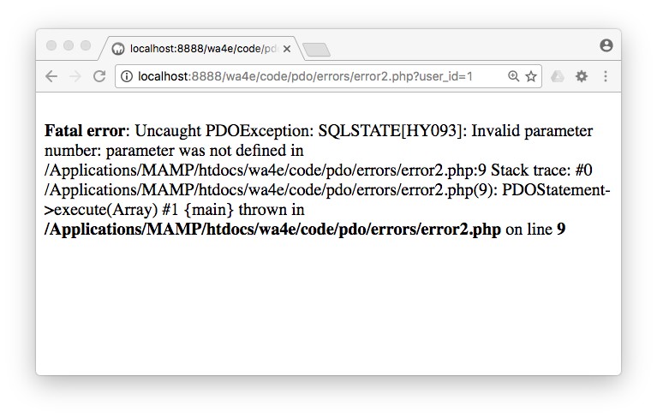
$pdo->setAttribute(PDO::ATTR_ERRMODE, PDO::ERRMODE_EXCEPTION);
$stmt = $pdo->prepare("SELECT * FROM users where user_id = :xyz");
$stmt->execute(array(":pizza" => $_GET['user_id']));
$row = $stmt->fetch(PDO::FETCH_ASSOC);
if ( $row === false ) {
echo("<p>user_id not found</p>\n");
} else {
echo("<p>user_id found</p>\n");
}
errors/error2.php

Slide 43
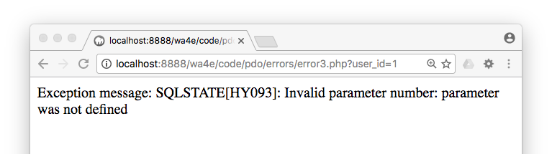
$pdo->setAttribute(PDO::ATTR_ERRMODE, PDO::ERRMODE_EXCEPTION);
try {
$stmt = $pdo->prepare("SELECT * FROM users where user_id = :xyz");
$stmt->execute(array(":pizza" => $_GET['user_id']));
} catch (Exception $ex ) {
echo("Exception message: ".$ex->getMessage());
return;
}
$row = $stmt->fetch(PDO::FETCH_ASSOC);
errors/error3.php

Slide 44
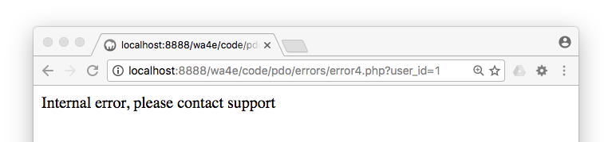
$pdo->setAttribute(PDO::ATTR_ERRMODE, PDO::ERRMODE_EXCEPTION);
try {
$stmt = $pdo->prepare("SELECT * FROM users where user_id = :xyz");
$stmt->execute(array(":pizza" => $_GET['user_id']));
} catch (Exception $ex ) {
echo("Internal error, please contact support");
error_log("error4.php, SQL error=".$ex->getMessage());
return;
}
$row = $stmt->fetch(PDO::FETCH_ASSOC);
errors/error4.php

Slide 45
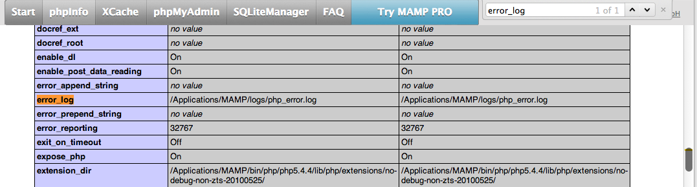
Where do error_log()s go?
When in doubt, look at PHPInfo...

Slide 46
Where do error_log()s go?
File Paths:
- /Applications/MAMP/logs/php_error.log
- c:\xampp\php\logs\php_error_log
Open the log file and scroll to the bottom
Watch the log actively
- On Mac / Linux use: tail -f filename
- Windows: http://ophilipp.free.fr/op_tail.htm

Slide 47
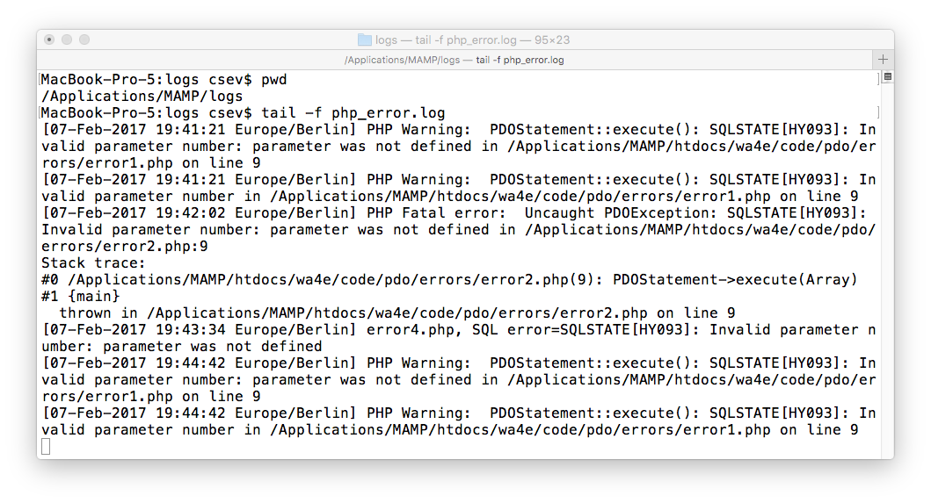

Slide 48
Summary
Making database connections
Doing database operations
SQL security (a.k.a. we love PDO prepared statements)
Exploring errors...

Slide 49

Acknowledgements / Contributions
These slides are Copyright 2010- Charles R. Severance (www.dr-chuck.com) as part of www.wa4e.com and made available under a Creative Commons Attribution 4.0 License. Please maintain this last slide in all copies of the document to comply with the attribution requirements of the license. If you make a change, feel free to add your name and organization to the list of contributors on this page as you republish the materials.
Initial Development: Charles Severance, University of Michigan School of Information
Insert new Contributors and Translators here including names and dates
Continue new Contributors and Translators here

