Slide 1
STRINGS IN PHP BY EKTA MAKAWANA
Notes:
‹#›

Slide 2
Objectives
‹#›
What is String ?
Manipulate strings
Parse strings
Compare strings
Notes:
‹#›

Slide 3
Text Strings & Its construction
‹#›
A text string contains zero or more characters surrounded by double or single quotation marks
Text strings can be used as literal values or assigned to a variable
echo "<p>This is test string !!</p>";
$Explorer = “Hello Friends !!”;
echo $Explorer;
Text strings can also be surrounded with single quotation marks

Slide 4
Constructing Text Strings (continued)
‹#›
To include a quoted string within a literal string surrounded by double quotation marks, you surround the quoted string with single quotation marks
To include a quoted string within a literal string surrounded by single quotation marks, you surround the quoted string with double quotation marks

Slide 5
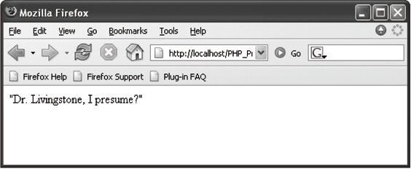
Constructing Text Strings (continued)
‹#›
<?php
$ExplorerQuote = '<p>"Dr. Livingstone, I presume?"</p>';
echo $ExplorerQuote;
?>
Figure 5-1 Output of a text string containing double quotation marks

Slide 6
Working with String Operators
‹#›
In PHP, you use two operators to combine strings
Concatenation operator (.)
$Destination = “Paris”;
$Location = “France”;
$Destination = “<p>” . $Destination . “ is in “. $Location . “</p>”;
echo $Destination;
Concatenation assignment operator (.=)
$Destination = "<p>Paris";
$Destination .= “ is in France.</p>";
echo $Destination;

Slide 7
Adding Escape Characters and Sequences
‹#›
An escape character tells the compiler or interpreter that the character that follows it has a special purpose
In PHP, the escape character is the backslash \
echo ‘<p>John \'s real name was Radix.</p>';
Do not add a backslash before an apostrophe if you surround the text string with double quotation marks
echo "<p>John 's real name was Radix.</p>";

Slide 8
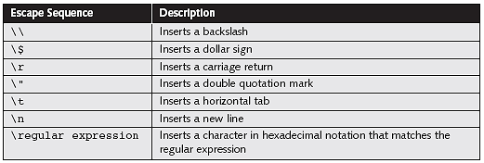
Adding Escape Characters and Sequences
‹#›
The escape character combined with one or more other characters is called an escape sequence
Table 5-1 PHP escape sequences within double quotation marks

Slide 9
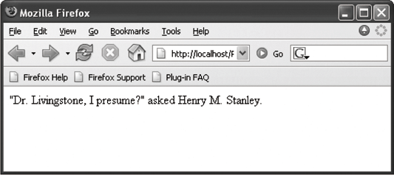
Adding Escape Characters and Sequences
‹#›
$Explorer = "Henry M. Stanley";
echo "<p>\"Dr. Livingstone, I presume?\“ asked $Explorer.</p>";
Figure 5-3 Output of literal text containing double quotation escape sequences

Slide 10
Simple and Complex String Syntax
‹#›
Simple string syntax uses the value of a variable within a string by including the variable name inside a text string with double quotation marks
$Vegetable = "broccoli";
echo "<p>Do you have any $Vegetable?</p>";
When variables are placed within curly braces inside of a string, it is called complex string syntax
$Vegetable = "carrot";
echo "<p>Do you have any {$Vegetable}s?</p>";

Slide 11
Parsing Strings
‹#›
Parsing is the act of extracting characters or substrings from a larger string
When programming, parsing refers to the extraction of information from string literals and variables

Slide 12
Counting Characters and Words in a String
‹#›
The most commonly used string counting function is the strlen() function, which returns the total number of characters in a string

Slide 13
Counting Characters and Words in a String
‹#›
The str_word_count() function returns the number of words in a string
Pass the str_word_count() function a literal string or the name of a string variable whose words you want to count
<?php
$BookTitle = “Three Mistakes of my life";
echo "<p>The book title contains ". str_word_count($BookTitle). " words.</p>";
?>
Output :
The book title contains 5 words.

Slide 14
Finding and Extracting Characters and Substrings
‹#›
There are two types of string search and extraction functions:
Functions that return a numeric position in a text string
Functions that return a character or substring
Name of Book

Slide 15
strpos() Function
‹#›
Performs a case-sensitive search and returns the position of the first occurrence of one string in another string
Pass two arguments to the strpos() function:
The first argument is the string you want to search
The second argument contains the characters for which you want to search
If the search string is not found, the strpos() function returns a Boolean value of false

Slide 16
strchr() and strrchr() Functions
‹#›
Pass to both functions the string and the character for which you want to search
Both functions return a substring from the specified characters to the end of the string
strchr() function starts searching at the beginning of a string
strrchr() function starts searching at the end of a string

Slide 17
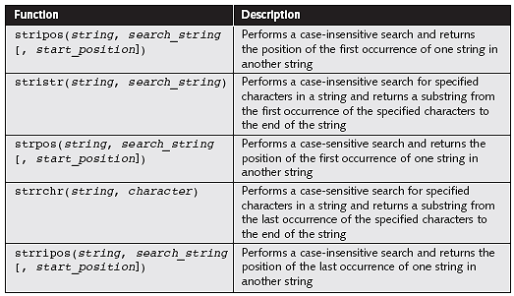
Finding and Extracting Characters and Substrings
‹#›
Table 5-3 PHP string search and extraction functions

Slide 18
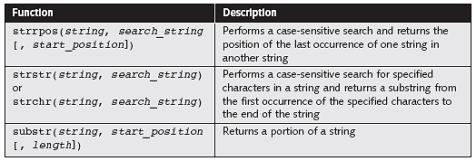
Finding and Extracting Characters and Substrings
‹#›
Table 5-3 PHP string search and extraction functions (continued)

Slide 19
substr() Function
‹#›
To extract characters from the beginning or middle of a string, combine the substr() function with other functions
You pass to the substr() function a text string along with the starting and ending positions of the substring you want to extract
<?php
$Email = "president@whitehouse.gov";
$NameEnd = strpos($Email, "@");
echo "<p>The name portion of the e-mail address is '“ .
substr($Email, 0, $NameEnd) . "'.</p>";
?>

Slide 20
str_replace() and str_ireplace()Functions
‹#›
The str_replace() and str_ireplace() functions both accept three arguments:
The string you want to search for
A replacement string
The string in which you want to replace characters
<?php
$Email = “president@whitehouse.gov";
$NewEmail = str_replace("president", "vice.president", $Email);
echo $NewEmail; // prints 'vice.president@whitehouse.gov‘
?>

Slide 21
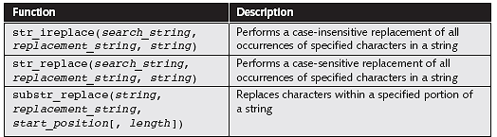
Replacing Characters and Substrings
‹#›
Table 5-4 PHP string replacement functions

Slide 22
Converting Between Strings and Arrays
‹#›
The str_split() and explode() functions split a string into an indexed array
The str_split() function splits each character in a string into an array element using the syntax:
$array = str_split(string[, length]);
The length argument represents the number of characters you want assigned to each array element

Slide 23
Converting Between Strings and Arrays
‹#›
The explode() function splits a string into an indexed array at a specified separator
The syntax for the explode() function is:
$array = explode(separators, string);

Slide 24
Converting Between Strings and Arrays
‹#›
<?php
$Presidents = "George W. Bush;William Clinton;George H.W. Bush;Ronald Reagan;Jimmy Carter";
$PresidentArray = explode(";", $Presidents);
foreach ($PresidentArray as $President) {
echo "$President<br />";
}
?>
If the string does not contain the specified separators, the entire string is assigned to the first element of the array

Slide 25
explode() Function
‹#›
Does not separate a string at each character that is included in the separator argument
Evaluates the characters in the separator argument as a substring
If you pass to the explode() function an empty string as the separator argument, the function returns a value of false

Slide 26
implode() Function
‹#›
Combines an array’s elements into a single string, separated by specified characters
The syntax is:
$variable = implode(separators, array);

Slide 27
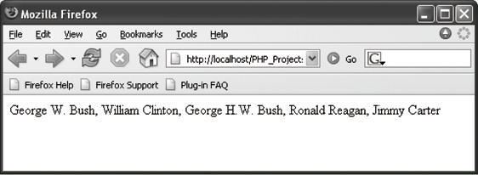
implode() Function
‹#›
<?php
$PresidentsArray = array("George W. Bush",
"William Clinton",
"George H.W. Bush",
"Ronald Reagan",
"Jimmy Carter");
$Presidents = implode(“, ", $PresidentsArray);
echo $Presidents;
?>
Figure 5-6 Output of a string created with the implode() function

Slide 28
Comparing Strings
‹#›
<?php
$Florida = "Miami is in Florida.";
$Cuba = "Havana is in Cuba.";
if ($Florida == $Cuba) {
echo "<p>Same location.</p>";
} else {
echo "<p>Different location.</p>";
}
?>
Output :
"Different location.";

Slide 29
Comparing Strings (continued)
‹#›
<?php
$FirstLetter = "A";
$SecondLetter = "B";
If ($SecondLetter > $FirstLetter) {
echo "<p>The second letter is higher in the alphabet than the first letter.</p>";
} else {
echo "<p>The second letter is lower in the alphabet than The first letter.</p>";
}
?>
Output:
The second letter is higher in the alphabet than the first letter.

Slide 30
American Standard Code for Information Interchange (ASCII)
‹#›
Numeric representations of English characters
ASCII values range from 0 to 256
Lowercase letters are represented by the values 97 (“a”) to 122 (“z”)
Uppercase letters are represented by the values 65 (“A”) to 90 (“Z”)
Since lowercase letters have higher values than uppercase letters, they are evaluated as being “greater” than the uppercase letters

Slide 31
String Comparison Functions
‹#›
The strcasecmp() function performs a case-insensitive comparison of strings
The strcmp() function performs a case-sensitive comparison of strings
Both functions accept two arguments representing the strings you want to compare
Most string comparison functions compare strings based on their ASCII values

Slide 32
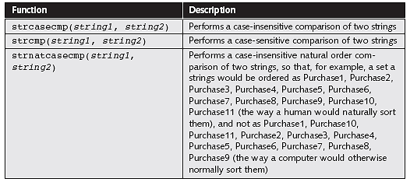
String Comparison Functions
‹#›
Table 5-5 PHP string comparison functions

Slide 33
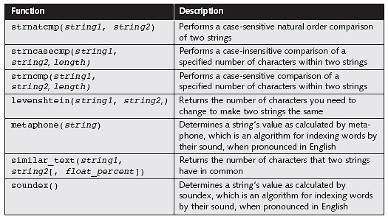
String Comparison Functions (continued)
‹#›
Table 5-5 PHP string comparison functions (continued)

Slide 34
Determining the Similarity of Two Strings
‹#›
The similar_text() and levenshtein() functions are used to determine the similarity between two strings
The similar_text() function returns the number of characters that two strings have in common
The levenshtein() function returns the number of characters you need to change for two strings to be the same

Slide 35
Determining the Similarity of Two Strings
‹#›
Both functions accept two string arguments representing the values you want to compare
<?php
$FirstName = "Don";
$SecondName = "Dan";
echo "<p>The names \"$FirstName\“ and \"$SecondName\“ have “ . similar_text($FirstName,$SecondName) . “ characters in common.</p>";
echo "<p>You must change “ . levenshtein($FirstName, $SecondName). “ character(s) to make the names \"$FirstName\“ and \"$SecondName\“ the same.</p>";
?>

Slide 36
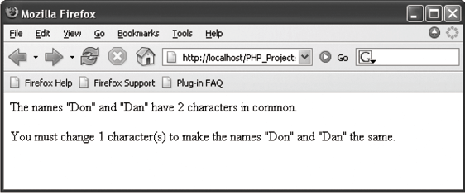
Determining the Similarity of Two Strings
‹#›
Figure 5-7 Output of a script with the similar_text() and levenshtein() functions
Name of Book

Slide 37
‹#›
For more reference please refer below links :
http://www.w3schools.com/php/php_ref_string.asp
http://myphpscriptz.com/php-scripts-tutorials/11-most-important-string-functions-php-a-programmer-should-know/
Name of Book

Slide 38
Summary
‹#›
The concatenation operator (.) and the concatenation assignment operator (.=) can be used to combine two strings
An escape character tells the compiler or interpreter that the character following the escape character has a special purpose
The most commonly used string counting function is the strlen() function, which returns the total number of characters in a string

Slide 39
Summary (continued)
‹#›
Use the str_replace(), str_ireplace(), and substr_replace() functions to replace text in strings
The str_split() and explode() functions split a string into an indexed array
The implode() function combines an array’s elements into a single string, separated by specified characters
The strcasecmp() function performs a case-insensitive comparison of strings, whereas the strcmp() function performs a case-sensitive comparison of strings

Slide 40
Summary (continued)
‹#›
The similar_text() and levenshtein() functions are used to determine the similarity of two strings

Slide 41
Thank You
‹#›

