Slide 1
PHP - Training
Web Application Concept
Communication

Slide 2
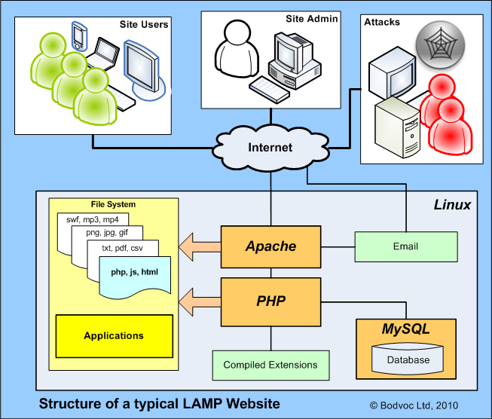
Web Application Concept
Web Applications are dynamic web sites combined with server side programming which provide functionalities such as interacting with users, connecting to back-end databases, and generating results to browsers.
Examples
Online Banking
Social Networking
Online Reservations
eCommerce / Shopping Cart Applications

Slide 3
Web Application Concept
Two Main Categories
Client Side Scripting / Coding
Client Side Scripting is the type of code that is executed or interpreted by browsers. (generally viewable by any visitor to a site)
HTML (HyperText Markup Language)
CSS (Cascading Style Sheets)
JavaScript
Etc…
Server Side Scripting / Coding
Server Side Scripting is the type of code that is executed or interpreted by the web server.
Server Side Scripting is not viewable or accessible by any visitor or general public.
PHP (very common Server Side Scripting language - Linux / Unix based Open Source - free redistribution, usually combines with MySQL database)
ASP (Microsoft Web Server (IIS) Scripting language)
ASP.NET (Microsoft's Web Application Framework - successor of ASP)

Slide 4
Web Application Concept
Reference
http://en.wikipedia.org/wiki/Web_application
http://en.wikipedia.org/wiki/Apache_HTTP_Server
http://en.wikipedia.org/wiki/LAMP_(software_bundle)
http://code.tutsplus.com/tutorials/an-introduction-to-apache--net-25786

Slide 5
Transparent Communication
Professional / Team Work
HR / Company Policy
Pre-Informed to Reporting Head
Proactive Approach
No Assumption
Ask for Clarification
Put your queries
Etc….

Slide 6
Thank You

