Slide 1
PHP Functions
Notes:
‹#›

Slide 2
Functions
What is a Function?
A function is a reusable piece of code or block of code that performs a specific action.
The function contains the set of programming statements enclosed by {}. A function can be called multiple times to provide reusability and modularity to the PHP program.
Functions can either return values when called or can simply perform an operation without returning any value.
Why use Functions?
Better code organization: Same type of code remain on the one place .
Example addition of the variables, subtraction of the variables.
Reusability: Once function is defined we can use it many times as we want.
Example: one function for the adding two variables can be user many times where we have to add two values.
Easy maintenance: Can change the code functionality at once to all of the scripts where it is used.
Example: We can add extra condition before after the sum of the two variable function.

Slide 3
Functions(Continue..)
Type Of Functions:
Built In Functions
User Defined Functions
Built In Functions
Built in functions are functions that exist in PHP installation package. These built in functions are what make PHP a very efficient and productive scripting language. The built in functions can be classified into many categories. Below is the list of the categories.
String Functions
Array Functions
Date and Time Functions
Math Functions
File Functions
Miscellaneous Functions
PHP Built In Functions
Notes:
‹#›

Slide 4
Functions(Continue..)
User Defined Function
As name suggest User Defined Function created by the user by their need. User Defined function can be use full for the given way.
You have routine tasks in your application such as adding data to the database.
Performing validation checks on the data.
Authenticating users in the system etc.
Rules that we must follow when creating our own functions.
Function names must start with a letter or an underscore but not a number.
The function name must be unique.
The function name must not contain spaces.
It is considered a good practice to use descriptive function names.
Functions can optionally accept parameters and return values too.

Slide 5
Functions(Continue..)
Different type of User Defined Functions
Function without arguments without return type.
Function without arguments with return type.
Function with arguments without return type.
Function with arguments with return type.
User Defined Function Syntax.
// Function Declaration Syntax
function function_name (arg1,arg2,....) {
// Block of code
}
// Function Calling Syntax
function_name(param1,param2,...);
PHP Functions

Slide 6
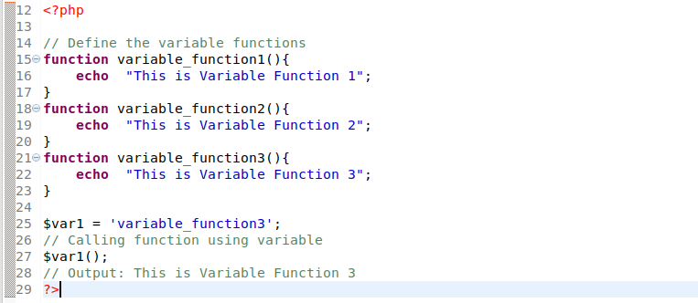
Functions(Continue..)
Variable Functions
PHP supports the concept of variable functions. This means that if a variable name has parentheses appended to it, PHP will look for a function with the same name as whatever the variable evaluates to, and will attempt to execute it.
Example:

Slide 7
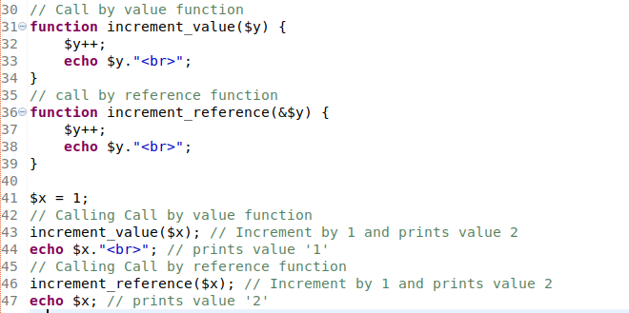
Functions(Continue..)
Function Call By Value & Call By Reference
Call by value means passing the value directly to a function. The called function uses the value in a local variable and any changes to it do not affect the source variable.
Call by reference means passing the address of a variable where the actual value is stored. The called function uses the value stored in the passed address and any changes to it do affect the source variable.
Example:

Slide 8
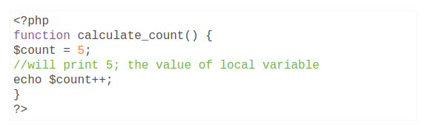
Variable Scope
Scope can be defined as the range of availability a variable has to the program in which it is declared. PHP variables can be one of four scope types:
1. Local variables :-
A local scope is a restricted boundary of a variable within which code block it is declared. That block can be a function, class or any conditional span. The variable within this limited local scope is known as the local variable of that specific code block.
2. Global Scope Variables :-
PHP global variables can be defined by using global keyword. If we want to use global variables inside a function, we have to prefix the global keyword with the variable.

Slide 9
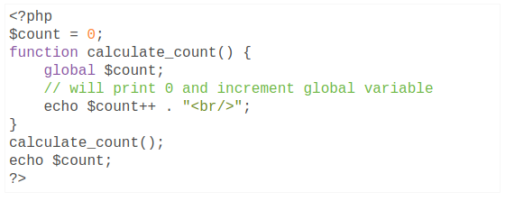
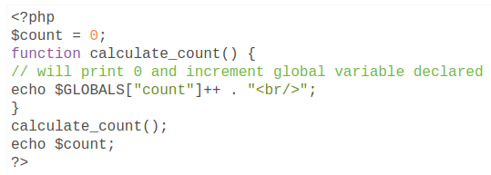
PHP has a predefined superglobal variable called $GLOBALS. It is an associative array with the name of the variable as key and value as the array element. We can use this array variable to add an array of PHP variables in a global scope.
Click Me
3. Static Variables :-
When a function is completed, all of its variables are normally deleted. However, sometimes you want a local variable to not be deleted.
To do this, use the static keyword when you first declare the variable:
static $rememberMe;
Then, each time the function is called, that variable will still have the information it contained from the last time the function was called. However, variable is still local to the function
Click Me

Slide 10
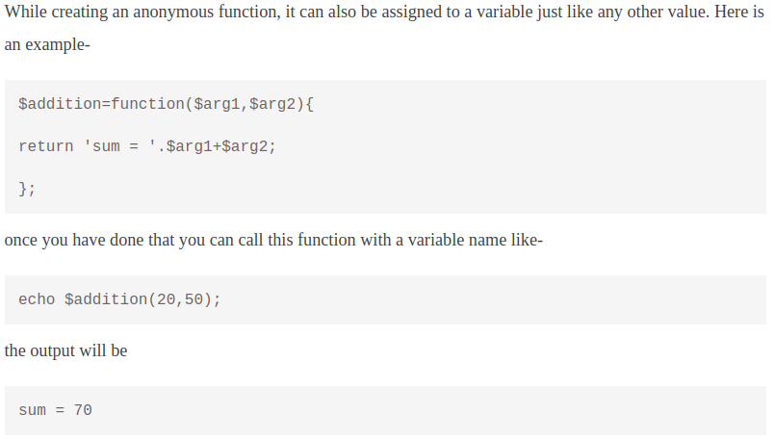
Functions(Continue..)
Anonymous Functions
Anonymous functions, also known as closures, allow the creation of functions which have no specified name.
How to use anonymous functions?
Assign it to a variable, then call it later using the variable's name.
Pass it to another function that can then call it later.
Example Usage : 1 (Assign it to variable)

Slide 11
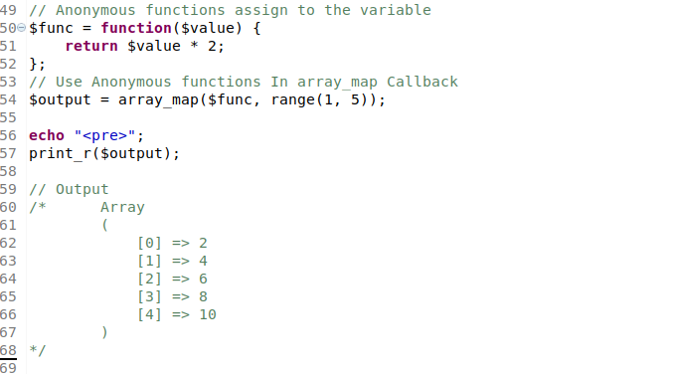
Example Usage : 2 (Use as a callback)

Slide 12
Thank you

